Slide 1
Multi Collision models of GRBs
What do we learn from neutrino constraints?
Jonas Heinze
PAHEN 2019
Berlin, 26.9.2019

Slide 2
Gamma Ray Bursts
Energetic outbursts of gamma-rays $L_{iso,γ}≈{10}^{49}−{10}^{53} erg / s$
Two main populations by duration:
Long GRBs $→ ∼10 −100 s$ core-collapse supernovae?
Short GRBs $→ ∼0.1 −1 s$ neutron star mergers? (GW170817A !)
Large variety of observed light curves
Fast time variability $t_{ν}$ $→$ radiation in compact regions
Sources of UHECRs?
Neutrino production?
Image credit: J.T. Bonnell (NASA/GSFC)

Slide 3
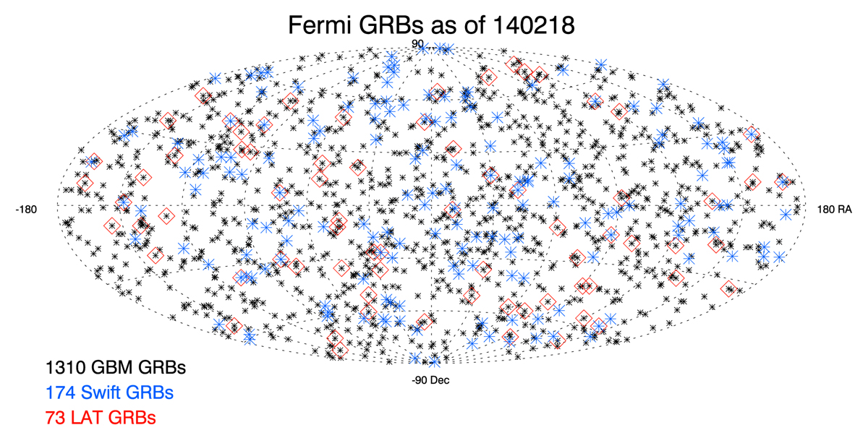
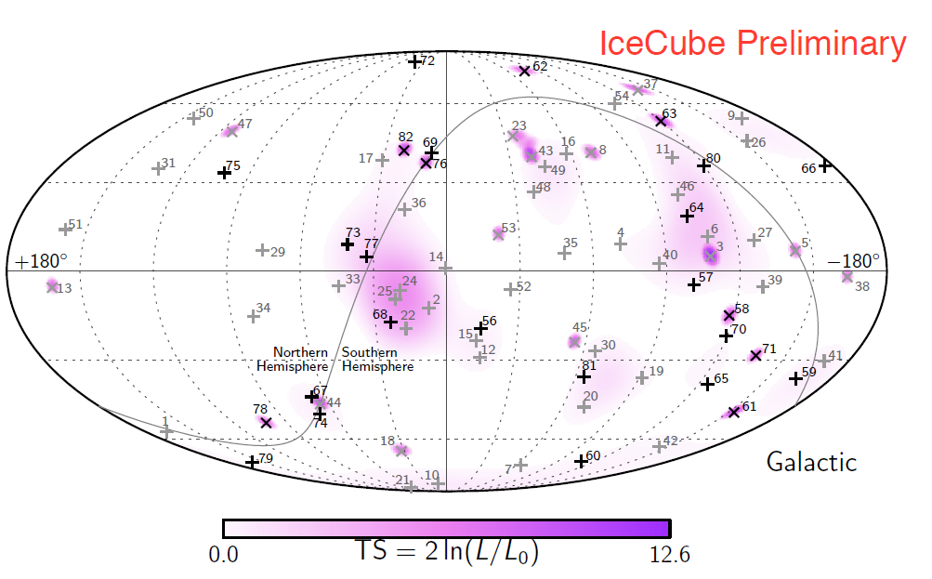
IceCube GRB stacking limits
PoS(ICRC2017)0981
Image credit: Fermi-LAT and GBM Collaborations
Look for neutrinos in coincidence with GRBs
1172 Bursts from catalogues
Consistent with background only
Protons mostly excluded…
… but nuclei?
$≤1 \%$ of the diffuse flux from prompt GRB emission
IceCube, Nature 484 (2012) 351-353
Updated: Astrophys.J. 843 (2017)
What about the UHECR – GBR connection?
IceCube, Astrophys.J. 843 (2017) no.2, 112
See e.g.
Ahlers, Gonzales-Garcia, Halzen, Astropart.Phys. 35 (2011)
He et. al., Astrophys.J. 752 (2012)
Baerwald, Bustamante, Winter, Astropart.Phys. 62 (2015)

Slide 4
Internal shock model
$$E_{iso, γ}≈{10}^{49} −{10}^{54} ergs$$
Central engine:
Plasma acceleration
$$Γ_{bulk}≈100 −500$$
Internal Shocks:
Particle acceleration
Prompt emission
Circumburst medium:
Afterglow emission
Image credit: NASA's Goddard Space Flight Center

Slide 5
Internal shock model
$$E_{iso, γ}≈{10}^{49} −{10}^{54} ergs$$
Central engine:
Plasma acceleration
$$Γ_{bulk}≈100 −500$$
Internal Shocks:
Particle acceleration
Prompt emission
Circumburst medium:
Afterglow emission
Image credit: NASA's Goddard Space Flight Center

Slide 6
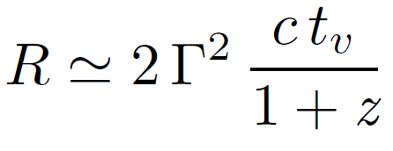
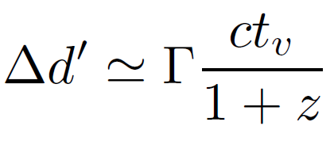
One Zone radiation model
UHECR acceleration and neutrino production
Compute single average collision!
$→$ Then scale to full burst
Geometry Estimates:
Photon energy density:
$→$ Scales with radius as $R^{−2}$
Nuclei injection density:
$→$ Photo-disintegration / Photo-pion-production
$→$ Secondary neutrinos
Photon Field: Broken power law
Baryonic Loading
Nuclei Injection

Slide 7
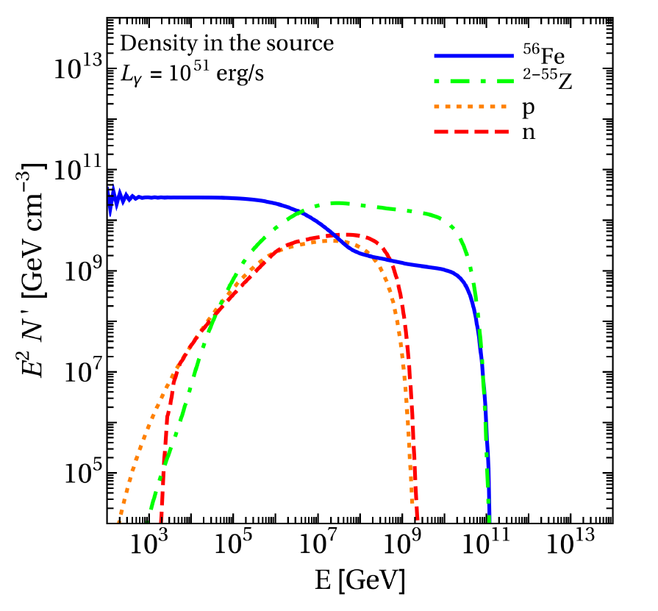
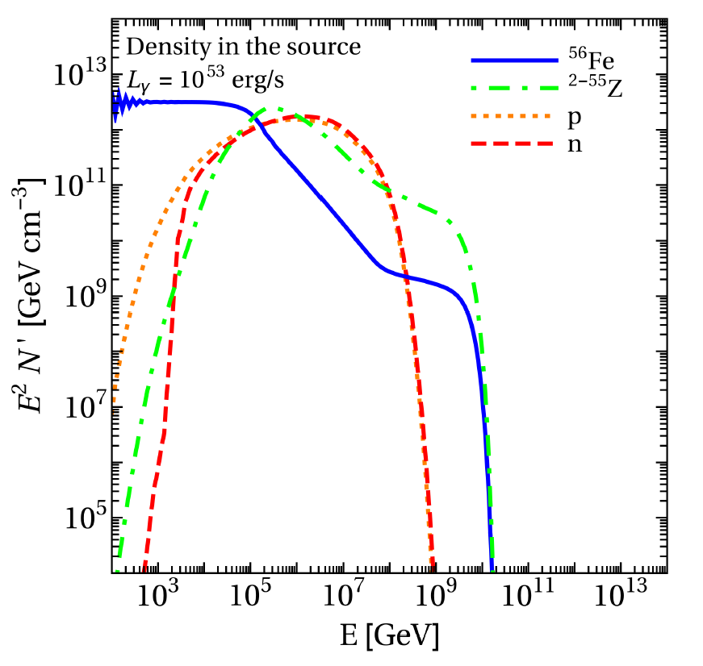
One Zone model
Biehl, Boncioli, Fedynitch, Winter, Astron.Astrophys. 611 (2018)
Partial disintegration
In source UHECR spectra
Nuclear survival
Optically thick
for nuclei
Disintegration rate
scales with radius and luminosity

Slide 8
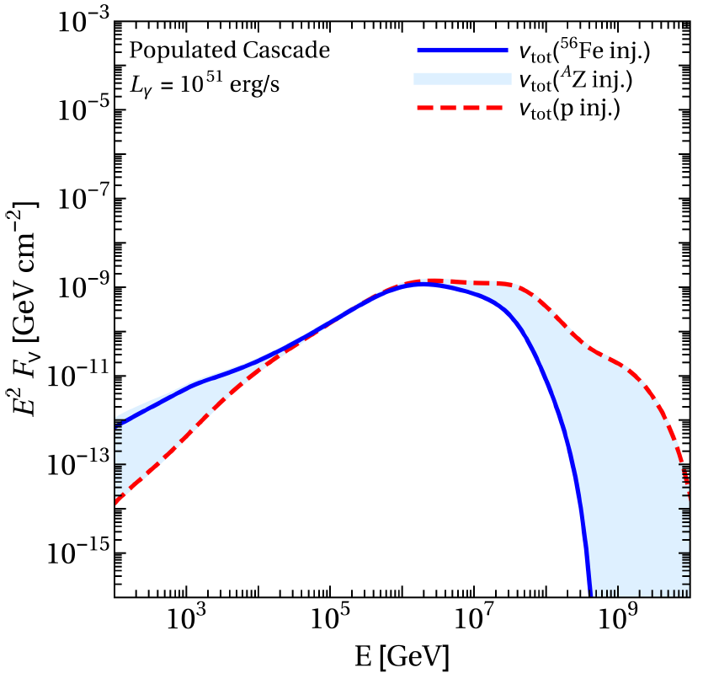
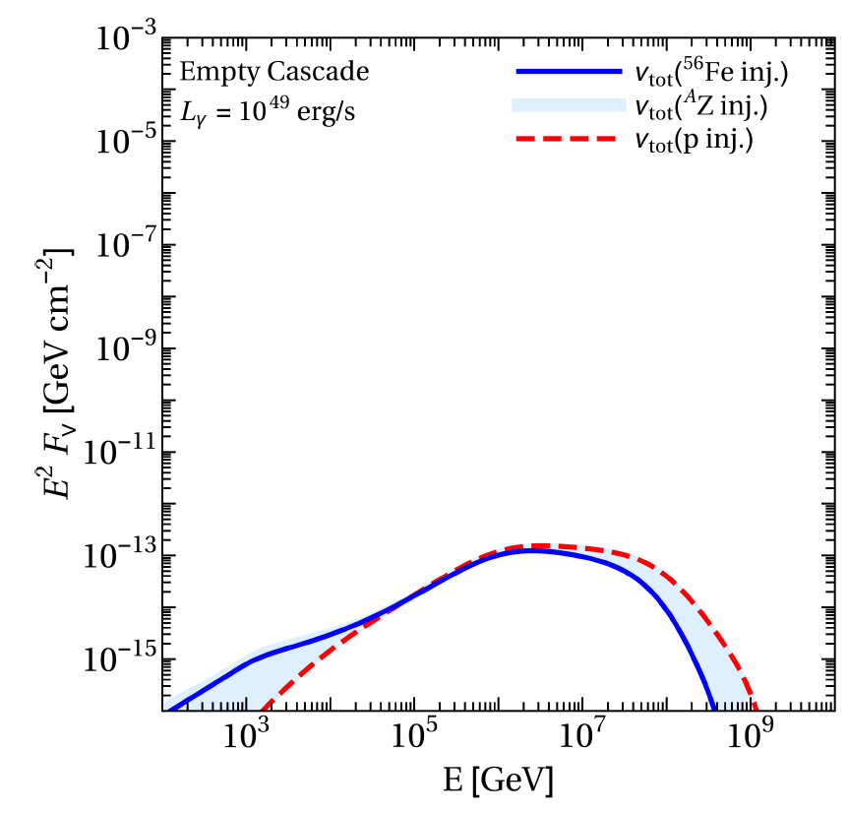
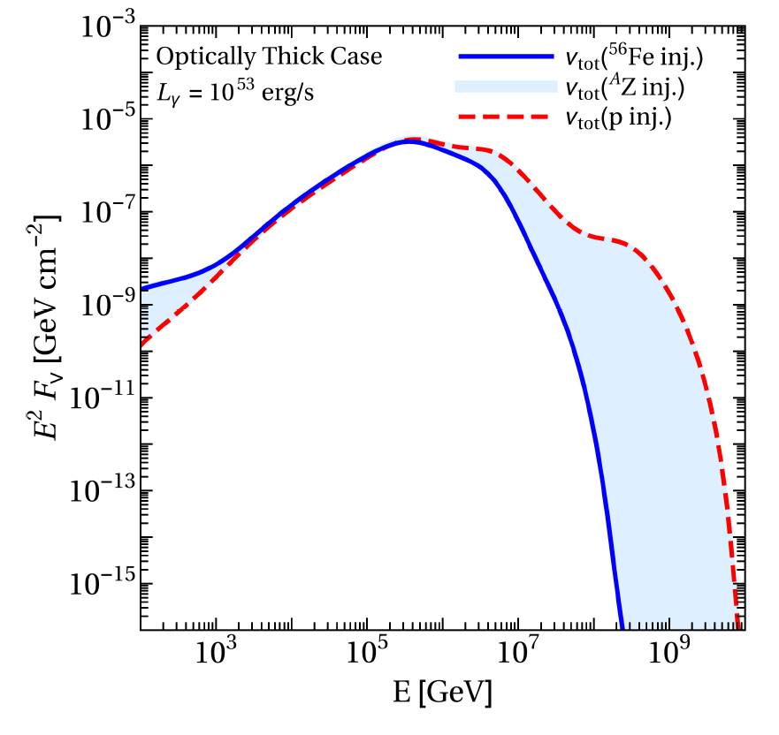
One Zone model
Biehl, Boncioli, Fedynitch, Winter, Astron.Astrophys. 611 (2018)
Partial disintegration
Neutrino flux
Nuclear survival
Optically thick
for nuclei
Neutrino production scales similarly to Disintegration rate!
Neutrino peak robust under composition

Slide 9
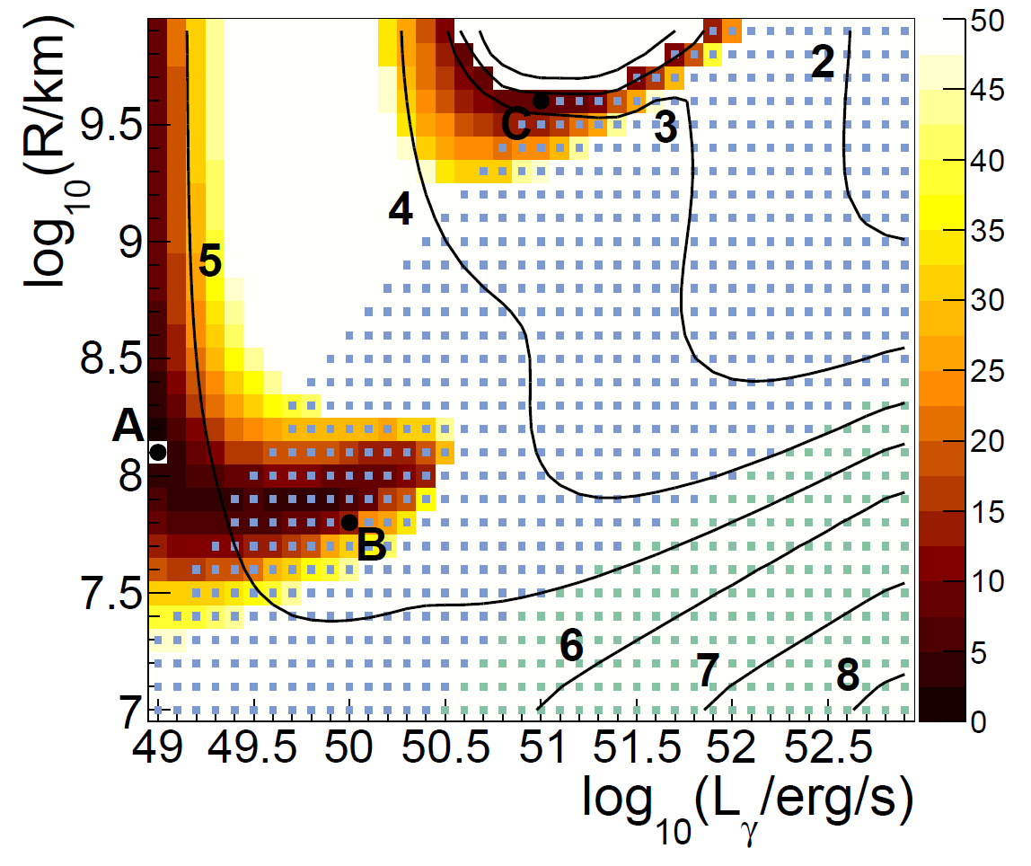
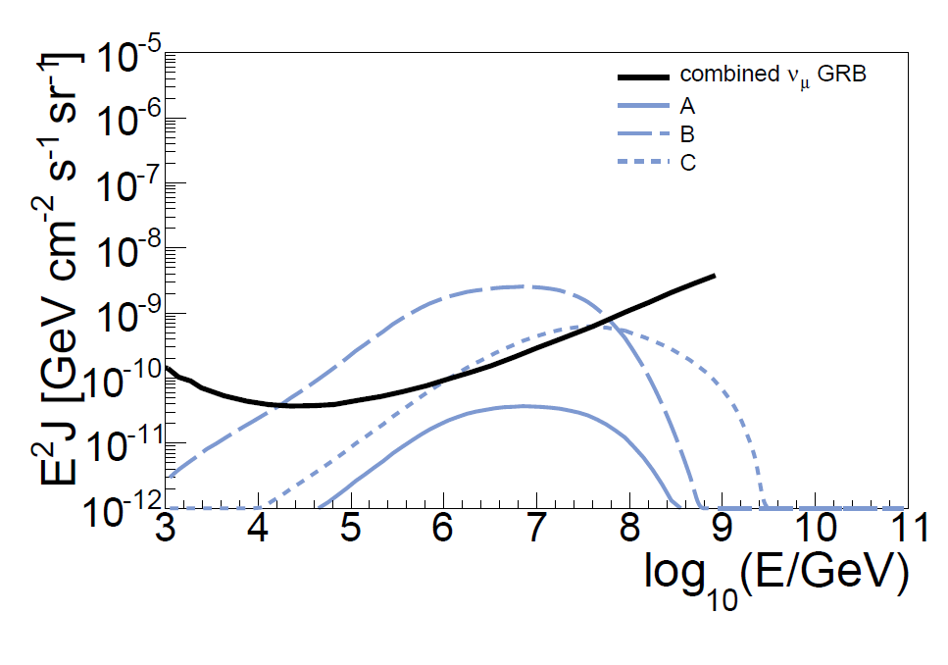
One Zone model
Biehl, Boncioli, Fedynitch, Winter, Astron.Astrophys. 611 (2018)
Fit to UHECR data and neutrino constraints
Magnetic Reconnection?
Long GRBs in internal shock model
Low luminosity GRBs?
… or Long GRBs in more complex model?

Slide 10
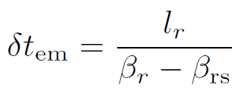
Multi Collision model
Bustamante, JH, Murase, Winter, Astrophys.J. 837 (2017)
Rudolph, JH, Fedynitch, Winter arXiv: 1907.10633
Compute the full jet evolution now:
Merged Lorentz Factor:
Available internal energy:
Dissipated energy:
Timescale and thickness from shock speed:
Collision model originally developed in:
Alternative collision models $→$poster by Annika Rudolph
Radiation parameters are now a model output!
Kobayshi, Piran, Sari, ApJ 490 (1997)
Daigne, Mochkovitch, MNRAS 296 (1998)
Rudolph, JH, Fedynitch, Winter arXiv: 1907.10633

Slide 11
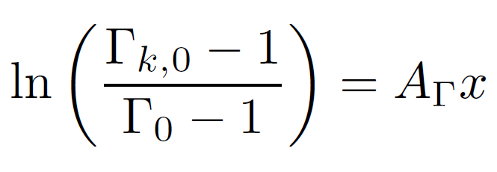
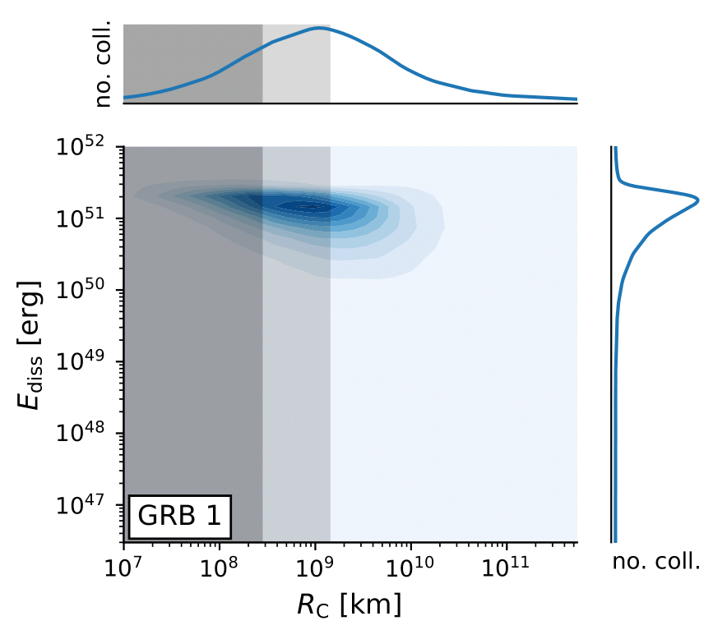
Multi Collision model
Bustamante, JH, Murase, Winter, Astrophys.J. 837 (2017)
Rudolph, JH, Fedynitch, Winter arXiv: 1907.10633
Purely stochastic shell distribution
Fireball evolution
Radiation model
Initial Shell Distribution
Distribution of collisions
Light curve
One-Zone
Multi-collision
Distance from central engine
Observed time

Slide 12
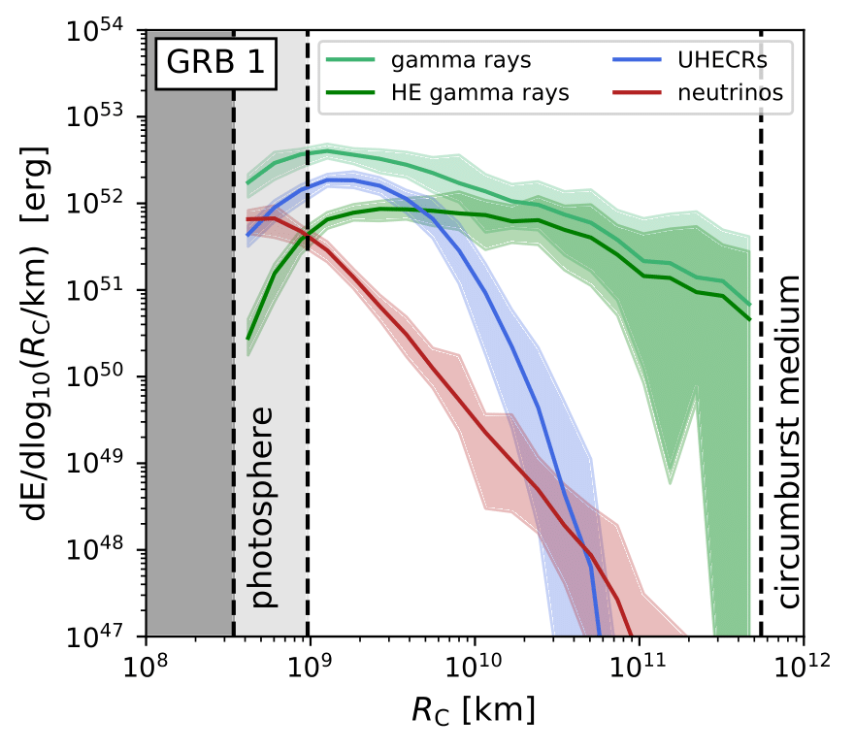
Particle Production regions
Multi Collision model
UHECR from intermediate radii
UHECRs
HE gamma rays
Neutrinos
Inefficient acceleration
Bustamante, JH, Murase, Winter, Astrophys.J. 837 (2017)
Rudolph, JH, Fedynitch, Winter arXiv: 1907.10633
Optically thick
Separates the production regions:
Neutrinos close to the photosphere
UHECRs at intermediate radii
(high energy) gamma rays from all radii
Distance from central engine

Slide 13
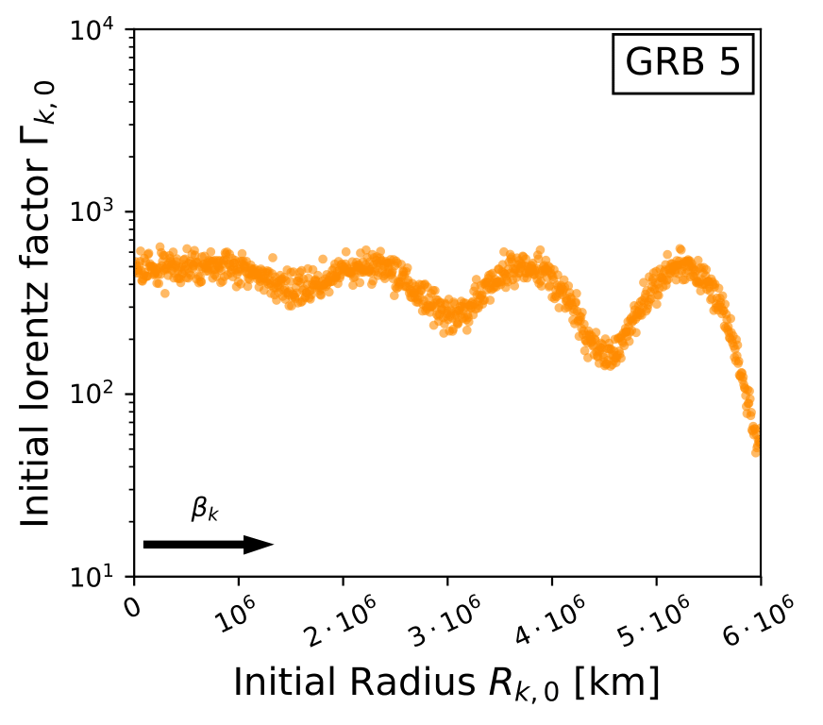
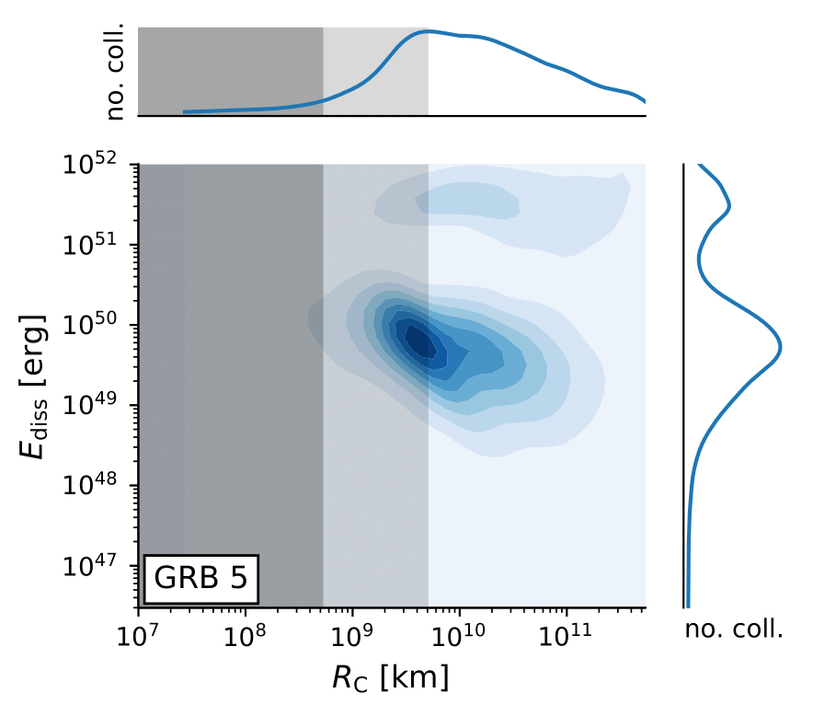
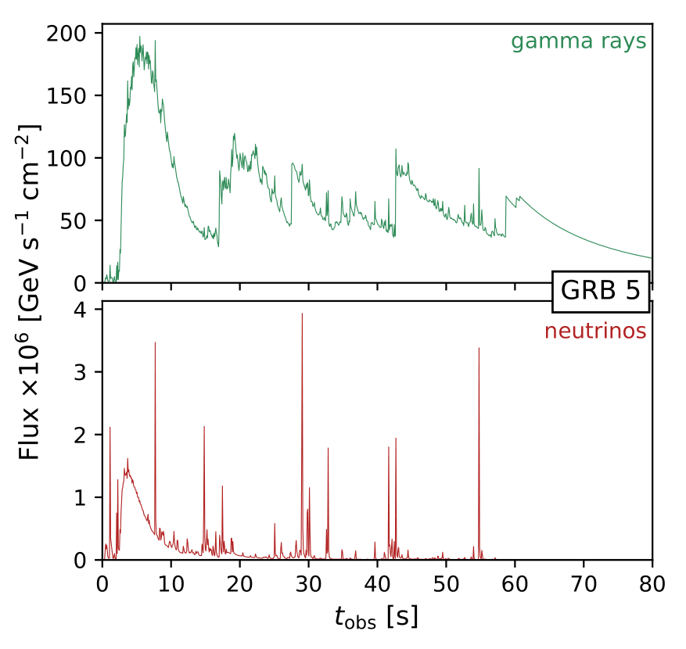
Disciplined (structured) engine
Bustamante, JH, Murase, Winter, Astrophys.J. 837 (2017)
Rudolph, JH, Fedynitch, Winter arXiv: 1907.10633
Multi Collision model
Fireball evolution
Radiation model
Initial Shell Distribution
Distribution of collisions
Light curve
bimodal distribution
Distance from central engine
Observed time

Slide 14
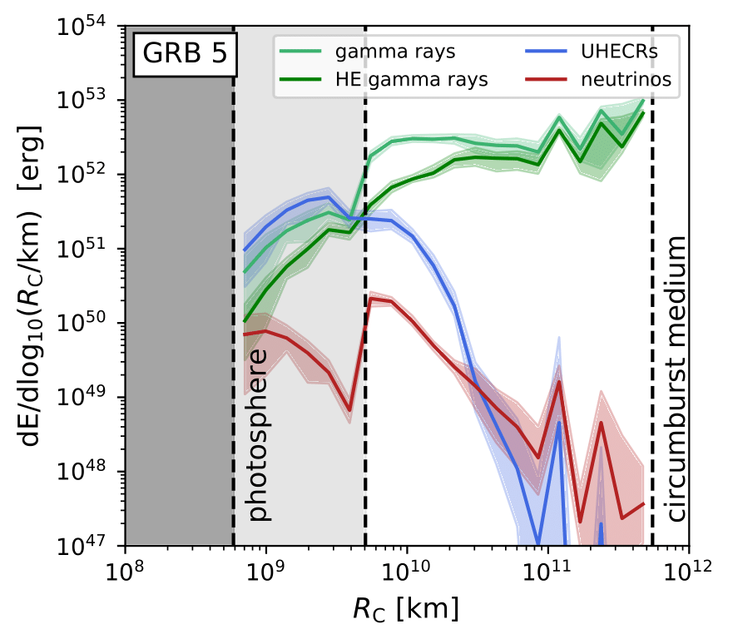
Particle production regions
Bustamante, JH, Murase, Winter, Astrophys.J. 837 (2017)
Rudolph, JH, Fedynitch, Winter arXiv: 1907.10633
Multi Collision model
Stochastic engine
Disciplined engine
Distance from central engine
Distance from central engine

Slide 15
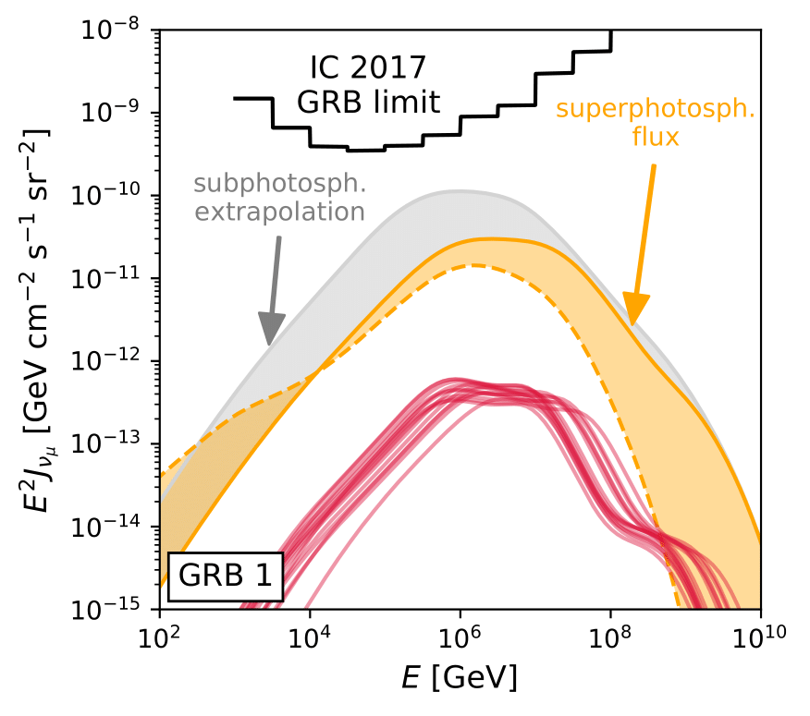
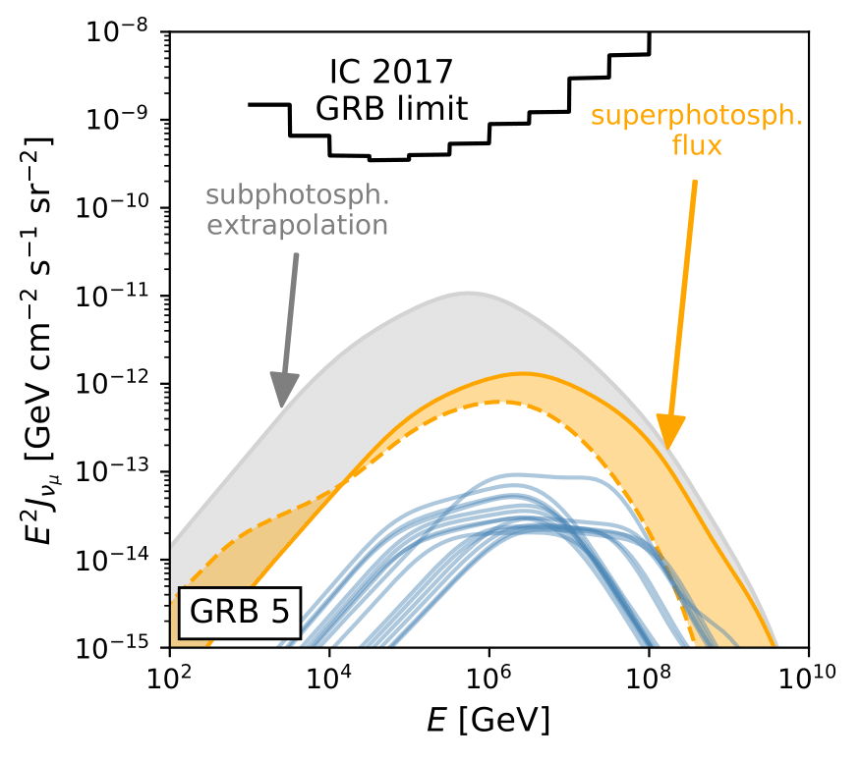
Neutrino fluxes: Engine comparison
Bustamante, JH, Murase, Winter, Astrophys.J. 837 (2017)
Multi Collision model
Flux for fixed GRB number at z = 2
Stochastic engine
Disciplined engine
Strong neutrino emitter
Weak neutrino emitter
Composition
10 max. collisions optically thick
10 max. collisions optically thin

Slide 16
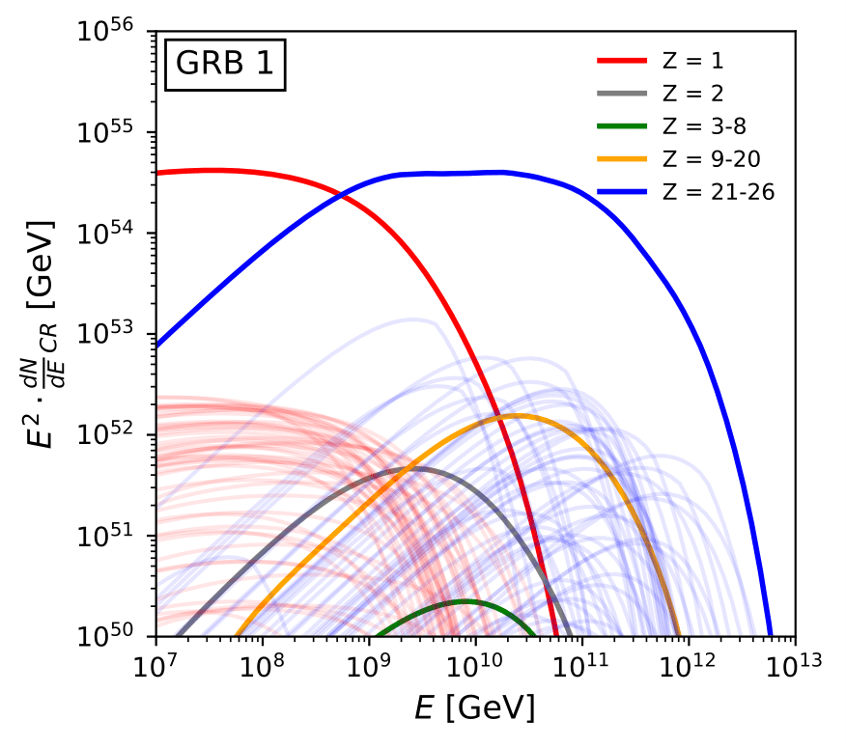
UHECR escape: Engine comparison
Multi Collision model
Ejected spectra for pure iron injection
Stochastic engine
Disciplined engine
Reduced disintegration
Superposition softens the spectrum!

Slide 17
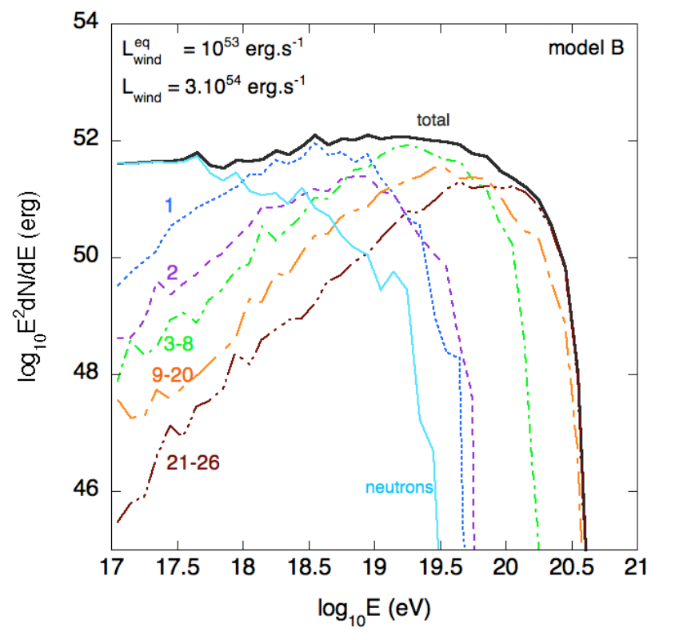
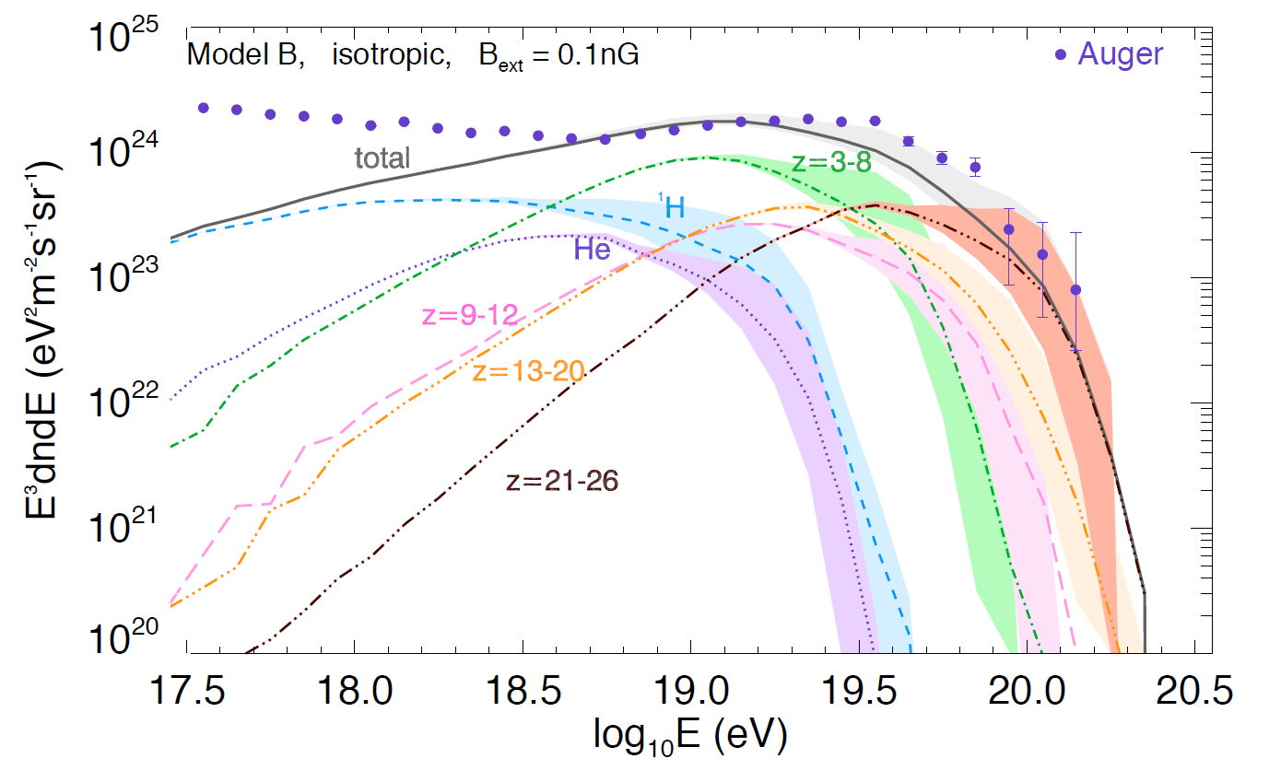
Multi Collision model - Fit to UHECR data
Globus, Allard, Mochkovitch, Parizot, Mon.Not.Roy.Astron.Soc. 451 (2015)
Globus, Allard, Parizot, Phys.Rev. D92 (2015)
$$β_{shell}$$
Disciplined engine $→$ controlled collision radius
Hard spectra (good for UHECR fit)
… but no stochasticity in light curve
Only a single engine model!
Extragalactic propagation

Slide 18
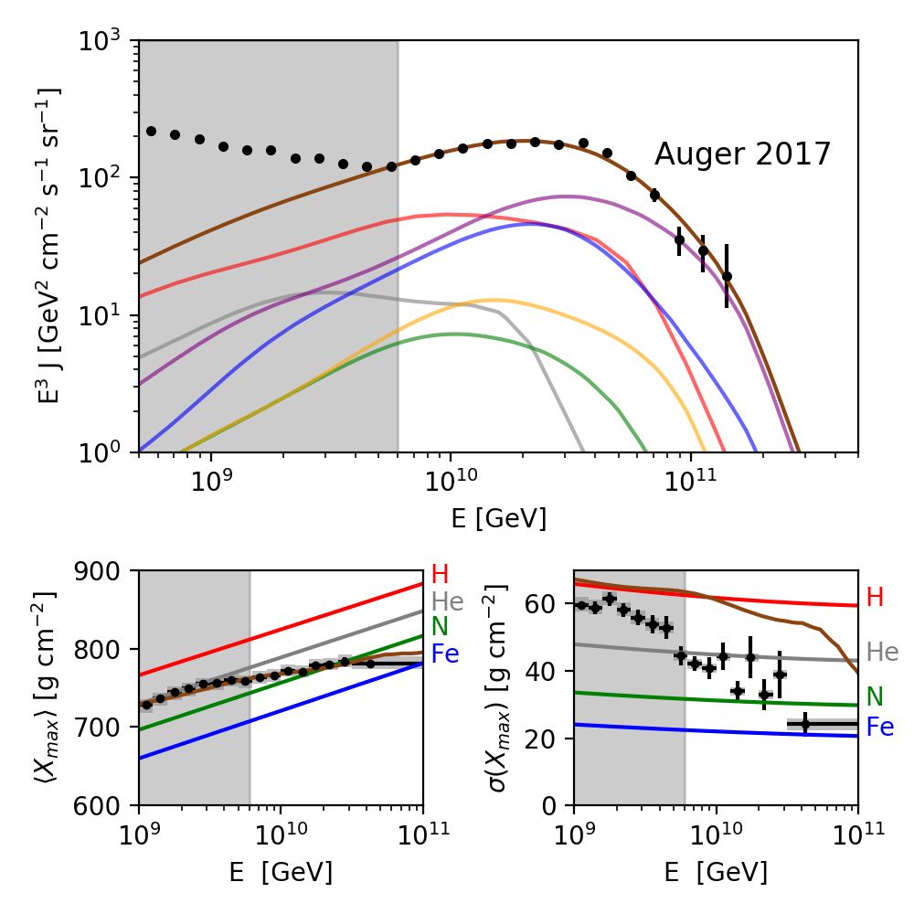
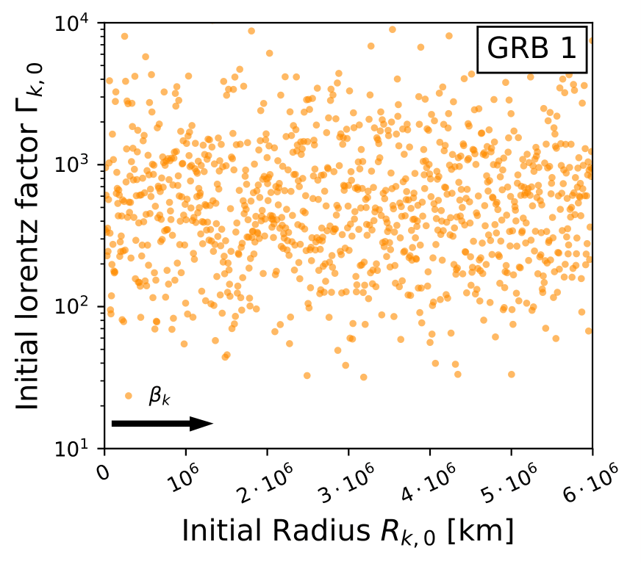
Outlook – Fit to UHECR data
Multi Collision model - Stochastic engine
Preliminary
Efficient implementation of multi-collision model
Allows to scan engine behavior
Free injection composition
Good fit to UHECR spectrum and $⟨X_{max}⟩$
Stochastic engine problem for $σ\left(X_{max}\right)$ (Mass overlap)
JH, Biehl, Rudolph,, Boncioli, Fedynitch, Winter in preparation
Average mass
$$→{⟨X}_{max}⟩$$
Mass overlap
$$→σ(X_{max})$$

Slide 19
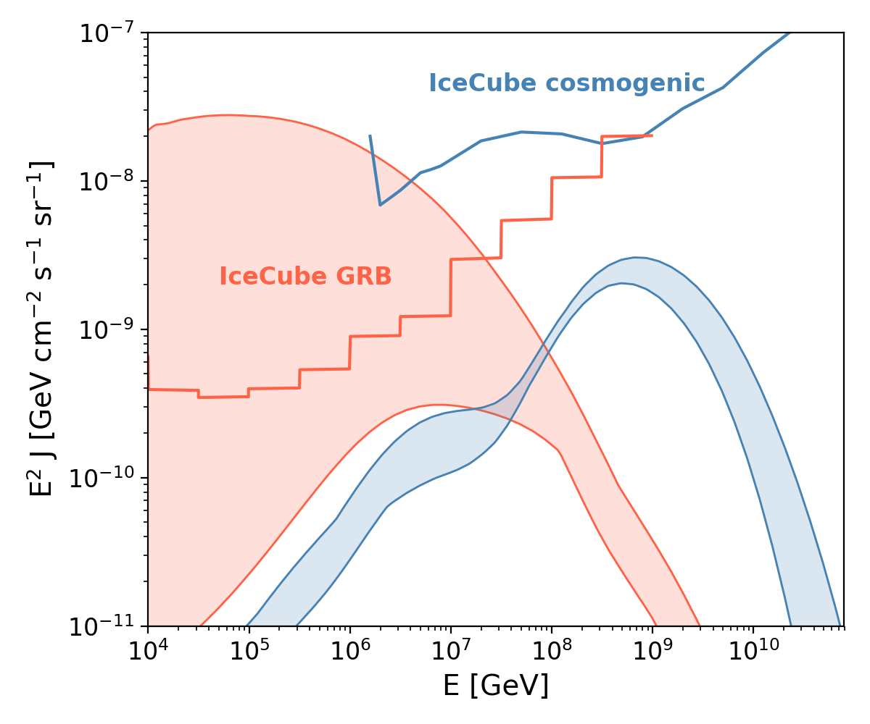
Outlook – Fit to UHECR data – Neutrino ranges
Multi Collision model - Stochastic engine
Neutrino range from engine parameter scan
High stochasticity $→$ high neutrino flux
Neutrino flux can test stochasticity!
Preliminary
Preliminary: Flux level can be lower for (qualitatively) different GRB engine
JH, Biehl, Rudolph,, Boncioli, Fedynitch, Winter in preparation
Stochasticity (mainly)
Cosmogenic neutrinos
Source
neutrinos
Stochasticity

Slide 20
Conclusion
One zone GRB models require low luminosity and/or large collision radii
Multi Collision Models separate particle production regions:
Neutrinos from small radii; UHECRs from intermediate; gamma-rays from all radii
The observed light curve indicates UHECR disintegration and neutrino production
Engine behavior can (partially) decouple the UHECR acceleration/escape and neutrino production
UHECR fit in principle still viable depending on the engine behavior .... … but stochasticity of the engine/light curve limited by $σ(X_{max})$ and neutrino production

Slide 21
Backup Slides

Slide 22
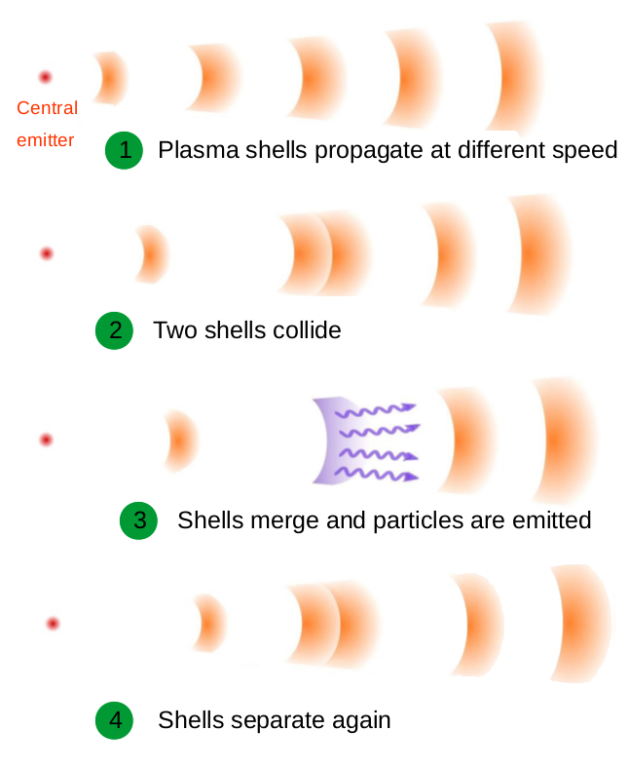
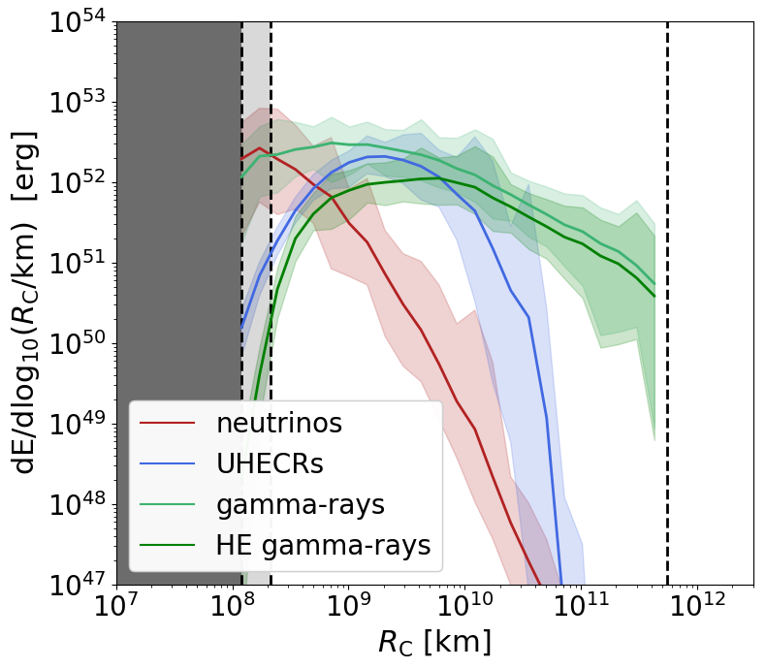
Ultra-efficient collision model
Rudolph, JH, Fedynitch, Winter arXiv: 1907.10633

Slide 23
Ultra-efficient vs. baseline
Particle production regions
Rudolph, JH, Fedynitch, Winter arXiv: 1907.10633

Slide 24
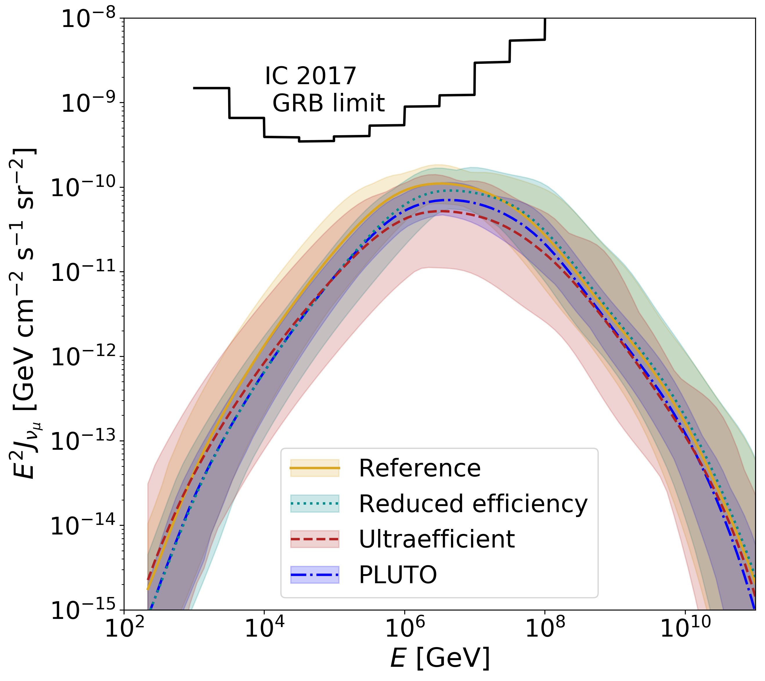
Alternative collision models - neutrino fluxes
Rudolph, JH, Fedynitch, Winter arXiv: 1907.10633

Slide 25
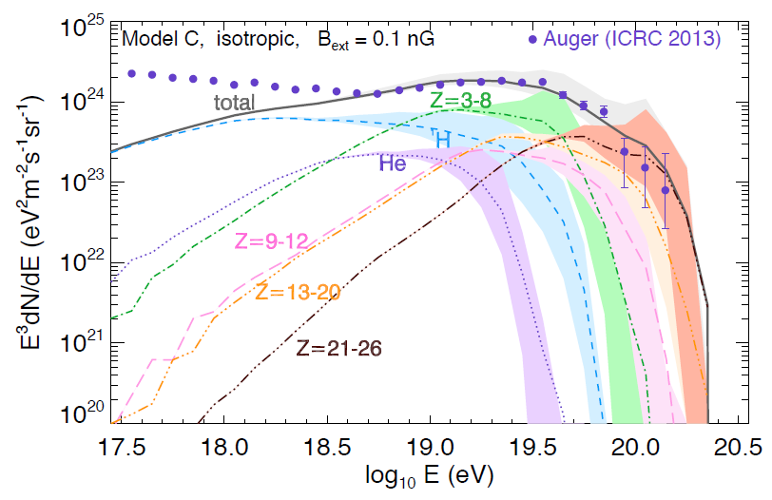
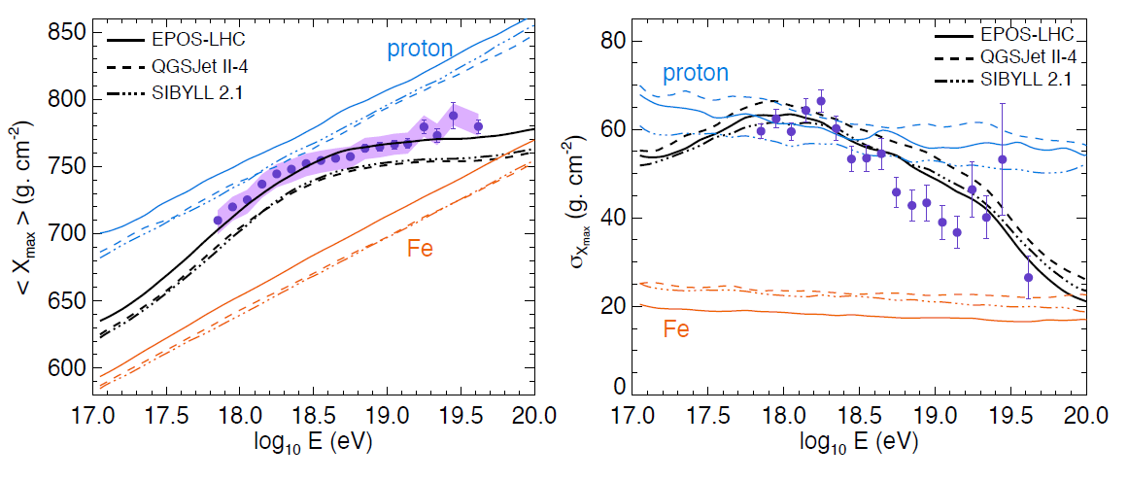
Multi-collision fit to UHECR data
Globus, Allard, Parizot, Phys.Rev. D92 (2015)

