Slide 1
Tests on Chess 2 ASIC
Yubo Han_{IHEP} , Dionisio Doering, Pietro Caragiulo, Larry Ruckman, Camillo Tamma, Su Dong

Slide 2
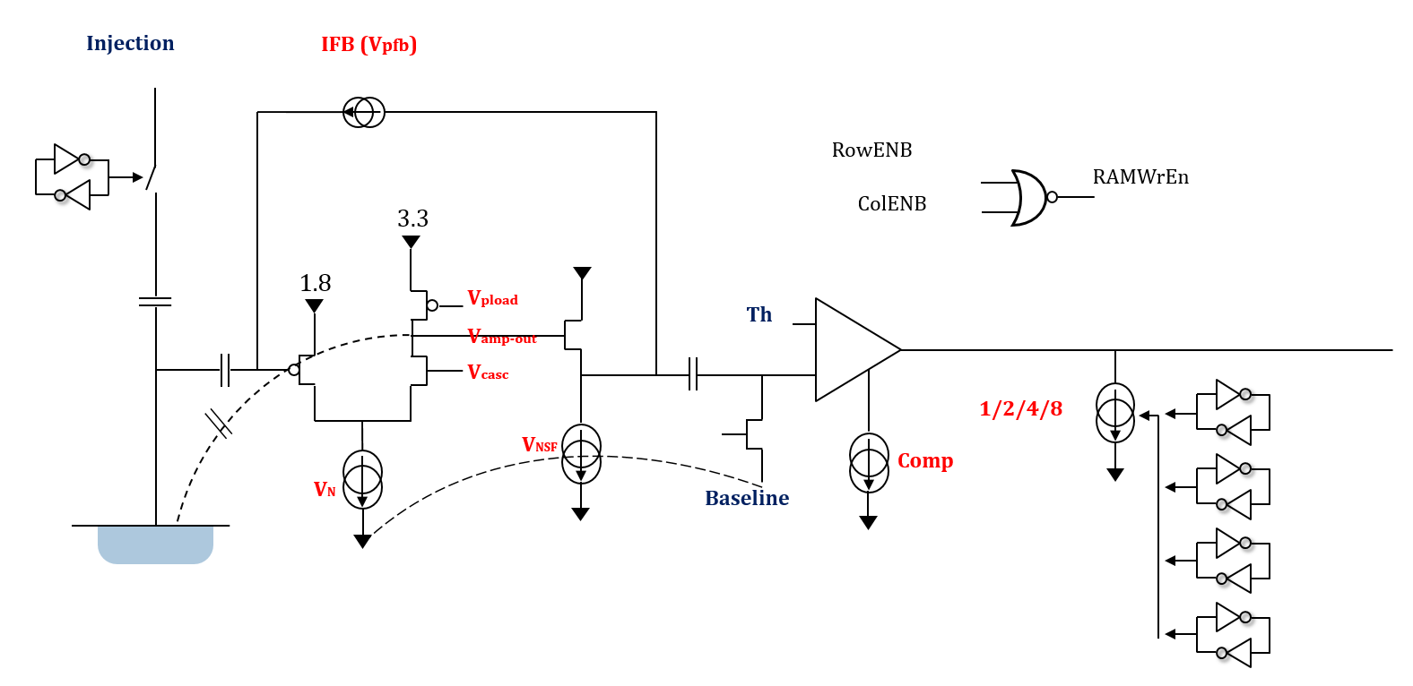
Pixel description

Slide 3
Outline
Review:
A sharp peak with correct time information of Qinj observed
Pre-amp (preliminary) optimization based on the sharp peak
Tests: (the uniformity of pixels in one matrix)
Check Trimming
Changing the VPTtrim value from 1~15
If Difference of results from different pixels varies with VPTrim
Check performance of the whole matrix
Validation of the stream readout
Distribution of the “BL”, Noise level, signal level
Updates on decoding and processing code

Slide 4
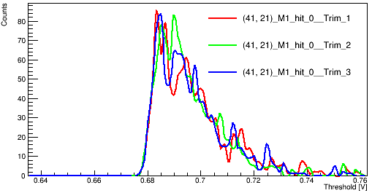
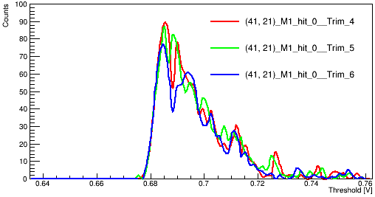
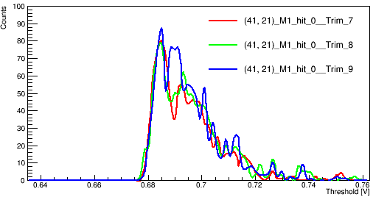
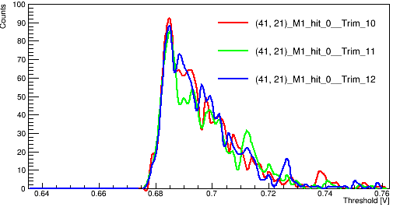
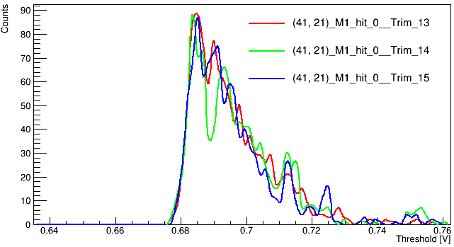
Check Trimming: varies VPTrim
Trimming’s goal: to have even BL/TH among pixels in one matrix
Board #01: std resistance (200Ohm/cm)
Counts number vs threshold
One random pixel : (41,21)
BL = 0.7V
Bias voltage: -30V
Qinj : +2V (0~2V)
[50ns width, no delay]
VPTrim : 1~15
No big change observed

Slide 5
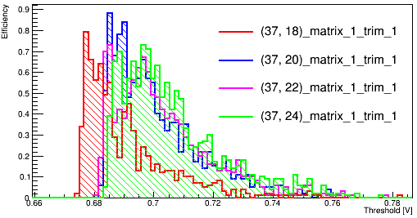
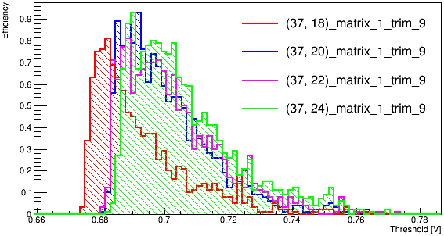
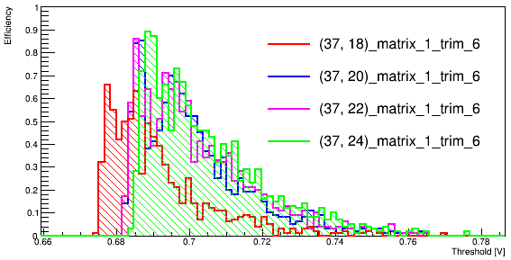
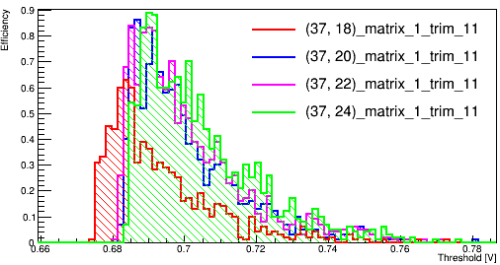
Check Trimming: difference between 4 pixels
If the difference between 4 pixels changes with different VPTrim
(37,18),(37,20),(37,22),(37,24)
Same testing configuration
Enable one pixel at a time
VPTrim: 1,6,9,11
Slightly different (too small to know if we could benefit from it)

Slide 6
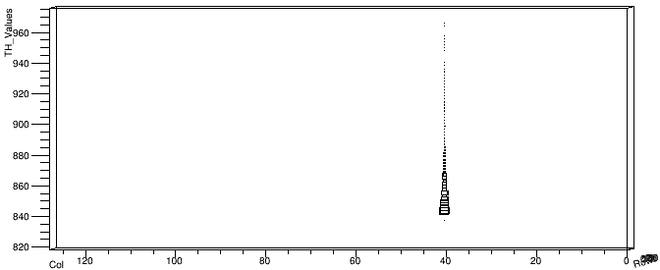
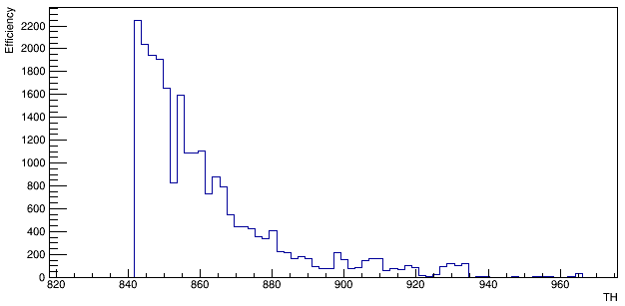
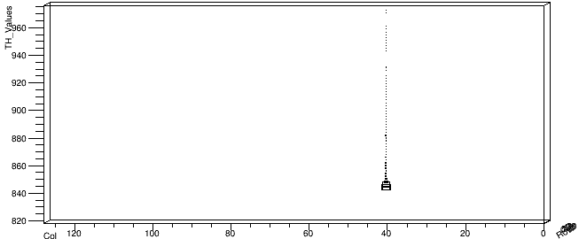
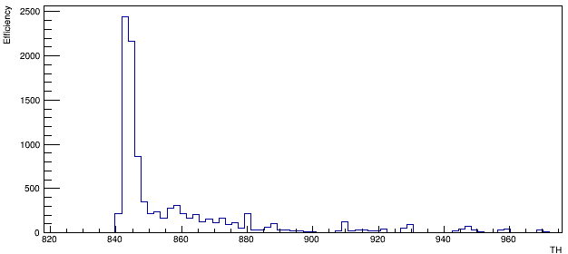
Validation of the stream readout
Enable one pixel: (41,21). (Same test configuration)
3-d map (see from the row direction) col-row-threshold
The Counts vs threshold
Clear Difference between Qinj and noQinj
Qinj
Qinj
No Qinj
No Qinj

Slide 7
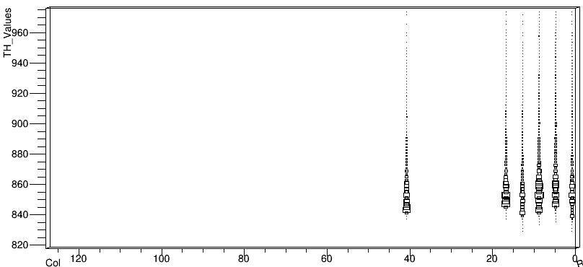
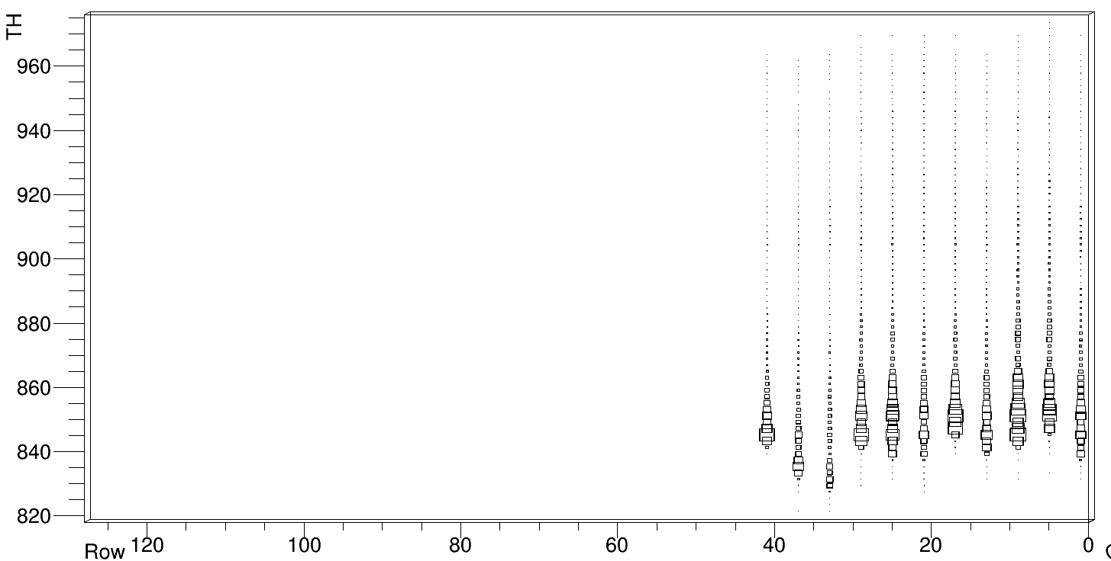
Validation of the stream readout
How many pixels we could read at a time
Gradually increase the testing pixels up to 11
(41,21)+(1,21),(5,21),(9,21),(13,21),(17,21),(21,21),(25,21),(29,21),(33,21),(37,21)
Read 1000 frame at each Threshold step
Two 3-d plot with 6 and 11 pixels enabled shown on the right
(already see difference actual “BL”)

Slide 8
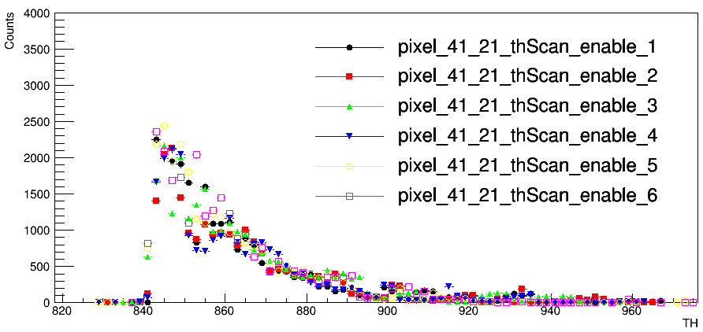
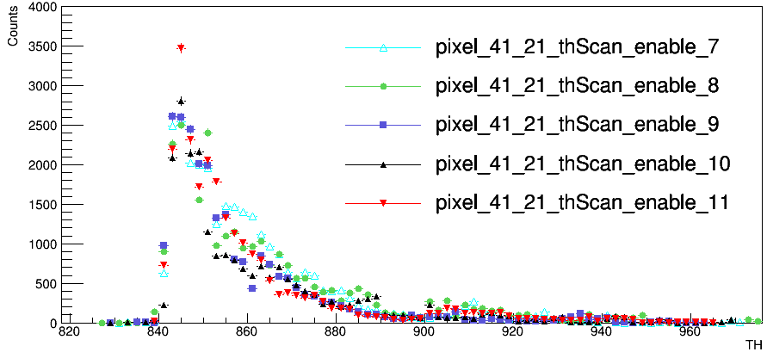
Validation of the stream readout
How many pixels we could read at a time
Gradually increase the testing pixels up to 11
(41,21)+(1,21),(5,21),(9,21),(13,21),(17,21),(21,21),(25,21),(29,21),(33,21),(37,21)
Read 1000 frame at each Threshold step
Counts vs Threshold of pixel (41,21) of different number of pixels enabled at a time
8 pixels (could be changed)

Slide 9
Testing all the pixels in Matirx 1
Tests to loop over all the pixels:
Matrix 1 (Matrix 2 has an extremely hot pixel)
Qinj +2V [50ns width no delay]
Bias: -30V (0.81mA)
BL=0.7V(868) Threshold sweeping: 818~976 (step:2)
1000 frames at each threshold
Enable 8 pixels at a time(in different row)
(0,0),(15,0)……(112,0)
(1,0),(16,0)……(113,0)
…
(15,0),(30,0)……(127,0)
Data: 512 files (65GB)
Update the data processing scripts to a c++ package (much faster)

Slide 10
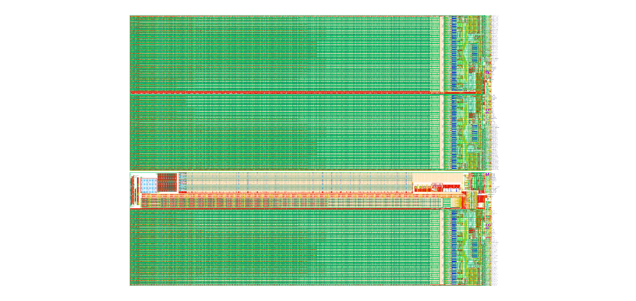
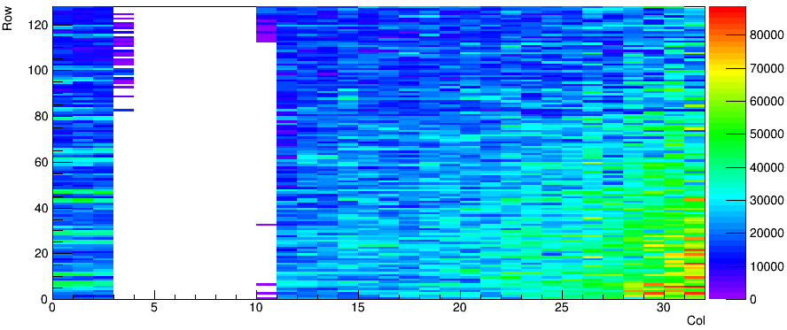
Tests on all the pixels
#01 board (200 Ohm/cm)
Plots : The total Counts number with Qinj (map)
Column = 3-10 is known dead region for this device
Higher Counts at right bottom corner
Temperature related?

Slide 11
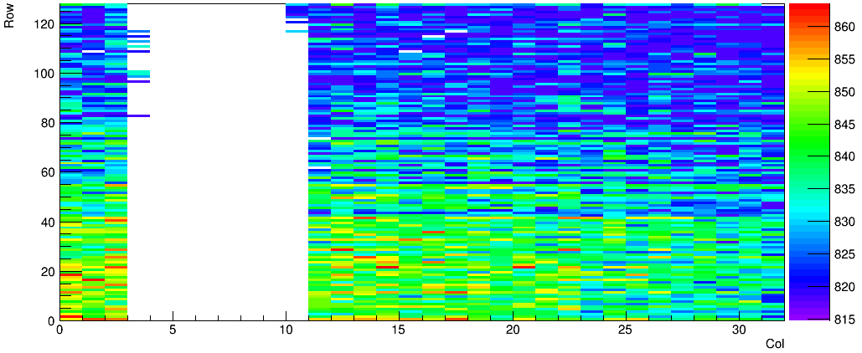
Tests on all the pixels
Comparing the actual BL level
Configuration:
BL = 0.7V(868)
Plots: threshold value for left edge at 800/1000 Counts
nonuniform distribution different with total Counts number distribution.
~0.016V(20) difference in general

Slide 12
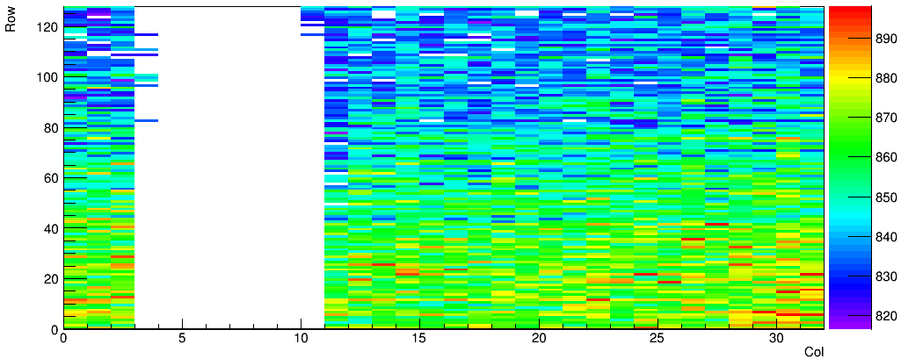
Tests on all the pixels
Trying to get the signal level
BL = 0.7V(868)
Plots: threshold value for right edge at 800/1000 Counts
nonuniform distribution
Higher at right bottom corner
~0.024V(30) difference in general

Slide 13
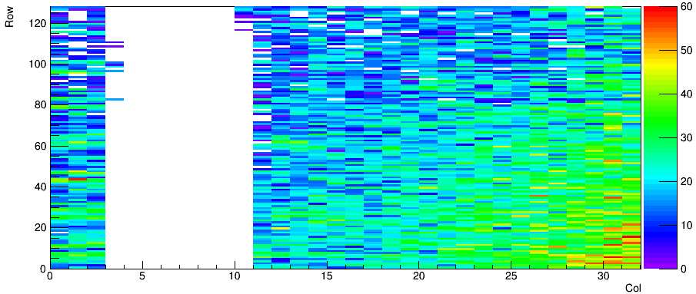
Tests on all the pixels
To get the signal size
Plots: TH_2-TH_1
TH_1: start from lower threshold (800/1000)
TH_2:start from higher threshold (800/1000)
nonuniform distribution
Higher at right bottom corner
~24mV(30) in general

Slide 14
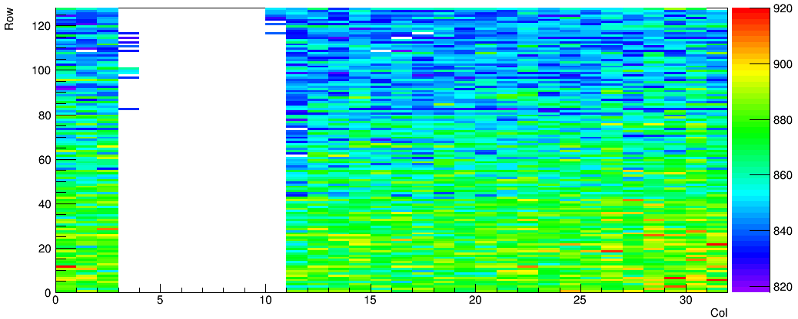
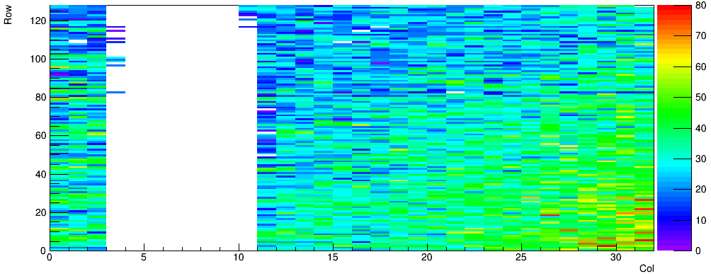
Tests on all the pixels
TH_2
TH_1
Set The counts requirement to 500/1000
TH_2-TH_1 ~40mV(50) (slightly bigger)
Range

Slide 15
Tests on all the pixels: Qinj off
NoQinj
Tests on half of the pixels
100 frames per threshold
Plot: Total Counts number

Slide 16
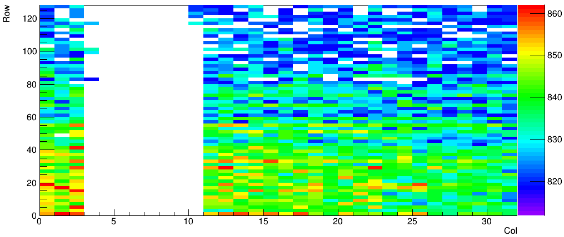
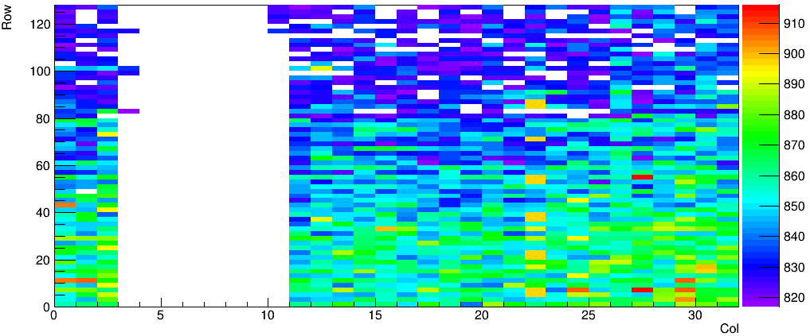
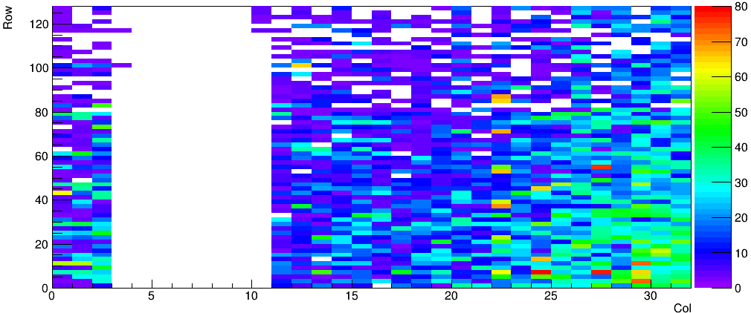
Tests on all the pixels: Qinj off – threshold with Counts of 50/100
TH_2
TH_1
Range: noise level of each pixels
Range ~ 8mV(10) in general
Range

Slide 17
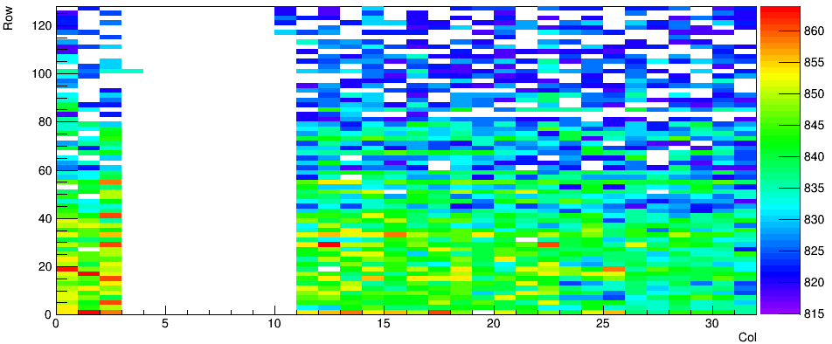
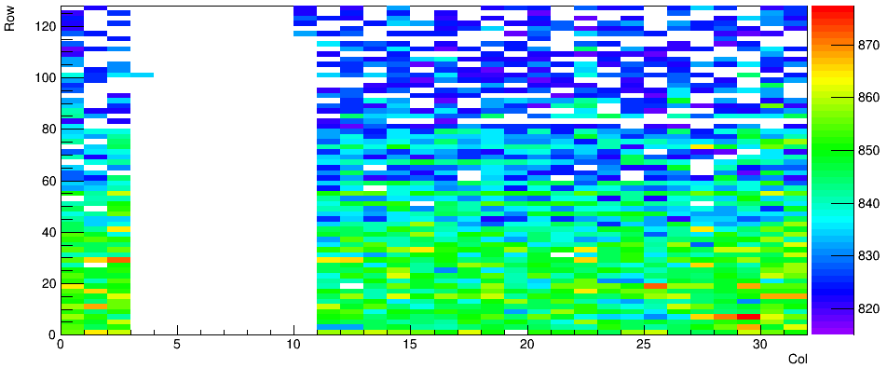
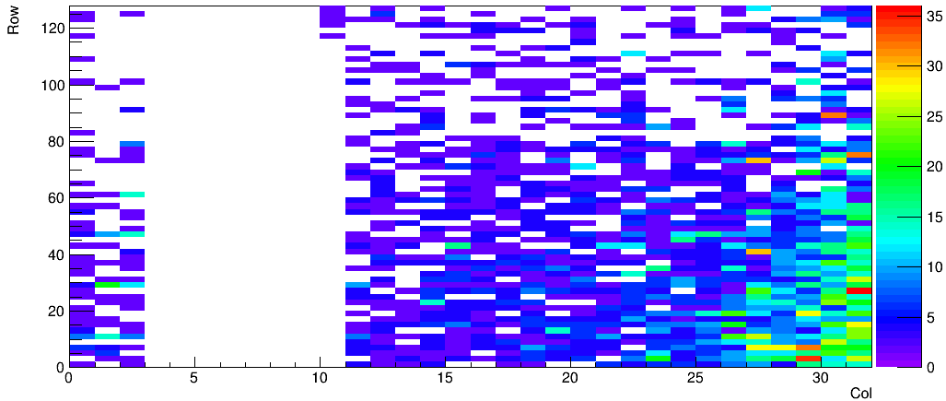
Tests on all the pixels: Qinj off – threshold with Counts of 100/100
TH_2
TH_1
Range ~ 4mV(5) in general
Range

Slide 18
Summary and next
Tests about the Trimming function -> seems not working
Validate that the stream readout could see the sharp peak
Test with 8 pixels enabled at a time looping over whole matrix
The actual BL distribution
The signal and noise level distribution
…
Next:
If the delay of latching the data related to the misaddress problem
More performance study of pixels from different part of the matrix
Mask bad performance pixels ……

Slide 19
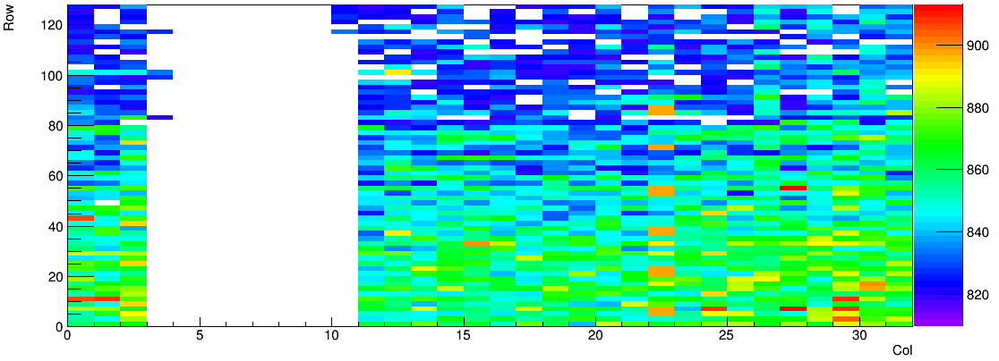
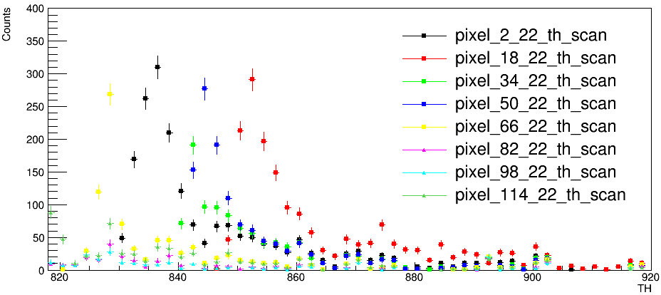
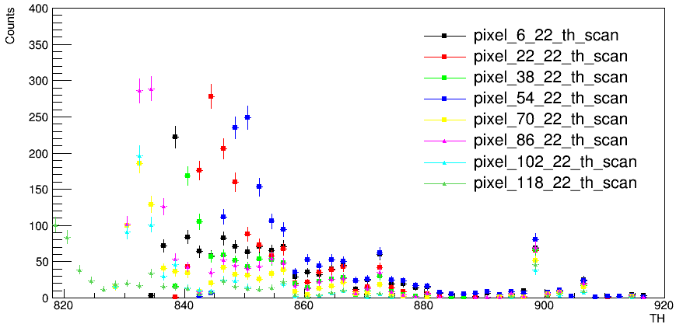
Backup: No Qinj – Counts number
TH_2
Increase the counts requirement to get over the peak at threshold=900
Or just block those pixels

Slide 20
BACKUP
Counts vs threshold
Pixel： (41,21)

