Slide 1
Vorstellung & Projektziele
Interessensgemeinschaft für
Mikroelektronik & Eingebettete Systeme
Kick-Off Verbund Tracking
Prof. Dr.-Ing. Michael Karagounis
13.02.2019 Heidelberg

Slide 2
Berufliche Stationen
Professor für Elektronik, Fachhochschule Dortmund
  Analog/Digital CMOS Design
  Bauelemente & Schaltungen
  Mikrocontroller Programmierung
Professor für Grundlagen der Elektrotechnik, Hochschule Hamm-Lippstadt, Hamm
RF Designer, Intel Mobile Communications GmbH, Duisburg
  PLL für GNSS Frontend in TSMC 28 nm
Analog/Mixed Signal CMOS IC Designer, EPOS GmbH & Co. KG, Duisburg
  Digital Controlled Voltage Regulator in TSMC 65 nm
Promotion zum Dr.-Ing. , Prof. Wupper (Fernuni Hagen), Prof. Wermes (Uni Bonn)
  Dissertation: „Analog Integrated CMOS Circuits for the Readout and
  Powering of Highly Segmented Detectors in Particle Physics Applications“

Slide 3
Laborvorstellung
IMES: Interessengruppe für Mikroelektronik und eingebettete Systeme
Laborgruppe besteht aus 3 Professoren, 2 technische Mitarbeiter, 5 Doktoranden
Mitgliedschaft bei Europractice und Mosis
EDA Cluster
  2 Linux Server (1 TB RAM, 24 Kerne)
  15 Linux PCs
EDA Software
  15 Cadence Lizenzen
  10 Mentor Lizenzen
  3 (Analog) +1(Digital) Synopsys Lizenz
Designkits für verschiedene Technologien
  TSMC, UMC, Globalfoundries, AMS
Forschungsprojekte
  Shunt-LDO Regler für Serial Powering bei ATLAS und CMS (RD53)
  DCS Controller Chip für den ATLAS Pixel-Detektor (ATLAS / Uni Wuppertal)
  VULCAN Photomultiplier Readout-Chip (JUNO / Forschungszentrum Jülich)
  Time-of-Flight Sensorik (ELMOS AG)
  Optische Winkelmessung (Adivco Microelectronics)

Slide 4
Forschungsthemen im Rahmen des Tracking Verbundes
Verbesserungen des Shunt-LDO Reglers für Serial Powering
  Verbesserung der Reglereigenschaften durch bessere Biasing-Schaltungen
  Schutzschaltungen gegen Überspannung & Überlast
  Low-Power Mode für die Installationsphase
  Startup
  Stabilisierung ohne externen Kondensator (capless)
Vollintegrierter DC/DC Wandler mit Wandlungsfaktor 4
  Hochfrequenz Buck-Converter unter Verwendung interner Induktivitäten & Wire-Bonds
  Switched-Capacitor Wandler
DCS Controller Chip für das Kontrollsystem des ATLAS Pixeldetektors
  CAN zu I2C Brückenchip
  CanOpen kompatible Brückenlogik
  Strahlenharte 5V Regler
  Strahlenharte CAN Driver/Receiver
  Strahlenharter / SEU toleranter Mikrocontroller (MIPS, ARM, RISC-V)

Slide 5
Shunt-LDO Regulator Concept
The Shunt-LDO regulator combines the functionality of an LDO voltage regulator with the capability of a shunt regulator to drain a constant current
Two control loops: 1) constant output voltage 2) constant current flow through the regulator
$$≈k\frac{V_{in}−V_{ofs}}{R_{3}}$$
$$I_{in}≈kI_{Ref}$$
$$I_{Ref}$$
$$I_{Ref}≈\frac{V_{in}−V_{ofs}}{R_{3}}$$
$$V_{in}=V_{ofs}+\frac{R_{3}}{k}I_{in}$$
k : 1
$$V_{out}=2V_{ref}$$

Slide 6
V/I Characteristic
$$V_{in}=V_{ofs}+\frac{R_{3}}{k}I_{in}$$
$$I_{in}$$
$$R_{in}$$
$$V_{in}$$
$$V_{ofs}$$
$$I_{in}$$
$$R_{in}$$
$$V_{in}$$
$$V_{ofs}$$

Slide 7
Modifications to Bias Scheme
External resistor Riref to improve radiation tolerance of main reference current Iref
Configurable Rofs resistor for high Vofs voltage in low power mode
Vofs startup circuit for startup with low input currents in low power mode
Vref
Vofs

Slide 8
Under Shunt Protection
overload current situation is considered as undershunt current scenario
  high load current reduces shunt current
In undershunt current case Vref is reduced
minimum voltage defined by current source
  Vmin=2.3µA x 150kOhm=350mV
additional injected current (1-2µA) can be configured by DAC setting
At shunt current lower < 11 mA additional current is disabled

Slide 9
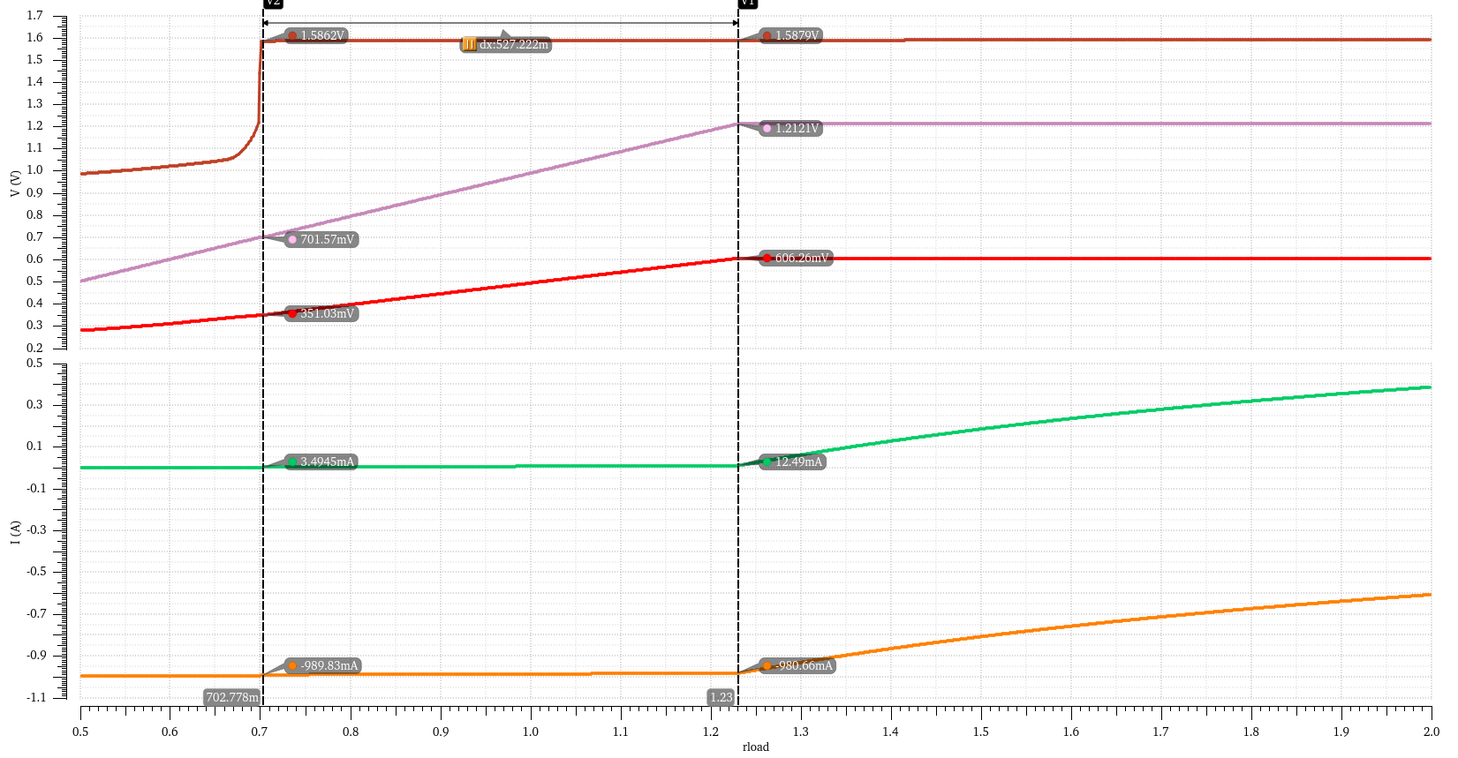
Under Shunt Current Limitation
Nominal Simulation
Vin
Vout
Vref
Ishunt
Iload(negative)

Slide 10
Overvoltage Protection Voltage Clamp
voltage clamp implemented as shunt regualtor
Operated in parallel to SLDO
takes all excess current in case Vin =>2v

Slide 11
Rectification Circuit and Low Power Mode Interface
Rectification circuit with 2x multiplication circuit
AC signal is inverted and applied to a transistor in parallel two one of Rofs resistiors
  Inverter is supply by Vpre using a resistor instead of PMOS to avoid SEU issues
C1=100nF
C2=1pF
C3=1pF
C4=10pF
R2=10MΩ
R4=10MΩ

Slide 12
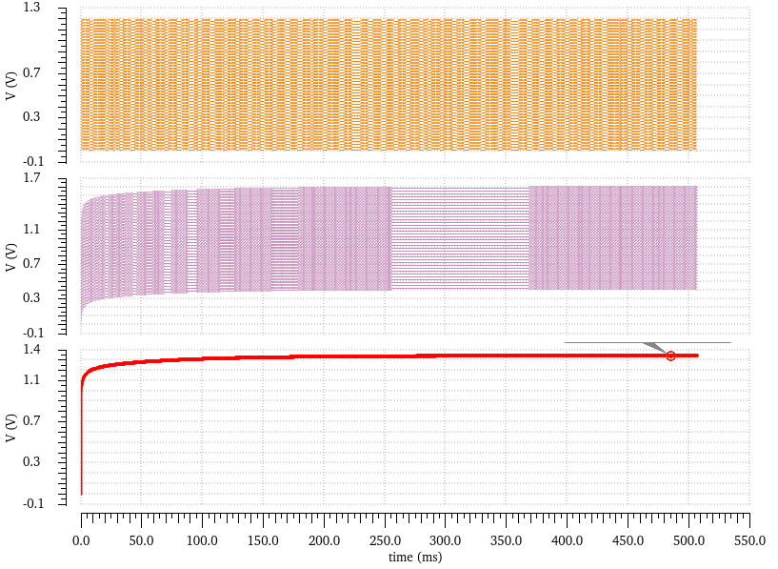
AC rectifier operation
U_{D2}
U_{D3}
U_{C4}
AC input signal with 1.2V peak to peak amplitude and 1MHz frequency

Slide 13
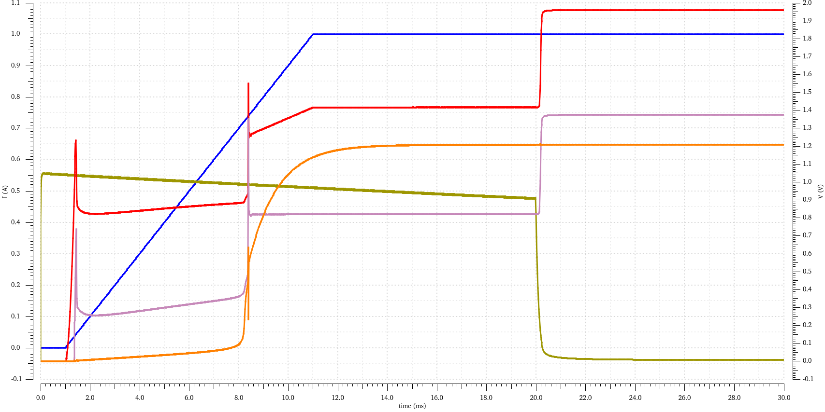
Switching between High-Power and Low-Power at 1 A input current
Isup
Vin
Vofs
AC
Vout

Slide 14
Vofs Startup Circuit
Reg-VT
PMOS
Low-VT
NMOS
wide-swing cascode current mirror with low-vt NMOS transistors draw current first
standard cascode current mirror wit reg-vt PMOS transistrs drain current later
  difference between current is injected to R_{ofs}

Slide 15
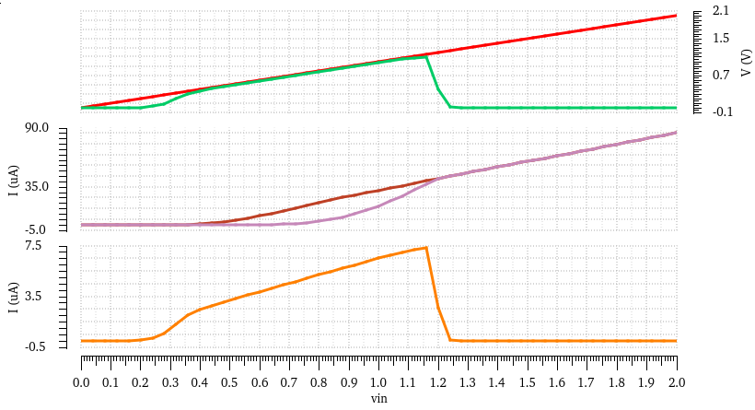
Vofs Startup Circuit Simulation
Vin
VofsHalf
IstartN
IstartP
Iextra

Slide 16
DCS Controller Chip Purpose
I
0
Pixel
-
Pixel
-
Pixel
-
Pixel
-
Pixel
DCS
-
Computer
Module
Module
Module
Module
Module
U
0
c
.
a
.
CAN
100
m
PSPP Chip
PSPP Chip
PSPP Chip
PSPP Chip
PSPP Chip
c
c
DCS
Controller
SCB
serves as gateway between the CAN bus of the DCS computer and the SCB bus to which the PSPP chips are connected to
placed at Patch Panel 0 (PP0) at the End of Sub-structure card (EoS)
CAN has been chosen for communication due to robustness and reliability
provides local monitoring functions (temperature) for the installed location

Slide 17
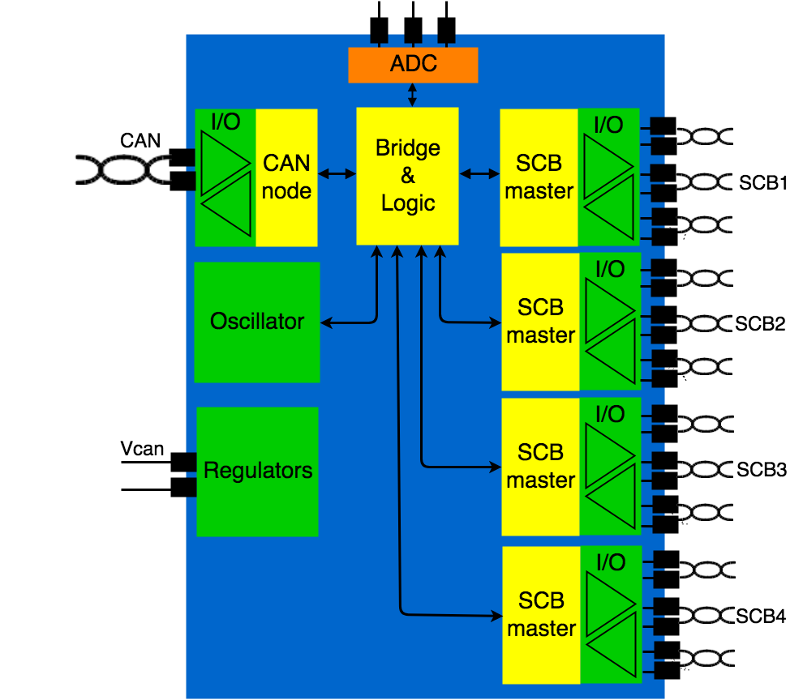
DCS Controller Chip Blocks
CAN Receiver
CAN Protocol
Unit
CAN Driver
Voltage
Regulators
ADC
Bridging Logic
Power-On
Reset
Oscillator
SCB Receiver
SCB Protocol
Unit
SCB Driver

Slide 18
3.3V CAN Driver with levelshifter
Levelshifter
CAN Driver needs 3.6V CMOS signal
to switch transistor M6
Levelshifter translates EN signal
from 1.2V to 3.6 V voltage level
Levelshifter consists of lower and upper part
Lower part is a switchable resistive voltage divider
Divison ratio depends on switching state
Lower part shifts signals above 2.4 V
Upper part is classical levelshifter circuit
Creates CMOS signal switching between 2.4V and 3.6V
CAN Driver

Slide 19
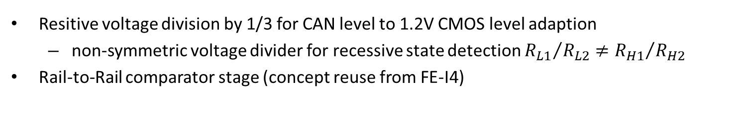
3.3V CAN Receiver
Resitive voltage division by 1/3 for CAN level to 1.2V CMOS level adaption
  non-symmetric voltage divider for recessive state detection ${R_{L1}}/{R_{L2}}≠{R_{H1}}/{R_{H2}}$
Rail-to-Rail comparator stage (concept reuse from FE-I4)

Slide 20
Power Supply Architecture
x 3
Pass-Devices
x 5
Pass-Devices
x 7
Pass-Devices
Common
Supply
Rail
Three linear regulators for the required supply volages of 1.2V, 2.4V and 3.6V
  The higher the output voltage the smaller the number of cascoded pass-device transistors
The 1.2V regulator supplies also the amplifier of the 2.4V and the 3.6V regulator
The 1.2V regulator requires a startup-circuit circuit
  due to feedback loop from regulator output voltage to amplifier supply voltage

Slide 21
Complete 1V2 Regulator Circuit
Startup Circuit
Pass-Device
Biasing
Error Amplifier Biasing
Error Amplifier
ESR
Compensation

Slide 22
Zusammenfassung & Ausblick
Shunt-LDO Regler & DCS Controller Chip
  Anspruchsvolle Projekte mit wenig Ressourcen unter hohem Zeitdruck
  Bei SLDO: Robustheit & Sicherheitsmaßnahmen im Vordergrund
  Bei DCS Controller: strahlenharte Schaltungen bei 5V Betrieb
Raum für innovative Themen & Ideen
  Reduktion der Anzahl externer Komponenten bei Spannungsreglern
  SEU-/strahlenharte Mikrocontroller

Slide 23
Parallel vs Serial Powering Scheme I
$$V_{drop}=nR_{C}I_{m}$$
$$R_{C}$$
$$I_{o}=nI_{m}$$
Modules are connected in parallel
Powered by constant voltage source
Total supply current scales with the
number of modules
Large supply currents affect efficiency
IR drops on power cables
$$V_{0}$$
$$V_{m}$$
$$V_{m}$$
$$η=\frac{1}{1+n\frac{I_{m}^{}R_{C}}{V_{m}}}$$
$$I_{m}$$
$$V_{m}$$
$$I_{m}$$
DC/DC conversion decreases supply
current and increases efficiency
DC/DC conv. has high material budget
$$I_{m}$$

Slide 24
Parallel vs Serial Powering Scheme II
$$V_{drop}=R_{C}I_{m}$$
$$I_{0}=I_{m}$$
$$V_{m}$$
Modules are connected in series
Powered by constant current source
Total supply current is defined by maximum load
current of a single module
Total supply voltage across the chain scales with
the number of powered modules
Regulator circuitry required to generate
constant supply voltage out of constant current
$$V_{m}$$
$$η=\frac{1}{1+\frac{R_{C}I_{m}}{nV_{m}}}$$
$$V_{m}$$
$$V_{0}=nV_{m}$$

Slide 25
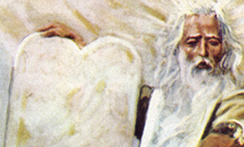
The Serial Power Commandments
You shall prevent the break of the serial powering chain
You shall avoid hot spots
You shall distribute power equally across the chips and the module
You shall avoid single point of failure
You shall introduce redundancy
You shall operate several regulators in parallel

Slide 26
Shunt Regulator Operation Principle
Voltage regulation by current steering
Current flow through load defines $V_{out}$
Referenced voltage $V_{out}=\left(1+\frac{R_{1}}{R_{2}}\right)V_{ref}$
Excess current $I_{Shunt}$ is shunted by M1
$I_{in}>I_{load}$→ $η=\frac{I_{load}}{I_{in}}$
$$I_{shunt}$$
$$I_{load}$$
Very steep voltage to current characteristic
$→$ Small voltage source output impedance J
$→$ Unbalanced current distribution across parallel
$→$placed regulators L
Parallel placed regulators generate different $V_{out}$
  voltage reference variations
  error amplifier offset
  resistor mismatch
  ground shifts
Current will flow through regulator with small $V_{out}$
Regulator may be destroyed due to overload cond.
$$I_{in}$$
$$V_{out}$$

