Slide 1
Introduction to DESY
J. Mnich
February 17, 2020 EDIT School

Slide 2
What does »DESY« stand for?
Our first particle accelerator: Deutsches Elektronen-SYnchrotron

Slide 3
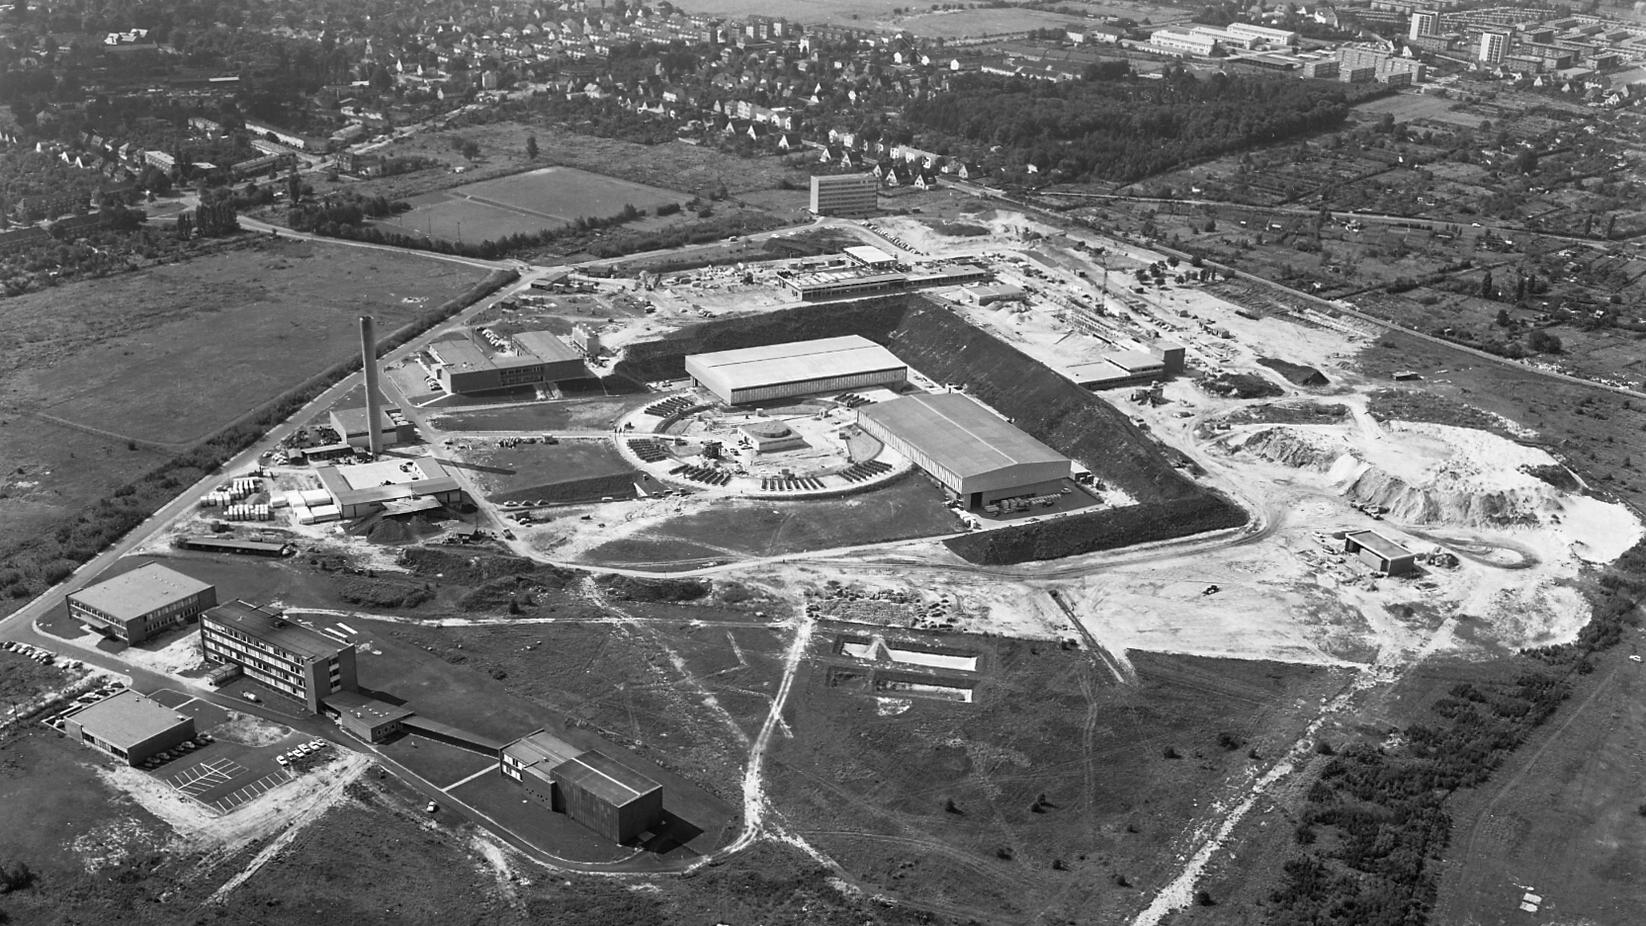
DESY, Begin of operation 1965
Notes:
Picture was taken in 1963

Slide 4
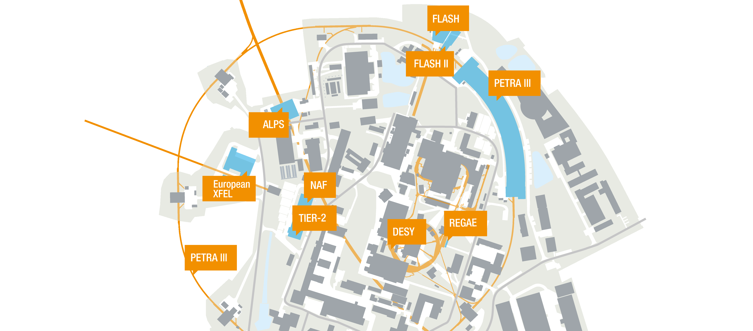
Today: Many particle accelerators
Many particle accelerators on campus attract research projects

Slide 5
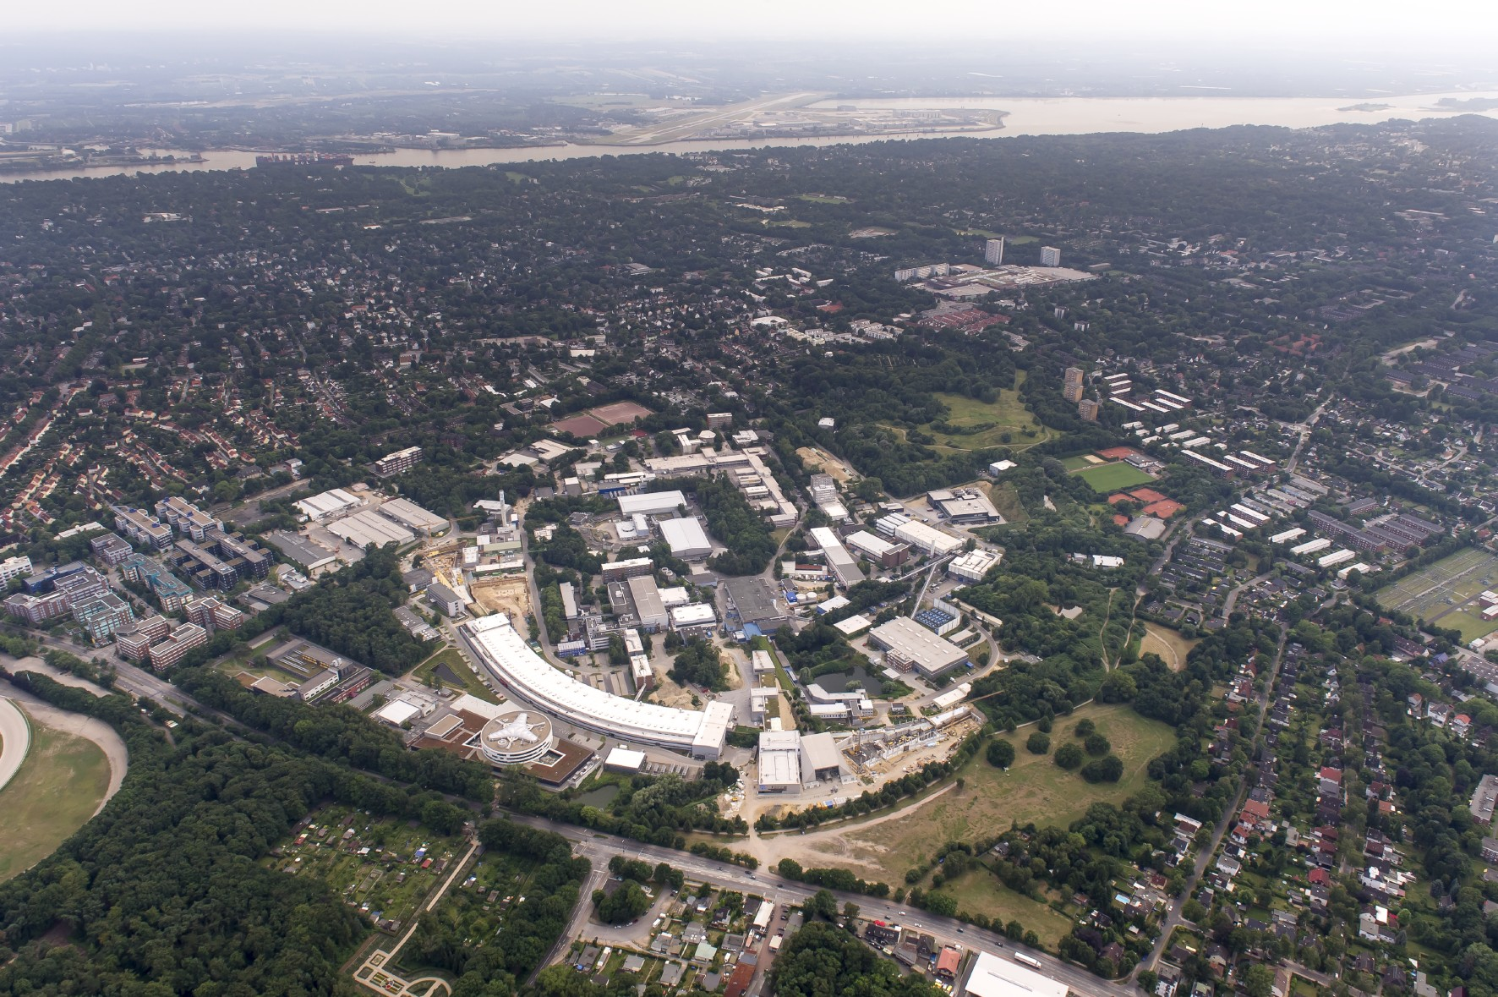
Campus Hamburg

Slide 6
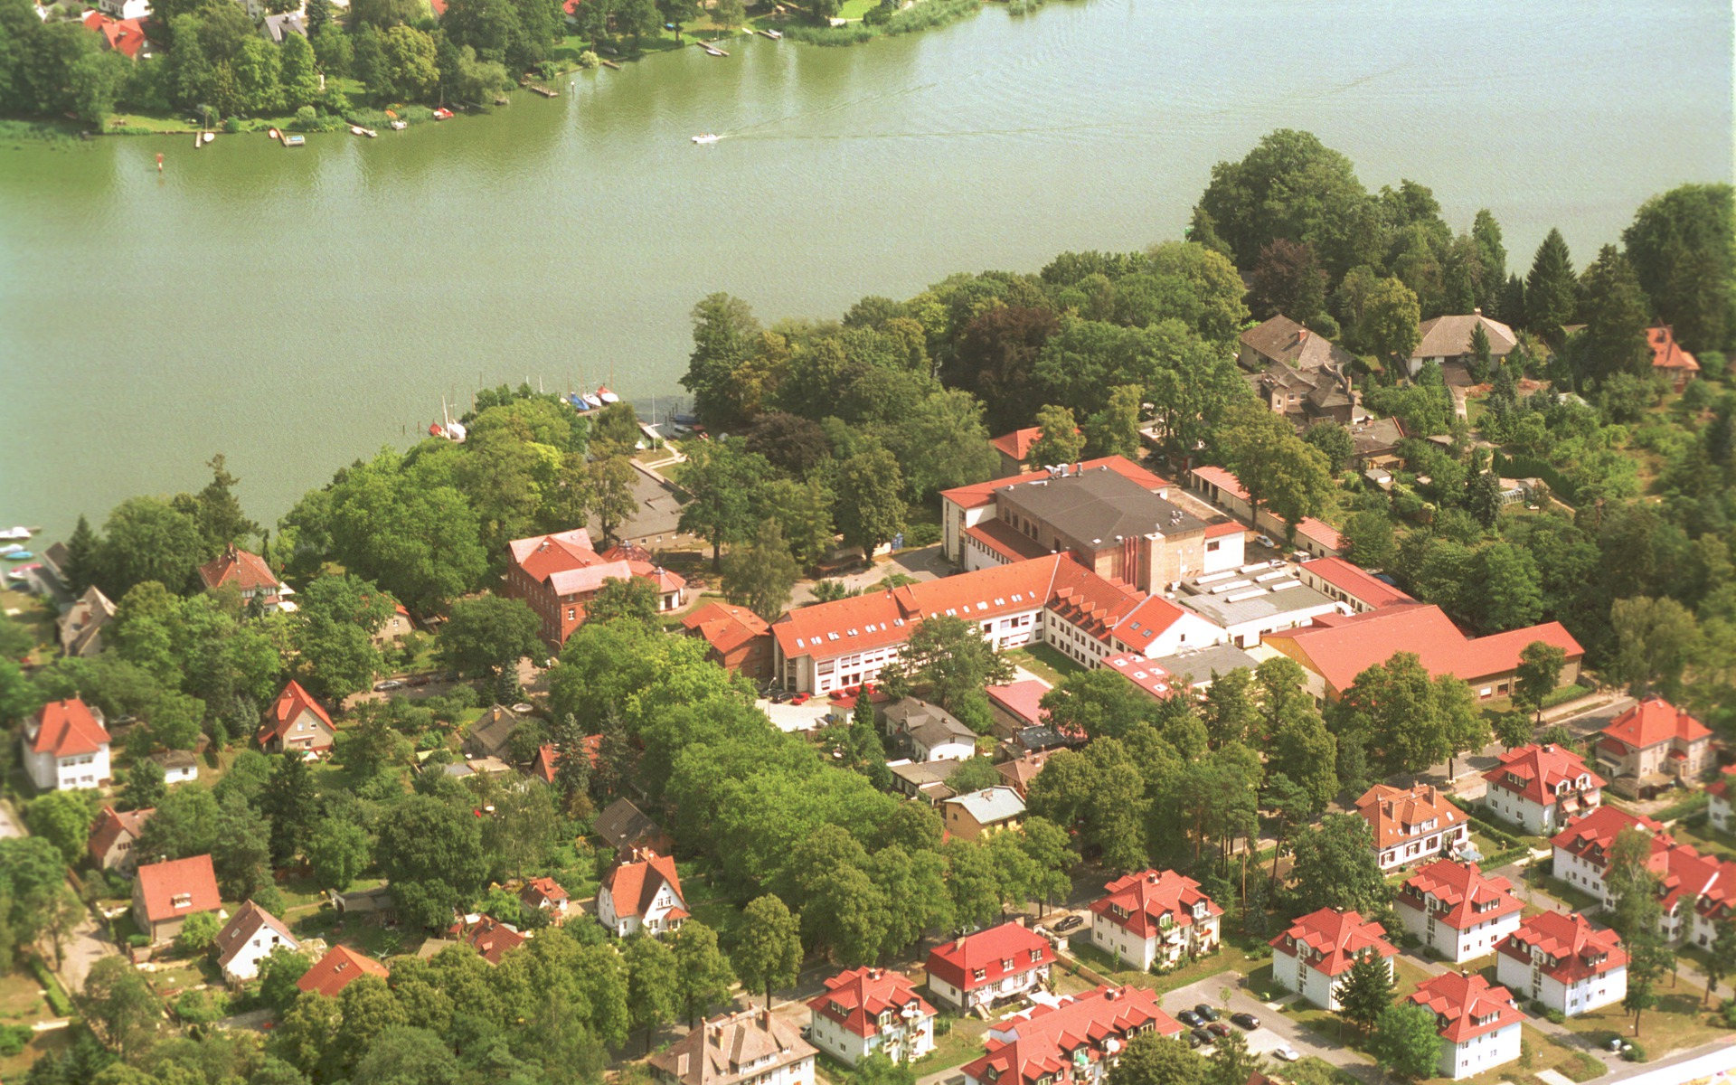
Campus Zeuthen

Slide 7
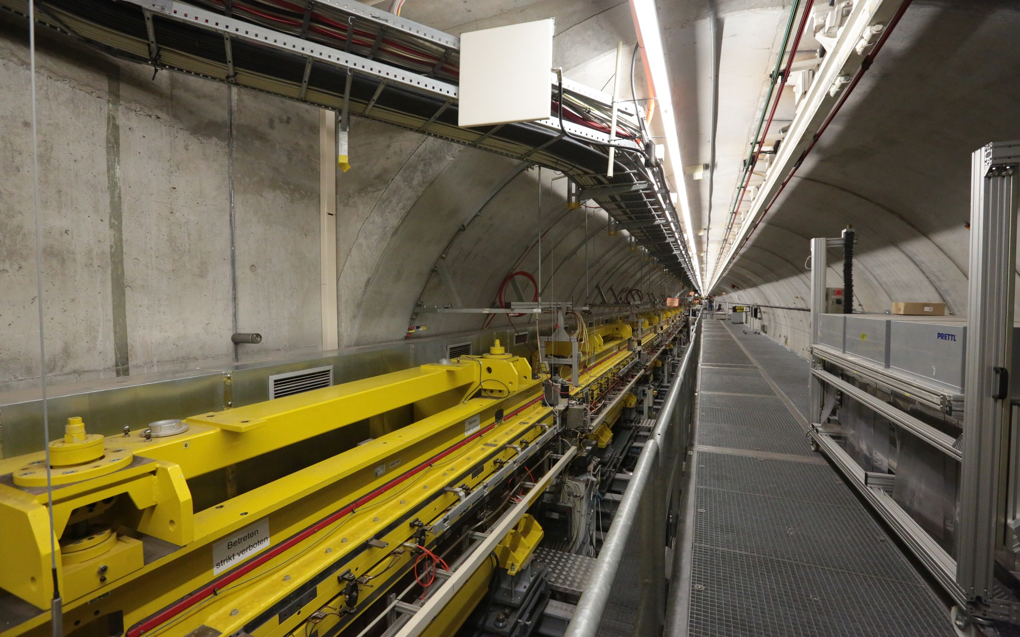
16 kilometres of tunnels

Slide 8
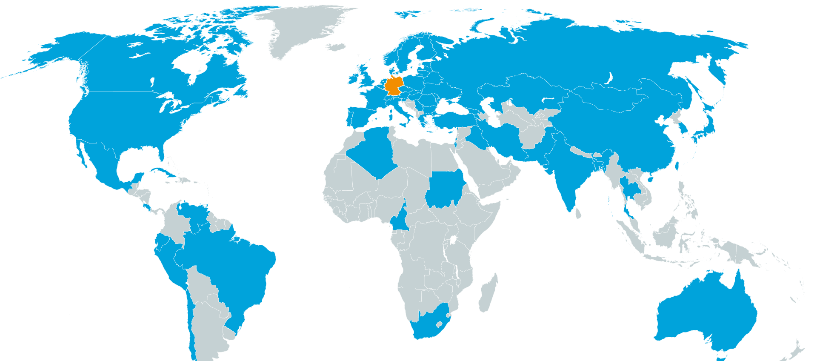
Hello World!
3000 scientists from more than 40 countries
use our research infrastructures every year.

Slide 9
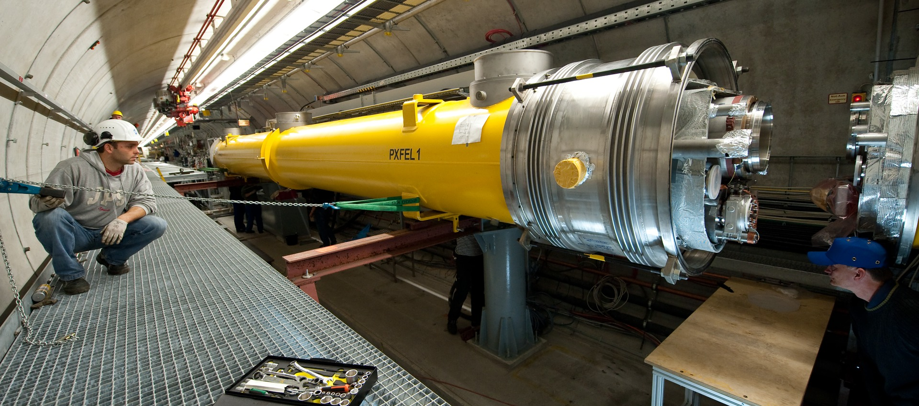
Developing and building
Accelerators
Accelerator module with superconducting technology (so-called TESLA technology)
Mounting at FLASH

Slide 10
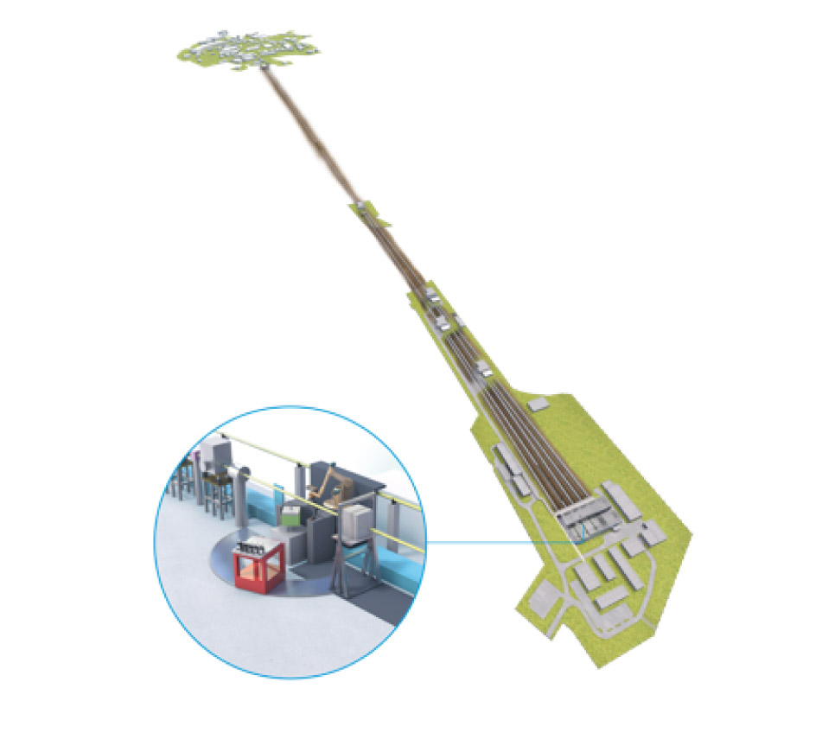
The X-ray laser
Photon Science > What lies ahead?
With the European XFEL starts a unique X-ray lightsource.
DESY is the main shareholder.
3.4 km long free-electron laser
superconducting electron accelerator
independent research institute
27,000 flashes per second
- every flash is less than 100 trillionth seconds
New research opportunities
movies of chemical reactions
three-dimensional images

Slide 11
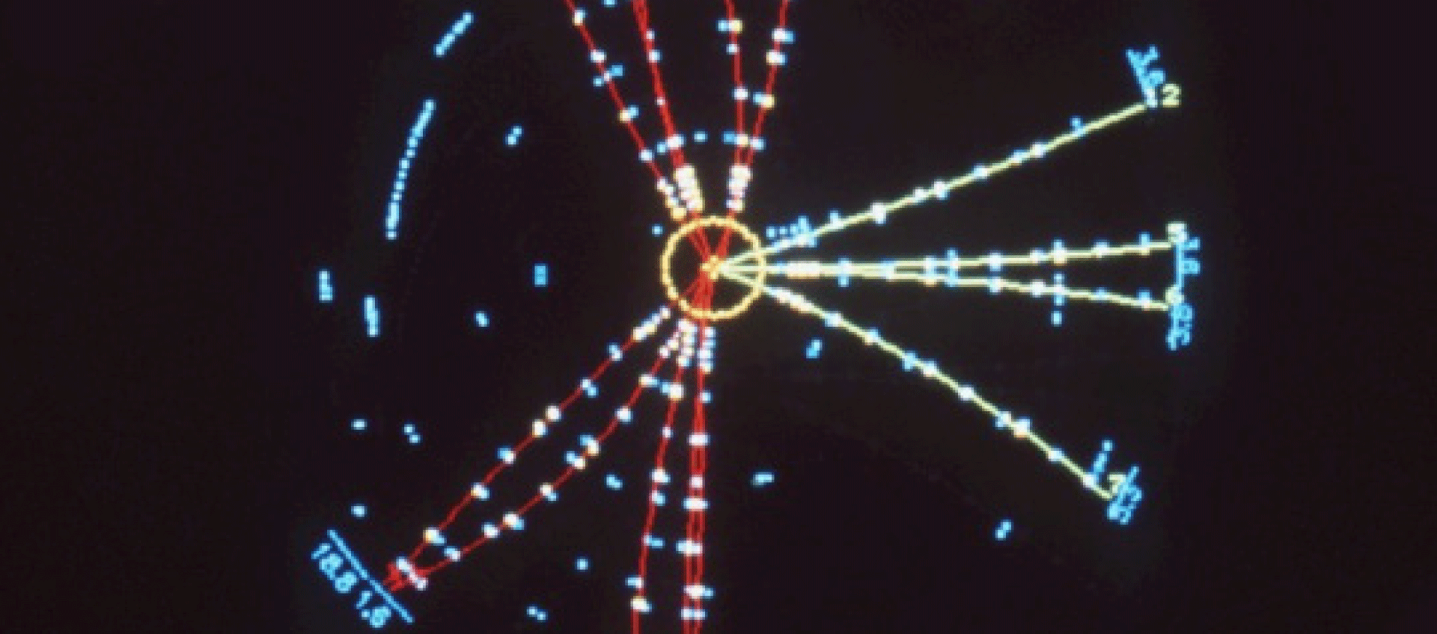
Discovery of the gluon
Particle Physics > Highlights at DESY
Gluons bind quarks in the nucleus of the atom.
1979

Slide 12
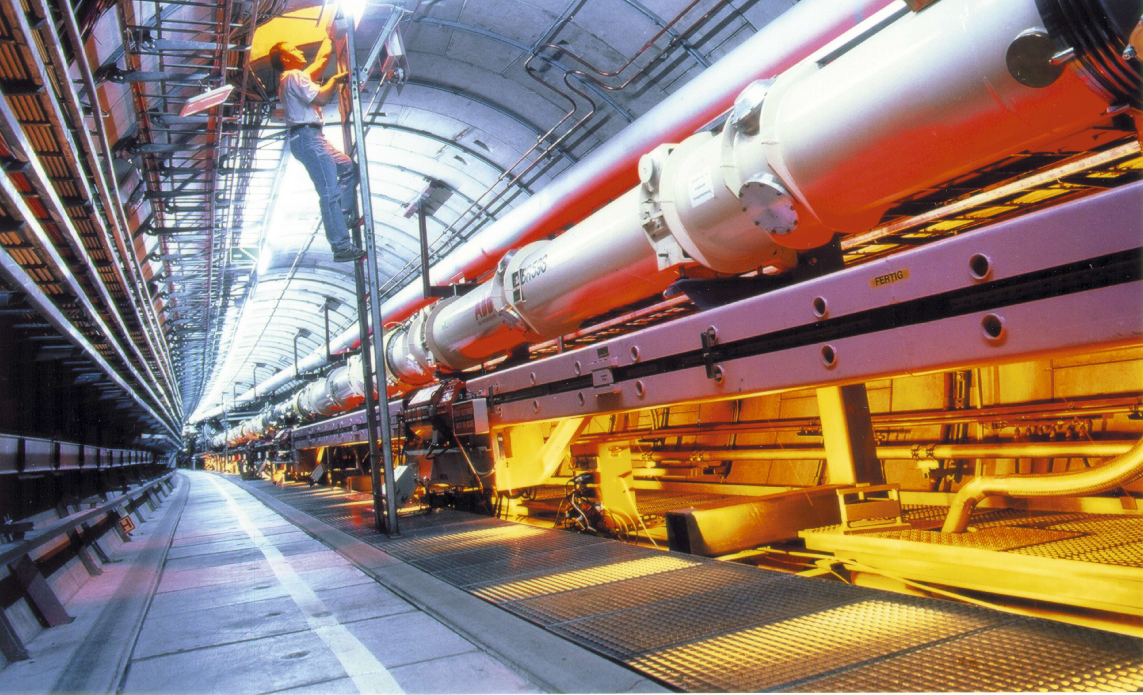
HERA: Understanding the proton
Particle Physics > Highlights
The proton is much more complicated than we thought for a long time.
1992 to 2007

Slide 13
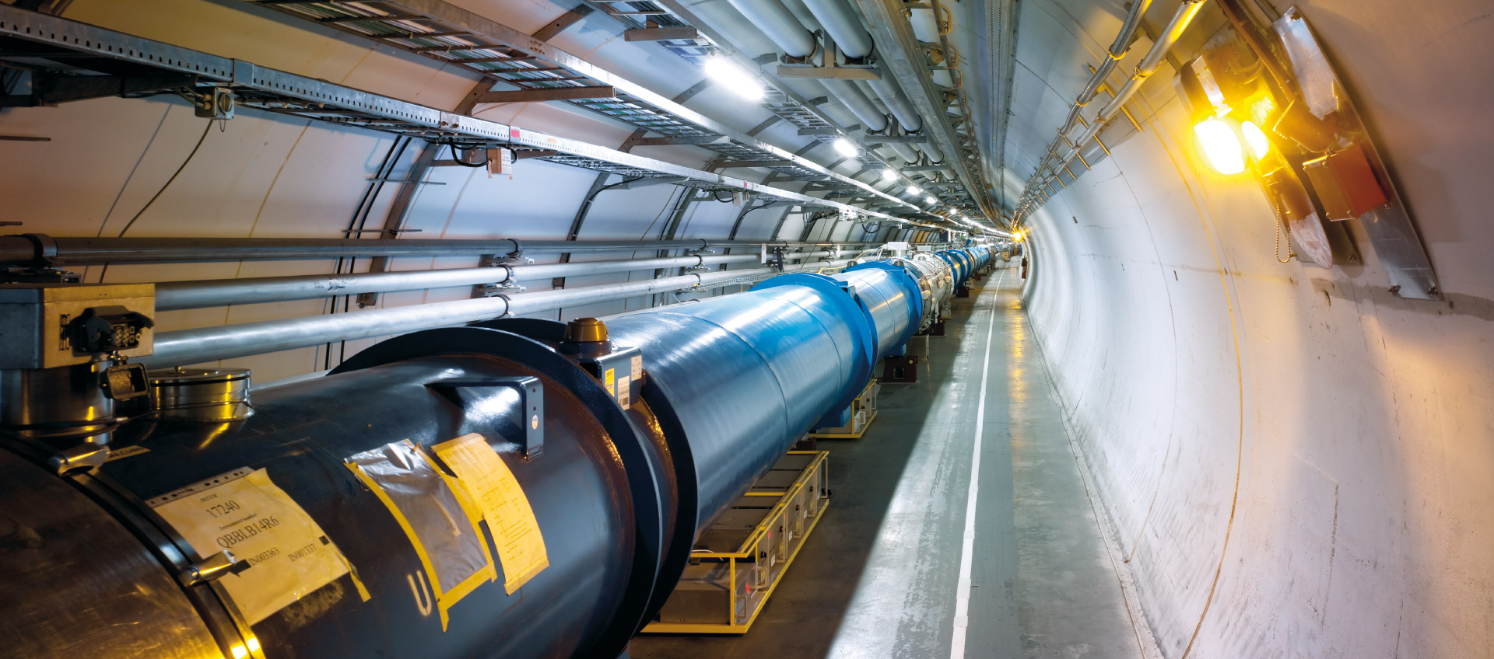
Participation at the LHC
Particle Physics > Today
— the Large Hadron Collider at CERN in Geneva
27 kilometer

Slide 14
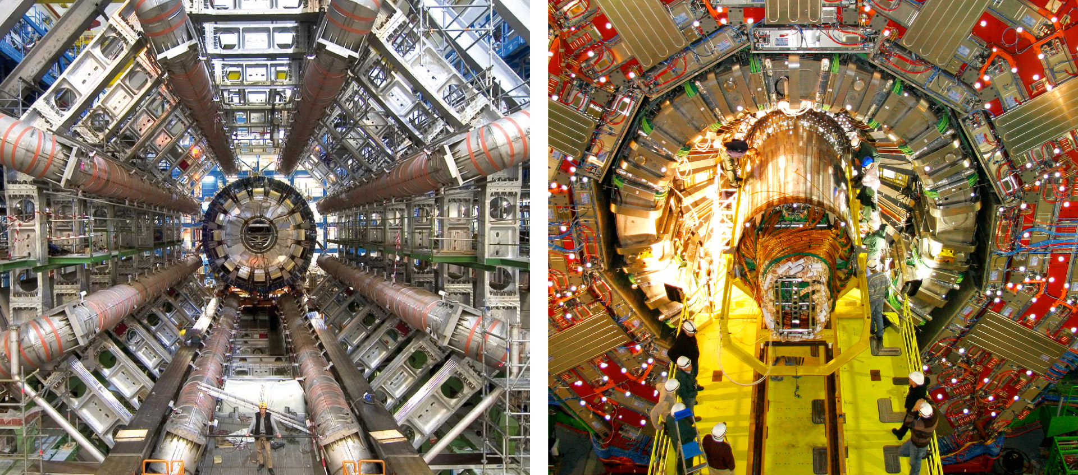
Participation at the LHC
Particle Physics > Today
— the Large Hadron Collider at CERN in Geneva
ATLAS and CMS

Slide 15
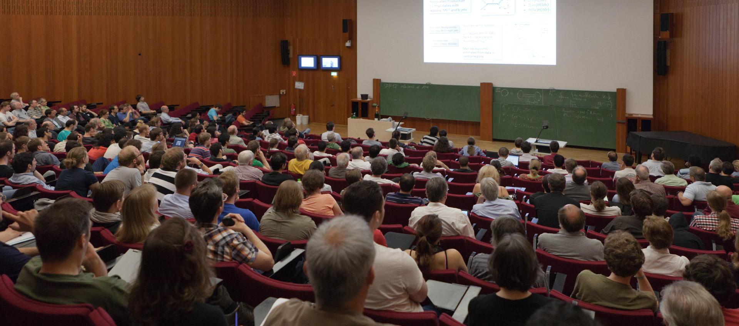
Discovery of the Higgs boson
Particle Physics > Highlights
DESY scientists played a vital role at the discovery of the particle, which plays an important role for the mass.
2012

Slide 16
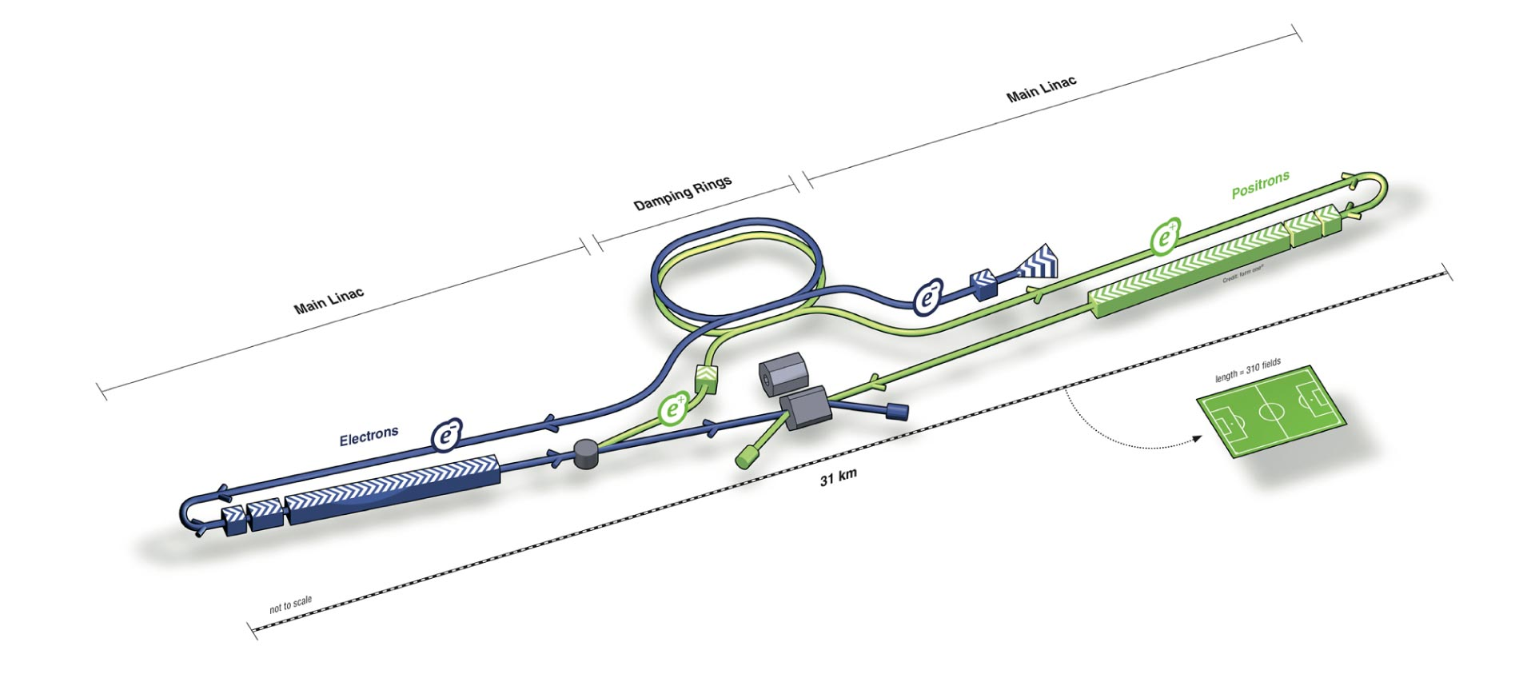
International Linear Collider
Particle Physics > What lies ahead?
Accelerator and detector technology: DESY.

