Slide 1
Canadian ATLAS Tier-1
Di Qing
TRIUMF ATLAS Tier-1
TRIUMF-Helmholtz Workshop on Scientific Computing
September 16-17, 2019
DESY, Hamburg, Germany
Di Qing

Slide 2
Outline
Overview of the Canadian ATLAS Tier-1 centre and role
ATLAS tasks and workflows
ATLAS resource usages at the Canadian Tier-1
Our experience and CPU utilization improvement
TRIUMF-Helmholtz Workshop on Scientific Computing
Di Qing, TRIUMF

Slide 3
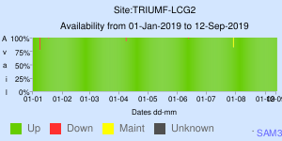
Canadian ATLAS Tier-1
Key player in large-scale distributed computing (ATLAS experiment only)
Providing storage for the raw and secondary datasets
Providing computing capacity for data processing, simulation, and physics group activities
Providing 10% of worldwide Tier-1 resources
Primary Tier-1 services and resources relocated to a new data centre at Simon Fraser University last year
Current capacity in production:
7680 cores (SFU) + 4744 cores (TRIUMF, simulation only)
11 PB disk (at SFU)
31 PB tape (at SFU)
>10 years stable 24x7 operations
Site Availability ~100%
TRIUMF-Helmholtz Workshop on Scientific Computing
Di Qing, TRIUMF
Notes:
Designed for ATLAS workflows

Slide 4
Tier-1 cluster at SFU
Designed for ATLAS workflows at Tier-1
TRIUMF-Helmholtz Workshop on Scientific Computing
Di Qing, TRIUMF

Slide 5
ATLAS Workflow Management schematic
Source: ATLAS ProdSys2 tutorial
TRIUMF-Helmholtz Workshop on Scientific Computing
Di Qing, TRIUMF

Slide 6
ATLAS workflows and resource requirements
Main ATLAS Tier-1 tasks
Resources required
Simulation
Data reprocessing
Data merging
Derivation production (secondary dataset)
Users analysis
Physics groups activities
Single core/multiple cores
CPU time, disk space, memory
CPU intensive vs IO intensive
Priority
TRIUMF-Helmholtz Workshop on Scientific Computing
Di Qing, TRIUMF

Slide 7
ATLAS storage usage at Canadian Tier-1
Secondary dataset
NTUP
Storage usage as September 13, 2019
Disk usage ~8.4PB
Tape usage ~16.0PB
Total size ~24.4PB
9.83% of all Tier-1s’ usage
Group data
Raw data
Simulation
TRIUMF-Helmholtz Workshop on Scientific Computing
Di Qing, TRIUMF
Notes:
Close to 10 % of all Tier-1s’ storage usages

Slide 8
Slots of ATLAS running jobs at Canadian Tier-1
Group production
Reprocess campaign
13k slots
Simulation
Event generation
Reconstruction
TRIUMF-Helmholtz Workshop on Scientific Computing
Di Qing, TRIUMF

Slide 9
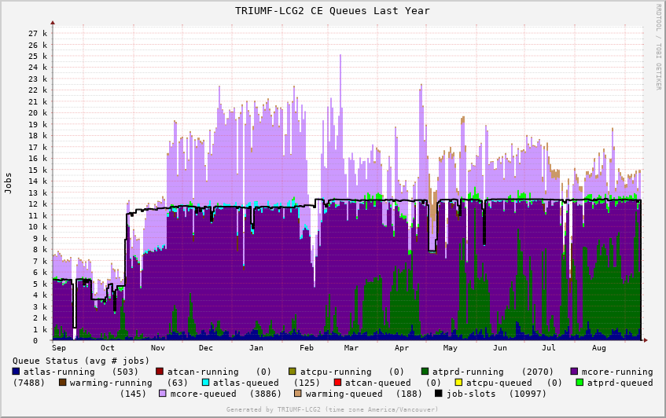
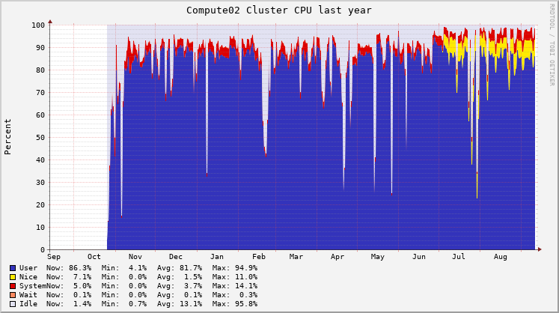
Local monitoring on CPU usages
CPU slot usage from batch system point of view ( one year)
CPU utilization of one sub cluster (1152 cores) (one year)
Total job slots ~12.4k
TRIUMF-Helmholtz Workshop on Scientific Computing
Di Qing, TRIUMF

Slide 10
CPU resources are not fully utilized
Average CPU efficiency ~91.6% in 2019
CPU utilization rate even lower, ~84.6%
Reasons
Staging in/out data
Sequential step of multi-core job
No payloads from ATLAS
Draining jobs
Switching between single core/multi-core productions
90%
Started running BOINC
TRIUMF-Helmholtz Workshop on Scientific Computing
Di Qing, TRIUMF

Slide 11
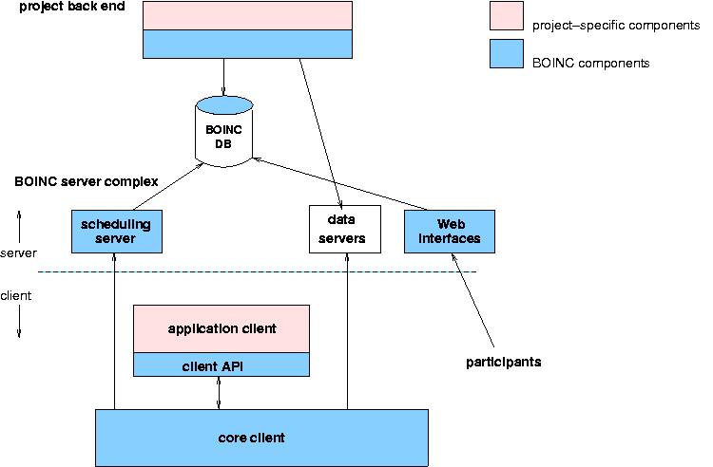
BOINC jobs and ATLAS@home project
Computing with BOINC
A platform for distributed computing
Can be used in volunteer computing and in-house computing
Tasks run at background with low priority
Examples include SETI@home, Rosetta@home and Einstein@home
ATLAS at home project
A project to use the internet-connected volunteer resources
Run simulation of ATLAS experiment - CPU intensive
Now also used by some grid sites and HPC to backfill nodes
Source: https://sarwiki.informatik.hu-berlin.de/BOINC
TRIUMF-Helmholtz Workshop on Scientific Computing
Di Qing, TRIUMF

Slide 12
Running ATLAS@home on TRIUMF ATLAS Tier-1 clusters
Started in March 2018 at TRIUMF
Started to run BOINC jobs at SFU in June 2019
Implementations
Create account on LHC@home
Select ATLAS project
Install and configure BOINC client
Tune the configurations
Avoid the impacts on normal productions
Use CGroup to control the CPU share of BOINC jobs
Limit the number of cores (25%) which BOINC can use
TRIUMF-Helmholtz Workshop on Scientific Computing
Di Qing, TRIUMF

Slide 13
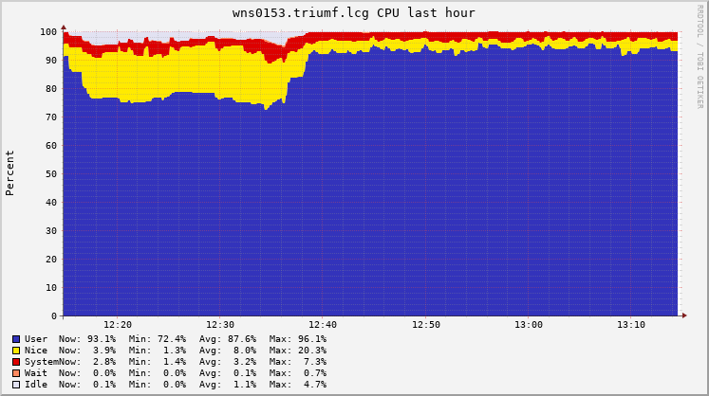
What is gained with BOINC jobs
CPU usage of BOINC processes with very low priority
Backfill nodes
Increase the CPU utilization of the cluster
One hour
Processes of ATLAS jobs with normal priority
Total CPU usage
One year
TRIUMF-Helmholtz Workshop on Scientific Computing
Di Qing, TRIUMF
Notes:
Nodes with 48-core and 3 800GB SSDs at SFU location

Slide 14
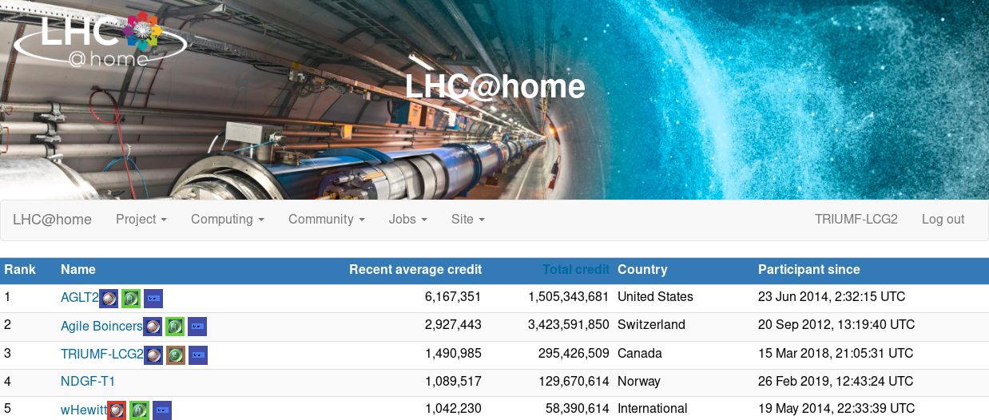
Contribution to ATLAS@home project
Provided a lot of ‘additional’ resources to ATLAS
TRIUMF Contributions as September 12, 2019
TRIUMF-Helmholtz Workshop on Scientific Computing
Di Qing, TRIUMF

Slide 15
Impact of BOINC jobs is small
CPU efficiency of ATLAS productions slightly dropped
Less than 1% for our new cluster
Potentially compete with the normal production jobs on memory
Disk space and network bandwidth usage are trivial
Accounting
The contributions of BOINC jobs are not officially accounted by ATLAS and WLCG
We are working on solutions
TRIUMF-Helmholtz Workshop on Scientific Computing
Di Qing, TRIUMF

Slide 16
Thank you!
Questions?
TRIUMF-Helmholtz Workshop on Scientific Computing
Di Qing, TRIUMF

