Slide 1
nVent – Schroff
Influences for the cooling performance of a MTCA.4 Crate
Ralf Waldt
Field Application Engineer
November 26, 2019

Slide 2
Agenda
The presentation demonstrates the influences of different circumstances to the cooling performance of a MTCA.4 crate.
Test set up
Reference crate
Measurements:
Air distribution of the reference crate
2 Slots with higher air impedance
2 Slots with lower air impedance
2 Slots open on ATM area and RTM area
Air filter 30% blocked
Conclusion

Slide 3
Thermal Test Lab

Slide 4
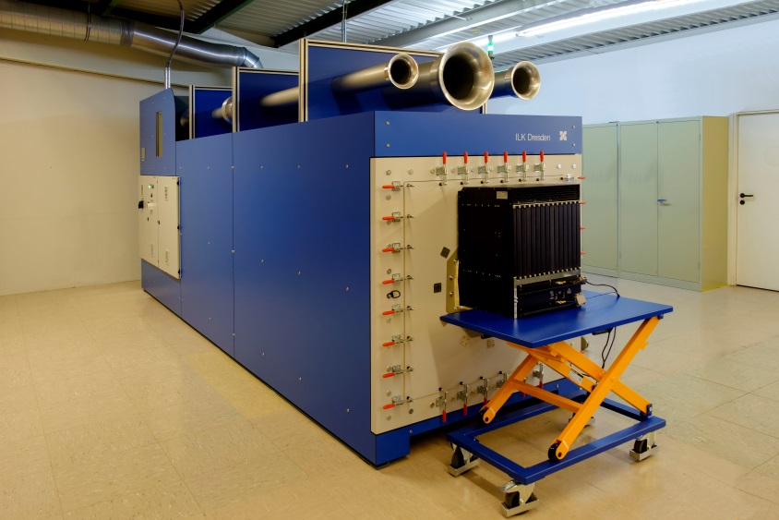
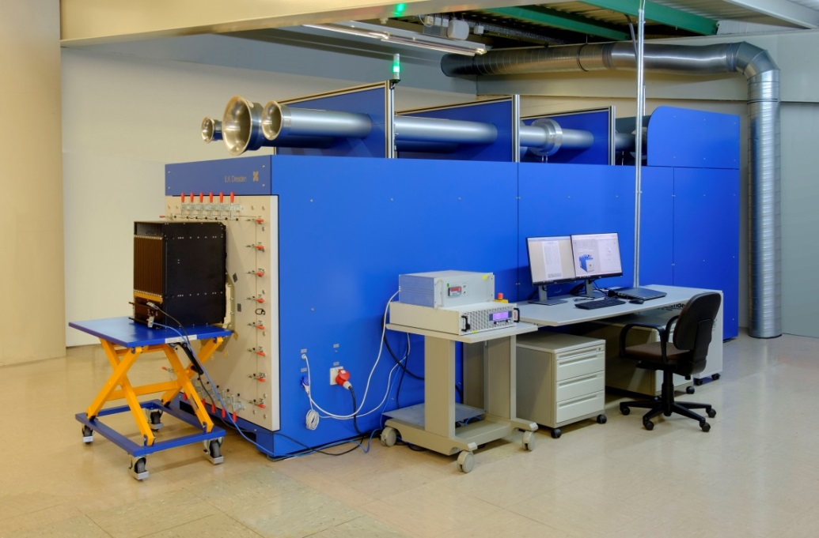
Thermal Test Lab: Air performance test rig
Air performance test rig
Measurements up to 5.000 m³/h at a test pressure of 3.000 Pa
Measurements in according to DIN EN ISO 5167-2
Fan comparison, volumetric air flow, fan speed, power consumption
Output characteristic curves of fans with characteristic drag curves or characteristic systems curves
The control and data acquisition is realized by a PC-based data acquisition system

Slide 5
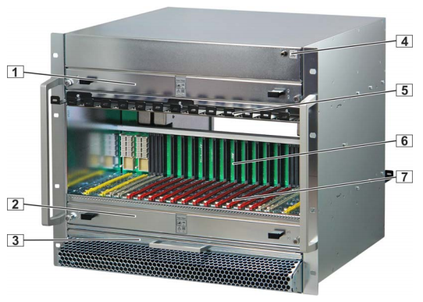
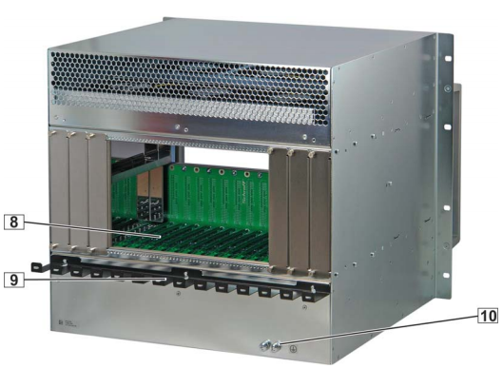
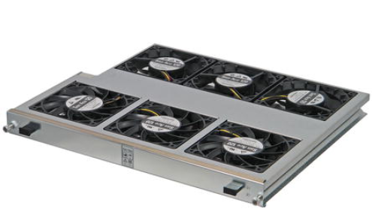
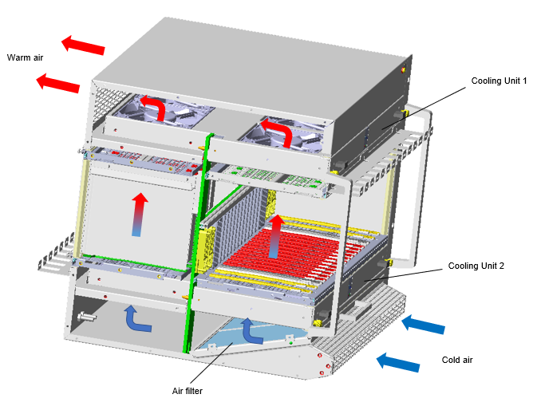
Test Object
MicroTCA.4 crate, 9 U, 84 HP, for 12 double mid‐size AdvancedMC modules, 2 MCHs, 4PMs
Front view Rear view Fan tray
Cooling concept
1 Upper Cooling Unit (CU1)
2 Lower Cooling Unit (CU2)
3 Air filter
4 ESD Wrist Strap Terminal
5 Cable Tray
6 Backplane
7 Card cage
8 Rear card cage
9 Cable Tray
10 Ground Terminal

Slide 6
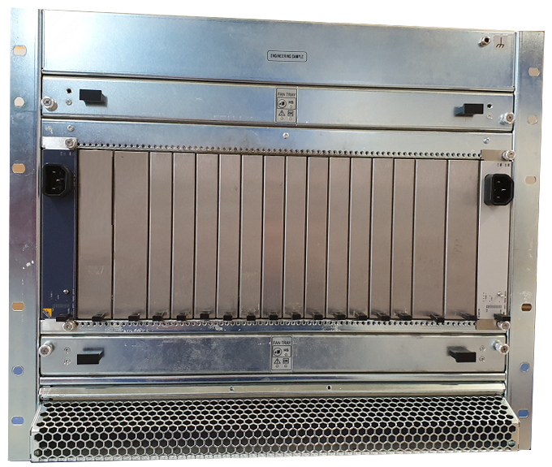
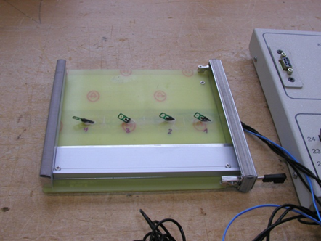
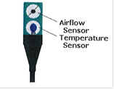
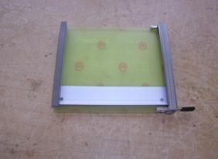
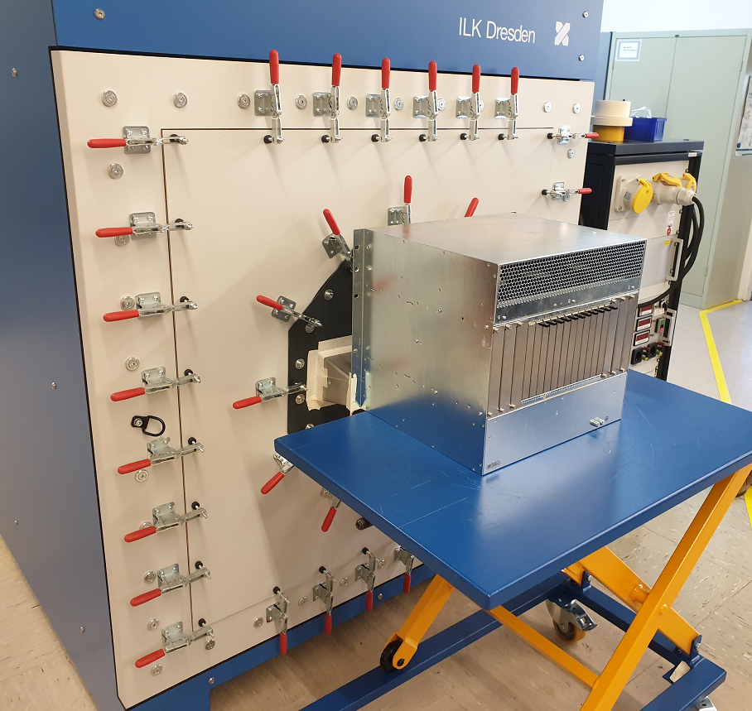
Test set up
CP-TA measuring method for MTCA
(Test method developed acc. to CP-TA: Communications Platforms Trade Association)
Determining the air distribution of a system
Measurement Boards
Flow Impedance Board
Data is transmitted to a PC
Determining the Impedance of the Double Mid-Size MTCA impedance boards

Slide 7
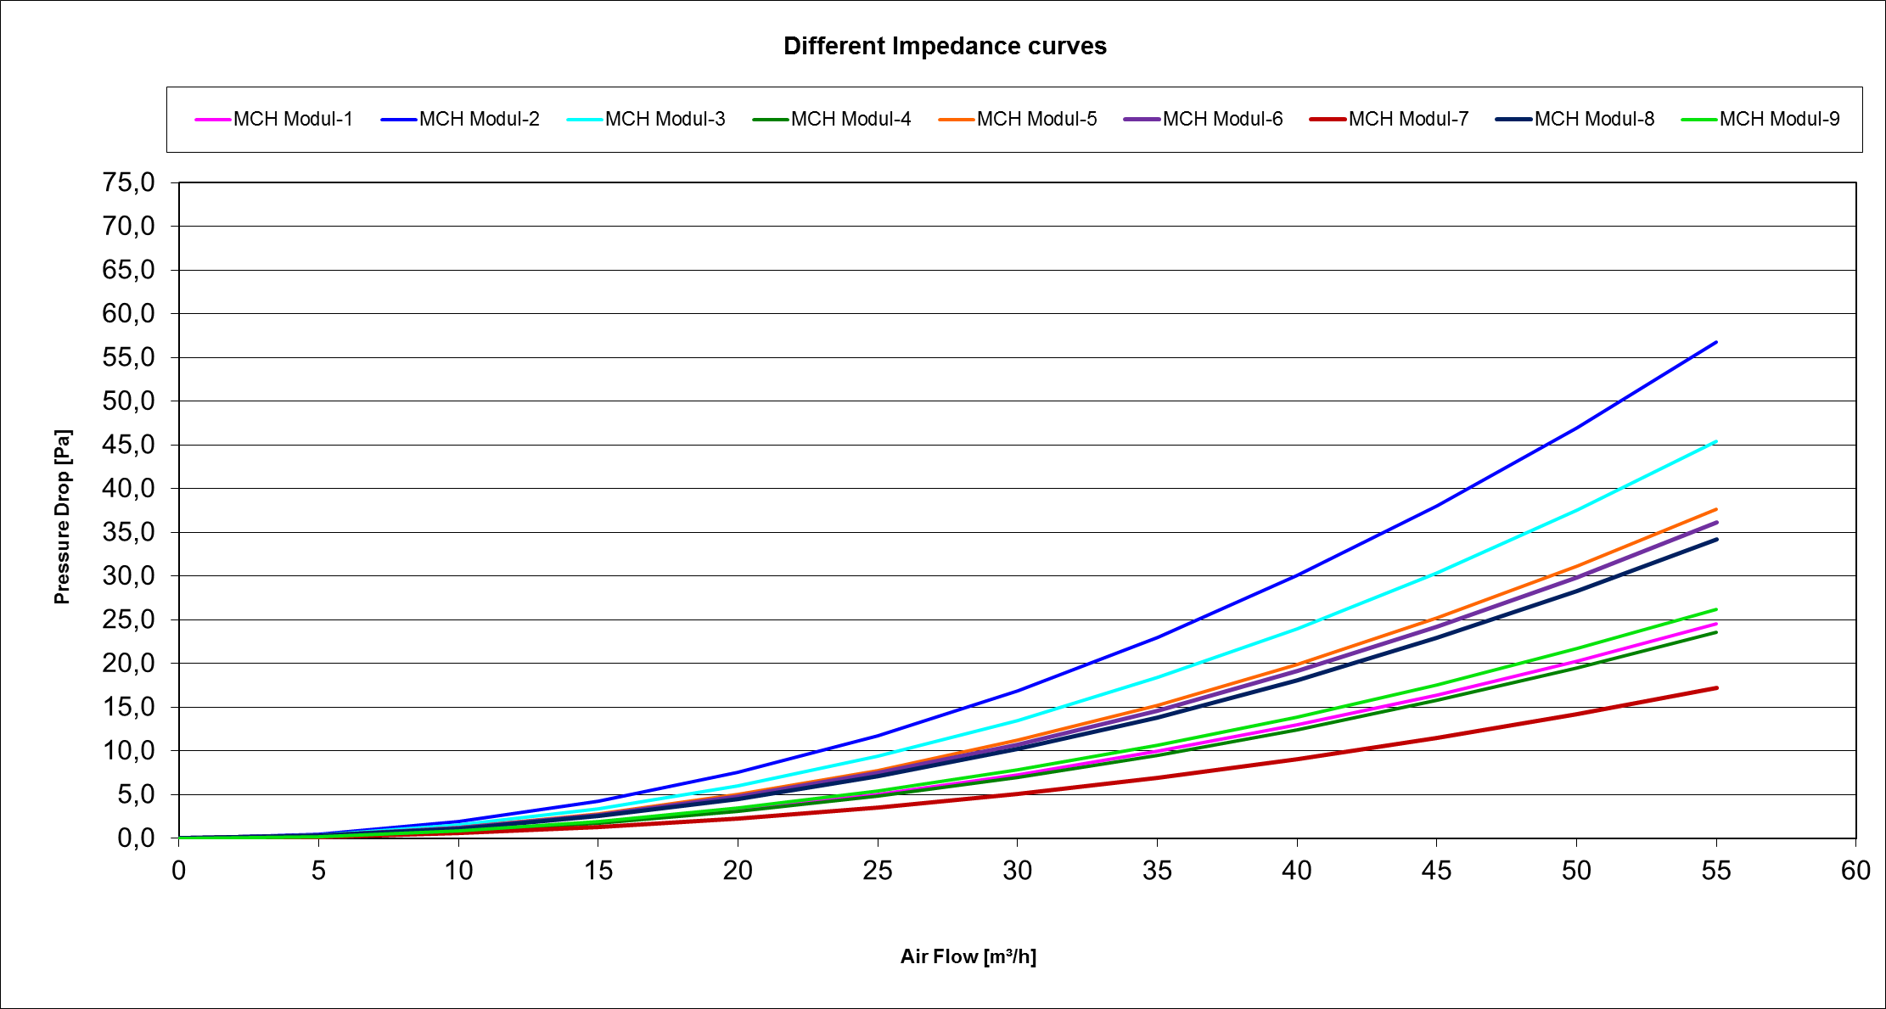
Thermal Test Lab: CP-TA measuring method for MTCA Systems
CP-TA measuring method for MTCA
Determining the Impedance of the Double Mid-Size MTCA impedance boards
Choice: The blue curve is the reference curve for the
MTCA Board used for the measurements

Slide 8
Remark
The measuremts had been realized with max. fan speed
Comparison of the two different measurement methods
Air performance test rig for air volume measurements
Measurement of the total air flow of the chassis
MTCA air distribution measurement: air distribution
Measurement of the air speed of the Front Boards, calculation of the global/total air flow based on the effective board area
Measurement accuracy
The bulk airflow measurement in the wind tunnel is very accurate. The measurement tolerance is in the 1 – 2% range. The air distribution measurement is not as accurate due to high tolerances of the air speed sensors. Therefore there are some differences between the results of the two different measurement methods; they can be up to 5 – 10%.

Slide 9
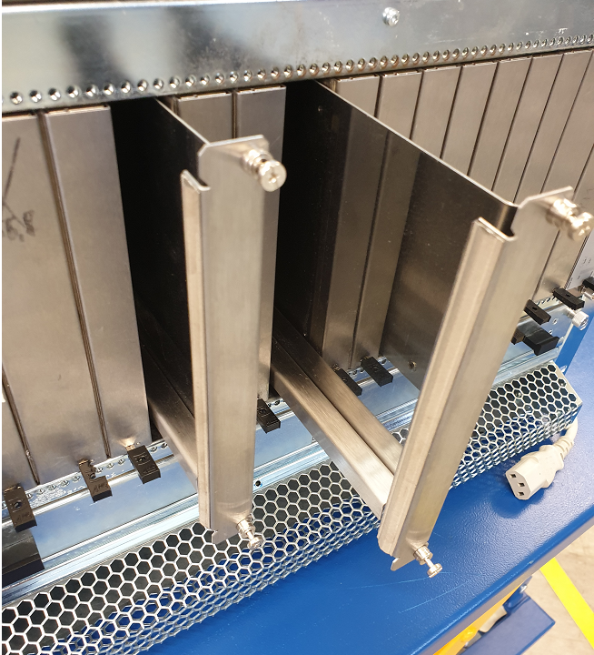
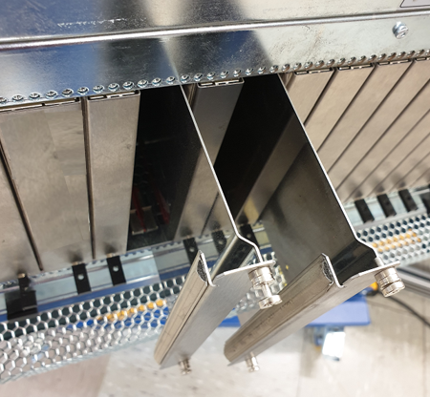
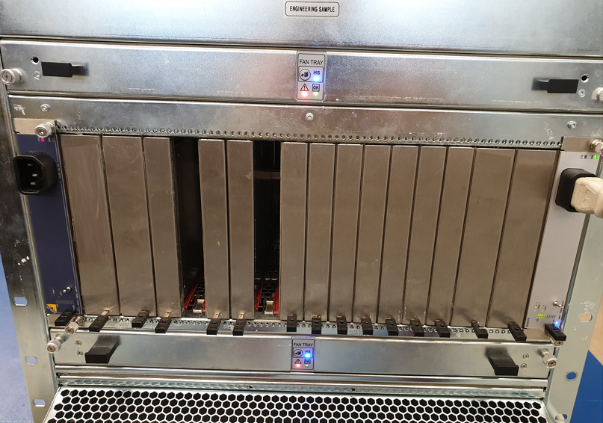
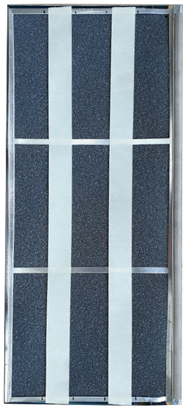
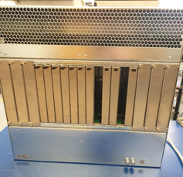
Measurements
1. Measurement: All AMC modules with impedance acc. to the
reference curve
2. Measurement: Front AMC slot 2 and slot 4 completely blocked
-> represents AMC modules with higher air impedance
3. Measurement: Front AMC slot 2 and slot 4 covered only with
front panels.
-> represents AMC modules with lower air impedance
4. Measurement: AMC slot 2 and slot 4 completly open
5. Measurement: RTM slot 2 and slot 4 completly open
6. Measurement: Air filter 30% blocked

Slide 10
Measurement 1
Reference configuration: All AMC modules with impedance acc. to the reference curve
Results: Air distribution/bulk airflow calculated 555 m³/h Flow characteristic test rig 602 m³/h ΔV 47 m³h
Air volume per slot: PM1 -> 25,1m³/h; PM2 -> 23,7 m³/h; MCH1 -> 22,9 m³/h; AMC1 - > 23,3 m³/h; AMC2 -> 26,1 m³/h; AMC3 -> 23,8 m³/h; AMC4 -> 23,5 m³/h; AMC5 -> 24,6 m³/h; AMC7 -> 22,7 m³/h; AMC8 -> 24,5 m³/h;
AMC9 -> 25,0 m³/h; AMC10 -> 25,0 m³/h; AMC11 -> 25,9 m³/h; MCH2 -> 27,4 m³/h; PM3 -> 25,8m³/h;
PM4 -> 28,8 m³/h

Slide 11
Measurement 2
AMC slot 2 and slot 4 completely blocked
versus standard configuration
Results: Air distribution/bulk airflow calculated 520 m³/h Flow characteristic test rig 597 m³/h ΔV 77 m³h
Increase air volume: PM2 -> +4,4 m³/h; MCH1 -> +2,2 m³/h; AMC1 - > 2,9 m³/h; AMC3 -> 3,5 m³/h

Slide 12
Measurement 3
AMC slot 2 and slot 4 covered only with front panels
versus standard configuration
Results: Air distribution/bulk airflow calculated 494 m³/h Flow characteristic test rig 609 m³/h ΔV 115 m³h
Increase air volume: PM2 -> +3,2 m³/h; MCH1 -> +2,2 m³/h
Reduction air volume: AMC3 -> -4,2 m³/h; AMC5-> -2,3 m³/h; AMC6 - > -2,5 m³/h; AMC7 -> -1,2 m³/h; AMC8 -> -4,3 m³/h;
AMC9 -> -3,8 m³/h

Slide 13
Measurement 4
AMC slot 2 and slot 5 are completely open
versus standard configuration
Results: Air distribution/bulk airflow calculated 487 m³/h Flow characteristic test rig 589 m³/h ΔV 102 m³h
Increase air volume: PM1 -> +1,4 m³/h; AMC7 -> +1,6 m³/h
Reduction air volume: PM2 -> -1,0 m³/h; MCH1 -> -0,7 m³/h; AMC1 -> -2,8 m³/h; AMC3 -> -4,2 m³/h; AMC4-> -2,7 m³/h;
AMC6 - > -3,6 m³/h; AMC8 -> -1,2 m³/h; AMC8 -> -3,2 m³/h; AMC9 -> -0,4 m³/h
AMC9 -> -3,8 m³/h

Slide 14
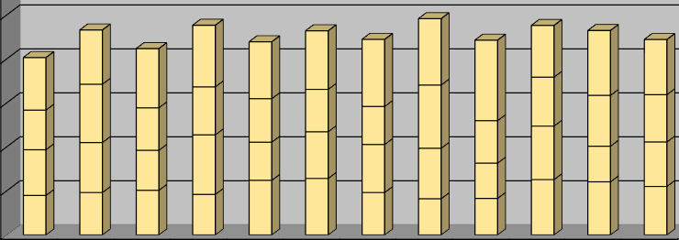
Measurement 5
RTM slot 2 and slot 5 are completely open
versus standard configuration
Results: Air distribution/bulk airflow calculated 547 m³/h Flow characteristic test rig 581 m³/h ΔV 34 m³h
Reduction air volume: RTM1 -> -2,0 m³/h; RTM3 -> -0,7 m³/h; RTM4 -> -3,4 m³/h; RTM6 -> -1,6 m³/h; RTM7-> -0,5 m³/h;
RTM8 - > -0,4 m³/h; RTM9 -> -0,2 m³/h; RTM10 -> -0,4 m³/h; RTM11 -> -0,2 m³/h

Slide 15
Measurement 6
Air filter 30% blocked
versus standard configuration
Results: Air distribution/bulk airflow calculated 534 m³/h Flow characteristic test rig 558 m³/h ΔV 24 m³h
Increase air volume: PM2 -> +2,0 m³/h; AMC2 -> +5,2 m³/h; AMC3 -> +1,9 m³/h; AMC4 -> +5,8 m³/h; ; AMC5 -> +2,1 m³/h;
AMC11 -> +5,4 m³/h; AMC12 -> +2,6 m³/h; PM3 -> +0,5 m³/h
Reduction air volume: PM1 -> -2,1 m³/h; MCH1 -> -0,2 m³/h; AMC1 -> -0,3 m³/h; AMC6 -> -2,8 m³/h; AMC7-> -4,5 m³/h;
AMC8 - > -4,3 m³/h; AMC9 -> -3,5 m³/h; AMC10 -> -4,8 m³/h; MCH2 -> -3,8 m³/h; PM4 -> -4,6 m³/h
AMC9 -> -3,8 m³/h

Slide 16
Conclusion
There is no homogeneous air distribution in a crate.
The test object shows the worst value in AMC slot 7 -> 22,7 m³/h and the best
value in AMC slot 2 -> 26,1 m³/h .
What ever will be done the neighbour modules will be the most effected.
But due to turbulances also other slots may be effected.
Open slots are reducing the airflow more or less for the whole crate.
A blocked air filter increases the air impedance of the whole crate and more or less all slots have to suffer.
Remarks:
If a ΔT of 12°C is required, 1 m³/h air volume represents approx. 3,6 W heat dissipation.
Advices:
If possible the hot spots should be placed in the slots with the best airflow.
Unused slots should be covered by air blockers.
Sometimes overtemperature alarms can also be caused by a dirty air filter.

Slide 17
Thank You

