Slide 1
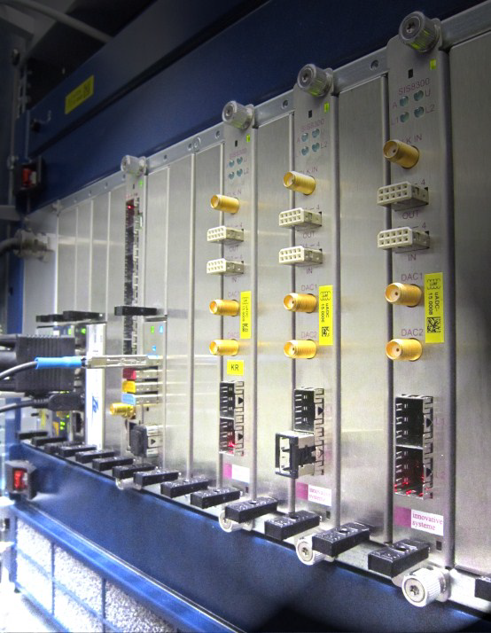
Magnetic and Radiation Field Compatibility of MTCA and PXIe based Instrumentation - 8th MicroTCA Workshop S. Simrock December 5, 2019

Slide 2
Outline
Magnetic Field Testing
Methodology
Test Setup
Test Results MTCA
Test Results PXIe, cRIO, (CPU, Network switches)
Radiation Testing
Methodology
Test Setup
Gamma test results
Neutron test results

Slide 3
Magnetic Field Tests (1)
Test | Priority | Computer | Chassis | ADC-Board | Timing-board
Fans | P1
Speed changes | P3 | 1 | 1 | na | na
Stopped | P1 | 1 | 1 | na | na
Voltage | P1
no voltage | P1 | 1 | 1 | na | 3
Cycling | P1 | 1 | 1 | na | 3
overvoltage | P1 | 1 | 1 | na | 3
Communication failure / degradation | P1
Complete loss | P1 | 1 | 1 | Implemented | Implemented
Reduced rate | P2 | na | na | 3 | 3
Data errors | P3 | na | 3 | 3 | 3
Functional failure /degradation | P2
I/O channel | P2 | na | na | na | Implemented
Data error | P3 | na | na | 3 | Implemented
Hang / block | P2 | na | na | 2 (manual) | Implemented
Electrical degradation | P3
Offset | P3 | na | na | na | 2
Gain | P3 | na | na | na | 2
Noise | P3 | na | na | na | 2
Induced voltage | P3 | na | na | na | 2
Immediate | P3 |  | Implemented | Implemented | Implemented
Long term (after time) | P3 |  | Implemented | Implemented | Implemented

Slide 4
Magnetic Field Tests (2)
Test | Priority | Computer | Chassis | ADC-Board | Timing-board
Effects on data | P2
Corrupt data in memory | P2 | na | na | 3 | 2
Corrupt data in configuration | P1 | 3 | 3 | 3 | 3
Corrupt data in binary (exec.) | P1 | na | na | Implemented | na
Effects on system / on board | P1/P2
Hang | P1/P2 |  | Implemented | Implemented | Implemented
Re-boot | P2 |  | Implemented | Implemented | na
Hardware failure | P3
Increased leakage current | P2 | ? | ? | ? | ?
Overheat (current temp) | P3 | 1 | 1 | 2 | 1
Burn out (defect) | P2 |  | Functional test will error/fail if there is damage due to test, but there is not a separate monitoring of this.
Other
Recoverable | P2 |  | Implemented | Implemented | Implemented
Unrecoverable | P1 |  | Implemented | Implemented | Implemented
Immediate | P3 |  | Implemented | Implemented | Implemented
Long term (after time) | P3 |  | Implemented | Implemented | Implemented

Slide 5
Magnetic Field Tests (3)
A typical test scenario includes the following steps:
Ensure that magnet is not powered
Installation of device under test in magnet (IO chassis with power supply )
Set-up of external test equipment and connection of communication links.
Power-up equipment and test all functions
Increase field level in small steps, log performance data and observe functional behaviour.
Repeat 5. until effect from magnetic field is observed.
Log and document effect.
Lower field and verify whether effect disappears.
Again raise field level to detect other effects which might occur at higher field levels.
Stop test when effect does not allow to learn more by going to higher field levels.

Slide 6
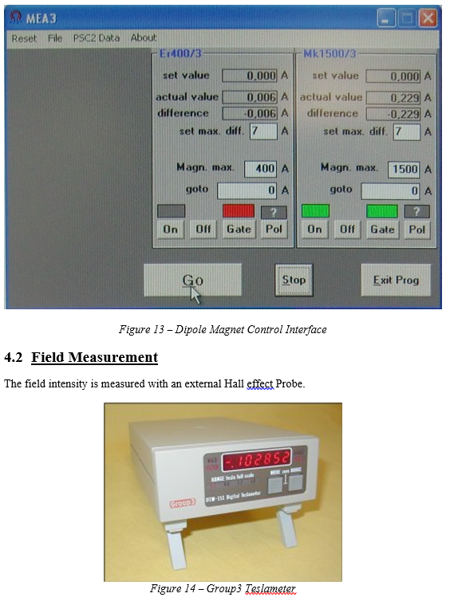
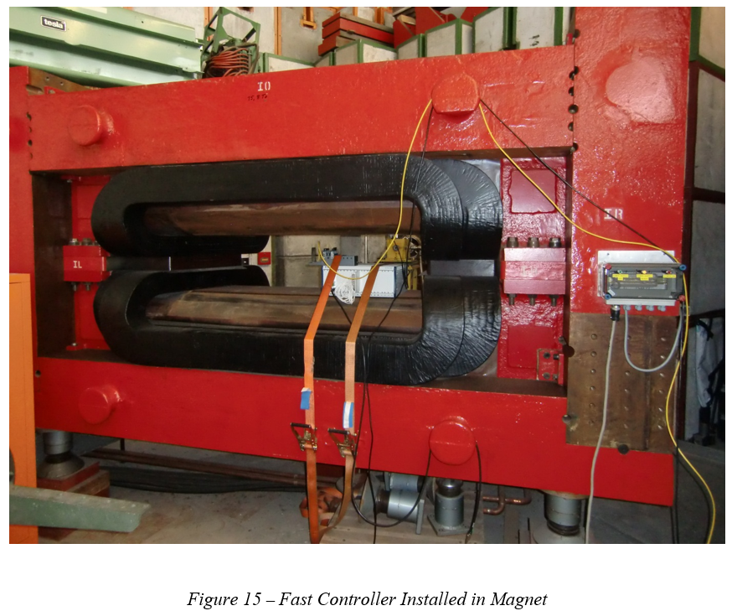
Magnet for Testing

Slide 7
Test Results MTCA (1a)

Slide 8
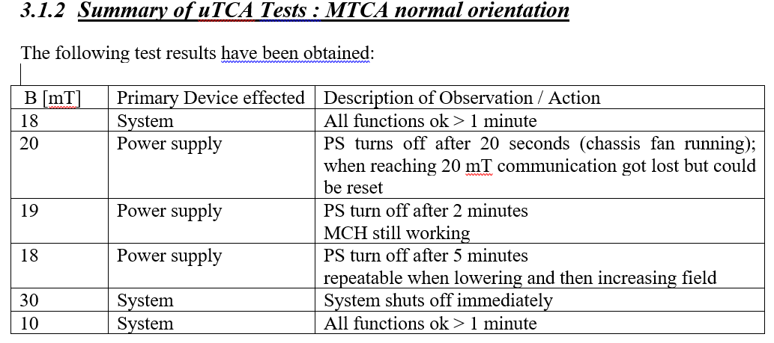
Test Results MTCA (1b)

Slide 9
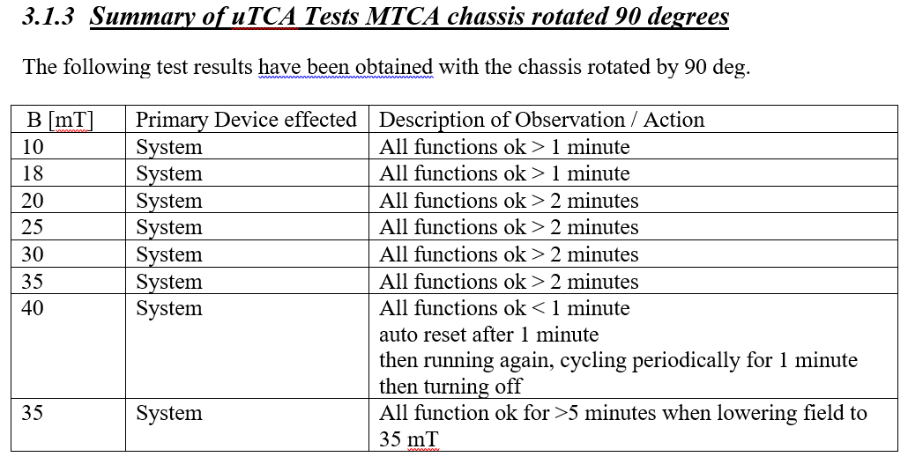
Test Results MTCA (1c)

Slide 10
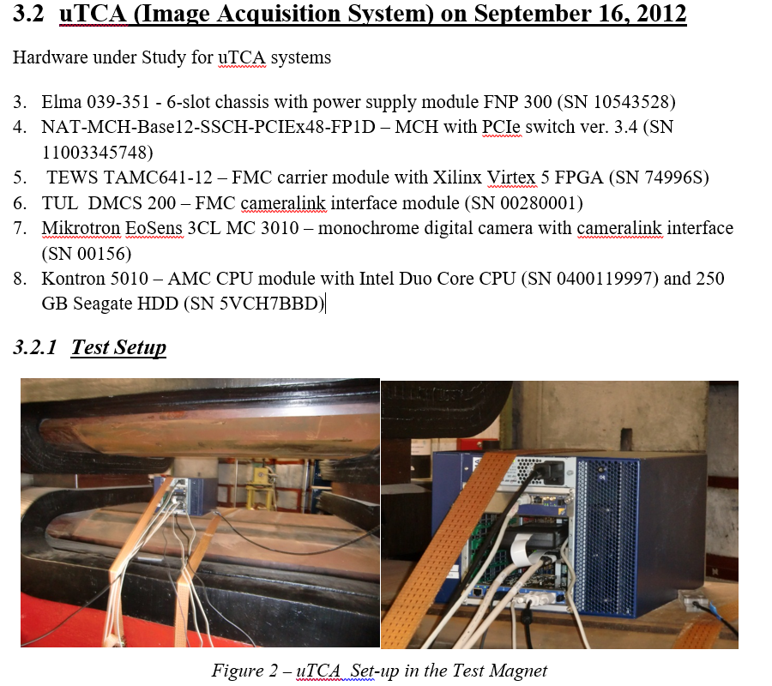
Test Results MTCA (2a)

Slide 11
Test Results MTCA (1b)

Slide 12
Test Results MTCA (1c)

Slide 13
Test Results MTCA (2a)

Slide 14
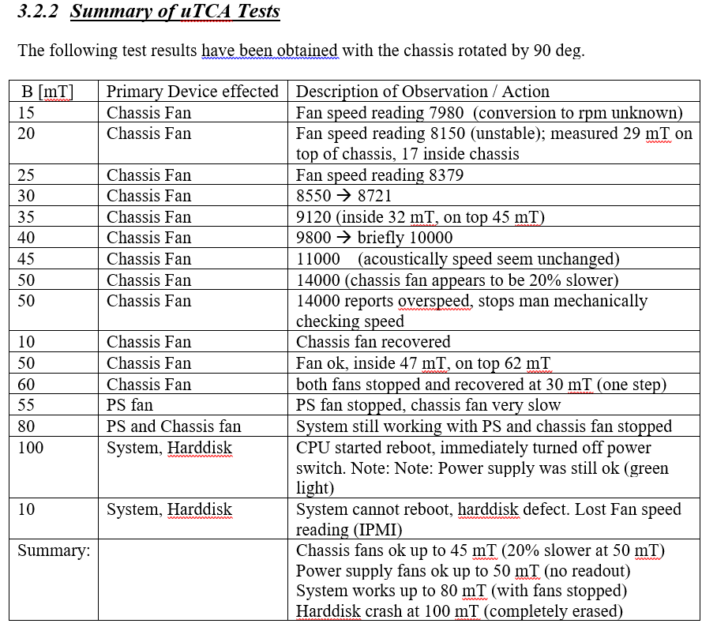
Test Results MTCA (2b)

Slide 15
Test Results MTCA (2c)
Permanent damage at end of test:
Broken HDD 250 GB
Two broken fans of MTCA chassis (14x14 cm) – front and rear fan, demagnetised
Additional Notes
The HDD is totally erased at the end of the test - even BIOS is detecting some errors. There are always some data on HDD that should not be erased (list of broken sectors, HDD structure, etc.).
After replacing HDD and reinstalling CODAC 3.1 the CPU is working again.
Found out also that the rear fan is not working. It has some problems to start rotating. When pushing the rotor blades it starts rotating. But after power off, it cannot start again.
Fan needs to be replaced.
Chassis is mainly made of steel (not aluminium), there are small aluminium parts but the main cover is steel.
The rear fan permanent magnet was probably degaussed by magnetic field. The rotor blades cannot be correctly positioned and the fan has sometimes problems to start rotating. After disassembling and re-assembling the fan it works again.
MCH never send any warning, even when rear or front fan were stopped.

Slide 16
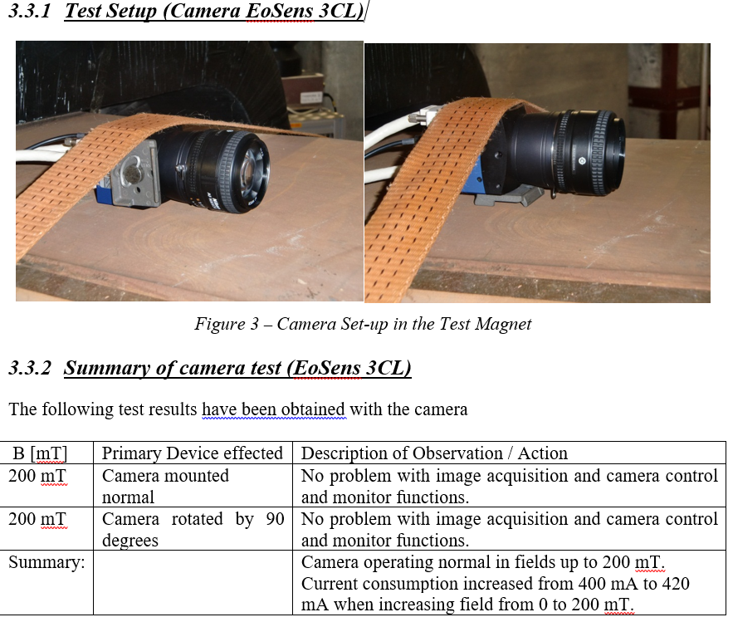
Camera Test (EoSens 3CL)

Slide 17
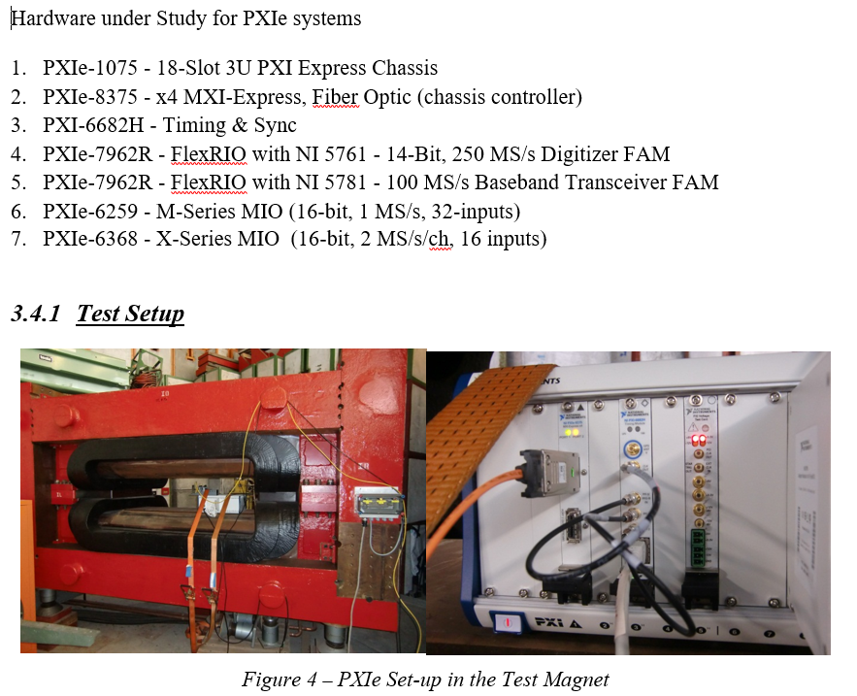
PXIe Tests (1)

Slide 18
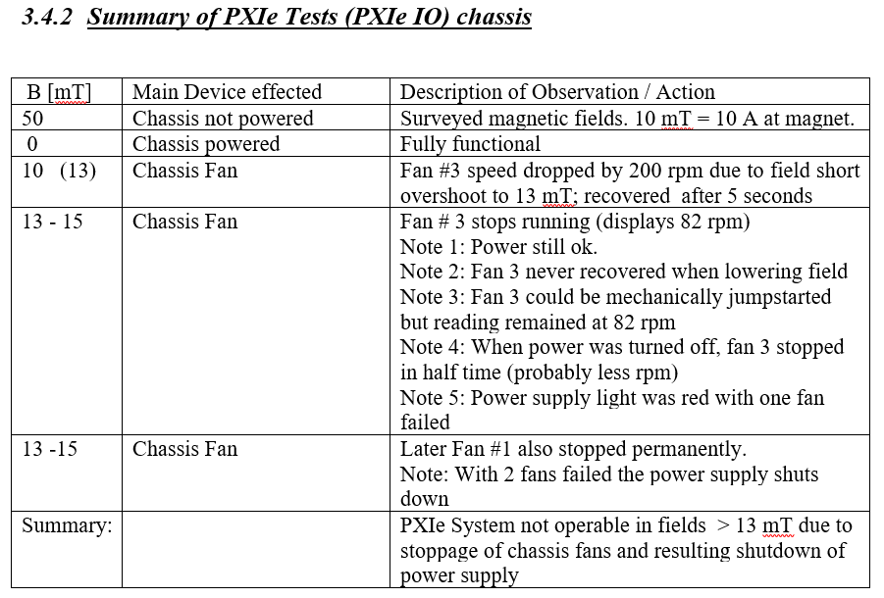
PXIe Tests (2)

Slide 19
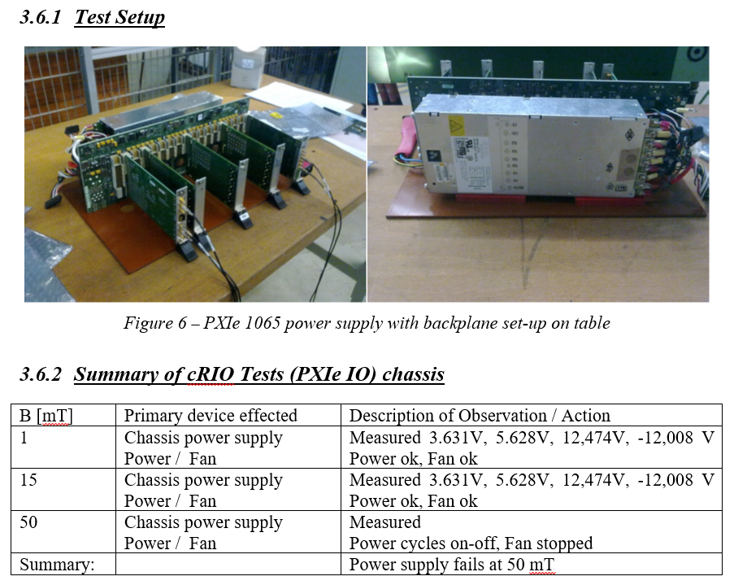
cRIO Test

Slide 20
Radiation Tests

Slide 21
Fast Controller Testing by CODAC
The tests were performed at:
ENEA Casaccia for Gamma testing IDM: https://user.iter.org/?uid=E35L2Q
ENEA Frascati for high energy neutron testing IDM: https://user.iter.org/?uid=E35L2Q
JSI (Triga reactor) for thermal neutron testing. IDM : https://user.iter.org/?uid=HK34LK
Atomki for thermal neutron (and high energy neutron and Gamma) testing IDM: https://user.iter.org/?uid=DZJH2F

Slide 22
Detailed effects studied for Fast Controllers
Fans
Speed changes
Stopped
Voltage
no voltage
Cycling
overvoltage
Communication failure / degradation
Complete loss
Reduced rate
Data errors
Functional failure /degradation
I/O channel
Data error
Hang / block
Electrical degradation
Offset - Gain – Noise
Effects on data
Corrupt data in memory
Corrupt data in configuration
Corrupt data in program (binary)
Effects on system / on board
Hang-up
Re-boot
Hardware failure
Increased power consumption
Overheat (current temp)
Burn out (defect)
Other
Recoverable
Unrecoverable
Immediate
Long term (after time)

Slide 23
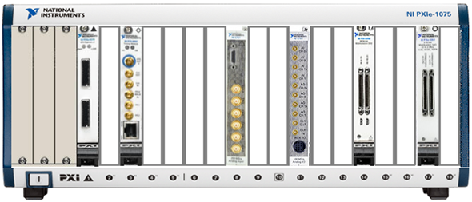
Fast Controller Configuration (PXIe)
PXIe - 1075
18-Slot 3U PXI Express Chassis
PXIe - 8375 – x4 MXI-Express, Fiber
PXI - 6682H – Timing & Sync
PXIe - 7962R / NI 5761 – FlexRIO 14-Bit, 250 MS/s Digitizer
PXIe - 7962R / NI 5781 – FlexRIO 100 MS/s Baseband Transceiver
PXIe - 6259 – M-Series MIO

Slide 24
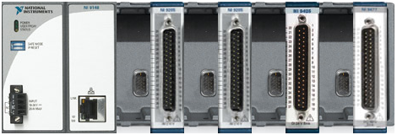
Fast Controller Configuration (cRIO)
NI 9148
8-Slot Ethernet Chassis for C-Series
NI 9205 – 32-Channel Analog Input
NI 9264 – 16-Channel Analog Output
NI 9425 – 32 Channel Sinking Digital Input
NI 9477 – 32-Channel Sinking Digital Output

Slide 25
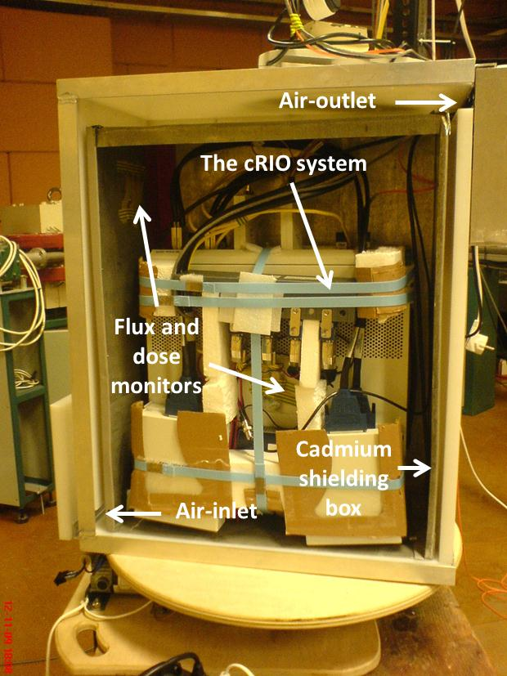
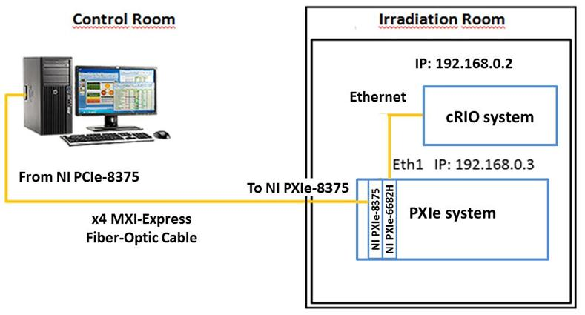
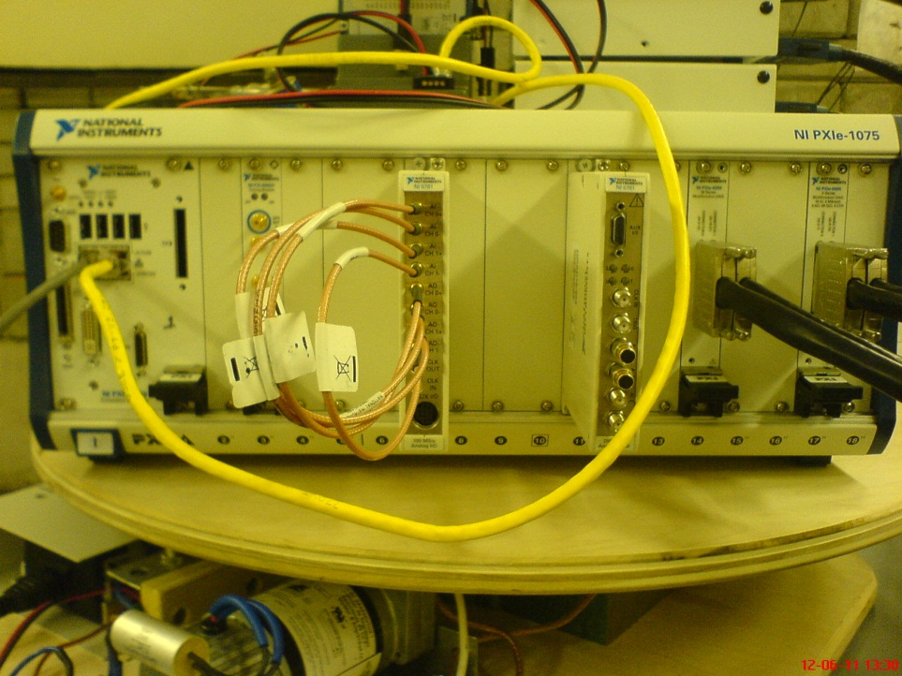
Test-Set Up at Atomki

Slide 26
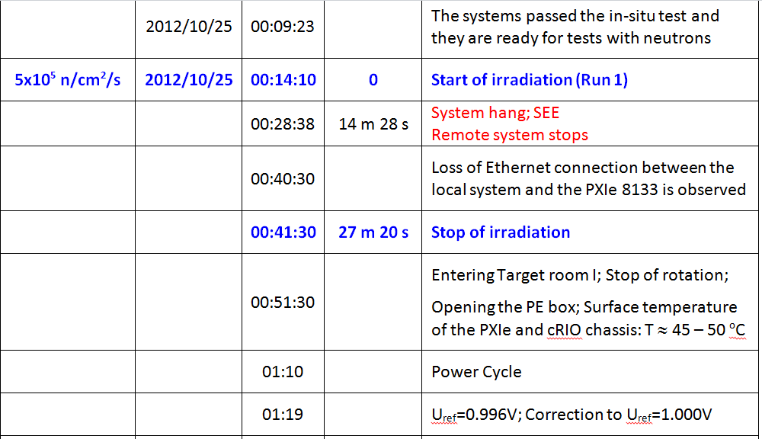
Typical Test Reports at Atomki (1)

Slide 27
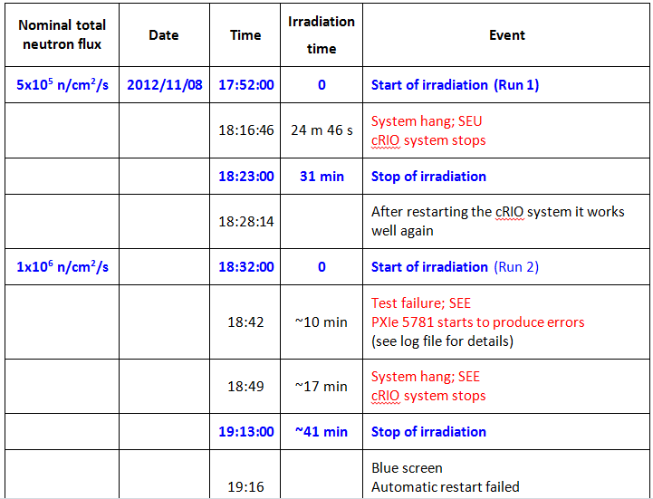
Typical Test Reports at Atomki (2)

Slide 28
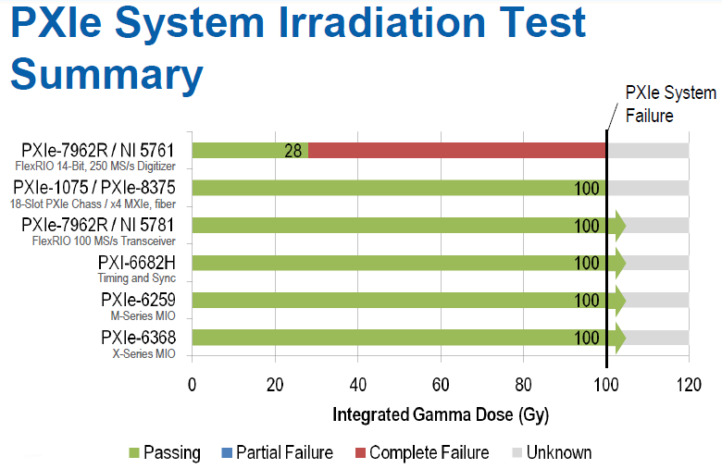
Results from fast Controllers Test (Gamma)

Slide 29
Results from fast Controllers Test (Gamma)

Slide 30
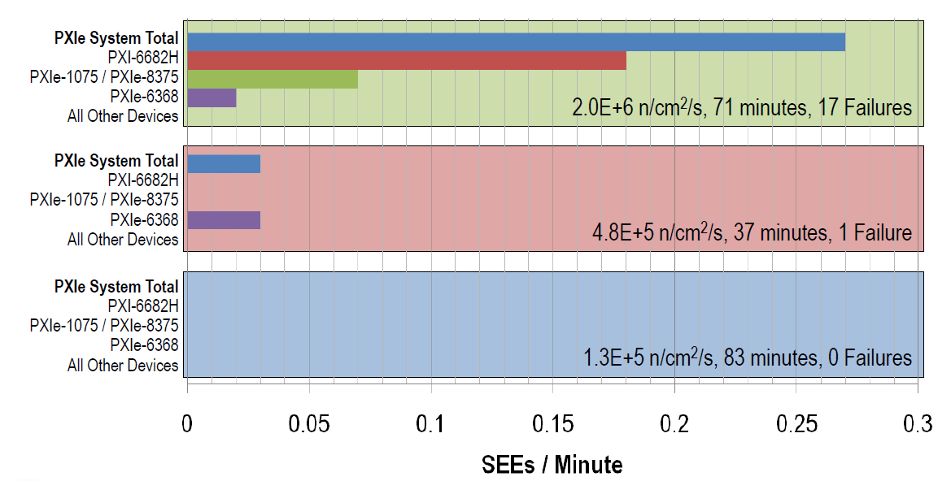
Results from Fast Controller Tests (Neutron 14 MeV)

Slide 31
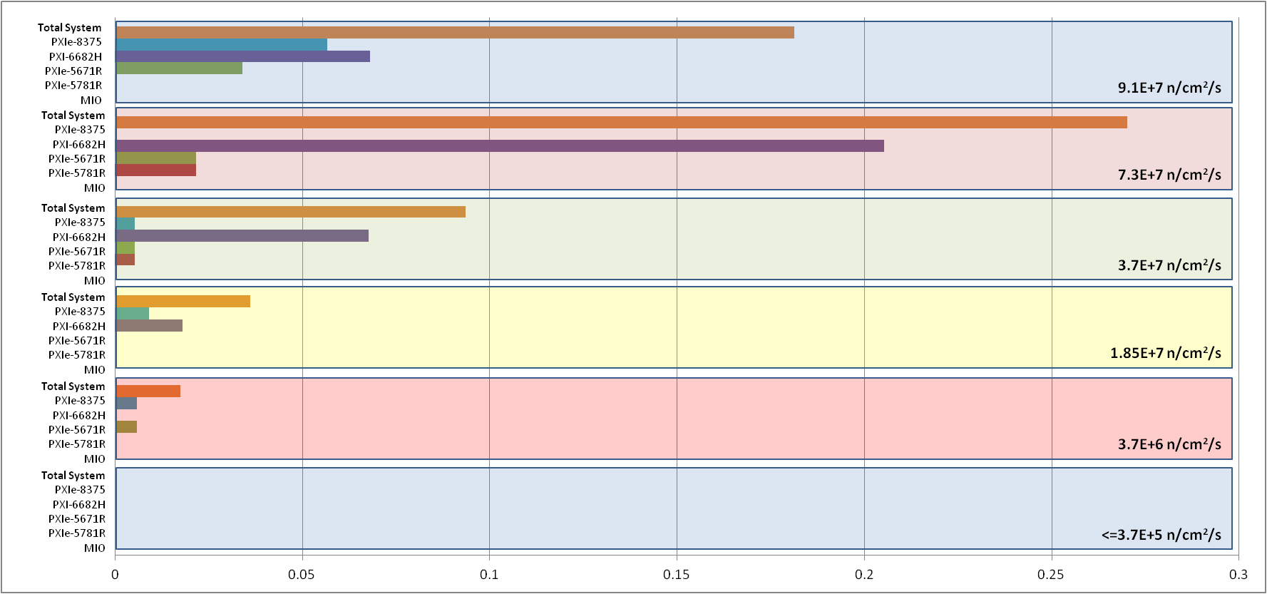
Results from Fast Controllers Test (thermal neutron)
SEU/min

Slide 32
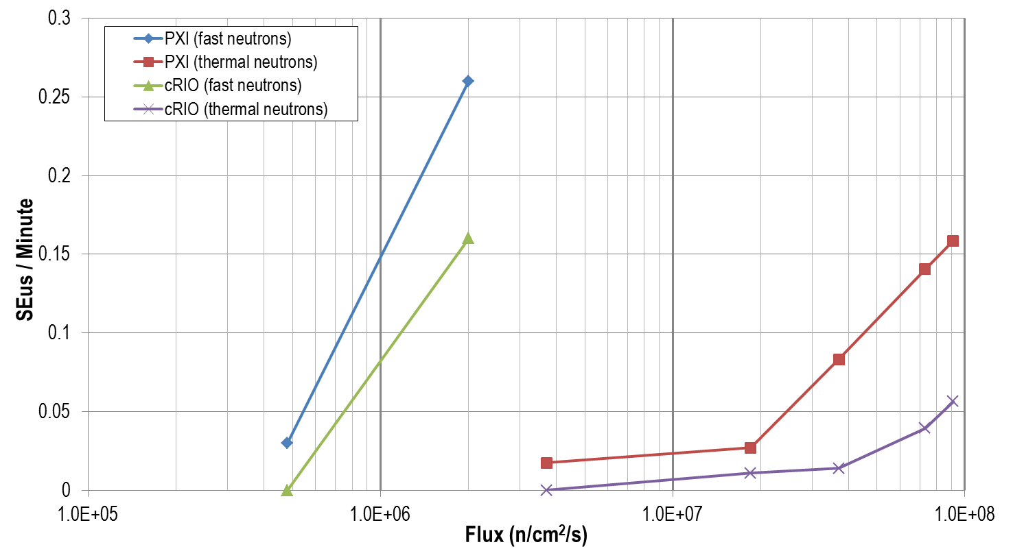
Results Thermal vs high energy neutrons

Slide 33
Observations from the Radiation Tests
For NI fast controllers in PXIe and cRIO
Gamma: - Failure between 30 to 100+ Gy - Increase in noise and offset expected noticeable starting at 1 Gy (not measured)
Neutron induced SEU (PXIe configuration) ~ 1 SEU / hour for 1e5 n/cm^2/sec (14 MeV neutrons) ~ 0.1 SEU/hour for 1e5 n/cm^2/sec (thermal neutron)

