Slide 1
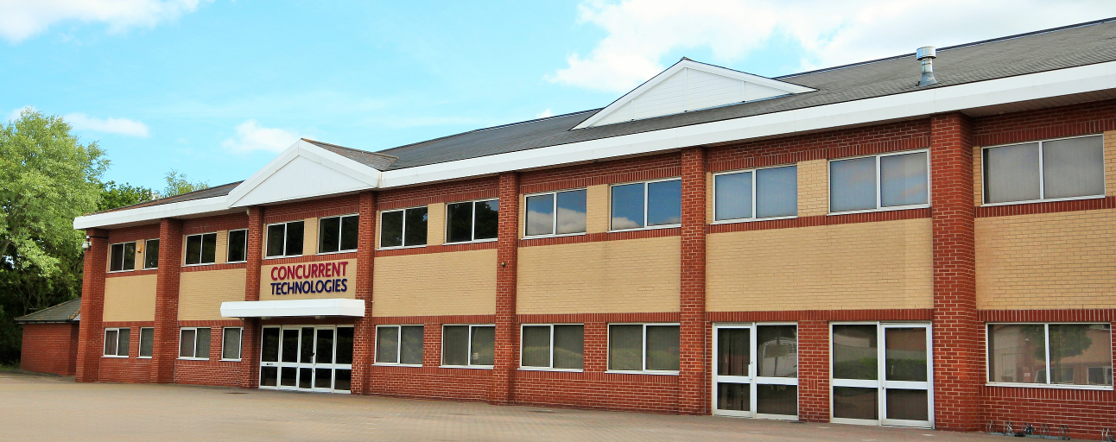
Trends that are Influencing
Intel Processor based AdvancedMCs
8th MicroTCA Workshop for Industry & Research
Notes:
Good Afternoon, My name is Paul Prictoe. I work for Concurrent Technologies. Our headquarters is located in Colchester, Essex, UK.
We are a market leader in the design, development and manufacture of embedded solutions based on Intel processor devices.
I’m going to give you a short presentation on the Trends that are Influencing our products with a focus on AdvancedMC’s.

Slide 2
Main Trends
Performance
Security
Software
Notes:
There are three big drivers that we see changing the landscape for Intel processor boards.
These are performance, security and software.

Slide 3
Performance
Notes:
I’m going to start by talking about performance.

Slide 4
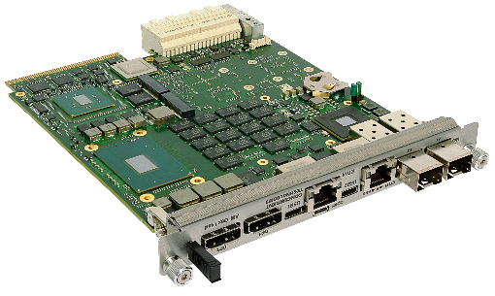
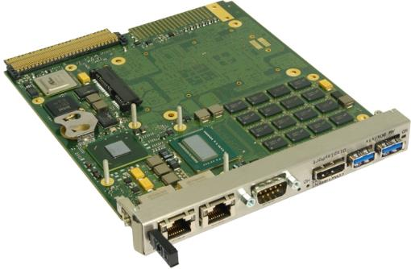
Performance
AM E4x/msd
AM G6x/msd
GFLOPs
AM 90x/x1x
Notes:
All the Intel processor devices we use come from Intel’s ‘Internet of Things Group’ In essence this group satisfies the embedded market.
This group usually characterises devices already available from other Intel groups but sometimes creates their own devices for long-life embedded applications.
Prior to ~2015 these processors were guaranteed a 7-year life cycle. All new devices are available for 15-years.
Over the last few years, we’ve seen some significant CPU performance increases, partly due to an increase in the number of CPU cores and partly due to increased clock frequencies per core. In the last 7 years we’ve seen four-fold improvement in CPU performance alone.
We have just launched our new AM E4x board, which is now our highest performing AMC. We are also working with Intel on their next generation processors which will accelerate this trend. We are closely aligned with Intel and typically gain early access to their silicon such that we are ready to announce boards the same day they launch the silicon publicly. We do this to enable our customers to access the latest technologies and also to maximise the longevity of the silicon.

Slide 5
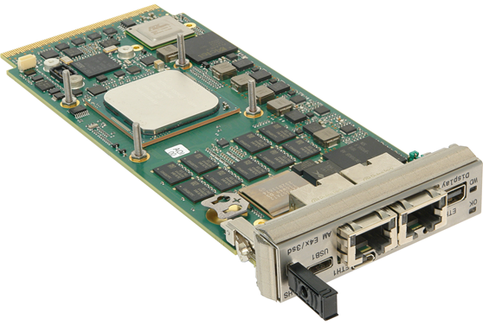
AM E4x/msd Product Highlights
AdvancedMC board based on Intel Xeon processor D-1500:
  Default is 12-core D-1559
Significant Performance Upgrade for Compute Intensive Applications
PCIe gen 3 fabric using local switch with Non-transparent bridge and DMA capabilities
Front panel connectivity includes:
  2 x 10G Ethernet
  USB 3.0
  RS232
  DisplayPort
Optional SATA based flash drive module
Notes:
The AM E4x is a single AMC module within the same power budget as our other AMC processor boards and is available with a 12-core processor.
We’ve used the same processor device on several other form factors and have achieved VMware certification for applications requiring virtualization.
Effectively we’re providing a miniature server with high speed network connectivity and local expansion. This is easier to visualise from the block diagram on the next slide

Slide 6
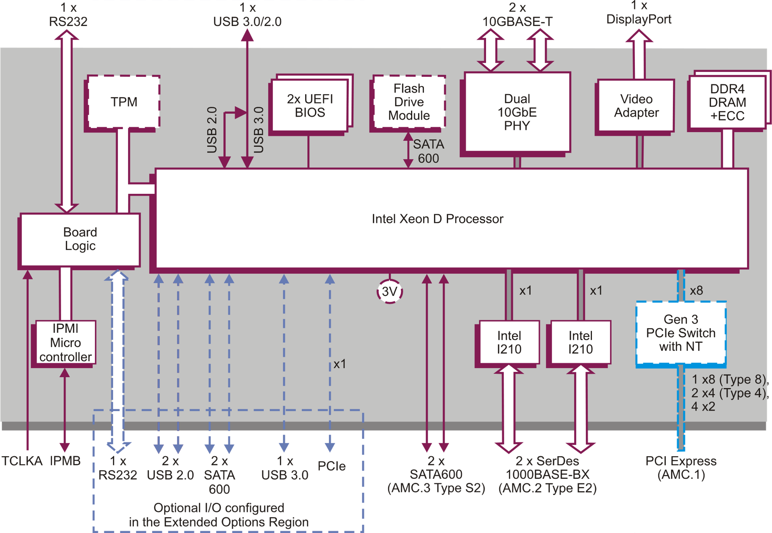
AM E4x/msd Block Diagram
Notes:
The connections at the top are at the front of the board. We are limited by real-estate but aim to provide connectivity to enable you to load your application and connect external network devices.
The connections at the bottom go out to the MicroTCA backplane. In this case, they are compatible with a number of our previous AMC modules – this makes the AM E4x a plug in upgrade for customers who have been using our AM 92x and AM F5x AMC modules. Generally we aim to provide backwards compatibility.

Slide 7
AM E4x/msd Block Diagram
Notes:
The AM E4x includes dual 10G Ethernet ports on the front for high bandwidth Ethernet links that are good for remote connectivity.
In some other form factors we are seeing a trend towards 25, 40 and even 100G Ethernet with a preference for fibre rather than copper for the physical connection.
The AM E4x has two standard RJ45 jacks making it very easy to use as a replacement in previous solutions.

Slide 8
AM E4x/msd Block Diagram
Notes:
Like our previous generation AMC modules the AM E4x includes flexible PCIe Gen 3 fabric connections: 1 x8, 2 x4, 4 x2 with NT and DMA capability.
PCI Express allows for high bandwidth fabric interconnectivity and we are expecting to announce PCIe Gen 4 capable processor boards during 2021 with PCIe Gen 5 capable boards possible in 2022.
To make use of the higher bandwidth offered by PCIe Gen 4 and Gen 5, all parts of the system need to support the same speeds. This will require substantial effort on behalf of the ecosystem to include the use of new PCB materials combined with significant signal integrity analysis. Realistically this is a very complex task and could rule out some ‘own design’ products. The physics community will need to think carefully about this over the next couple of years.

Slide 9
AM E4x/msd Block Diagram
Notes:
Next I want to talk about security, like it’s predecessors the AM E4x has a Trusted Platform Module (TPM) as one of many security features offered.

Slide 10
Security

Slide 11
Security Trends
Everyone needs to be responsible for computer security
Our processor board can act as the root of trust - if you enable certain features
AM 90x/x1x
AM G6x/msd
IPMI 1.2
RMCP
TPM 1.2
UEFI BIOS
RMCP+
TPM 2.0
Secure Boot
Guardian Security
Notes:
The most important thing about security is that it is everyone's responsibility.
We need to think about what might happen at all stages of a project and work out what we can do to prevent a so called ‘bad actor’.
Many of Concurrent Technologies’ products are used in defence applications, we provide a range of standard and optional features that can be enabled to improve security.
We don’t implement all these features on AMC products, but we do offer an increasing number, some of which are very simple to use.
As an example, we provide the means so that boards like the AM G6x/msd can act as the root of trust in your system. best seen on the next slide:
IPMI: Intelligent Platform Management Interface
RMCP: Remote Management Control Protocol

Slide 12
Trust Levels and Attestation
Each part of the boot firmware/software can be measured
The hashes are recorded securely in the TPM
TPM
Firmware
Operating System
Application
Remote Attestation confirms correct operation
Notes:
In this situation, before the initial boot code is run it is ‘measured’ and that value is securely stored in the TPM.
The TPM acts like a digital safe and it can store a range of measurements representing each piece of the firmware and software stack for the system.
It is subsequently possible to read the values from the TPM remotely and confirm the values are as expected, if not then you know there is an issue and can do something about it.
This is one of the most basic security strategies, other more stringent ones are possible that will prevent any ‘incorrect’ or ‘malicious’ code from running but that requires more effort.
As an observation, the high speed physics community appears to be the least security conscious industry we deal with and yet has some very high profile use cases.
If you want to know any more about any of our security capabilities then please engage with us

Slide 13
Software Technologies
Notes:
Lastly I’ll talk about some high level software trends

Slide 14

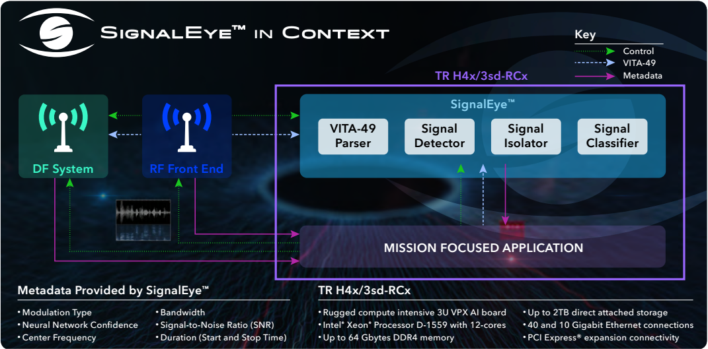

Artificial Intelligence
Better performance enabling Inference at the Edge deployments
Mainly used for identifying visual artefacts
But also complex RF patterns
Notes:
We’ve seen some significant interest in using our embedded boards to do Inference at the Edge.
Historically, many of the applications and industries we’ve dealt with capture data from a mission or a test and then analyse it offline using traditional methods.
Now that both processing performance has improved and AI techniques have developed, we have a strong need to do the initial analysis in real time in order to provide actionable intelligence.
This doesn’t preclude offline analysis but it does provide very quick answers to sometimes difficult problems. Typically most of the inferencing applications we’ve seen involve the recognition of objects from some type of visual sensor, but we’ve also been involved in a defence application to scan RF data and identify various artefacts about these transmissions. The range and ease of use of the available models and tools is making inference much more user friendly.

Slide 15
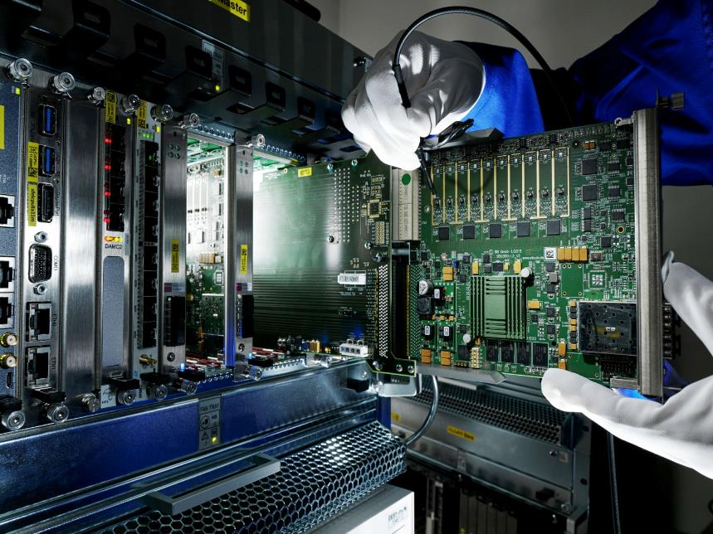
Easier Acceleration using Heterogeneous Resource Pools
Many applications use diverse hardware resources (CPU, FPGA, GPU etc)
Each hardware resource requires a different programming language/tools
This takes a lot of time and a high level of software investment
Notes:
Going one stage further, there is a trend to use all available computing resources as a heterogeneous resource pool.
This is very different to today’s architectures which consist of a variety of different CPU/FPGA/GPGPU resources that are programmed to do a specific task using a dedicated language/tool. Whilst this enables a very highly optimised solution it takes a lot of time and effort to code and support.

Slide 16
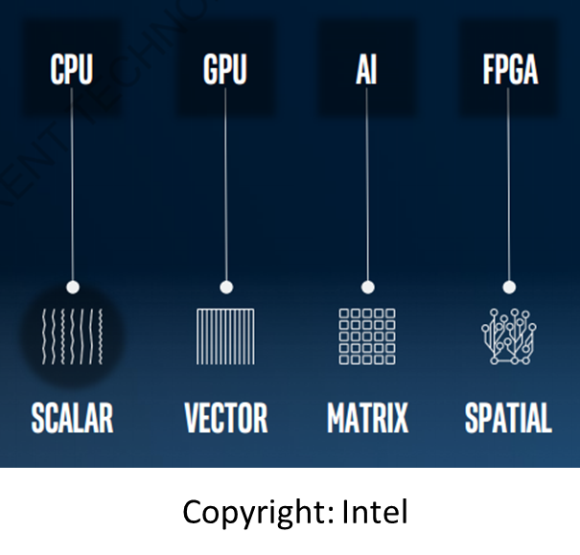
OneAPI Concept
To deliver a unified programming model to simplify development across diverse architectures
OneAPI Industry Initiative is designed to drive cross industry adoption
Based on Data Parallel C++ and API libraries
Public beta now available https://software.intel.com/en-us/oneapi
No hardware required, try it on the Intel® DevCloud
Notes:
The idea behind OneAPI is to provide a unified programming model that is based on C++ that generates code that is scheduled to run on the most efficient resource.
For example, a part of the code that needs to make decisions would likely run best on the CPU resources, whilst a convolution would likely operate most efficiently on an FPGA. This isn’t likely to generate as well optimised code but it does allow new resources to be added to a pool to enhance performance without any change to the underlying code. If anyone is interested then there is a link in the presentation to the public beta program that Intel are running. By registering it’s possible to get access to their DevCloud. There’s no need to provide any hardware for an initial investigation.

Slide 17

Questions
Contact Details: Paul Prictoe
pprictoe@cct.co.uk
https://www.gocct.com

