Slide 1
MicroTCA based BPM system design
Yu Liang
2019-12-05

Slide 2

Outline
Introduction of the BPM system
01
Overall system design
02
Implementation of DSP algorithm
03
Test
04
Summary
05
Notes:
模板来自于 http://meihua.docer.com/
2

Slide 3
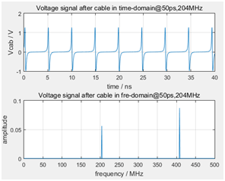
Introduction of the BPM system
HLS II
Energy | 800MeV
RF Frequency | 204 MHz
Harmonic Number | 24
Current | 360mA
Circumference | 66m
The beam undertest is a narrow pulse with a repetition frequency of 204 MHz, thus the signal energy is located at 204MHz and its integral multiples, and the signal strength can be measured by harmonic signal.
Considering the interference lead by the high frequency cavity of the accelerator, second harmonic(408 MHZ) is chosen as the input signal to calculate beam position.

Slide 4
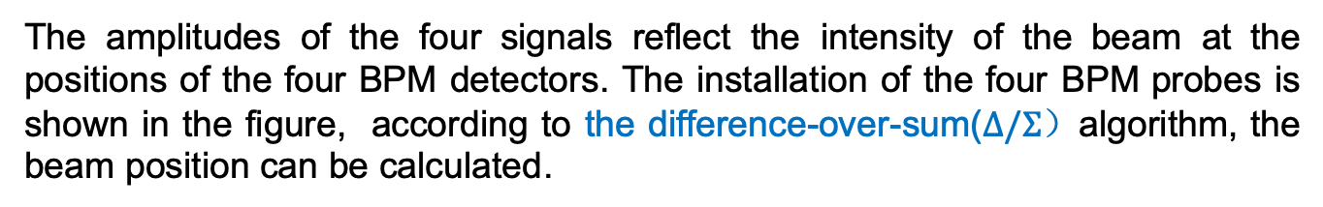
Introduction of the BPM system
Beam position is a basic and important parameter of the accelerator. Beam position monitor system includes beam detectors, signal processing electronics and data acquisition.
The signals coupled by BPM detectors need to be processed electronically to obtain the position information.
The amplitudes of the four signals reflect the intensity of the beam at the positions of the four BPM detectors. The installation of the four BPM probes is shown in the figure, according to the difference-over-sum($Δ/Σ）$algorithm, the beam position can be calculated.

Slide 5
Introduction of the BPM system
Technical Requirements & Specifications
DATA TYPE | MODE | REQUIREMENT | DESCRIPTION
ADC | ON-DEMAND | - - | Raw ADC data (108.8Mhz sample rate)
TBT | ON-DEMAND | 5 um rms | Turn-by-Turn data (4.533Mhz sample rate)
FA | ON-DEMAND | 200 nm rms | Fast Acquisition Data (10KHz sample rate)
SA | STREAMING | 200 nm rms | Slow Acquisition Data (10Hz sample rate)

Slide 6
Outline
Introduction of the BPM system
01
Overall system design
02
Implementation of DSP algorithm
03
Test
04
Summary
05
Notes:
模板来自于 http://meihua.docer.com/
6

Slide 7
Overall system design
Based on the principle of software radio technology, the signal processing is integrated in the digital part as much as possible. A full digital beam position measurement system includes analog front end, ADC and digital front end.
Signals from the beam position monitor detectors are adjusted by the analog front end, digitized by the ADC and then sent to the FPGA. Multi-rate signal processing, CORDIC algorithm, difference-over-sum algorithm are implemented in the FPGA. TBT data, fast acquisition data(FA data) and slow acquisition data(SA data) are obtained after the digital signal processing in the FPGA.

Slide 8
Overall system design
AFE
Signals from the beam position monitor detectors are adjusted by the analog front end. The input signal filtered by a band-pass filter to exact the signal component of 408MHz frequency, and then amplified by a low niose amplifier and attenuated by a adjustable attenuator until its amplitude adaptive to the range of the ADC. An additional band-pass filter is employed to suppress out-of-band noise and spurious frequency components.
The attenuation of the analog front end can be adjusted and read back in real time through the serial port. The adjustment step is 0.25dB, and the attenuation ranges from 0dB to 31.75dB.

Slide 9
Overall system design

Slide 10
Overall system design
ADC
The frequency of the signal undertest is 408MHz, and our clock frequency is 108.8MHz. As shown in the figure, according to the bandpass sampling theorem, we move the signal from the eighth Nyquist zone to the first Nyquist zone, that is, the high frequency signal is converted into the intermediate frequency signal.

Slide 11
Overall system design
DFE
Firstly, multiply the IF digital signal with two orthogonal signals generated through the NCO respectively, so as to obtain two orthogonal streams,I stream and Q stream with low frequency.
Then,CIC filter and FIR filter are used to decimate the data rate of the streams and suppress the out-of-band noise.
Next,with the I stream and Q stream, the signal amplitude is calculated by CORDIC algorithm module.
The signal position information (TBT data) can be calculated with the four signal amplitudes, using the difference-over-sum algorithm.
To obtain FA data and SA data, CIC filter and FIR filter are adopted to decimate the data rate.

Slide 12
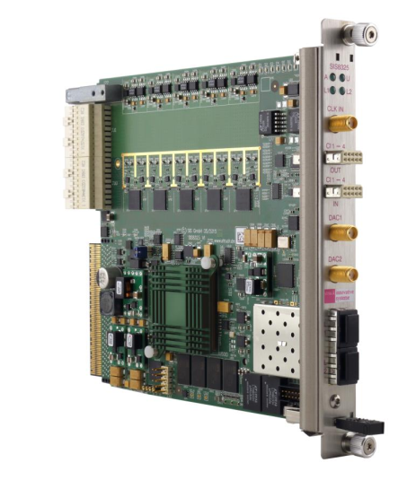
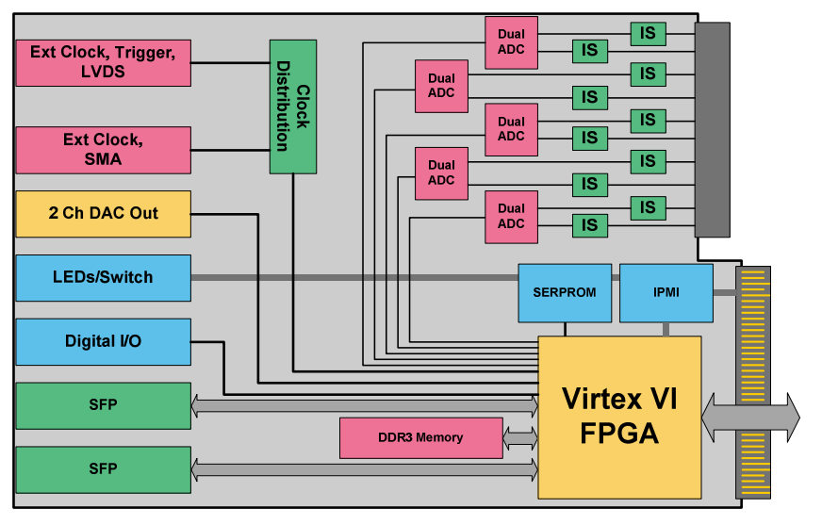
Overall system design
BPM based on MTCA.4
SIS 8300-L2 board ~ a standard AMC

Slide 13
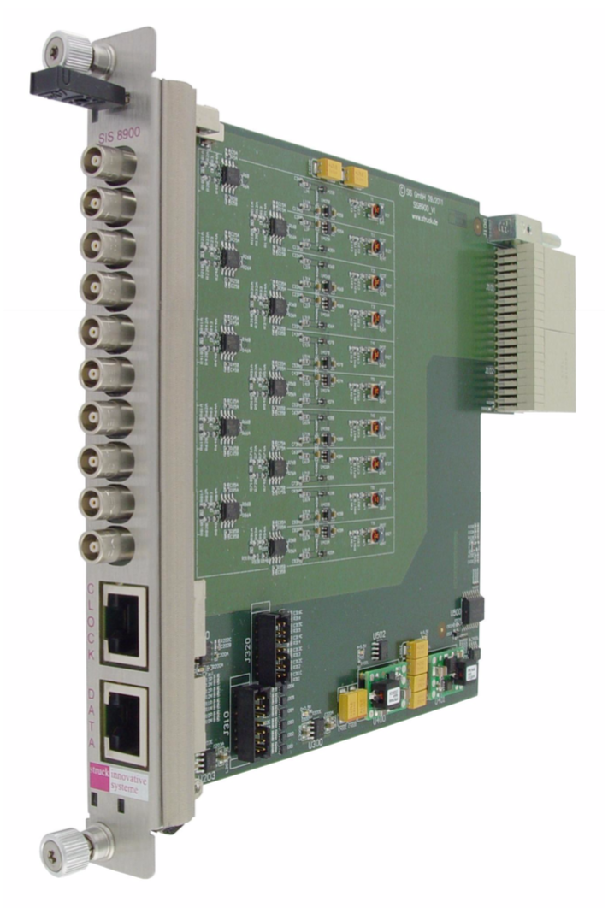
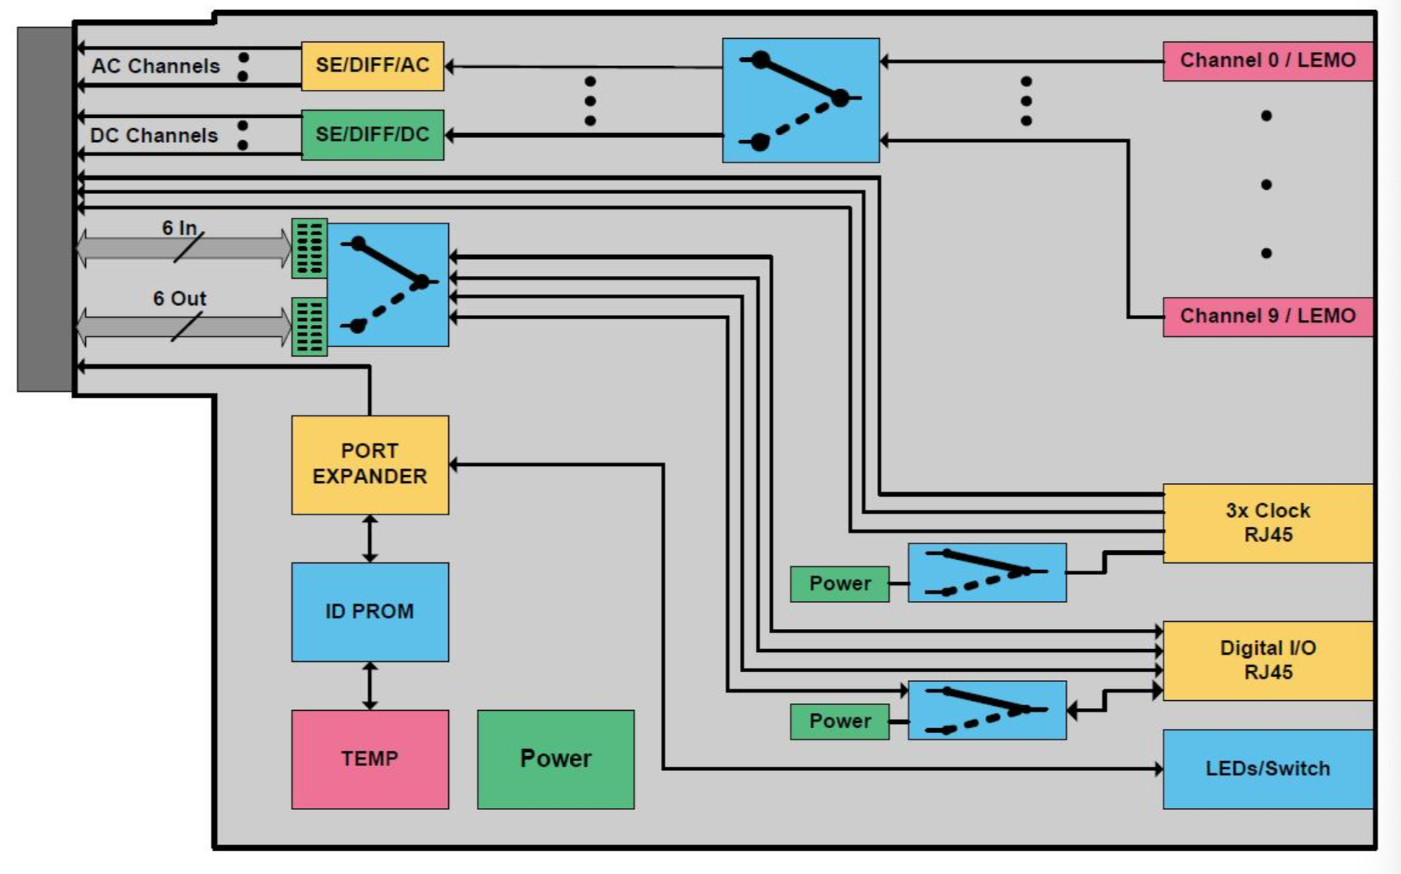
Overall system design
BPM based on MTCA.4
SIS8900 board~ The SIS8900, a signal conditioning input card for the SIS8300, is a 10 channel single ended input RTM according to the MTCA.4 standard.

Slide 14
Outline
Introduction of the BPM system
01
Overall system design
02
Implementation of DSP algorithm
03
Test
04
Summary
05
Notes:
模板来自于 http://meihua.docer.com/
14

Slide 15
Implementation of DSP algorithm
DSP algorithm
1.Digital down conversion
Multiply the IF digital signal with two orthogonal signals generated through the NCO to obtain two orthogonal streams.
2. multi-rate signal processing
CIC filter and FIR filter are used to decimate the data rate of the streams and suppress the out-of-band noise.
3.CORDIC algorithm
With two orthogonal streams, the signal amplitude is calculated by CORDIC algorithm.

Slide 16
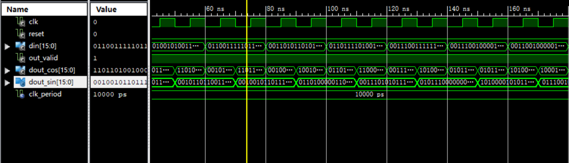
Implementation of DSP algorithm
NCO
To convert the IF signal to the fundamental frequency，the IF digital signal is multiplyed by two orthogonal signals generated by NCO.
NCO is implemented by the Xilinx IP core, with the output sine and cosine signals with frequency of 27.2MHz and the resolution of 16-bit.These two signals are multiplied by four digital signals respectively to obtain the IQ orthogonal streams of the four beam signals.

Slide 17
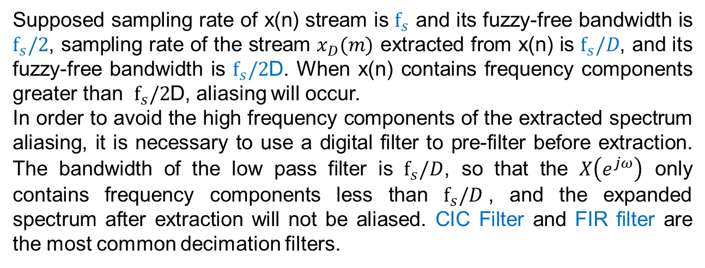
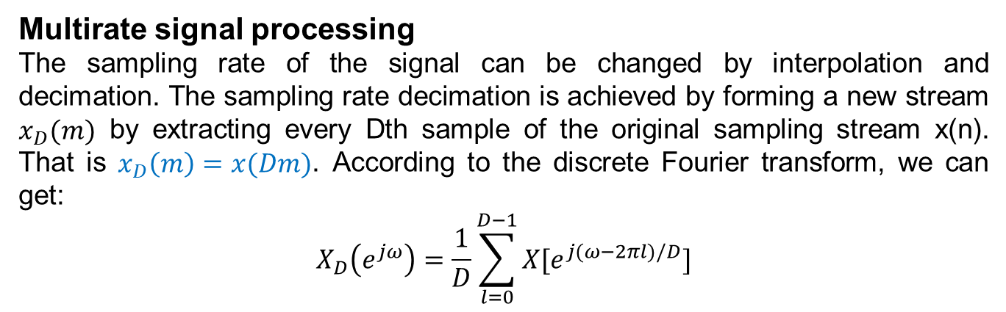
Implementation of DSP algorithm
.
Multirate signal processing
The sampling rate of the signal can be changed by interpolation and decimation. The sampling rate decimation is achieved by forming a new stream $x_{D}(m)$ by extracting every Dth sample of the original sampling stream x(n). That is $x_{D}\left(m\right)=x(Dm)$. According to the discrete Fourier transform, we can get:
$$X_{D}\left(e^{jω}\right)=\frac{1}{D}\sum_{l=0}^{D−1}{X[e^{j(ω−2πl)/D}]}$$
Supposed sampling rate of x(n) stream is $f_{s}$ and its fuzzy-free bandwidth is $f_{s}/2$, sampling rate of the stream $x_{D}(m)$ extracted from x(n) is $f_{s}/D$, and its fuzzy-free bandwidth is $f_{s}/2$D. When x(n) contains frequency components greater than $f_{s}/2$D, aliasing will occur.
In order to avoid the high frequency components of the extracted spectrum aliasing, it is necessary to use a digital filter to pre-filter before extraction. The bandwidth of the low pass filter is $f_{s}/D$, so that the $X\left(e^{jω}\right)$ only contains frequency components less than $f_{s}/D$, and the expanded spectrum after extraction will not be aliased. CIC Filter and FIR filter are the most common decimation filters.

Slide 18
Implementation of DSP algorithm
CORDIC algorithm
Coordinate Rotational Digital Computer(CORDIC) algorithm is employed to calculate the amplitude with the I and Q streams.
The basic idea of the CORDIC algorithm is to perform a vector rotation, and this algorithm can be implemented by addition, subtraction and shift operations simply, without multiplication and square root.

Slide 19
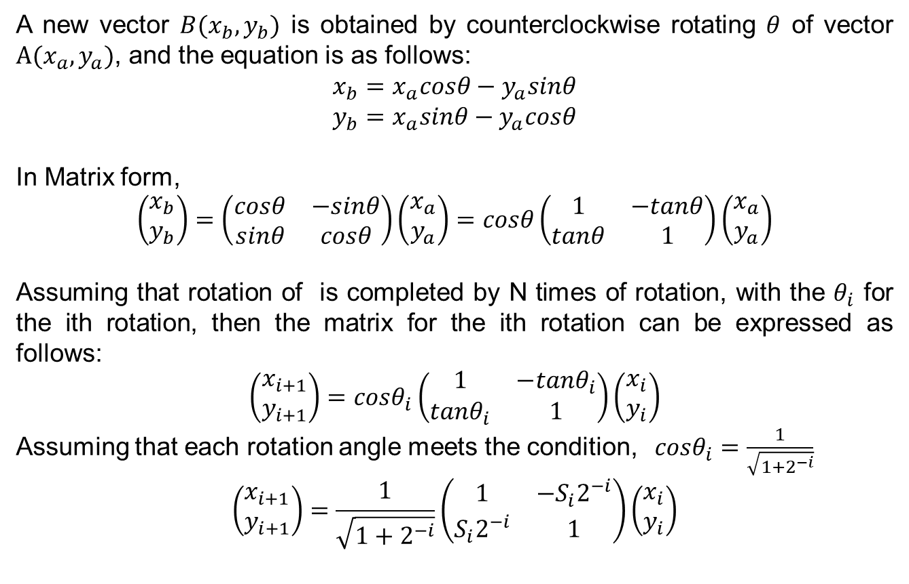
Implementation of DSP algorithm
A new vector $B(x_{b},y_{b})$ is obtained by counterclockwise rotating $θ$ of vector $A(x_{a},y_{a})$, and the equation is as follows:
$$x_{b}=x_{a}cosθ−y_{a}sinθ$$
$$y_{b}=x_{a}sinθ−y_{a}cosθ$$
In Matrix form,
$$\left(\begin{matrix}x_{b} \\ y_{b}\end{matrix}\right)=\left(\begin{matrix}cosθ & −sinθ \\ sinθ & cosθ\end{matrix}\right)\left(\begin{matrix}x_{a} \\ y_{a}\end{matrix}\right)=cosθ\left(\begin{matrix}1 & −tanθ \\ tanθ & 1\end{matrix}\right)\left(\begin{matrix}x_{a} \\ y_{a}\end{matrix}\right)$$
Assuming that rotation of is completed by N times of rotation, with the $θ_{i}$ for the ith rotation, then the matrix for the ith rotation can be expressed as follows:
$$\left(\begin{matrix}x_{i+1} \\ y_{i+1}\end{matrix}\right)=cosθ_{i}\left(\begin{matrix}1 & −tanθ_{i} \\ tanθ_{i} & 1\end{matrix}\right)\left(\begin{matrix}x_{i} \\ y_{i}\end{matrix}\right)$$
Assuming that each rotation angle meets the condition, $cosθ_{i}=\frac{1}{\sqrt{1+2^{−i}}}$
$$\left(\begin{matrix}x_{i+1} \\ y_{i+1}\end{matrix}\right)=\frac{1}{\sqrt{1+2^{−i}}}\left(\begin{matrix}1 & −S_{i}2^{−i} \\ S_{i}2^{−i} & 1\end{matrix}\right)\left(\begin{matrix}x_{i} \\ y_{i}\end{matrix}\right)$$

Slide 20
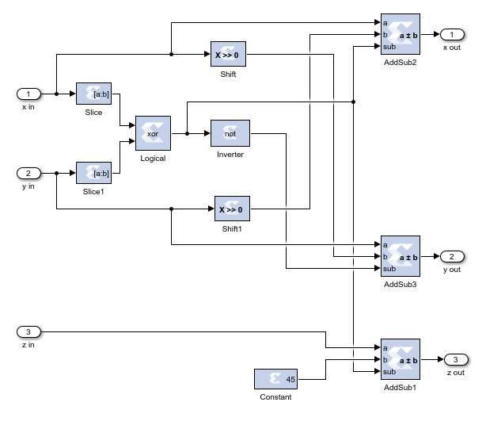
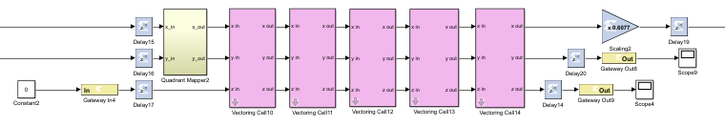
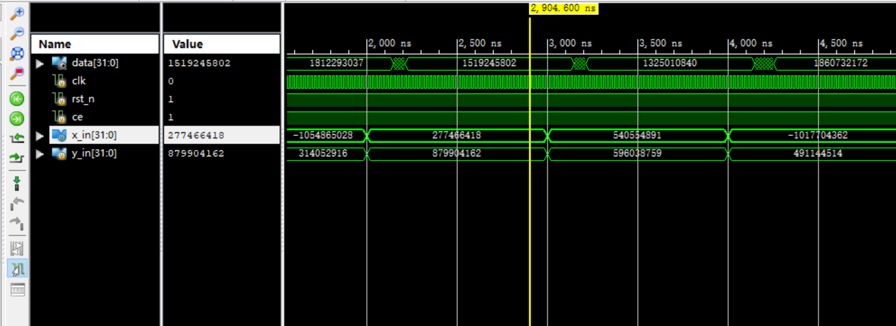
Implementation of DSP algorithm
Before the input signal enters the first CORDIC cell, quadrant adjustment is required. A signal vector consisting of I and Q is adjusted to the first or fourth quadrant before processd in CORDIC cell.
According to the result of the simulation, high-precision amplitude can be obtained by five-level CORDIC cell.

Slide 21
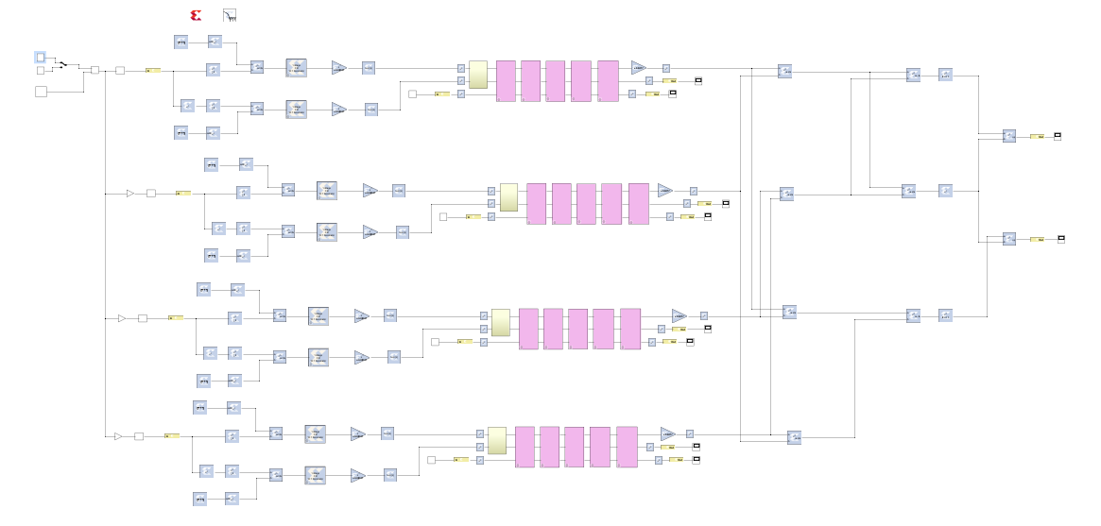
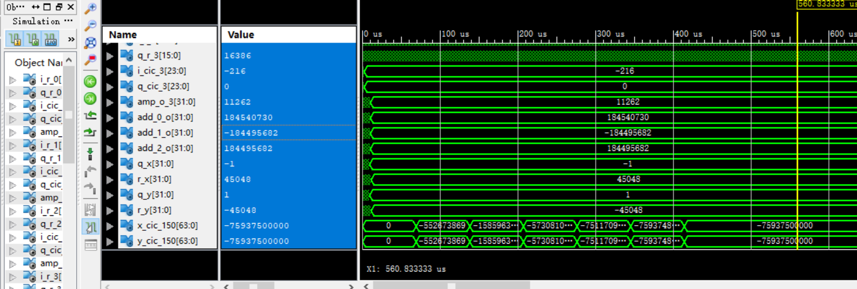
Implementation of DSP algorithm
The simulation of the overall DSP algorithm in system generator.

Slide 22
Outline
Introduction of the BPM system
01
Overall system design
02
Implementation of DSP algorithm
03
Test
04
Summary
05
Notes:
模板来自于 http://meihua.docer.com/
22

Slide 23
Test
We conducted tests on the system in the laboratory. The system under test is based on MTCA.4. The AFE is a integrated preprocessing circuit to adjust the amplitude of the inupt signal from the BPM detector. SIS8900 and SIS8300-L2 are stuck in MTCA. 4.
In the tests, the 408MHz RF signal and 108.8MHz synchronous clock are generated using the high perference signal source. RF signal is split into four signals as the input signal of the AFE. After filtered, amplified and attenuated in the AFE, passing through the SIS8900, signals are sent to the SIS8300-L2 to calculate the beam position. The results calculated in FPGA are transfered to the host computer by PCI Express interface for further analysis.

Slide 24
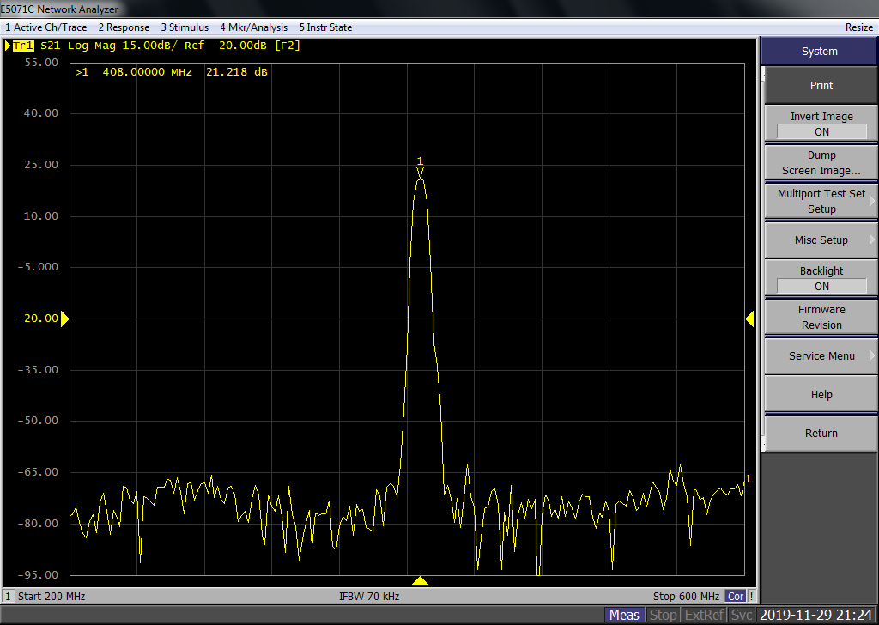
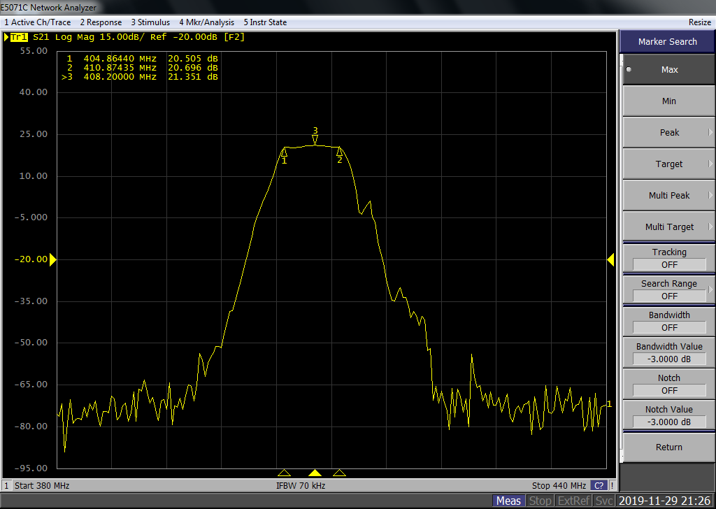
Test
First, we conducted tests on the performance of the RF front end. The typital frequency response is shown as follows. As for the 408MHz RF signal, the out-of-band suppression is better than 80 dB.

Slide 25
Test
We conducted the linearity tests of the analog front end by adjusting the amplitude of the input signal source. The figure shows the linearity test results.

Slide 26
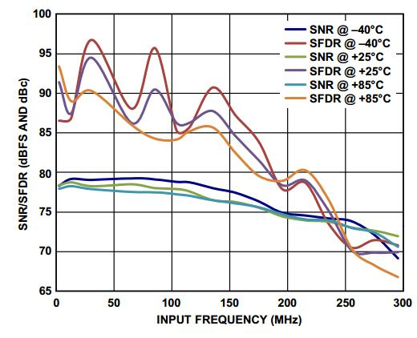
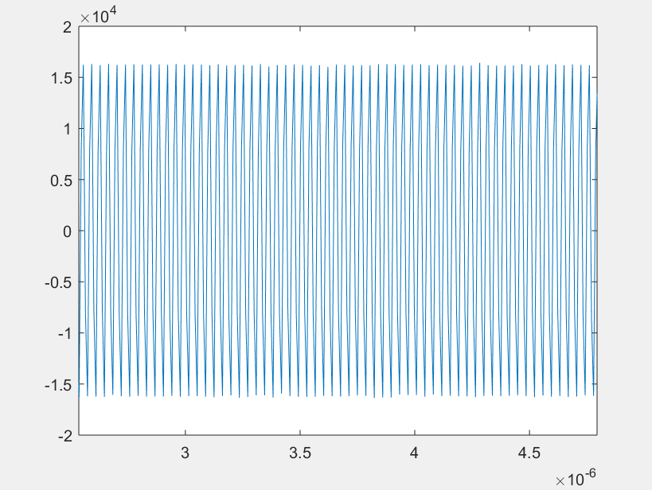
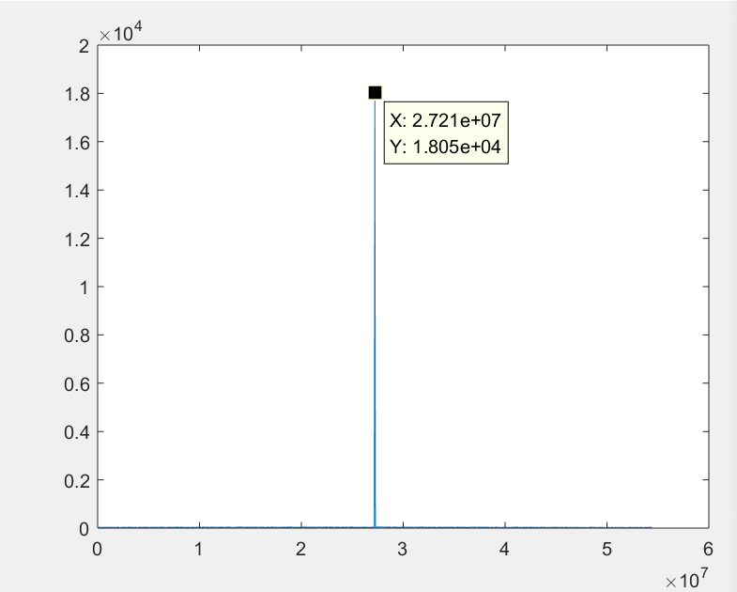
Test
ADC raw data
Problem: No matter how you adjust the amplitude of the input signal and the attenuation of the AFE, the ADC data is always less than half of the range of ADC.

Slide 27
Test
Adjusting the input signal amplitude range from -40dbm to -4dBm, the TBT data resolution is better than 4.5um, the fast data resolution and the slow resolution is better than 420 nm, 170 nm respectively.

Slide 28
summary
1.Overall system design has been completed
2.Off-line test has been completed
3.The online stability test for long time has not been completed
4.TBT data and SA data meet the requirements
5. FA data has not met the requirements
ADC is not suitable for this system, and needs to be replaced.

Slide 29

Thanks ！

