Slide 1
REDUNDANT CPU ON MTCA SYSTEM WITH PCI EXPRESS NON TRANSPARENT BRIDGE
L.Petrosyan (DESY)

Slide 2
PCI Express NTB
NTB used to connect two independent address/Host domains
A Non-Transparent bridge consist of two back-to-back PCIe endpoints, a Virtual and Link side endpoints.
NTB isolates Address spaces of different Hosts by appearing as an endpoint to each side
Host 1
Upstream
PortA
Downstream PortB
NTB
PortC
NTB Provides:
Allow to have second CPU on MTCA system (7th MicroTCA Workshop)
Allow to have redundant CPU on MTCA system (now)
Virtual Side
Host 2
Link Side

Slide 3
NTB FAILOVER
To protect against a failing Host taking the entire system down, a backup Host can be in place, ready to take over.
The passive Host2 is waiting for the active Hos1t to fail.
When the Virtual side Host1 fail, passive Host2 initiates the sequence:
Host 1
Upstream
PortA
Configure PortA to be the NT Port and PortC to be the Upstream Port
Reset Upstream Port Secondary Bus
Re-enumerate the hierarchy and start operation.
Host 1
Virtual Side
Link Side
Downstream PortB
NTB
PortC
Downstream PortB
NTB
PortA
Virtual Side
Host 2
Link Side
Host 2
Upstream
PortC

Slide 4
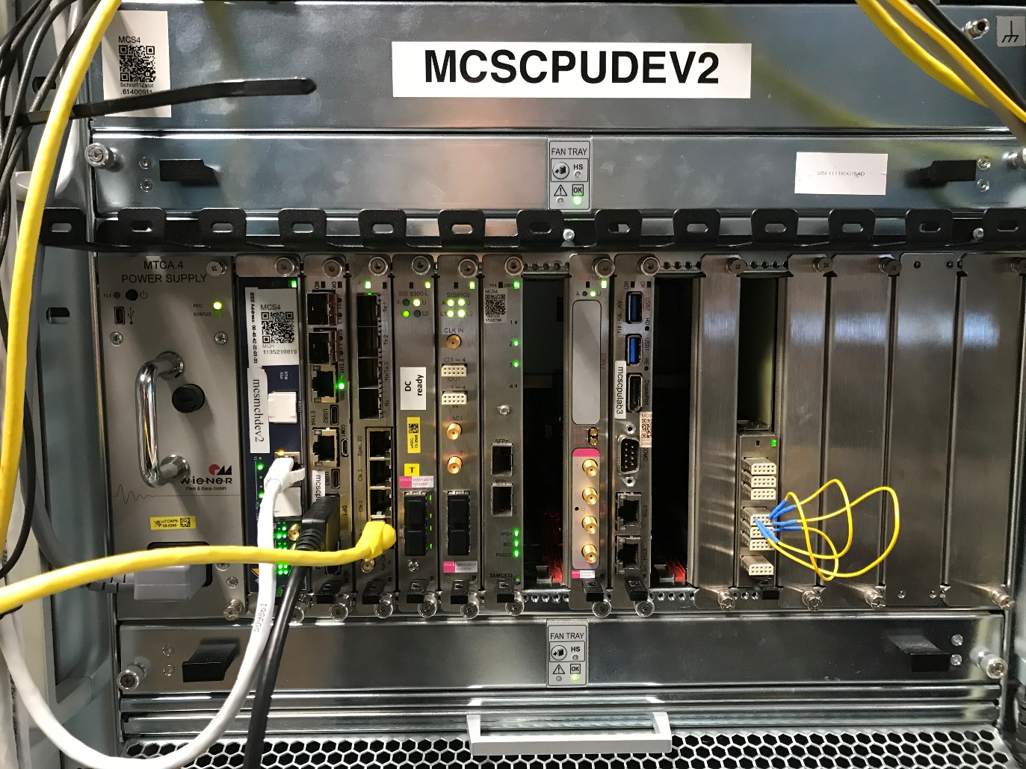
Redundant CPU Test
NAT MCH with PEX8748 PCIE Switch
Host1 in Slot 1 (PCIE Switch Port19)
Host2 in Slot 8 (PCIE Switch Port16)
PCIENTBV – PCIE NTB device driver is running on both CPUs

Slide 5
Redundant CPU Test
Virtual Side Host1(Upstream Port)
Link Side Host2 (NTB Port)
Do not start failover while the Host1 is not loaded
LOAD DRIVER
LOAD DRIVER
NTB SCRATCH REG.
USER.NOTIFY
USER.NOTIFY
DETECKT SIDE
DETECKT SIDE
START
USER.CMND
COUNTER
GET START
GET COUNTER
USER.NOTIFY
START/STOP
FAILOVER
NOTIFY USER
REBOOT
NO
Is START
Fail checking could be started-stopped by user or by OS, for example, when the system is going to be rebooted
Force Ports reconfiguration
RECONFIGURE
PCIE SWITCH
RESENT COUNTER
Is COUNTER 0
NO
DELAY
Configure.
Upstream Port as NTB
NTB Port as Upstream
INCREMENT
COUNTER
REBOOT_NOTIFIER
DELAY

Slide 6
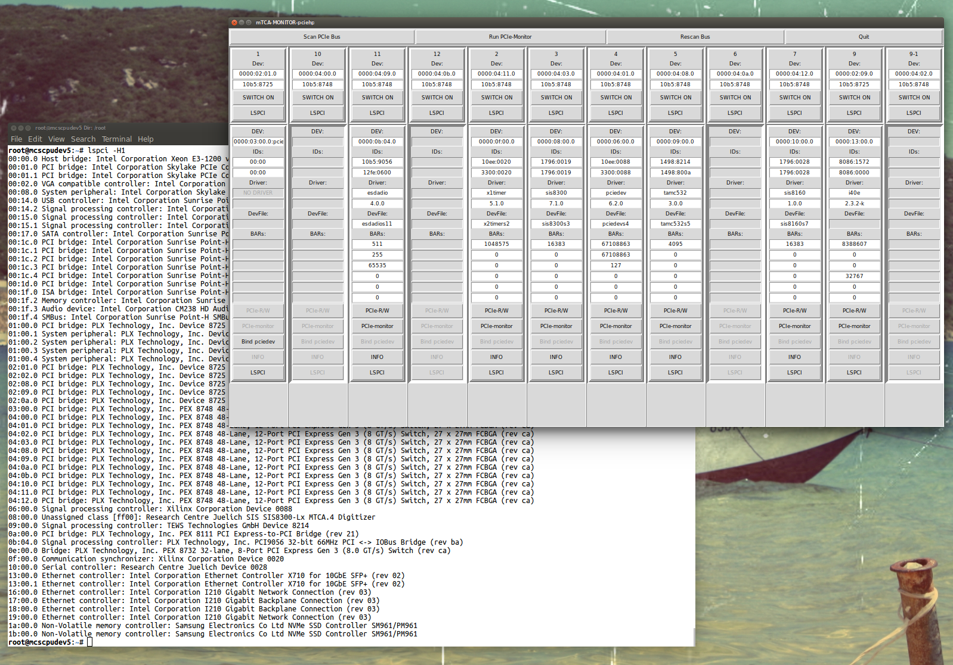
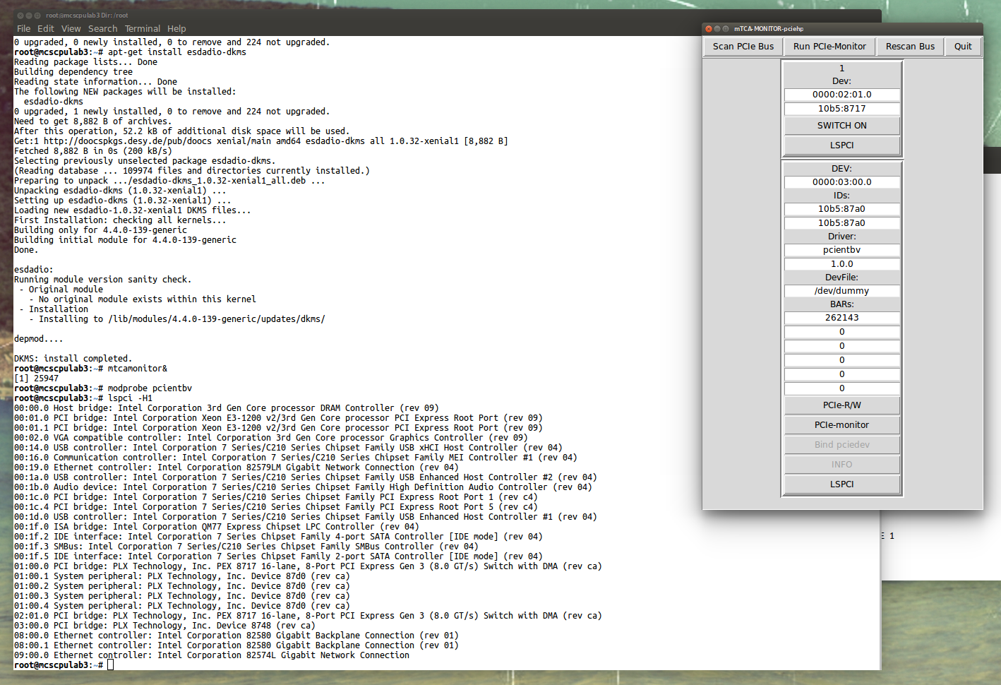
Redundant CPU Test
Virtual Side Host 1.
All AMC cards are visible from this side
NTB Endpoint in slot 8 (Port 16, 10:00.0)
Link Side Host 2.
Only NTB Endpoint is visible

Slide 7
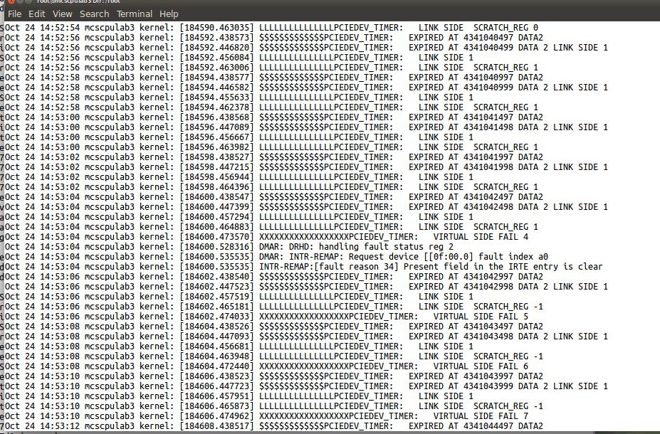
Redundant CPU Test
Heartbeats messages on the Link Side Host2 NTB devise driver
Host1 is OK
Host1 Fail
Using NAT MCH Diag tool, we can see the PCIE Switch Upstream Port Register is changed
Port 19 Upstream, Port 16 NTB
Port 16 Upstream, Port 19 NTB

Slide 8
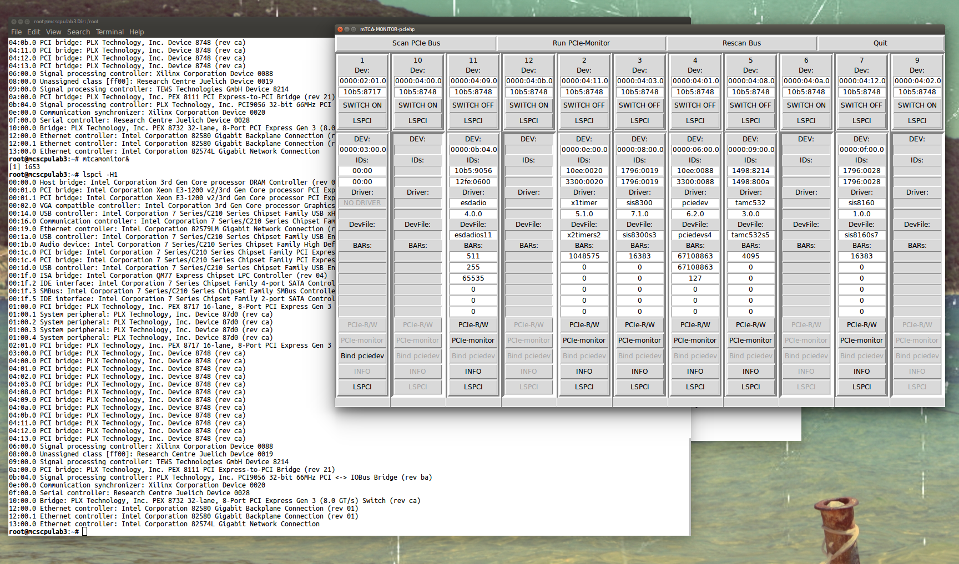
Redundant CPU Test
After the Host1 fail is detected, the NTB device driver has reconfigured the PCIE switch and rebooted the CPU
Now Host 2 is Upstream host, and we can see all AMC modules from this host.
The same picture we had before on Host1

Slide 9
Info
The source codes can be found on https://github.com/MicroTCA
The information and Linux packages can be found on a DOOCS web page http://doocs.desy.de
Mail doocs@desy.de
THANK YOU

