Slide 1
Insight on Failures of MTCA.4 Systems installed in FLASH and EuXFEL Tunnels
2019 MTCA.4 workshop
Hamburg, 05.12.2019
Julien Branlard and Christian Schmidt
for the LLRF team

Slide 2
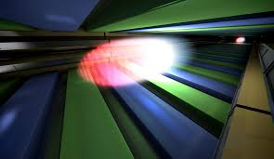
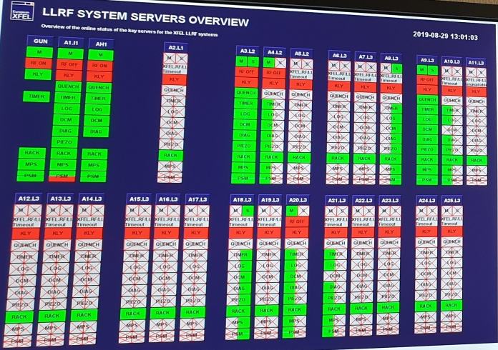
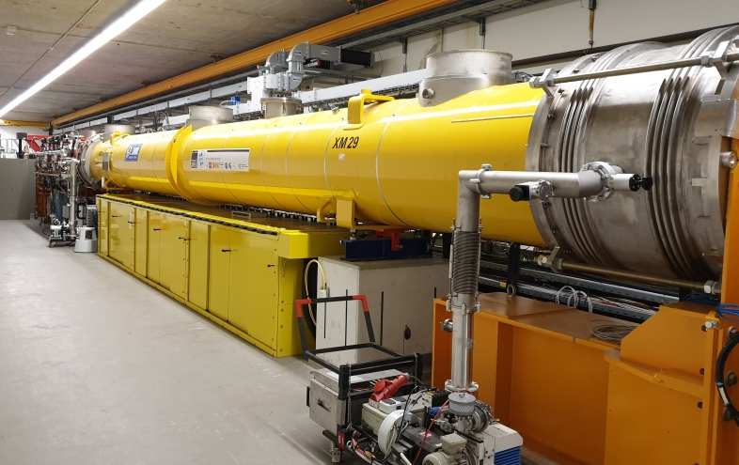

AGENDA
INTRODUCTION: FLASH and XFEL
RADIATION and SHIELDING
FAULTS in MTCA.4 LLRF SYSTEMS
OUTLOOK
© alamy

Slide 3
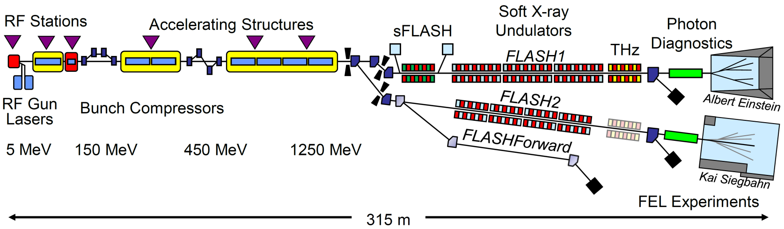
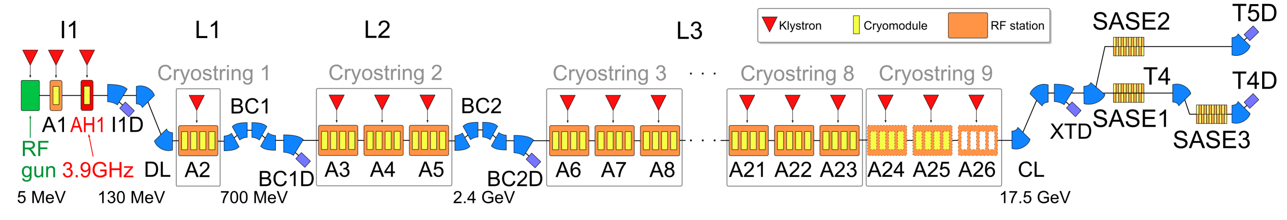
FLASH and XFEL
FLASH operated with MTCA.4 since 2013
XFEL operated with MTCA.4 since 2017
3.4 km

Slide 4
MTCA.4 LLRF components* in the tunnels
 | XFEL | FLASH
ADCs | ~ 350 | 16
DWCs | ~ 350 | 14
CPUs | ~ 55 | 4
MCHs | ~ 55 | 4
TIMER | ~ 55 | 4
DAMC02 | ~ 30 | 2
TCK7 | ~ 55 | 3
PM | ~ 100 | 4
others | ~ 20 | 6
TOTAL | ~ 1070 | 57
Only components installed in tunnels are listed
Other components are useful as witness outside of radiation prone environments
* more in other subsystems (technical interlock, special diagnostics, etc…)

Slide 5
Measuring Radiation
Shielding Conditions

Slide 6
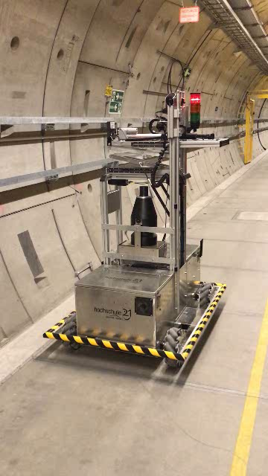
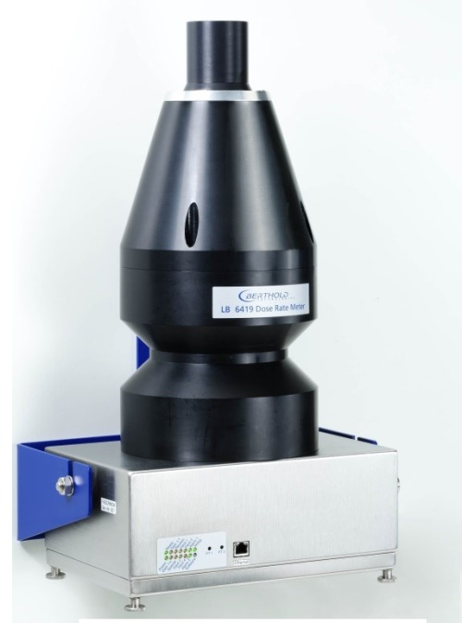
How is radiation measured
Pandora
  FLASH/ XFEL installed in the tunnel
  Measure gamma and neutrons
  Sparse measurement spots
  Mounted on remote controlled robot (XFEL)
RadFet
  Mounted on racks
  Measure integrated radiation
RadCon
  Gamma counters
  Installed as USB stick on MTCA CPUs
  Fast “live” read outs
MARWIN: Mobiler und Autonomer Roboter für Wartung und INspektion

Slide 7
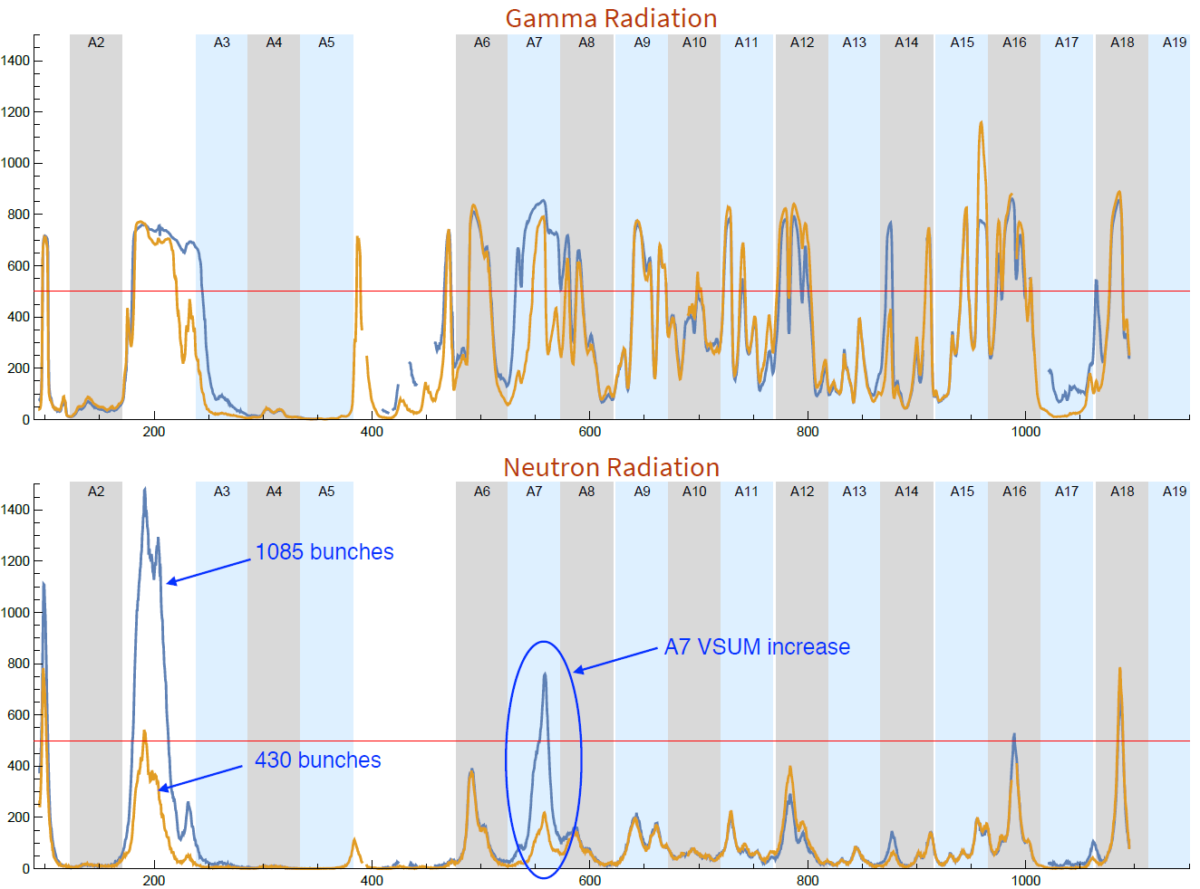

How is radiation measured
Pandora
  FLASH/ XFEL installed in the tunnel
  Measure gamma and neutrons
  Sparse measurement spots
  Mounted on remote controlled robot (XFEL)
RadFet
  Mounted on racks
  Measure integrated radiation
RadCon
  Gamma counters
  Installed as USB stick on MTCA CPUs
  Fast “live” read outs
Dose rate [μSv/h]
Dose rate [μSv/h]

Slide 8
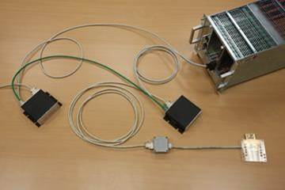
How is radiation measured
Pandora
  FLASH/ XFEL installed in the tunnel
  Measure gamma and neutrons
  Sparse measurements
  Mounted on remote controlled robot (XFEL)
RadFet
  Mounted on racks
  Measure integrated radiation
RadCon
  Gamma counters
  Installed as USB stick on MTCA.4 CPUs
  Fast “live” read outs
MTCA crate
Sensor mounted in dosimon boxes
Sensor mounted on FMC
external stand-alone sensor

Slide 9
How is radiation measured
Courtesy N. Walker
Pandora
  FLASH/ XFEL installed in the tunnel
  Measure gamma and neutrons
  Sparse measurements
  Mounted on remote controlled robot (XFEL)
RadFet
  Mounted on racks
  Measure integrated radiation
RadCon
  Gamma counters
  Installed as USB stick on MTCA.4 CPUs
  Fast “live” read outs

Slide 10
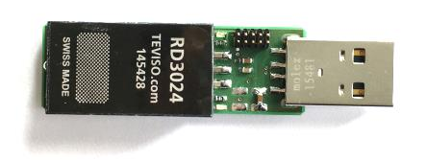
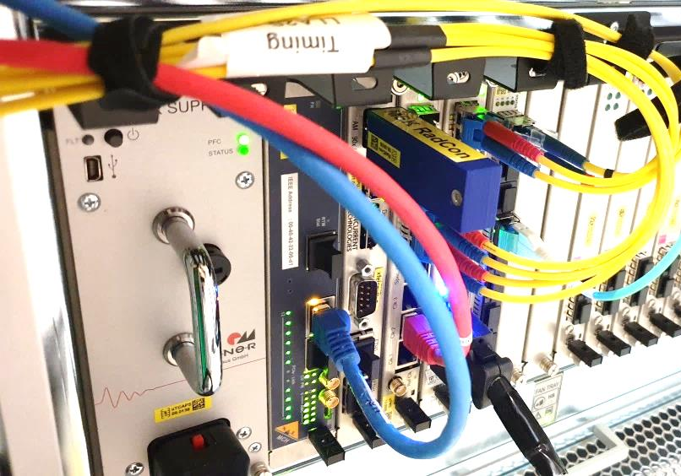
How is radiation measured
Pandora
  FLASH/ XFEL installed in the tunnel
  Measure gamma and neutrons
  Sparse measurements
  Mounted on remote controlled robot (XFEL)
RadFet
  Mounted on racks
  Measure integrated radiation
RadCon
  Gamma counters
  Installed as USB stick on MTCA.4 CPUs
  Fast “live” read outs

Slide 11
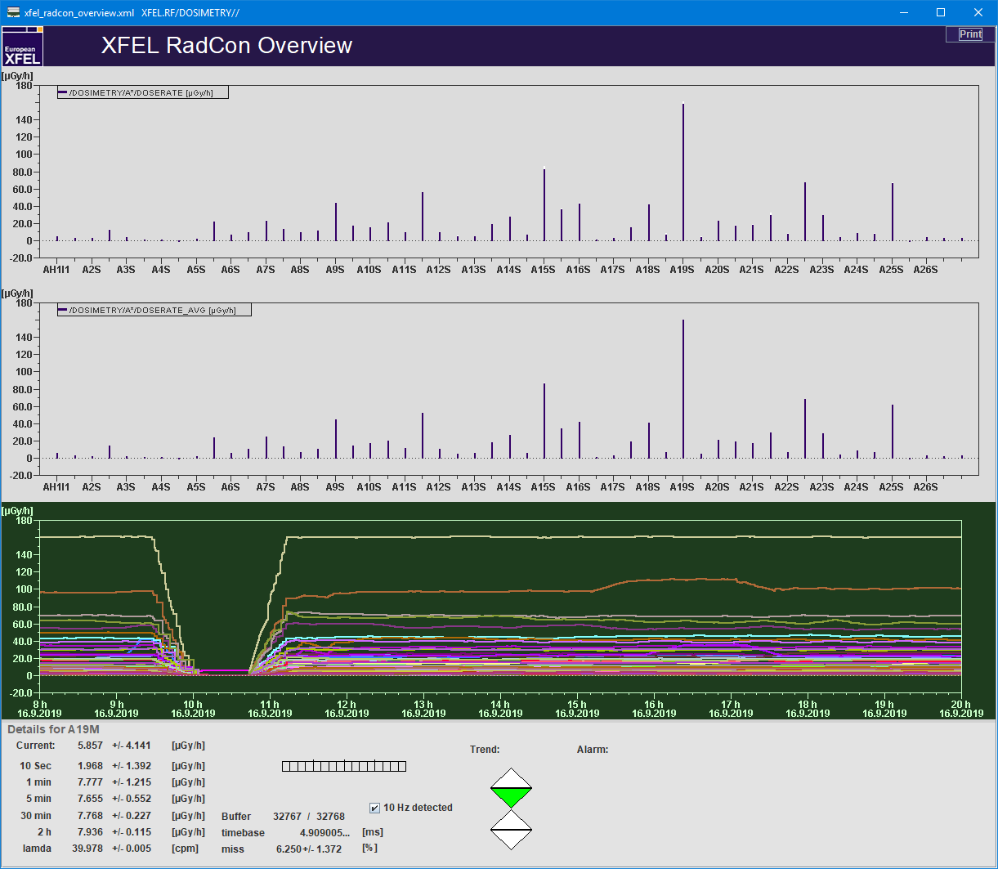
How is radiation measured
Pandora
  FLASH/ XFEL installed in the tunnel
  Measure gamma and neutrons
  Sparse measurements
  Mounted on remote controlled robot (XFEL)
RadFet
  Mounted on racks
  Measure integrated radiation
RadCon
  Gamma counters
  Installed as USB stick on MTCA.4 CPUs
  Fast “live” read outs
Machine ramp
down/up
Single RF station
gradient adjustment

Slide 12
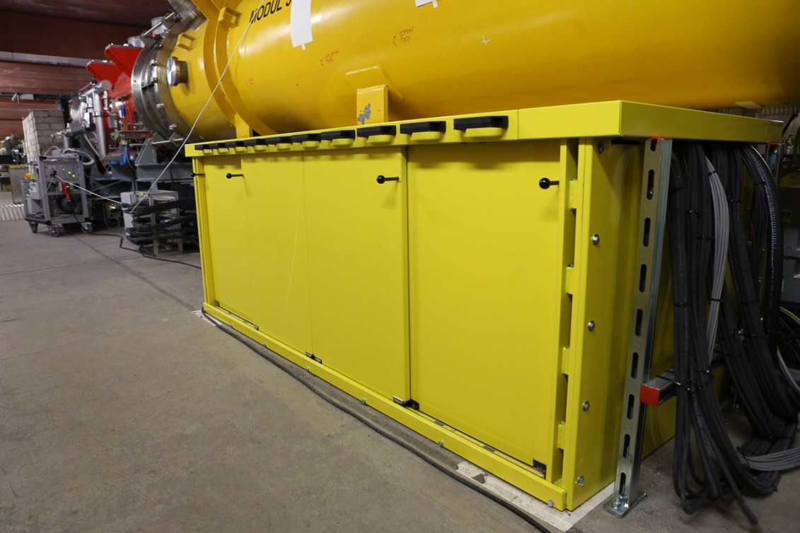
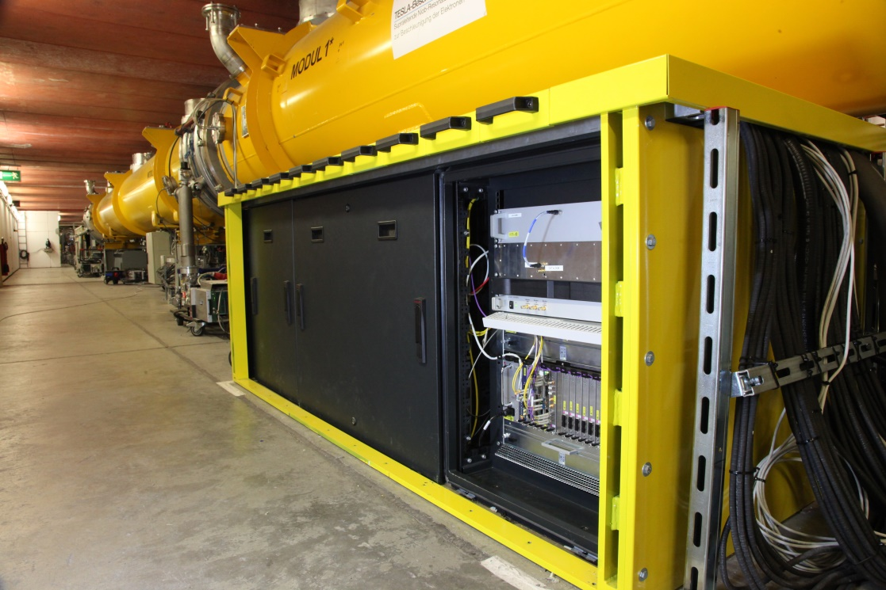
Shielding conditions at FLASH
Primary intention: testing electronics in radiation environment for XFEL operation conditions
  Drawback is accessibility and maintainability
  Benefit of shorter cable length (latency and less prone to environmental conditions)
Gun / ACC1 / ACC39 rack shielding with sliding door in front and back
ACC23 rack shield enclosure without doors

Slide 13
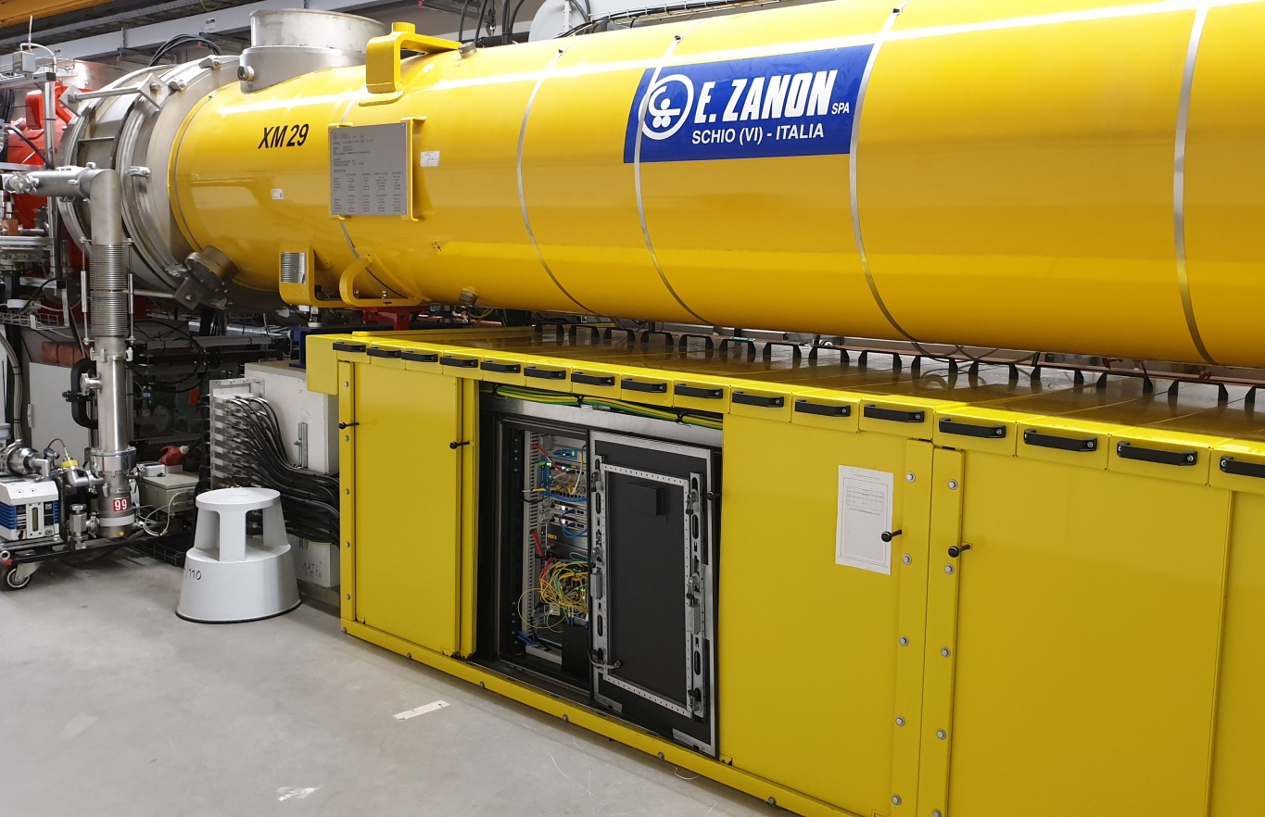
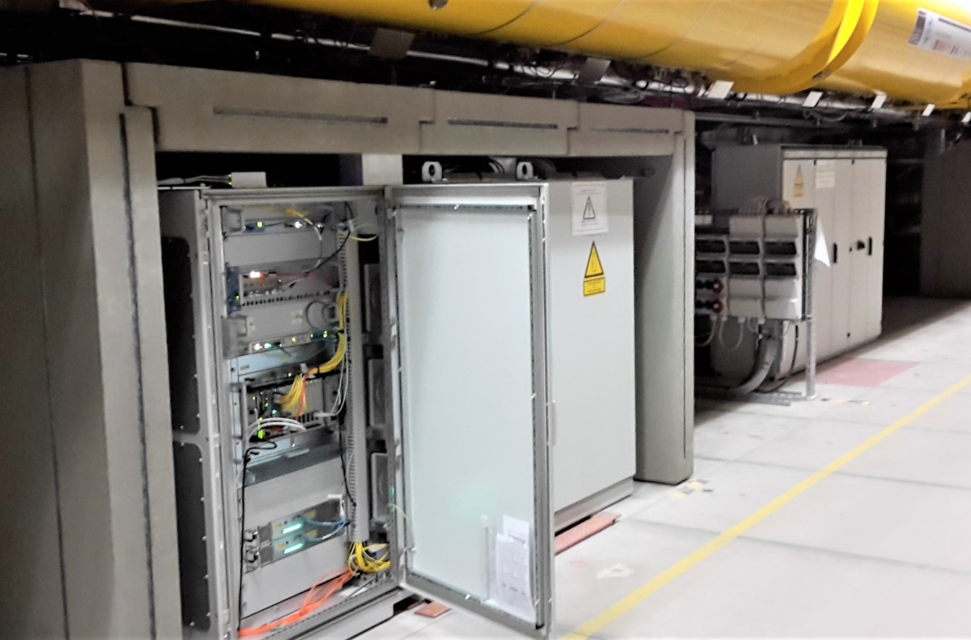
Shielding conditions at XFEL
Inside the injector : boron-based shielding identical to FLASH
Inside the main tunnel : heavy duty concrete blocks

Slide 14
Gradient induced radiation (i.e. not beam-induced)
Courtesy N. Walker
shutdowns
shutdowns
Lower gradient
(11 GeV run
instead of 14 GeV)
Lower gradient
(11 GeV run
instead of 14 GeV)
Radiation readout (RadFet estimated daily dose rates)
Change in station voltage wrt average

Slide 15
Faults in MTCA.4 systems installed in FLASH and XFEL

Slide 16
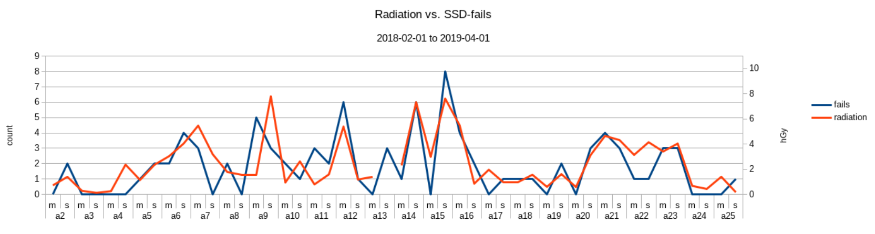
SSD failures at XFEL
SSD exchange
  2017 : 15
  2018 : 72
  2019 : 22 (Jan – Apr)
  Not a single failure outside of XTIN, XTL, XTDs since 2017
  Not so many failures in SASE tunnels anymore, but LLRF stations and BC1
Period 2018-02-01 to 2019-04-01
Courtesy Tim. Wilksen

Slide 17
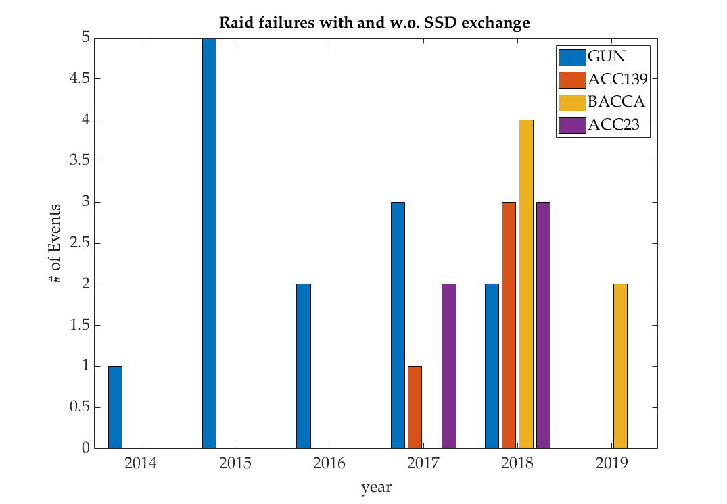
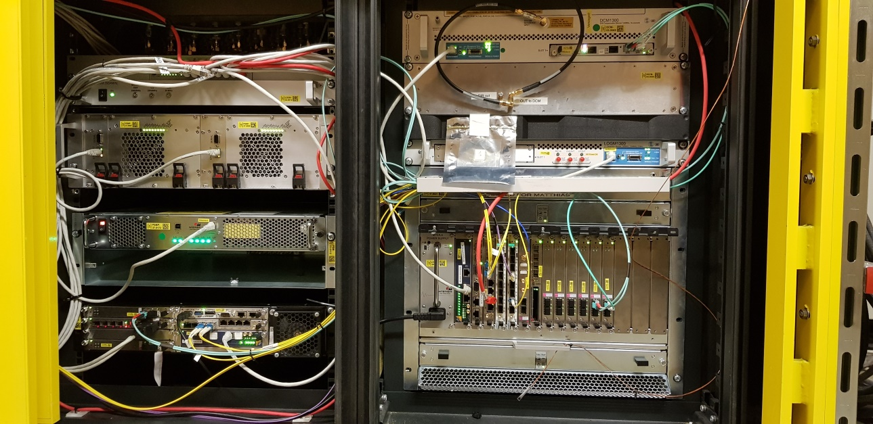
SSD failures at FLASH
Cryomodule
Beam direction
1
2
Nb of failures decreased in 2019 , especially for the GUN
  1➔ BACCA installation in ACC139 Rack
  2➔ Change of gun crate inside rack
Gun / ACC1/39 Rack Equipment, GUN crate (2U left side has been moved down to increase distance to beam pipe and CM)

Slide 18
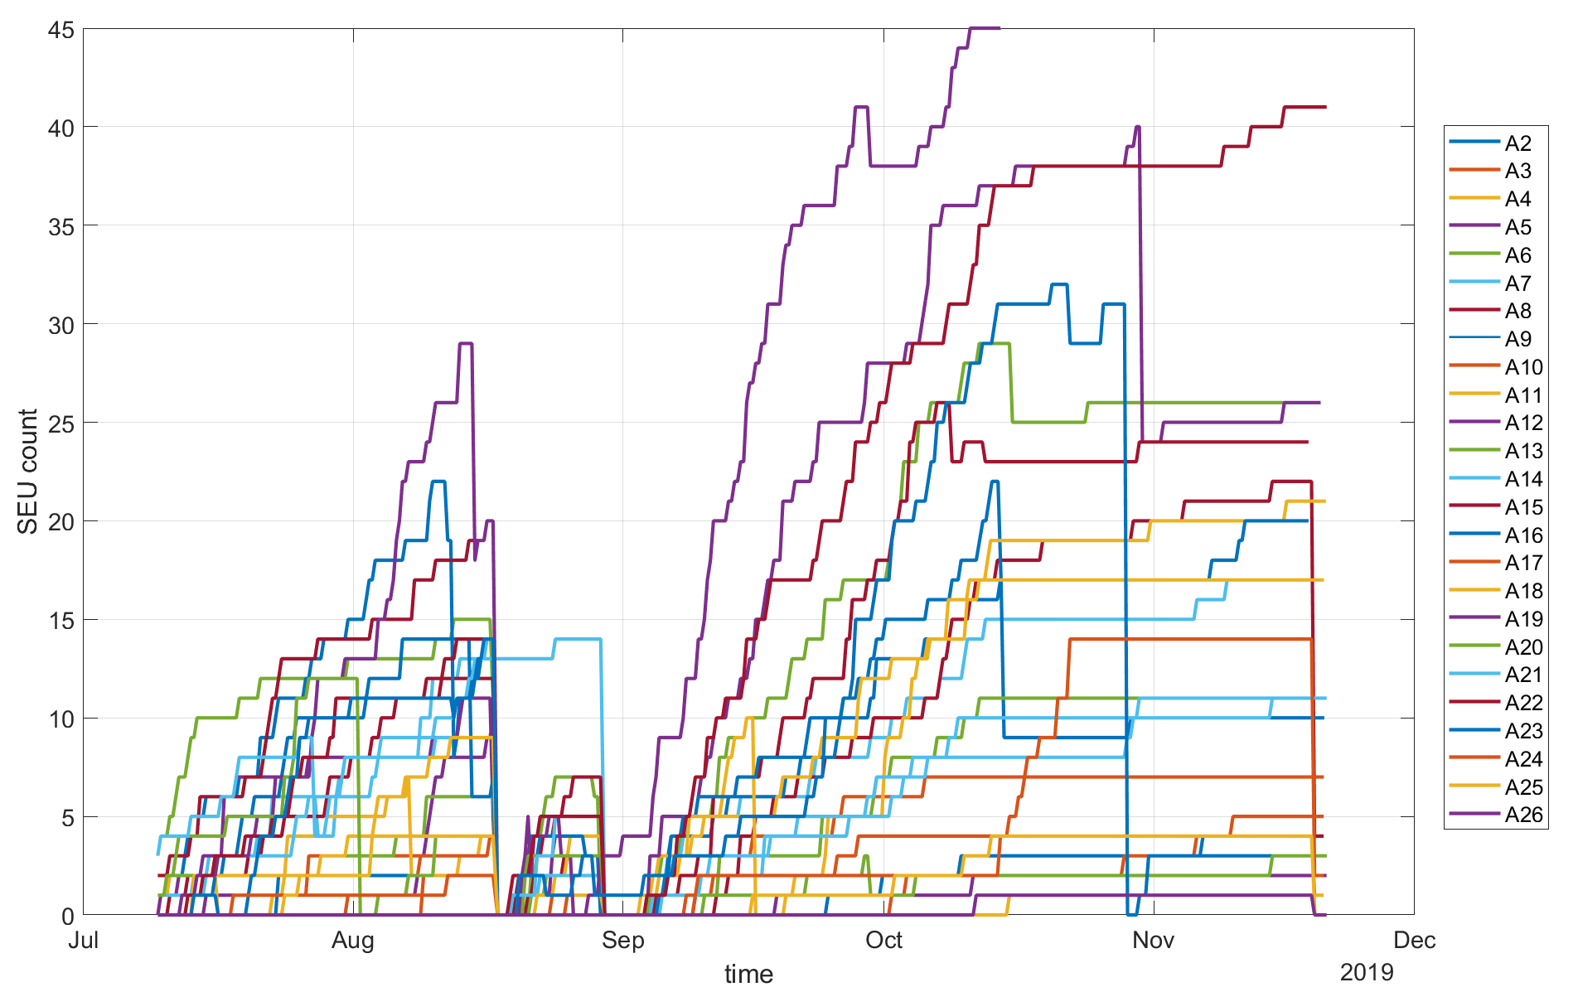
SEUs (ADCs only) at XFEL
Single event upsets
crate / board reboot
A19
A12
shutdown
A22
shutdown
A23
power outage
A6

Slide 19
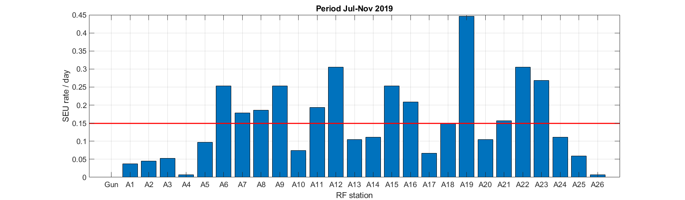
SEUs (ADCs only) at XFEL
6 boards x 2 crates (master & slave) x 25 RF station = 300 boards
Rate is moderate: 0.15 SEU / RF station / day (12 boards)
Usual suspects: A6, A9, A12, A15-16, A19, A22, A23

Slide 20
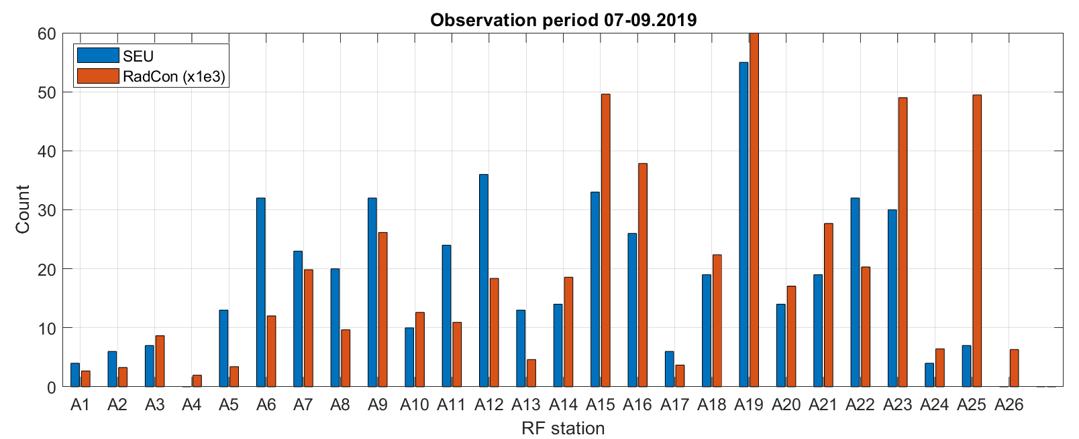
SEUs (ADCs only) at XFEL
Correlation between radiation and failures
  2 months observation period
  Correlation with radiation hits (RadCon) readouts
  LLRF firmware now has single SEU correction block

Slide 21
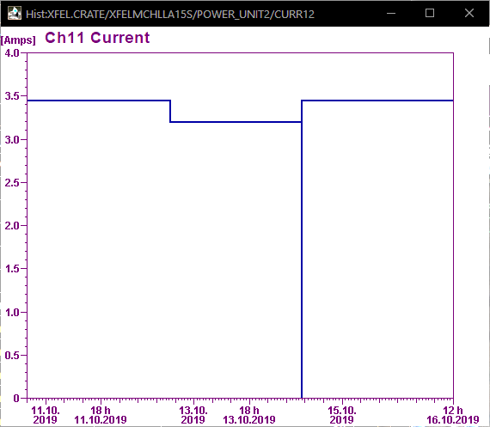
PCIe failures
Board current consumption read from power supply
PCIe link to an ADC board disappears during operation
  Not always the same board
  Happens on LLRF crates only
  (fw? most heavily equipped crates ?)
Diagnostics
  Seems unrelated to radiation conditions
  Coincidentally observed on current consumption
    Current drops (cause or consequence ?)
    PhD devoted to “self healing” systems
  Currently not handled properly by server (work in progress)
Impact of new NAT firmware* ?
  PCIe configuration was changed in new FW
failure
board reboot
  * New FW → backplane manager support + bug fix in handling slot 12 at reboot
  also, PS redundancy issues were fixed
  currently under test, installation planned for Summer 2020

Slide 22
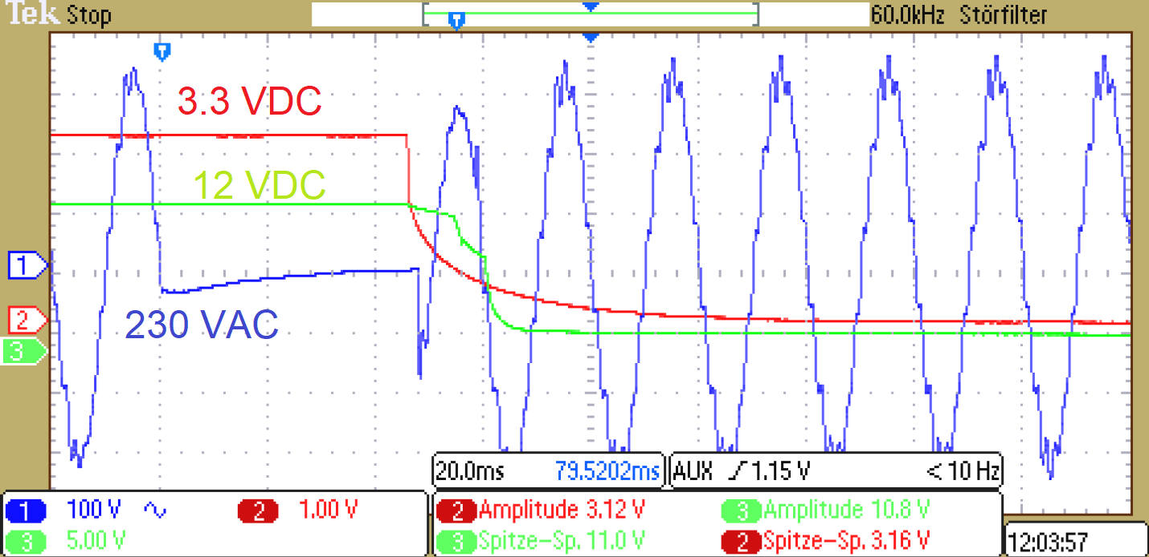
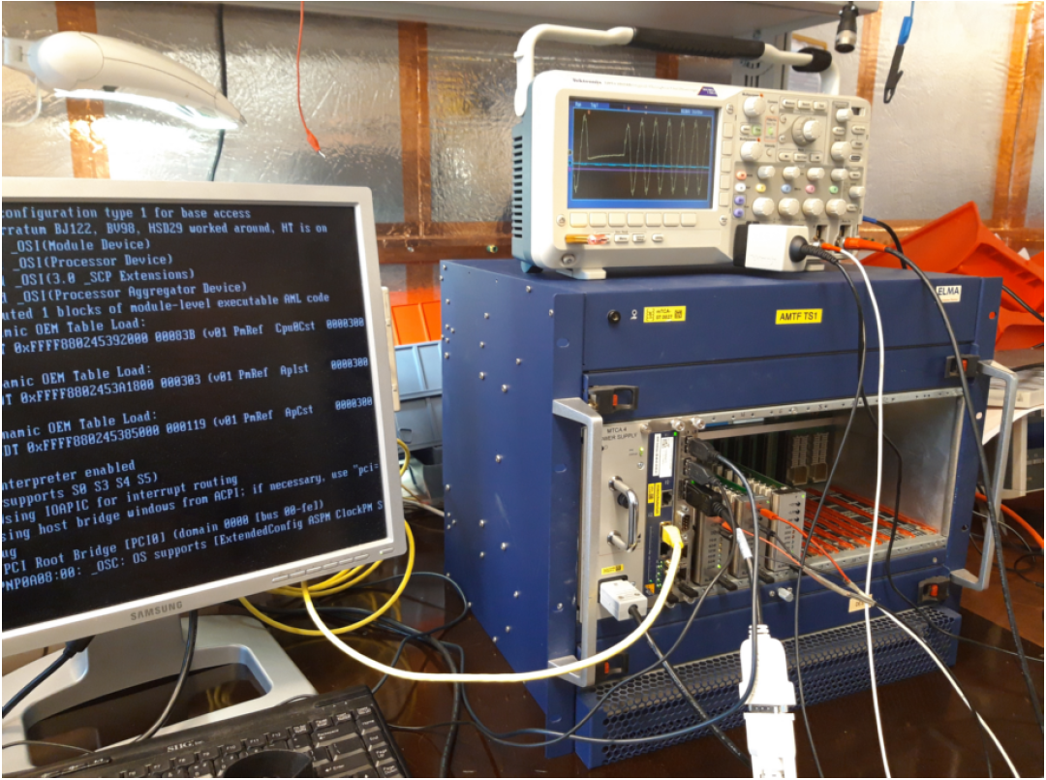
Power glitch affecting 1kW power supplies
Problem discovered a couple of years ago:
  If power glitch shorter than ~30 msec ➔ crate runs without interruption
  If power glitch longer than ~100 msec ➔ crate stops and restarts
  If power glitch around 50-80 msec ➔ crate sometime hangs
  and can’t be recovered remotely (power cycle in-situ required)
The higher the load, the shorter the critical time (fans speed, nb. boards etc…)
Affected all MTCA users at DESY
MSK developed test stand and communicated with Wiener
Problem was investigated at Wiener → new firmware
MTCA4PS-v1-08-5136-0.hpm (*)
With new firmware, problem could NOT be reproduced
FW update of all 1kW power supplies summer and winter 2019
(*) for the XFEL/FLASH setup
See Mariusz Grecki’s poster

Slide 23
OUTLOOK
XFEL (summer 2020)
Operation with backplane manager (MCH-RTM)
Operation with full redundancy (2x 1kW PS)
FLASH
No hardware failure, no MTCA.4 components exchanged because of issues so far
New FW with SEU correction (winter 2019)
Installation of RadCon (winter 2019)
PCIe link failures under investigation (currently dominating issue in terms of LLRF system down time at XFEL)
PhD student to look into HW failure signature and and possible mitigation strategies
More tools to keep detect radiation bursts and draw a radiation map

Slide 24

Thank you
Julien Branlard
MSK
julien.branlard@desy.de
+49 (0) 40 8998 1599
Christian Schmidt
MSK
Christian.schmidt@desy.de
+49 (0) 40 8998 1869

