Slide 1
Broadening the Frequency Range of a Ferromagnetic Axion Haloscope with strongly coupled Cavity-Magnon Polaritons
Graeme Flower, Jeremy Bourhill, Maxim Goryachev and Michael Tobar

Slide 2
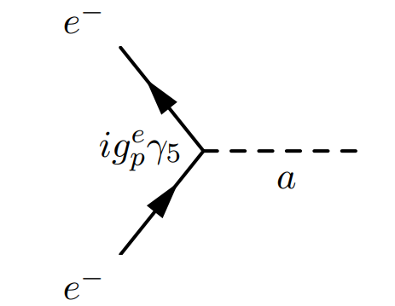
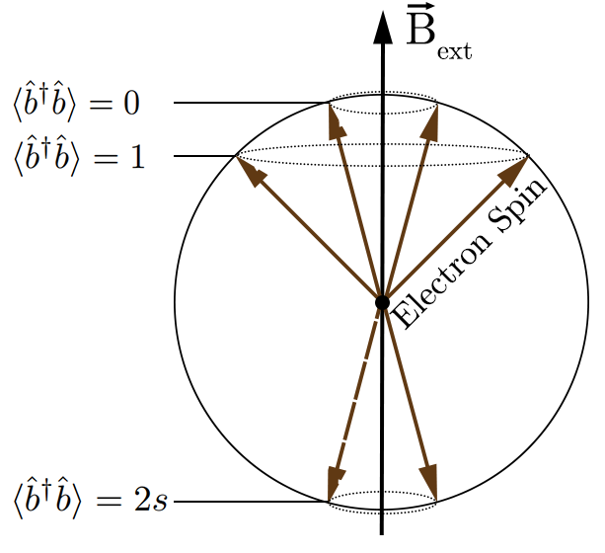
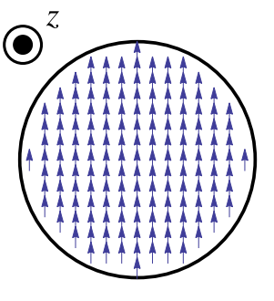
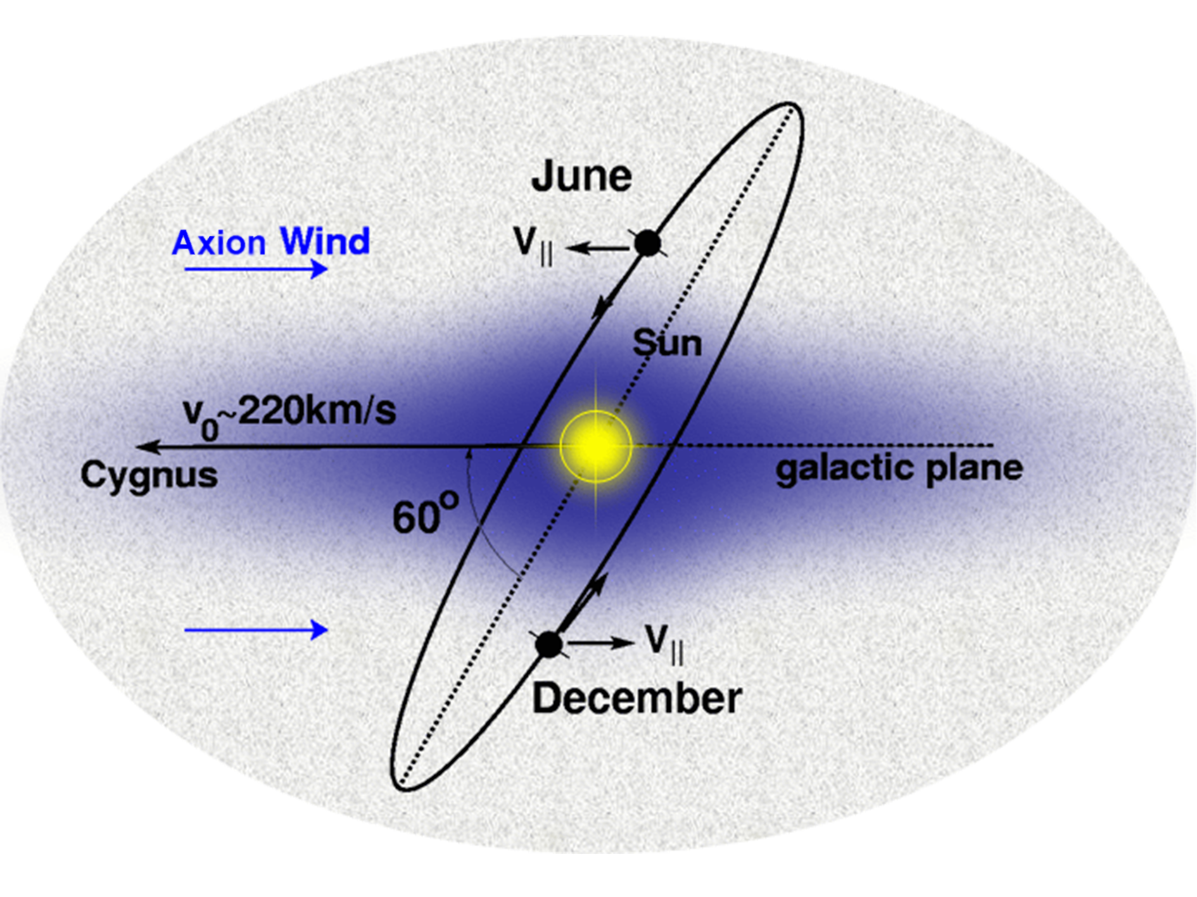
Introduction
Ferromagnetic Axion Haloscopes detect axion dark matter wind by exploiting their coupling to electrons.
This coupling is similar to the coupling between electrons and a magnetic field: thus we define it as a pseudo-magnetic field.
This can drive a spin resonance (magnons), including an ensemble.
Readout through a microwave cavity – combined system forms cavity-magnon polaritons

Slide 3
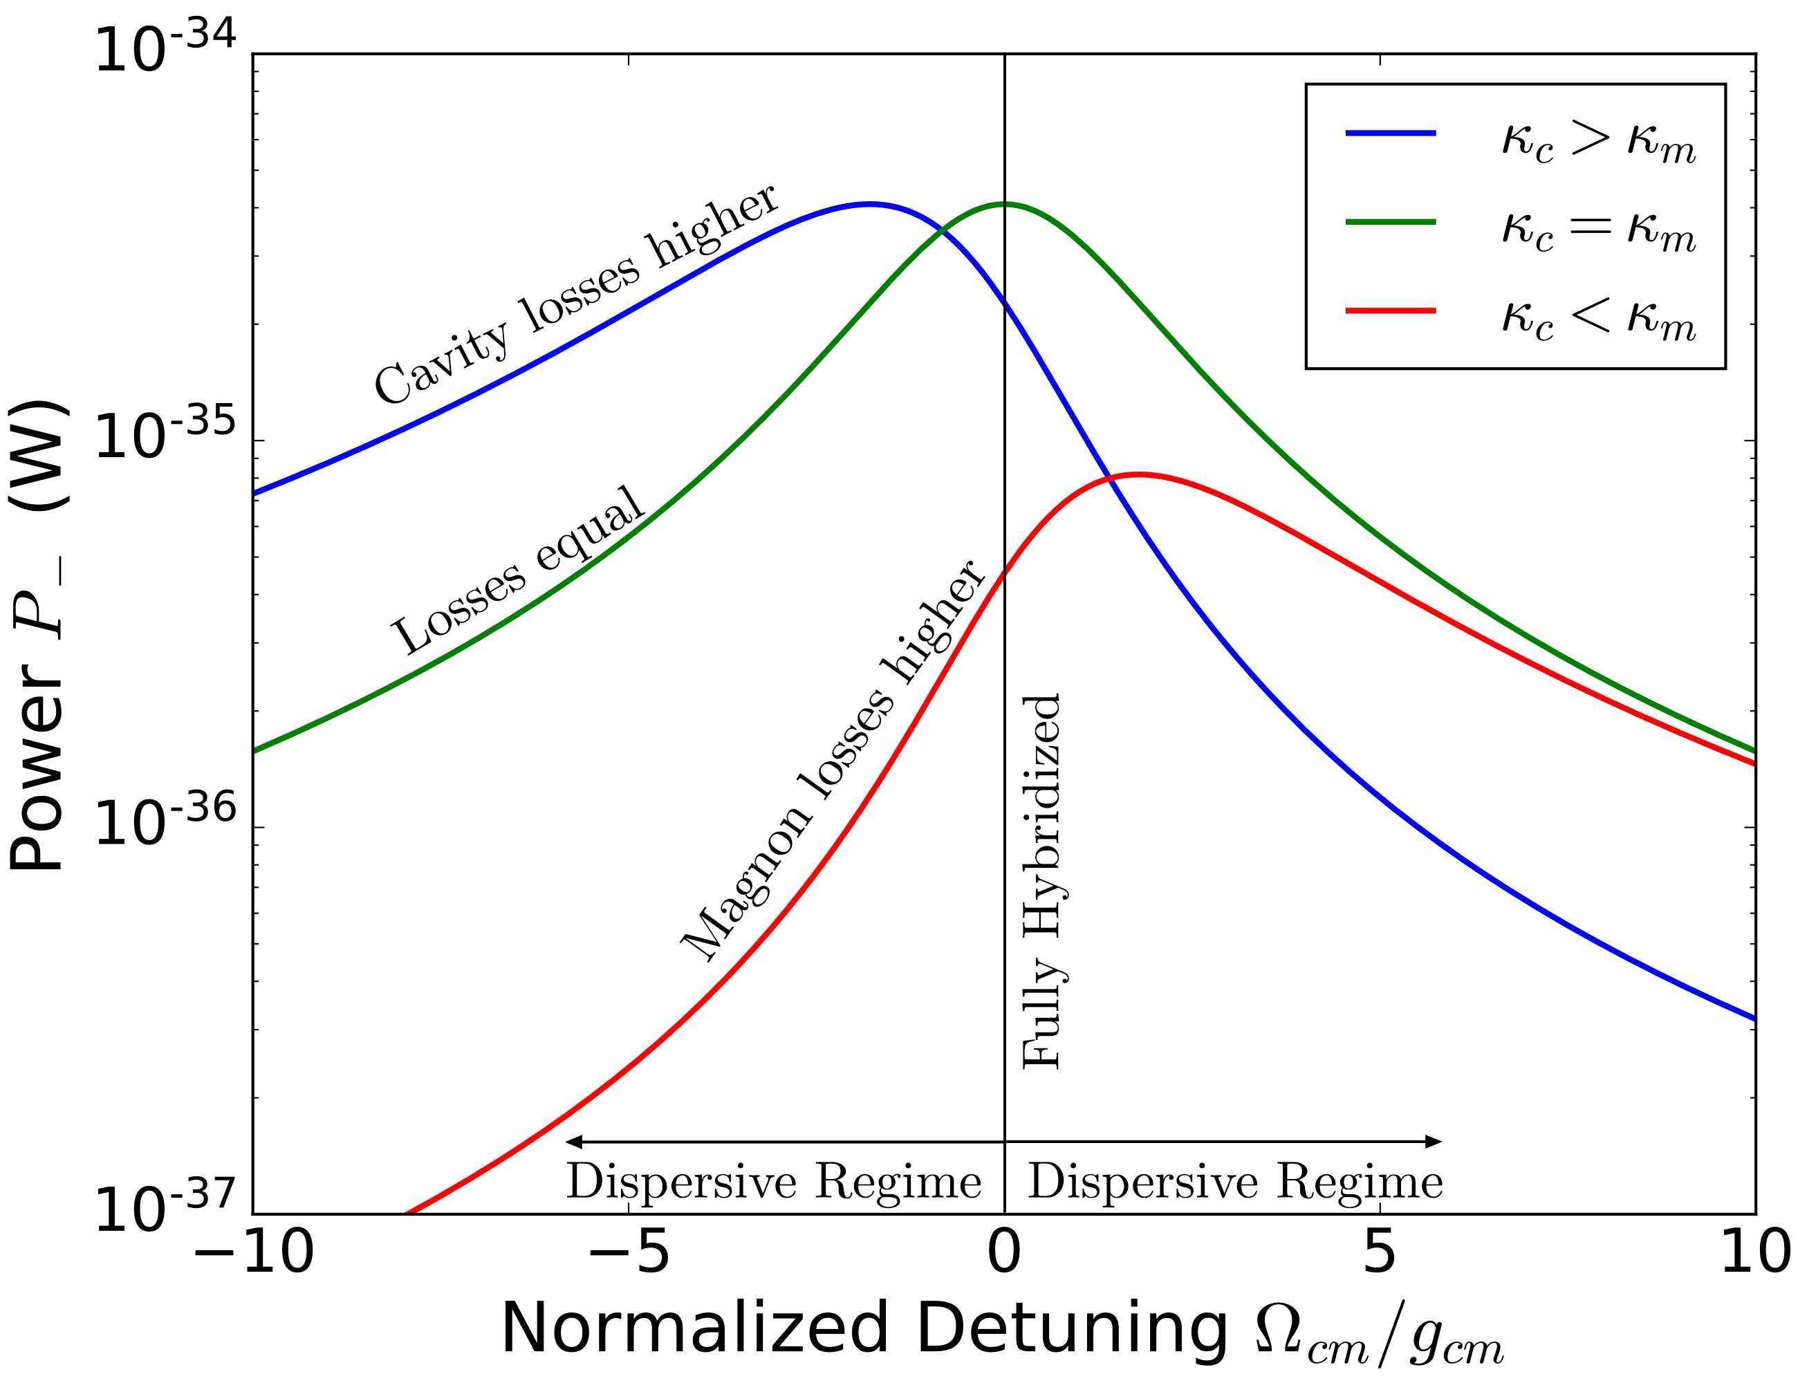
The Model and Dispersive Regime

Slide 4
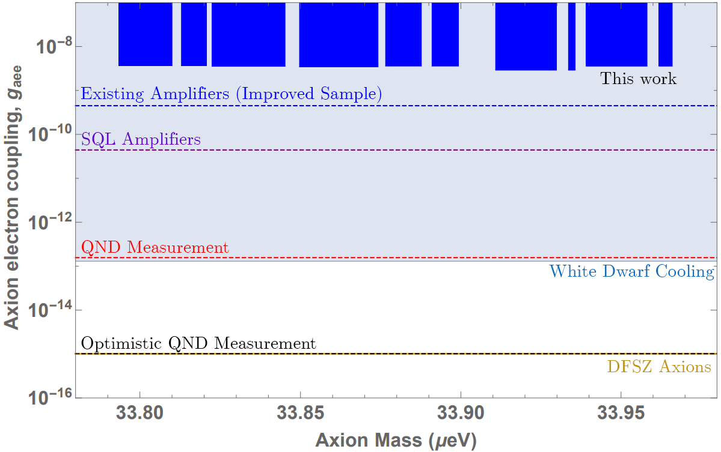
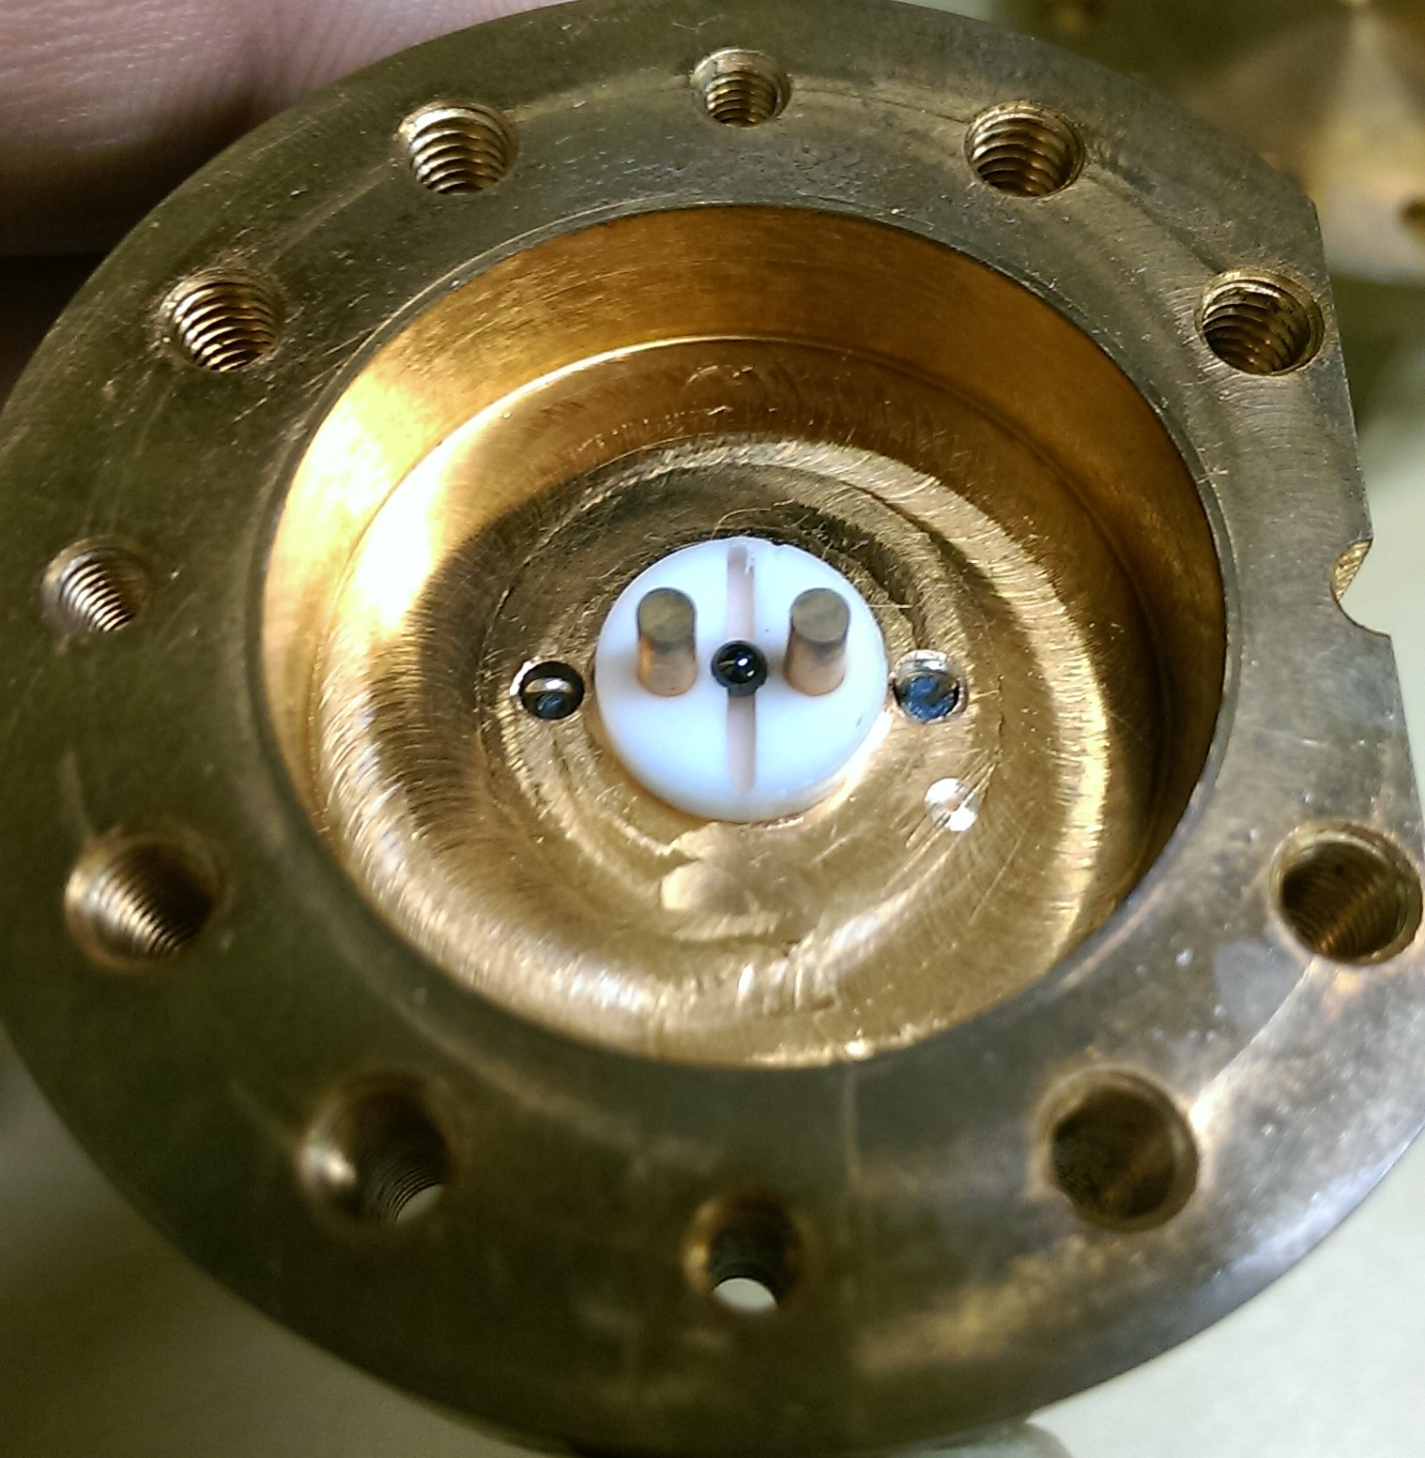
Experiment and Results
Yttrium Iron Garnet Sphere
Two post re-entrant Cavity

Slide 5
Improvements and Future Work
Existing Amplifiers (Improved sample):
Readily available ferrimagnets with more spins and lower loss will improve signal power
SQL Amplifiers:
Low noise amplifiers will allow small signals to be easier to resolve
QND measurement:
Single photon counters (ideally QND ones) can be shot noise limited to avoid backaction entirely
Optimistic QND measurement:
To detect QCD axions we need best possible measurement noise and further research into improving signal power
Paper available in Physics of The Dark Universe: https://doi.org/10.1016/j.dark.2019.100306

