Slide 1
Summary and next steps
Beate Heinemann (DESY and University of Freiburg)
April 16th 2019

Slide 2
Very Short Summary
Beam line designed very advanced already
First parts of LUXE already exist!
Magnet reserved
New fast kicker to be installed this summer
Could start ordering magnets this autumn!
Theoretical motivation further elaborated
Several aspects of QED in strong field
BSM physics also? E.g. axions => need to check if it could be competitive/complementary with other lab-based experiments
Laser systems
Many challenges to design a “precise” laser
Two benchmarks for intensity uncertainty:
25% (Matt: “this can be done for sure”)
10% (Matt: “less than that is hard”)
Detectors:
Very wide range of rates for several detectors => first ideas include silicon tracking, cerenkov and calorimeters

Slide 3
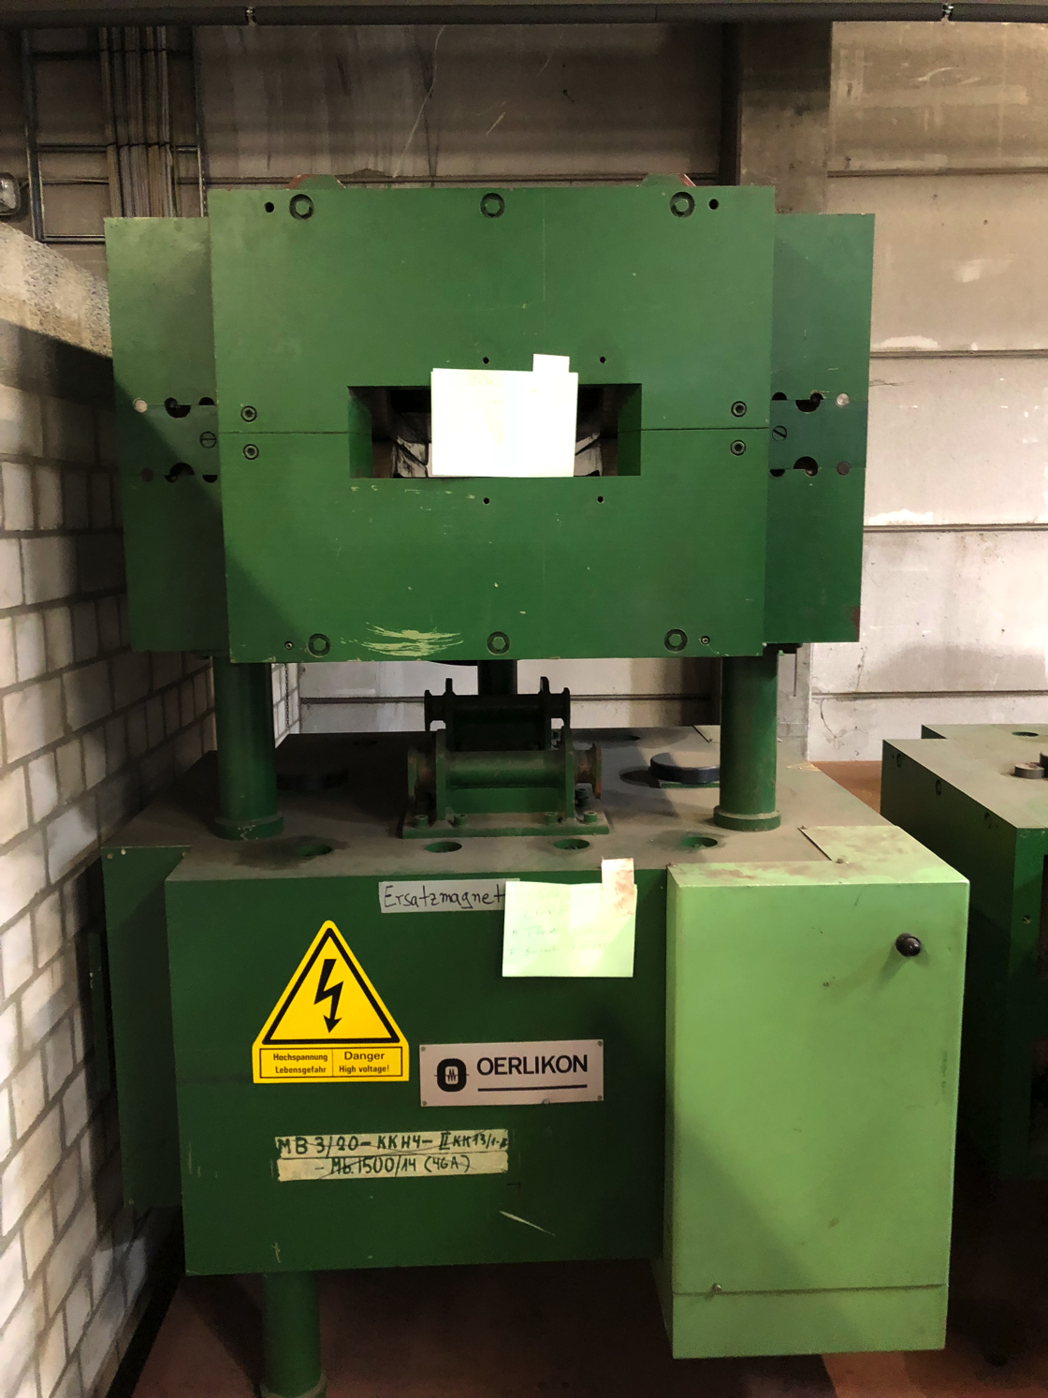
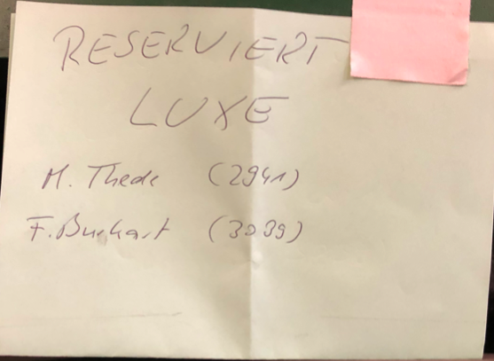
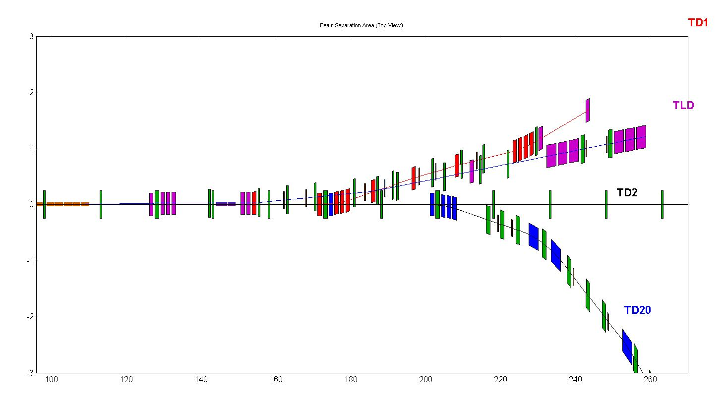
The first parts of LUXE

Slide 4
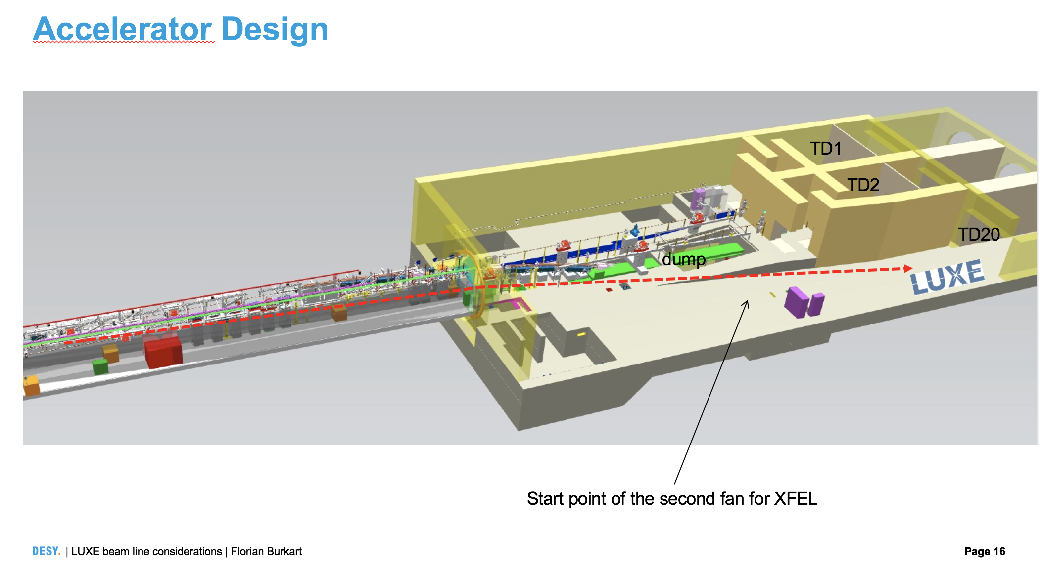
Location
Strong preference for location right after LINAC (start of 2nd fan)
More space
No interference with SASE4/SASE5
No photon beam in the way
No worries about legal process
Synergetic other activities thinkable (e.g. test beam)

Slide 5
Location

Slide 6
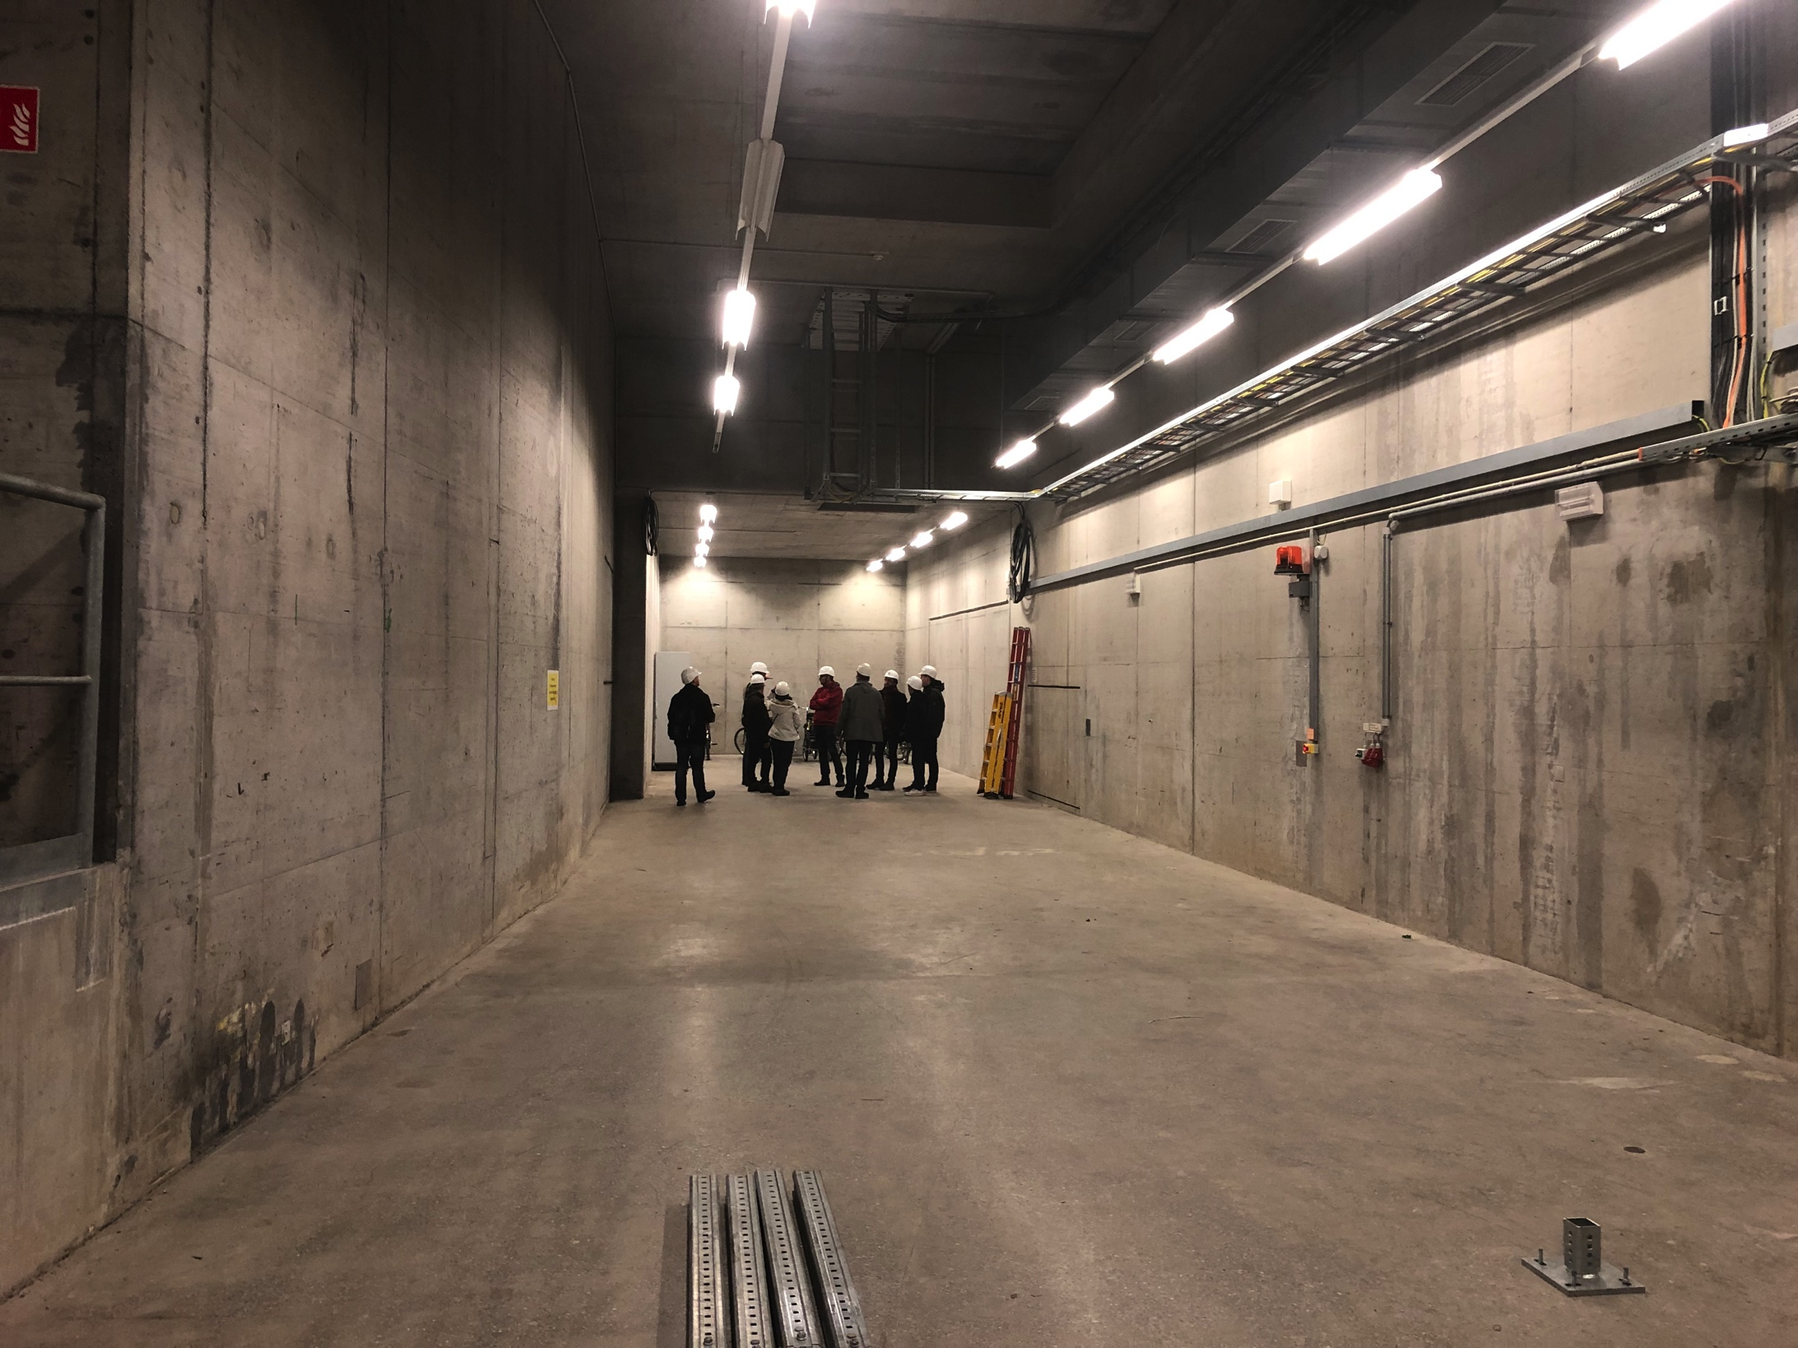
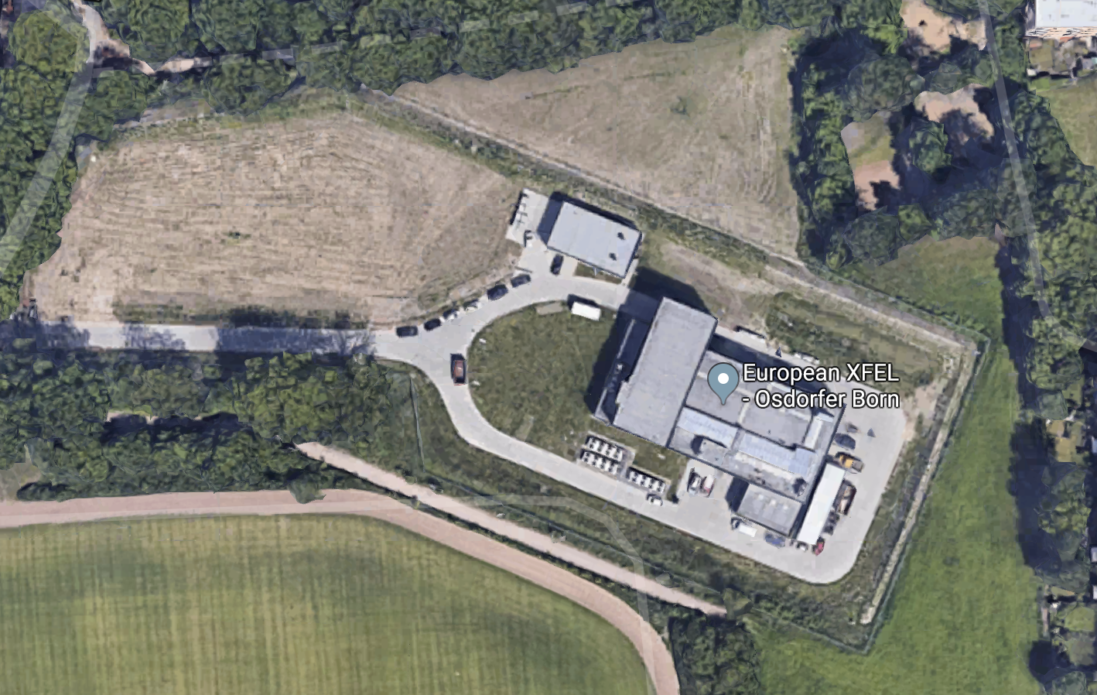
Location: Osdorfer Born
Decide: let’s use this location as default for all planning purposes

Slide 7
Local Support
Directorate of European XFEL very supportive from the start
Last month the SAC of the EU.XFEL confirmed scientific value to be high
Sergei emphasized that it is critical that we do not interfere the photon science programme
Directorate of DESY very supportive
Strategy fund granted 1.5 years ago
The directorate of DESY has included in its financial planning support for the civil construction (for a volume of up to 3M Euro) for the LUXE experiment, pending successful application of an ERC or other equivalent sources.
Positive remarks by intl. review committees when presented
Part of plan for next funding period (POF IV)
Leadership of European XFEL Linac and DESY MD in general also very supportive

Slide 8
Time scale constraints I
Access to XFEL generally only possible during yearly shutdowns
Normally about 4 weeks per year
Plus some shorter (hours- days) a few times per year
Longer shutdown planned ~2021 (about ~8 weeks)
SASE4/SASE5 installation starting ~2023
Need to understand how many shutdowns needed for installation
Beam line elements => could order magnets this autumn
Laser
Detector system
Important to prepare installation as much as possible on surface
Make it ”plug in” and possible to control remotely as much as possible
Need rooms for several parts in Osdorfer Borm
Initial laser
Data acquisition, IT, … control room
Final laser
}
Maybe find room in existing building => check?
Likely need new building => check if possible

Slide 9
Time scale constraints II
Need to write “letter of intent” this summer (by end of August)
Basis for evaluation by XFEL.EU committees (MAC and SAC, and then Council)
Basis for all funding applications => e.g. ERC grant in November
Should contain
Physics case
Required modifications of XFEL.EU accelerator
Conceptional (and realistic) design of laser and detectors
Simulation studies showing that this design gets the desired physics (or at least significant part of it)
This is in four months from now!
This year is last round of current ERC grant scheme => unclear how things will be after this year => apply for synergy grant this year
Results need to be obtainable within funding period of seven years
Money will start to flow after summer 2020 (if successful)
Need to work on alternative funding sources in parallel

Slide 10
Proposed Time scale: Phase-0
April 2019:
Decide on location => at end of LINAC
Summer 2019:
Determine work plan for beam line modifications to understand cost and shutdown compatibilities
August 2019:
Publish letter of intent
November 2019
Application for ERC synergy grant for phase-0 “prototype” experiment
Obtain letter of support by management and council of EU.XFEL
Order first magnets
Winter 2020 and 2021
Installation: assume it extends over shutdowns (2021 shutdown may be “longer”)
2022+2023: prototype experiment (stage-0)
Commissioning, data taking and publication of results

Slide 11
Draft Time scale: Phase-1
2024:
Install more powerful laser (need to get money for it before)
2025-2027: Data taking with high-power laser (stage-1)
Interesting to run at different energies, beam currents,… configurations
Plan to benefit from requirements of other experiments
Would like to run as much as possible

Slide 12
Major points that came up: I
DESY funding statement on civil construction
See page 7.
Can also obtain letter if needed from DESY particle physics director for funding proposals
Osdorfer Born location:
Where can we put initial and final laser there?
Where can we have control room?
What are dimensions/space constraints in tunnel?
Simulations
Why is positron energy spectrum so hard?
Should also simulate “normal” XFEL parameters: 14 GeV and 1.5e9 electrons/bunch
Compare between different calculations (Nina, Tony, Andreas)
What are tails of the beams (photon and electron)
What wavelength should we use to optimize physics programme?

Slide 13
Major points that came up: II
Laser
Need to know the pulse shape and parameters very well
Large impact on x-axis of “money plot”
Design of laser control system requires knowledge of tunnel dimensions
Should aim to have laser capable of delivering ~50% higher power than we need as many losses can (and do) occur
e.g. could try for 1 PW laser even if don’t need full power
Should use gaussian laser pulses if we aim for stability
Want to make design of initial and final laser as similar as possible
Detectors
Need to do full Geant simulation to study secondary interactions, backgrounds, shielding
Could also use “off-the-shelf” detectors designed for photon science?
Increase realism of simulation of detectors and study background rejection

Slide 14
Conclusions
LUXE Project strongly supported, looks very promising in general
Tight time scale driven by document due in Aug. 2018
Need to make progress fast!
Need more meetings to help converge
Should we increase frequency of meetings to every two weeks?
Should we have another full-day meeting in the summer (before Aug)?
Should draft outline and assign responsibilities to chapters
We will have meeting at 2pm among senior people to discuss resources (human and financial)
Very interesting talks, I learned a lot! Thanks to all the speakers!!

Slide 15
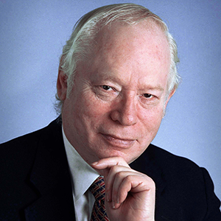
Final Words
Steven Weinberg (03/2019, interview at APS):
Do you think the problems faced by particle physicists today are different from those that you faced as a young scientist?
I do. It was a different situation 50 years ago. Back then, we had experimental data coming out of our ears, and a lot of it didn’t seem to fit any pattern. The problems seemed formidable, but there were so many ways to go with new theories. It really was a thrilling time to be a physicist.
Nowadays, it’s very hard to think of a challenge that we can get our teeth into. The current puzzles don’t offer theorists many opportunities to propose solutions that can be tested experimentally.
Do you have any advice to offer the next generation?
Winston Churchill had a motto at the beginning of World War II: “Keep buggering on.” In that spirit, I think it’s better to do something than to do nothing. My advice is to try crazy ideas and innovative experiments. Something will come up.
Steven Weinberg,
NP 1979

Slide 16
Have a good trip home!

