Slide 1
XFEL Beam Distribution Kicker System
LUXE Workshop
Frank Obier
Hamburg,16.04.2019

Slide 2
Layout of Accelerator
SASE2
T5D
SASE1
T4D
TLD
SASE3

Slide 3
A Typical Pattern for User Operation
… driving SASE1, SASE2, and SASE3 simultaneously.
TLD
Pilot bunches for Feedbacks
SASE1
SASE3
kicked bunches to suppress lasing in SASE1
TLD
Gap for the rise time of beam distribution
kicker KL
SASE2
T5D
KS Kickers
KL Kickers
SASE2
Experiments
SASE1
SASE3
T4D
TL
| XFEL Beam Distribution Kicker System | Frank Obier, 16.04.2019

Slide 4
A Typical Pattern for User Operation
Pulse current KS Kicker
T5D
KS Kickers
KL Kickers
SASE2
Experiments
SASE1
SASE3
T4D
TL
| XFEL Beam Distribution Kicker System | Frank Obier, 16.04.2019

Slide 5
A Typical Pattern for User Operation
Pulse current KL Kicker
T5D
KS Kickers
KL Kickers
SASE2
Experiments
SASE1
SASE3
T4D
TL
| XFEL Beam Distribution Kicker System | Frank Obier, 16.04.2019

Slide 6
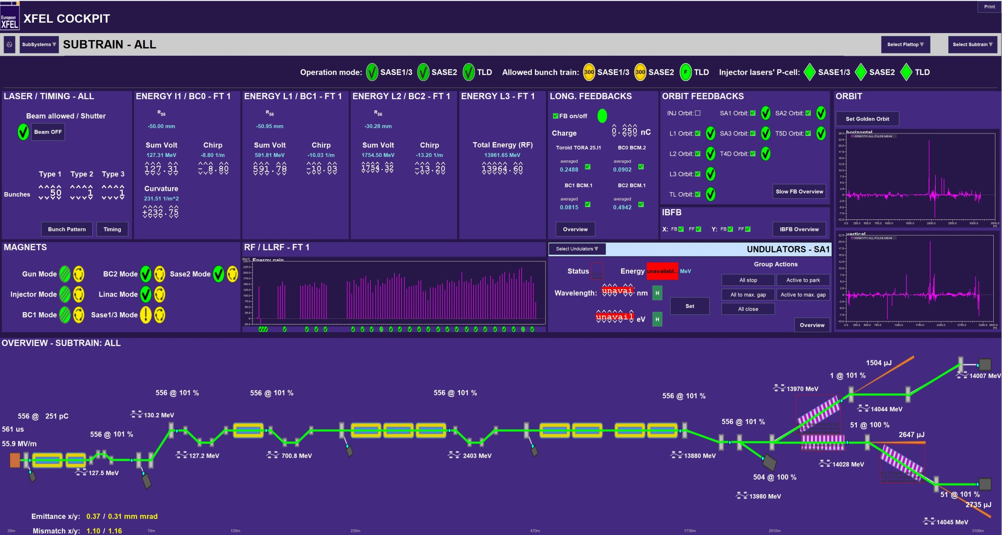
A Typical User Pattern form 15.04.2019

Slide 7
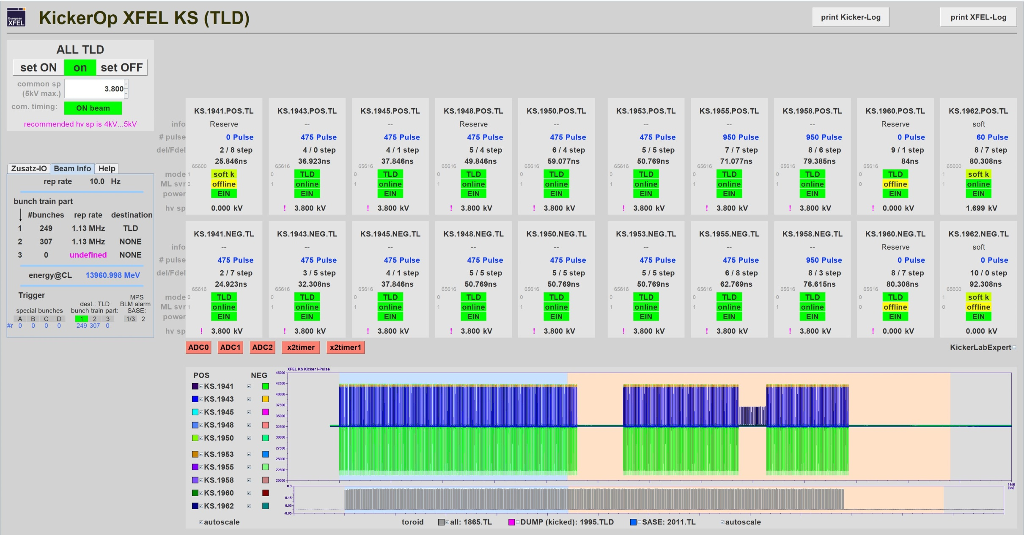
A Typical User Pattern form 15.04.2019
bunch train with 556 bunches

Slide 8
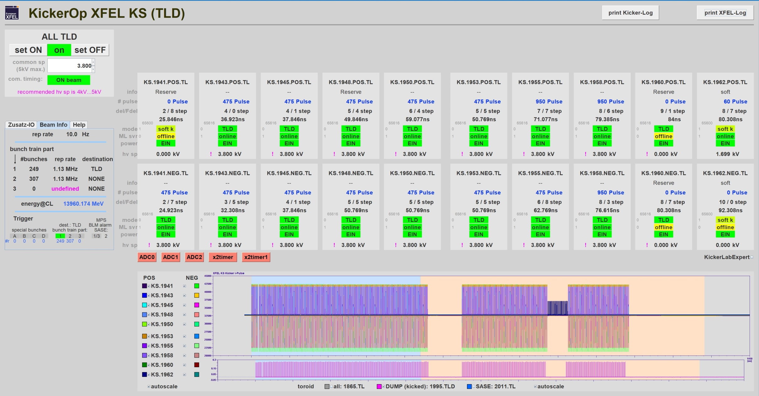
A Typical User Pattern form 15.04.2019
504 bunches go to the Dump

Slide 9
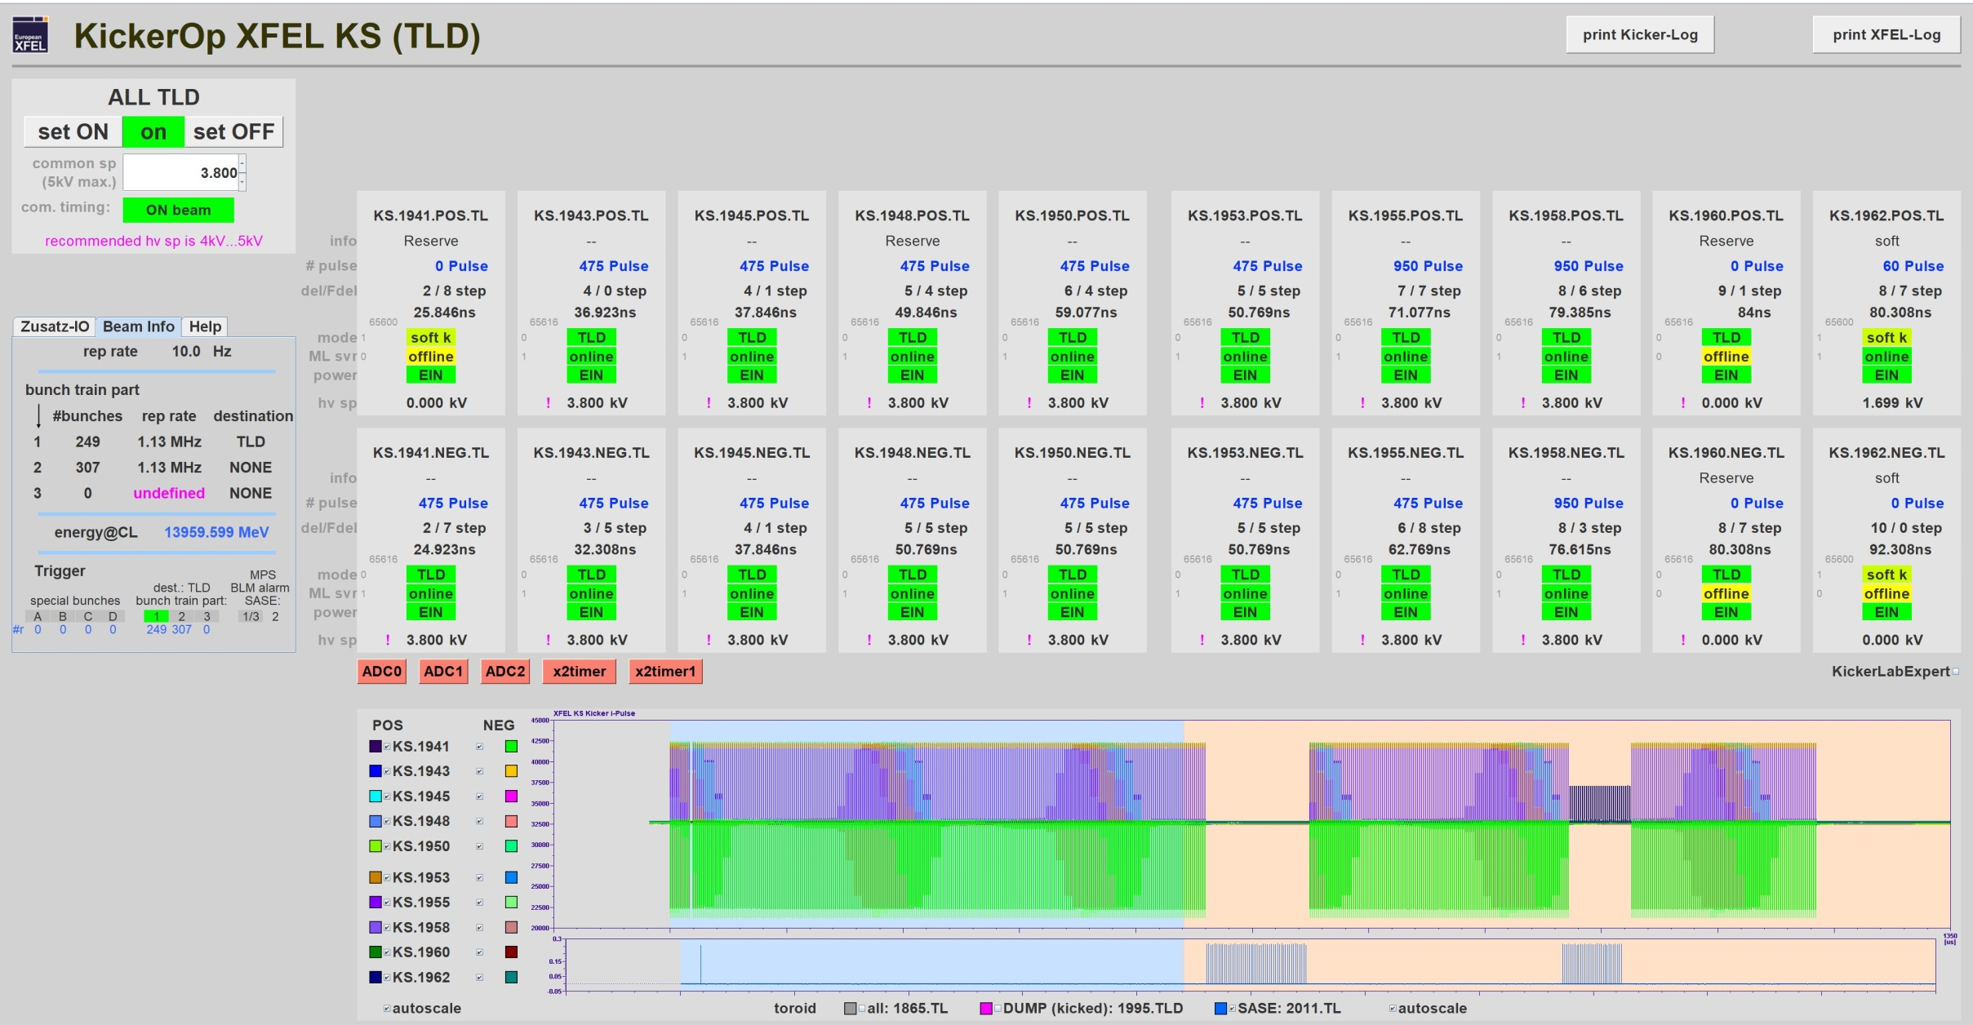
A Typical User Pattern form 15.04.2019
kicked bunches to suppress lasing in SASE1
1 bunch for SASE 2
29 bunches for SASE 1
22 bunches for SASE 3

Slide 10
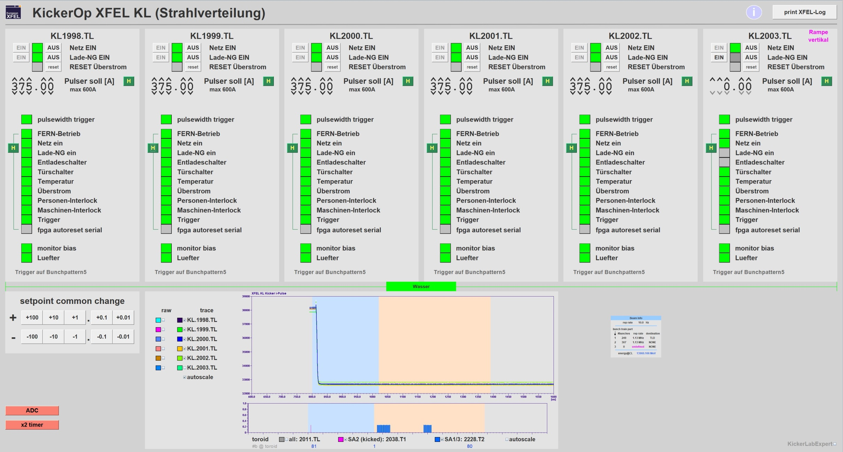
A Typical User Pattern form 15.04.2019
29 bunches for SASE 1
1 bunch for SASE 2
22 bunches for SASE 3

Slide 11
Specification
 | Dumpkicker KS | Beam Distribution Kicker KL
Kicker typ | Stripline Kicker (50Ω) | Air-core coil kicker
Pulse frequency | 0-4.5MHz | 0-10Hz
Pulse length | 30ns | 14-600us
Pulse form | rectangular | rectangular
Rise time | 14ns | 14µs
Fall time | 15ns | 10µs
Max. pulse voltages | 5kV | 200V
Max. pulse current | 100A | 600A
Amplitude stability | 1.5% | 3*10⁻⁴
Kick angle per kicker | 0.0723mrad | 0.113mrad
Kicker active length | 2m | 0,93m
Energy | 17.5GeV | 17.5GeV
Kick angle total | 0.506mrad | 0.523mrad
Number of kicker for total kick angle | 7 | 5
Number of installed kicker | 10 | 6

Slide 12
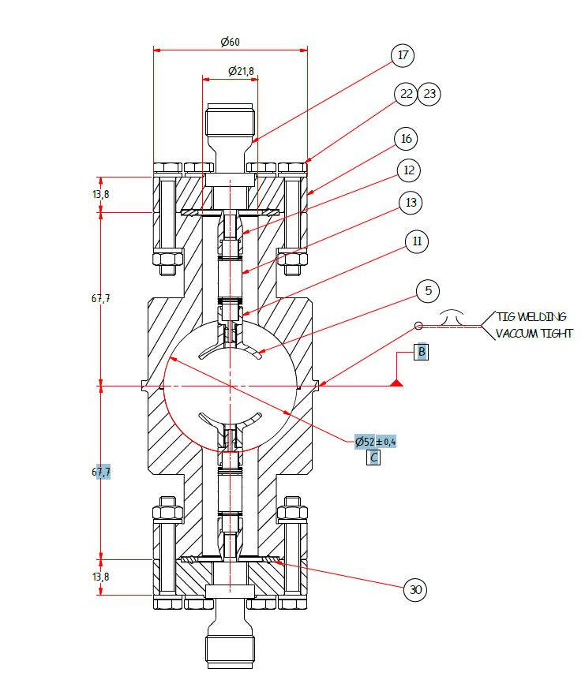
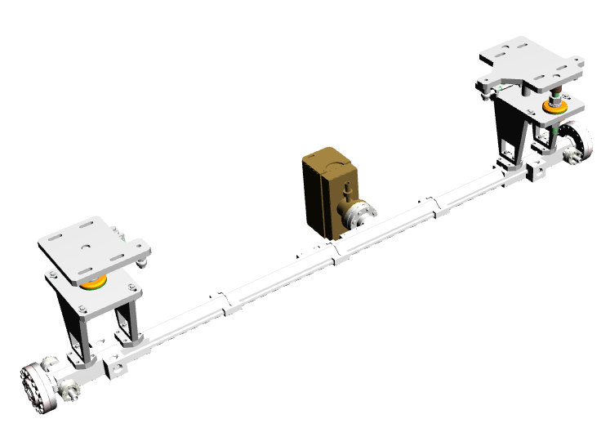
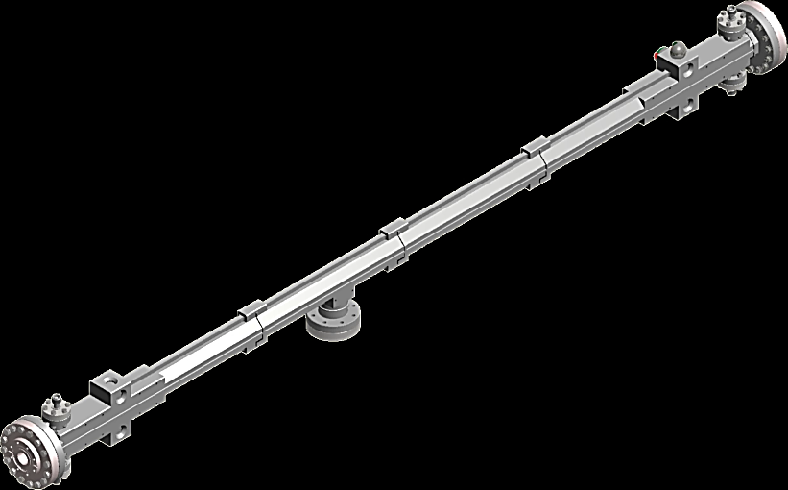
KS Kicker (Dump Kicker) for XFEL
Kicker design:
a strip line kicker inside of vacuum
a small reflectance factor, to match the kicker impedance to 50 ohm.
with the geometry of the conductor, and the distance between the conductor and the cage you can match the kicker impedance to 50Ω.
Design Collaboration with PSI
2m

Slide 13
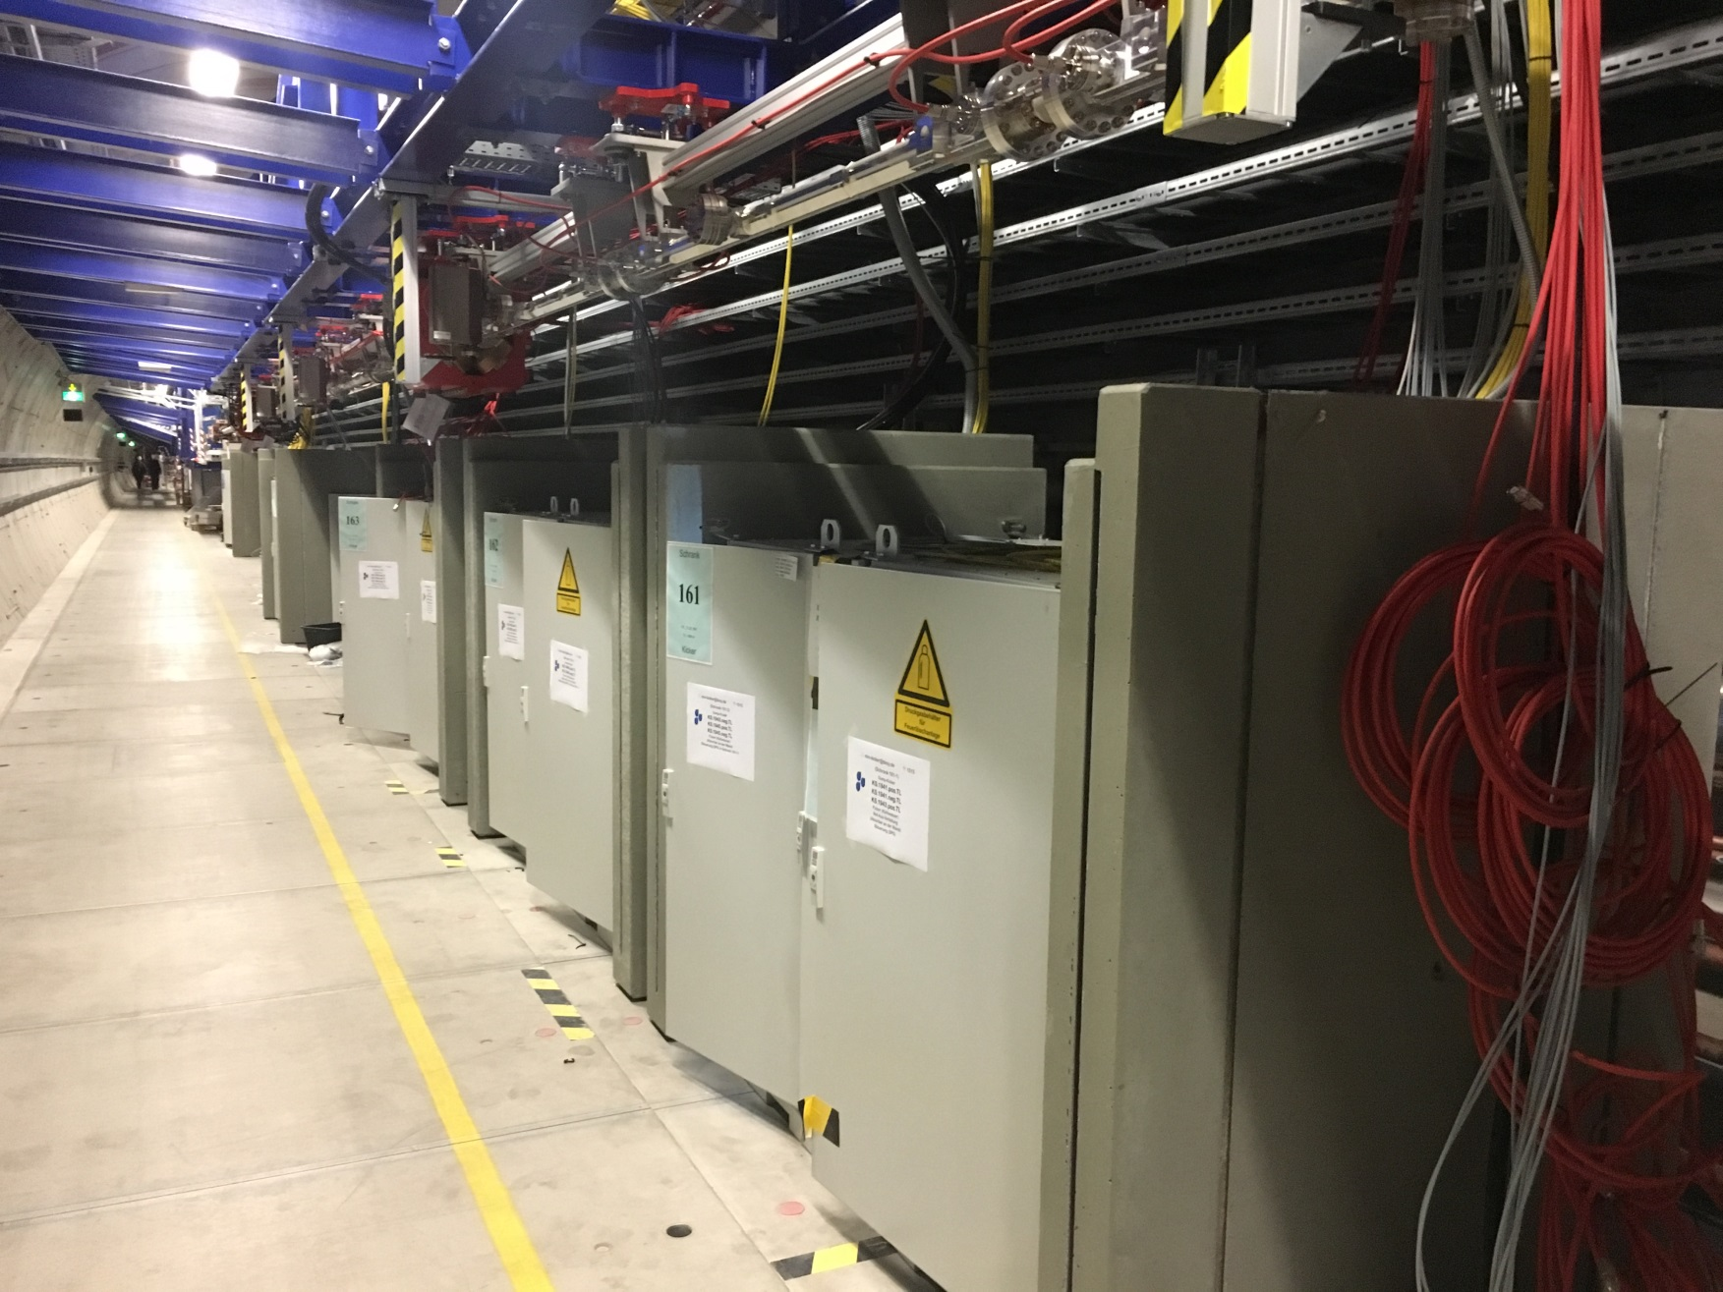
XFEL Installation Area of the KS Kicker

Slide 14
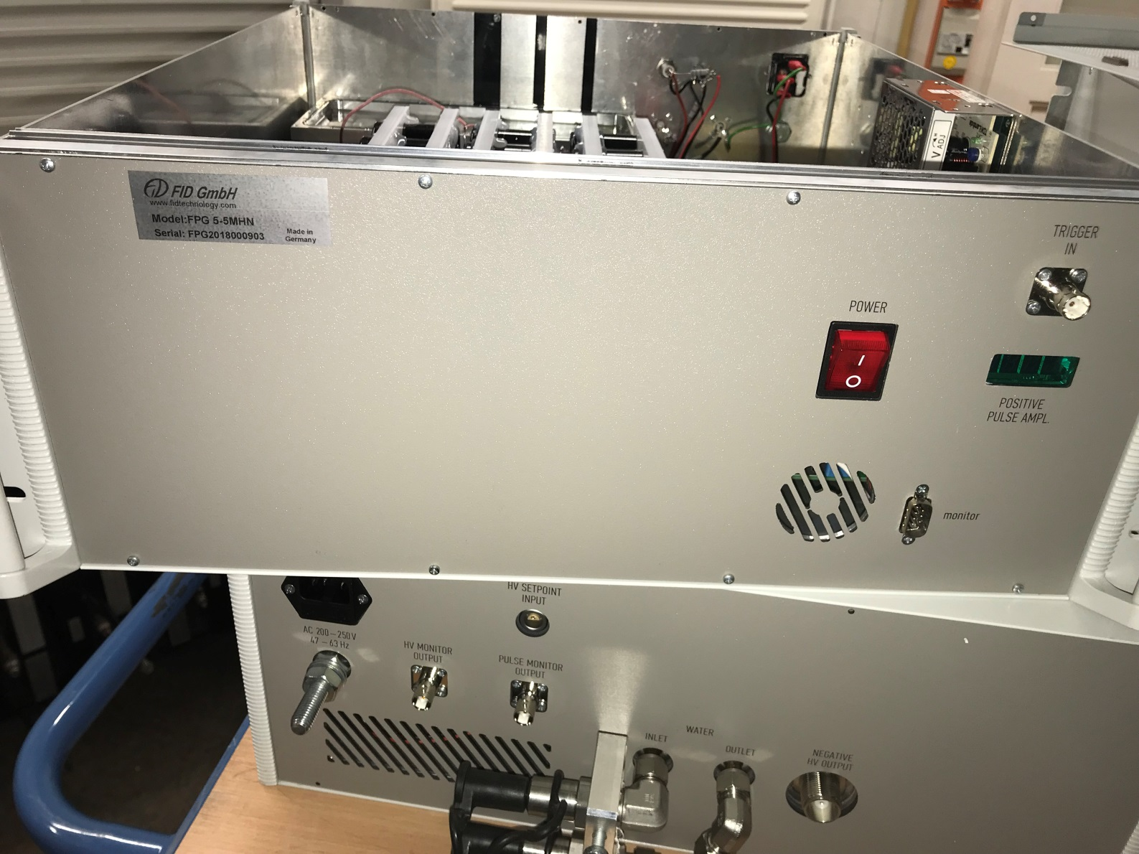
KS (Dump) Pulser from Company FID GmbH
fours version of pulser

Slide 15
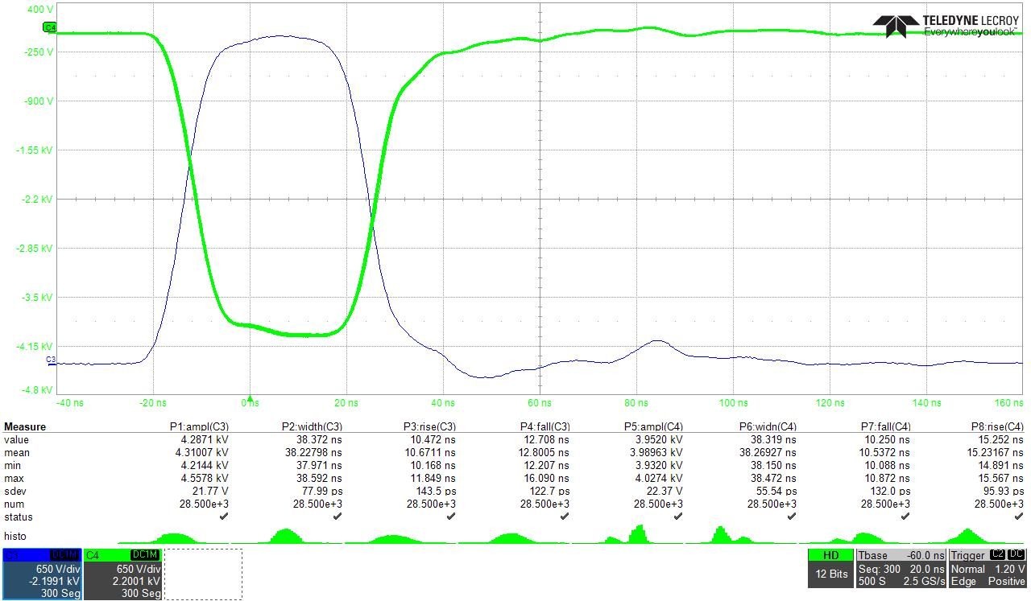
Pulse current of KS Kicker Pulser (FID GmbH)
10ns
25ns
13ns

Slide 16
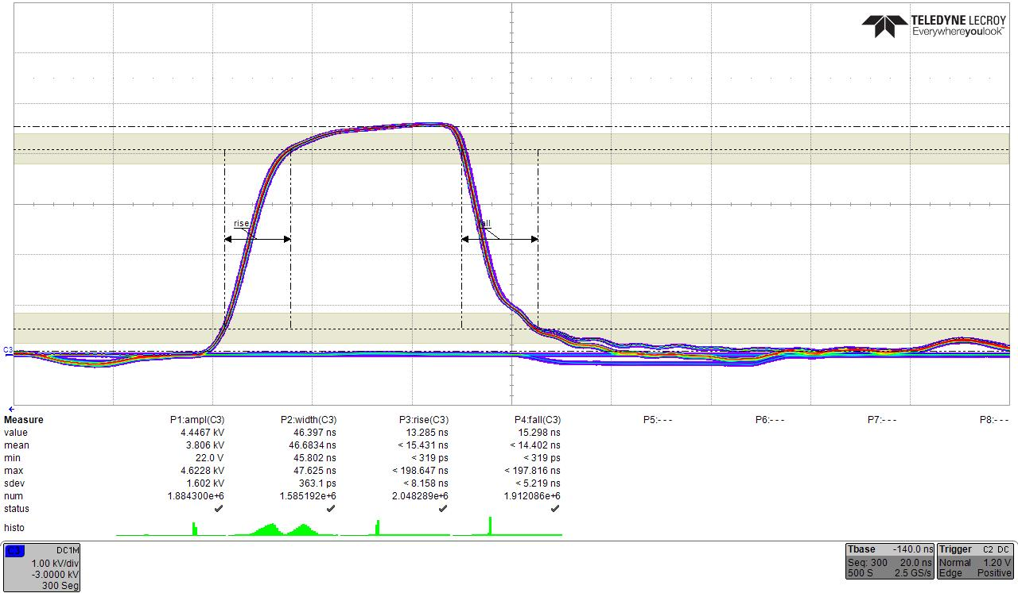
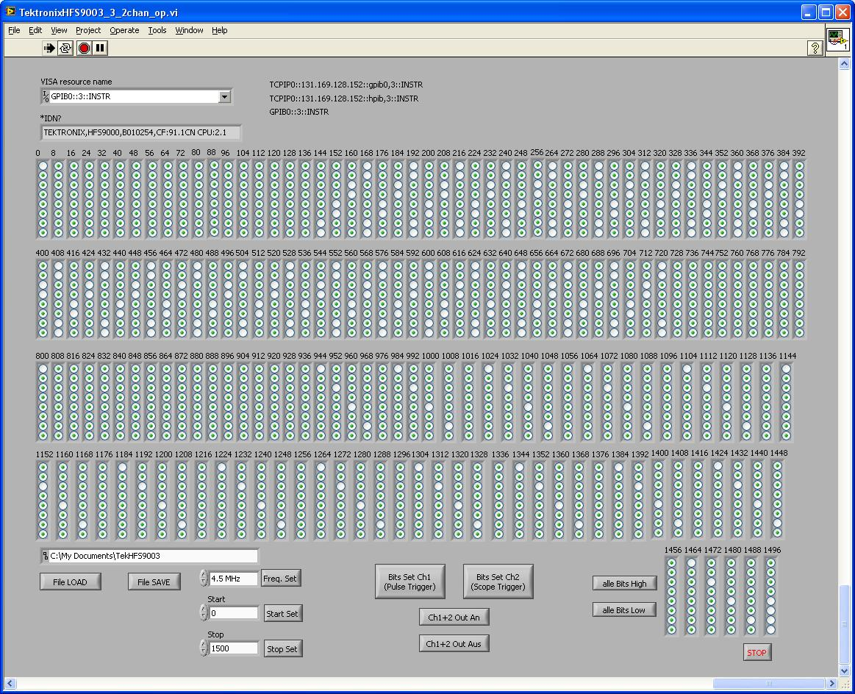
Overlay of 1500 pulses with a spacing of 1MHz
Variable pulse pattern / Pulse voltages 4.5kV
Trigger generator
XFEL Pulser (FID)
good stability of flat-top
good stability of flat-bottom
Test pattern 1500 Pulse „variable train“

Slide 17
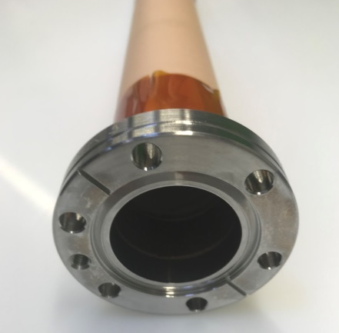
Beam Distribution Kicker (KL)
Kicker design:
kicker was realized a air coil outside beam vacuum
the geometry and the material was optimized to reduce the eddy current
coating material of ceramic chamber is stainless steel 1.4541 (titan stabilised)
a small reduction of the magnetic field by the sputtered chamber (thickness is 1µm)
Conductor Vacuum chamber

Slide 18
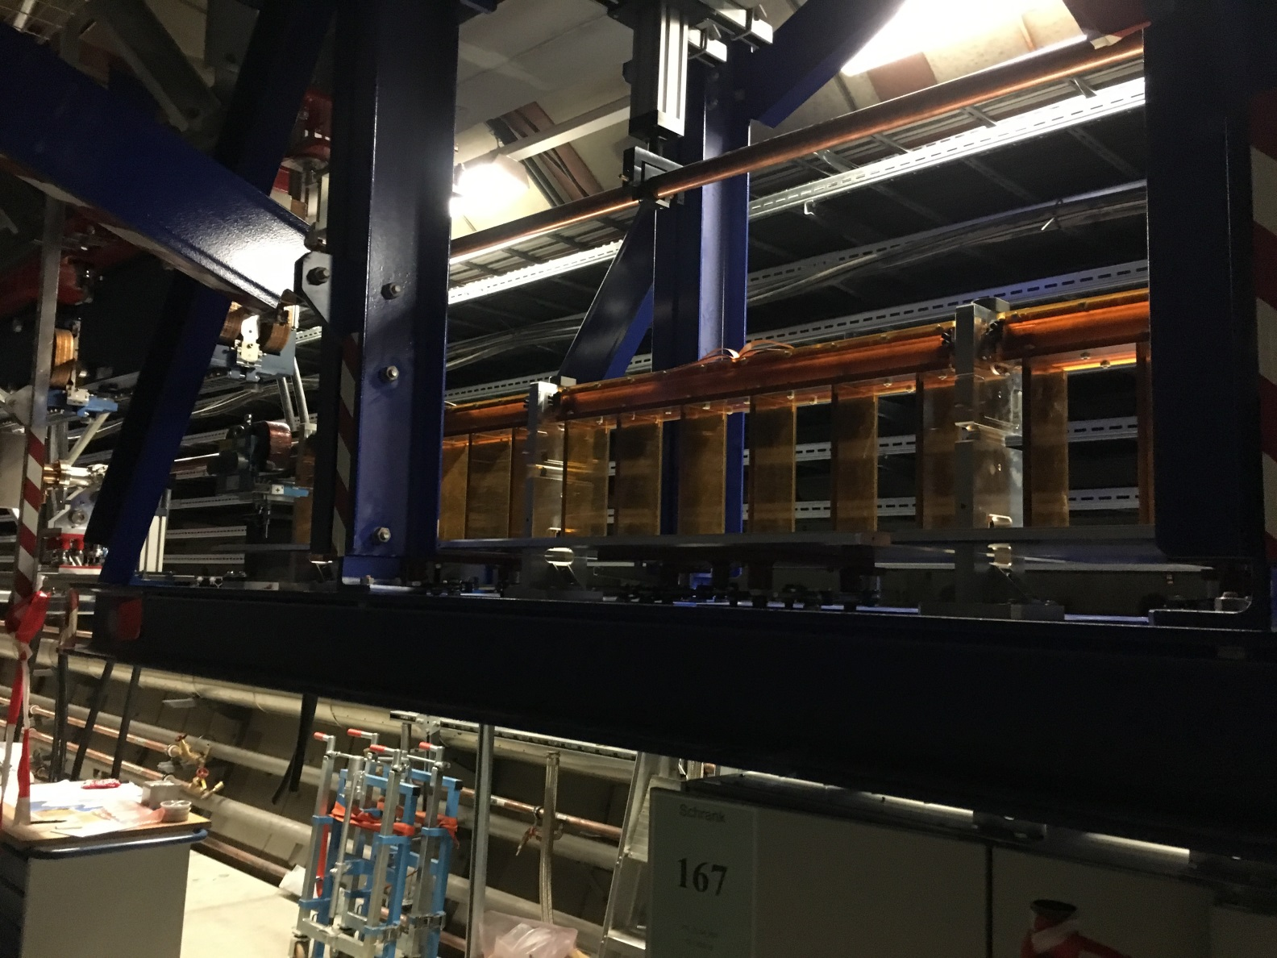
XFEL Installation Area of the Beam Distribution Kicker
Material PEI 1000

Slide 19
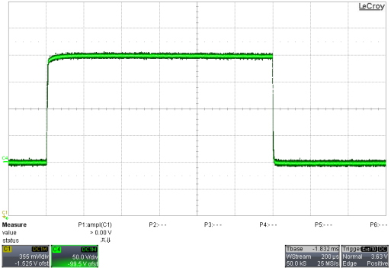
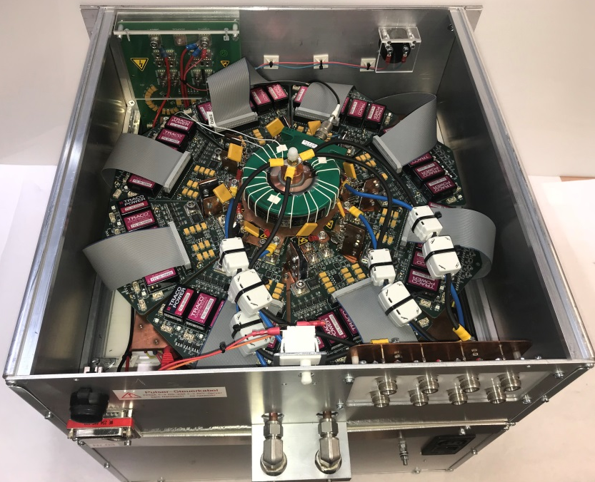
Principle Layout of the Pulser
8 Mosfet parallel
9 capacitor (450V 2200µF)
200A
Data:
Voltage U= 80V
Pulse current I_{max}=600A
Pulse length t= 1ms
Charge power supply
200µs/div
Capacitor
Kicker
Damping
resistor
Start up booster
+15V
Current set point
+
-
Actual current value
OP
Pulse length
-15V
8x Mosfet layer
Pulse current
Sensing resistor
Start up Booster
Pulse length
Constant current source

Slide 20
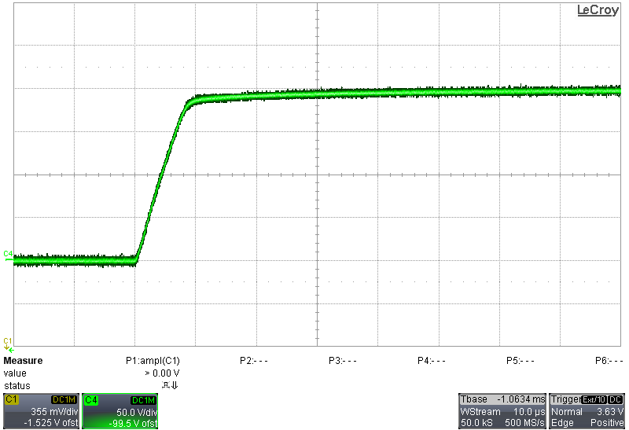
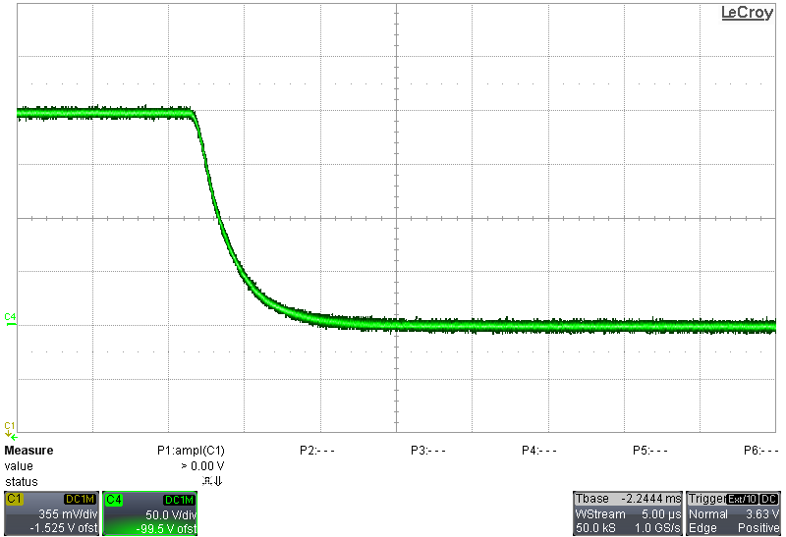
Rise and fall Time of the Pulse Current
Rise time = 10µs
Fall time =14µs

Slide 21
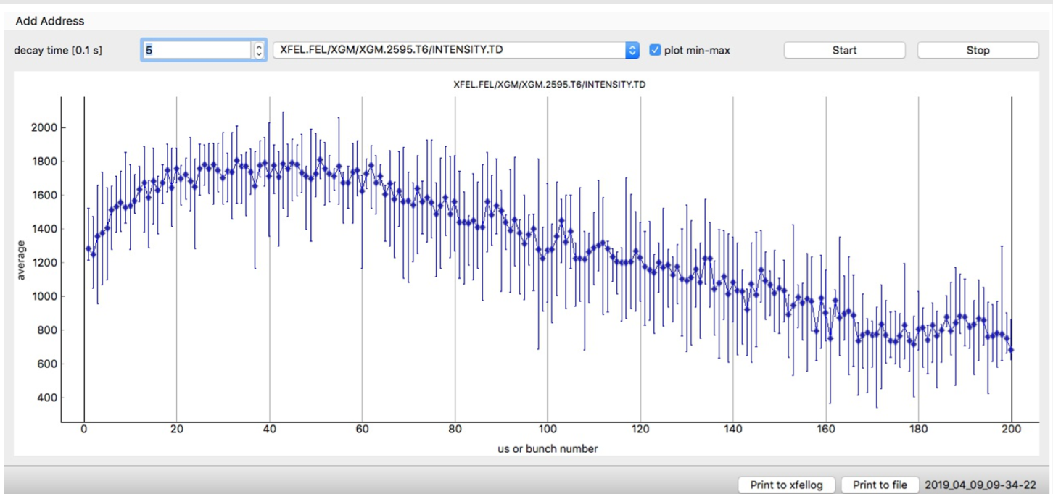
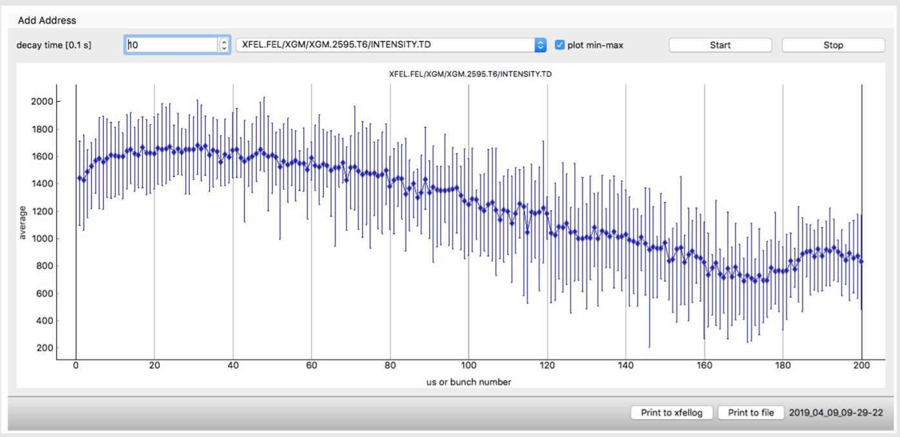
Measurement of pulse stability of KL Kicker Pulser
SA2 intensity at the beginning of the flat –top
SA2 intensity at the end of the flat -top
| XFEL Beam Distribution Kicker System | Frank Obier, 16.04.2019

Slide 22
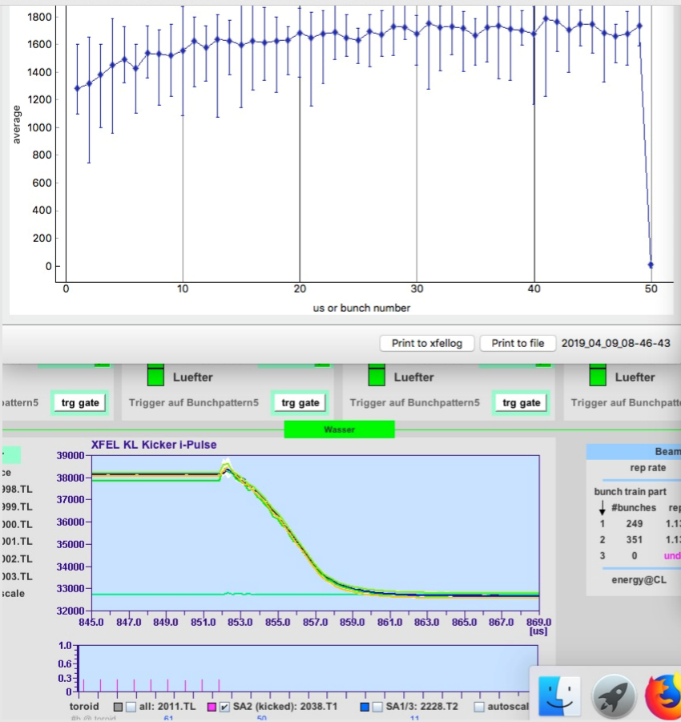
Timing optimization of KL Kicker Pulser

Slide 23
Specification of LUXE Kicker
 | Dumpkicker KS | Beam Distribution Kicker KL | LUXE Kicker | LUXE Kicker
Kicker typ | Stripline Kicker (50Ω) | Air-core coil kicker | Air-core coil kicker | Ferrite Kicker
Pulse frequency | 4.5MHz | 10Hz | 10Hz | 10Hz
Pulse length | 30ns | 14-600us | 1us | 2us
Pulse form | rectangular | rectangular | sine | sine
Rise time | 14ns | 14µs
Fall time | 15ns | 10µs
Pulse voltages | 5kV | 200V | 16000V | 4000V
Pulse current | 100A | 600A | 4800A | 1200A
Amplitude stability | 1.5% | 3*10⁻⁴ | 1*10⁻³ | 1*10⁻³
Kick angle per kicker | 0.0723mrad | 0.113mrad | 0,823mrad | 0,823mrad
Kicker active length | 2m | 0,93m | 0,93m | 0,93m
Energy | 17.5GeV | 17.5GeV | 17.5GeV | 17.5GeV
total Kick angle | 0.506mrad | 0.523mrad | 0.823mrad | 0.823mrad
Number of kicker for total kick angle | 7 | 5 | 1 | 1
Number of installed kicker | 10 | 6 | 1 | 1
Test with a Ferrite kicker after Summer Shutdown 2019
| XFEL Beam Distribution Kicker System | Frank Obier, 16.04.2019

Slide 24
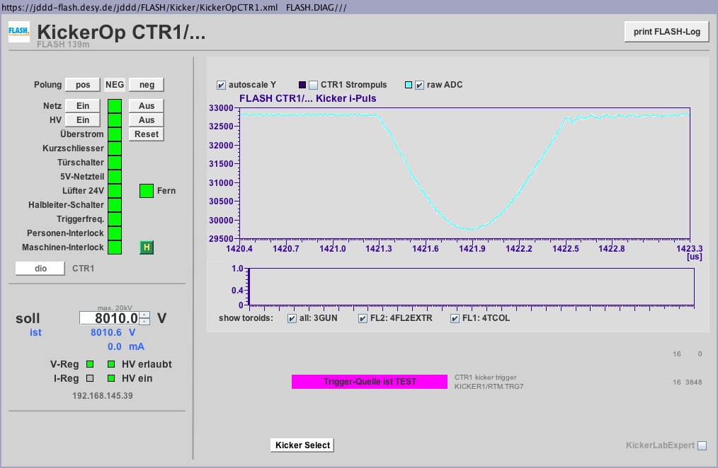
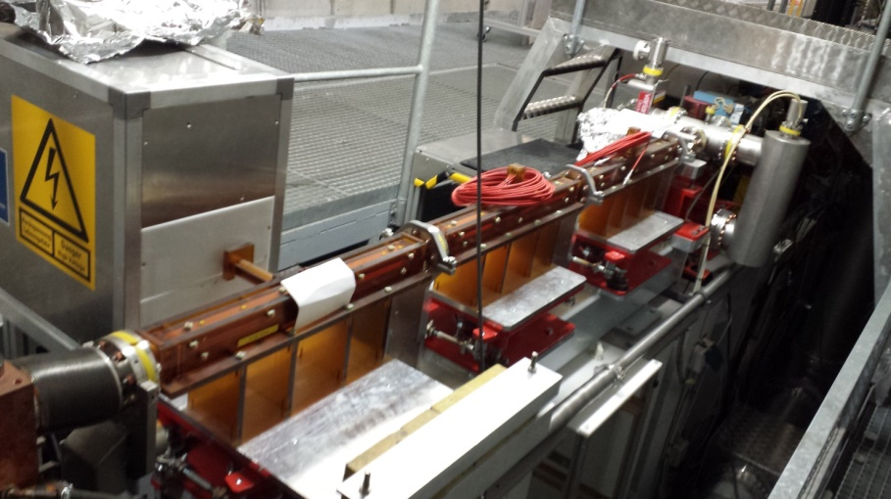
FLASH Diagnostic Kicker for the CRISP Experiment
I=2,5kA
1,2µs
4kV → 1.25kA Ferrit Kicker
8kV → 2.5kA
10kV → 3.1kA
16kV → 5.0kA Air-core coil Kicker

Slide 25
Thank you

Slide 26
Frank Obier
Department MIN
E-mail frank.obier@desy.de
Phone 040/8998-3050

Slide 28
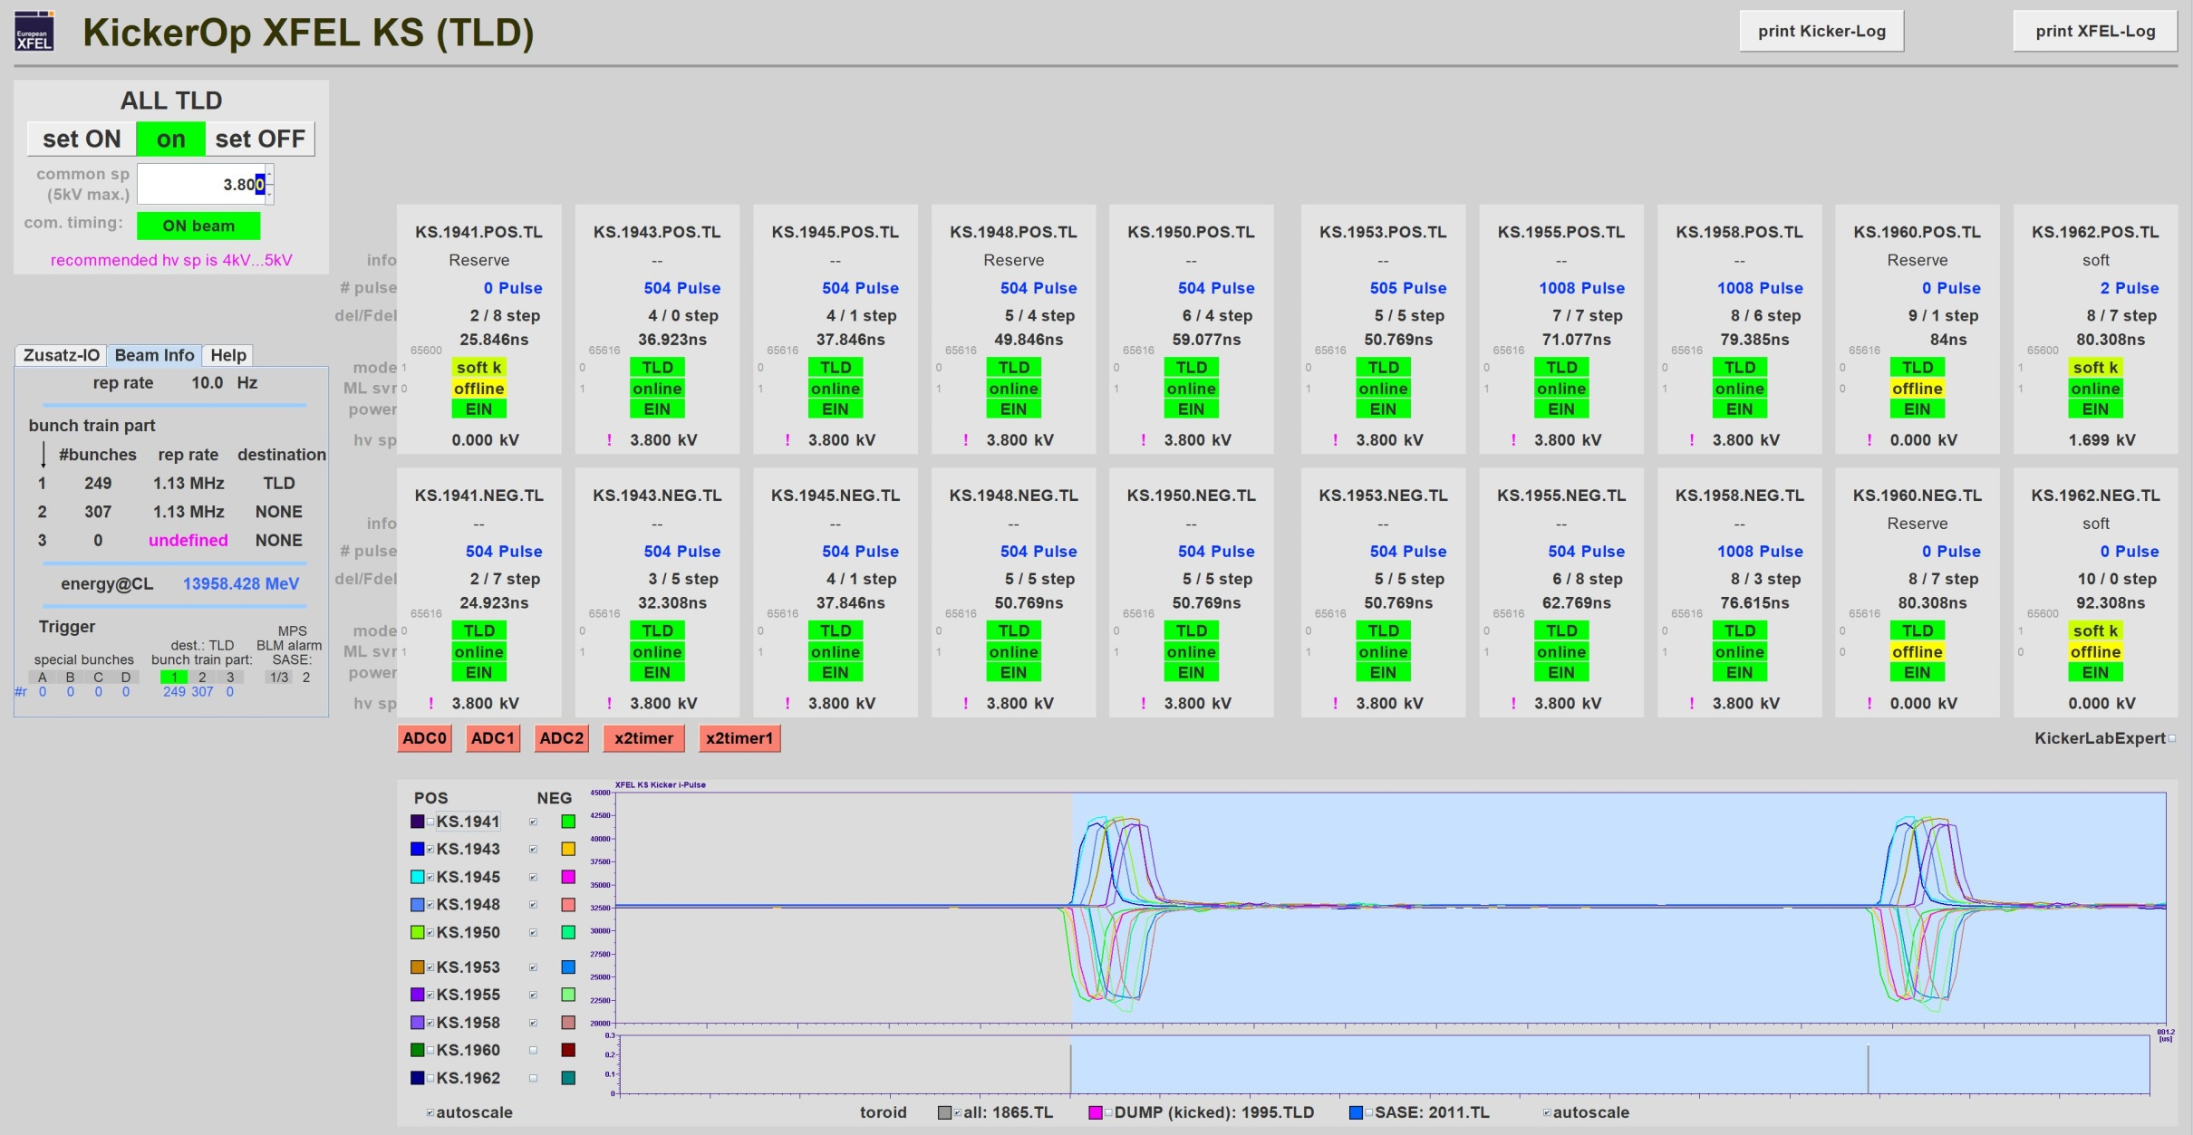
A Typical User Pattern form 15.04.2019

Slide 29
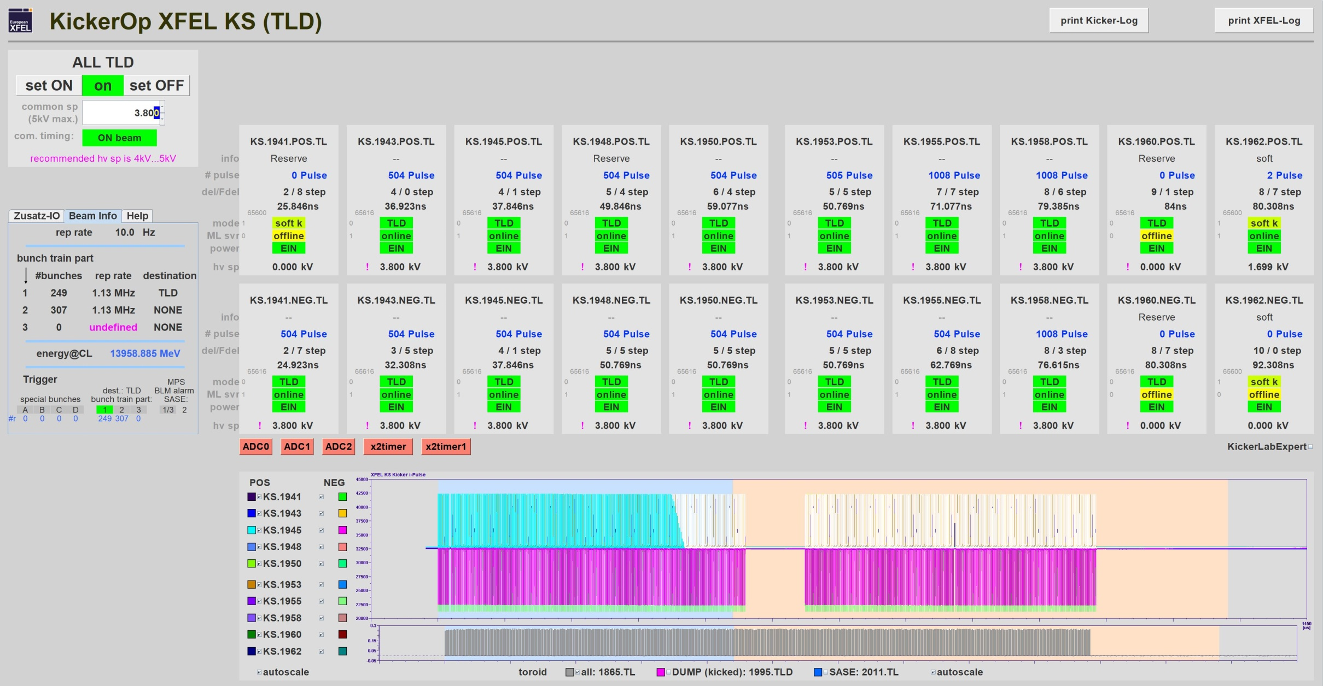
A Typical User Pattern form 15.04.2019
bunch train with 556 bunches

Slide 30
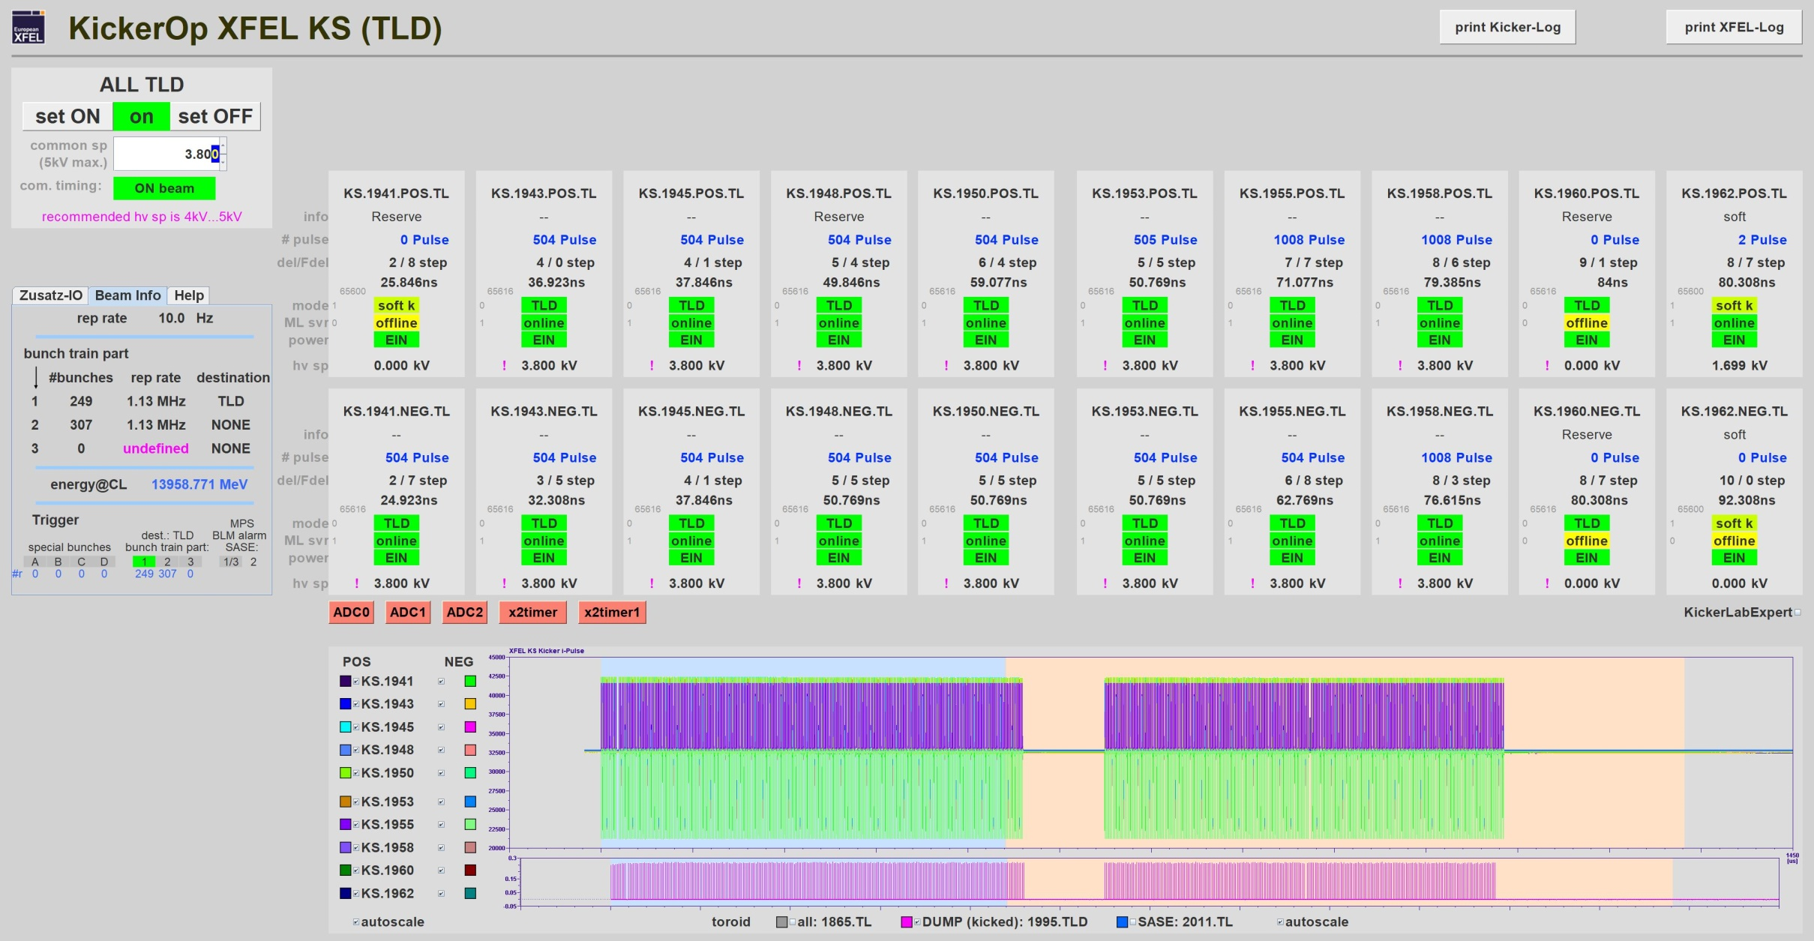
A Typical User Pattern form 15.04.2019
504 bunches go to the Dump

Slide 31
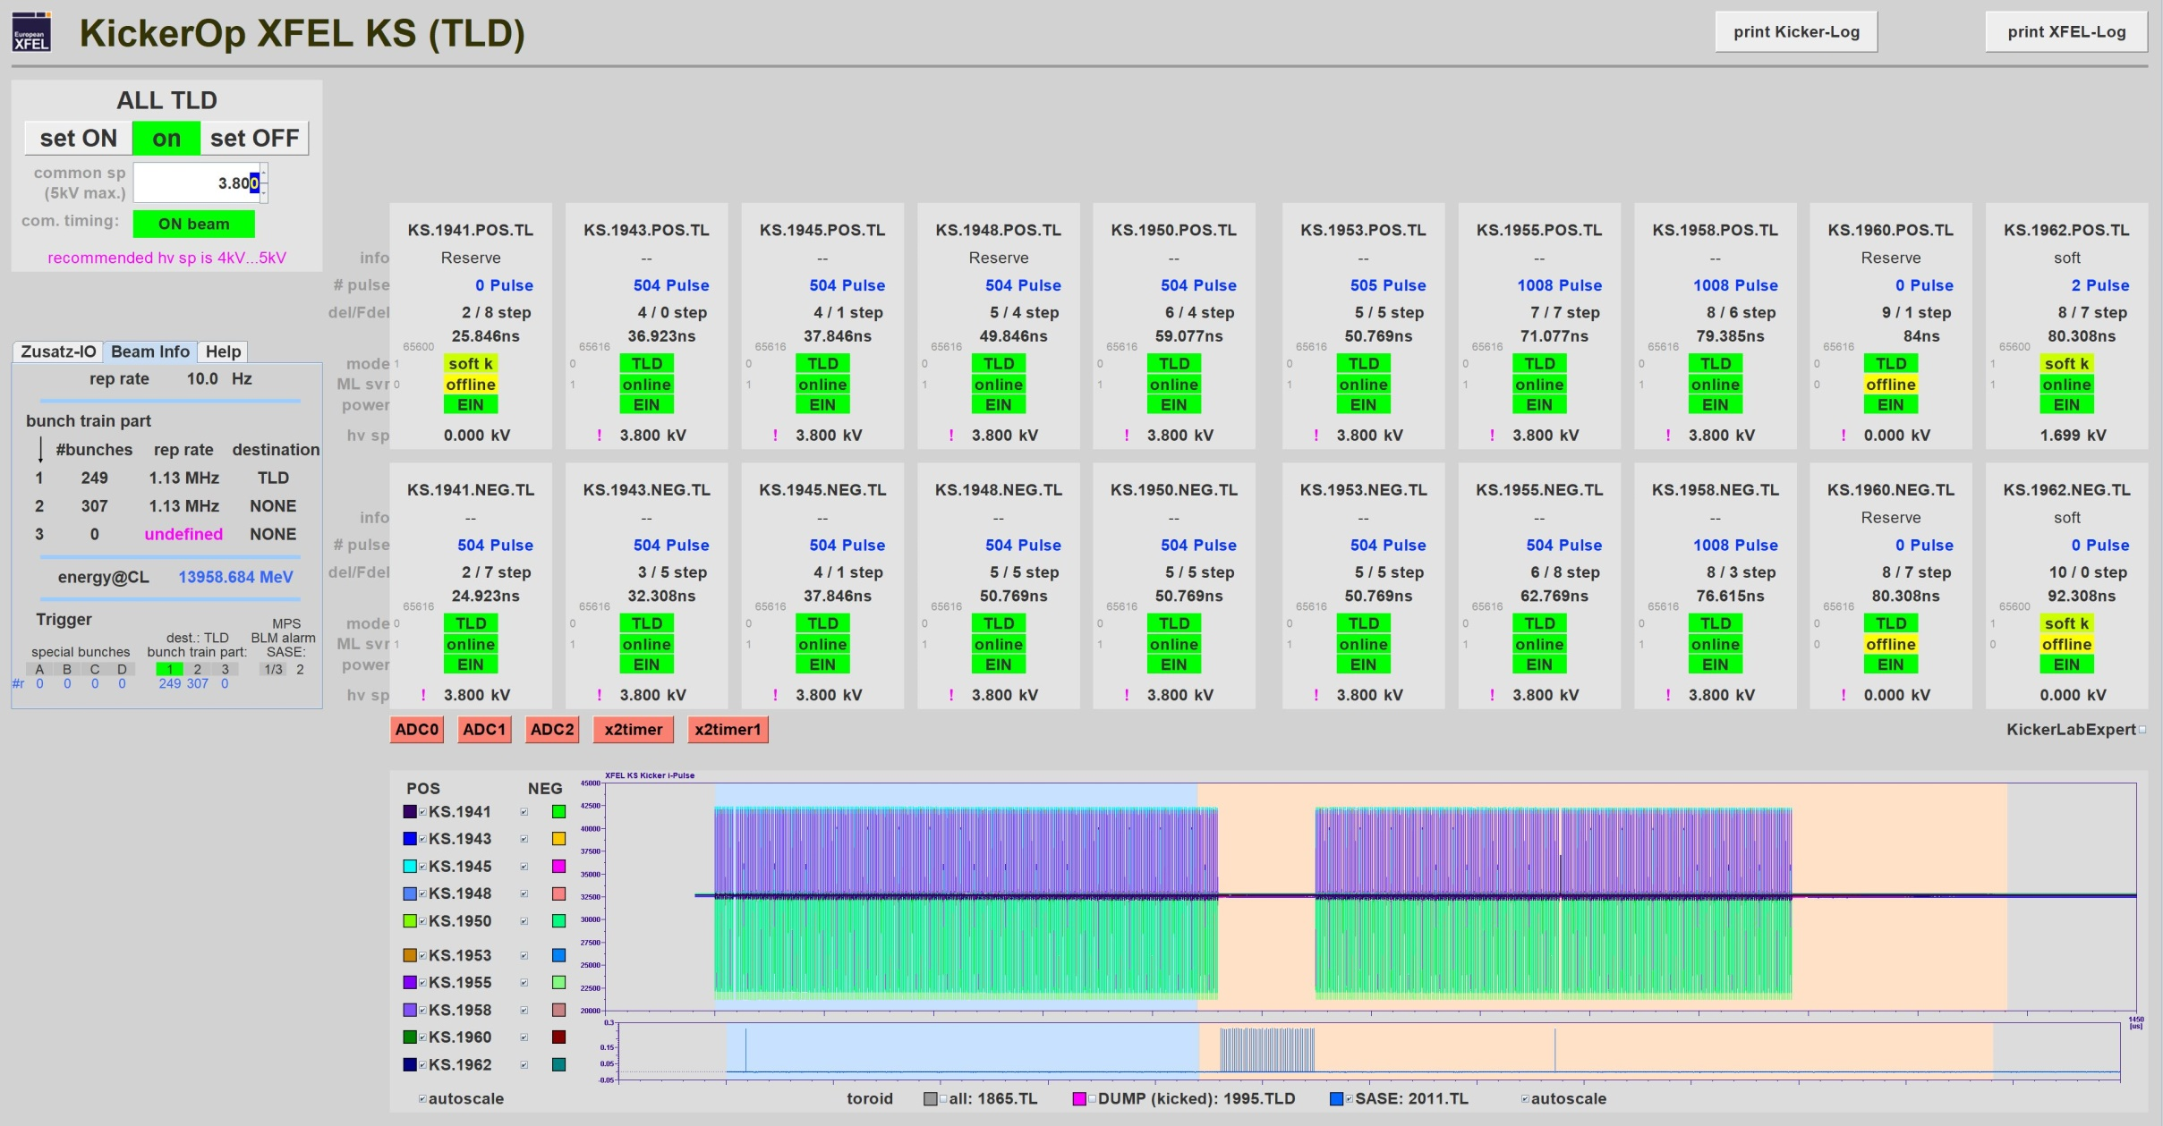
A Typical User Pattern form 15.04.2019
kicked bunches to suppress lasing in SASE1
1 bunch for SASE 2
51 bunches for SASE 1
1 bunches for SASE 3

Slide 32
A Typical User Pattern form 15.04.2019
51 bunches for SASE 1
1 bunch for SASE 2
1 bunches for SASE 3

