Slide 1
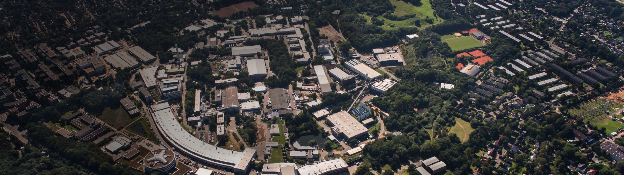

LUXE beam line design considerations
Florian Burkart (MPY1)
LUXE workshop
Hamburg, 16.04.2019

Slide 2
Outline
01 Beam Parameters
02 Experimental layout
03 Special topics
  Spectrometer Dipole
  Photoconverter foil
04 Location at the XFEL
  XSDU1
  XTD20
05 Lattice and beam optics
06 Outlook and conclusion

Slide 3
Beam parameters
Option 1: collide electron beam with laser pulse
Option 2: collide electron beam with foil → photon generation → collide photons with laser pulse
Electron beam parameters:
Electron energy: 17.5 GeV
Bunch intensity: up to 1 nC ( 6.25E9 e-)
Bunch length: 80 fs
Spotsize @ IP: σ = 5 μm
Repetition Rate: 1 – 10 Hz
Laser beam parameters
Energy: 0.35 J / 7 J,
Power: 10 TW / 200 TW
Laser Intensity : 10 x10¹⁹ W/cm²,
Wavelength: 800 nm
Crossing angle: 0.3 radians
Focus in x-y-direction: 10 μm
Pulse length: 35 fs
1 bunch operation!
Goal: Fully transparent for XFEL operation

Slide 4
General layout
Dipole
Experimental Area Hall
Triplet
1bunch
17.5 GeV e⁻
Linac
Kicker & Septa
Dipole
Dump
Kick out one bunch and send it to the experimental area.

Slide 5
Electron - Laser Collision
IP
Mirror
PDET
Laser
e⁺
Dipole
electrons
CAL
γCAL
γ
e⁺
γ
e⁻
Triplet
Mirror
pulse
e⁻
Dump
Dipole
EDET
E < 16 GeV
~ 20 m
~5 m
~15 m
tbd

Slide 6
Photon - Laser Collision
Collimation
Counter
IP
PDET
Mirror
Photon converter
e⁺
Laser
e⁺
Dipole
electrons
CAL
γCAL
γ
e⁺
γ
e⁻
Triplet
e⁻
Dump
pulse
e⁻
Dipole
Mirror
Dipole
Counter
E < 16 GeV
EDET
E < 16 GeV
5 m
15 m
5 m
10 m
tbd

Slide 7
General infrastructure requirements for LUXE
Electron beam line (> 20 m )
  Magnets (Fast kickers, septa, triplet, spectrometer)
  Beam instrumentation
  Collimator
  Photoconverter
  Single bunch beam dump.
Space for ~ 150 sqm Laserlab
Laser and laser beam transport system
Detectors
General infrastructure:
  Crane, power, water cooling, ventilation, IT
  Shielding
  Integration into XFEL Control and MPS system

Slide 8
General infrastructure requirements for LUXE
Electron beam line (~ 80 m)
  Magnets (Fast kickers, septa, triplet, spectrometer)
  Beam instrumentation
  Collimator
  Photoconverter
  Single bunch beam dump.
Space for 150 sqm Laserlab
Laser and laser transport
Detectors
General infrastructure:
  Crane, power, water cooling, ventilation, IT
  Shielding
  Integration into XFEL Control and MPS system

Slide 9
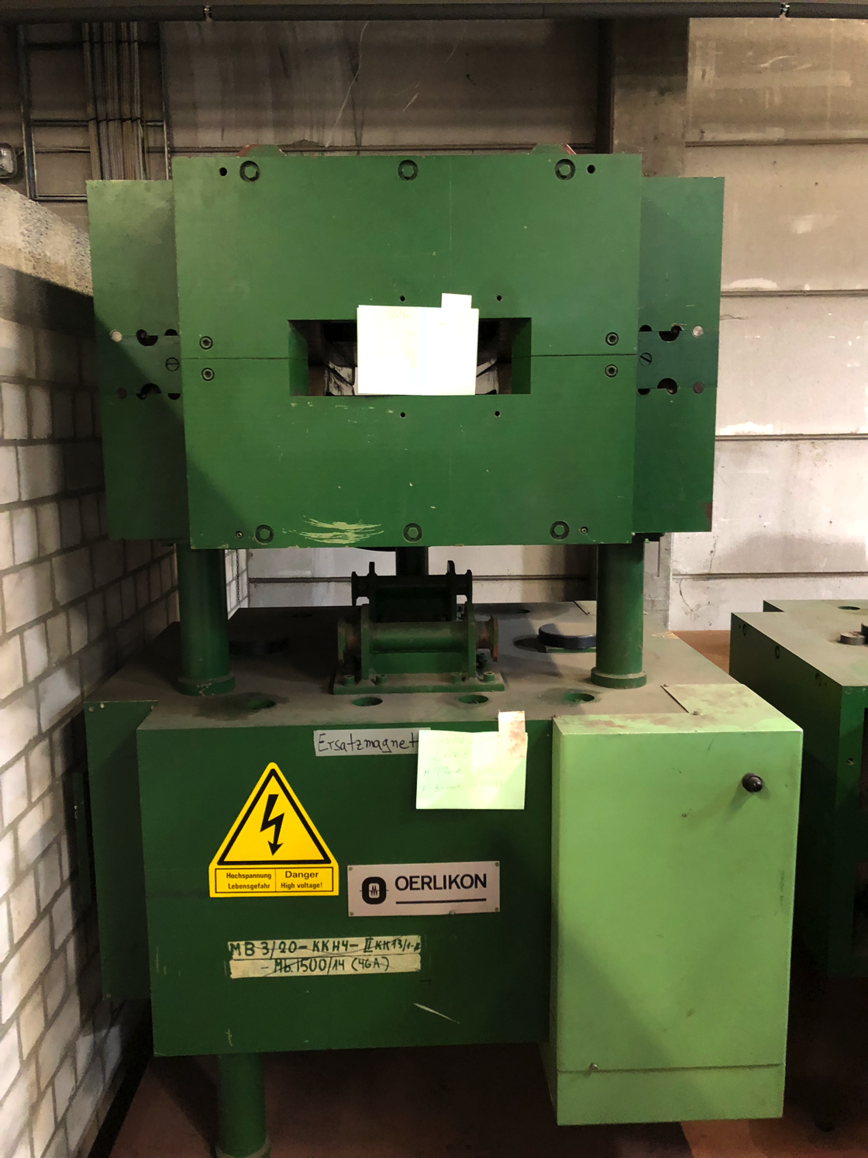
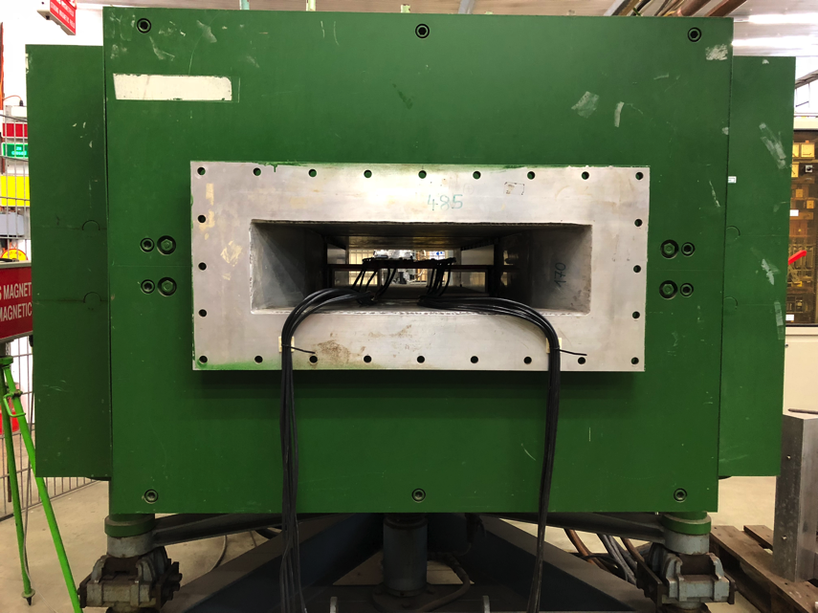
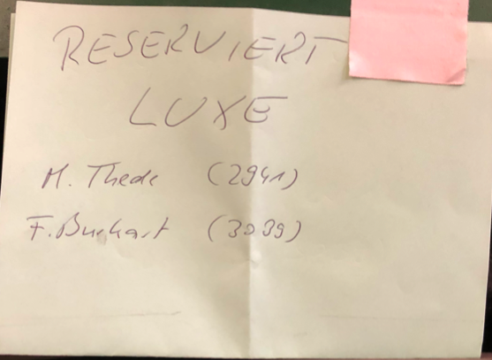
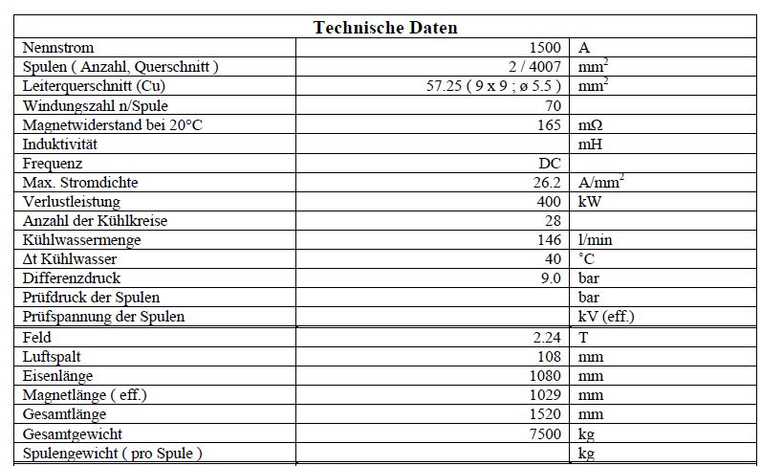
Spectrometer Magnet
Massive Device:
1500 A
2.24 T
7500 kg
10 cm aperture
1m length

Slide 10
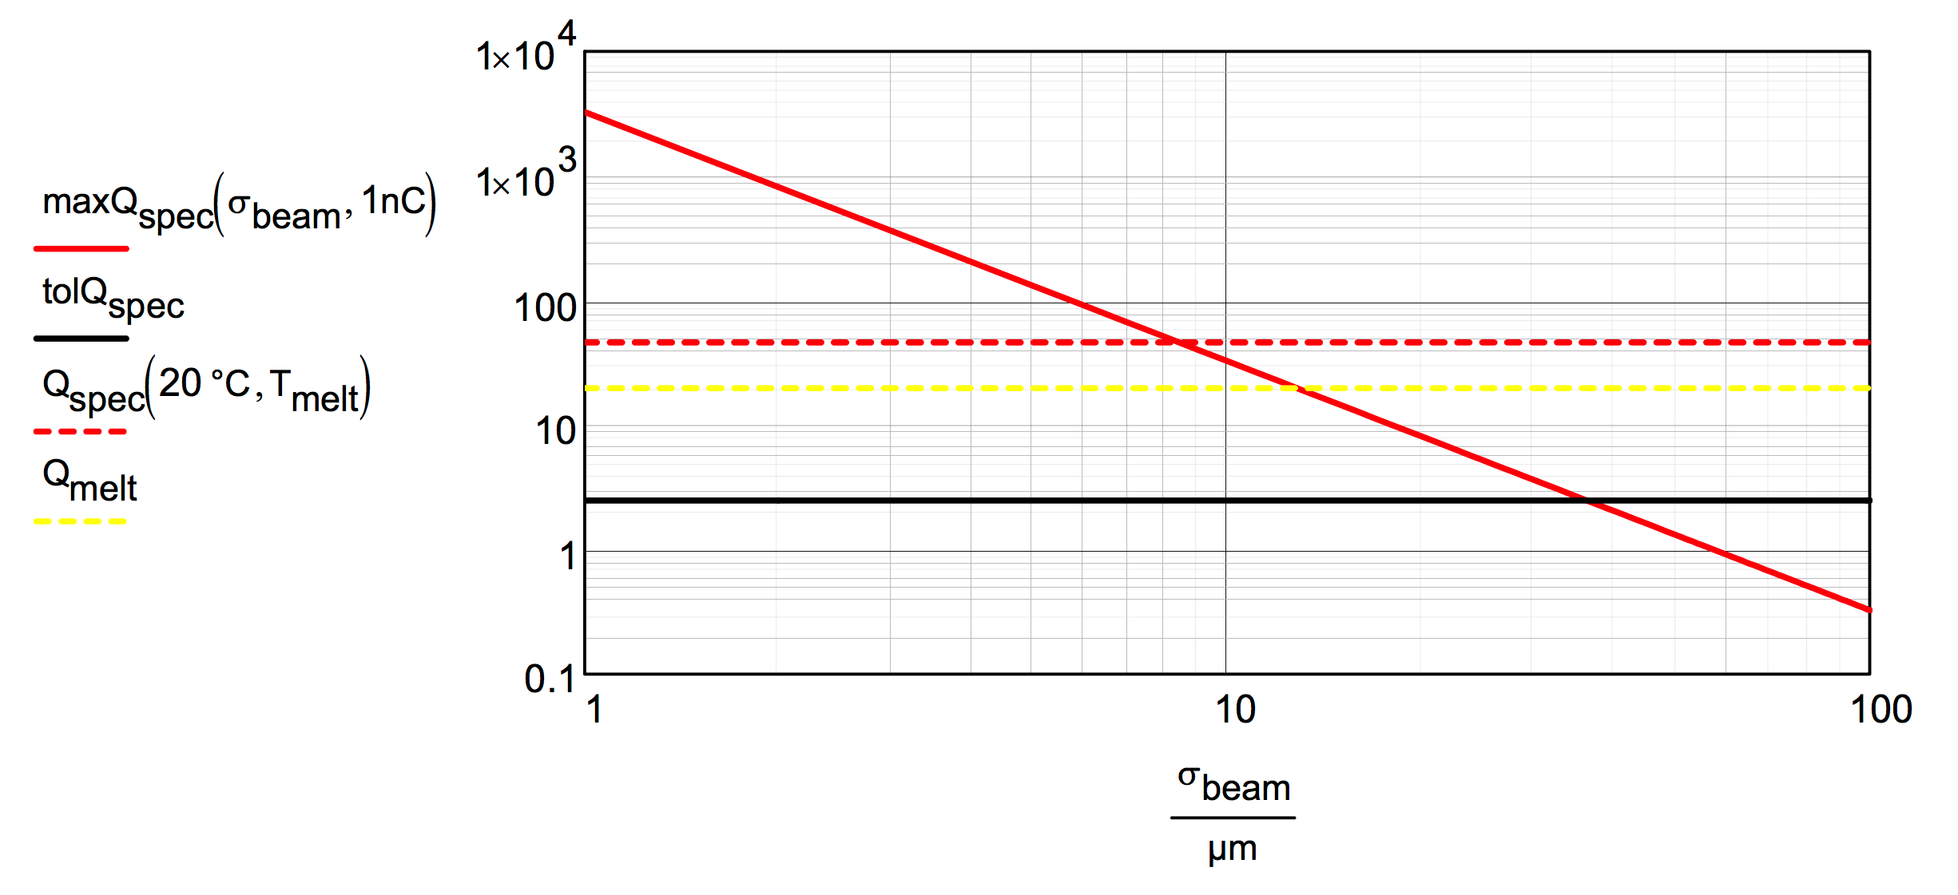
Photoconverter and a 17.5 GeV electron beam
Michael Schmitz
35µm Tungsten Foil
tol(dQ/dm): tolerable instantaneous energy deposition per pulse: ~24J/g (Tungsten), including stress in the material.
Limit at 1nC: the beam σ at the foil should be >40µm,
deposited heat of 1 bunch is mostly smeared out before
the next bunch arrives 100ms later (10Hz).
1E5
1E4
1E3
100
10
1
38

Slide 11
What has changed in the last 8 months?

Slide 12
Possible location at the XFEL
experiments
electron tunnel
electron switch
HED
photon tunnel
electron bend
MID
undulator
electron dump
SASE 2
3 – 24 keV
~
~
~
FXE
SPB
LINAC
17.5 / 14 / 10.5 GeV
SASE 1
3 – 24 keV
SASE 3
0.26 – 3 keV
SQS
SCS

Slide 13
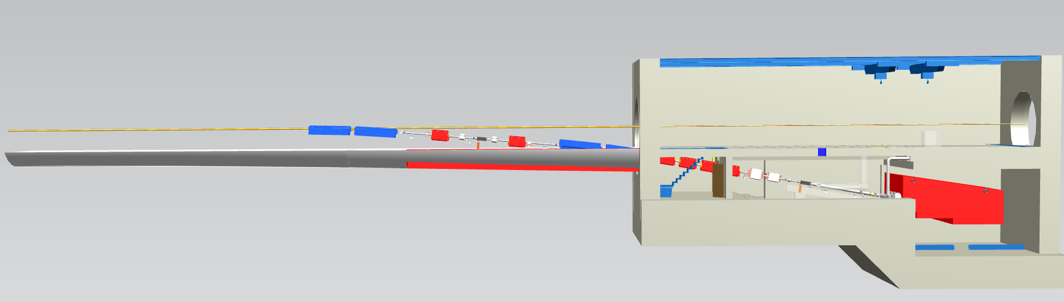
Schematic CAD Integration
Kicker/Septa
Bend
Triplet
IP
Dump

Slide 14
Location Considerations – XSDU1
XSDU1
Modification of beam line – downtime to be evaluated.
Potential impact on legal situation (additional extraction/beam dump, beam line) → „risk“ of plan-approval procedure.
Maybe radiation towards XTD7 → additional shiedling required.
New building at the surface.
Background from beam dump.
Already studied (optics, HW, …).

Slide 15
Possible location at the XFEL
experiments
electron tunnel
electron switch
HED
photon tunnel
electron bend
MID
undulator
electron dump
SASE 2
3 – 24 keV
~
~
~
FXE
SPB
LINAC
17.5 / 14 / 10.5 GeV
SASE 1
3 – 24 keV
SASE 3
0.26 – 3 keV
SQS
SCS

Slide 16
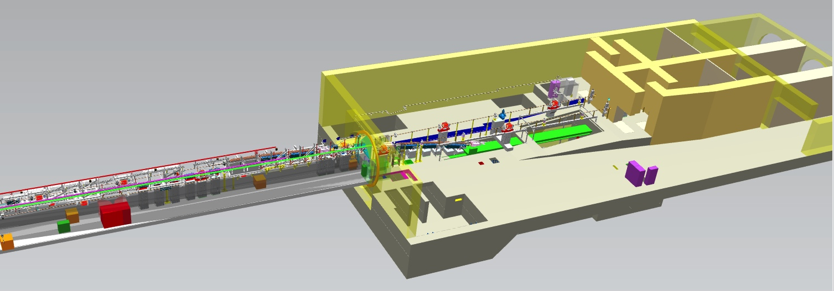

Accelerator Design
TD1
XTD20
TD2
TD20
dump
Start point of the second fan for XFEL

Slide 17
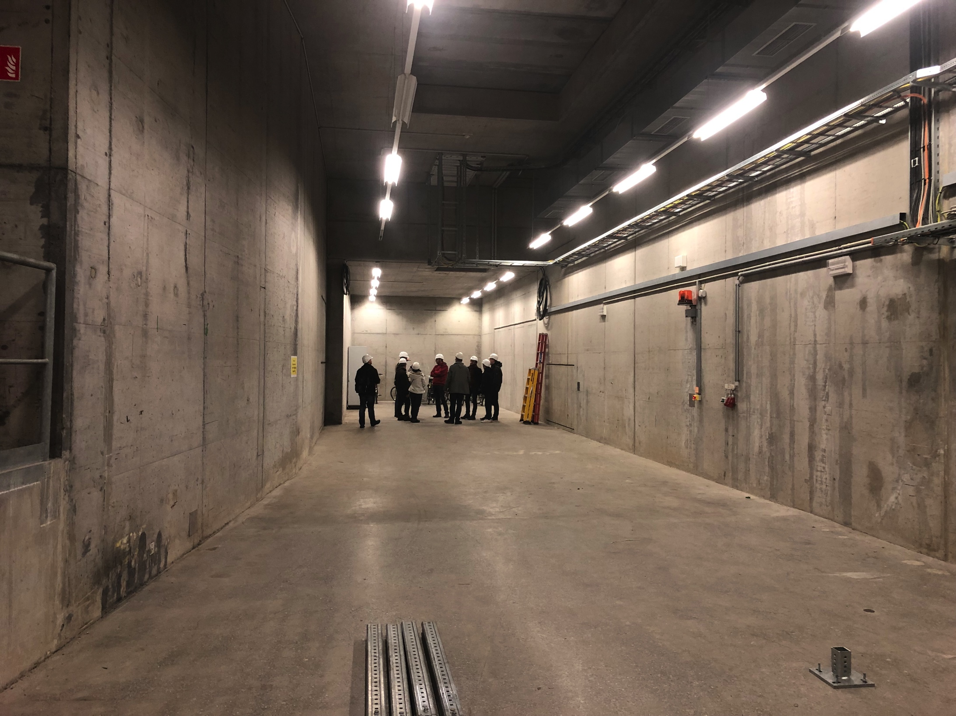
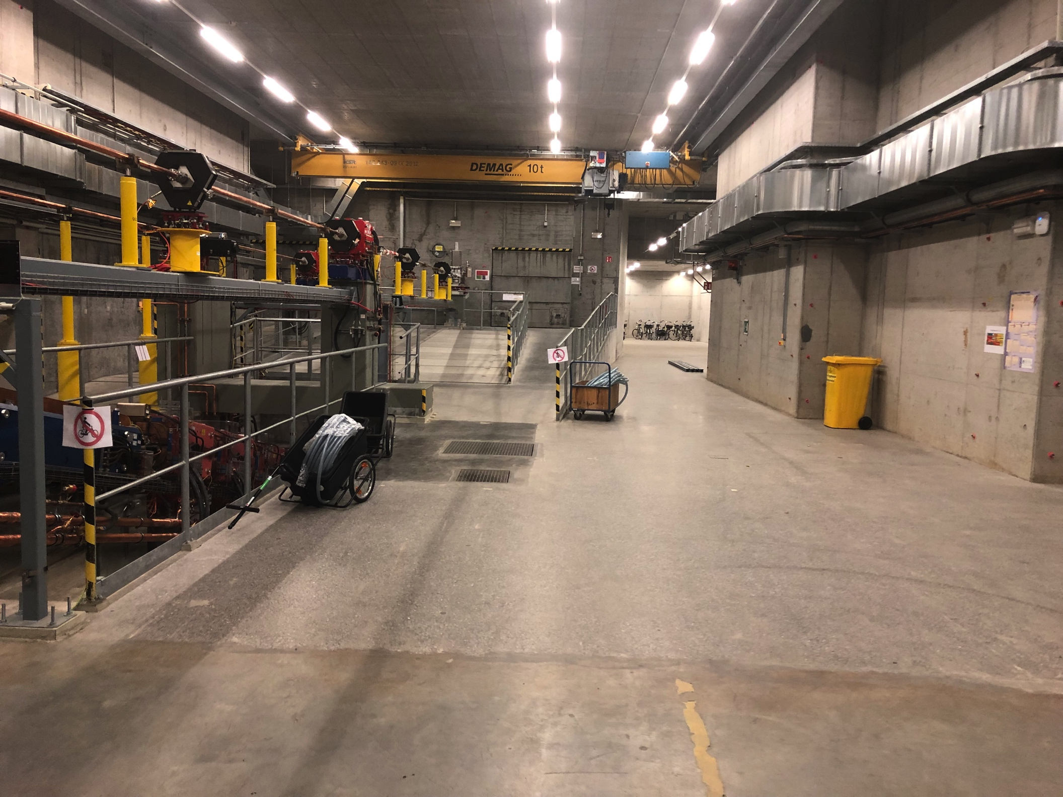

Slide 18
Location Considerations – XTD20
XTD20
Uses existing building and beam line design.
Major modification of extraction beam line - downtime to be evaluated.
Extraction and beam line already included in plan-approval.
Laser beam line transport via XS1 shaft.
Early implementation of the beam extraction for future XFEL upgrade and/or test beam area.
Additional demonstration of the flexibility of the facility.
New option to be studied.

Slide 19
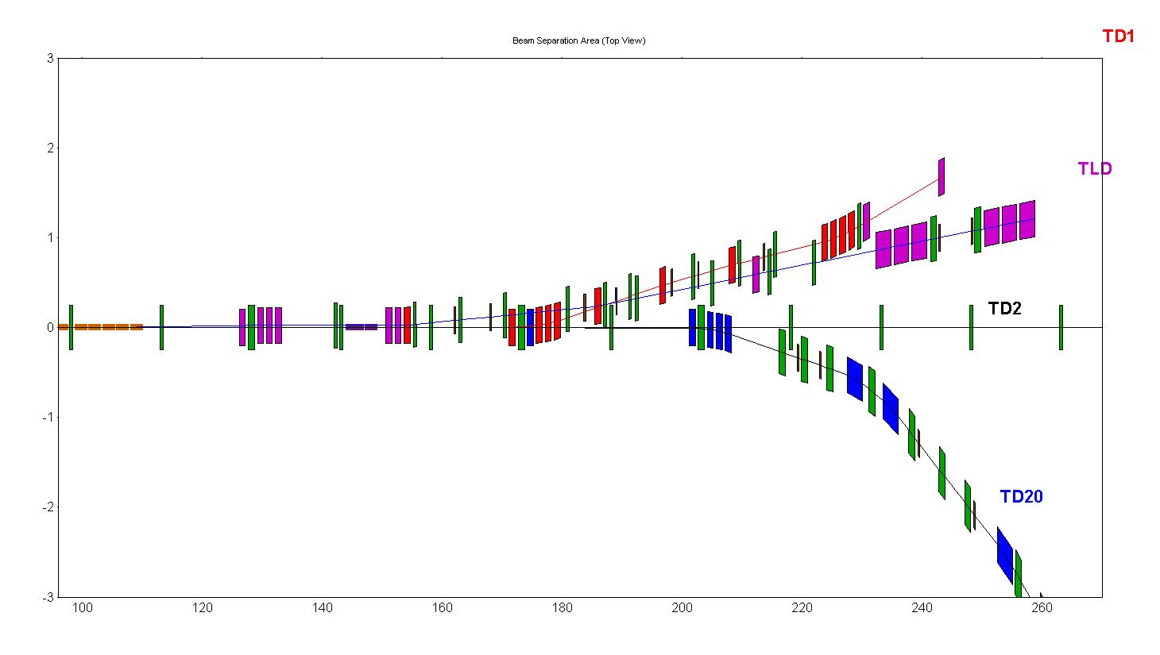
Accelerator Design
Nina Golubeva
Fast kicker magnets
TD20
Septa

Slide 20
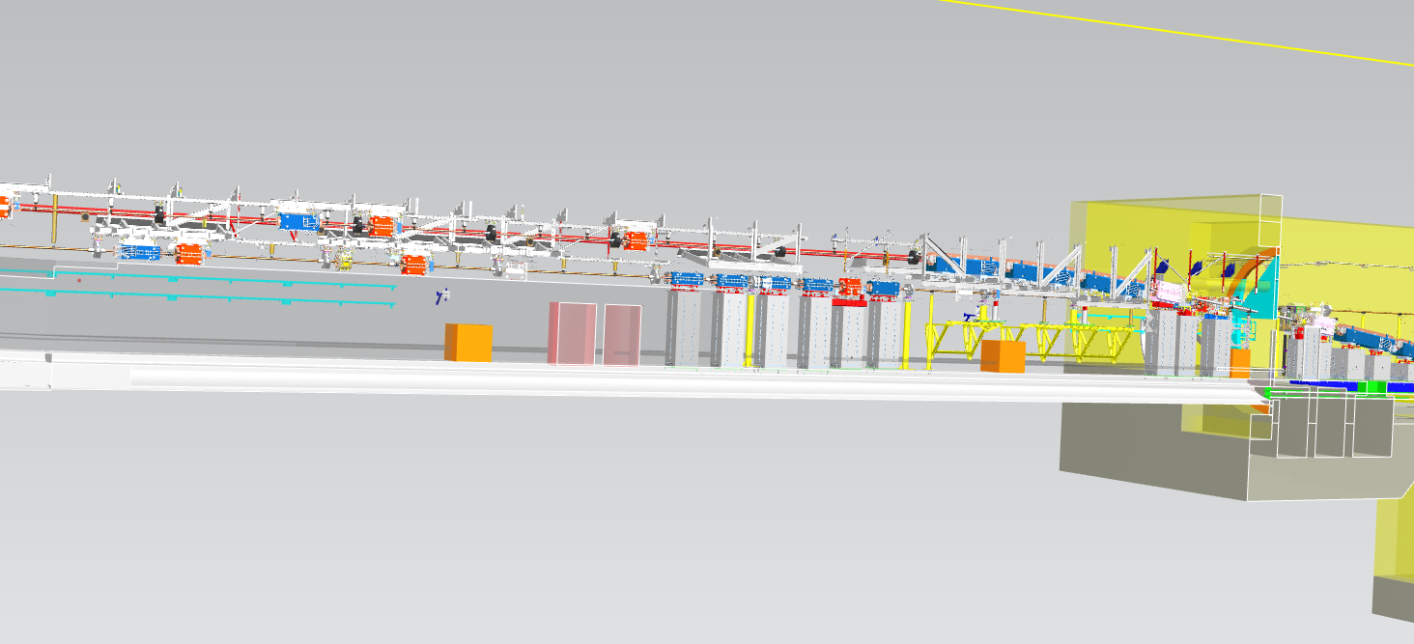
Tunnel Infrastructure

Slide 21
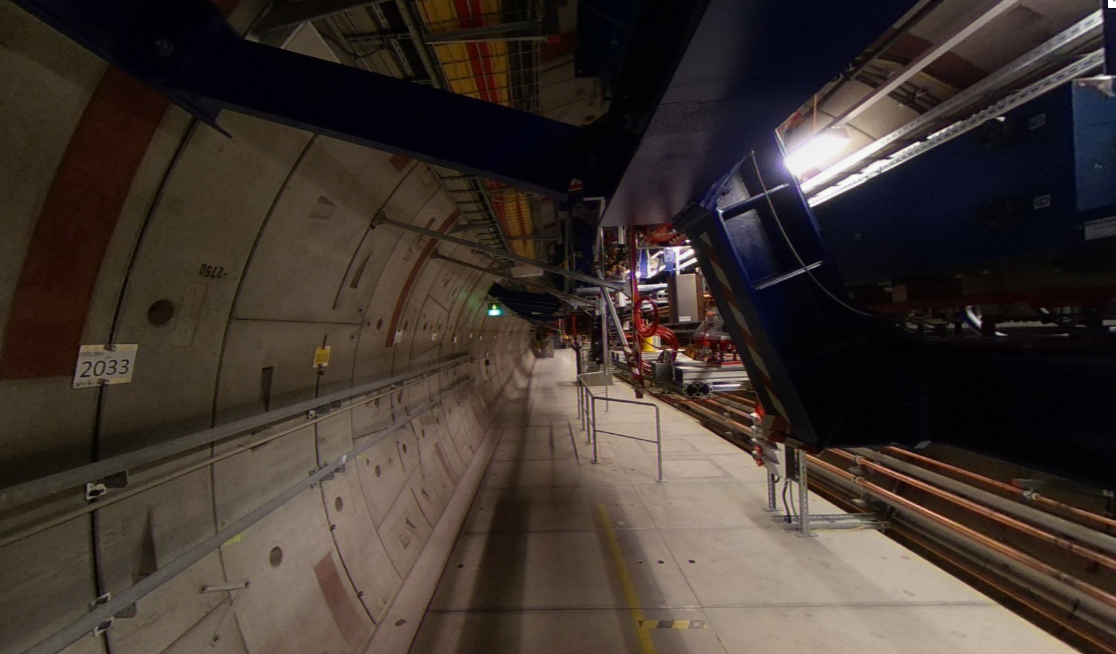
Support structure at the ceiling

Slide 22
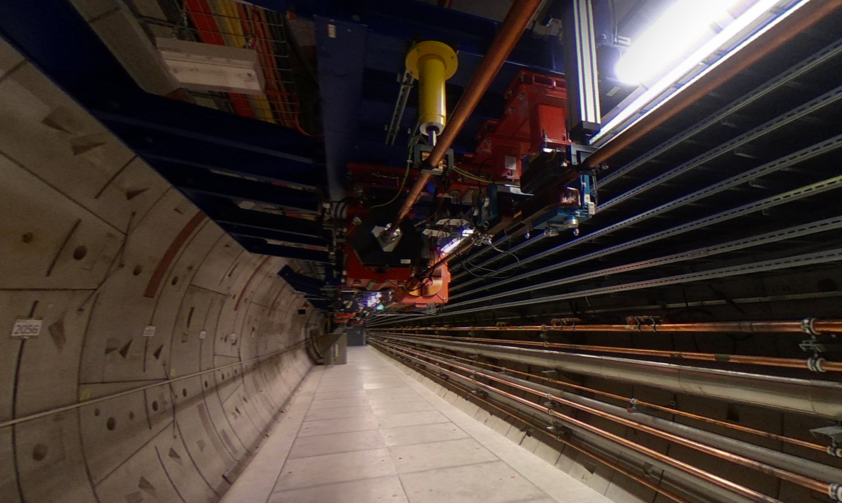

Slide 23
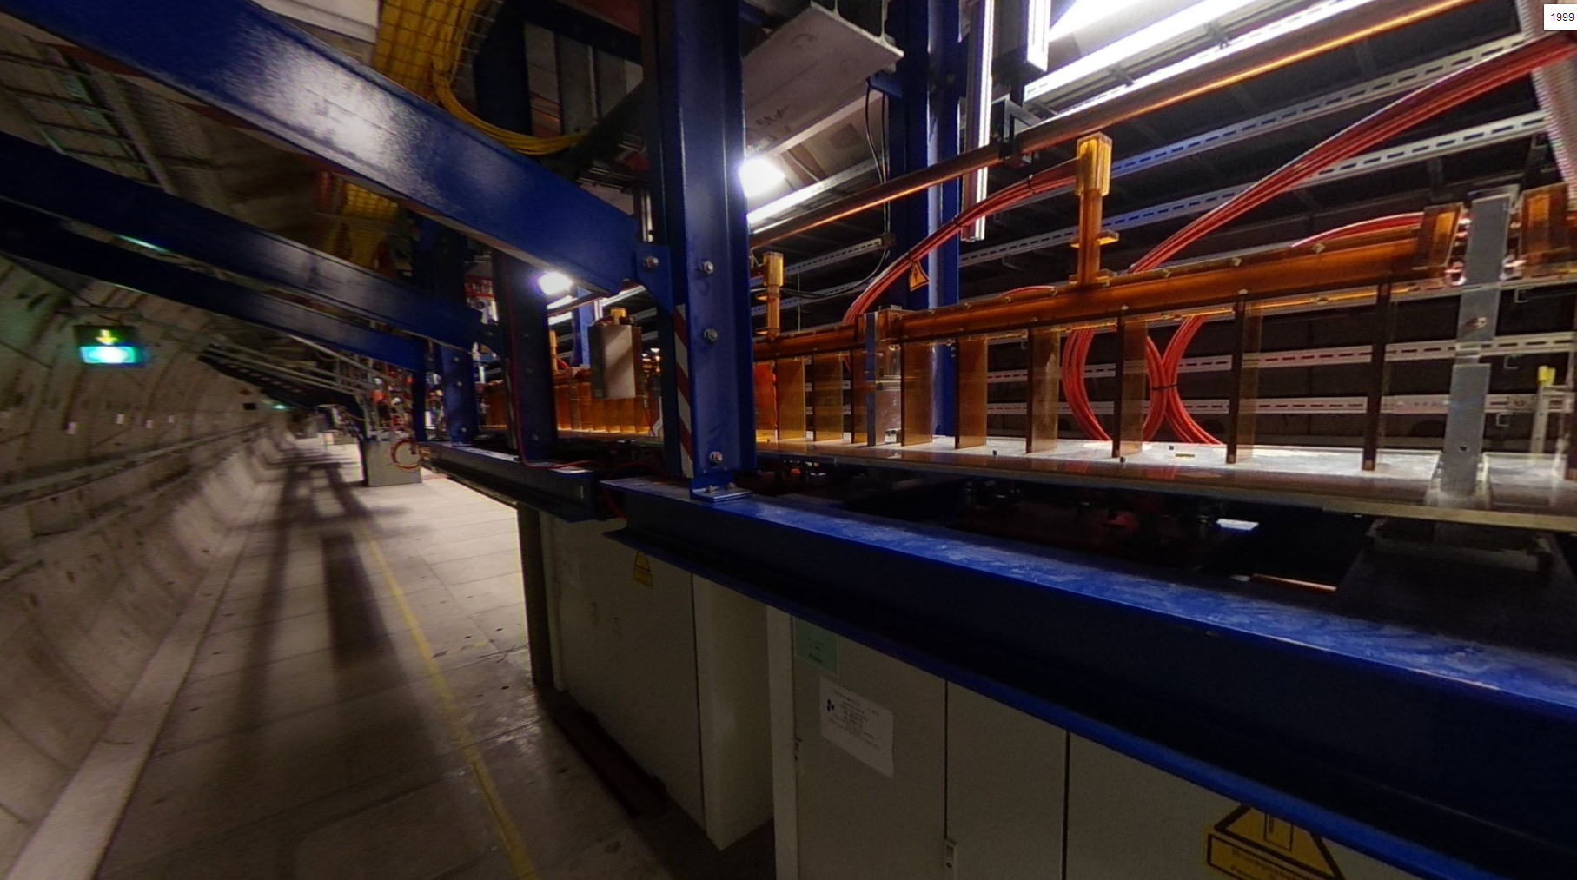
Kicker magnets

Slide 24
Lattice Design downstream of the third septum

Slide 25
Final focus
Preliminary!

Slide 26
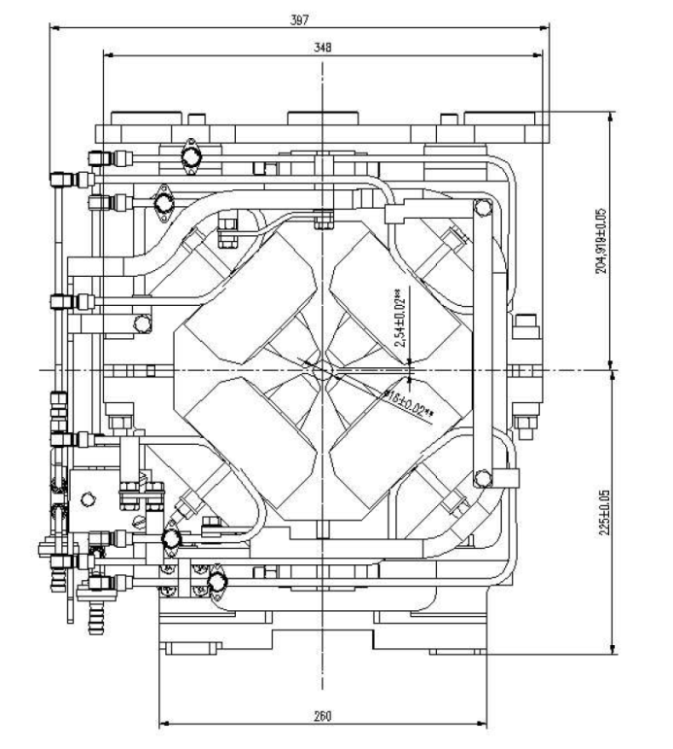
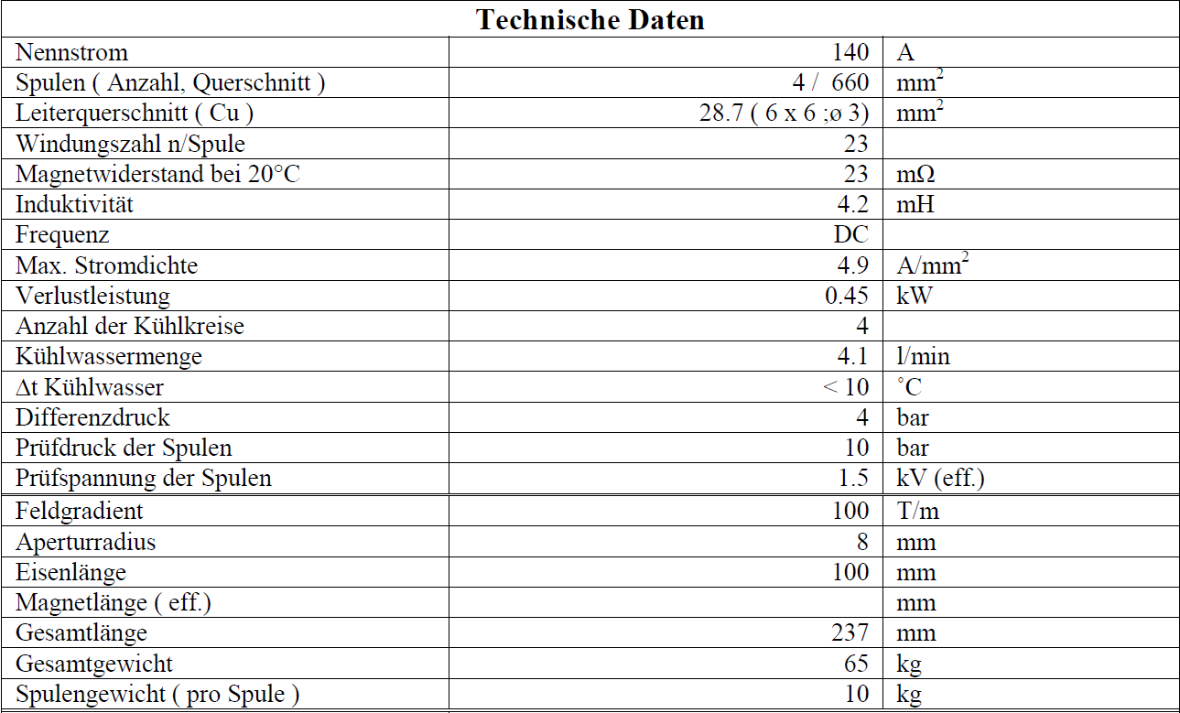
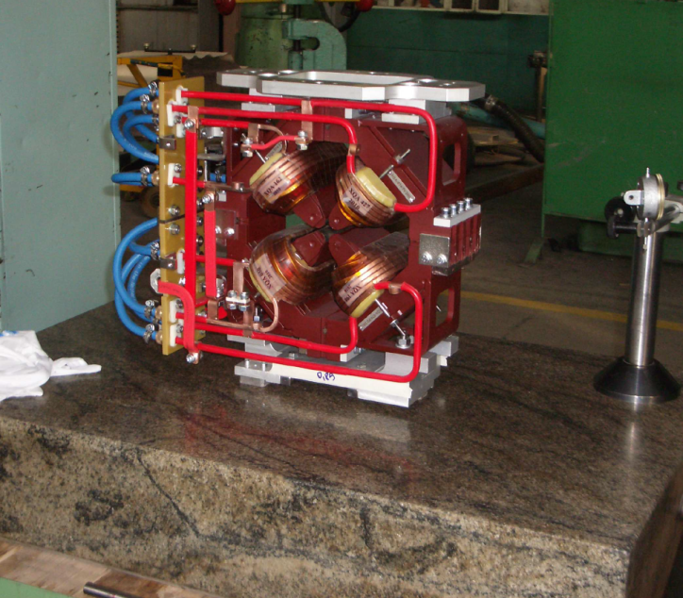
Triplet Magnet Parameters
Gradient: 100 T/m
Length: 10 cm
Aperture: 16 mm

Slide 27
LUXE @ XFEL MAC
Presented at the XFEL MAC: MAC is very interested and will follow any future development of LUXE with interest.
Recommendation: evaluate risk for XFEL user operation.
Main challenge: Fit construction into XFEL schedule.
→ Installation within a XFEL shutdown. No pertubation of XFEL operation.

Slide 28
LUXE status
XTD20 lattice design ü
LUXE final focus beam design ü
Start the discussion with the DESY technical groups. ü
  Radiation protection
  MEA (installation of the beam line in the tunnel)
  ZM1 (central construction department – integration into CAD model, design and construction of support structures)
  MVS (vacuum group)
At the moment: no showstoppers visible. ü
Include also power, water cooling, safety and access system, beam instrumentation, control groups. ongoing
Preliminary estimate of timeline and ressources. ongoing
Prepare hardware table.
Preparation of installation schedule – hopefully within 2 XFEL shutdowns.

Slide 29
LUXE and the interest of other groups
DESY radio protection showed interest in a fixed –target testbeam area.
DESY is interested in using testbeams at XFEL.

Slide 30
Conclusion
LUXE as QED basic research – would enlarge the scientific scope of XFEL.
Theory and accelerator community is very interested in conducting this experiment at the XFEL.
DESY and XFEL directorate supportive.
Design consideration with input from various DESY technical groups.
Layout and achievable parameters look feasible.
New possible location of the experiment found in XTD20.
Major modification of extraction beam line needed.
Early implementation of the beam extraction for future XFEL upgrade and/or test beam area.
Integration, Installation and Design studies ongoing.

Slide 31
Acknowledgements:
Winfried Decking, Beate Heinemann,
Reinhard Brinkmann, Ralph Assmann, Evgeny Negodin,
Norbert Tesch, Wolfgang Clement,
Nina Golubeva, Vladimir Balandin,
Markus Hüning, Frank Obier, Michael Schmitz
Lutz Lilje, Torsten Wohlenberg
Markus Körfer, Dennis Lenz
Cornelius Martens, Roland Platzer

Slide 32
Thank you

Slide 33
Dr. Florian Burkart
Department: MPY1
E-Mail: florian.burkart@desy.de
Phone: +49 40 8998 3039

