Slide 1
Potential calorimeter for LUXE
Yan Benhammou

Slide 2
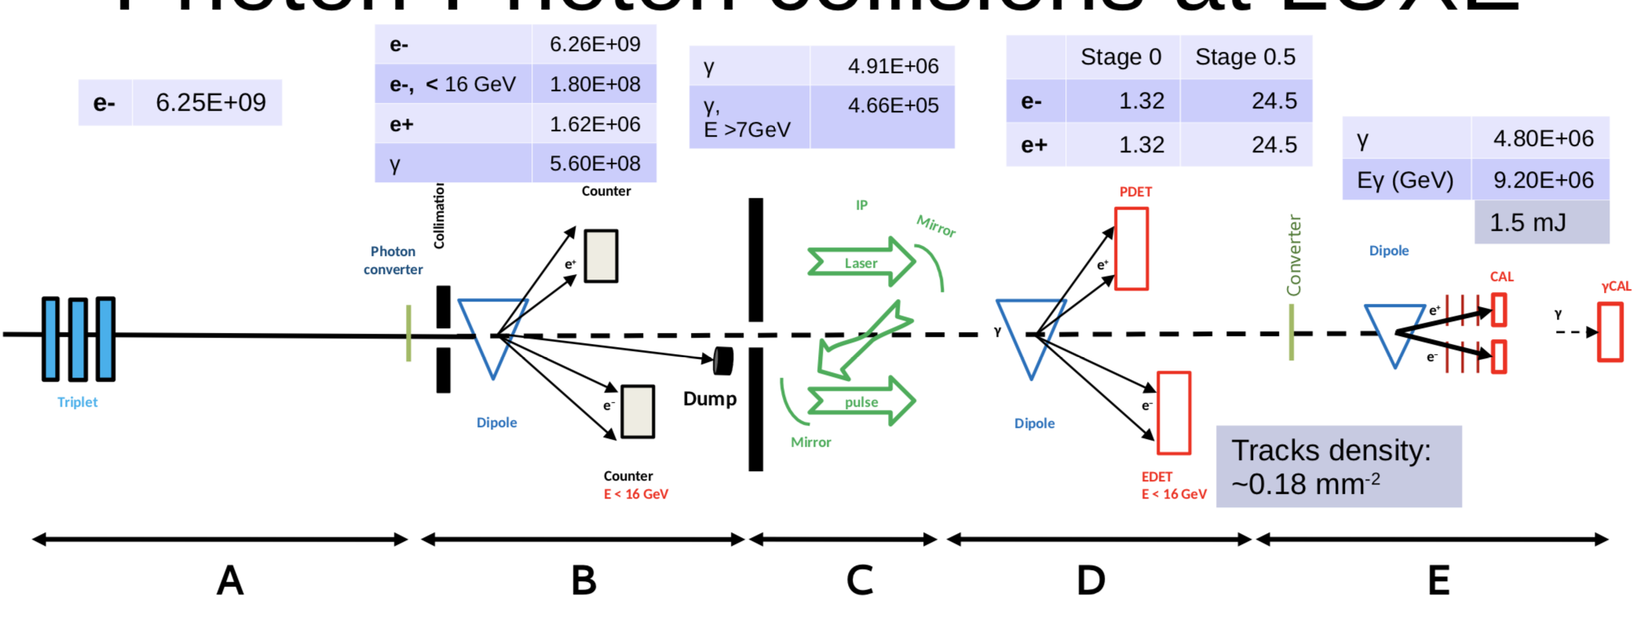
LUXE : photon-laser
Questions :
-
?

Slide 3
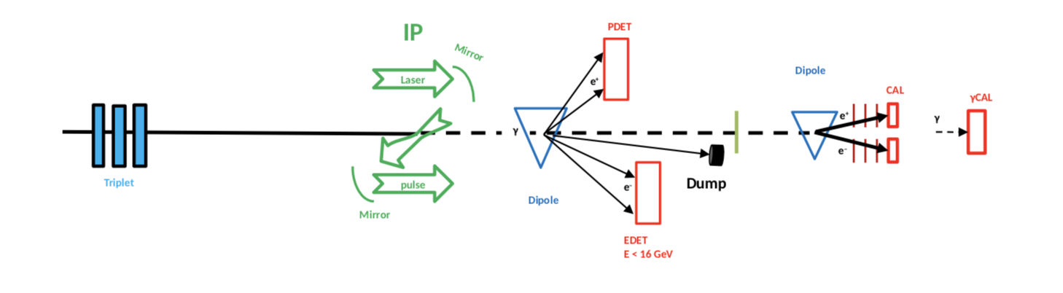
LUXE : electron - laser
Questions :
Trigger system ?
How do we synchronize over long distance ?

Slide 4
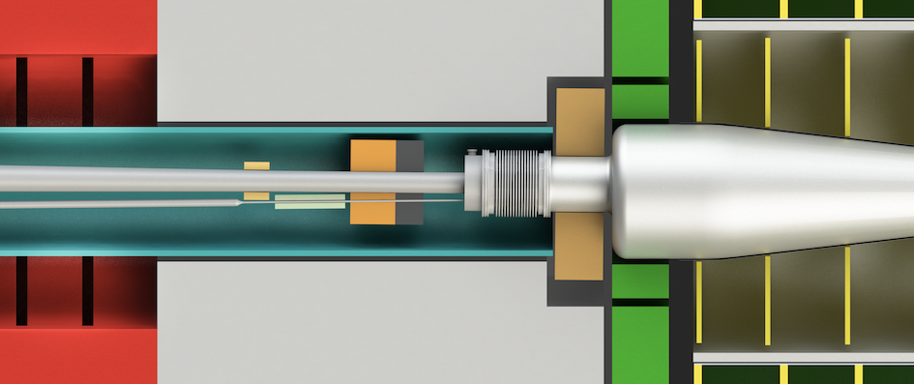
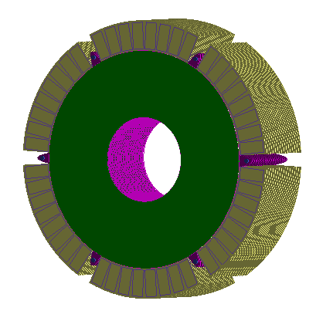
Luminosity calorimeter for linear collider
Measure the integrated luminosity (using Bhabha events) and extend the the calorimeter coverage at small polar angle :
  Electromagnetic sampling calorimeter
  layers of 3.5 mm thick tungsten plates with 1 mm gap for silicon sensors
LumiCal
IP

Slide 5
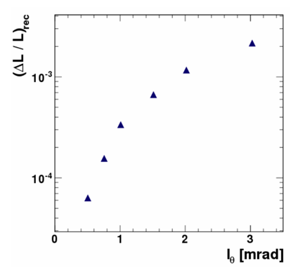
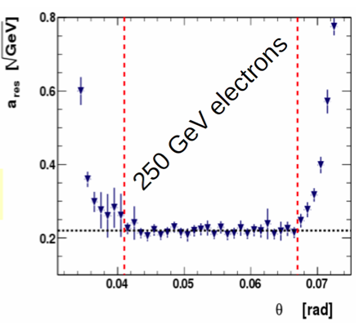

Goals and simulation
precision of luminosity measurement ~10⁻⁴
good energy resolution
compactness
Polar angle pad size
For I_{θ} =0.8 mrad, ΔL/L = 1.6 10⁻⁴

Slide 6
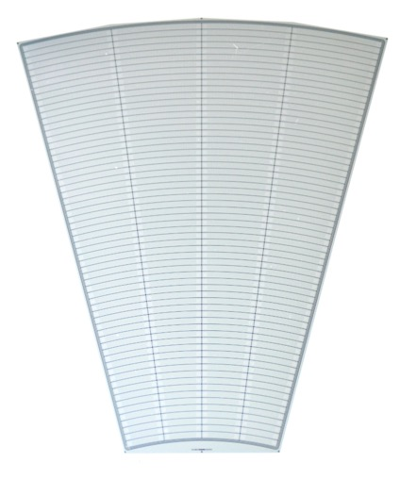
LumiCal sensor
4 sectors:
L1
R1
L2
R2
Silicon senor, 320 μm thickness
64 radial pads, pitch 1.8 mm
4 azimuthal sectors in one tile, each 7.5 degrees
12 tiles make full azimuthal coverage
p+ implants in n-type bulk
DC coupled with read-out electronics
40 modules were produced by Hamamatsu
Outer active radius R = 195.2 mm
channels: 1 - 64
3 x 100 μm guard rings
Inner active radius R = 80.0 mm

Slide 7
LumiCal test at DESY in 2016
Primary aim was to build LumiCal prototype for beam tests and demonstrate the principle of compact electromagnetic calorimeter;
Make the geometry of the detector module close to the designed for LumiCal at LC experiments;
Reduce the thickness of the sensor layer below 1 mm;
Provide mechanical rigidity for the module to simplify its handling during the assembly of calorimeter prototype;
Try to read-out all pads (256) of the LumiCal sensor.

Slide 8
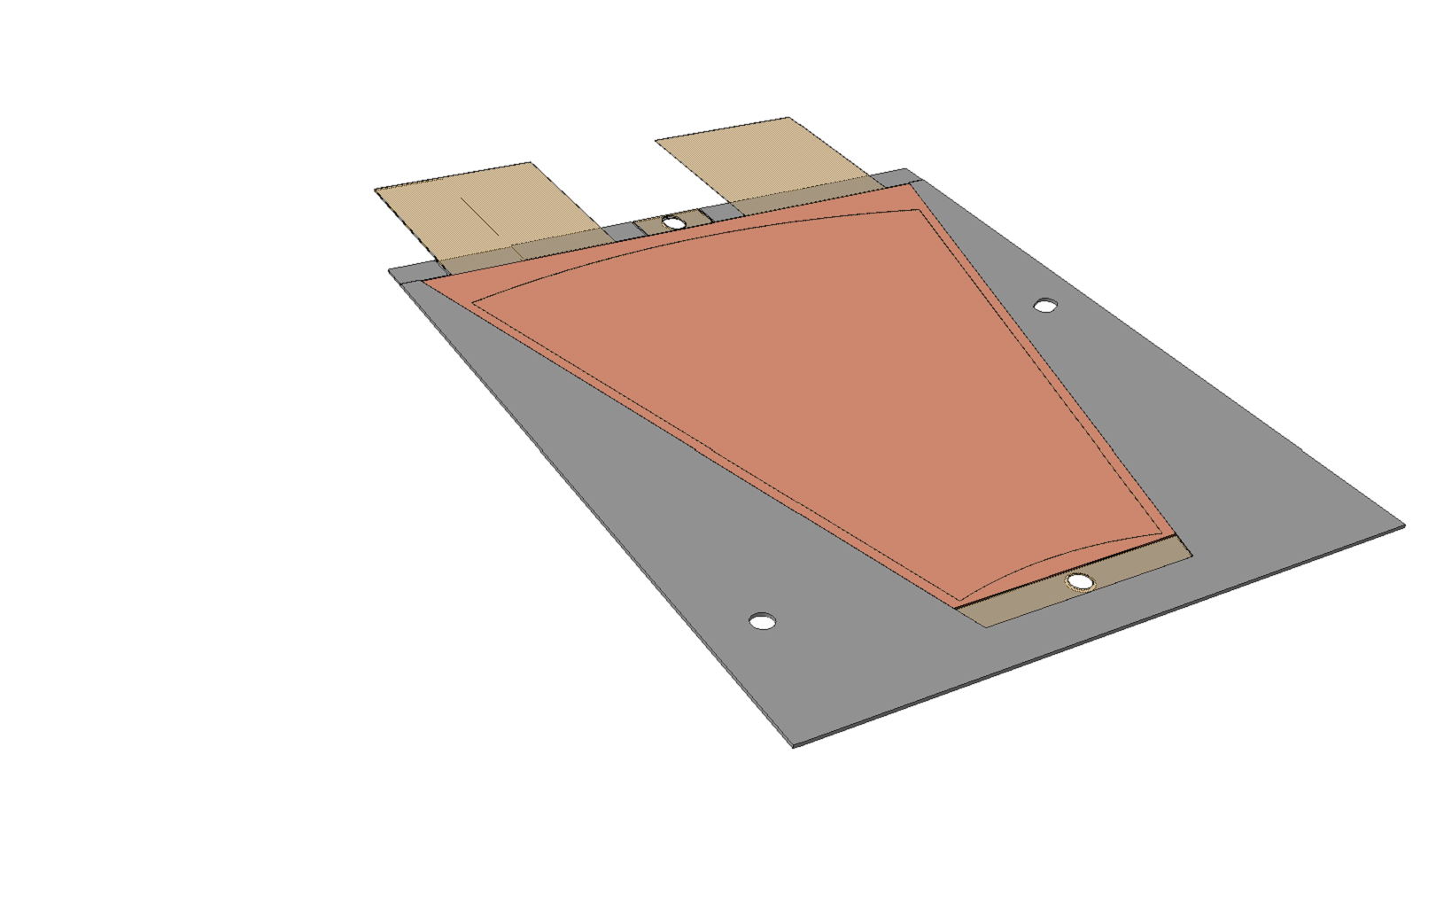
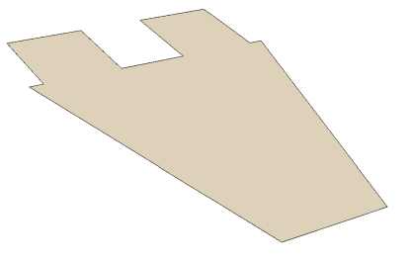
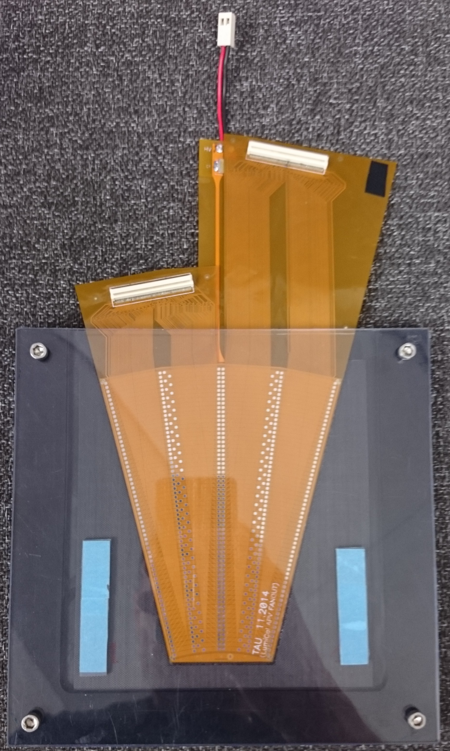
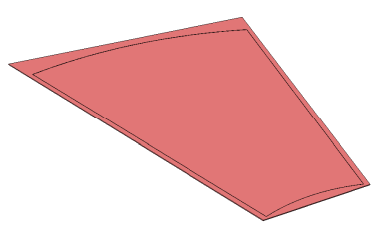
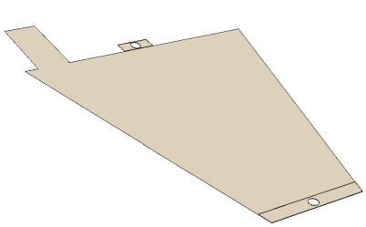
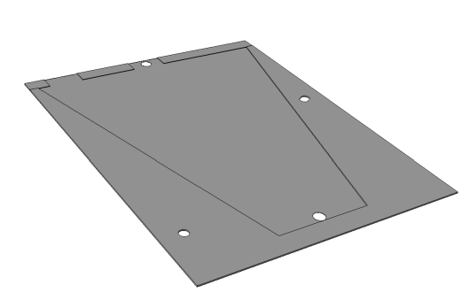
Thin module design
100 μm
320 μm
50 μm
150 μm
Design of a carbon envelope and two dedicated kapton boards
Kapton fan out (connectors)
Kapton Fan out
Sensor
envelope
Kapton HV
epoxy + wire bonding
Sensor
Conductive glue
Kapton HV
epoxy
Glue: 10-20µm
Envelope
750 μm

Slide 9
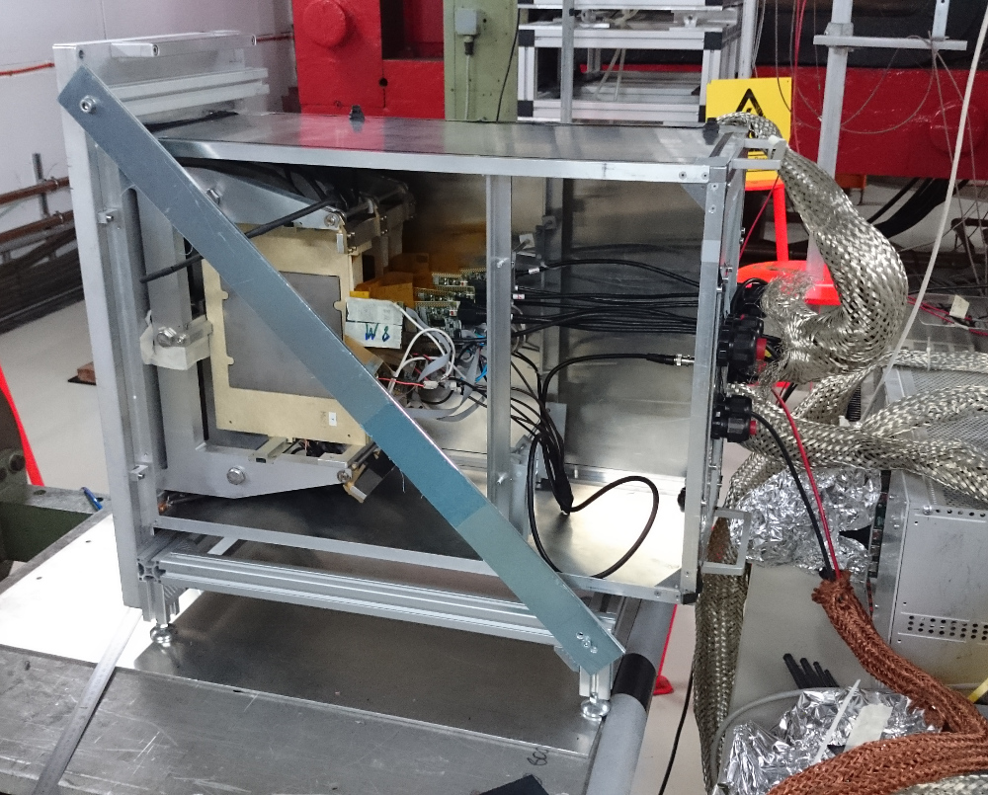
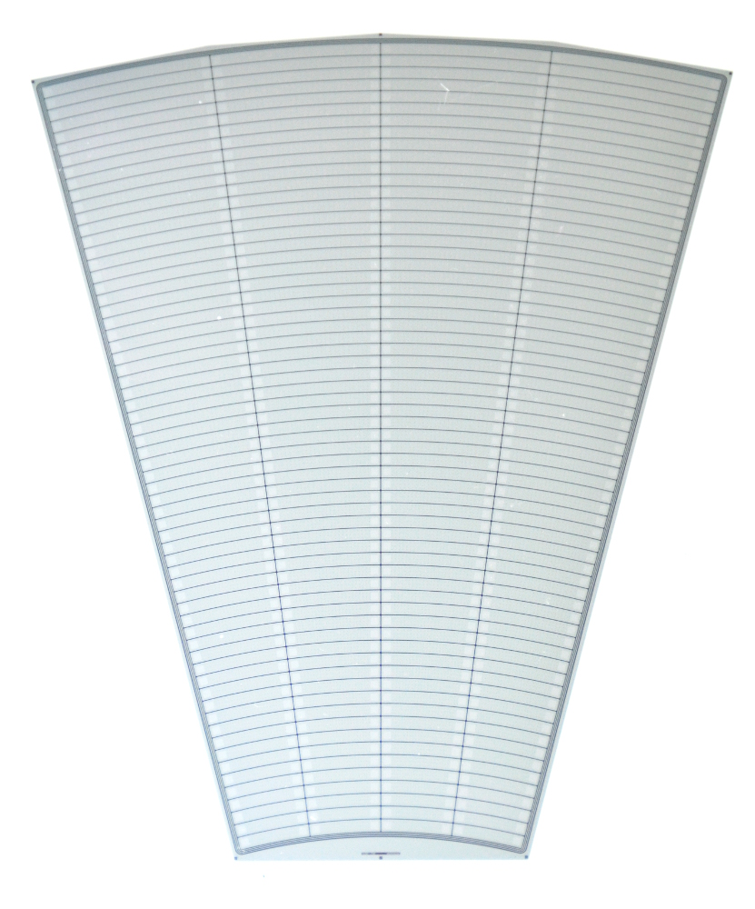
Test beam setup
Mainframe rotated by 90°
Electron beam 1 – 6 GeV
Dipole magnet 1 – 13 kGs
Target to produce γ
EUTelescope with 6 planes of silicon;
2 layers without W (tracker)
6 layers with W (calorimeter)
Detectors flip 90 degrees (better separation)
e⁻
γ

Slide 10
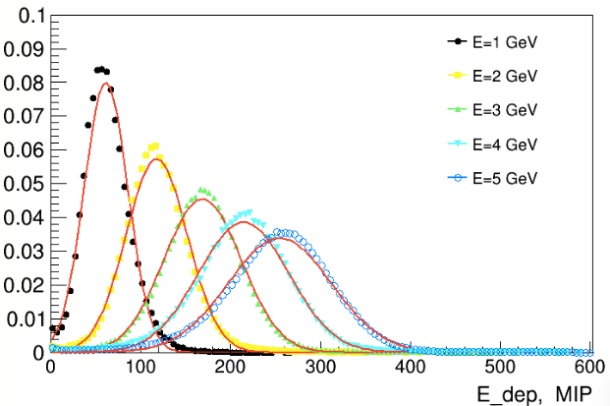
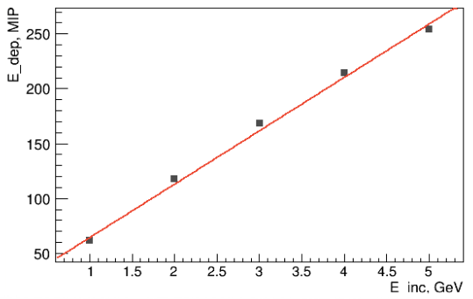
Energy Response of the Calorimeter
E beam, GeV

Slide 11
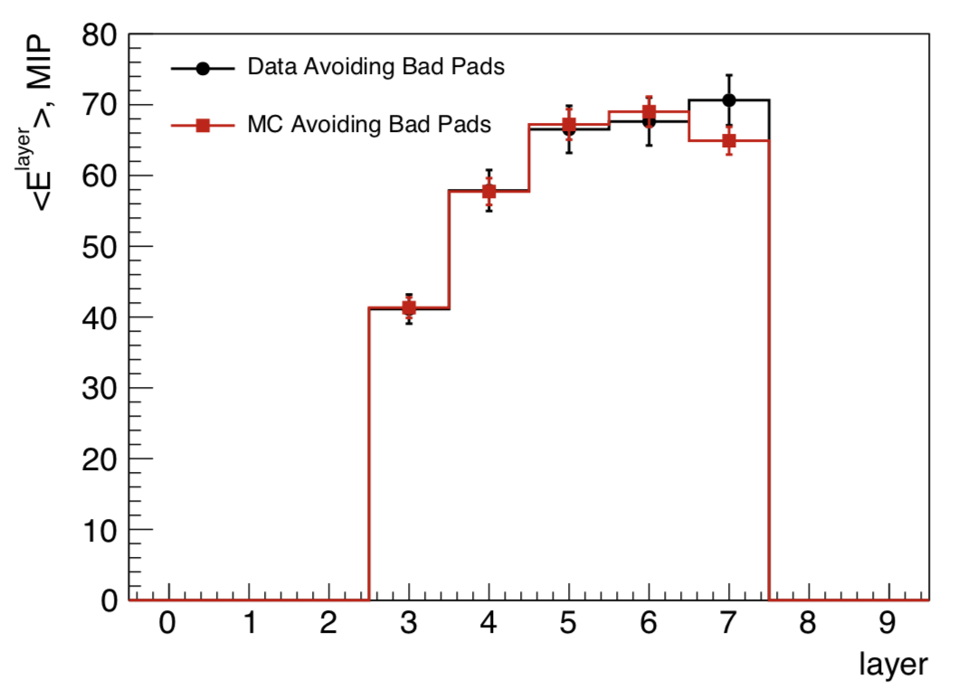
Longitudinal Shower
Sensitive layers are installed after 3, 4, 5, 6, 7 tungsten plates, it roughly corresponds to 3, 4, 5, 6, 7 X0.
Both distributions are, within statistical uncertainties, in reasonable agreement

Slide 12
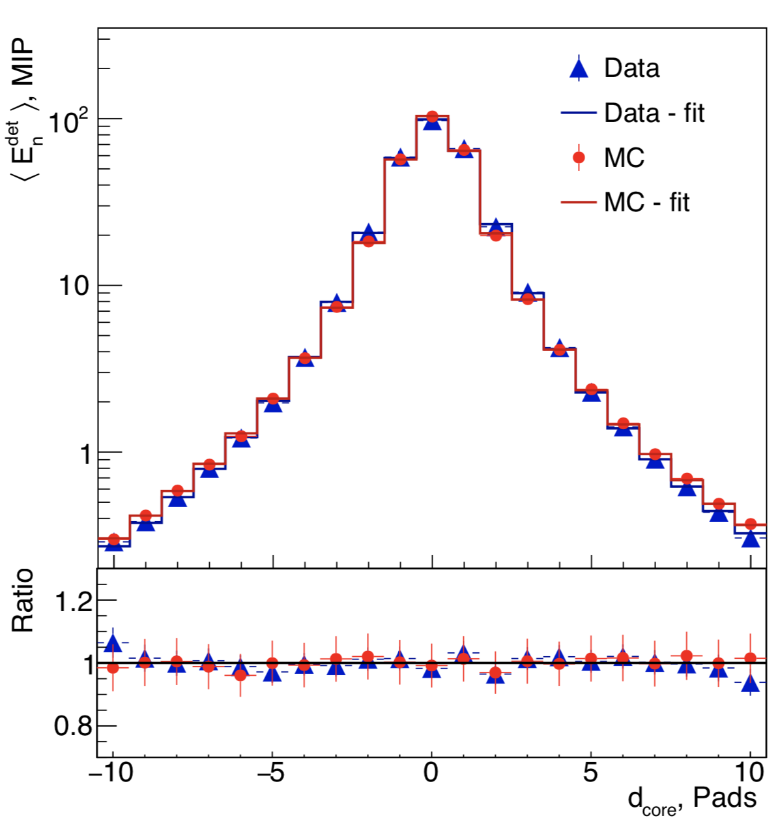
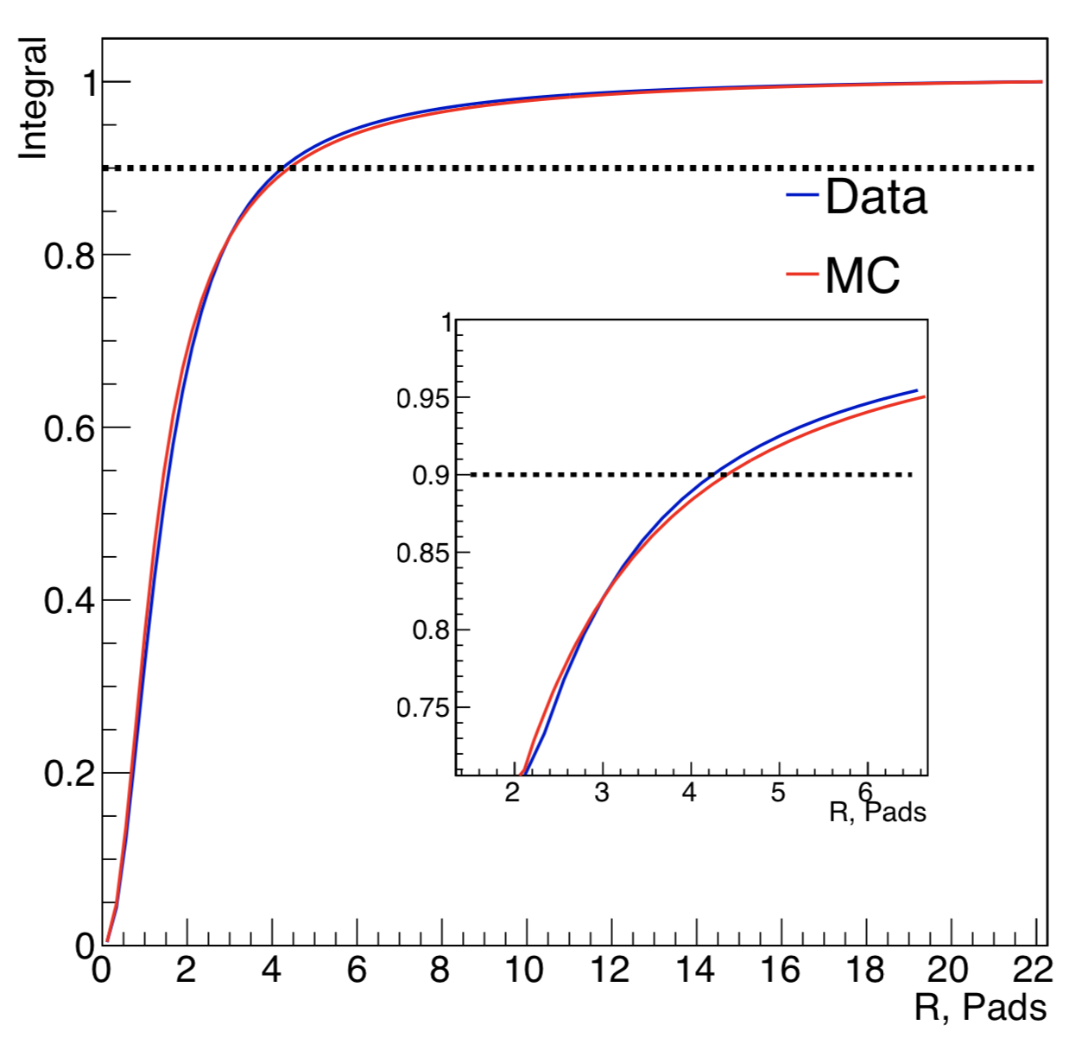
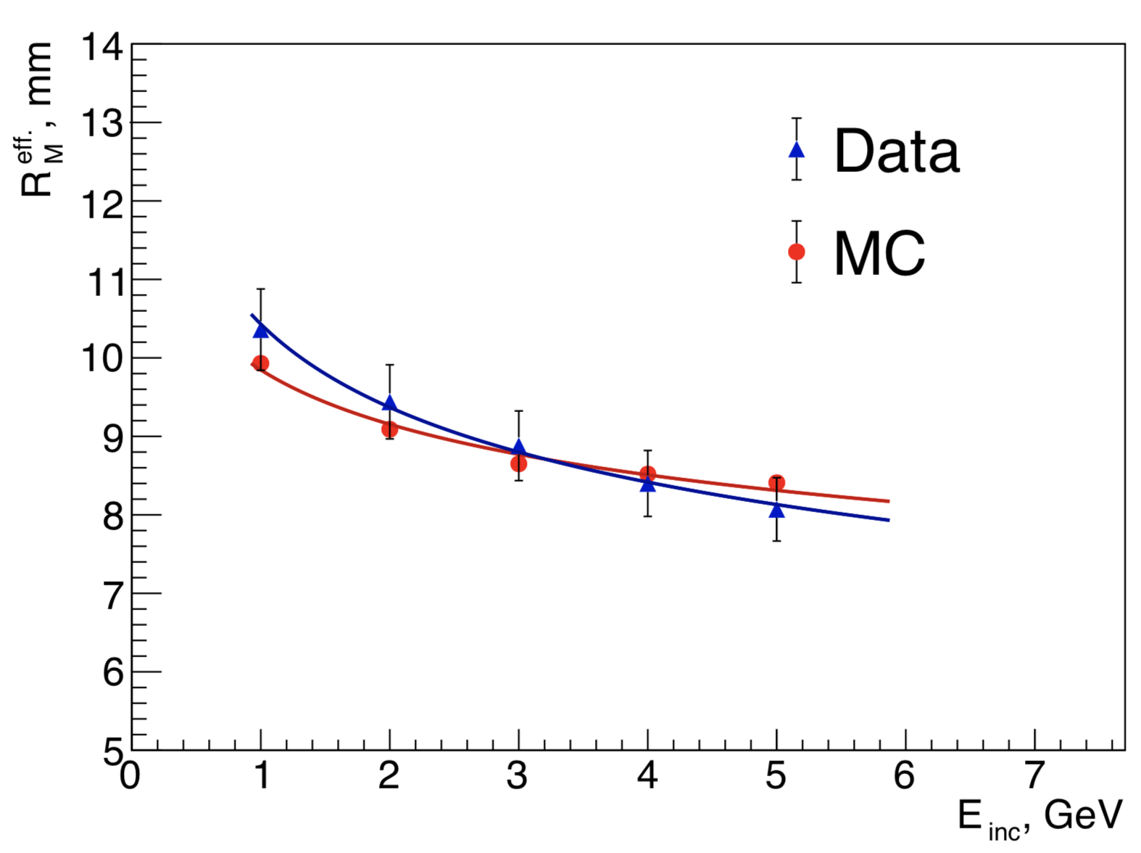
Shower Study in Transverse Plane
Moliere radius as a function of the electron energy
Moliere Radius : 8.1 ± 0.1 ± 0.3 mm

Slide 13
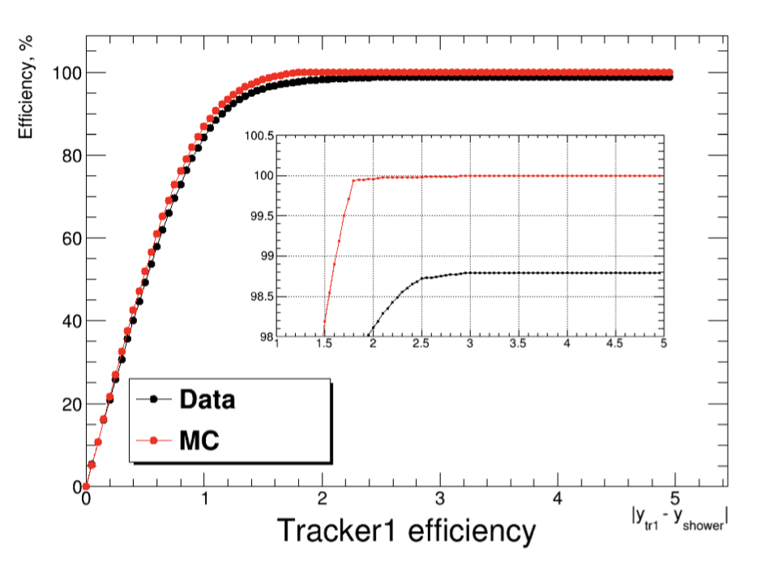
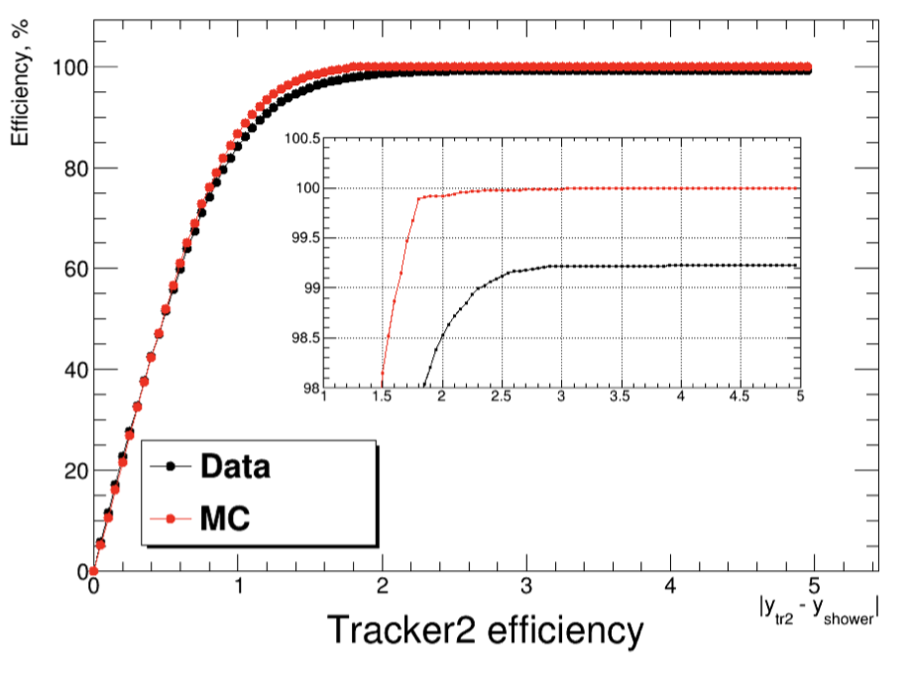
Tracker efficiency (work in progress)
2 first planes of silicon are installed w/o W : possibility to track charged particles
Efficiency of tracker layer X : calculated using tracker layer Y + calorimeter (for 5 GeV electrons)
Tracker 1 efficiency
Tracker 2 efficiency
difference position (mm)
difference position (mm)
Trackers’ efficiency achieve 98% for 2 mm range cut-off
MC needs corrections

Slide 14
Electron/photon identification (work in progress)
electron
photon
Identification efficiency:
electron ~95%
photon ~87%
influence of back-scattered events on e−/γ identification efficiency

Slide 15
conclusion
calorimeter prototype with eight modules of submillimeter thickness installed in 1 mm gap between tungsten absorbers, was tested with electron beam.
The calorimeter demonstrates good linear response to the beam of 1 GeV – 5 GeV and Moliere radius around 8 mm
The two planes used as tracker give a good efficiency around 98% (MC needs corrections)
End 2019, a 20 layers calorimeter will be tested at DESY
This calorimeter can be adjusted for the different LUXE needs. It will be good if we can start to meet so we can learn more about these needs (size, resolution, timing,..).
It will be also interesting for LUXE community to send people to our test beam at the end of this year.
Need to define the timing of the whole system if we want to synchronize the different detectors

