Slide 1
NuRadioMC Simulating the radio emission of neutrinos from interaction to detector
Christian Glaser for the InIceMC group
Christian Glaser, Daniel García-Fernández, Anna Nelles, Jaime Alvarez-Muñiz, Steven W. Barwick, Dave Z. Besson, Brian A. Clark, Amy Connolly, Cosmin Deaconu, Krijn de Vries, Jordan C. Hanson, Ben Hokanson-Fasig, R. Lahmann, Uzair Latif, Stuart A. Kleinfelder, Christopher Persichilli, Yue Pan, Carl Pfender, Ilse Plaisier, Dave Seckel, Jorge Torres, Simona Toscano, Nick van Eijndhoven, Abigail Vieregg, Christoph Welling, Tobias Winchen, Stephanie A. Wissel
arXiv:1906.01670

Slide 2
NuRadioMC Overview
Modular python code (C++ modules for time critical operations)
Open source: github.com/nu-radio/NuRadioMC
Community wide effort (InIceMC group)
Event
Generation
Signal
Generation
Signal
Propagation
Detector
Simulation
Cross section
Flavor-ratio
Arrival direction
…
Phase and frequency
LPM effect
…
Ice models
(analytic) ray tracing
…
Frequency and phase response
Flexible station layout
Trigger simulation
…
new
multiple interactions
e.g. tau decays
time domain calculation with realistic LPM
fast + precise analytic
ray tracer
NuRadioReco:
Detector simulation and event reconstruction

Slide 3
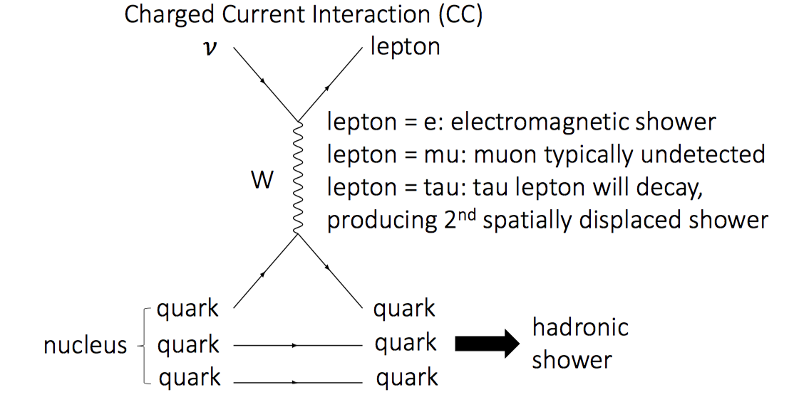
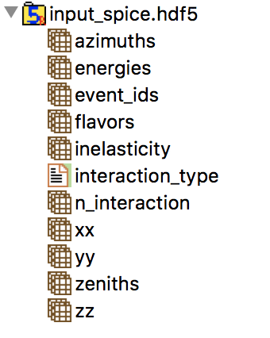
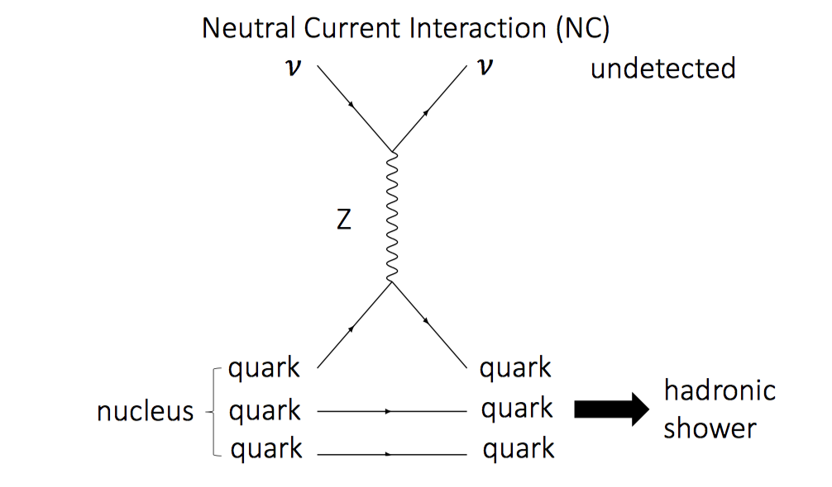
Event Generation
asf

Slide 4
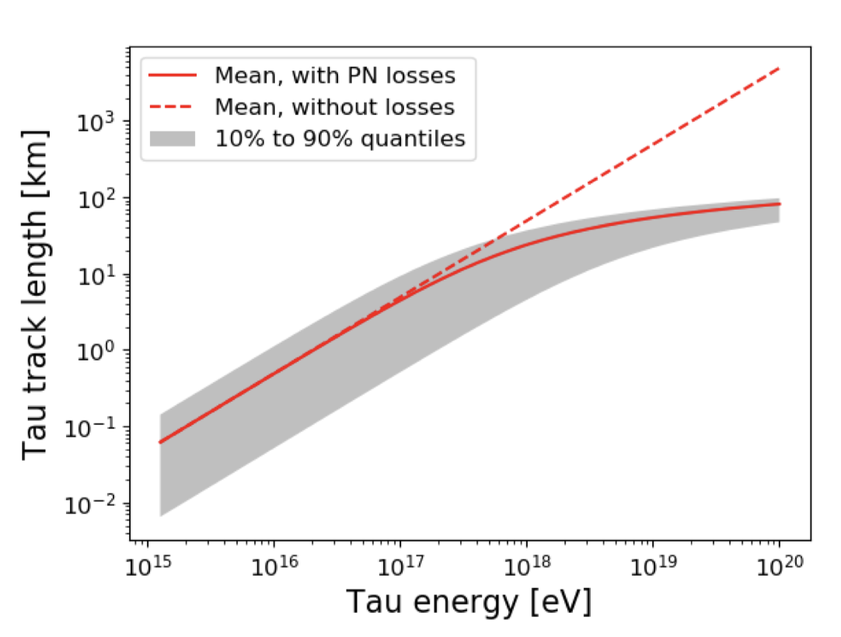
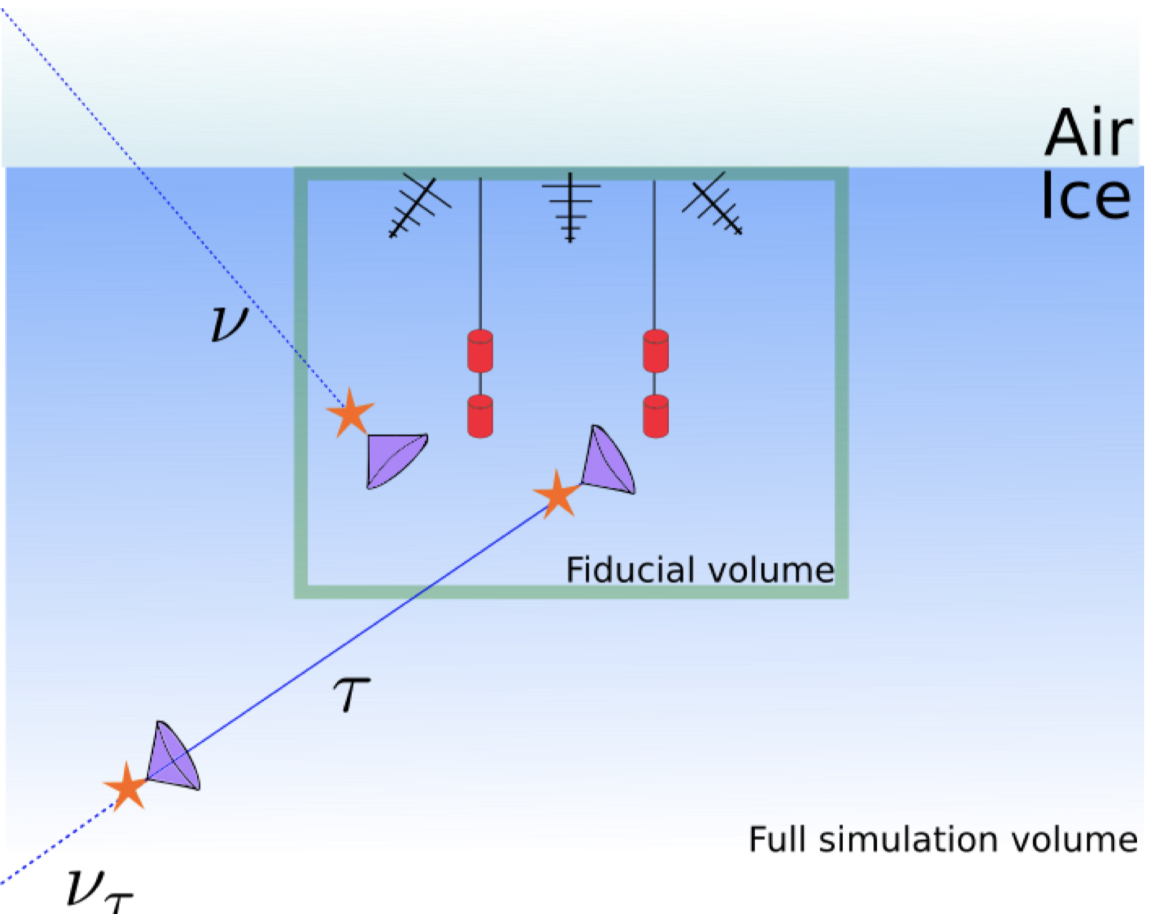
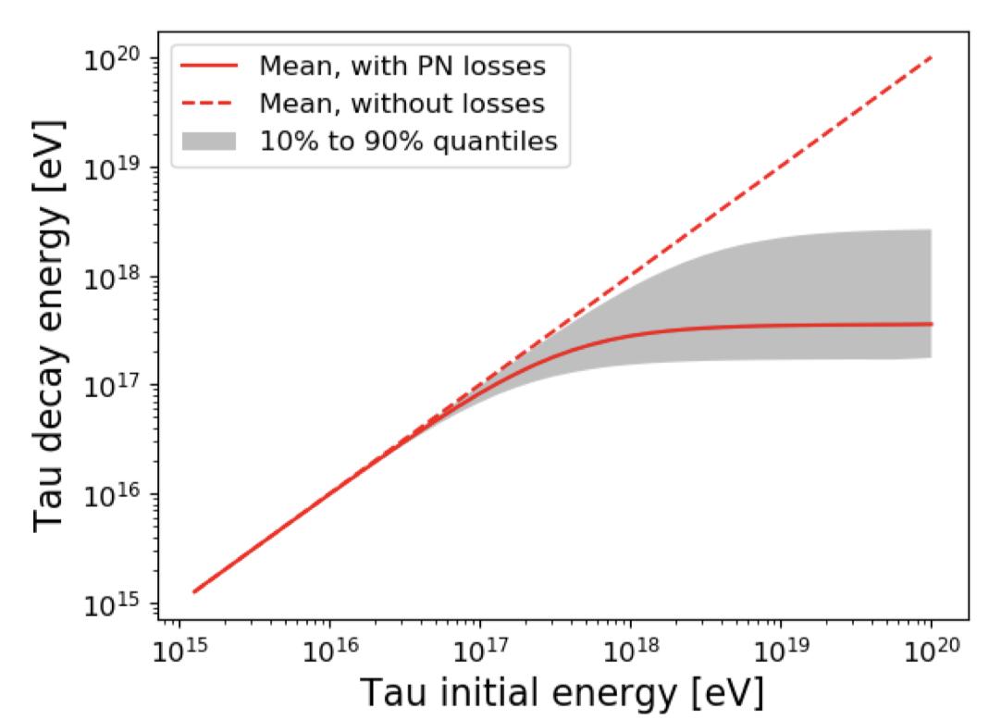
Tau decays
generalization: Integration of PROPSAL for lepton propagation (Daniel)

Slide 5
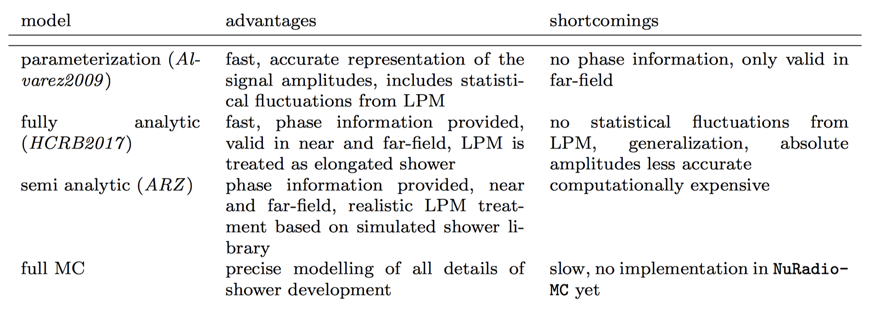
Signal Generation
Well tested reference implantation of all available models

Slide 6
ARZ time domain calculation based on charge-excess shower library

Slide 7
ARZ time domain calculation based on charge-excess shower library

Slide 8
ARZ time domain calculation based on charge-excess shower library

Slide 9
Comparison between models

Slide 10
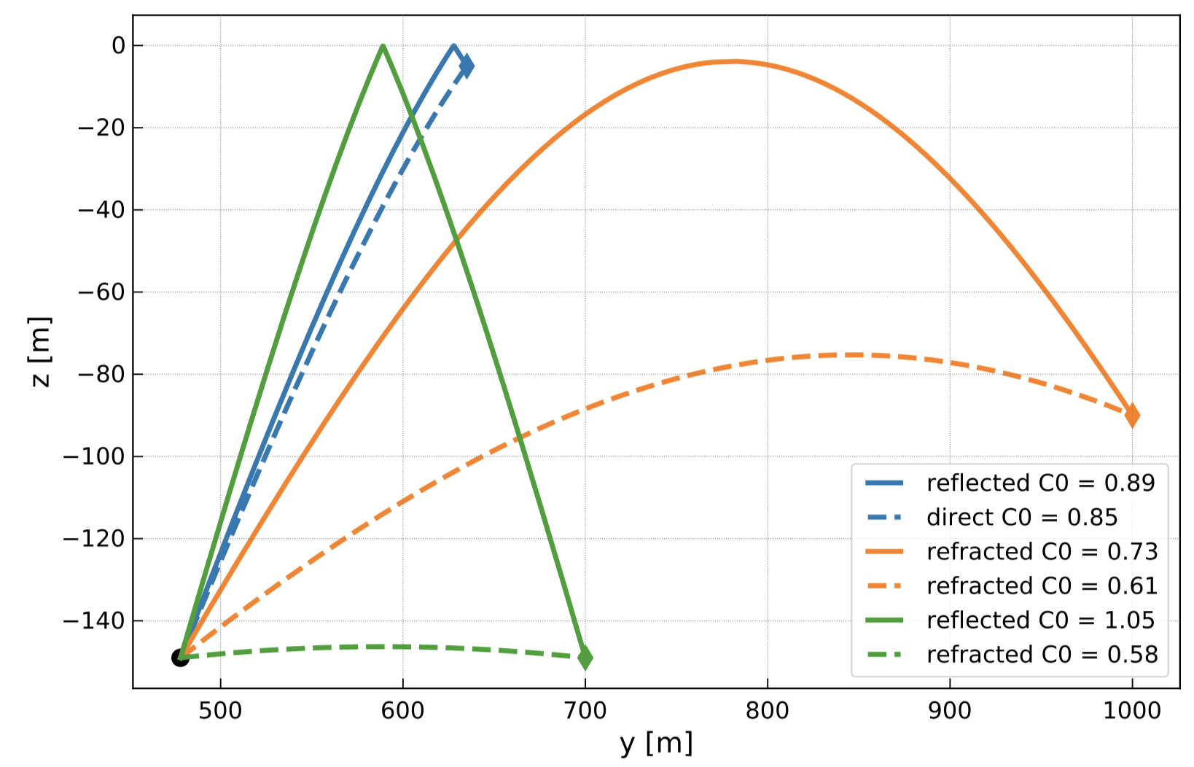
Signal Propagation
Analytic formula of signal path for exponential density profile (Jordan, Uzair)
Fast and precise calculation of signal paths
Analytic formulas for travel time + distance (Ben, Uzair)
Attenuation requires numerical integration
C++ implementation (Brian)
Interface to RadioPropa (Tobias, Ilse)

Slide 11
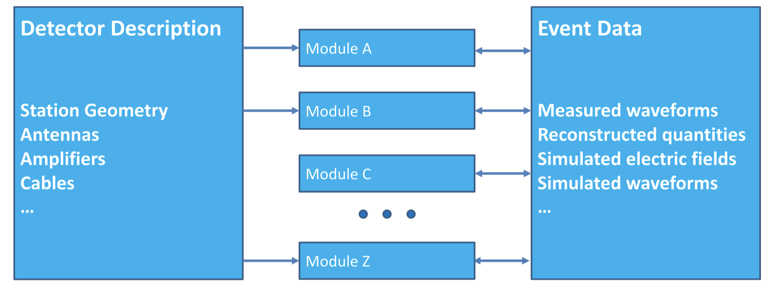
Detector Simulation
NuRadioReco: Detector simulation and event reconstruction
github.com/nu-radio/NuRadioReco
Glaser et al., EPJC 79: 464 (2019) arXiv:1903.07023
Flexible detector layout
any antenna position and orientation
State-of-the art event browser using web technologies
Different trigger modules

Slide 12
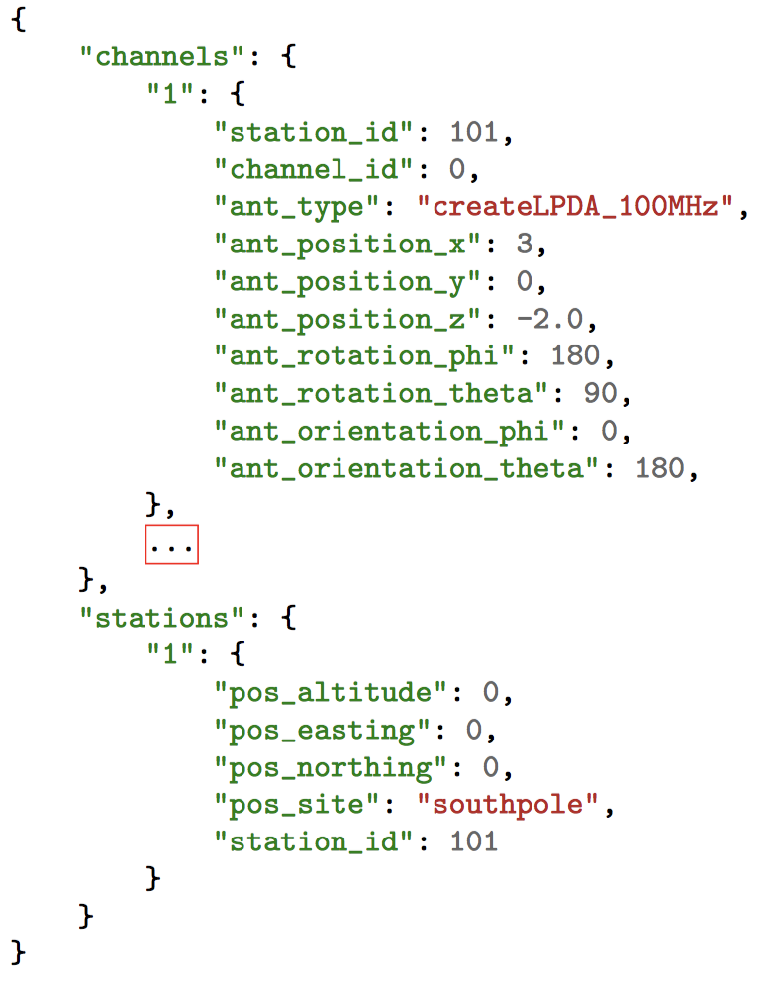
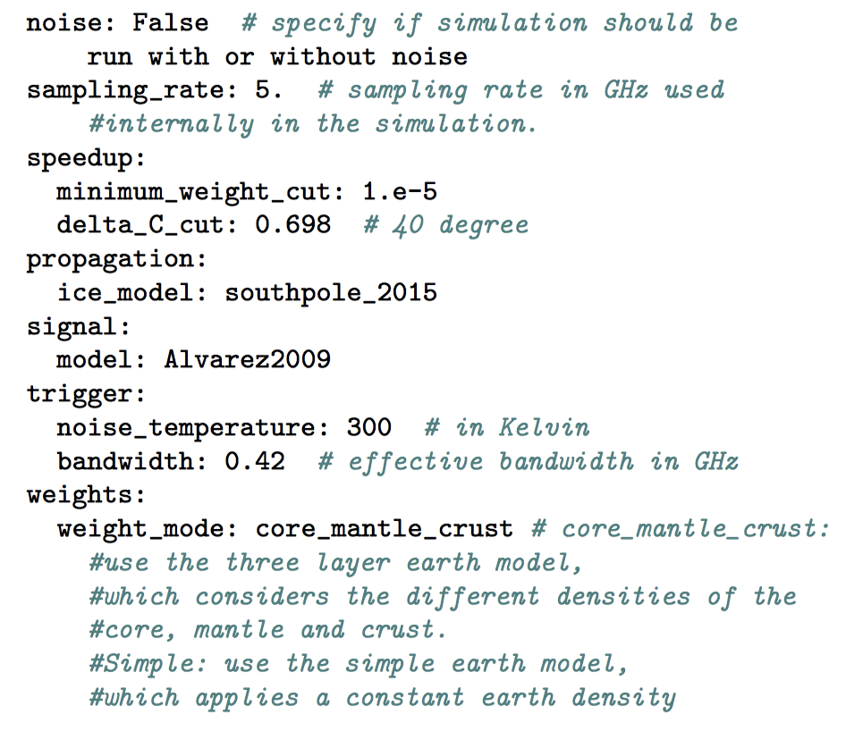
Example 1: Calculation of the sensitivity of an Askaryan neutrino detector
detector description
config

Slide 13
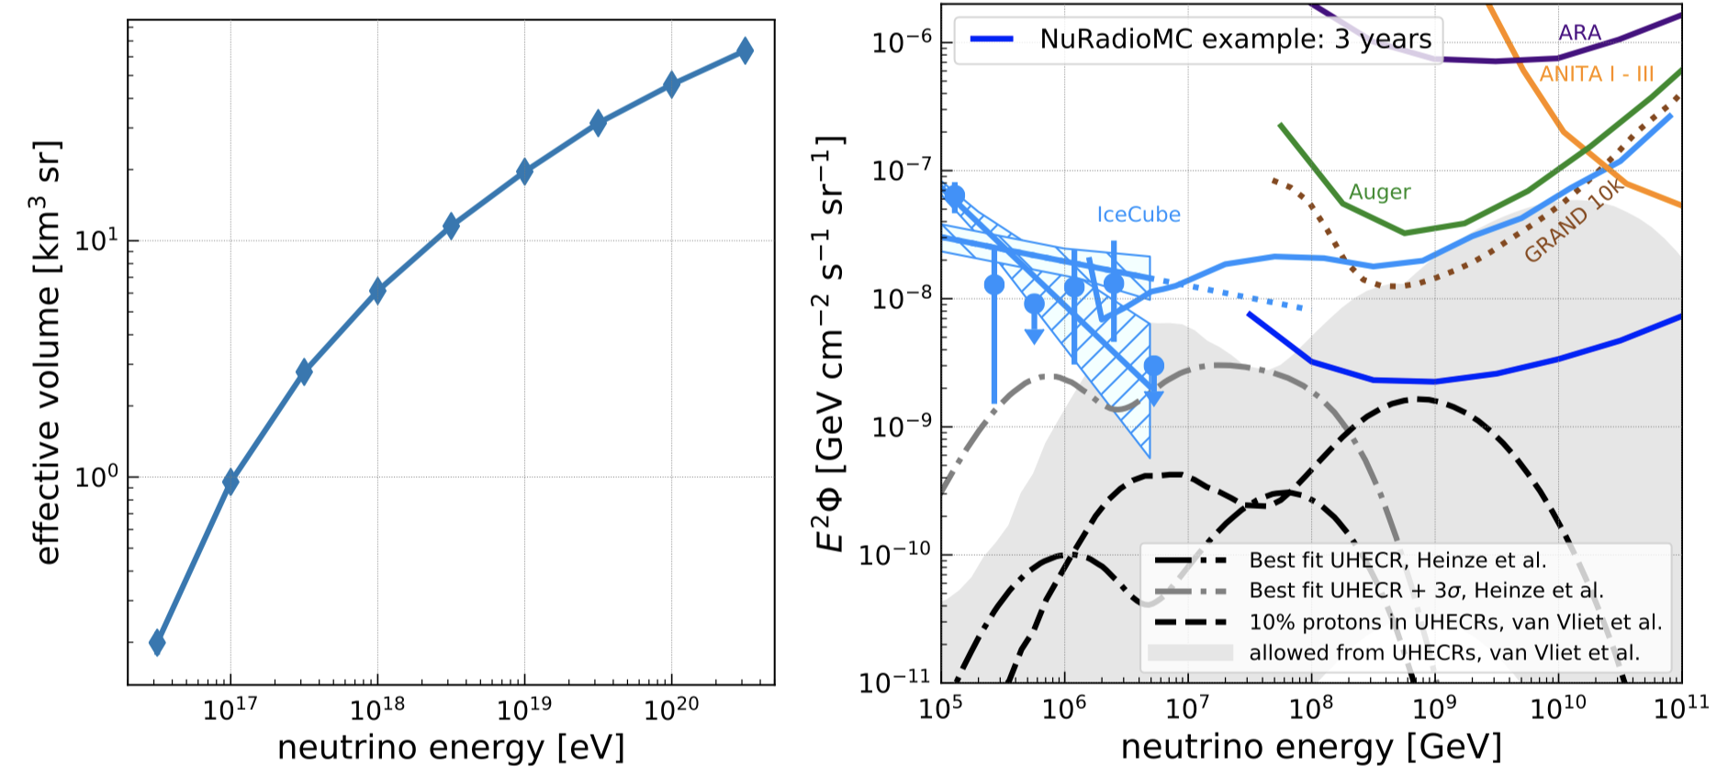
Results
Full example: https://github.com/nu-radio/NuRadioMC/wiki/Tutorial
Plotting scripts part of NuRadioMC

Slide 14
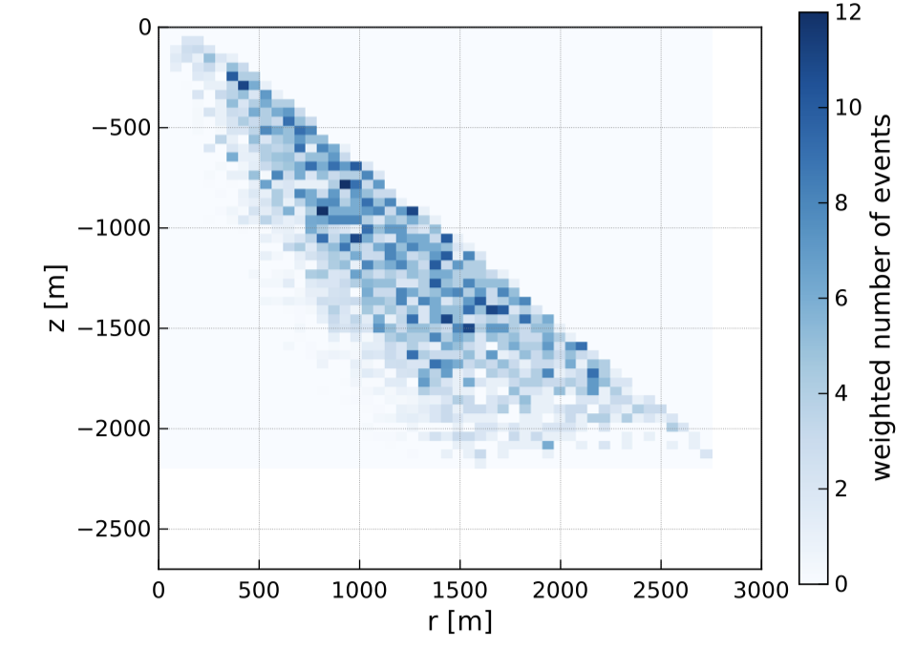
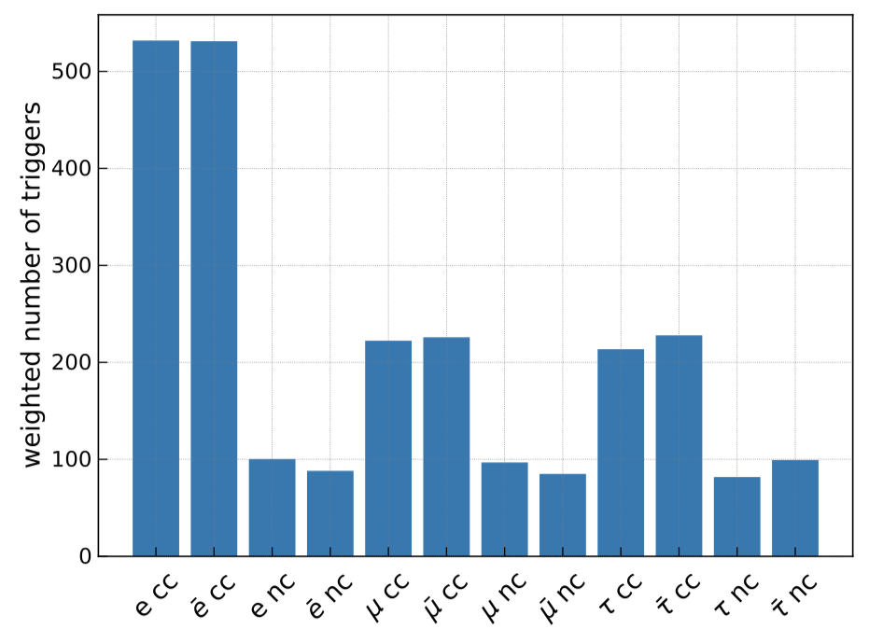
Debug Plots

Slide 15
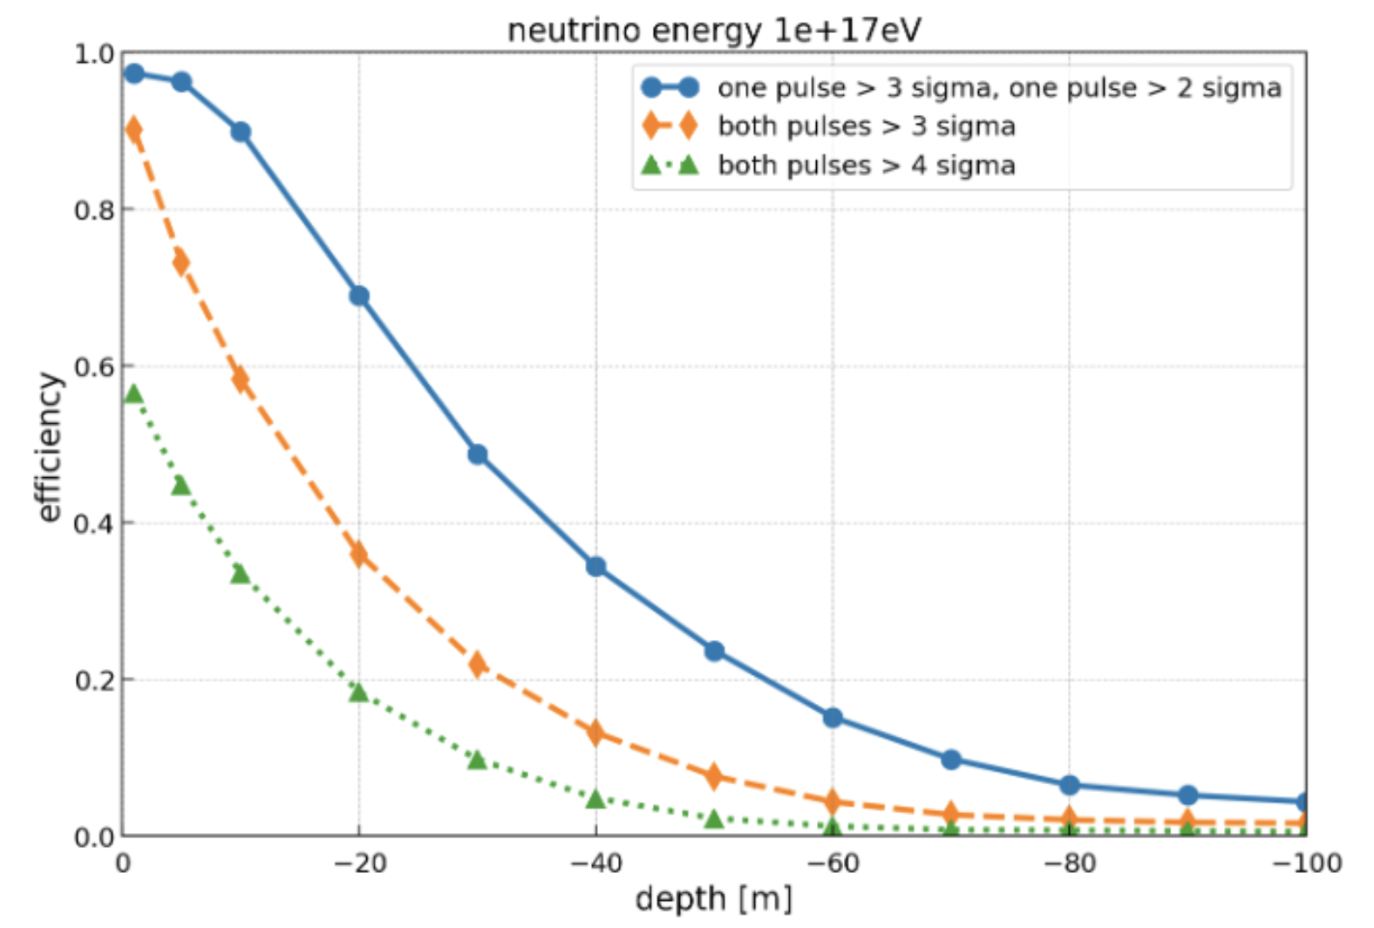
Direct + Reflected Efficiency

Slide 16
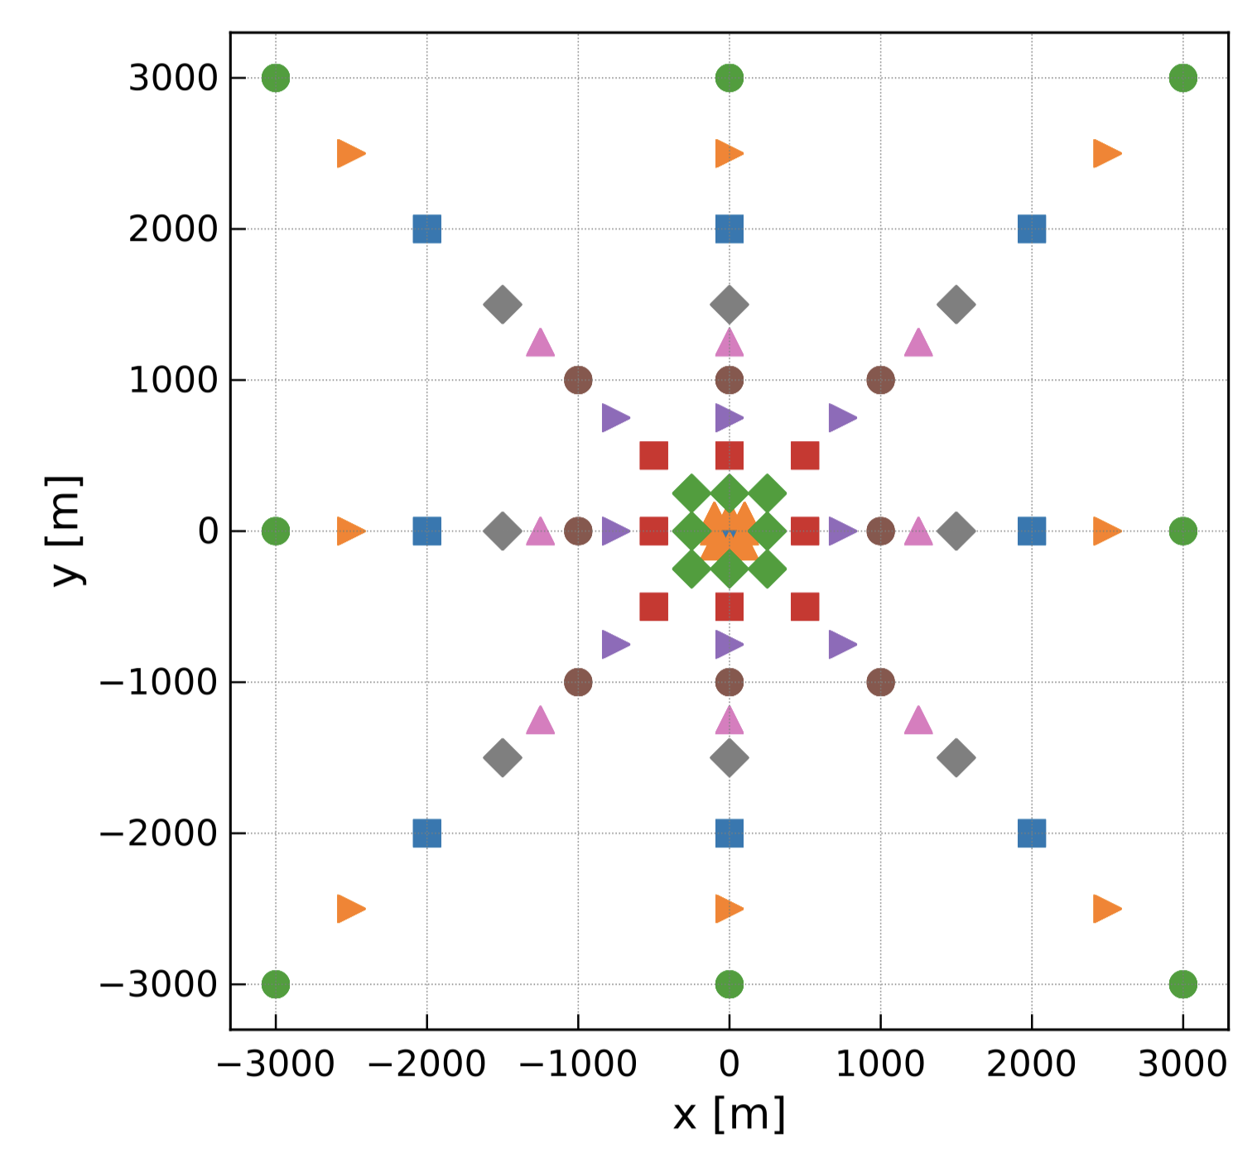
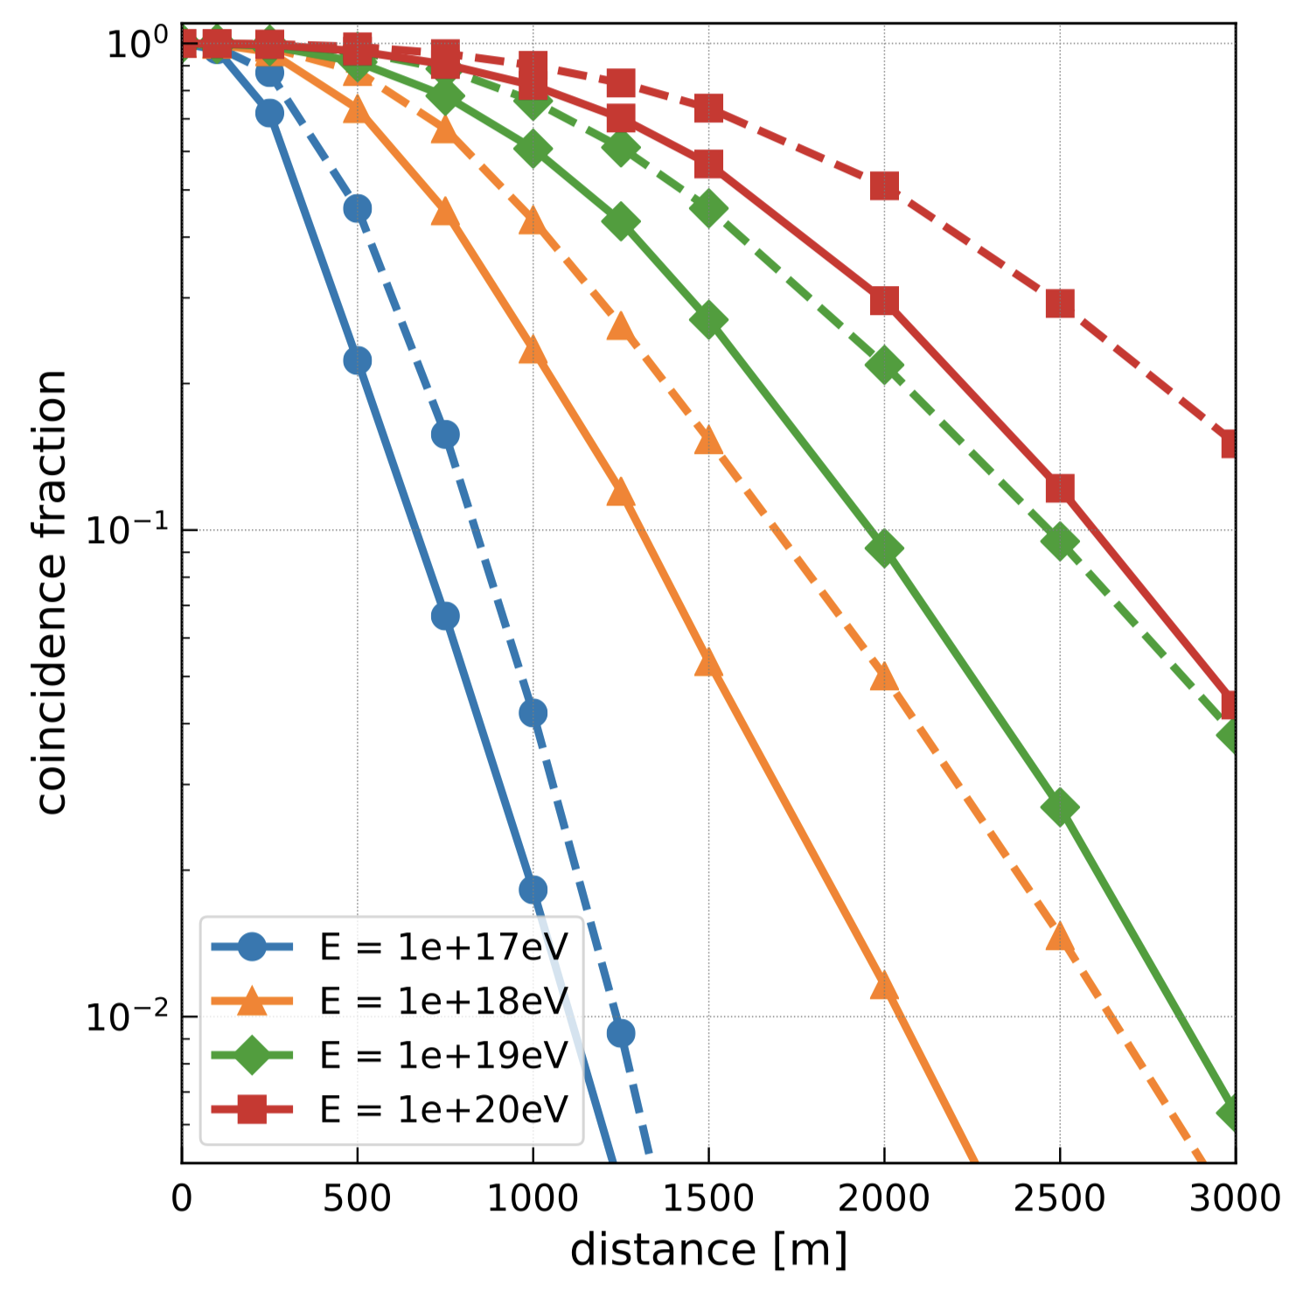
Multi Station Coincidences

Slide 17
Areas of Future Improvement
Full integration of any lepton propagation (PROPOSAL see Daniels talk)
Signal Propagation
ray tracing in any 3D index-of-refraction profile (RadioPropa, see Ilse’s talk)
beyond ray tracing (FTDT, see Krijn’s talk)
Microscopic simulation of radio emission
integration in CORSIKA8
Detector simulation
propagate signals from different parts of the shower to antennas
…

Slide 18
Conclusions NuRadioMC
New modular Python-based Monte Carlo framework
Community wide effort
Improvements in flexibility, (speed) and precision compared to previous tools
Emphasis on user friendliness and flexibility
Stand along usage of modular parts:
Reference implementation for neutrino community
All code open-source
Installation: “pip install NuRadioMC”

