Slide 1
BKR training for X-ray Gas Monitors at European XFEL
Theophilos Maltezopoulos
X-ray Photon Diagnostics (XPD)
Hamburg, 19.03.2019
Basic concept of XGM
24/7 operation
Quick fixes

Slide 2
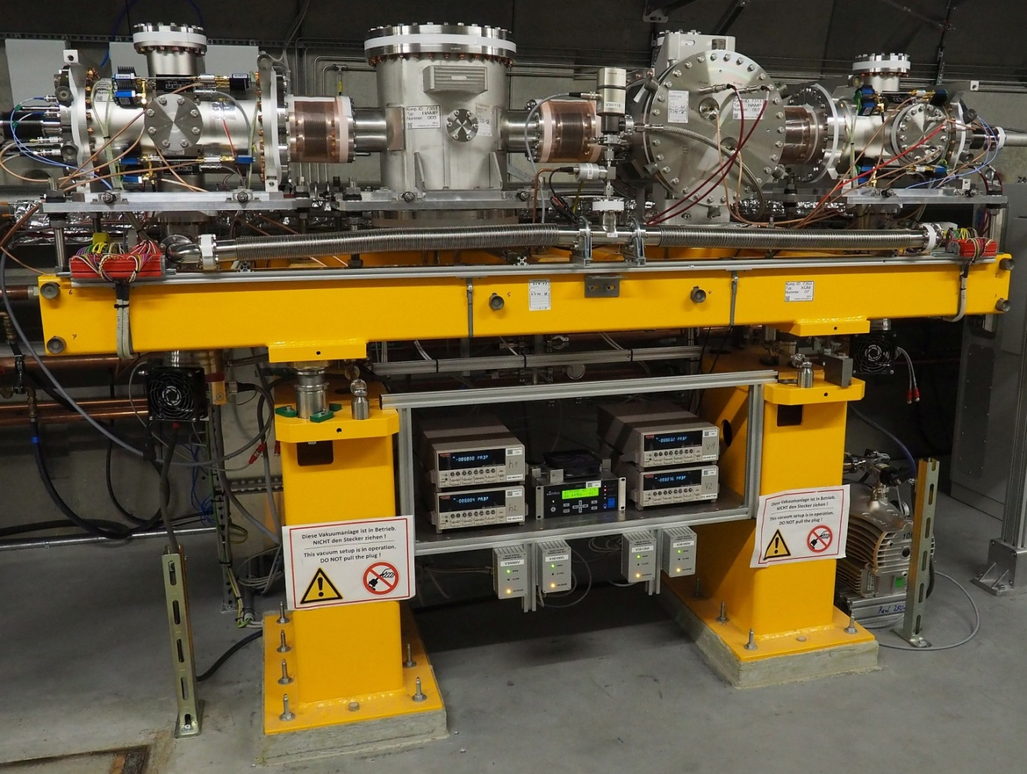
X-ray Gas Monitors (XGM) setup
XGMDh
HAMPh
HAMPv
XGMDv
Upstream
Downstream
X-ray beam
Developed at DESY
in the group of Kai Tiedtke
XGM@XTD10
Single-shot non-invasive pulse energy measurement
and average non-invasive beam position monitoring
Users
Operators

Slide 3
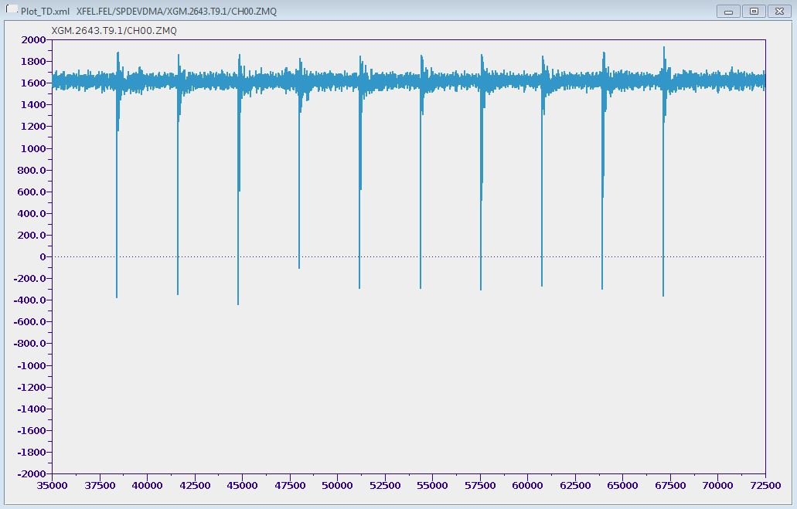
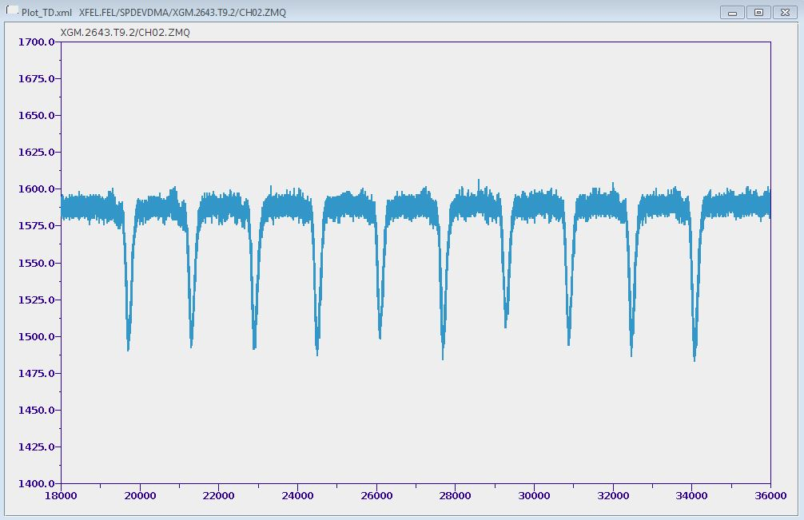
XGMD
HAMP
Vacuum
Vacuum
i₁
Averaged absolutely
calibrated ion signal
↓
Photon flux with
absolute measurement
uncertainty of 7-10 %
Pulse resolved
ion signal
i₂
Ions
h₁
HV_{i mesh}
h₂
Electrons
X-ray beam
HV_{HAMP}
MP stage
HV_{e mesh}
Electrons
Ions
HV_{e}
X-ray beam
Pulse resolved
electron signal
e₁
HV_{rep}
e₂
Software average in timescale of ion current → Cross calibration
XGMDh electrons (4 ns FWHM)
HAMPv ions (100 ns FWHM)

Slide 4
XGM equations
Number of ions created per pulse in the XGMD:
N_{ph} number of photons per pulse
σ_{ph} total photoionization cross section
z_{XGMD} length of Faraday cup (27.8 cm)
p_{atom} target gas pressure
k Boltzmann constant T temperature
$$N_{ion}=\frac{N_{ph}∗ σ_{ph}\left(ℏω\right)∗z_{XGMD}∗p_{atom}}{k∗T}$$
Ion current measured by Faraday cup of the XGMD:
$$I_{ion}=N_{ion}∗T_{Ni}∗q_{ph}\left(ℏω\right)∗N_{bunches}∗R_{rep}∗e$$
q_{ph} ion mean charge
T_{Ni} transmission of Ni mesh in front of the Faraday cup (80%)
N_{pulses} number of pulses per train
R_{rep} train repetition rate (10 Hz)
e elementary charge
Courtesy from A. Sorokin and K. Tiedtke

Slide 5
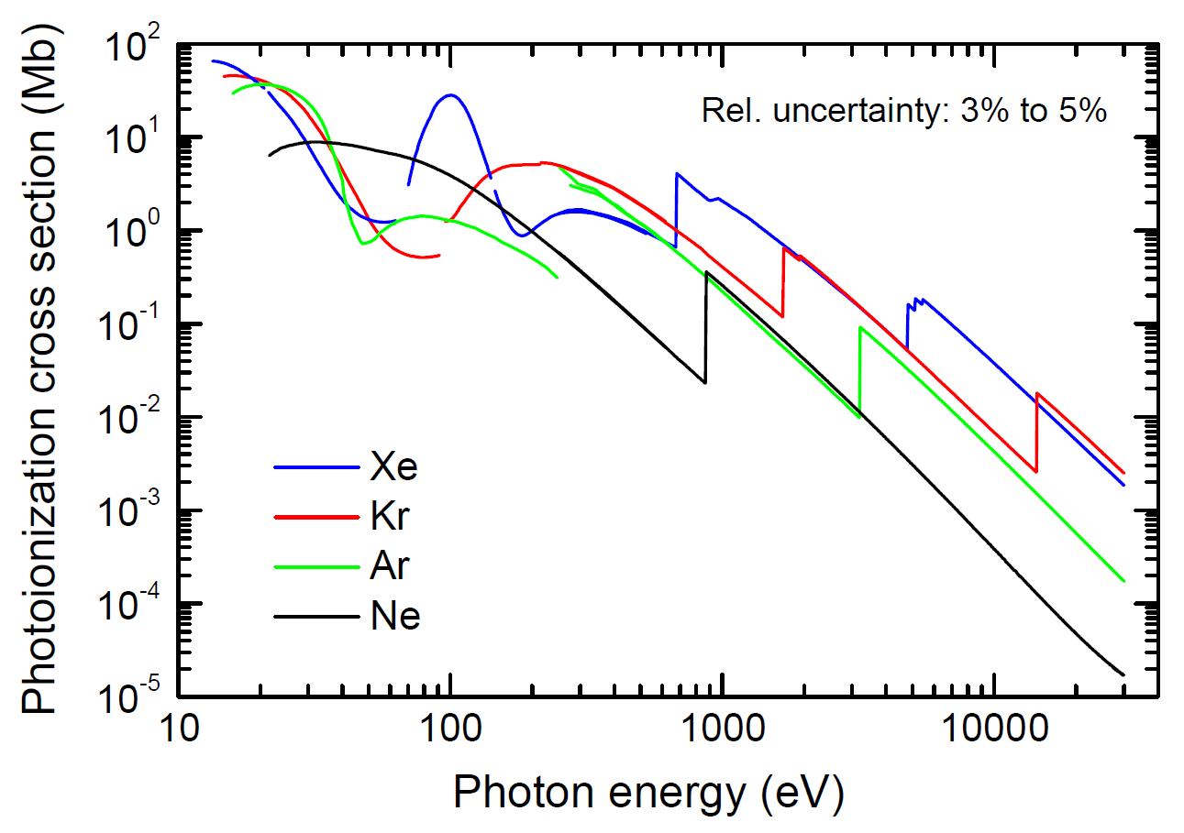
Cross sections
FLASH:
14 eV – 310 eV
SASE3:
250 eV - 3 keV
SASE1 / SASE2:
3 - 24 keV

Slide 6
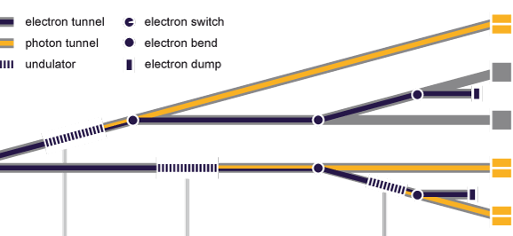
Locations of XGMs in the tunnels
XGM in XTD6
HED
MID
XGM in XTD1
XTD6
XTD7
XTD5
XTD3
XTD8
SASE2
XTD1
XGM in XTD9
SASE1
XTD9
FXE
XTD 2
SASE3
SPB
XTD 4
XGM in XTD2
SQS
XGM in XTD10
XTD 10
SCS
XGM at SCS

Slide 7
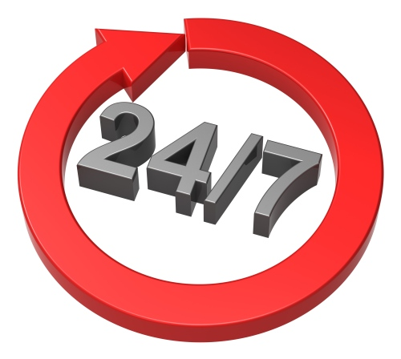
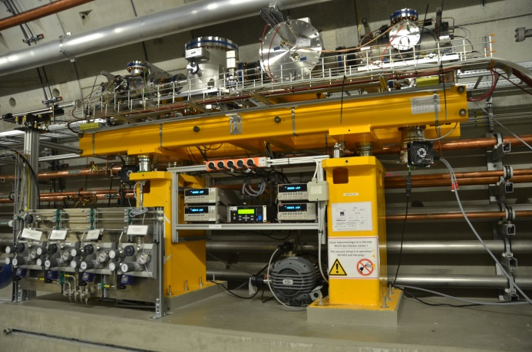
XGM installation
Gas supply (N₂, Kr, Ne, and Xe)
Differential pumping up- and downstream (vacuum group)
Vacuum and gas controls under Karabo (photon system control)
XGM measurement, controls, and data acquisition in DOOCS (accelerator system control)
DOOCS to Karabo bridge
Data acquisition in Karabo
XGM@XTD2

Slide 8
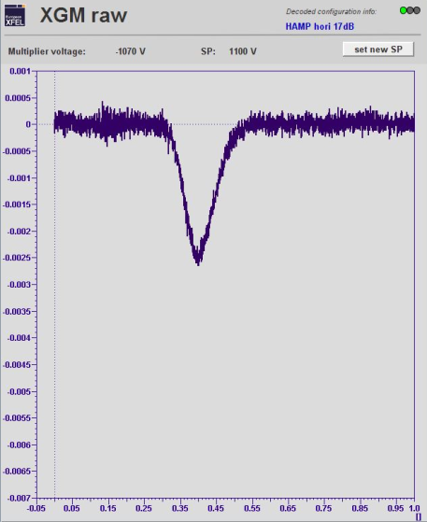
24/7 operation
XGM has no “official” 24/7 support !!!
Number of bunches
Pulse energy
2700 bunches
Full saturation
0 bunches
No lasing
Repetition rate
SASE search with HAMP signal
4.5 MHz
100 kHz
SASE1 photon energy
24 keV
6 keV
Simultaneous operation SASE1, SASE2, and SASE3
Fresh bunch …
Alternating trains pattern …

Slide 9
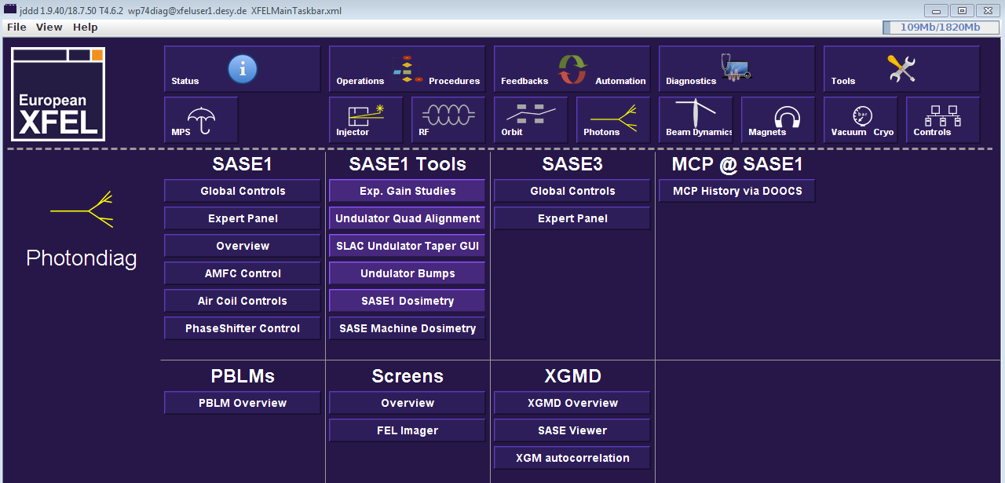
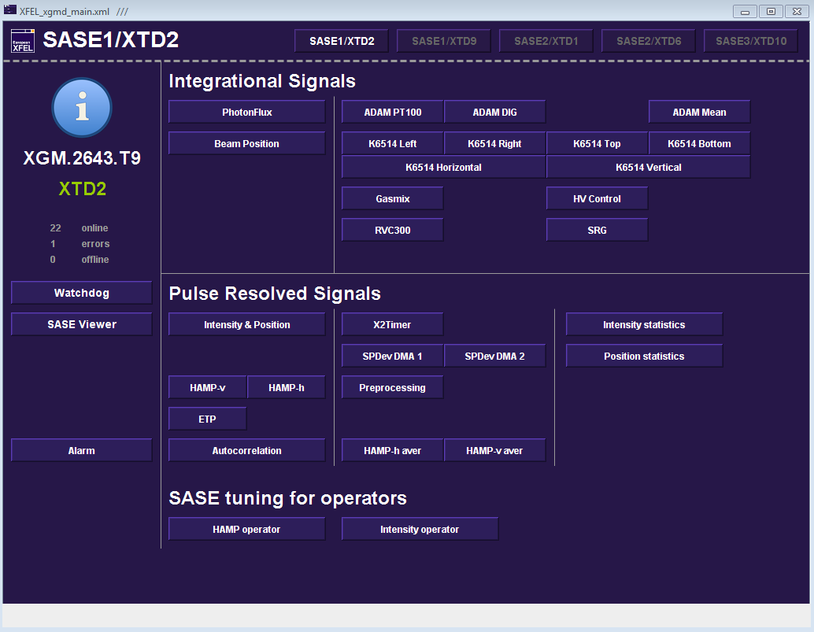
DOOCS

Slide 10
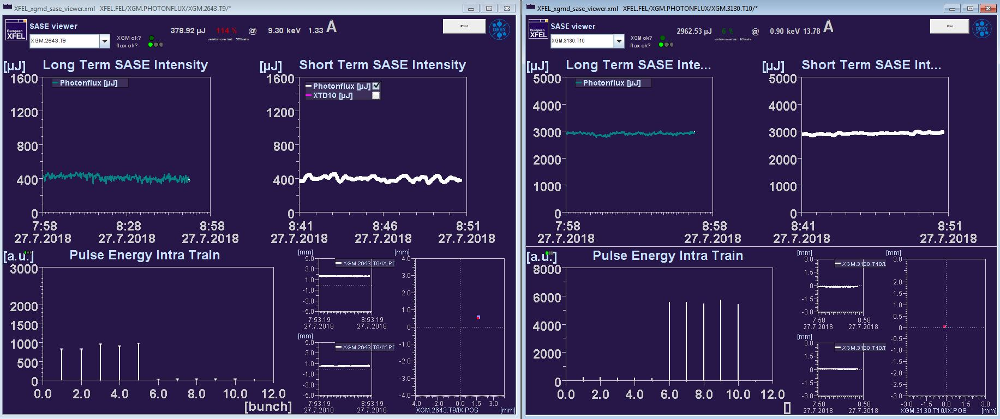
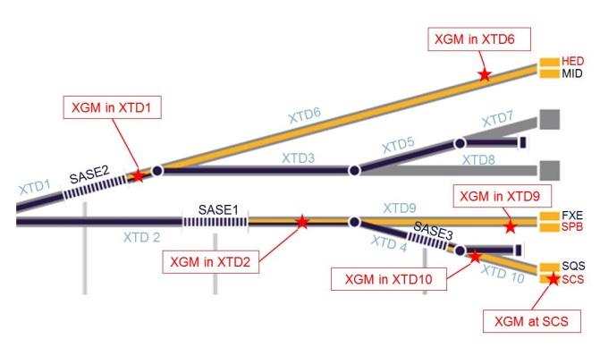
Fresh bunch operation with old SASE viewers
SASE1 / XTD2 XGM
SASE3 / XTD10 XGM
27.07.2018

Slide 11
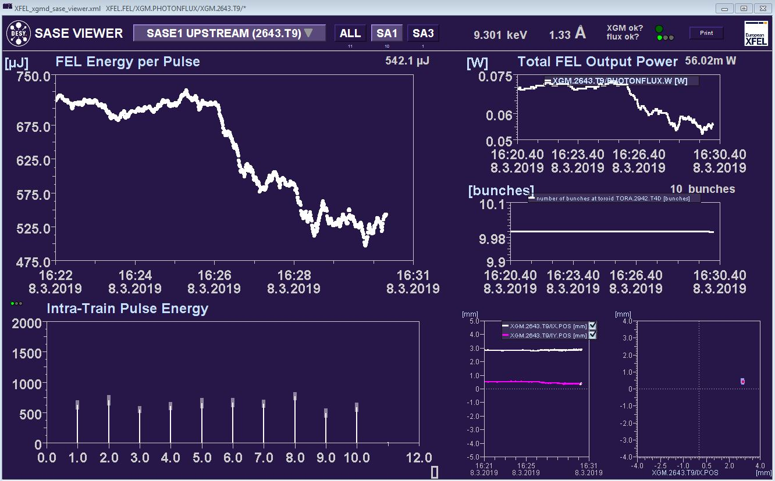
SASE1 XTD2 XGM with new viewer
???
???
Average
Single-shot ADC data
Average ion current
08.03.2019

Slide 12
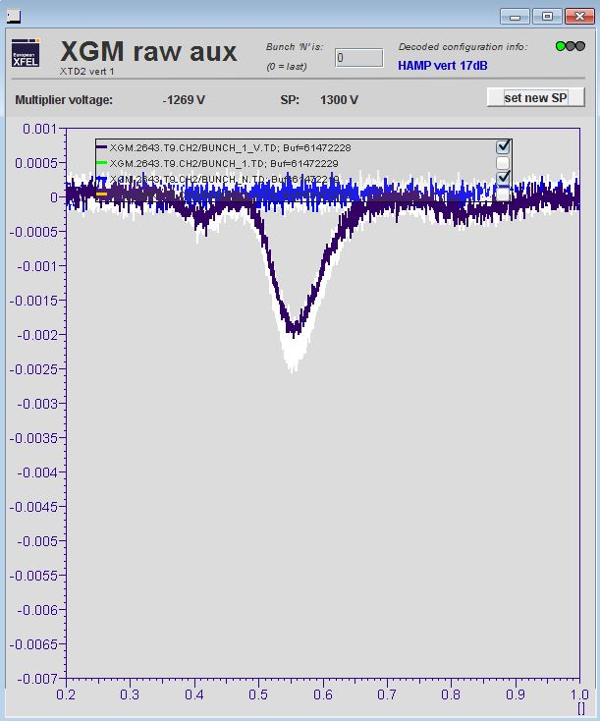
HAMP operator
Set needed HV
Max signal level !!!

Slide 13
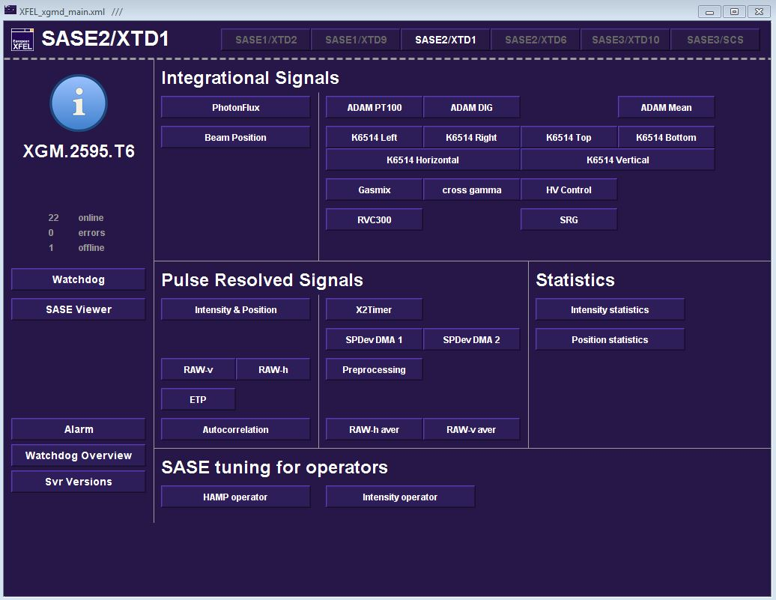
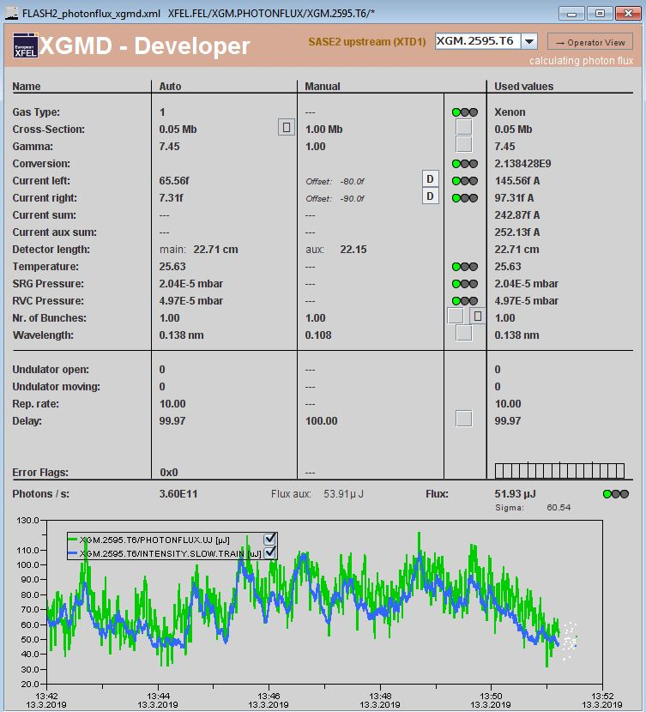
Photonflux overview
Status and errors
All green?
Fast signal calibrated to slow?
… only without fresh bunch !!!

Slide 14
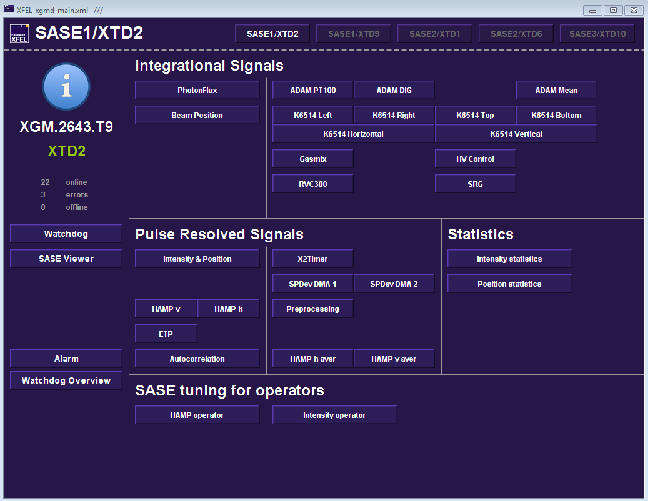
Keithley range
Proper Keithley range selected?

Slide 15
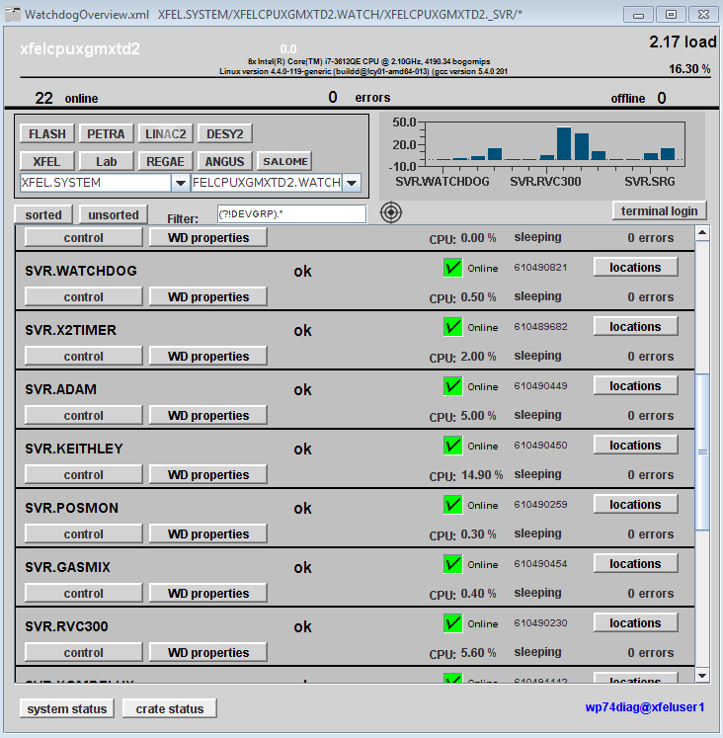
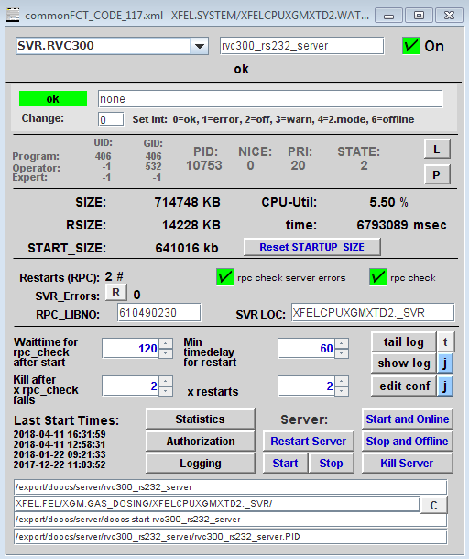
DOOCS server restart
Restart server,
or “Stop and Offline”
and “Start and Online”

Slide 16
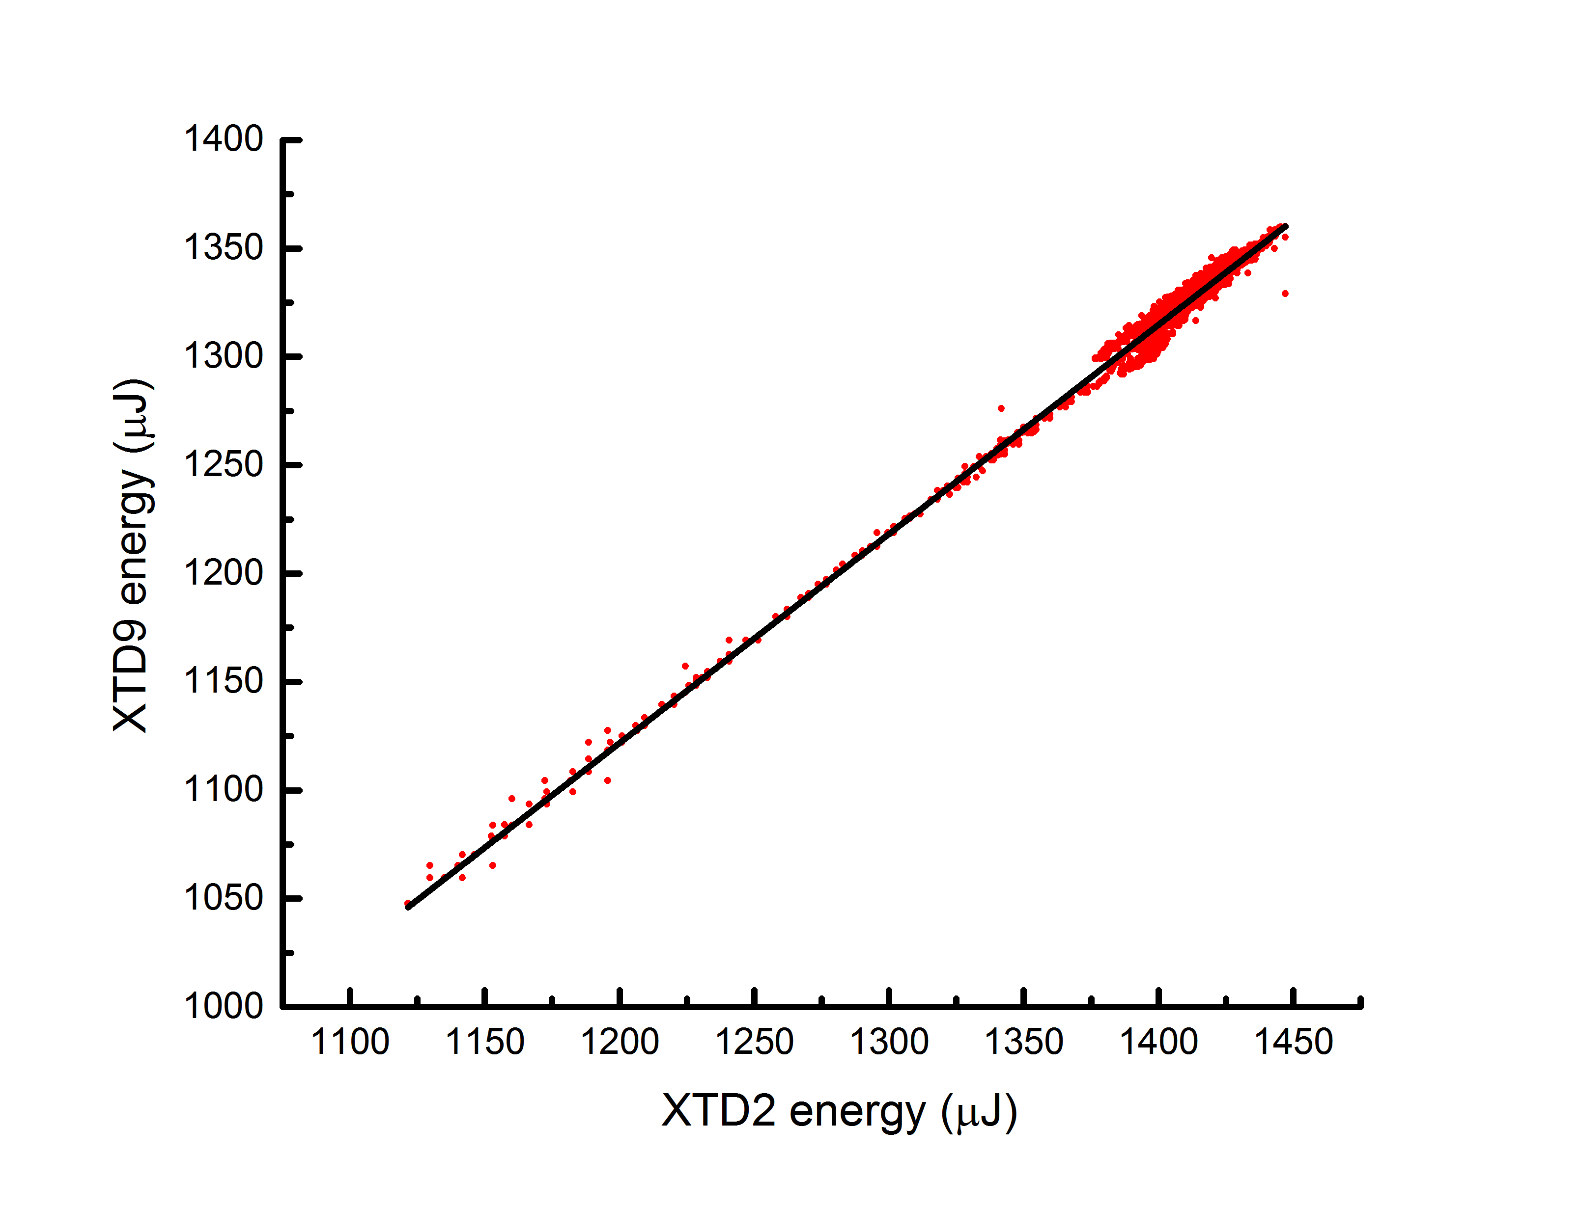
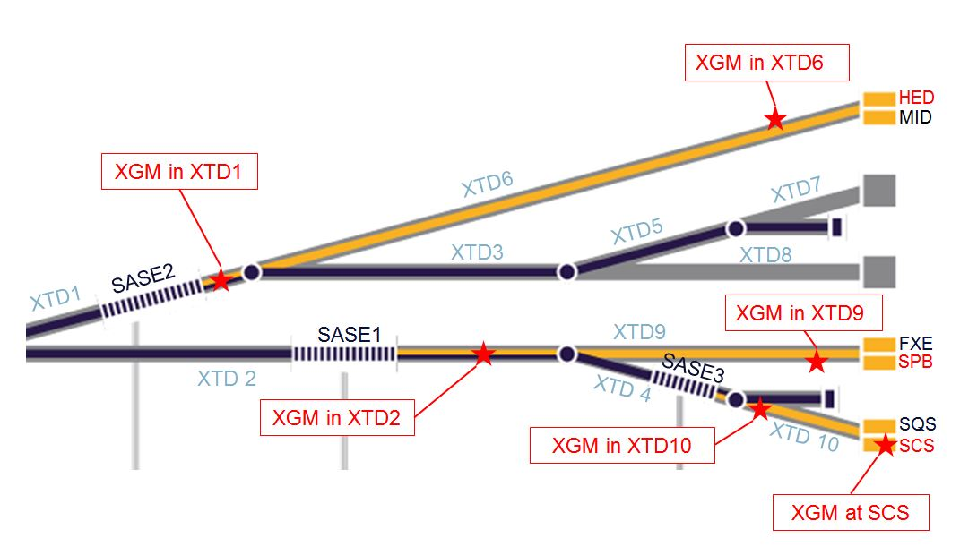
Averaged pulse energy: XTD2 versus XTD9 XGM
Slope: 0.97 (beamline losses)
15.06.2018
0.134 nm, 60 bunches, slow ion signal
both XGMs with Xe, Run 149

Slide 17
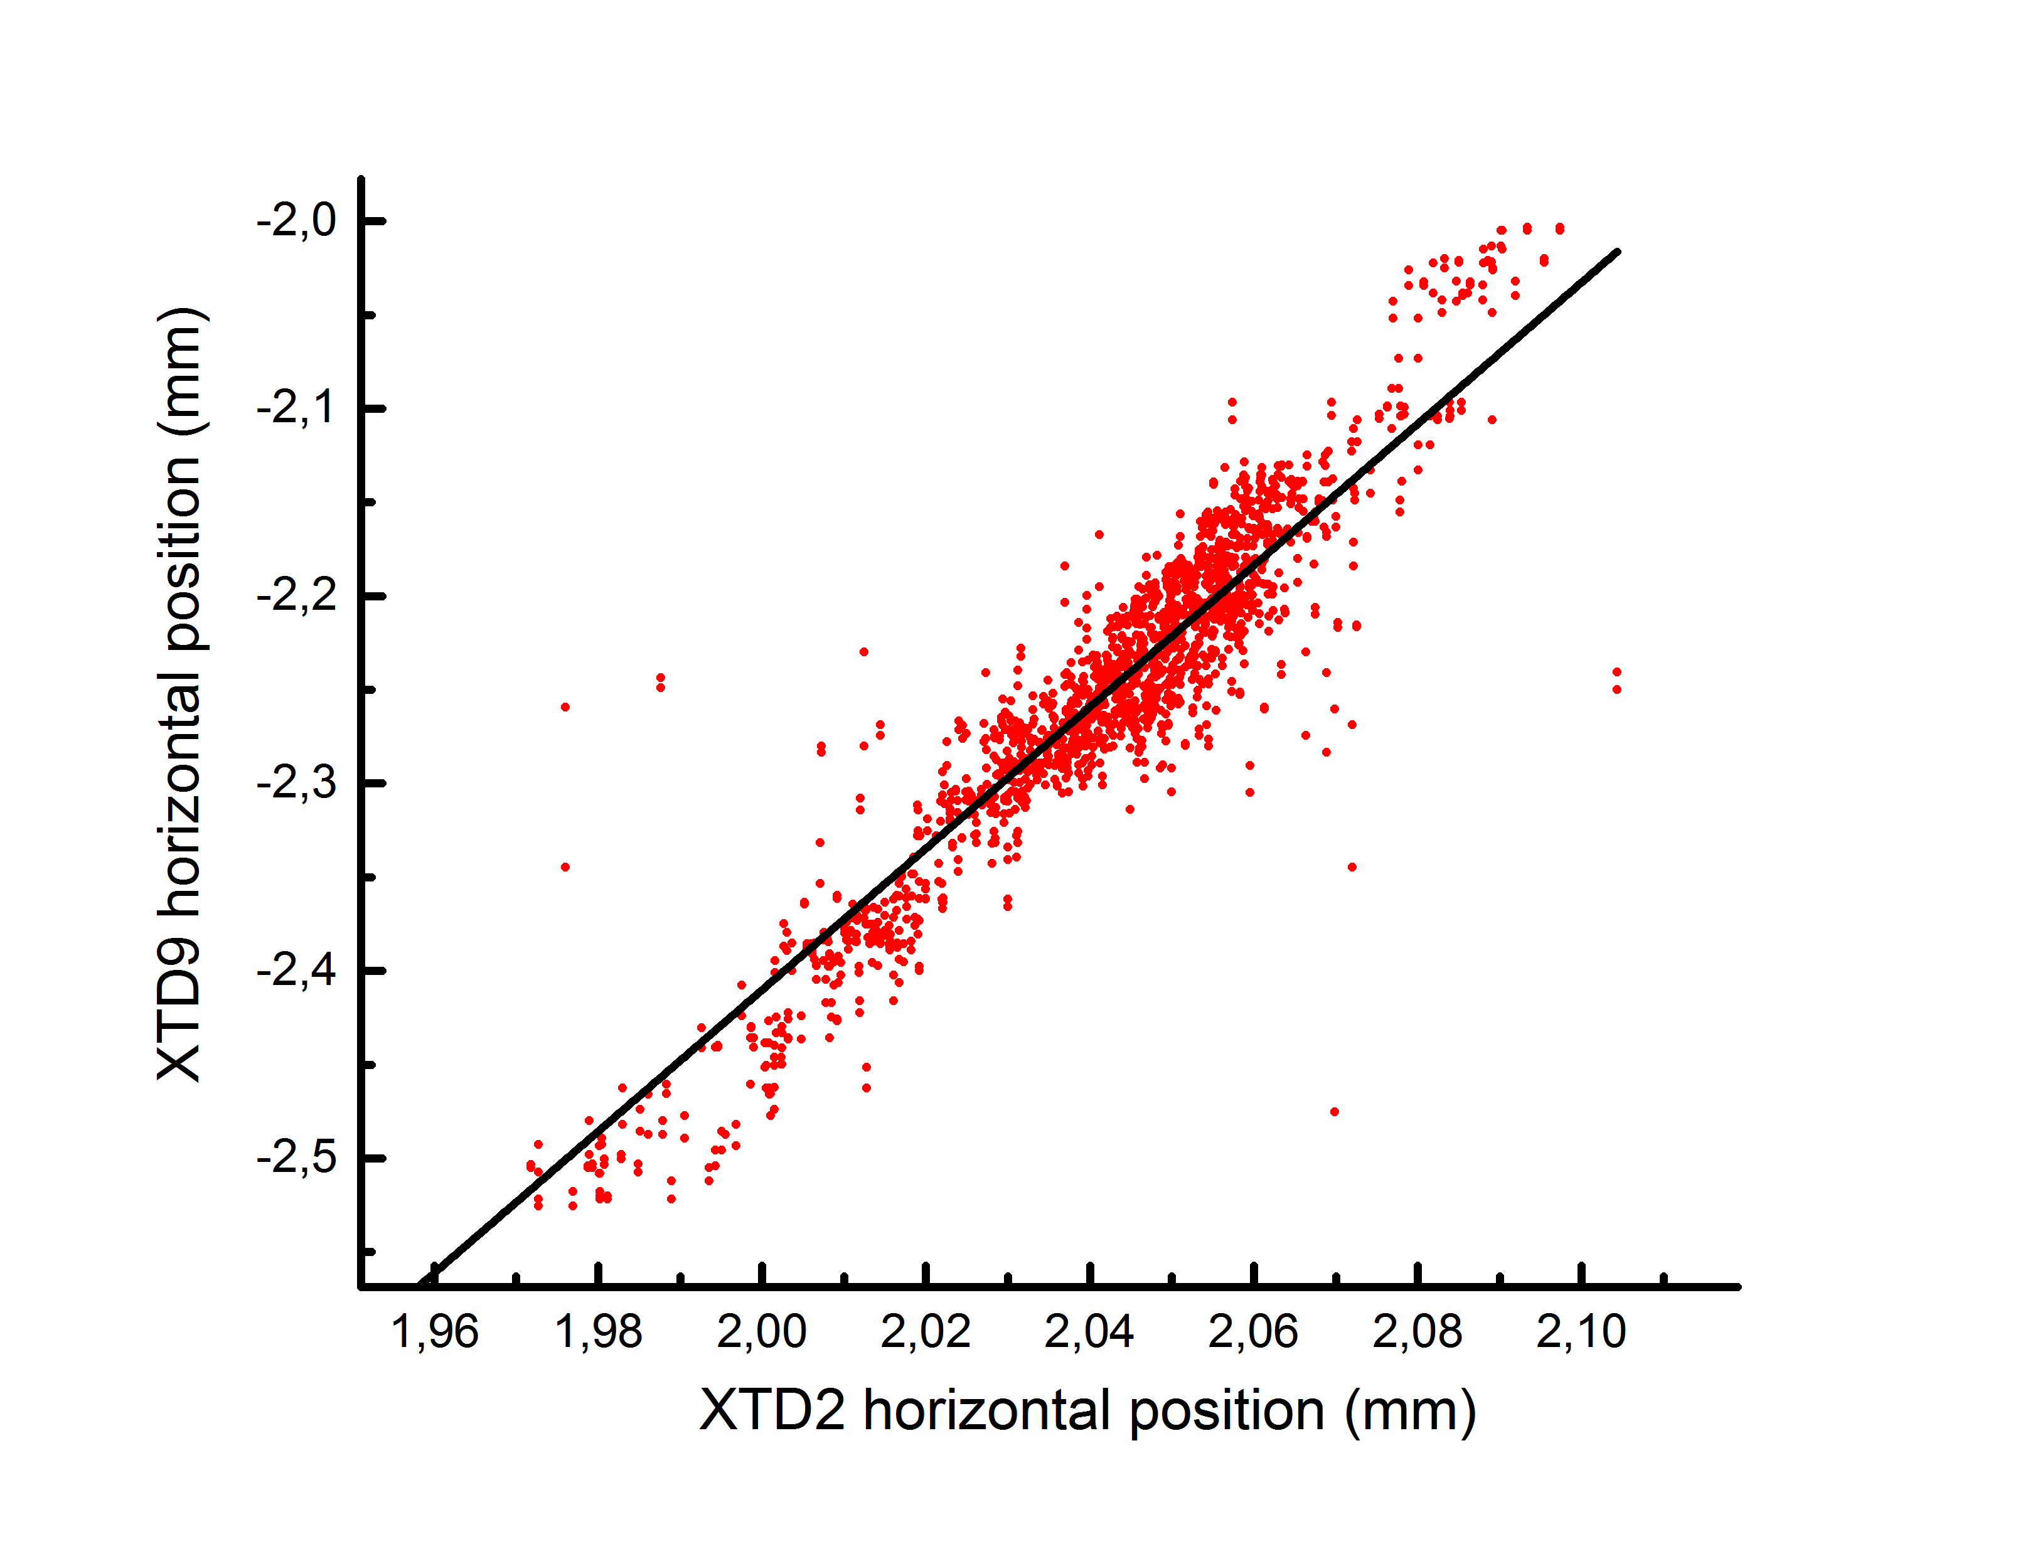
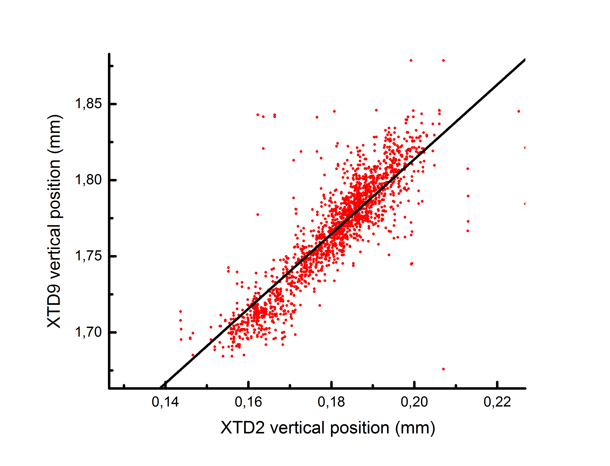
Averaged beam position: XTD2 versus XTD9 XGM
Pointing!
Pointing!
Slope: 3.8
Slope: 2.5
Distance SASE1 source to XGM@XTD2: 209 m
Distance SASE1 source to XGM@XTD9: 878 m, therefore: 0.4 mm / 878 m correspond to 0.5 μrad
Can be used for future active feedback
15.06.2018
0.134 nm, 60 bunches, slow ion signal
both XGMs with Xe, Run 149

Slide 18
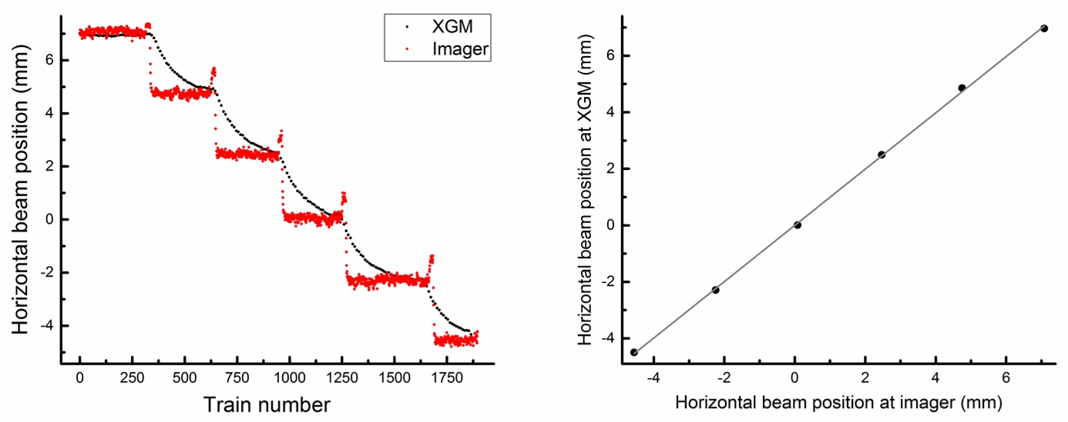
Position correlation: XGM versus Imager
Slope: 1
24.08.2017
0.136 nm, 60 bunches, slow ion signal
XTD9 XGM with Xe, Imager pop-in type I

Slide 19
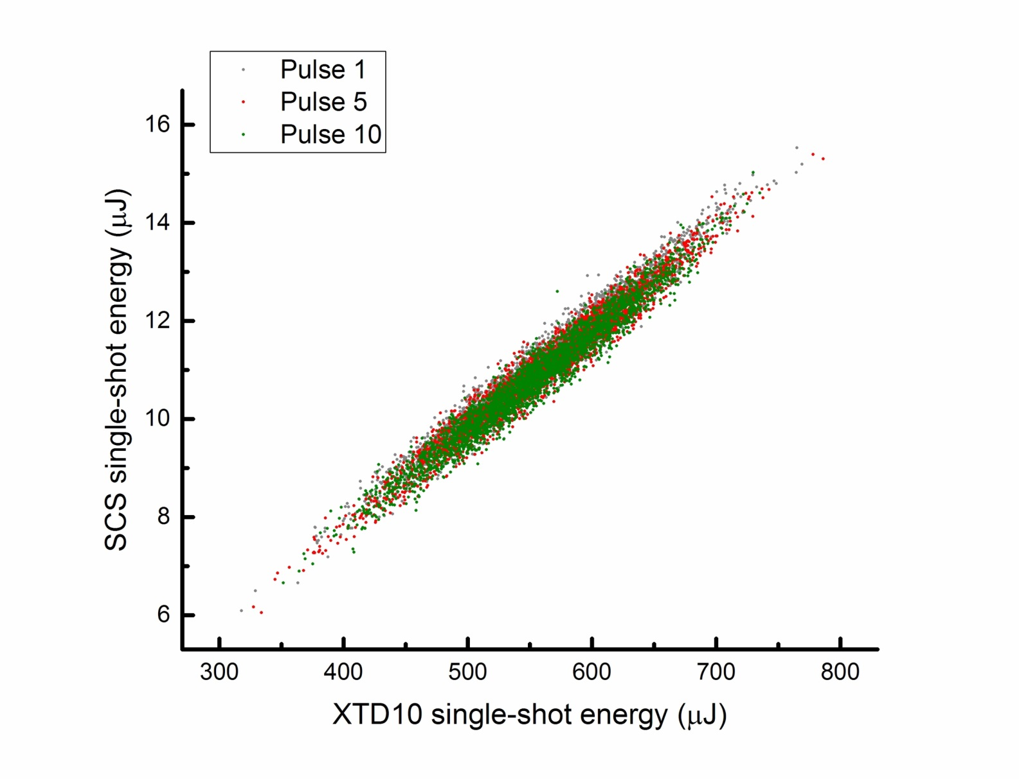
Single-shot pulse energy: XTD10 versus SCS XGM
Slope: 0.02 (overall transmission)
Correlation coefficient : 0.98
11.11.2018
1.127 nm, 120 bunches, run r0183,
gas attenuator set to 5.5 % transmission
XTD10 XGM with Kr, SCS XGM with Xe

Slide 20
Acknowledgments
People@DESY … 15 years of experience!
Kai Tiedtke
Ulf Fini Jastrow
Sören Grunewald
Andrey Sorokin
Susanne Bonfigt
Bican “Jimmy” Yilmaz
Machine operators
Transport group, Survey and alignment group
Grounding: Peter Göttlicher, Narcisse Ngada
Vladimir Rybnikov, Olaf Hensler
Tim Wilksen, Raimund Kammering
Lars Fröhlich
People@EuXFEL
Jan Grünert
Marc Planas
Florian Dietrich
Joakim Laksman
Torben Falk
Sonay Sayar
Wolfgang Freund
Andreas Koch
Naresh Kujala
Jia Liu
Johannes Risch
AE
CAS
ITDM
Vacuum group
SCS, SPB, HED
E-plan team
TS
… and many more

Slide 21
Summary
Basic concept of XGM
Position of XGMs in the tunnels
Simultaneous 24/7 operation of XGMs
Quick fixes
Cross-correlation results
Two new publications soon available:
A. A. Sorokin JSR 2019 “XGM for FELs”
Th. Maltezopoulos JSR 2019 “Operation of XGMs at Eu.XFEL”
Thank you for your attention !!!

Slide 22
Change of gas: Xe versus Kr
29.06.2017 - 2 bunches at 0.15 nm
$$\frac{I_{XTD2,Xe}}{I_{XTD9,Xe}}=\frac{I_{XTD2,Xe}}{I_{XTD9,Kr}}$$
… gives same pulse energy ☺
From synchrotron measurements:
< 10% for absolute pulse energy
< 20 μm for absolute beam position
24.11.2017
550 μJ, single bunch mode, at 0.136 nm
Absolute measurement uncertainty … … with Xe (XTD2): 39 μJ sigma (7%)
… with Kr (XTD9): 176 μJ sigma (32%)
10.11.2017
350 μJ, 2 bunches, at 0.133 nm
Absolute measurement uncertainty …
… with Xe (XTD2): 20 μJ sigma (6%)
… with Kr (XTD9): 90 μJ sigma (26%)

Slide 23
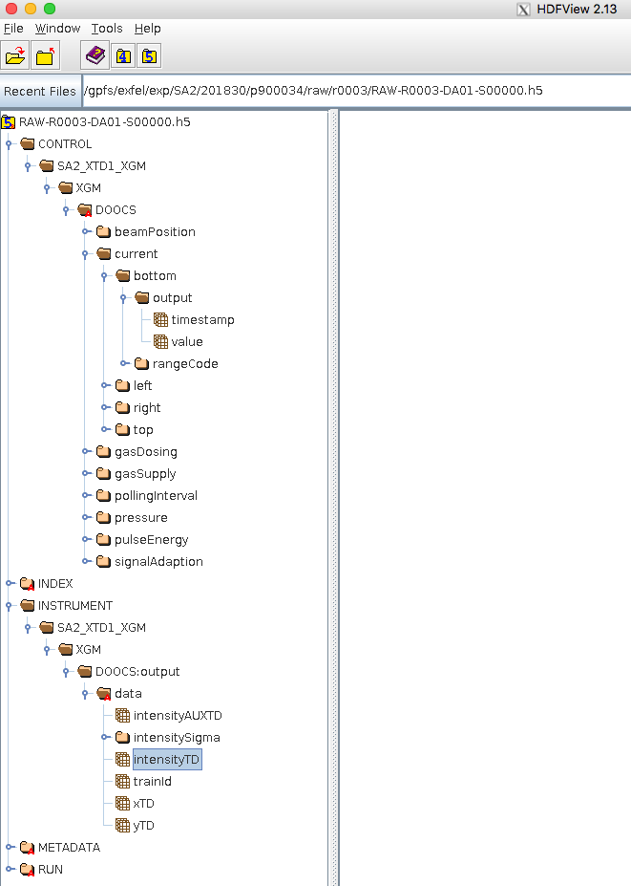
How to get XGM DAQ data
Average beam positions
Average data
Average pulse energies
Pulse resolved data
Single-shot pulse energies
Train IDs for sorting data

Slide 24
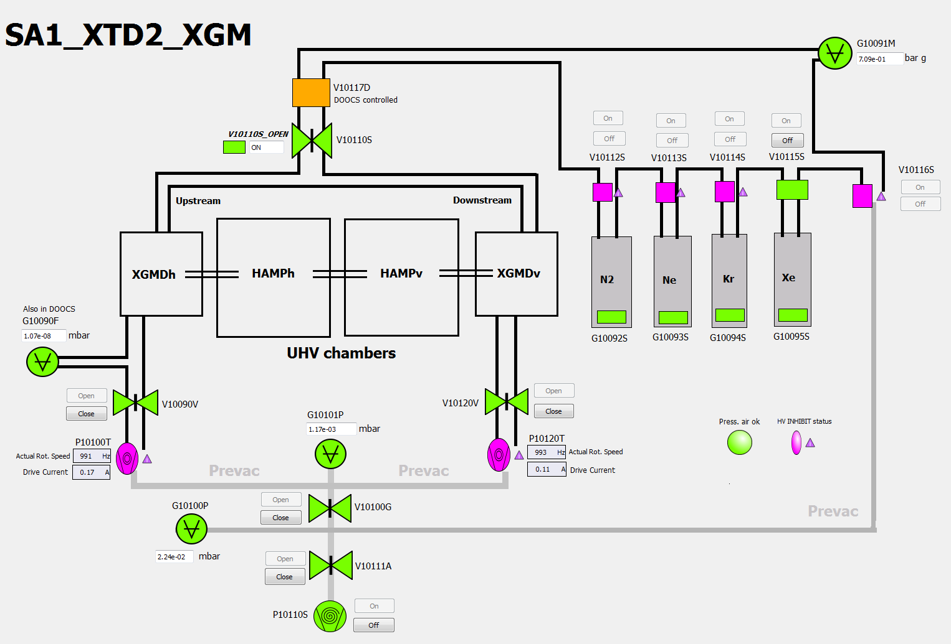
XGM Karabo scene
Gas needle is DOOCS controlled!
Emergency shutoff valve (status)
Gas type
Status of gas supply
“Vatterfly valves”
Interlock : not inhibiting = OK !

