Slide 1
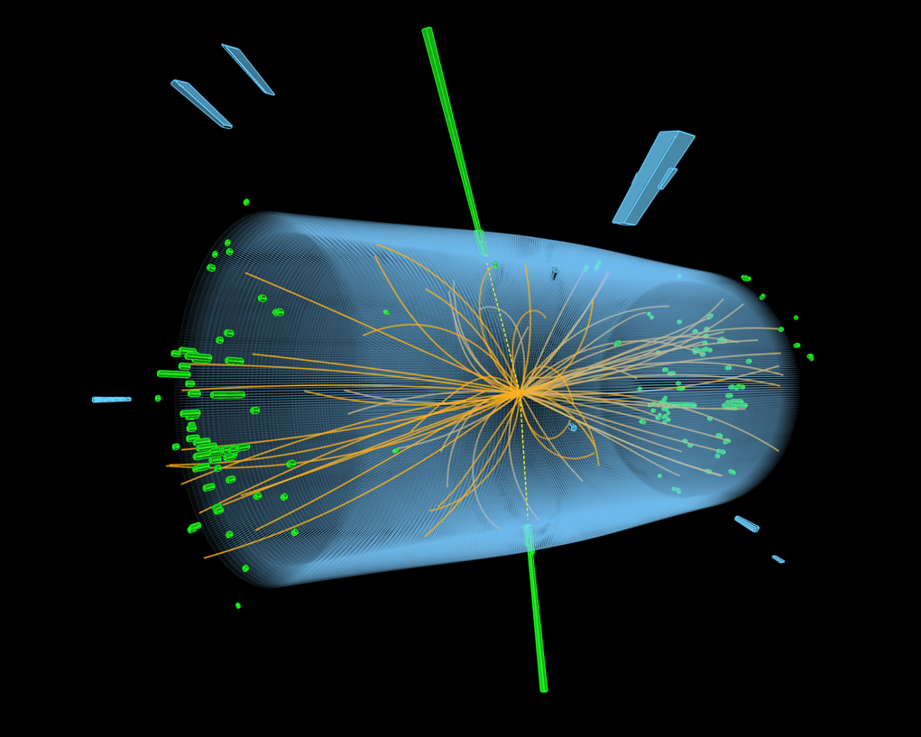
The PoF IV
Strategic Evaluation
Basic information
Thomas Schörner
DESY
18 March 2019

Slide 2
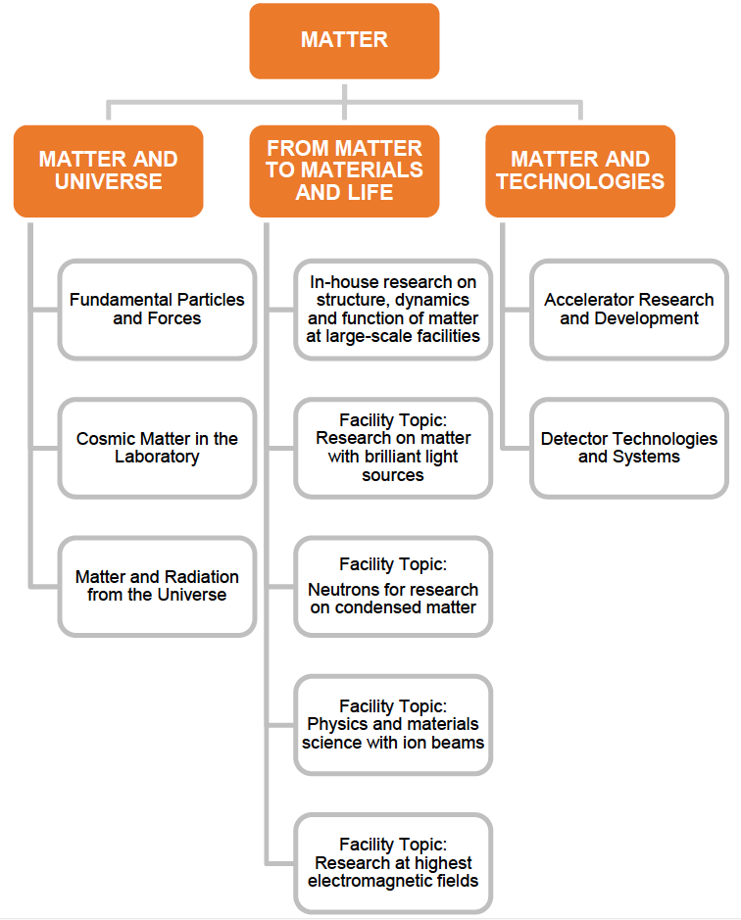
Reminder
Helmholtz / PoF Structure and competence teams
CT Experimental Particle Physics (EPP)
CT Theoretical
Particle Physics (EPP)
(CT structure used for 2017 status report
(retrospective SCIENTIFIC evaluation) in
order to achieve evaluation units of com-
parable sizes.)

Slide 3
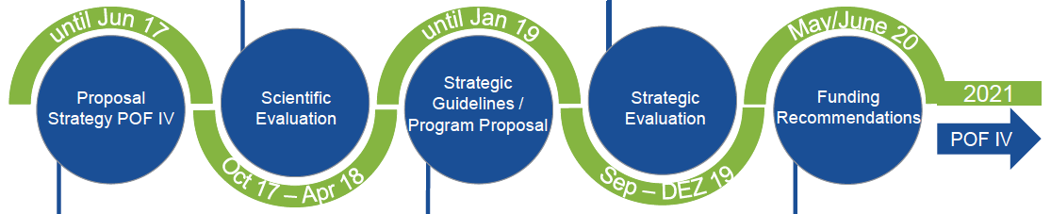
PoF III/IV
Overall timeline
DESY status report
prepared in 2017
units: CTs
Forschungs-
politische Ziele
2/2019
Evaluation
1/2020
Begin of
PoF IV
1/2021
„Strategiepapier
Materie“ 2017
Update 2/2019
Evaluation
at DESY
2/2018
Preparation
of strategic
proposals
Funding
recommendations
Later in 2019

Slide 4
Strategiepapier Materie
Originally June 2017; recent update
The scientific goals of the next decade are the following:
We explore the limits of the Standard Model of particle physics
We investigate the complexity in hadrons and nuclei and their role in the universe
We explore the origin of the various kinds of cosmic radiation
We analyze matter under extreme and non-equilibrium conditions
We map dynamical processes on atomic time and length scales
We interrogate complex (functional) materials for new applications
We decode complex biological structures and processes
We explore the physical limits of particle acceleration
We analyze the physical mechanisms of plasma acceleration
We investigate novel sensor materials
We push the limits of knowledge extraction

Slide 5
Strategiepapier Materie
Originally June 2017; recent update
Topic Fundamental Particles and Forces (DESY, KIT)
In this topic, we explore the origin of particle masses, the quantum structure of the vacuum and the strong
and electroweak force, and we search for physics beyond the Standard Model, particularly for dark matter
particles. Our focus is on the three themes i) Higgs boson and fundamental interaction, ii) Search for new
particles and phenomena, and iii) Cosmology and dark matter. Prominent instruments are the ATLAS and
CMS experiments at the Large Hadron collider of CERN and also the Belle/Belle II experiment to investigate
electron-proton collisions at KEK in Japan. We develop concepts for experiments at future colliders, for
experiments with neutrino radiation and for the search for dark matter. Part of the current activities of FZJ
– studying the fate of antimatter (baryo- and leptogenesis), more specifically the search for CP violation
via EDMs and neutrino oscillations – are also closely related to this topic.

Slide 6
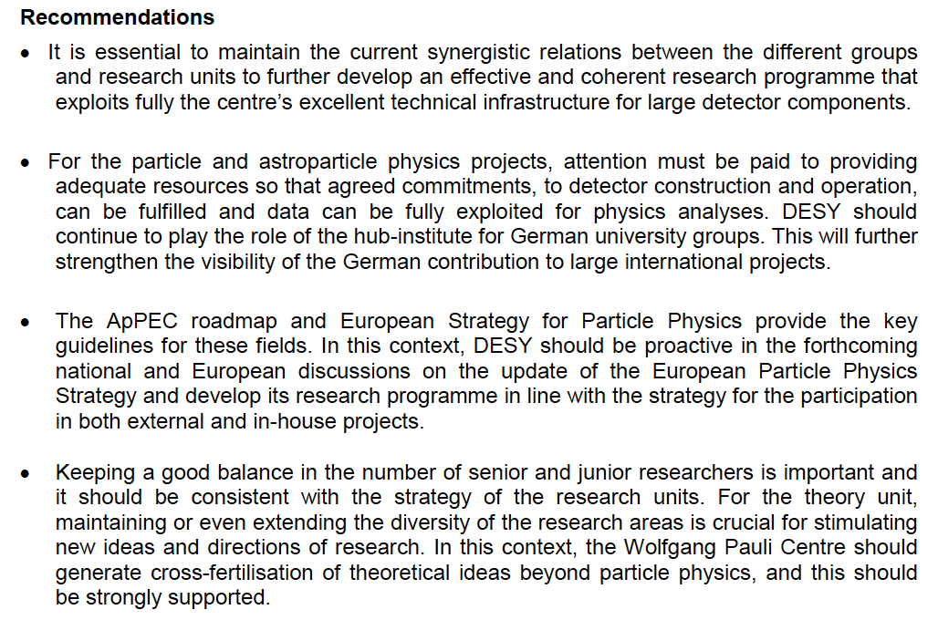
Looking Back: The Scientific Evaluation (Feb. 2018)
Desy contribution to MU (FPF and MRU)

Slide 7
Forschungspolitische Ziele
February 2019
Forschungsziele sind insbesondere
die Identifikation der fundamentalen Teilchen und ihrer Wechselwirkungen
sowie das genaue Verständnis der Struktur des Vakuums,
das Verständnis des Aufbaus und der Dynamik von Hadronen, Kernen und
Kernmaterie und ihrer Rolle bei der astrophysikalischen Entstehung der chemischen Elemente sowie
das Verständnis der Natur der Dunklen Materie und der Dunklen Energie sowie des Universums bei hohen Energien.
[Meilensteine]
Das Topic hat sich folgende spezifische Ziele gesetzt:
Es werden genaue Vermessungen der Eigenschaften des Higgs-Bosons am LHC/HL-LHC sowie hochpräzise Untersuchungen der elektroschwachen und starken Wechselwirkung am LHC/HL-LHC und mit dem Belle II-Experiment durchgeführt. Von Belle II werden tiefe Einblicke in die Ursachen der Materie-Antimaterie-Asymmetrie erwartet.
Die verfolgten Experimente dienen auch der Suche nach neuen Teilchen und Phänomenen, entweder durch eine direkte Beobachtung oder durch Abweichungen zwischen Theorie und Präzisionsmessung.
Neu in der PoF IV ist die Suche nach Axionen und ähnlichen hypothetischen Teilchenmit dem ALPS II-Experiment bei DESY. Darüber hinaus werden die technische und finanzielle Machbarkeit der möglichen Nachfolgeprojekte MADMAX und IAXO erarbeitet und ggf. bereits erste Demonstratoren fertiggestellt.
Diese Aktivitäten treiben das Thema das Verständnis der Kosmologie voran, beleuchten die „dunkle Seite“ des Universums und sind komplementär zu denen der Astroteilchenphysik im Topic Materie und Strahlung vom Universum.

Slide 8
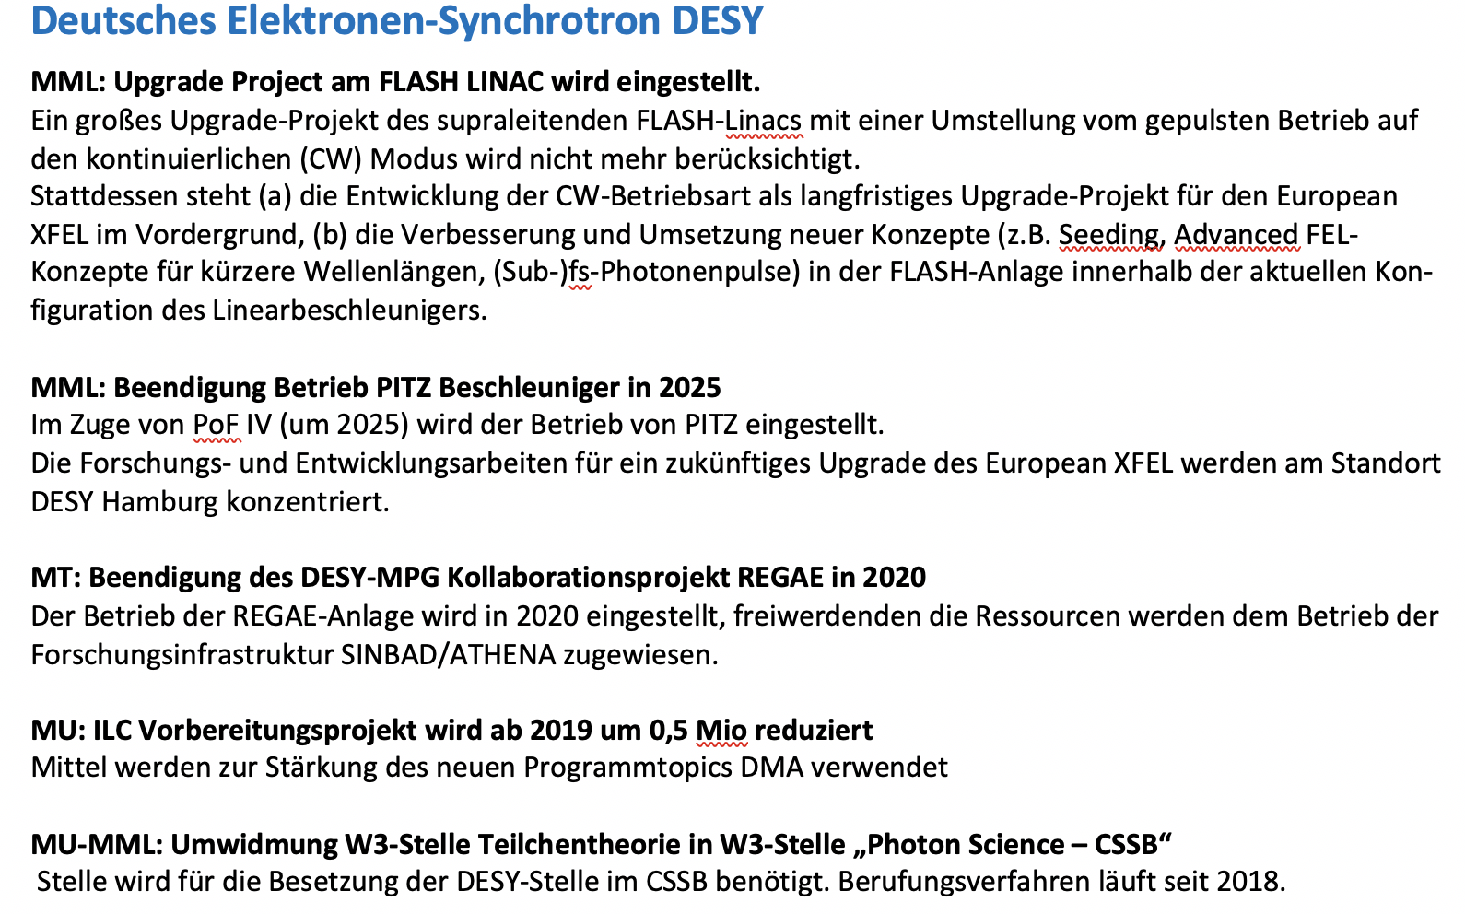
Posteriorities
February 2019

Slide 9


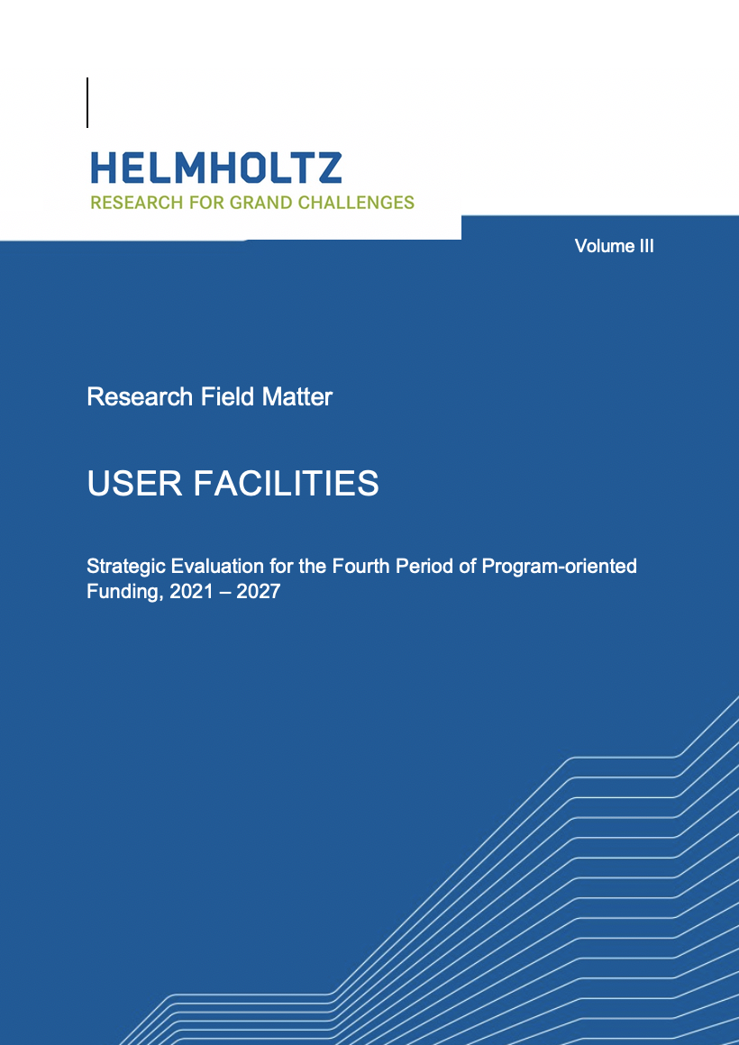
PoF IV: The Template
Three volumes

Slide 10
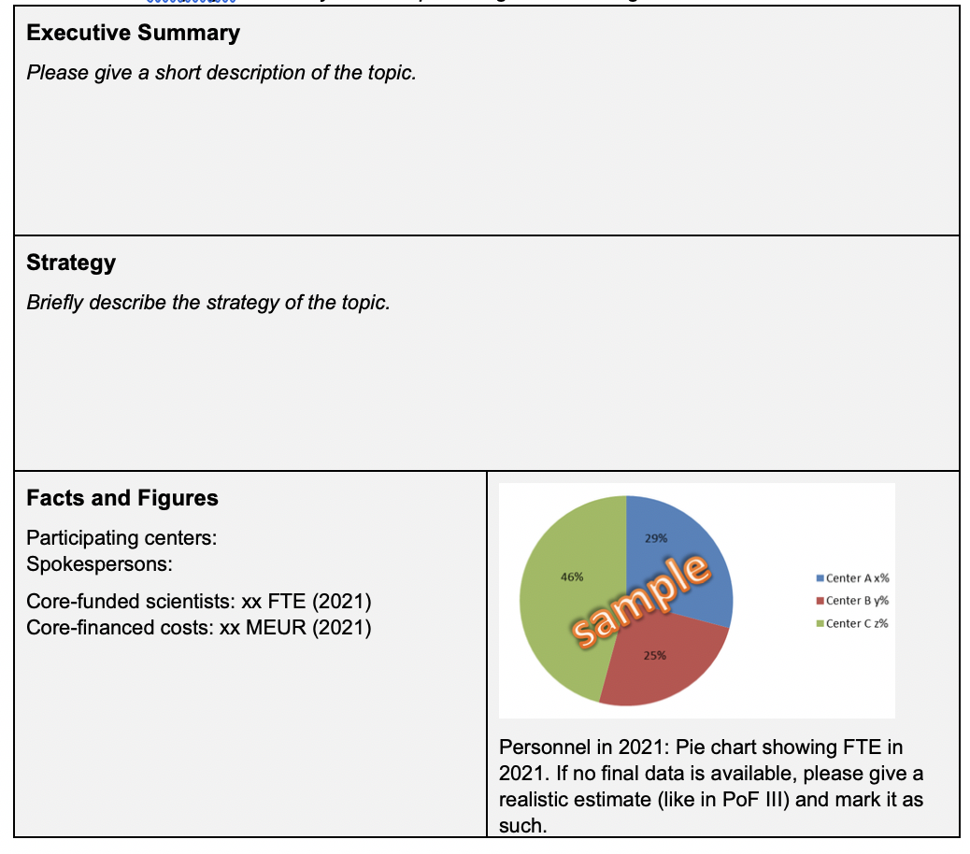
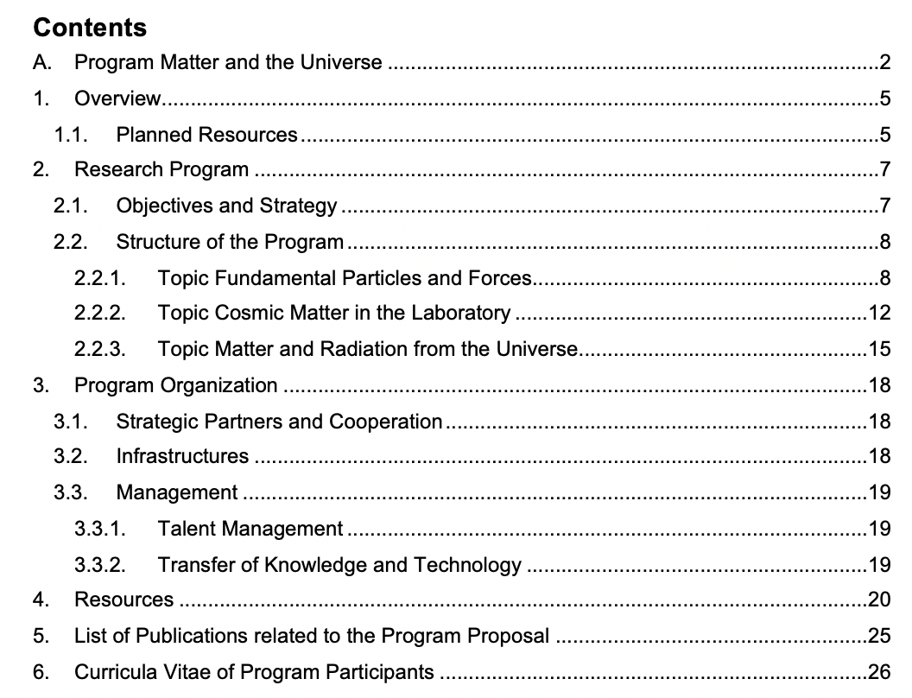
PoF IV: The Template
Volume 2 – program MU and topics (e.g. FPF)

Slide 11
PoF IV: The Template
Topic FPF structure of 11 pages
Strategic goals
Competences
Objectives and approach
Expected results (= milestone table; politically requested,
need 15-20, or ~per subtopic.
➔ we have these (prepared for CT discussions in 2018),
although not really in subtopic structure)
Synergies and collaboration
Infrastructures (e.g. DAF, test beam, Tier 2, labs and workshops, ...)
Opportunities and risks
➔ (My) conclusion for today and the coming weeks: Focus and strengths / competences, and milestones

Slide 12
PoF IV: The Evaluation
Goals
Objectives
Work programme
Work plan
Risks
Gain
Impact
Compe-tences
Ressources
Scientific quality
Strat. Focus
Contribution
Alignment
Organisational structure
Ressource planning

Slide 13
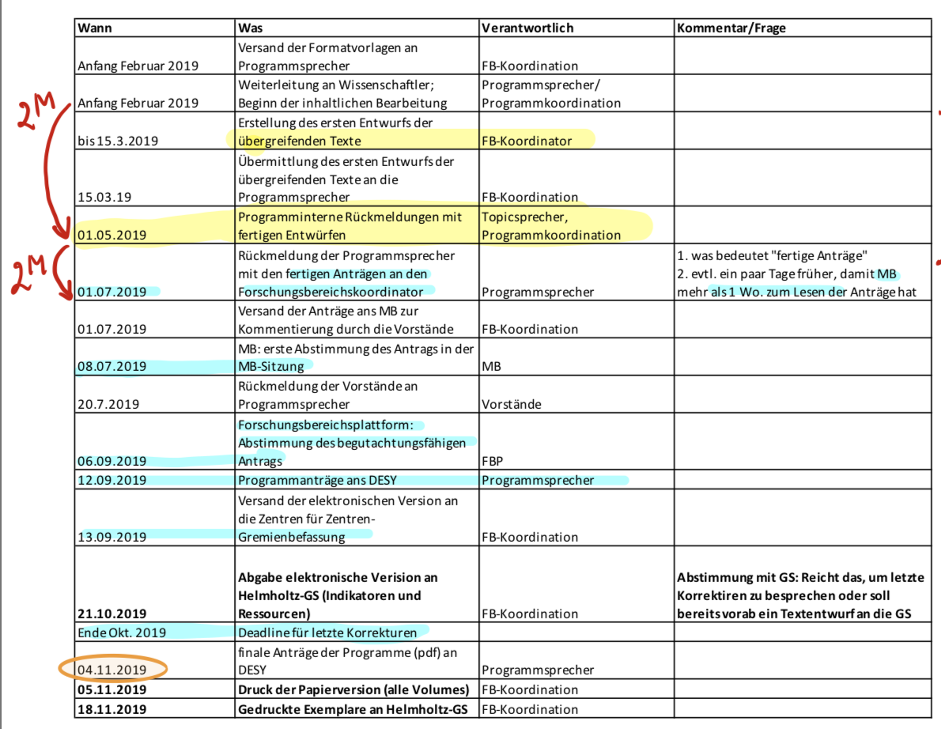
PoF IV: Next Steps
Timeline

Slide 14
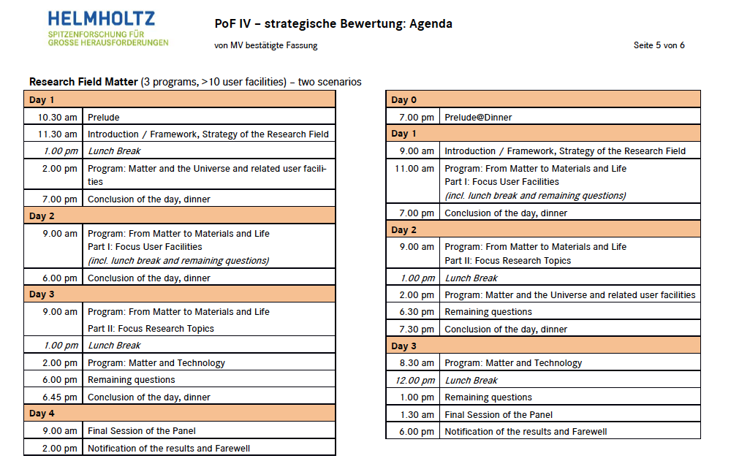
PoF IV: The Strategic Evaluation
27-30 January 2020

Slide 15
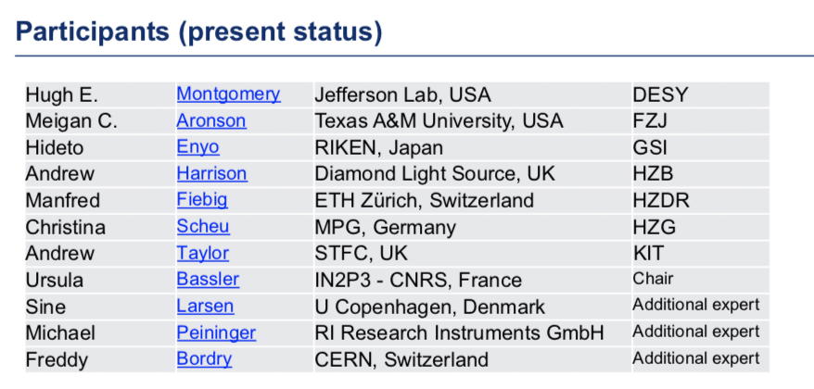
PoF IV: The Strategic Evaluation
27-30 January 2020

Slide 16
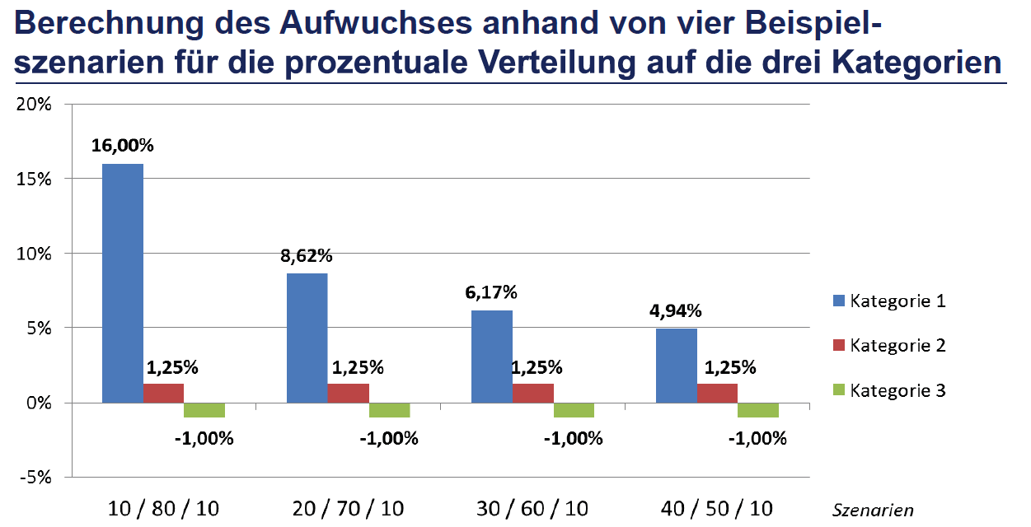
PoF IV: The Strategic Evaluation
27-30 January 2020; recommendations on topic level!
Assuming 2.5% overall increase
Note that 1.25% is below inflation
Note that PoF IV will last 7 years

Slide 17
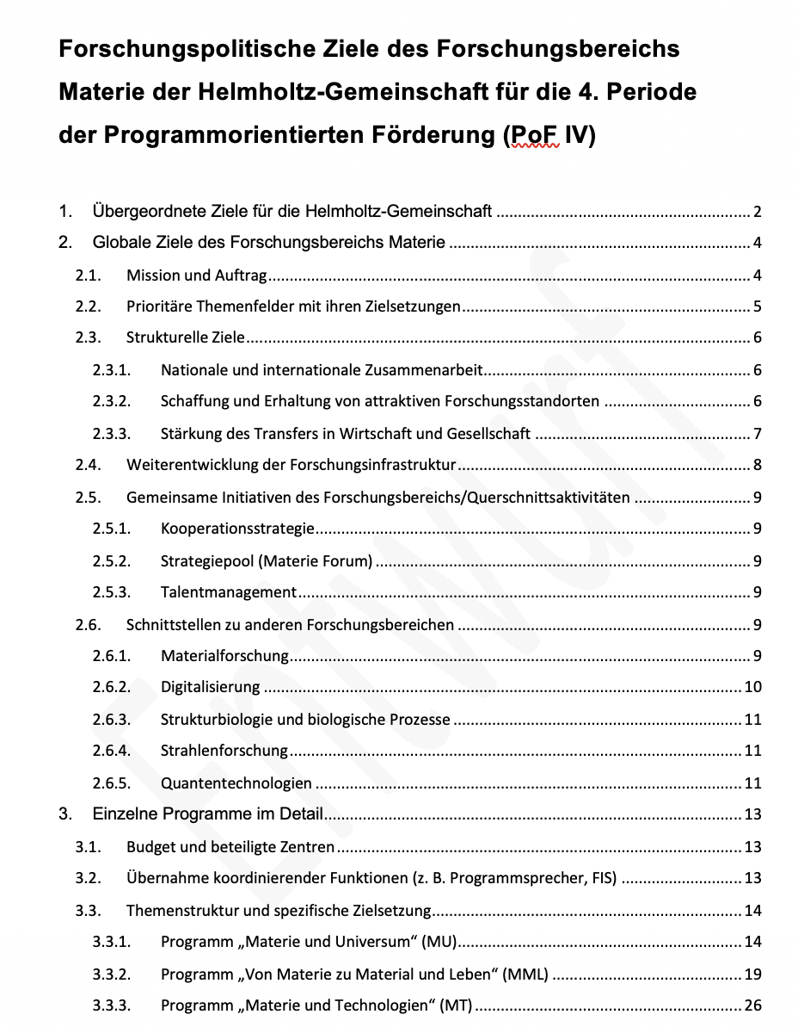
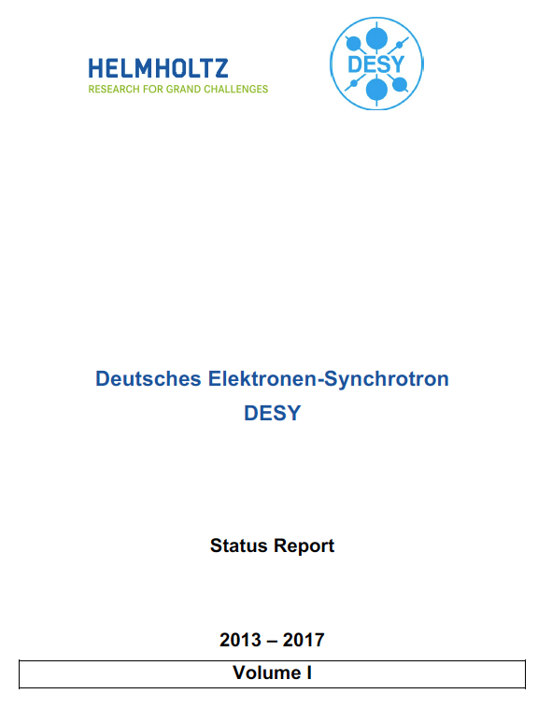
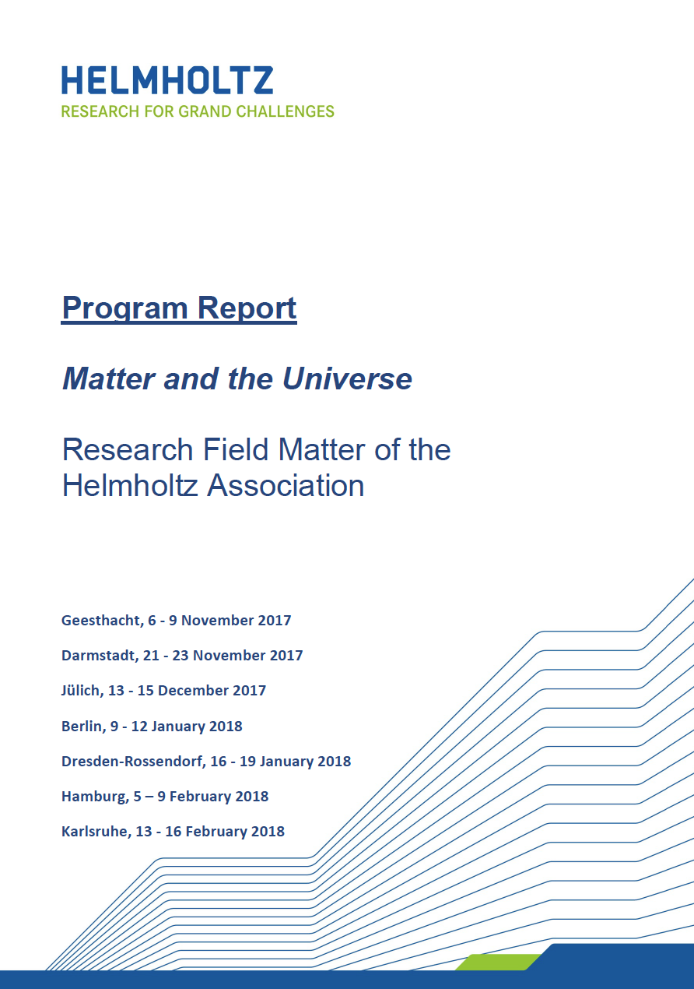
Summary
10 pages
Milestone paper
1-page summaries
Etc.

Slide 18
Backup

Slide 19
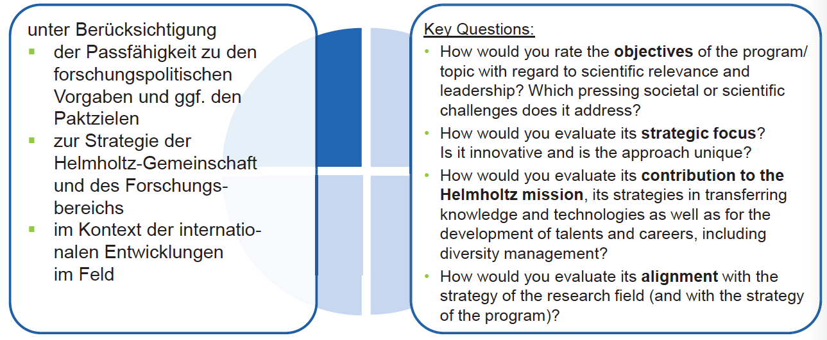
PoF IV: The Strategic Evaluation
Criteria – 4 dimensions: goals, work programme, competencies and ressources, gain and risks

Slide 20
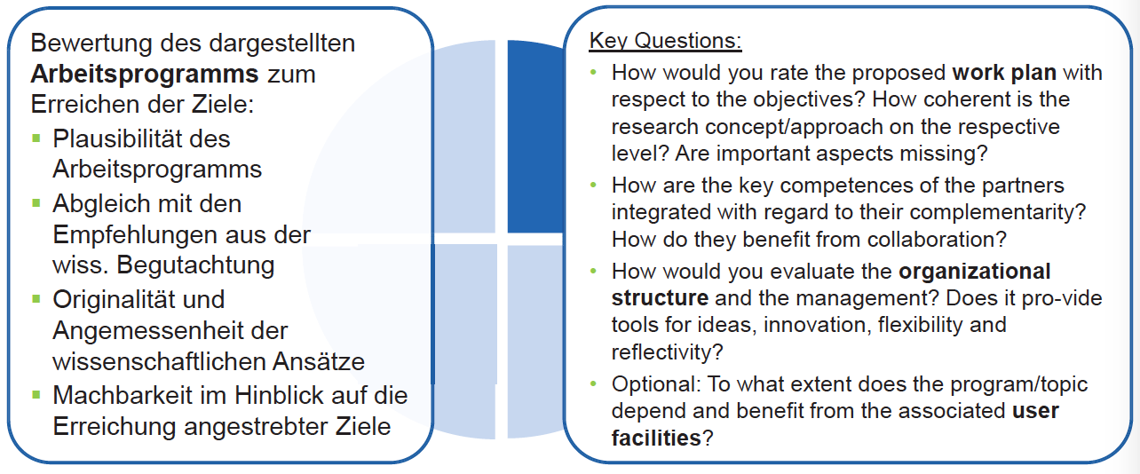
PoF IV: The Strategic Evaluation
Criteria – 4 dimensions: goals, work programme, competencies and ressources, gain and risks

Slide 21
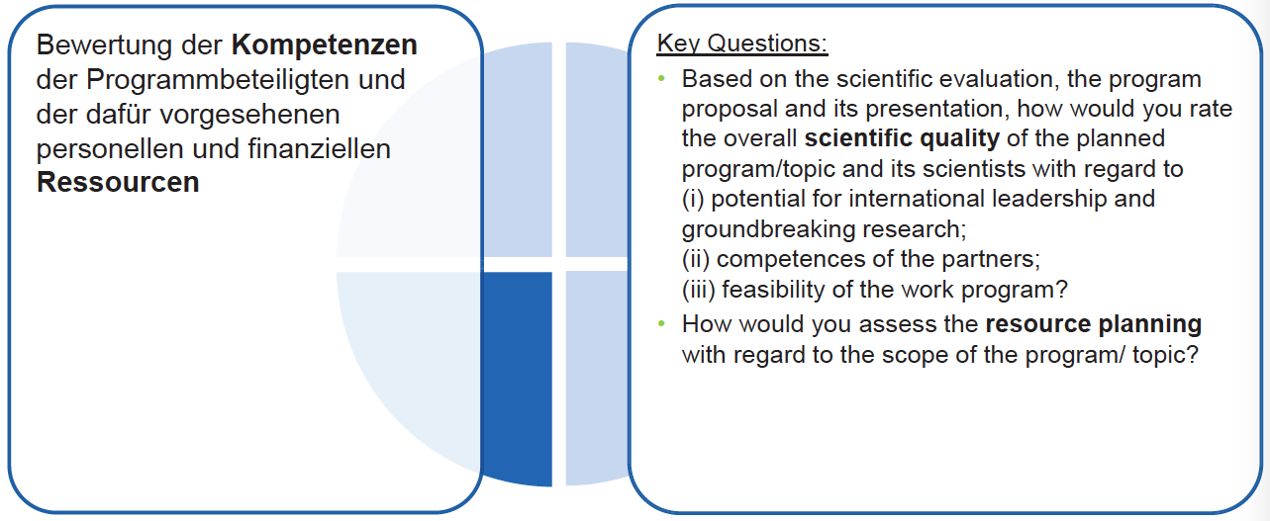
PoF IV: The Strategic Evaluation
Criteria – 4 dimensions: goals, work programme, competencies and ressources, gain and risks

Slide 22
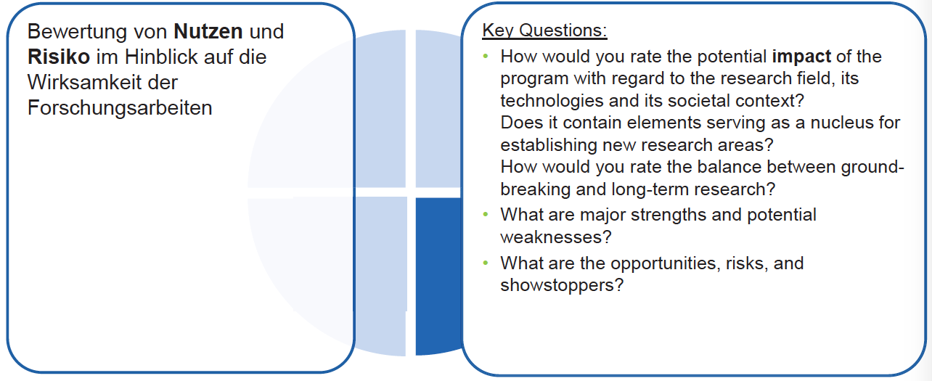
PoF IV: The Strategic Evaluation
Criteria – 4 dimensions: goals, work programme, competencies and ressources, gain and risks

