Slide 1
CMS Computing Model with Focus on German Tier1 Activities
Armin Scheurer
GridKa School 2009, High Energy Physics Session
Wednesday, 02.09.2009

Slide 2
Overview
The Large Hadron Collider (LHC)
The Compact Muon Solenoid (CMS)
CMS Computing Model
CMS in Germany
CMS Workflow & Data Transfers
CMS Service Challenges

Slide 3
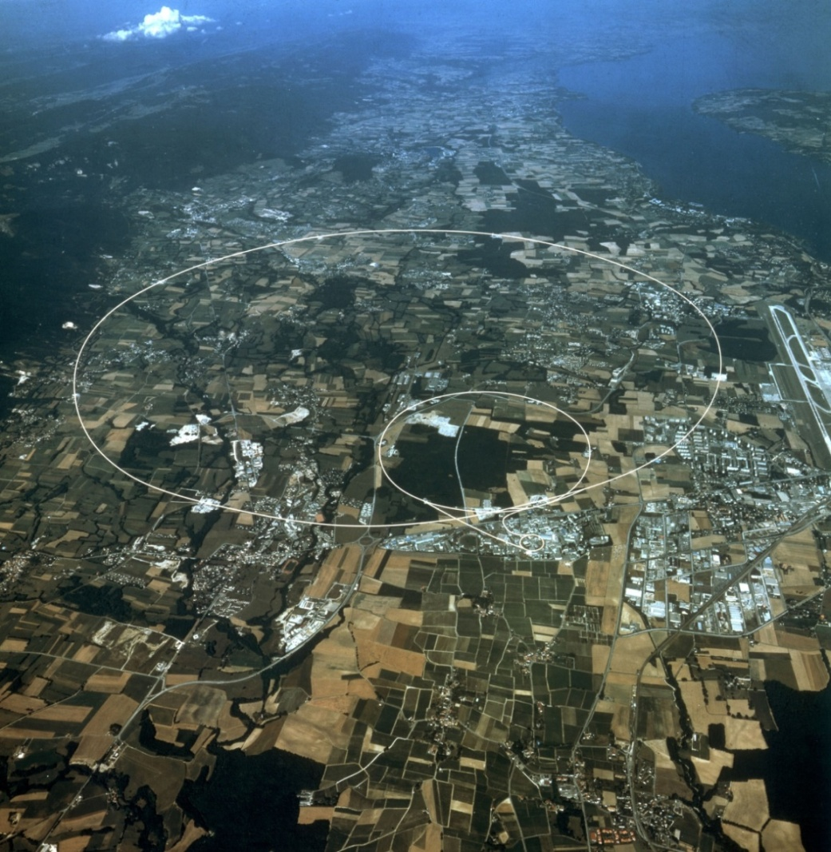
Large Hadron Collider
Proton-Proton Collider
  Circumference: 27 km
  Beam Energy: 7 TeV/c²
  Below Surface: 100 m
  Temperature: -271 °C
  Energy Use: 1 TWh/a
4 Large Experiments
  CMS (General-Purpose)
  Atlas (General-Purpose)
  LHCb (Physics of b-Quarks)
  Alice (Lead Ion Collisions)
2 Smaller Experiments
  LHCf and Totem
CMS
LHCb
ALICE
ATLAS

Slide 4
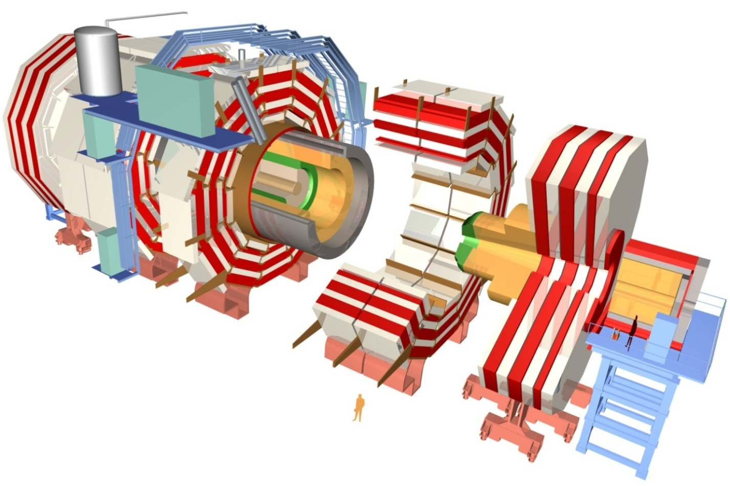
Compact Muon Solenoid
Muon Chambers
Hadronic
Calorimetry
Magnetic
Retrun Yoke
Technical Details:
Total Weigh: 12 500 t
Diameter: 15 m
Total Length: 21,5 m
Magnetic Field
  Solenoid: 4 Tesla
  Yoke: 2 Tesla
Readout Channels, e.g.
  Tracker: 10 Mio.
  Sum: 100 Mio.
Collission Rate: 40 MHz
Silicon Tracker
Superconducting
Solenoid
Electromagnetic
Calorimetry
Forward
Calorimetry
Data-Rate: Imagine a 100 MPixle-Camera taking 40 Mio. pictures per second!

Slide 5
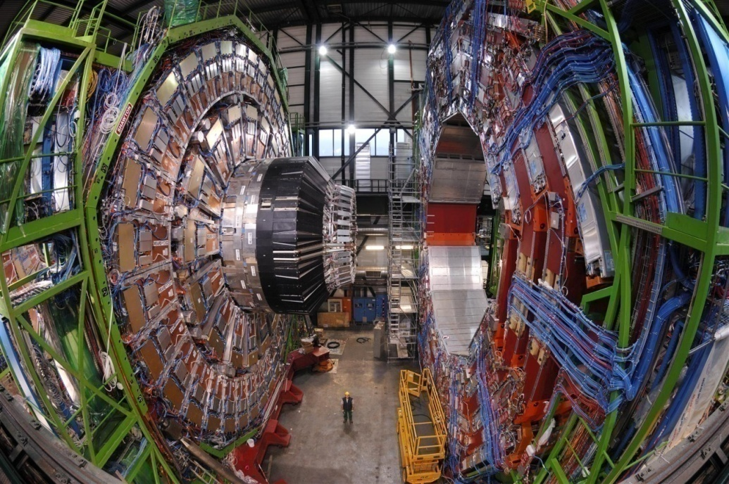
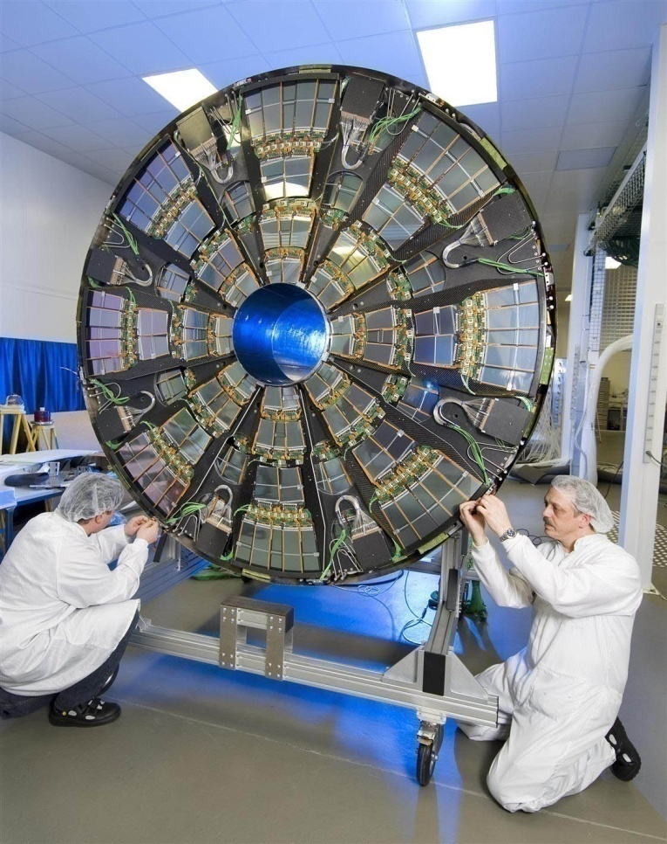
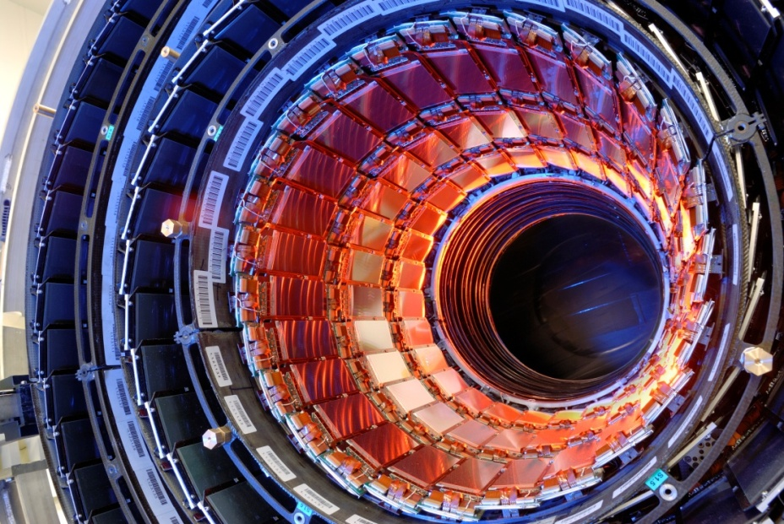
Pictures of CMS

Slide 6
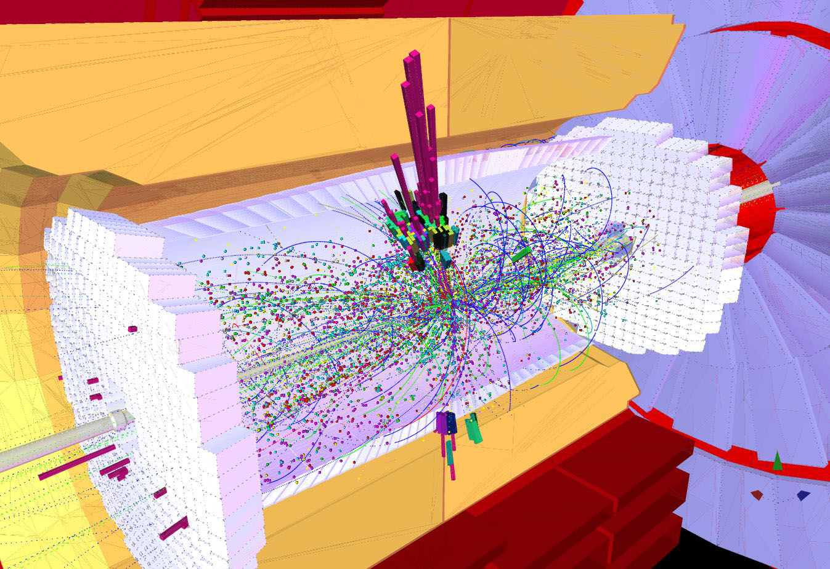
Physics Motivation
In each proton-proton collision, more than 1000 particles are created.
The decay products allow to conclude on underlying physics processes of the collision.
Test of the Standard Model (at the TeV energy scale)
Search for the Higgs-Boson
Physics beyond the SM (e.g. SUSY, extra dimensions, ...)

Slide 7
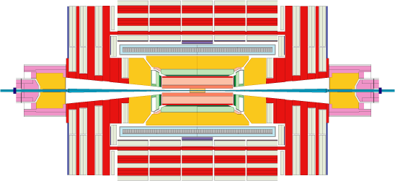
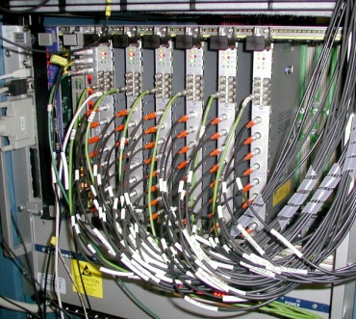
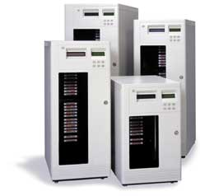
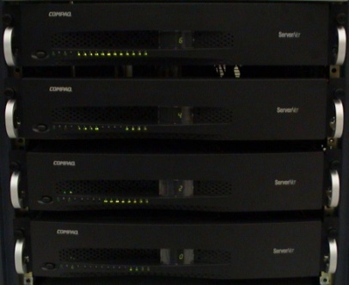
Trigger and Event Rate
60 TB/sec
Level 1 Trigger
Reduction with
ASICs (Hardware)
Collision Rate: 40 MHz
150 GB/sec
Event-Size: 1,5 MB
Tape & HDD
Storage
for Offline-
Analysis
225 MB/sec
High Level Trigger
Software Data
Reduction
Recorded Events: 150 per second
→ 1.5 PB of data per year

Slide 8
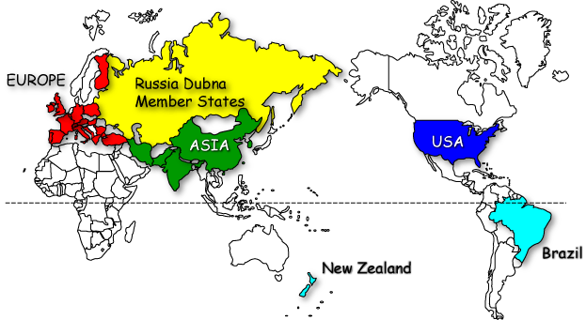
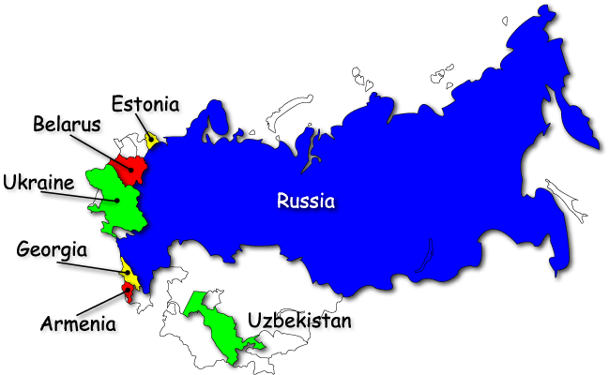
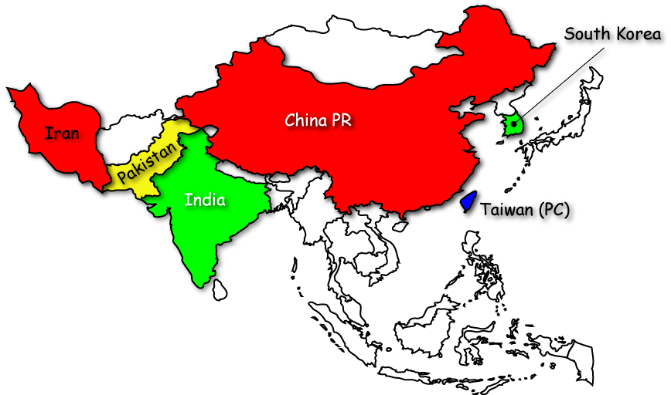
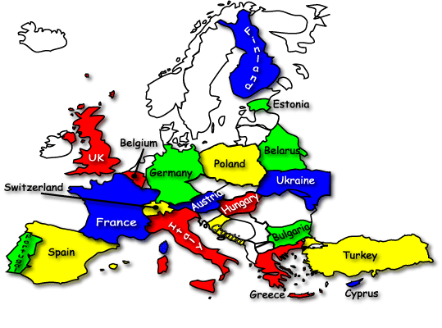
CMS Collaboration
CMS
38 Nations
182 Institutions
> 2000 Scientists &
Engineers

Slide 9

CMS Computing Model
LHC experiments have decided to use distributed computing and storage resources.
  The Worldwide LHC Computing Grid (WLCG).
Grid services based on the gLite middleware.
Computing centres arranged in a four-tiered hierarchical structure.
  Availability and resources are regulated by MOU (e.g. Downtime per year, response time, etc.).

Slide 10

CMS Tier Structure
Tier 2/3
CMS WLCG Structure
Tier 2/3
Tier 2/3
Tier 1
PIC
Spain
Tier 1
ASGC
Taiwan
Tier 2/3
Tier 2/3
Tier 2/3
Tier 1
FNAL
United States
Tier 0
Tier 1
CNAF
Italy
Tier 2/3
Tier 2/3
Tier 1
RAL
United Kingdom
Tier 1
CC-IN2P3
France
Tier 2/3
Tier 2/3
Tier 1
GridKa
Germany
Tier 2/3
Tier 2 Warsaw
Tier 2 CSCS
Tier 2/3
Tier 2/3 Aachen
Tier 2/3
DESY
Tier 3
Karlsruhe

Slide 11
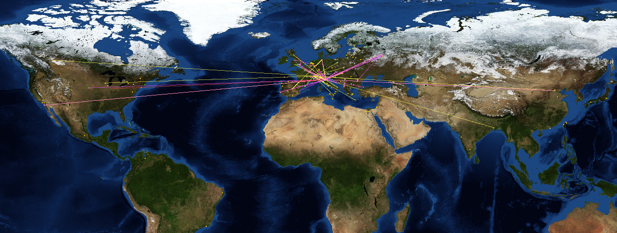
WLCG Resources
Taken from the WLCG Real Time Monitor:
  http://gridportal.hep.ph.ic.ac.uk/rtm/

Slide 12
Main Tier Responsibilities
Tier0:
  Storage of RAW detector data.
  First reconstruction of physics objects after data-taking.
Tier1:
  Host one dedicated copy of RAW and reconstructed data outside the Tier0.
  Re-processing of stored data.
  Skimming (creation of small sub data samples)
Tier2:
  Monte Carlo production/simulation.
  Calibration activities.
  Resources for physics groups analyses.
Tier3:
  Individual user analyses.
  Interactive logins (for development & debugging)

Slide 13

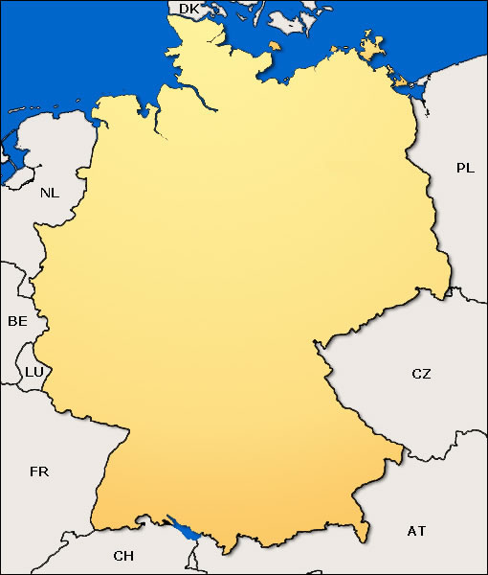





German CMS Members
Uni Hamburg
DESY Hamburg/
Zeuthen
RWTH Aachen
FSP-CMS (BMBF)
Forschungszentrum
Karlsruhe
Uni Karlsruhe

Slide 14
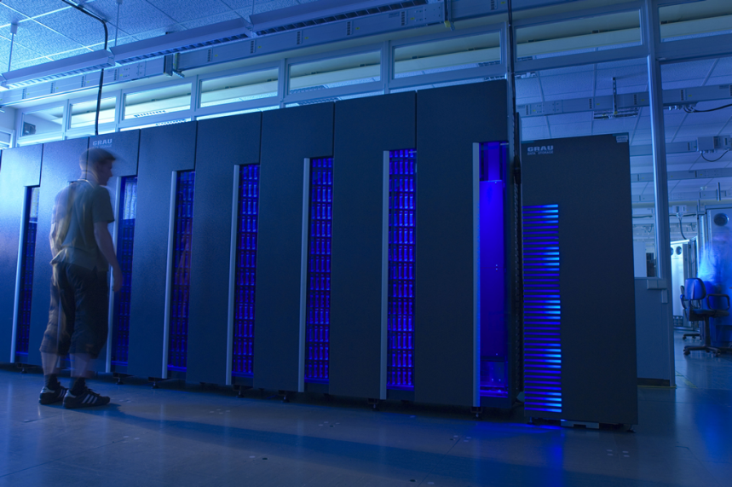
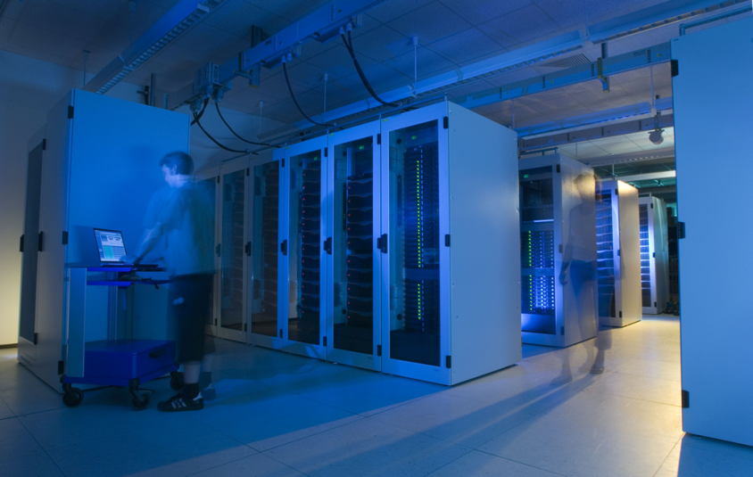
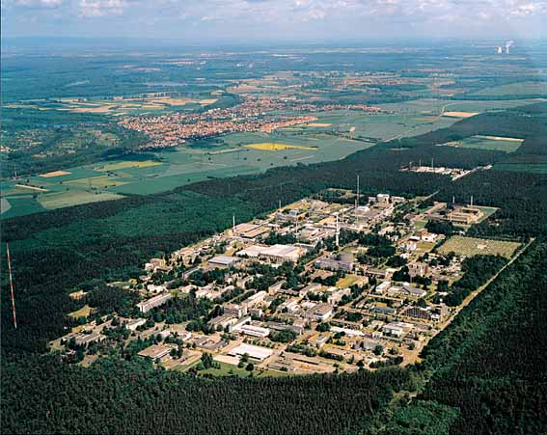
Tier1 GridKa
Located at Forschungszentrum Karlsruhe (KIT, Campus Nord)
Part of and operated by the Steinbuch Centre for Computing (SCC, KIT)
Multi-VO Tier centre (supports 8 HEP experiments)
  4 LHC experiments: CMS, ATLAS, ALICE, LHCb
  4 non-LHC experiments: CDF, D0, BaBar, Compass

Slide 15

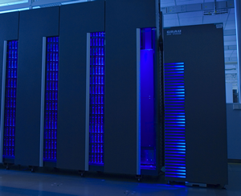
GridKa Resources
Network:
  10 Gbit link CERN – GridKa
  3 x 10 Gbit link to 3 European Tier1s
  10 Gbit link to DFN/X-Win (e.g. Tier2 connections)
Storage:
  Based on dCache (developed at DESY and FNAL)
  CMS Disk: ~ 650 TB + D-Grid: ~ 40 TB
  CMS Tape: ~ 900 TB
CPU:
  CMS Resources: ~ 800 cores, 2 GB Ram per core
  D-Grid Resources: ~ 500 cores, 2 GB Ram per core
  D-Grid resources: partially usable for FSP-CMS
CMS GridKa Resource Pledges
 | 2010 | 2011 | 2012
CPU [MSI2k] | 3.5 | 4.3 | 5.1
Disk [PB] | 1.6 | 2.0 | 2.4
Tape [PB] | 2.8 | 3.7 | 4.6

Slide 16
Tier2/3 and NAF Resources
Besides the Tier1 resources, considerable CPU and disk capacities are available in Germany 2008/2009:
  Tier2 (German CMS Tier2 federation):
    DESY: 400 cores, 185 TB disk
    RWTH Aachen: 360 cores, 99 TB disk
  Tier3:
    RWTH Aachen: 850 cores, 165 TB disk
    Uni Karlsruhe: 400 cores, 150 TB disk
    Uni Hamburg: 15 TB disk
  NAF (National Analysis Facility):
    DESY: 245 cores, 32 TB disk
  D-Grid resources, partially usable for FSP-CMS:
    RWTH Aachen: 600 cores, 231 TB disk
    GridKA: 500 cores, 40 TB disk

Slide 17
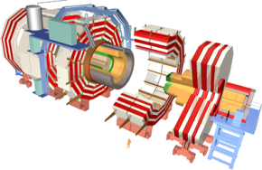

CMS Workflow
Prompt Reconstruction
Calibration
Express-Stream Analysis
Tier 0
RAW Input Data
Storage
CAF
T0 – T1: 600 MB/sec
Re-Reco
Skims
Tier 1
Tier 1
Tier 1
Tier 1
Tier 1
Tier 1
100 MB/sec
Tier 1
T1 – T2: 50 - 500 MB/sec
MC Upload
(20 MB/sec)
Simulation
Analysis
Tier 2
Tier 2
Tier 2
Tier 2
T 3
T 3
User
T 3
T 3

Slide 18

PhEDEx Data Transfers
Physics Experiment Data Export (CMS data placement tool):
  Various agents/daemons are run at the tier sites (depending on the tier level)
    upload, download, MSS stage-in/out, DB, ...
  Provides automatic WAN data transfers, based on subscriptions
  Automatic load-balancing
  File transfer routing topology (FTS)
  Automatic bookkeeping (database entries, logging)
  Consistency checks (DB vs. filesystem)
  File integrity checks

Slide 19
Other Involved Components
Monte Carlo Production Agent (ProdAgent)
CMS Remote Analysis Builder (CRAB)
Dataset Bookkeeping System (DBS)
Data Location Service (DLS)
Trivial File Catalog (TFC)
Grid middleware (gLite)
  SE, CE, RB, UI, ...
DBS:
Relates dataset/block
and site
DLS:
Relates dataset/block and
logical file name (LFN)
TFC:
Relates LFN and
local file name
Very complex system → Needs intense testing,
debugging and optimisation.

Slide 20
WLCG Job Workflow
User Interface
gLite WMS
Information Service
1. Submit Job
Match Maker
WM
Proxy
1. Input sandbox
Task
Queue
3. Discovery
Information
Supermarket
7. Output sandbox
2. Job
Workload
Manager
RB
Storage
Information
System
4. Job
Computing
Element
Job Controller
CondorG
5. Job
6. Job
execution
Storage
Element
6. Grid enabled data transfer & access

Slide 21
CMS Service Challenges - 1
Computing, Service and Analysis (CSA) Challenges: Test the readiness for data-taking
CSA06, CSA07 and CSA08 were performed to test the computing and network infrastructure and the computing resources at a level of 25%, 50% and 100% required for the LHC start-up.
The whole CMS workflow was tested:
  Production/Simulation
  Prompt reconstruction at the Tier0
  Re-reconstruction at the Tier1s
  Data distribution to Tier1s and Tier2s
  Data Analyses

Slide 22
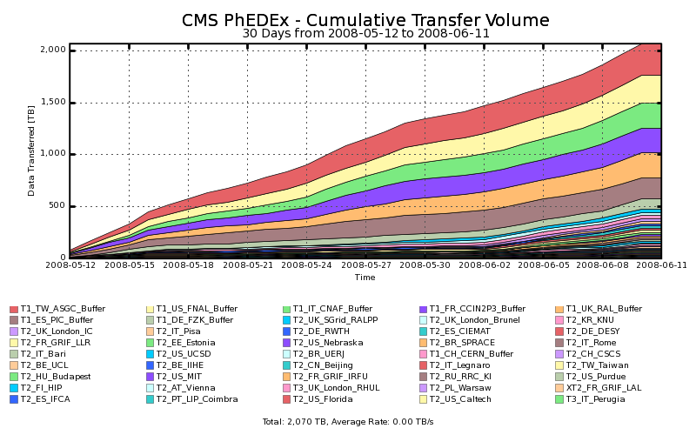
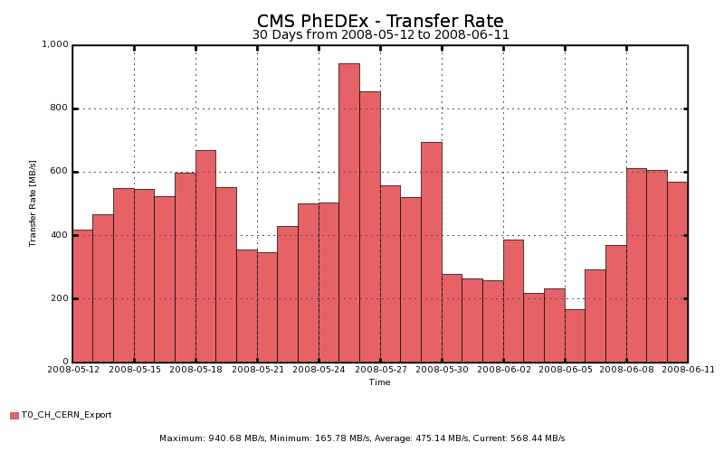
CMS Service Challenges - 2
Cumulative data volume transferred during CSA08:
  > 2 PetaByte in 4 weeks
Transfer rate from the Tier0 to the Tier1s:
  < 600 MB/sec
Goal was achieved only partially, problems with:
  Storage systems (CASTOR at CERN)
  Problems identified and fixed afterwards.

Slide 23
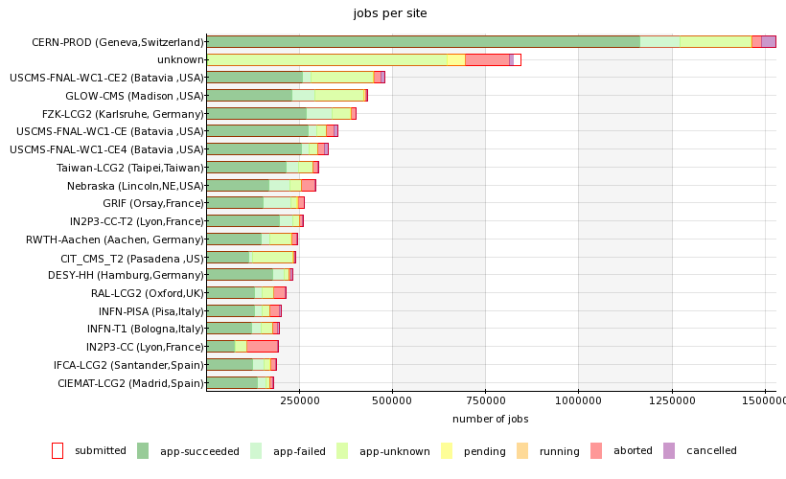
CMS Service Challenges - 3
CMS Grid-job statistics: May to August 2008
  German centres GridKa, DESY and Aachen performed extremely well, compared to all other CMS tier sites.

Slide 24
Results of CMS Challenges
Service | Goal 2008 | Status 2008 | Goal 2007 | Status 2007 | Goal 2006 | Status 2006
Tier-0 Reco Rate | 150-300 Hz | Achieved | 100 Hz | Only at bursts | 50 Hz | Achieved
Tier-0 → Tier-1 Transfer Rate | 600 MB/sec | Achieved partially | 300 MB/sec | Only at bursts | 150 MB/sec | Achieved
Tier-1 → Tier-2 Transfer Rate | 50-500 MB/sec | Achieved | 20-200 MB/sec | Achieved partially | 10-100 MB/sec | Achieved
Tier-1 → Tier-1 Transfer Rate | 100 MB/sec | Achieved | 50 MB/sec | Achieved partially | N/A | -
Tier-1 Job Submission | 50 000 jobs/day | Achieved | 25 000 jobs/day | Achieved | 12 000 jobs/day | 3 000 jobs/day
Tier-2 Job Submission | 150 000 jobs/day | Achieved | 75 000 jobs/day | 20 000 jobs/day | 48 000 jobs/day | Achieved
Monte Carlo Simulation | 1.5 x 10⁹ events/year | Achieved | 50 x 10⁶ events/month | Achieved | N/A | -

Slide 25
STEP09 Activities @ FZK
STEP09 was the first scheduled large-scale multi-vo test within the WLCG.
The following activities have been performed at GridKa during STEP09:
  1st STEP09 week (all files were on disk):
    Transfers T0 → T1
    Transfers T1 → T1
      All AODSIM data were successfully written to tape after transfer.
    Transfers T1 → T2
    Reprocessing tasks
  2nd STEP09 week (files were flushed from disk):
    Same tasks like during the first week

Slide 26
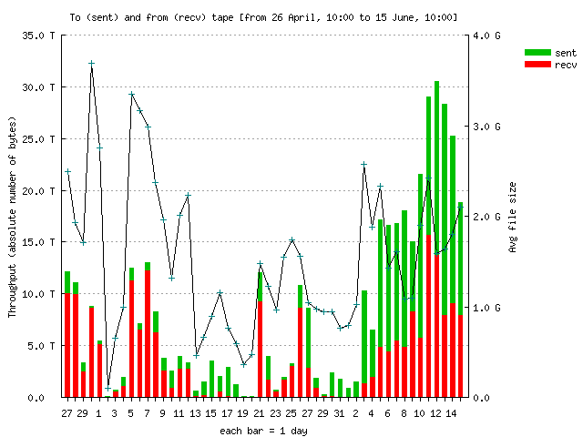
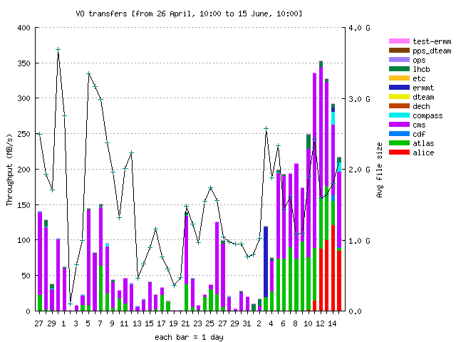
STEP09: Tape Performance
Tape I/O rates:
  1st week: 150 MB/sec
    mostly writing + reading
  2nd week: 250 MB/sec
    reading + writing
Tape I/O (all VOs)
Tape I/O rates
STEP09
Tape I/O:
  1st week: 10 -15 TB/day
    mostly writing + reading
  2nd week: 25-30 TB/day
    reading + writing
STEP09

Slide 27
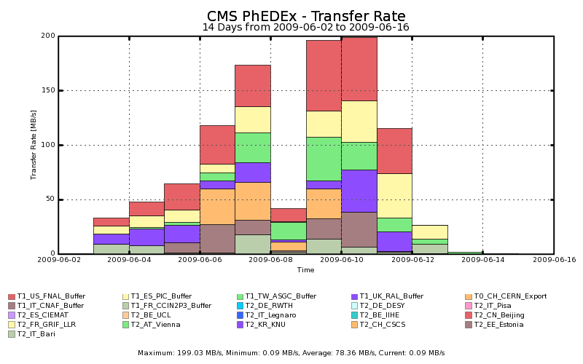
STEP09: Transfer Imports
First AODSIM Replication
Second AODSIM Replication
T0, T1 and T2 imports to GridKa during STEP09
    First week: 30 – 170 MB/sec, Second week: 25 – 200 MB/sec
    All AODSIM data successfully written to tape.

Slide 28

Summary
CMS uses Grid technology for data access and processing.
Altogether the WLCG/CMS computing model is very complex and needs intense testing.
Multiple service challenges have proven the readiness for first data.
PhEDEx is used for reliable large-scale data management.
Experience has shown, that monitoring is indespensable for the operation of such a heterogeneous system.
More information about the requirement of monitoring is presented later in this session.

