Slide 1
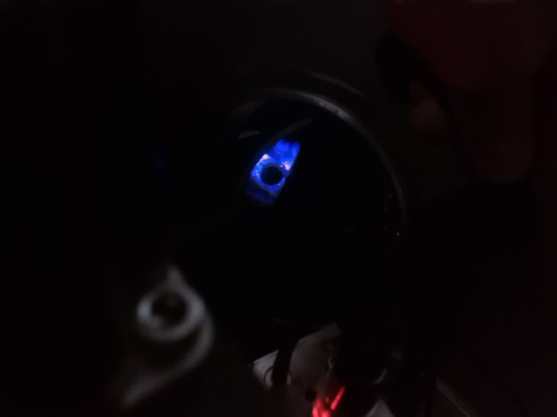
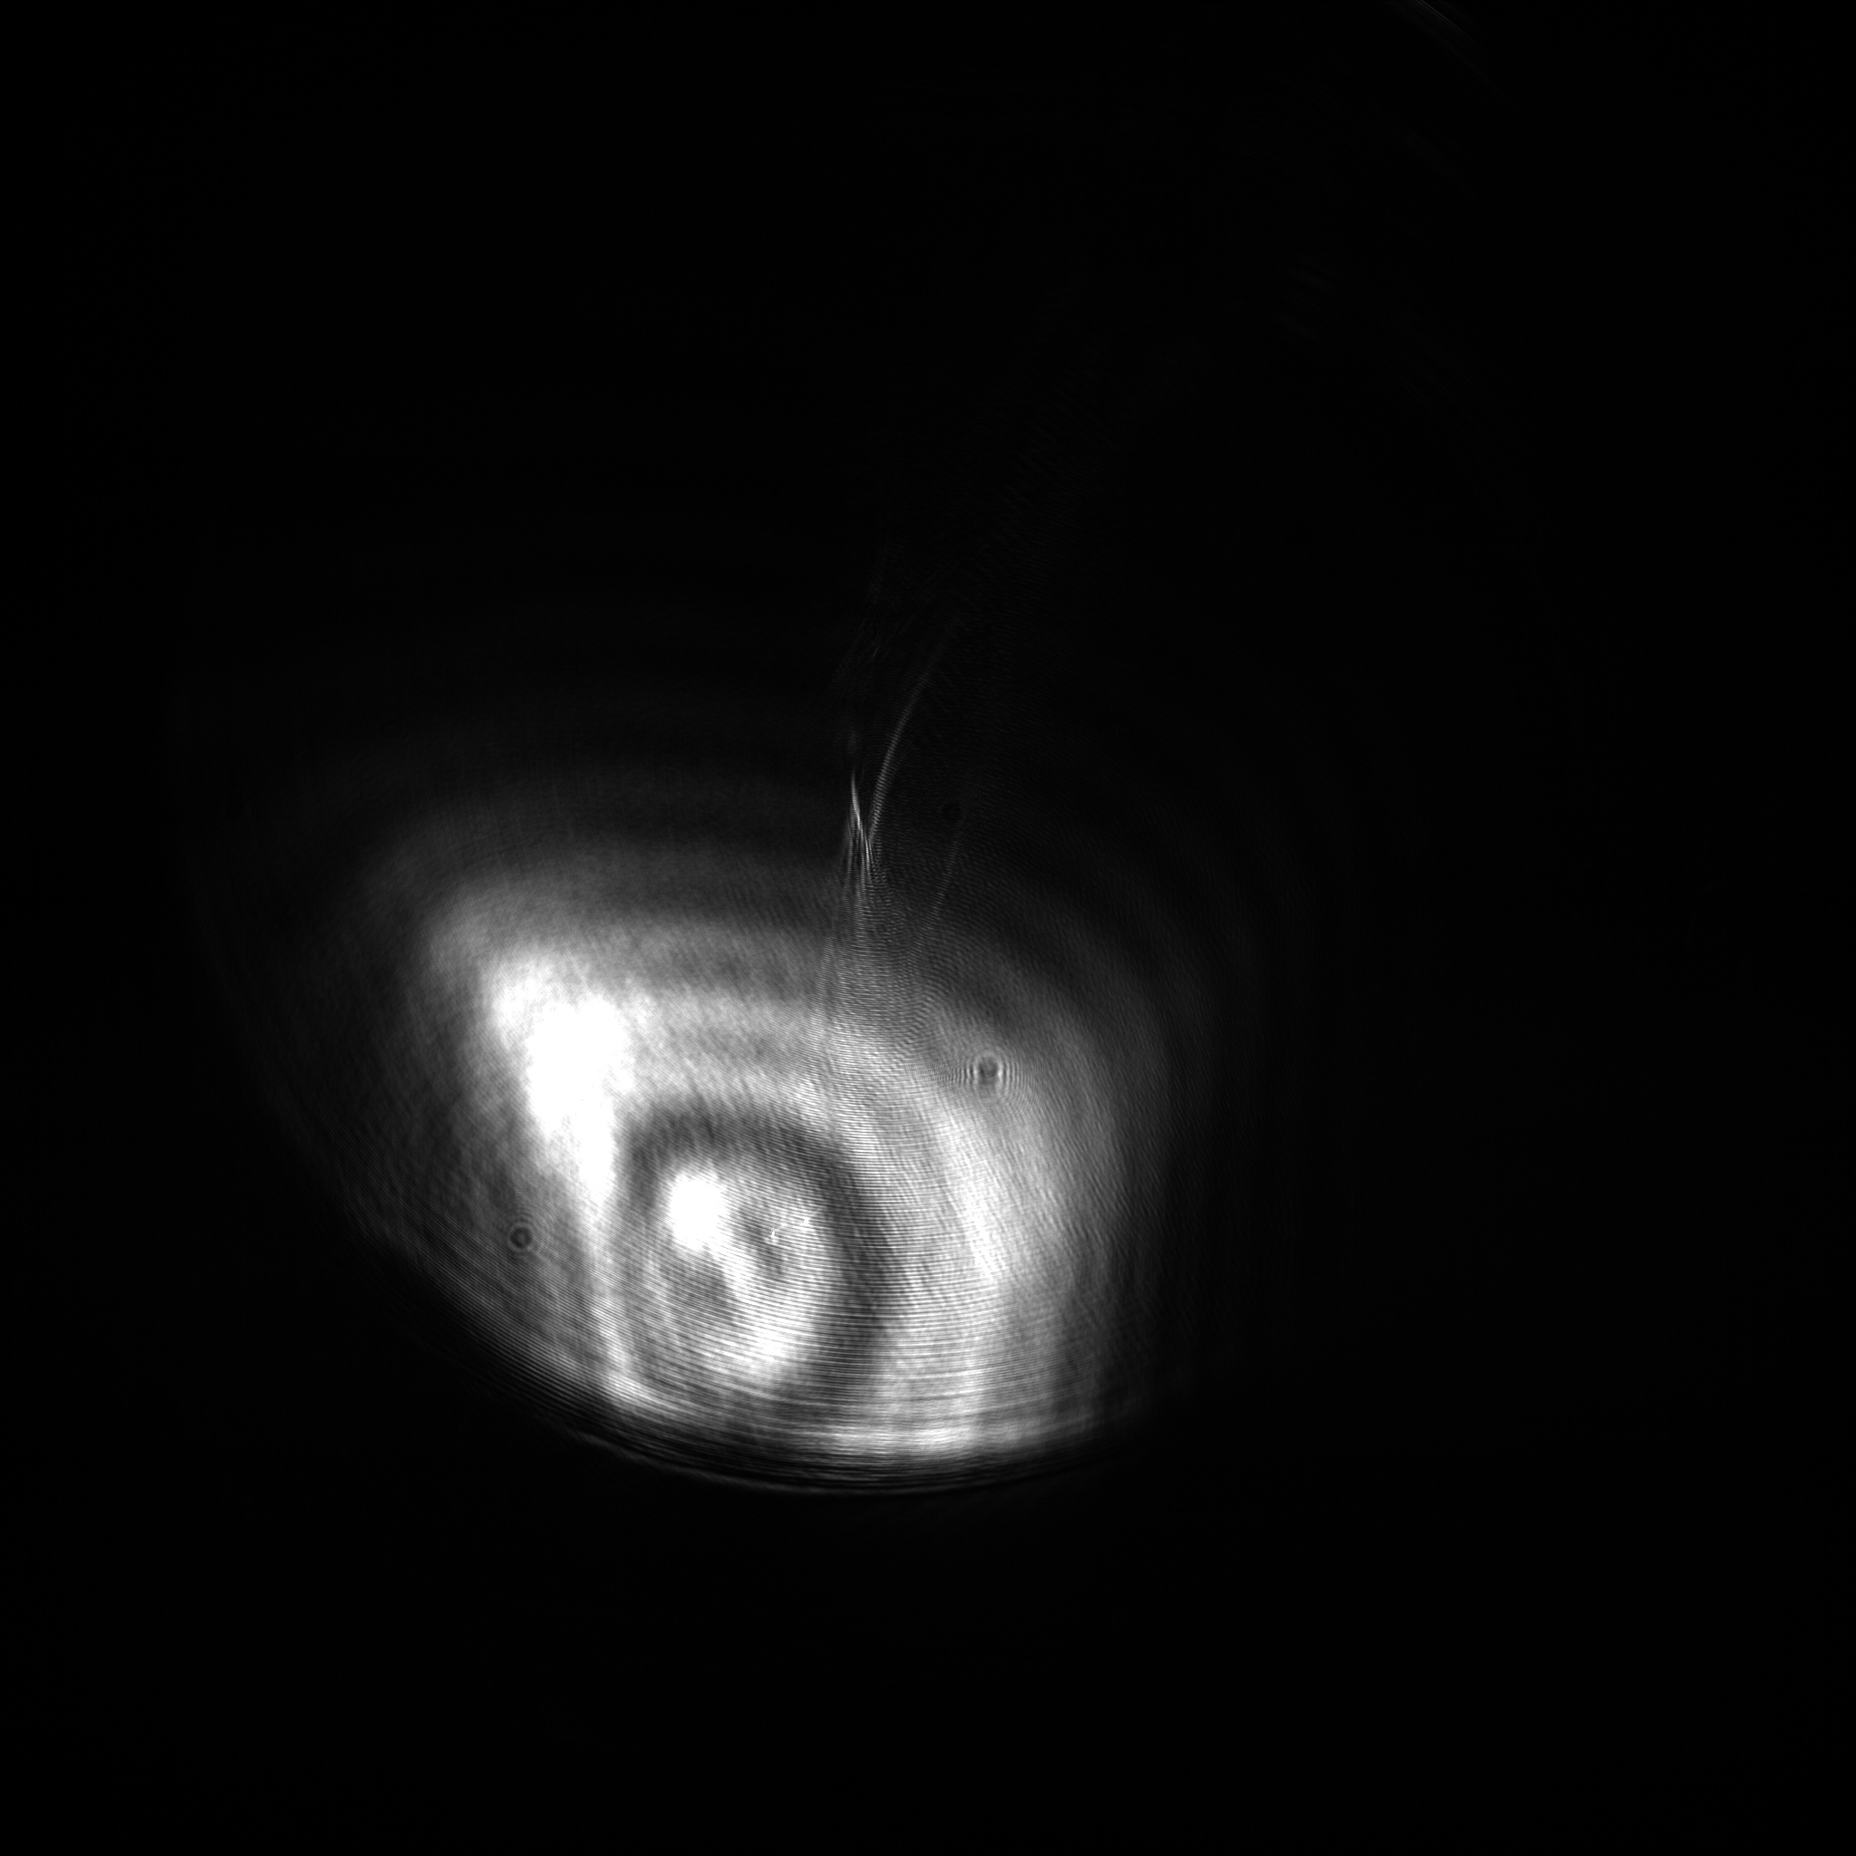
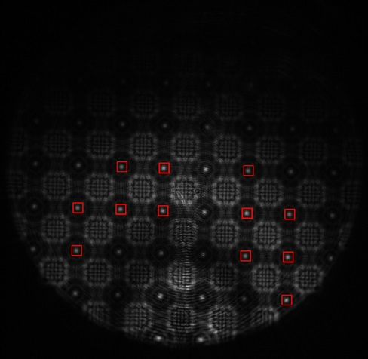
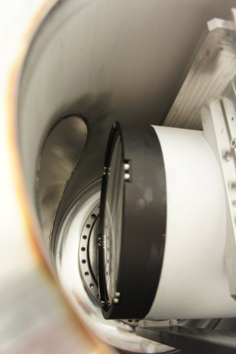
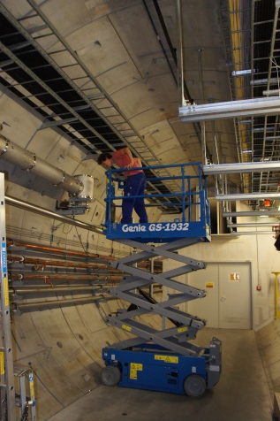
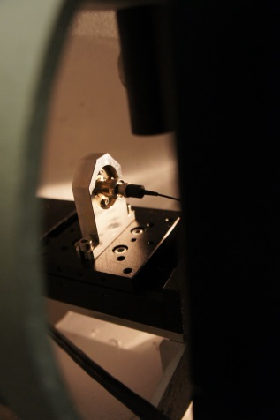
Alignment Accuracy in Long Straight Sections
SLRS: why do we need it ?
Dr. Johannes J. Prenting

Slide 2
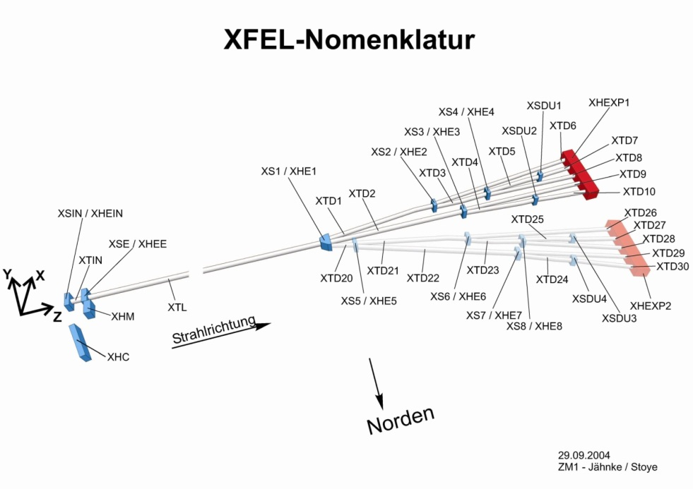
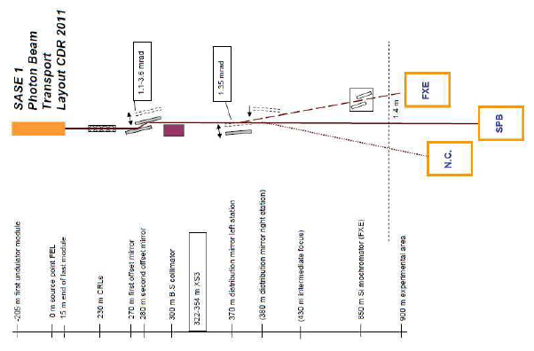
SLRS: why do we need it ? // obstacles
Distribution of SLR Systems inside the XFEL
Distribution of SLRS systems in the XFEL
3 SLR-Systems
SASE2: 555m
SASE3: 443m
SASE1: 535m
Accuracy requirements
for initial setup of beamlines:
Linac: 0.3mm wrt. 150m length
Photon beamlines: 1mm wrt. ~600m length
Additional relative alignment required after
beam-based-alignment -> given nominal values.
Accuracy requirement: 1mm / ~600m
Errors on classical optical survey allow certain accuracy
- systematic errors due to refraction (temperature gradient)
- Random errors: Instrument Accuracy, Measurement Geometry

Slide 3
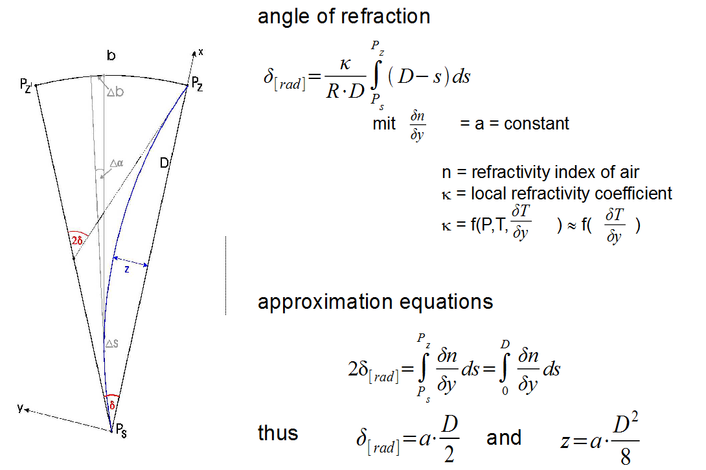
SLRS: why do we need it ? // obstacles
Systematic errors: refraction due to temperature gradient
Every line of sight gets bent to a spatial curve while travelling through the inhomogeneous medium of air. (Air layers with different density).
The turbulent part of refraction shows up as air flicker (not critical)
The static part of refraction shows up as a stable curvature of the line of sight (systematic error, critical)
Assumptions:
The refractive index of air is constant
The temperature gradient only is effective perpendicular to the line of sight
Then and only then:
The line of sight is a segment of a circle.
The sagitta „z“ can be estimated with the following approximation/rule of thumb:

Slide 4
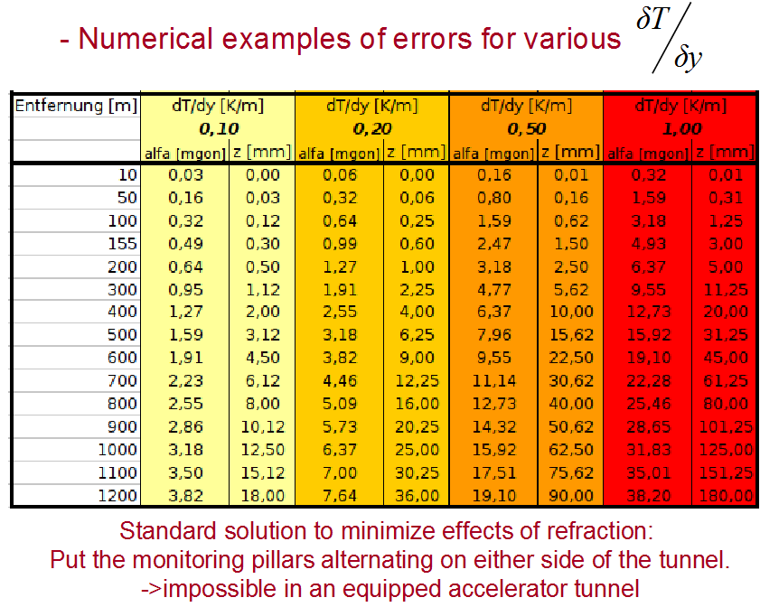
SLRS, obstacles: Numerical examples for various temperature gradients and measuring distances,
calculated from abovementioned approach. Shown are the angular error d delta (named alfa in the table) and the sagitta „z“ between straight line and line of sight:
Systematic errors: refraction due to temperature gradient
Numerical examples of errors for various

Slide 5
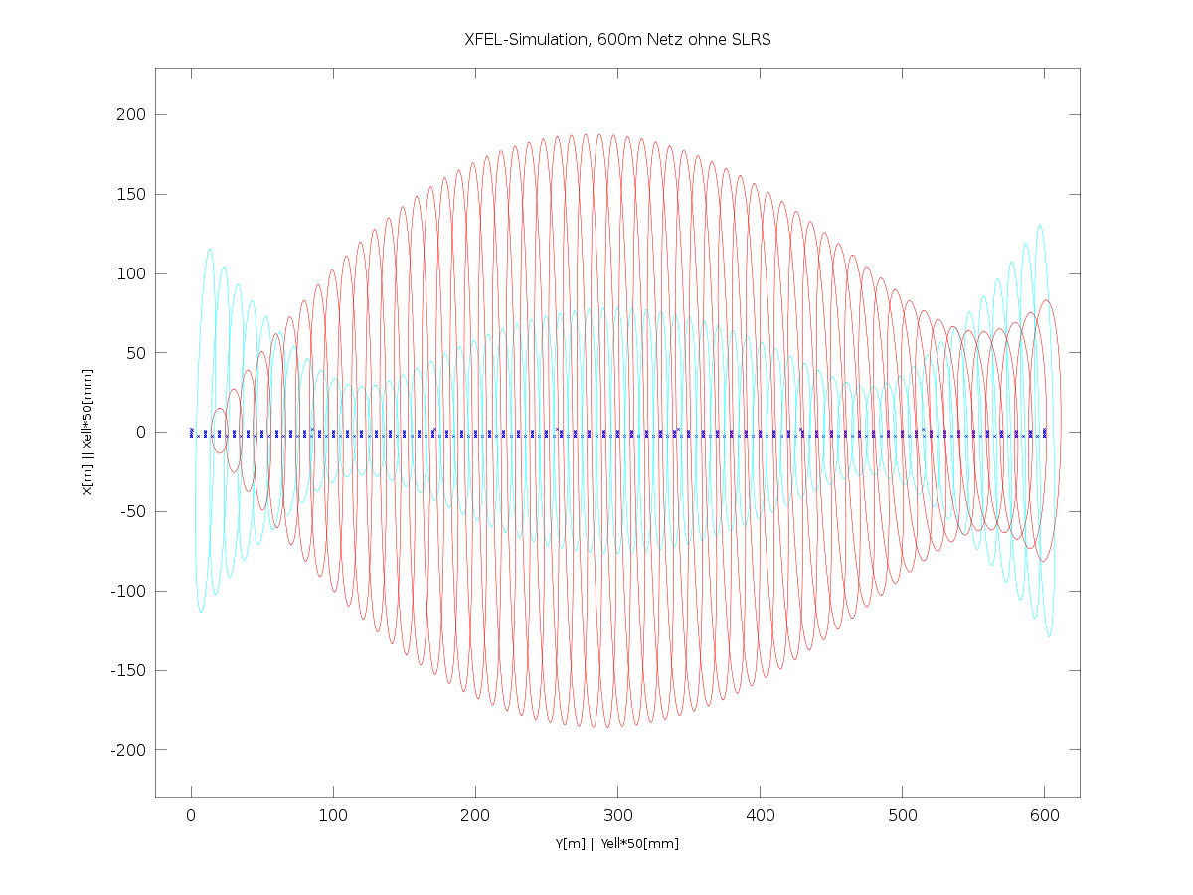
Simulation of Random Errors
Random errors: Instrument Accuracy, Measurement Geometry
Simulation of XFEL-Ref.pointgrid of
600m length, without SLRS
Dark Blue:
Gridpoints, a ring with 6 points every
9m
Instrument stands in between two rings.
Cyan:
Error of a component coordinate at a designated position within the reference grid.
@ the edge: 2,25mm, in the middle: 1,6mm
Red:
relative error between the 1. component and the component at the designated position.
max.: 3,75mm
DVW Exkursion DESY/XFEL
2014-03-18, Dr. Johannes Prenting, DESY

Slide 6
Simulation of Random Errors
Random errors: Instrument Accuracy, Measurement Geometry
Simulation of XFEL-Ref.pointgrid of
600m length, without SLRS
Dark Blue:
Gridpoints, a ring with 6 points every
9m
Instrument stands in between two rings.
Cyan:
Error of a component coordinate at a designated position within the reference grid.
@ the edge: 2,25mm, in the middle: 1,6mm
Red:
relative error between the 1. component and the component at the designated position.
max.: 3,75mm

Slide 7
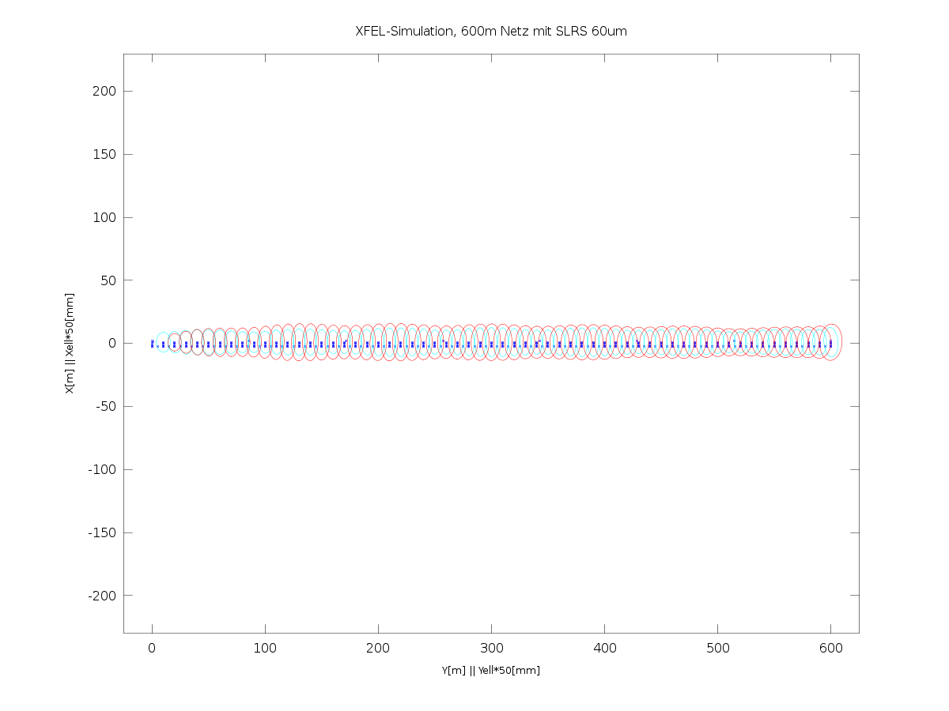
STRAIGHT LINE REFERENCE SYSTEM.
Random errors: Instrument Accuracy, Measurement Geometry
Simulation including SLRS
Simulation of XFEL-Ref.pointgrid of
600m length, incl. SLRS
with 60µm resolution
Dark Blue:
Gridpoints, a ring with 6 points every
9m
Instrument stands in between two rings.
7 SLRS Stations, evenly distributed over the lenght of 600m (every 75m)
Cyan:
Error of a component coordinate at a designated position within the reference grid.
max: 0.16mm
Red:
relative error between the 1. component and the component at the designated position.
max.: 0,32mm

Slide 8
Simulation of random and systematic errors combined
Random errors in a stretched geodetic network including refraction
The distortion due to refraction during the measurements is not detectable and not predictable.
Main reason for refraction: temperature gradients between the tunnel walls and the tunnel center.
Standard procedure: measuring across the tunnel from alternating sides to minimize refraction effects → not possible in an equipped tunnel
???
Notes:
8

Slide 9
System setup
System Integration
The SLRS (Straight Line Reference Surveyor) is a refraction free alignment system
It uses a collimated laser beam within an ISO200 vacuum tube
SLRS is used like a ruler put into the seemingly bent (refraction) tunnel network
There is no direct connection between the SLRS and machine components
SLRS provides correction parameters (dx, dz) for the geodetic network
Calibrated transfer pieces are used to connect the SLRS measuremets
with the tunnel network
Δx, Δz
Δx, Δz
Δx, Δz

Slide 10
System setup, Principle
The SLRS (Straight Line Reference Surveyor) is a refraction free alignment system
SLRS is used like a ruler put into the seemingly bent (refraction) tunnel network
SLRS provides correction parameters (dx, dz) for the geodetic network
It uses a collimated laser beam within an ISO200 vacuum tube
A laser light source emits coherent light (see right side of sketch)
A fiber end, aperture and a plano convex lens are used to expand and collimate the beam
Spheres put into the beam along the measuring section originate a poisson spot behind the centre of the sphere which can be viewed with a ccd camera
The centre of the sphere and the centre of its poisson spot in the image generate a straight line
A lens system focuses the expanded beam to the dimensions of the CCD sensor
Correlation algorithms are used to calculate the poisson centres in the image
3m
520m
3m
CCD Camera
Plano-convex lenses
Targets
Plano-convex lens
Aperture
Laser Point Source

Slide 11
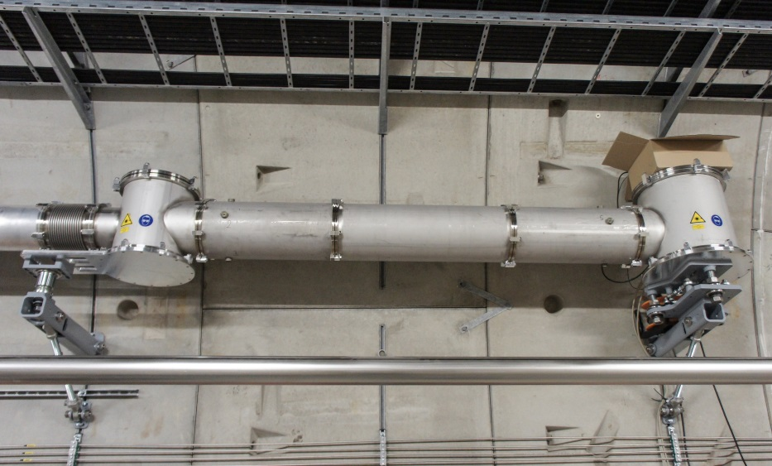
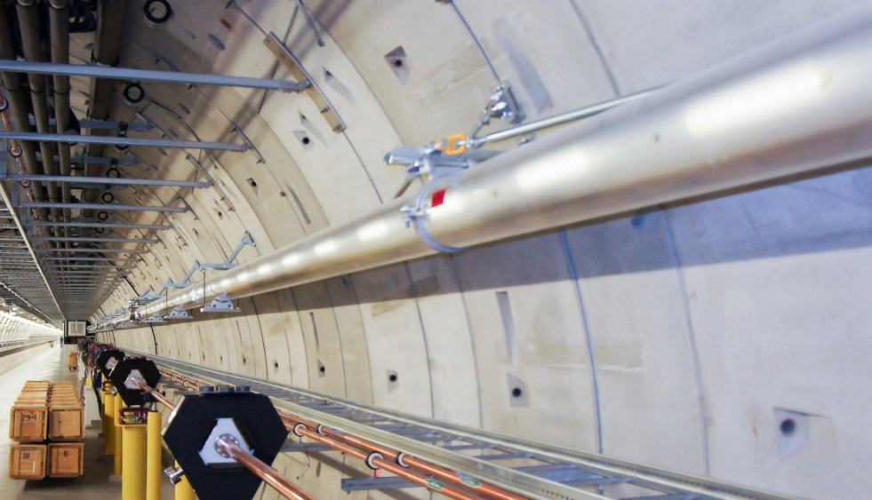
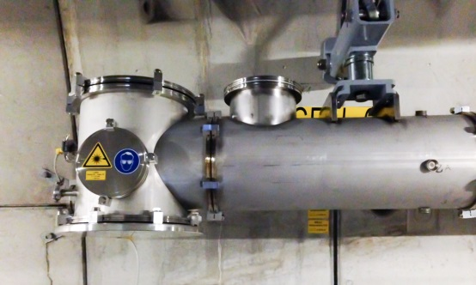
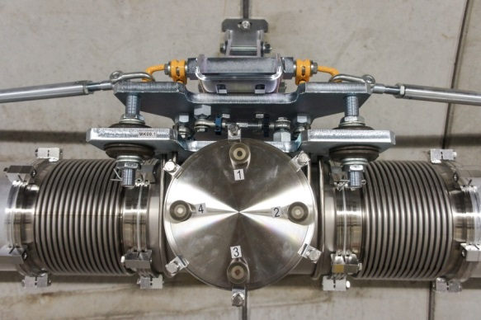
System setup
housing for laser, aperture, lens
camera housing
SLRS@SASE1, 482m
Tee piece connector & bellows
Actual setup:
Aluminum pipes, 7.73m/3.87m long, 200mm diameter. Supports are placed every 3 to 4.5m with fixed point and floating point fixing.
special housings for (laser, aperture, lenses) and (lenses & camera)
Tee piece connector with bellows, every 24m, every 2nd is
equipped with adapted measurement targets (aka target boxes)
blue laser (wavelength = 405nm) allows for small targets and provides fine interference patterns
revised plano convex lenses for minimal spherical aberration
GigE-Camera with 2048x2048 pix. resolution
Oerlikon/Leybold Trivac D 65 B Vacuum pumps

Slide 12
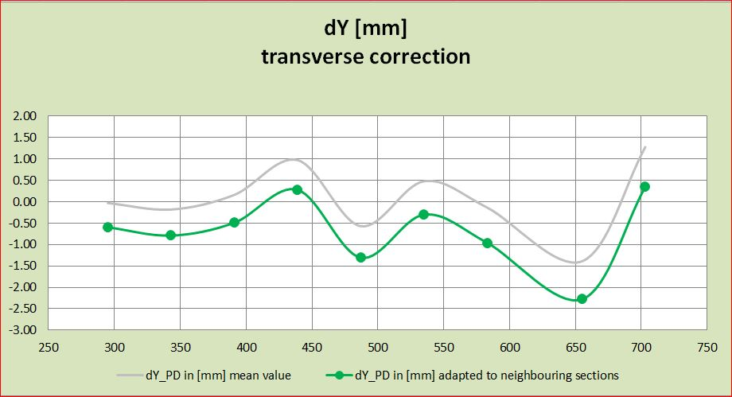
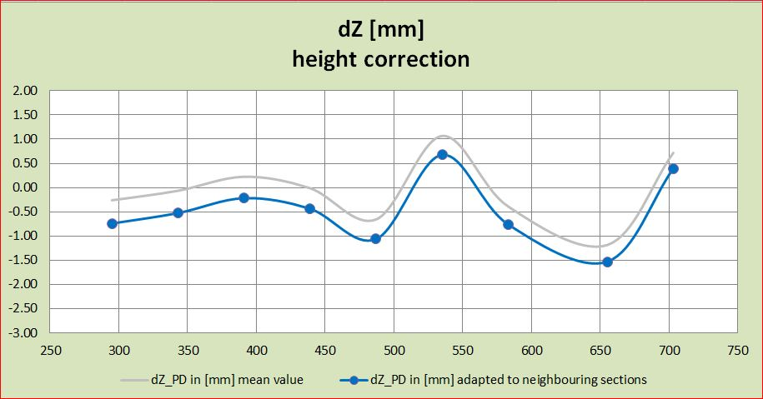
actual corrections from SLRS SASE 1

Slide 13
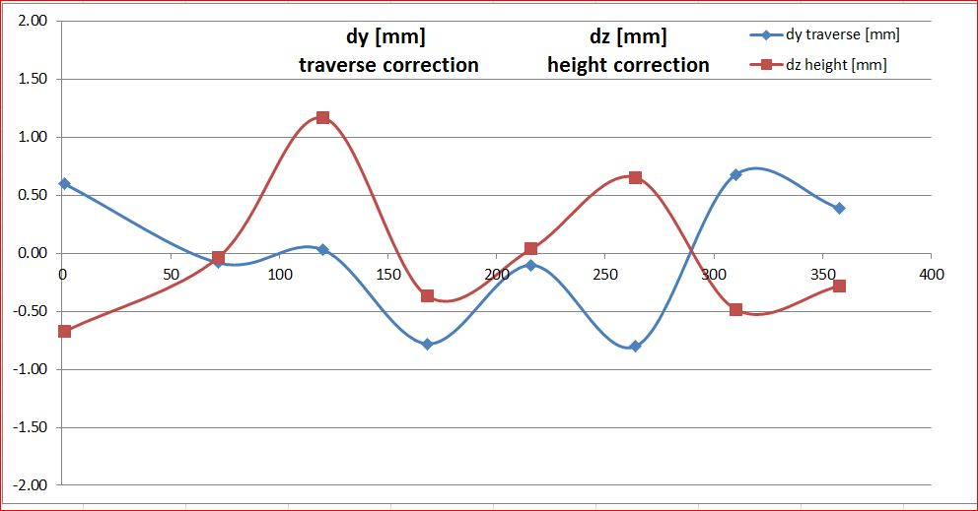
actual corrections from SLRS SASE 3

Slide 14
Conclusions
Motivation for the operation of the SLRS
The SLRS (Straight Line Reference Surveyor) is a refraction free alignment system
SLRS provides correction parameters (dx, dz) for the geodetic network
The correction parameters eliminate the systematic error caused by temperature gradient
random errors get minimized to a non critical amount (see slide 10)
at SASE1 and SASE3 correction values were in the order of +- 1,5mm
These errors would not be detected without the SLRS and would remain as unavoidable alignment errors

Slide 15
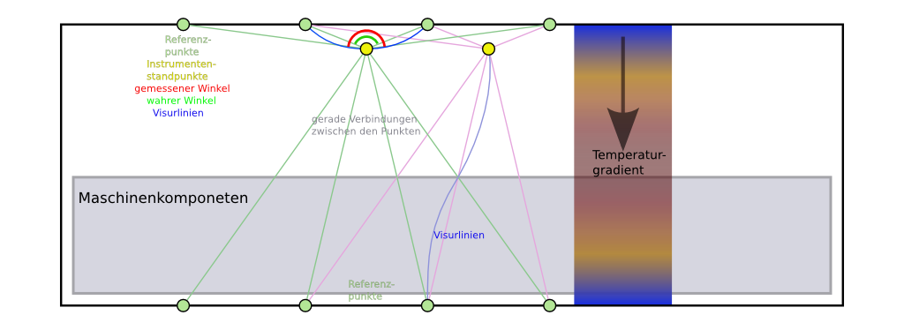
Different Measuring techniques
Polygonzugmessung über feste Standpunkte
Referenzierung des Polygonzuges über Sollkoordinaten des Beschleunigers
Freie Stationierung, Referenzierung über Referenzpunkte des Festpunktnetzes

Slide 16
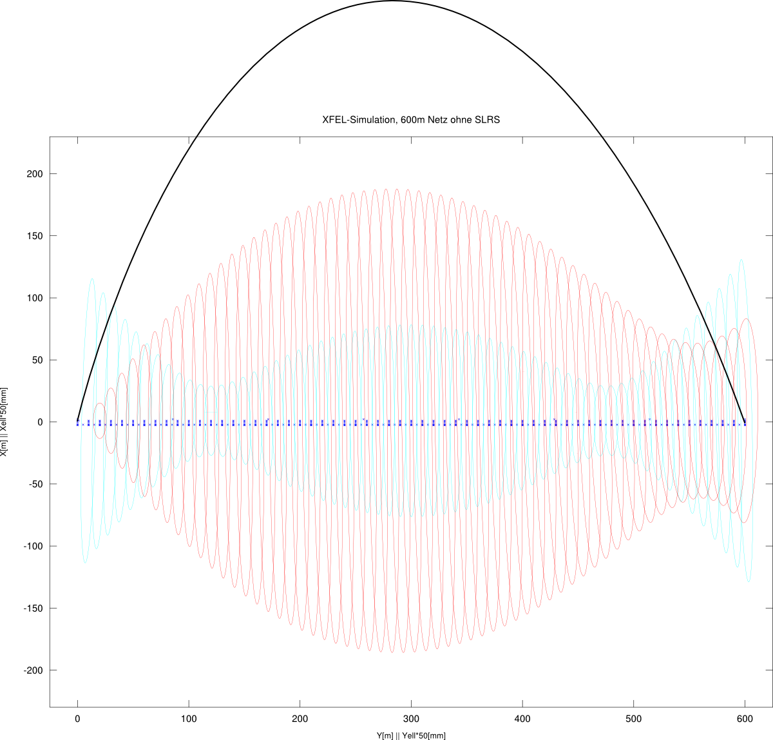
Simulation of random and systematic errors combined
Simulation of XFEL-Ref.pointgrid of
600m length, without SLRS
Dark Blue:
Gridpoints, a ring with 6 points every
9m
Instrument stands in between two rings.
Cyan:
Error of a component coordinate at a designated position within the reference grid.
@ the edge: 2,25mm, in the middle: 1,6mm
Red:
relative error between the 1. component and the component at the designated position.
max.: 3,75mm
Schwarz:
Verbiegung des Netzes durch Refraktion
ca. 9mm bei dT = 0,2K / 1m

