Slide 1
Translation of the AC & associated modification of tunnel infrastructure
A. Violante
G. Wellenreuther
C. Holz

Slide 2
Scope of work
Task | Responsible | Time / Duration
Shift of the PKG by ~24.4m (including the extension of precision climatization housing) | Company M+W, now exyte, contact person: C. Holz | WS 19/20 (25 days, excluding KW 52 +1) ➔ entire WS 19/20
Modification of cooling water (including extension of water collection pan etc.) | MKK2, contact person: A. Block, to be done by Fa. Kliewe | SS 19 (10 days), WS19/20 (5 days)
Modification of el. Power (basically shortening the existing connections) | MKK1, contact person: O. Mayer, to be done by Fa. Wille | WS 19/20 (2 days)
Dis/Re-Mounting of PKG Fire Safety Systems | SAVE, contact person: F. Saretzki, to be done by Fa. Wagner | WS 19/20 (1 / 2 days respectively)
Modification of IT connections | DESY IT, contact person: T. Ladwig | WS 19/20 (1 day)

Slide 3
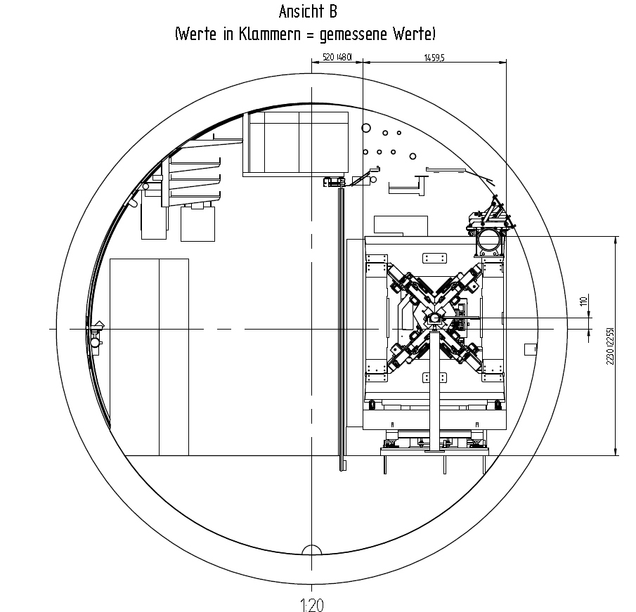
Start of the Apple X section @ LA ca. 2941m

Slide 4
Shift of the PKG
Note: End of the PKG in this drawing is @ LA = 2954,77m
cooling

Slide 5
End of the PKG / separating wall.
But in the current vtour XTD4 at 2957 / 2960m the PKG currently ends at around 2958,5-2959,0m...

Slide 6
Next downstream components
Lessons learned:
We have to speak about absolute positions, not about relative shifts.

Slide 7
Positions (LA coordinates)
Center of 1st Apple X: 2942,62m
End of PKG, current „real“ position: 2958,5 - 59,0m
End of the PKG after shift: ca. 2982m
Pump / El. Rack: 2979,7m / 2980 – 2981,7m
Pump + Rack are below the beamline ➔ lets shift the PKG as much as possible (ca. 27-27.5m) ➔ provide corrected CAD drawing to exyte before the SS ➔ exyte to provide us with assembly drawing in the following

Slide 8
Open questions
Transport services: How long / how many? Is MEA-5 available at all, at which cost? Is OCD sufficient?
CFD-simulation: Offer is ca. 30k€. Exyte is happy to do this, but sceptical about the benefit - what decision is to be taken based on the result? Why not instead keep the 30k€ to potentially modify the PKG should problems arise in 2020?
Responsibility for representation of all works in the CAD-model?

