Slide 1
DosiMon RadFet system requirements to the SASE3-VP Project
Location environment at SASE3 Helical Afterburner section
DosiMon System setup & requirements (frontend hw)
DosiMon System setup & requirements (backend hw, fw & sw)
Next steps
Open questions

Slide 2
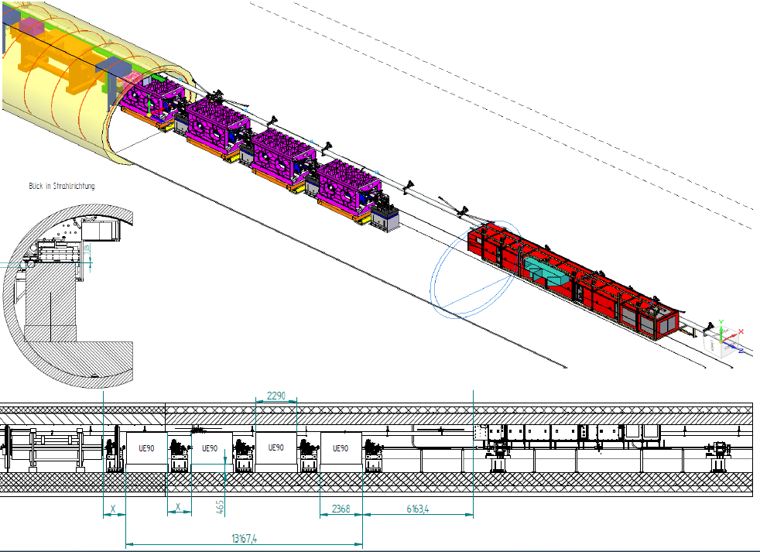
Location environment at SASE3 Helical Afterburner section
4 Helical Undulators w/t 3D-remote-adjustable gaps *
Measure integrated dose from high energy shower absorbed at UNDs
Synchrotron radiation from regular upstream undulators **
Well collimated beam from upstream undulator chambers ***
2 diagnostic crates w/t DosiMon interface available nearby
(DI2943T4D, DI3065T4D)
Offline radiation damage threshold measurements
* ➔ movable sensors needed
** ➔ shielded sensors needed
(Afterburner Kick Off Meeting 26.4.2018 J. Pflueger, European XFEL,WP71)
*** ➔ no chamber sensors

Slide 3
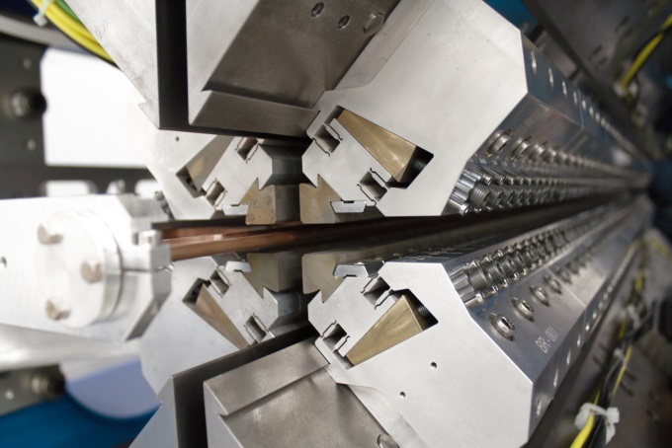
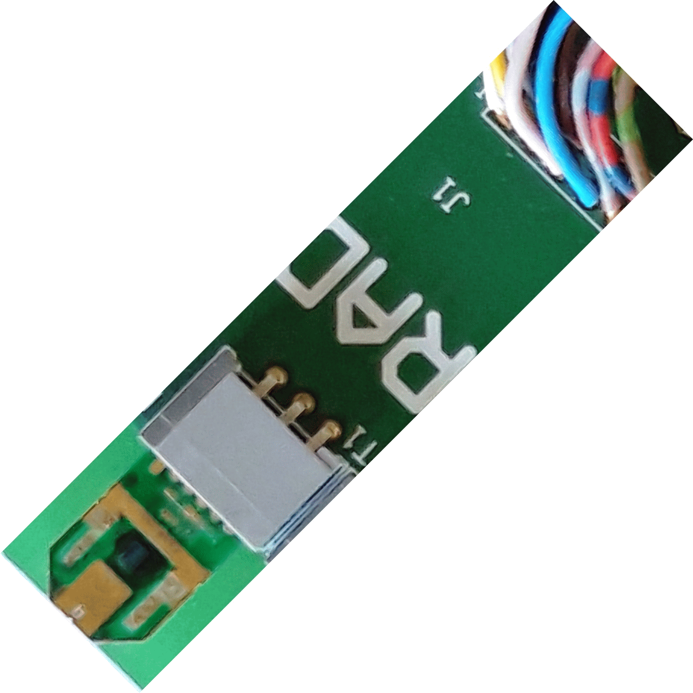
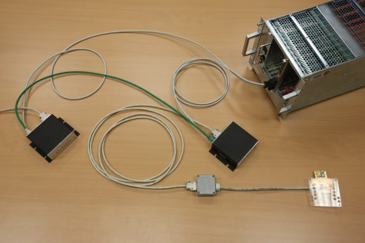
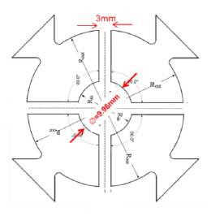
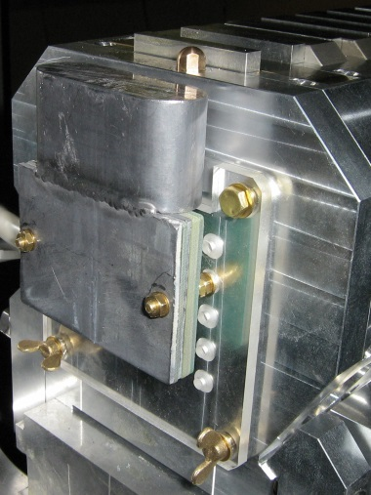
DosiMon System setup & requirements (frontend hw)
Established sensor frontend concept (RadFet (replaceable),TLD (ref.), Pt1000, ID-R, lead-cap)
Sensor holder with pre-defined, radially-adjustable displacement positions & stacked sensor positions for RadFet || TLD (NEW DESIGN!)
Special narrow lead cap shieldings (NEW DESIGN!)
Mounting holes needed
SPECIAL NEW LOW-SCALE SENSOR-HOLDER/LEAD-CAP DESIGN NEEDED !
(Afterburner Kick Off Meeting 26.4.2018
J. Pflueger, European XFEL,WP71)

Slide 4
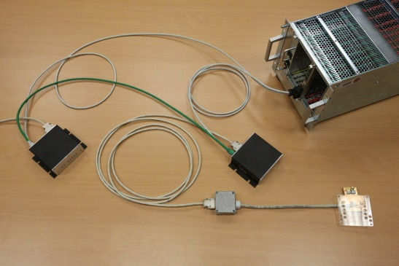
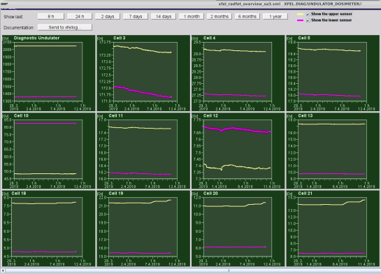
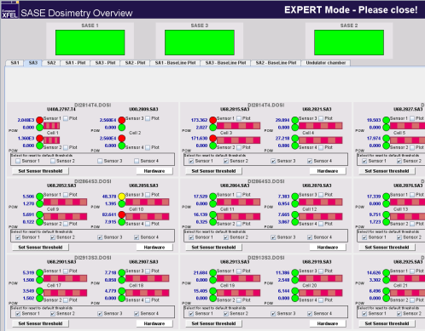
DosiMon System setup & requirements (backend hw, fw & sw)
Standard DosiMon frontend-readout electronics
(DosiBox, DosiMon-FMC, DAMC2, MTCA.4 crate)
=> 1 DosiBox per Helical Undulator => 4 DosiBoxes
(DosiMon-FMC available at the existing MTCA diagnostic crates)
Standard frontend firmware, standard device server & administration (ML-)server (MDI, MCS4/1)
standard operating procedures for regular SASE undulators apply
- determination of radiation damage levels by magnetic-field degradation measurements (WP71)
- configuration of new/individual radiation damage levels (normal/warning/error)
- confirmation of level-warnings/-errors after recognition by the operators
Operating- & experts-panels have to be adjusted
to different Helical Undulator structure/setup (MCS)
Cabling transfer-box to be mounted on existing side-plate

Slide 5
Next steps
Fix sensor frontend setup & define sensor holder geometry
(RadFet, TLD, Pt1000, ID-R, lead-cap) (MDI)
Define mounting positions (sensor holders, transfer box, cabling, …) (MDI, MVS, WP71, PSI)
Manufacture prototype of sensor frontend & assembly (MDI, ZM)
Check & release series assembly at Helical Undulator test-stand (WP71, PSI, MDI)
Manufacture sensor frontend series parts (16 series (+2 spare)) (MDI, ZM)
Mount 16 sensor frontends at the 4 helical undulators –
all work to be done by MDI in close cooperation with WP71
Estimated production & working time:
~ 3/4 year from design-start to series hw components, ~1 week assembly & adjustment
Estimated start of work: late summer 2019.

Slide 6
Open questions
Optimum mechanical alignment of sensors to frontside/inner edge of 1st magnet slice?
Calibration & definition of radiation damage-levels as appropriate for Helical Undulators?
Is the magnetic material equal to the material at the standard SASE undulators?
How & where can magnetic-field measurements be done? (→ WP71)
- In-Place at Helical Undulator inside the tunnel?
- Dismounting/remounting of magnet slice(s) from Helical Undulator
& magnetic-field measurement outside of the tunnel?
- Measurement of complete Helical Undulator outside of the tunnel (→ transport)?
determination of appropriate radiation damage levels probably needs …
- offline measurement of magnetic field degradation (see above)
- survey of typical longitudinal degradation vs em-shower development
→ how much degrade certain magnetic slices at „the typical“ shower?
→ how is polarized SASE affected by the typical longitudinal magnet-slice degradation-pattern?

Slide 7
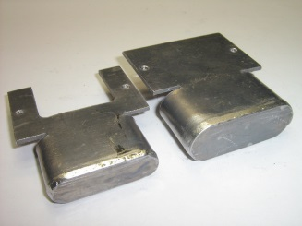
Thank you!
Questions?

