Slide 1


The constrained Exceptional
Supersymmetric Standard Model
(cE₆SSM)
Peter Athron
In collaboration with: S.F.King, D.J.Miller, S.Moretti and R.Nevzorov.
TexPoint fonts used in EMF.
Read the TexPoint manual before you delete this box.: AAAAAAA

Slide 2

Supersymmetric Models
Minimal Supersymmetric Standard Model (MSSM)
Next to Minimal Supersymmetric Standard Model (NMSSM)
U(1) extended - USSM
Exceptional Supersymmetric Standard Model (E₆SSM)
[Dine, Fischler and Srednicki]
[Ellis, Gunion, Haber, Roszkowski, Zwirner]
[S.F. King, S. Moretti, R. Nevzrov, Phys.Rev. D73 (2006) 035009]

Slide 3
Exceptional New Physics
just beyond the Standard Model
0
E₈ £ E₈ Heterotic String Theory
Exceptional New Physics
(exotic matter, e.g Leptoquarks)
Grand Unified Theory, e.g. SU(5), SO(10), E₆
Desert
Exotic matter from complete E₆ multiplets survives to low energies!
Supersymmetry, e.g. MSSM
E₆SSM
Electroweak physics

Slide 4
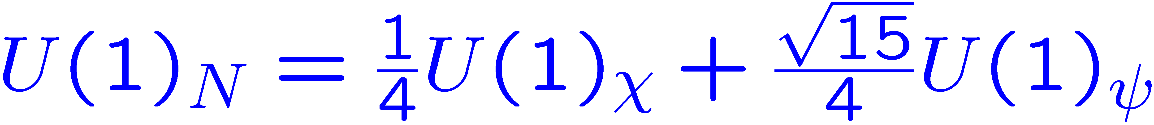







Exceptional Supersymmetric Standard Model
[Phys.Rev. D73 (2006) 035009 , Phys.Lett. B634 (2006) 278-284 S.F.King, S.Moretti & R. Nevzorov]
E₆ inspired model with an extra gauged U(1) symmetry
“Inspired” by:
Matter from 3 generations of E₆
Ordinary matter
3 generations of Singlet fields
3 generations of Higgs like fields
Exotic coloured matter
Extra SU(2) doublets
(for gauge coupling unification)
Provides a low energy alternative to the MSSM and NMSSM

Slide 5
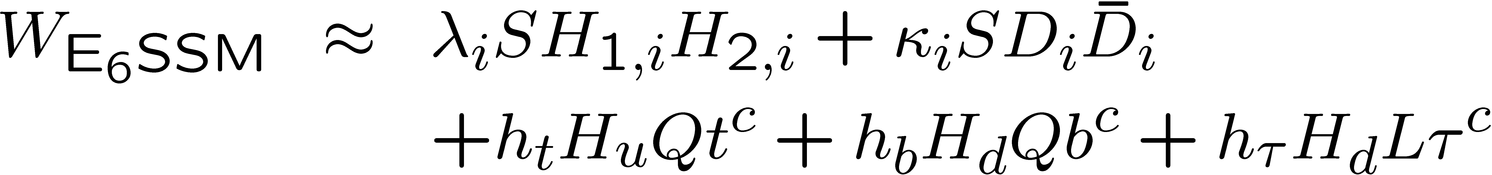
E₆SSM Superpotential
Imposing Z₂^{B/L} and Z₂^{H}
To ensure only 3rd gen. gets vevs, we choose:
Further integrating out super heavy, right handed neutrinos, and dropping ¹⁰ which decouples, leaves:

Slide 6



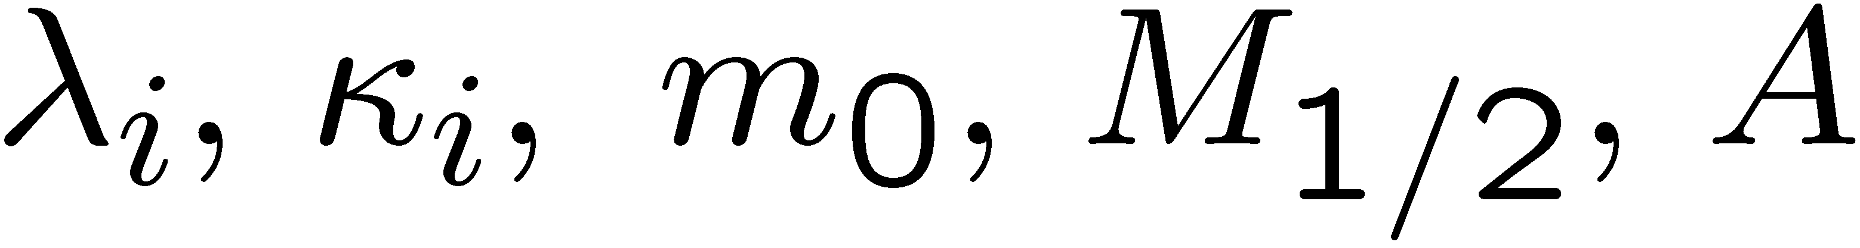
The Constrained E₆SSM
[PA, S.F.King, D.J.Miller, S.Moretti, R.Nevzorov, arXiv:0901.1192 PRD 80, 035009 (2009), arXiv:0904.2169 (Accepted for PLB)]
At M_{X} ¼ 10¹⁵ GeV
Universal Gaugino Mass
Universal trilinear soft mass
Universal scalar mass
Free parameters:
Renormalisation Group Equations (RGEs)
To connect these high scale conditions with low energies we derive RGEs for:
Gauge and Yukawa couplings (2 loop).
Soft breaking gaugino and trilinear masses (2 loop).
Soft scalar masses (1 loop).
RG evolution very different from MSSM
At 1 loop ¯₃ = 0 ) g₃ doesn’t run.

Slide 7

Restrictions on solutions
Procedure
Find low energy couplings and soft mass parameters consistent with:
cE₆SSM universality constraints;
gauge coupling unification;
EWSB conditions, , where V includes leading 1 loop stop contributions.
Calculate physical mass spectra.
Test against experimental constraints.
To ensure phenomenologically acceptable solutions, we require
squarks and gluinos & 300 GeV
exotic quarks and squarks & 300 GeV [HERA]
M_{Z}⁰ & 860 GeV
Insist on neutralino LSP
Keep Yukawa couplings . 3
Inert Higgs and Higgsinos & 100 GeV

Slide 8
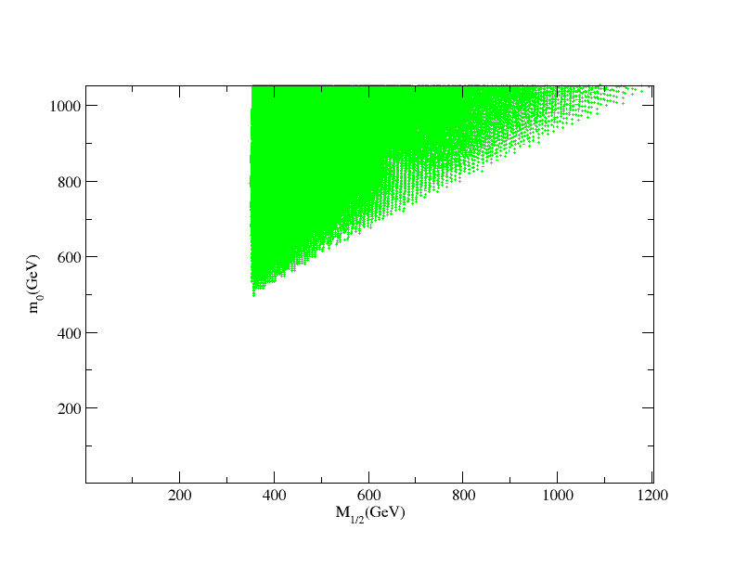

Allowed regions in the m₀ - M_{½} plane
Fix ¸₁ ₂= 0.1, vary ¸₃ and and s:
‘
m₀ = M_{½}
Note: since m₀, M_{1/2} are derived, some possible regions are sparsely populated

Slide 9
Representative
Scenarios

Slide 10
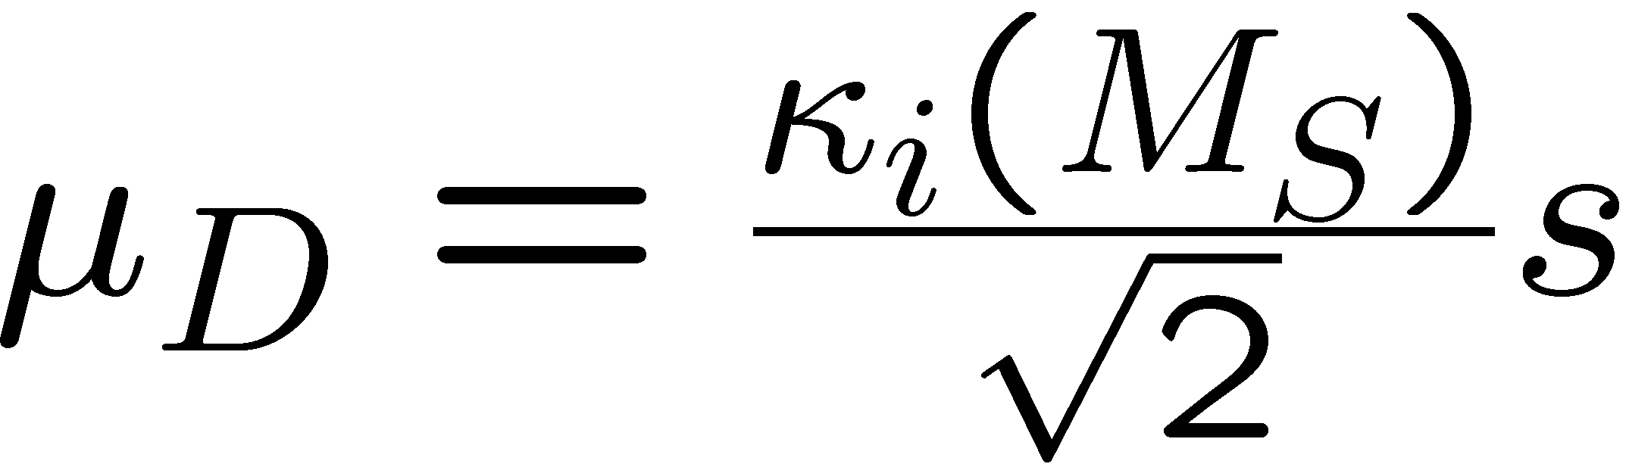
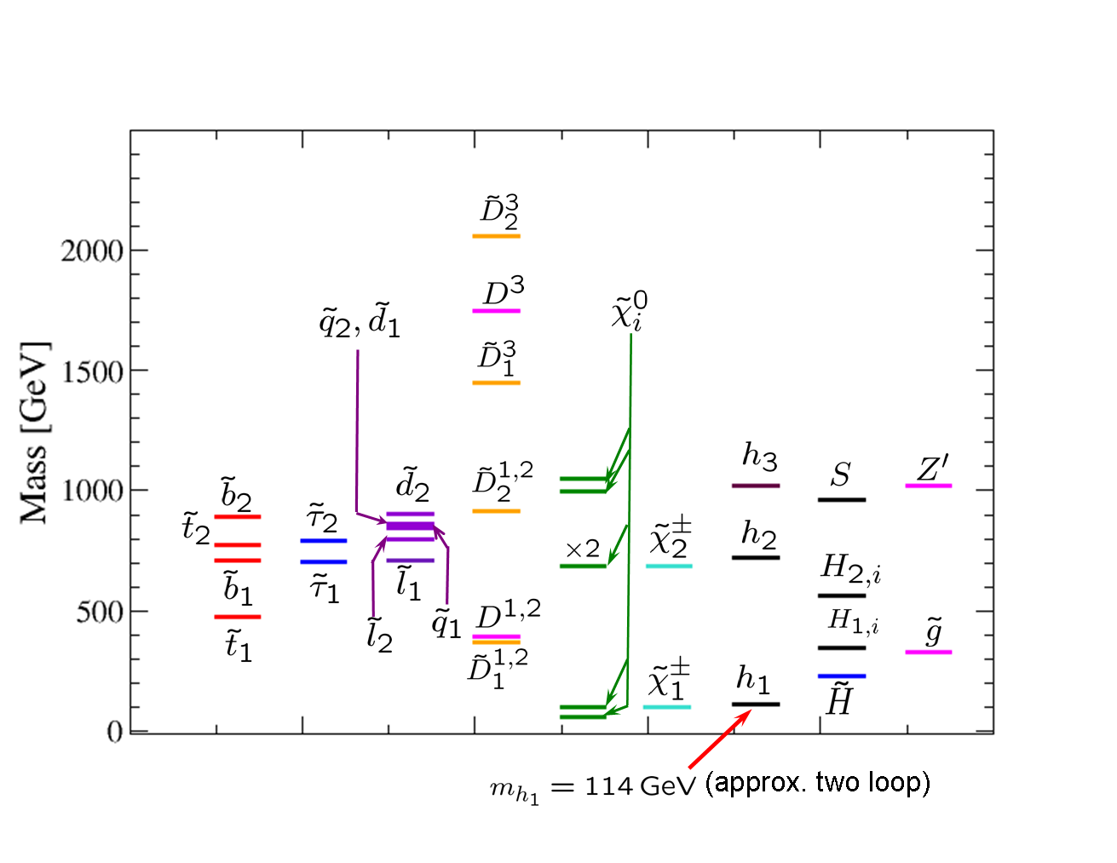
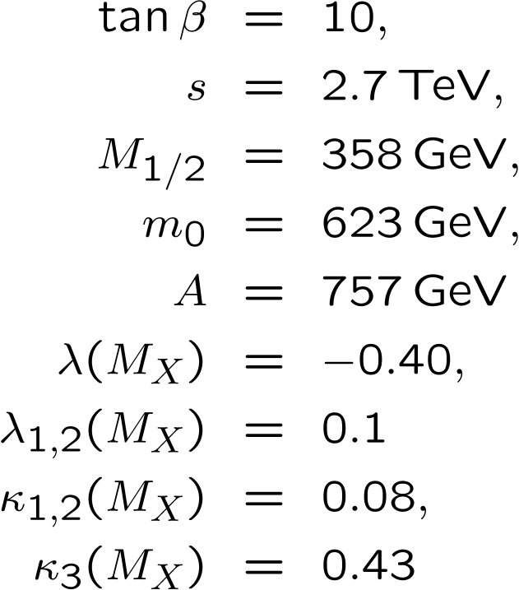
Scenario A (Light exotic fermions and scalars )
Large drives electroweak symmetry breaking
With a universal exotic coupling at the GUT scale
) exotic quarks are always heavy ( )
Break universality and exotic quarks can be light

Slide 11
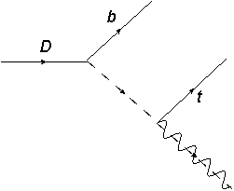
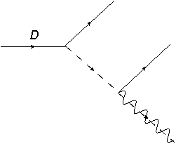
Exotic Signatures
Diquarks
Enhancement of
Leptoquarks
Scalar partners
Scalar similar, but without missing energy from
e.g.

Slide 12
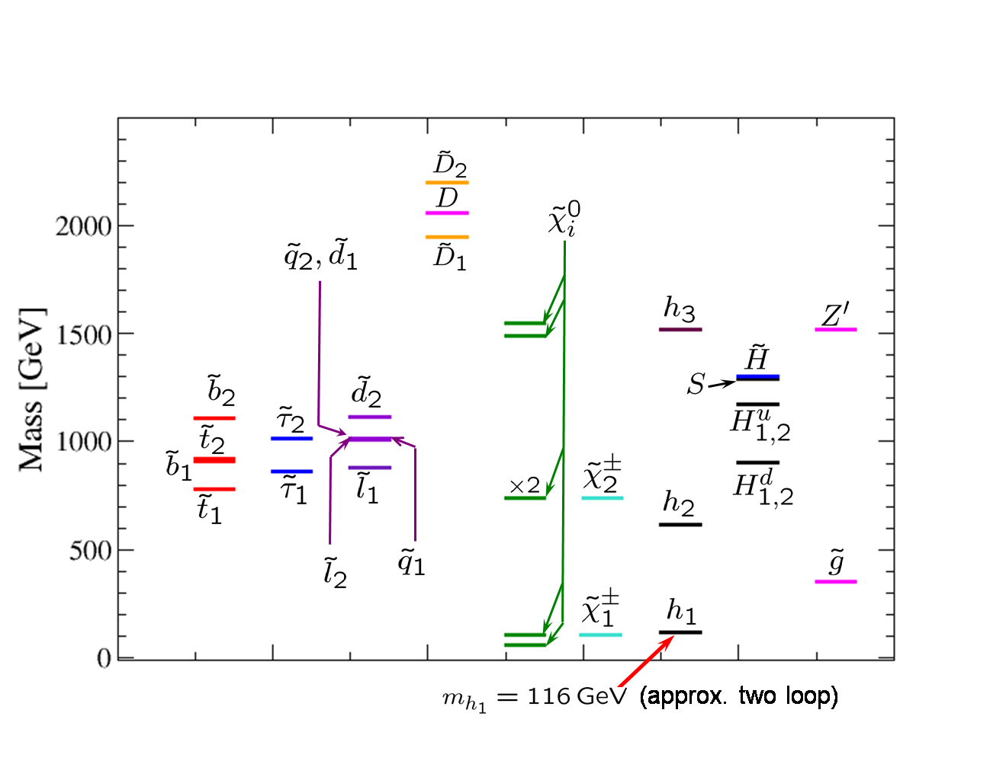
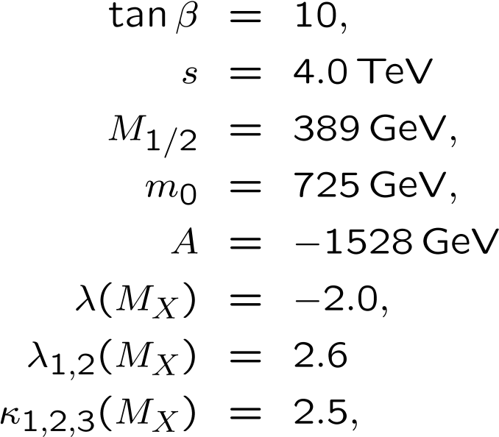
Caution:
It is possible all the exotics are heavy and challenging to detect, e.g.
Scenario B (Pessimistic)

Slide 13
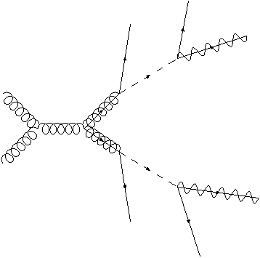
Caution:
It is possible all the exotics are heavy and challenging to detect, e.g. Scenario 6
Even in such a scenario there is still a striking prediction, which is a general result of the cE₆SSM.
All spectra have a clear hierarchy
Gluino is lighter than all sfermions of ordinary matter
Strong contrast with typical MSSM scenario
Result of the RGE evolution
Decay
) Appreciable enhancement of:
g
g
g

Slide 14

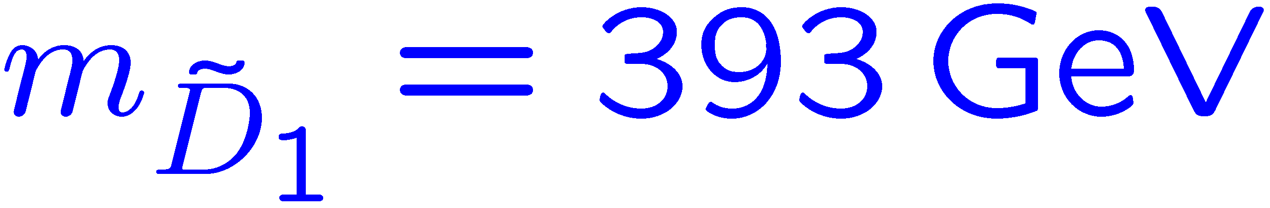

Conclusions
Radiative EWSB is realised within the cE₆SSM
Large volume of parameter space is phenomenologically viable and within range of LHC.
Presented realistic cE₆SSM scenarios with:
Light Inert Higgs and Higgsinos (charged and neutral), e.g Sc. 1
Exotic scalar diquarks/leptoquarks , e.g Sc. 3
Exotic diquarks/leptoquarks with non-universal , e.g Sc. 4
TeV scale U(1)_{N} Z’ boson with an unmistakable signature.
General cE₆SSM prediction of a hierachical structure with
Always two light neutralinos, a chargino and gluino, which can be produced at LHC
Light gluino for example produced via gluon fusion to give:
Substantially enhanced cross-section for:

Slide 15
Fittino and the E6SSM?
E6SSM Fittino?
Resolving MSSM/NMSSM/USSM and E6SSM with Fittino?
What we have:
Spectrum generator (not publicly available) for cE6SSM masses
SLHA output?
Feynman rules / Branching fractions – Work in Progress

Slide 16
cout << "Block MASS # Mass spectrum\n";
cout << "#PDG code mass particle\n";
cout << " 45 "; cout << heaviesthiggs; cout << " # Heaviest neutral CP-Even Higgs \n";
cout << " 1000045 "; cout << neutralino_masses[4]; cout << " # ~neutralino(5)\n";
cout << " 1000055 "; cout << neutralino_masses[5]; cout << " # ~neutralino(6)\n";
cout << " 0000032 ";cout << MZprime; cout << " # Z'\n";
cout << " 9900044 ";cout << mDfermion(1); cout << " # exotic fermion 1 \n";
cout << " 9900045 ";cout << mDfermion(2); cout << " # exotic fermion 2\n";
cout << " 9900046 ";cout << mDfermion(3); cout << " # exotic fermion 3 \n";
cout << " 9900054 ";cout << sqrt(mD1sq(1)); cout << " # exotic sfermion 11 \n";
cout << " 9900055 ";cout << sqrt(mD1sq(2)); cout << " # exotic sfermion 12 \n";
cout << " 9900056 ";cout << sqrt(mD1sq(3)); cout << " # exotic sfermion 13 \n";
cout << " 9900064 ";cout << sqrt(mD2sq(1)); cout << " # exotic sfermion 21 \n";
cout << " 9900065 ";cout << sqrt(mD2sq(2)); cout << " # exotic sfermion 22 \n";
cout << " 9900066 ";cout << sqrt(mD1sq(3)); cout << " # exotic sfermion 23 \n";
+ Inert Higgs

Slide 17
Back up slides

Slide 18
The μ problem
The MSSM superpotential is written down before EWSB or SUSY breaking:
) it should know nothing about the EW scale.
(
¹-parameter has the dimension of mass!
The superpotential contains a mass scale!
)
What mass should we use?
Forbidden by symmetry
The natural choices would be 0 or M_{Planck} (or M_{GUT})
Scale of origin
Phenomenological Constraints ) ¹ ¼ 0.1 -1 TeV
)

Slide 19


Discrete Symmetries
Z₂^{B} or Z₂^{L} symmetries
To evade rapid proton decay, impose Z₂^{B} or Z₂^{L} symmetries.
Like R-parity but is odd while is even.
Z₂^{B} ) leptoquarks ; Z₂^{L} ) diquarks.
Z₂^{H} symmetry (approximate)
To evade large Flavour Changing Neutral Currents, introduce Z₂^{H}.
3rd gen Higgs superfields (H_{1,3}, H_{2,3} and S₃) : even, all others : odd.
All couplings for exotic quarks and inert Higgs decay, violate Z₂^{H} ,
) Z₂^{H} only approximate !
For Renormalisation Group analysis and mass spectra:
Z₂^{H} violating couplings can be neglected.

Slide 20






New Exotic States
Extra gauged U(1)_{N} ) exotic Z’ boson
Complete E₆ 27-plets ) exotic matter
Exotic ‘quarks’: New colored SU(2) singlets, and with charge §¹/₃.
Either diquark or leptoquark in nature.
Inert Higgs: 3 generations of Higgs-like bosons. Only the 3rd, H_{u} = H_{2,3} & H_{d} = H_{1,3}
develop VEVs, h H⁰_{u} i = v_{u} & h H⁰_{d}i =v_{d} , giving mass to ordinary matter,
e.g.
The 1st and 2nd generation are neutral and charged scalars -- “inert Higgs”.
Singlets: 3 generations of SM singlets, . 3rd gen S = S₃ develops VEV, hSi = s,
) exotic masses , .
Breaks U(1)_{N} via effective μ-term, ¹_{eff} = ¸ s. Solves μ-problem of MSSM
without tadpoles/domain walls problems of NMSSM.
Survival ‘Higgs’: Two exotic SU(2) doublets, and relics of the and
multiplets, survive to low energies. These allow gauge coupling
unification.

Slide 21
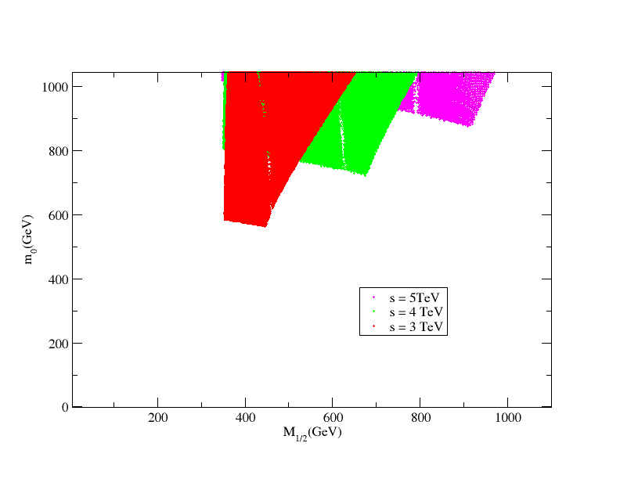



Allowed regions in the m₀ - M_{½} plane
Fix , ¸₁ ₂= 0.1, vary ¸₃ and
‘
(inert Higgs)

Slide 22
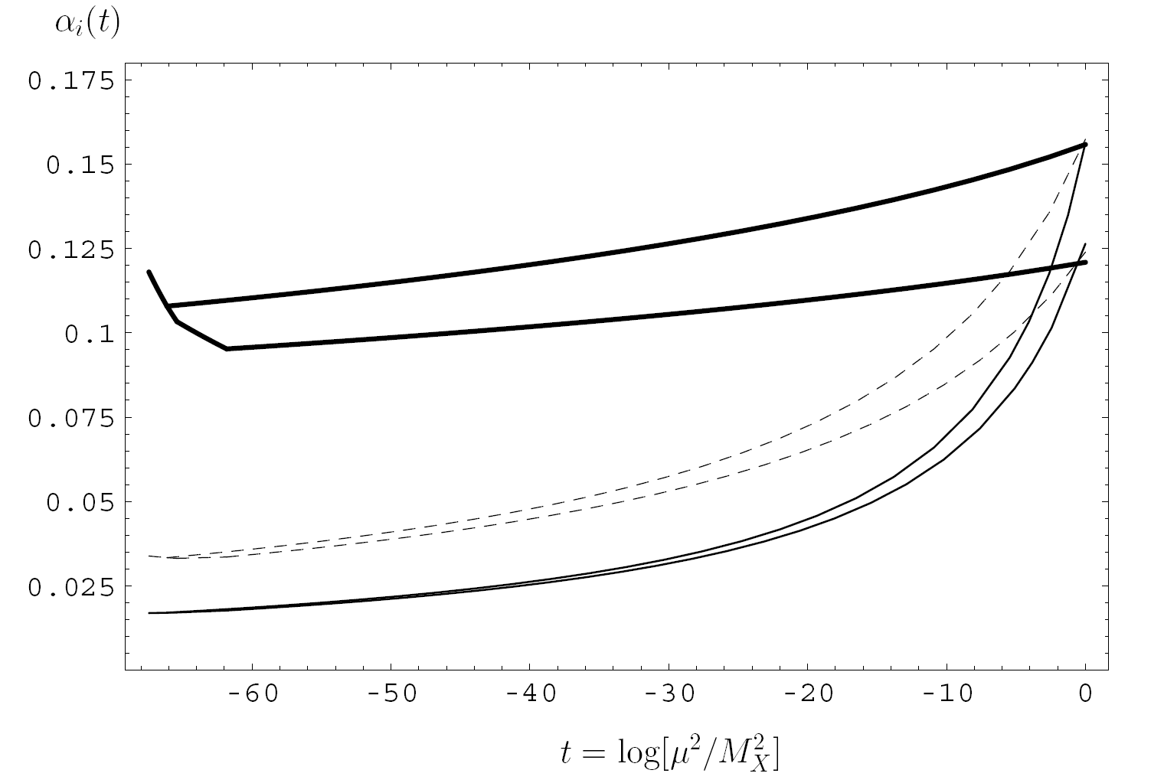

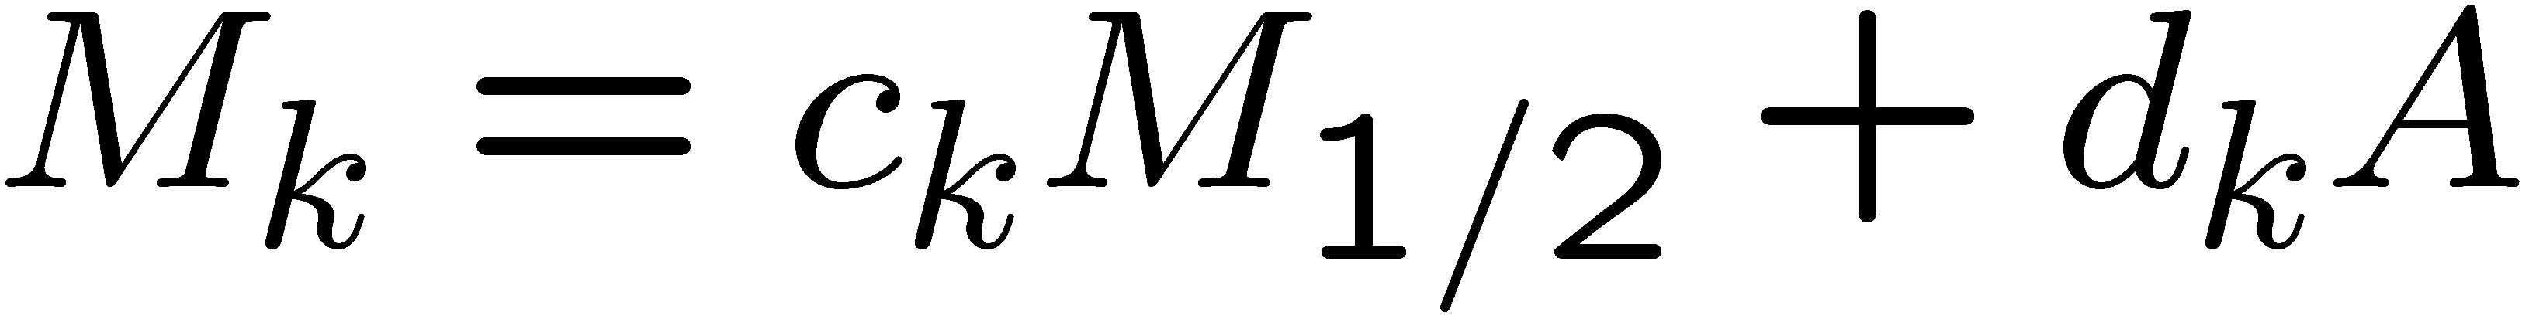

Gauge and Yukawa coupling RGEs independent of soft masses.
Sensitive to two loop RGEs and threshold corrections .
Soft masses can solved semi analytically:
Scalar masses
(1 loop)
Gaugino masses (2 loop)
Trilinear soft masses (2 loop)
Coefficients depend on Gauge and Yukawa evolution. Fit numerically:
Selectively switch parameters M_{1/2}, A and m₀ to zero and run to the low energies.
Unlike the cMSSM, in the cE₆SSM:
) Light Gaugino sector!

Slide 23


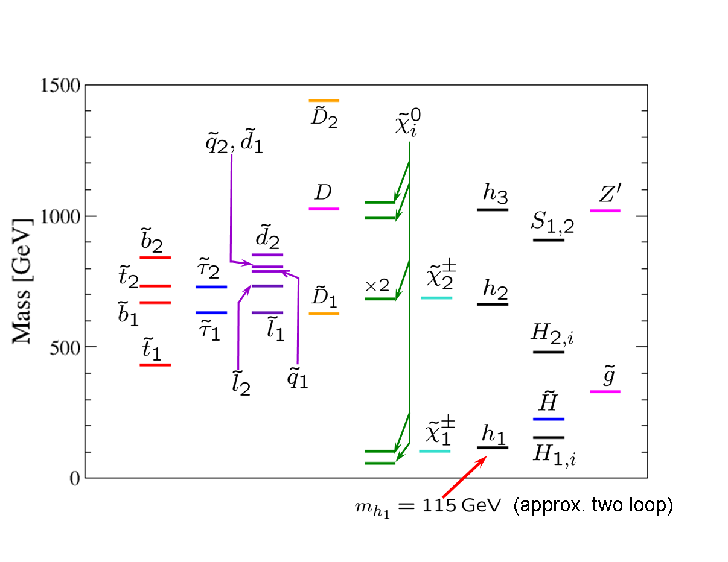

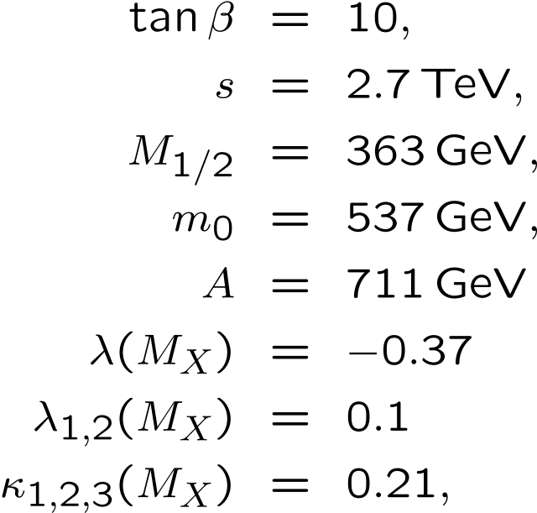
Scenario 1 (light spectra)
κ’s all equal, so exotic squarks all degenerate
Light Higgs and inert Higgs
Light gluino and chargino

Slide 24

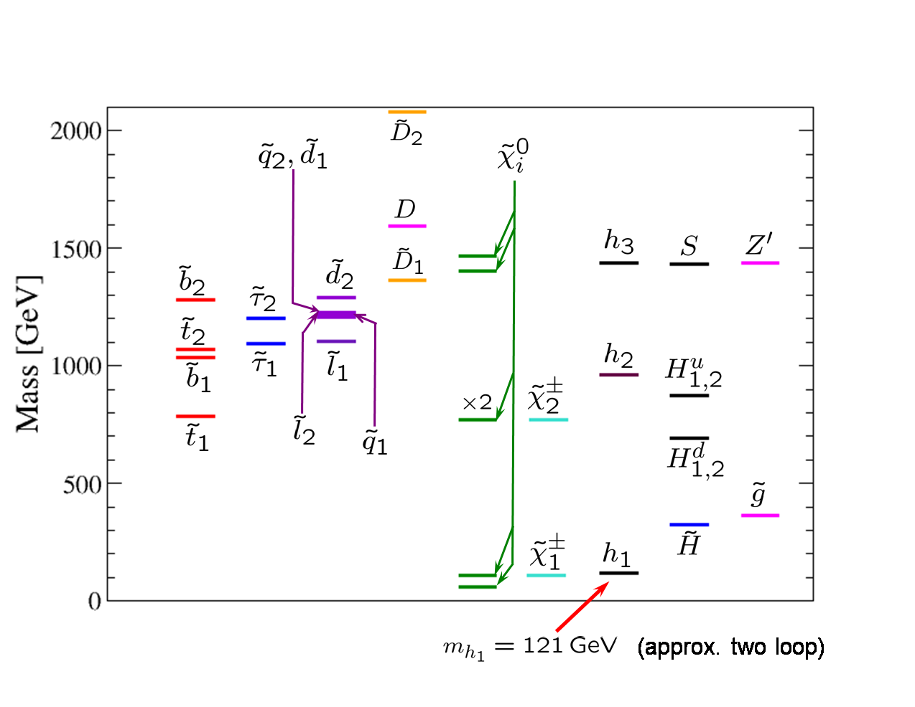
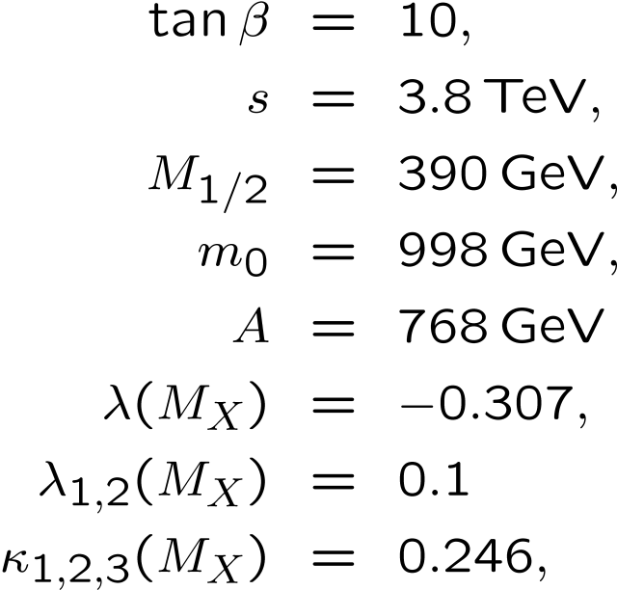
Scenario 2
Very split spectrum with light neutralinos/gauginos but very heavy scalars
Inert Higgsino is significantly lighter (324 GeV) than the Inert Higgs bosons

Slide 25
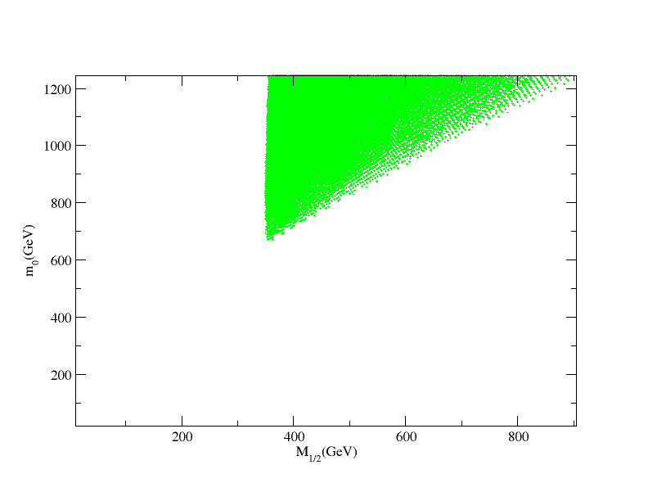

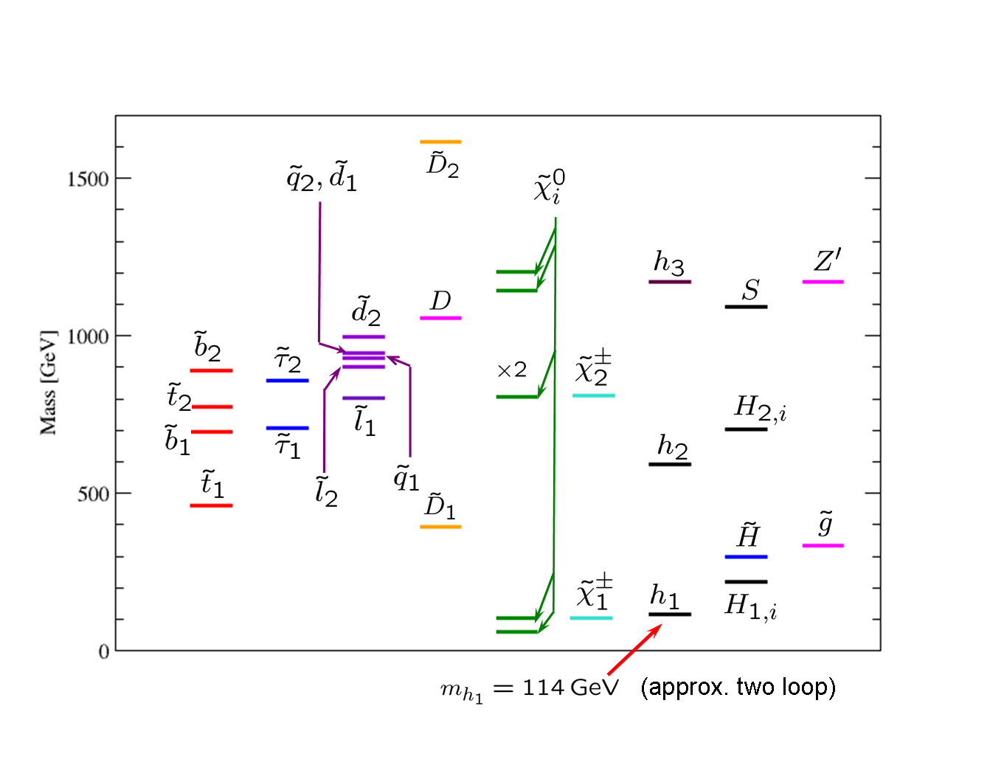
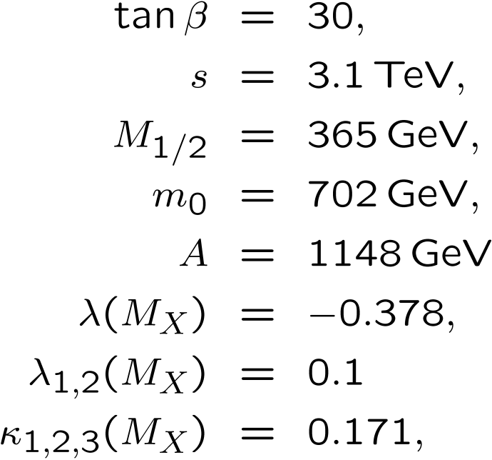
Scenario 3 (high with light spectra and light exotic scalar)
Large mixing in the exotics leads to a relatively light scalar leptoquark ( GeV )

Slide 26
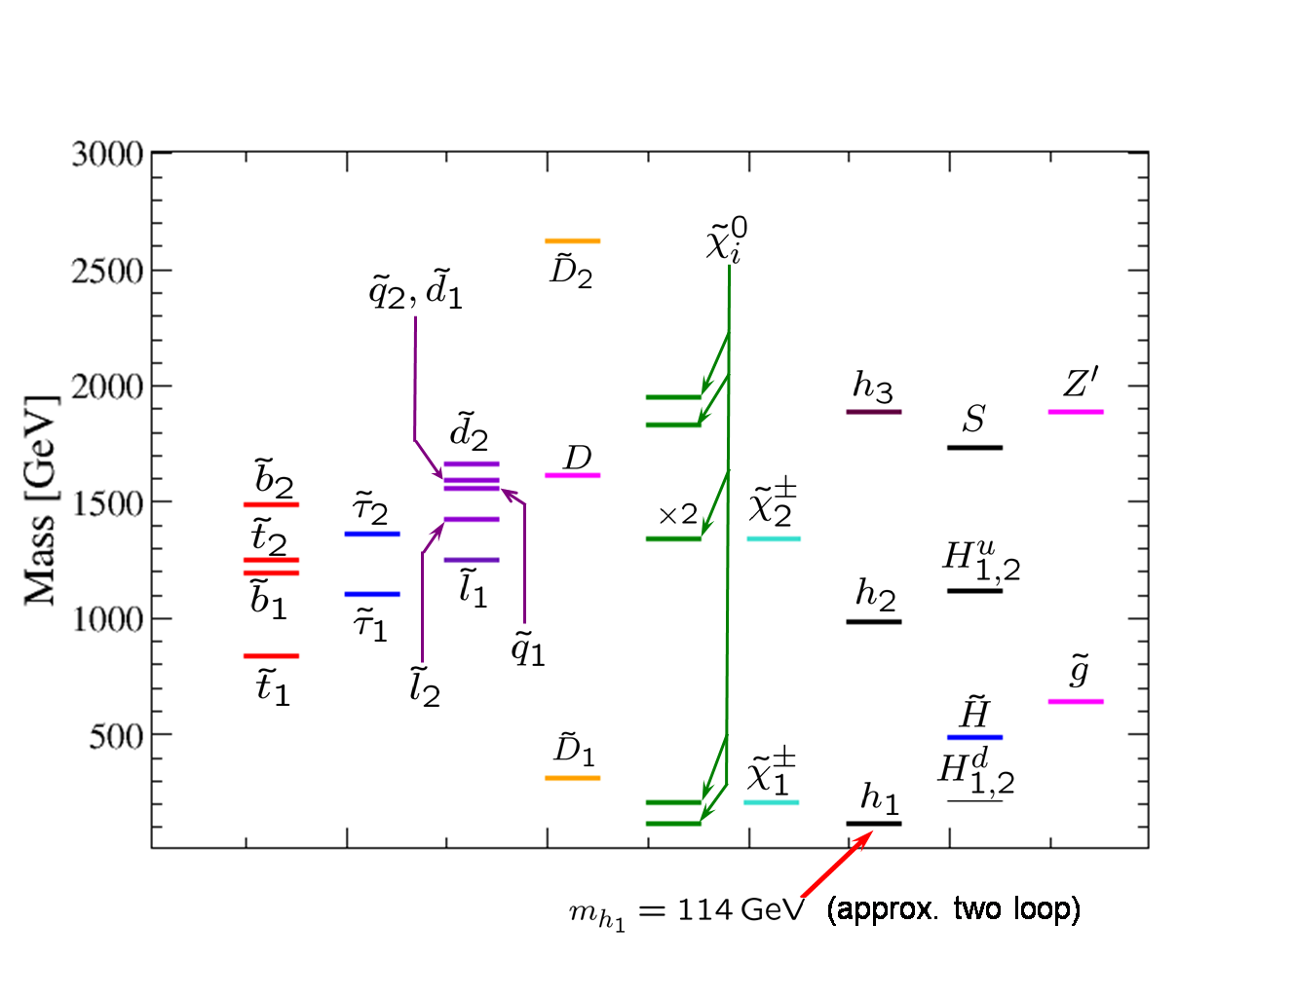
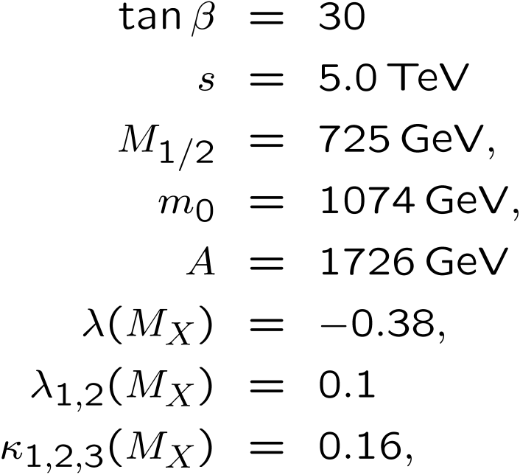
Scenario (high with heavy spectra and light exotic scalar)
Mixing effect in exotic squarks but with a very heavier spectrum.
Also features light Inert Higgs bosons, due to large and negative D-term contributions (/ s²)

