Slide 1
Automated Optimization of Markov Chains
Philip Bechtle
Xavier Prudent

Slide 2
Last update of Fittino results: http://arxiv.org/abs/0907.2589
Minimisation and Scanning Techniques:
“Two different parameter estimation techniques are used in the following, a Markov Chain Monte Carlo and Toy Fits.“
Markov Chain Monte Carlo:
Scan χ2 surface around its minima
Sampling density ~ likelihood in Bayesian approach
Use directly the χ2 values to define best fit point and 1-2σ uncertainties
Toy fits: 2 steps
1) Search for the absolute minimum χ2 point (with Markov Chain or Simulated Annealing)
2) Calculate observables, smear them, create toy data (pseudo-experiment)
What is a Markov Chain… ?

Slide 3
Let’s assume a non-trivial/non-analytical function…
χ2 surface, defined by measurement M (fixed), and model parameters P (unknown).
#1 – Pick a starting point
#2 – Build a proposal distribution (“candidate law”)
#3 – Pick a second point according to the proposal distribution
#4 – Compare the χ2 values of these 2 points:
If χ2[1] > χ2[2] : accept point 2
If χ2[1] < χ2[2] :
→ generate uniform distributed random number R in [0,1]
→ If(χ2[1]/χ2[2] < R ) accept point 2
χ2 (P,M==M₀)
And so on …
χ2[2]
2
χ2[1]
1
χ2[2]
2
P

Slide 4
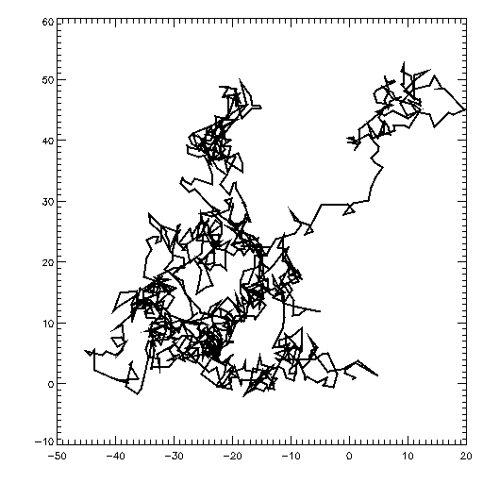
This algorithm (Metropolis-Hasting) gives out a suite of numbers, each depending ONLY on the precedent
Markov chain
Brownian mouvement
Higher density around minima
Possibility to accept points in a worse χ2 region
Allows scan of the surface
Depends on the proposal distribution (width, correlations)
χ2
2
1
Secondary minimum
Absolute minimum

Slide 5
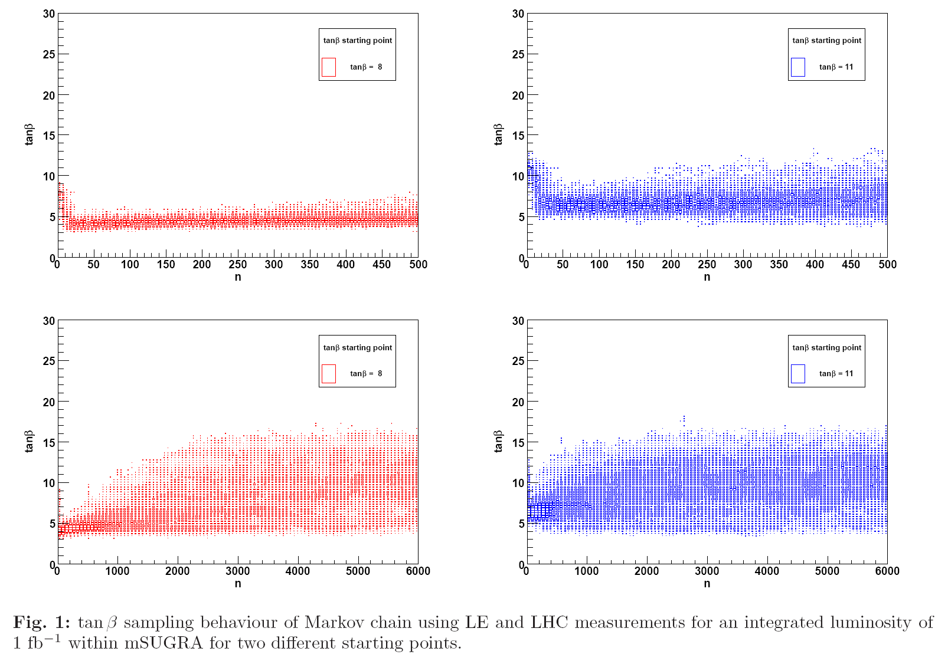
The scanning efficiency depends on:
- the starting point,
- the width of the proposal distribution
- the length of the chain (CPU !)
Should get irrelevant
Should be carefully optimized

Slide 6
Optimization of the proposal distribution width
Proposal distribution considered: Gaussian (Uniform available)
Developed & tested with mSUGRA SPS1a scenario
LHC observables for 1/fb
Fitted variables: A₀, M₀, M₁₂, tanβ

Slide 7
Step #1
For each variable:
1) define starting points / widths (e.g: M0 = 10 +- 2.5)
2) run a chain of 1000 points with Gaussian proposal width
3) compute the success rate s = (#accepted points)/(#total point = 1000)
[empirical optimal scanning efficiency is 50 %]
- if s is “close to 0.5”, then keep that width (2.5) and stop optimization
- if s is “far from 0.5”, then modify the width
4) rerun a chain with that new width
5) and so on until s get close to 0.5

Slide 8
s
Exemple with a low efficiency scanning s < s_{min}
“close/far” … ?
1
s_{max}
Choose an acceptance range for s,
For optimization stability: [0.48, 0.52]
Assume simple linear dependency
0.5
s_{min}
s_{old}
0
w_{old} = width used for the previous chain
s_{old} = success rate obtained with wold
s_{lim} = closest limit of the acceptance range (here 0.48 or 0.52)
w_{new} = width to be used for the next chain
c = constant adapted to ensure fast/stable convergence (set to 4)

Slide 9
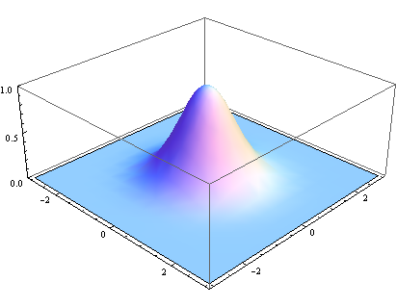
Step #2
The same procedure as before is repeated as in step #1
But …
Variables modified altogether
Proposal distribution = multidimensional uncorrelated Gaussian
step2
step1

Slide 10
Stability and Performance of Width Optimization

Slide 11
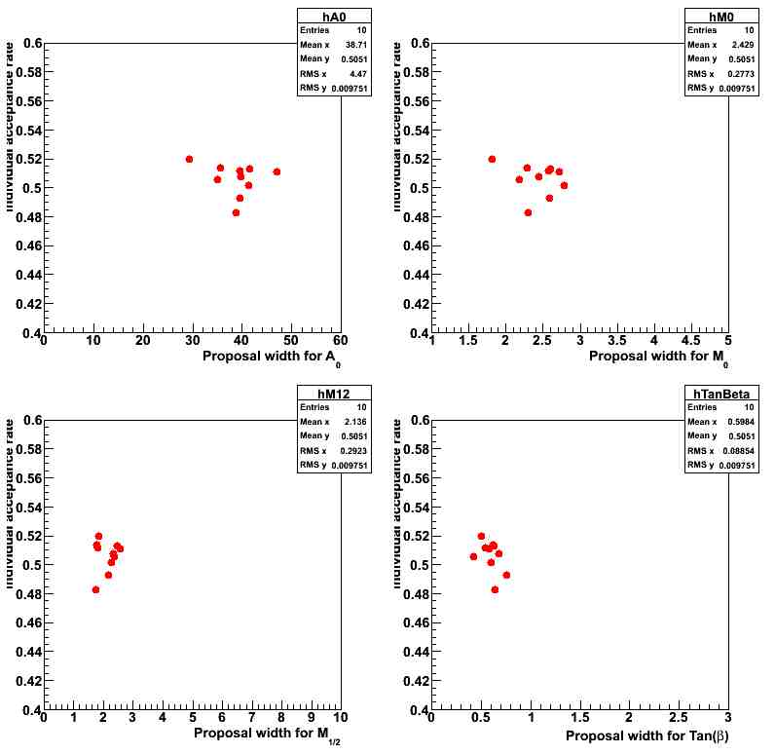
Stability of this optimization algorithm tested with 10 random seeds
And chain length n = 50, 100, 200, 500, 1000 (here example for n=1000)
Success rate
Success rate

Slide 12
Performance test
Starting point #1
M0 = 110
M12 = 265
A0 = 400
TanBeta =15
- Starting point #2
M0 = 90
M12 = 230
A0 = -300
TanBeta = 6
Consider 2 extreme starting points for Markov chains
Take the 2 extreme widths (low,high) given out by optimization, plus a medium value
low
med
high
Run a Markov chain of 80,000 points for each configuration of proposal width and starting point
If optimization is
- Effective : point distribution should not depend on starting point…
- Stable : point distribution should not depend on used random seed…

Slide 13
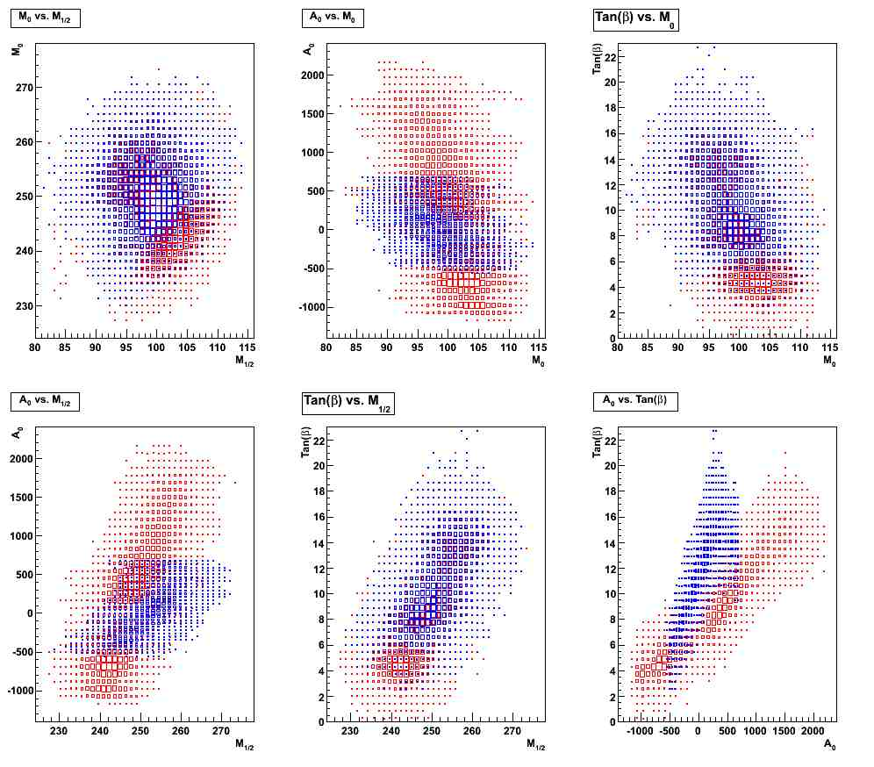
For default values of the widths (no optimization)
Starting point #1
Starting point #2

Slide 14
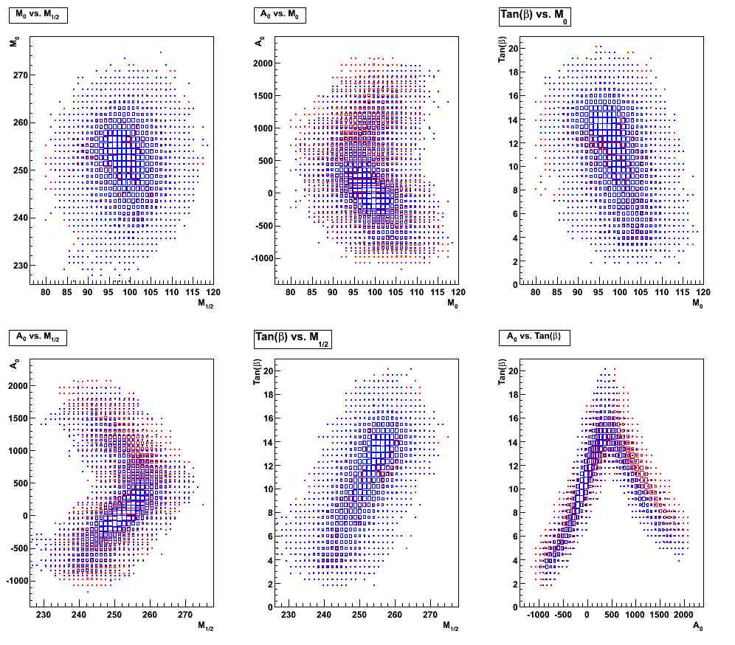
After optimization of the widths (example for chain length n=1000)
Starting point #1
Starting point #2

Slide 15
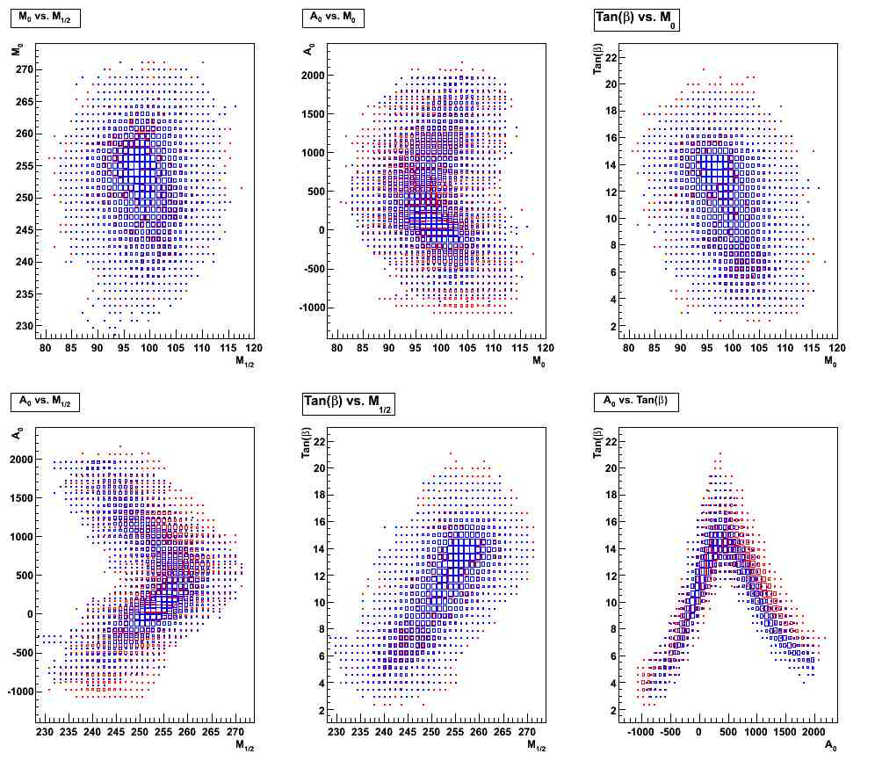
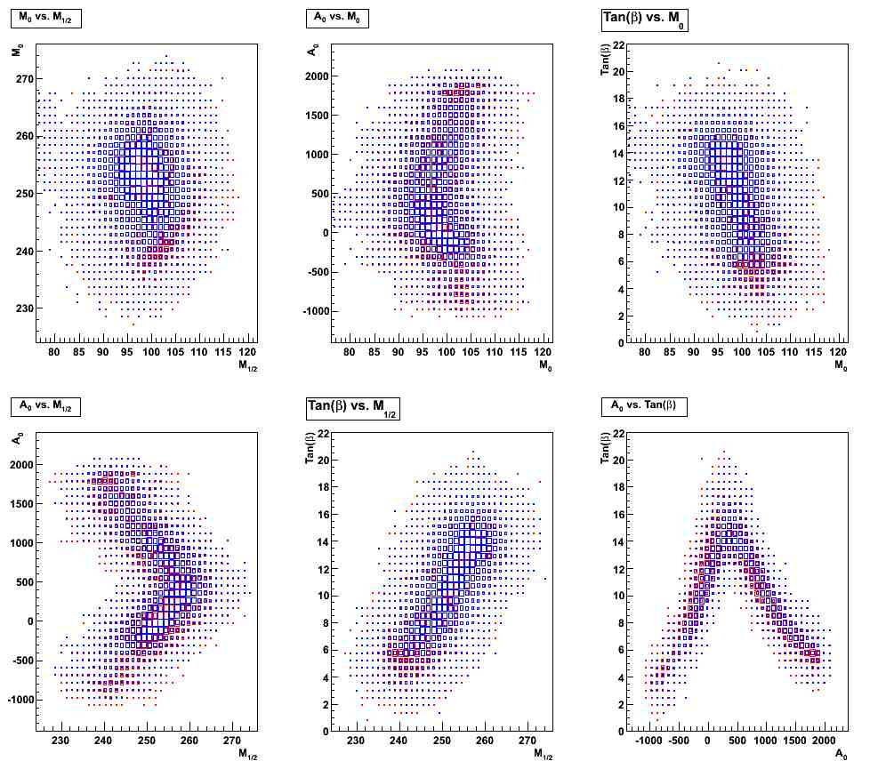
Optimization performance stability (for n=1000)
Lowest width
Higher width

Slide 16
How to Use this Optimization ?
Available in Fittino since version svn 502
In fittino.cpp, implemented in the function Fittino::widthOptimization
Main parameters can be tuned from the fittino input file:
Must be switched on to perform optimization
UseMarkovChains on
MarkovInterfaceFilePath /link/myInterfaceFile.txt
WidthOptimization 1
NumberOptimizationSteps 1000
AcceptanceRange 3
The optimized width are written in the MarkovInterfaceFile
If no width are found in the interface file and WidthOptimization ==1, optimization is performed. 0 by default
Number of steps in the Markov chain used for optimization, 1000 by default
3 possible acceptance ranges: 1=[0.4,0.6], 2=[0.44,0.56], 3=[0.48,0.52]
To be modified soon …
For 200 steps, optimization rakes ~2h, for 1000 : ~9h
Adapt your batch script …

Slide 17
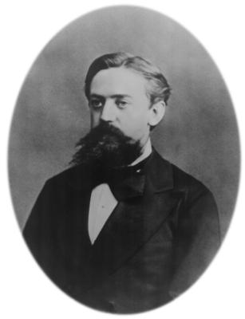
Conclusion and Plan
Improvement of Markov chains related algorithms
- key point for scan stability, optimization of CPU usage
Correlations being included in the global optimization (~1 week)
Any comment/suggestion/feed-back welcome
Work in progress …
Andrei Markov, 1856-1922

