Slide 1
Olympus Target and Vacuum System
Jim Kelsey

Slide 2
Specifications
Target cell is a 27mm x 9 mm ellipse x 60 cm long. It will be made of 100 micron thick pure aluminum.
Target cell will be connected to a frame that will be attached to a cryo-head and allow cooling to 20 K.
Target cell will be protected by an upstream tungsten collimator with a 25mm x 7mm opening.
Hydrogen flow will be 1.5 x 10¹⁷ Atoms/sec.
Window opening will accommodate in plane angles from 80° to 20° from ±20 cm from the target origin. It will accommodate 10° from the origin as well as ± 18° out of plane.

Slide 3
More Specs.
Scattering Chamber windows will be 25 micron thick SS.
Scattering Chamber will be made out of 6061 Aluminum.
Vacuum system will be pumped using 5 stages of a “dry” system of Maglev turbos and hook and claw roughing pumps.
Nominal vacuum will be in the 10e-8 scale at the end of these stages. This can be improved into the 10e-9 scale if necessary with the addition of NEG modules.
Vacuum system will be all stainless steel. Supports will be 6061 aluminum.
Beam line will be smooth bore throughout.

Slide 4
Alignment
Target cell will be bore sighted in its “cold” state. We can then transfer these coordinates to the fiducials on the scattering chamber. We can then align the chamber to the interaction point and along the beam.
Vacuum beam line can be surveyed at flanges and positioned to be centered on beam.

Slide 5
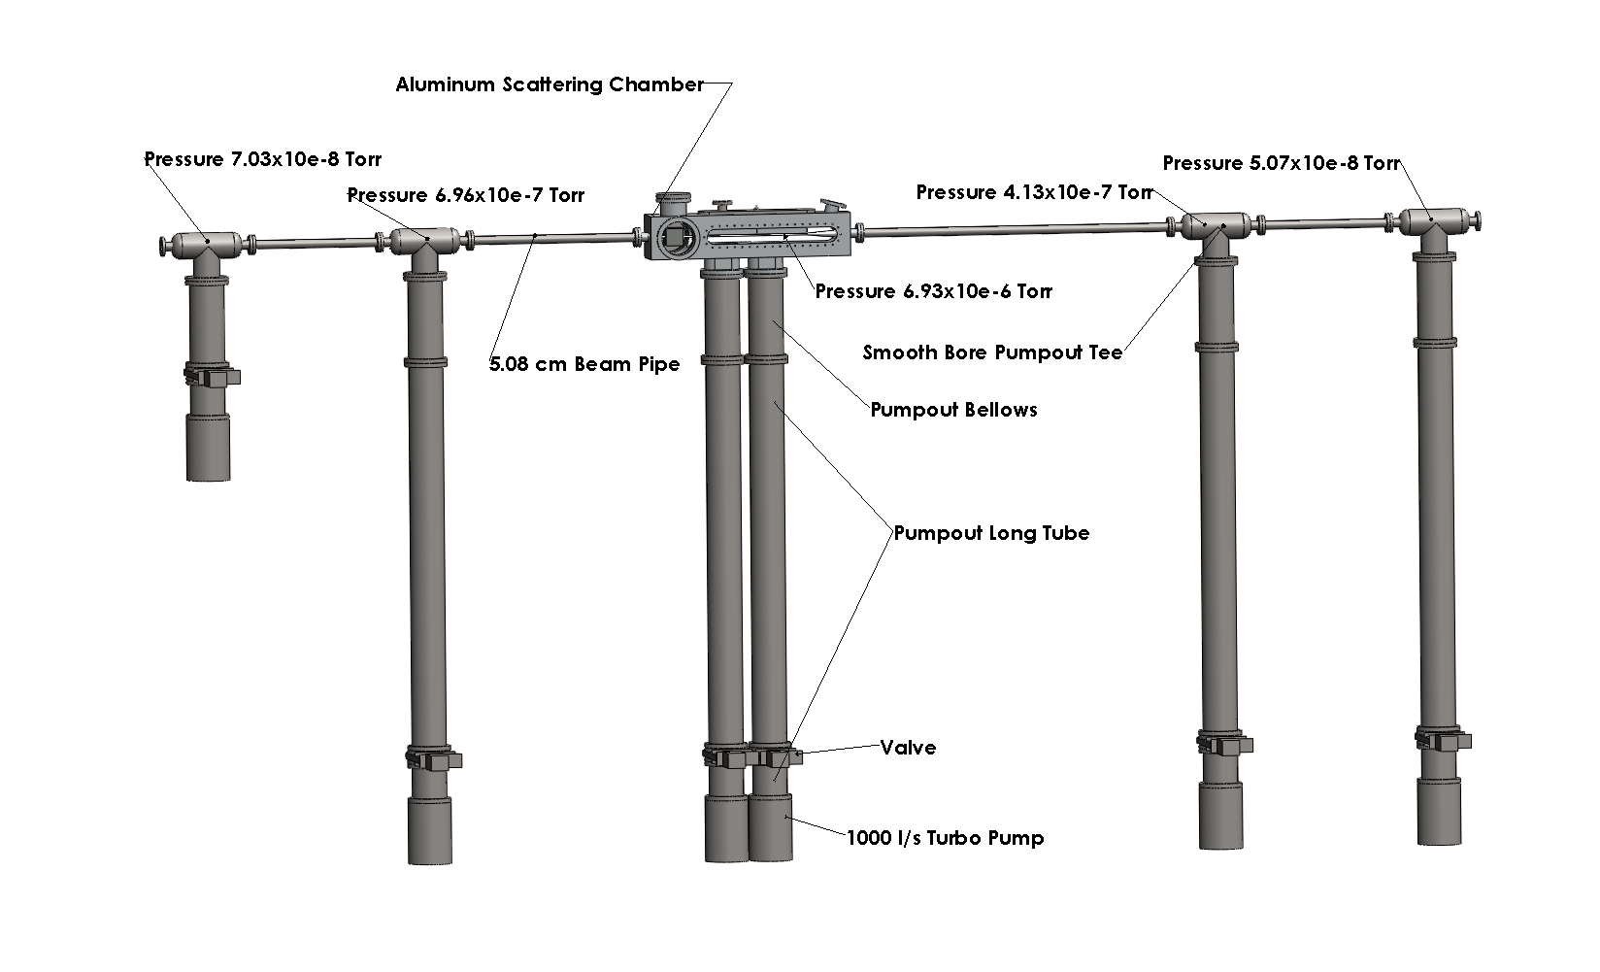
Vacuum system will have two configurations. One for beam tests and one for running with Olympus. These configurations mainly involve changing the height of the supports and the pump-out tube heights.

Slide 6
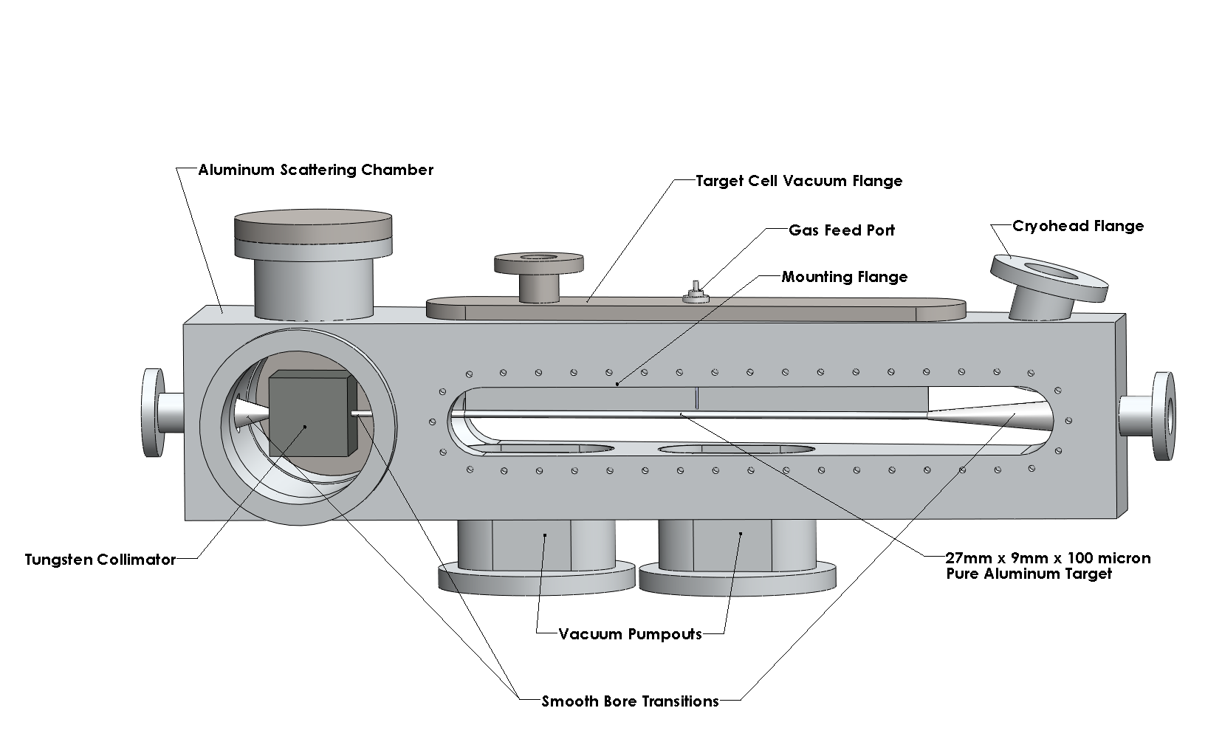

Slide 7
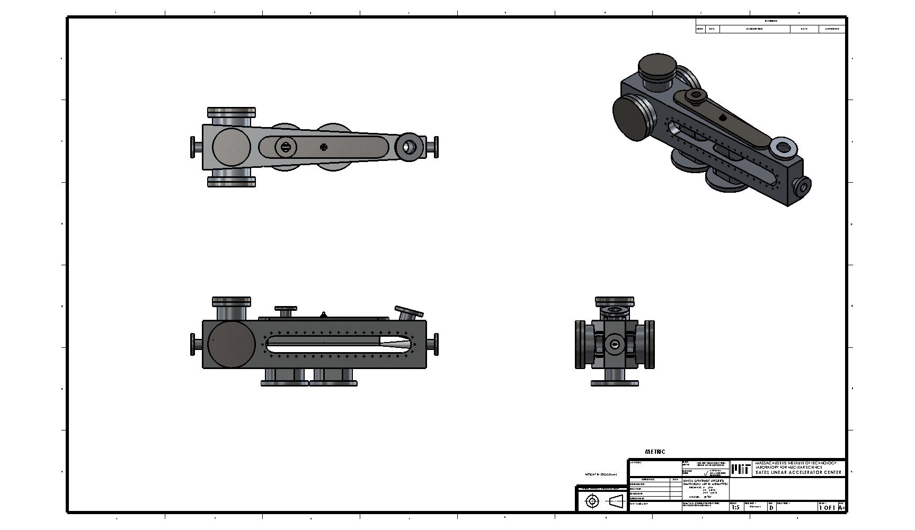

Slide 8
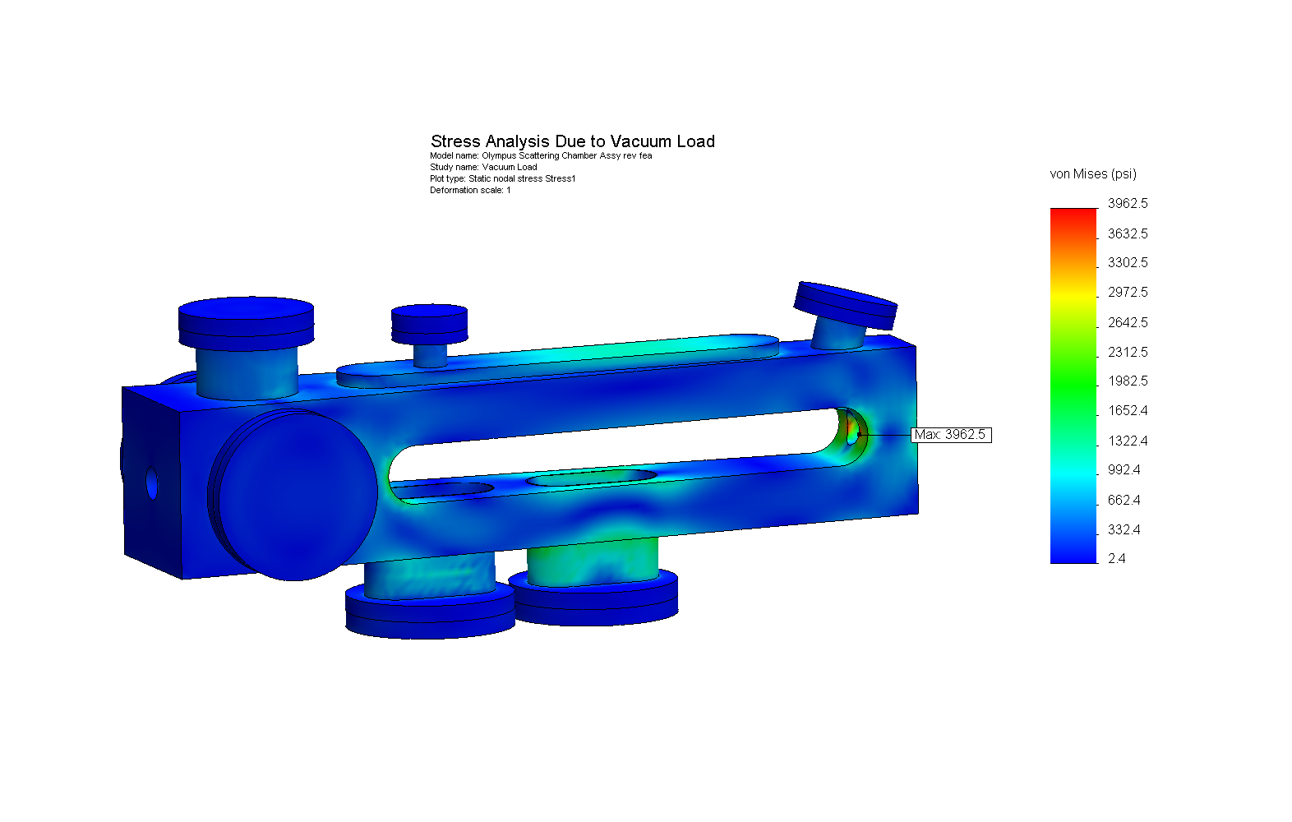

Slide 10
Target and Vacuum System Costs
 | k$
Gas Feed System | 30
Target Cell Cooling | 30
Target Chamber | 50
Wakefield Suppressors | 10
Fixed Collimator | 8
Control System | 20
Vacuum System | 75
Support Structure | 50
Manpower | 227
Total | 500

Slide 11
Task Duration
Design and draft target and scattering chamber | 1.5 months
Design and draft vacuum system including smooth bore bellows | 1.5 months
Build scattering chamber | 2 1/2 months
Build vacuum system | 3 months
Design, draft, and build collimator and smooth bore transitions | 2 months
Design, draft and build supports | 3 months
Assemble and test | 1.5 months

Slide 12
Schedule

