Slide 1
Tests on Chess 2 ASIC
Yubo Han_{IHEP} , Dionisio Doering, Pietro Caragiulo, Larry Ruckman, Camillo Tamma, Su Dong

Slide 2
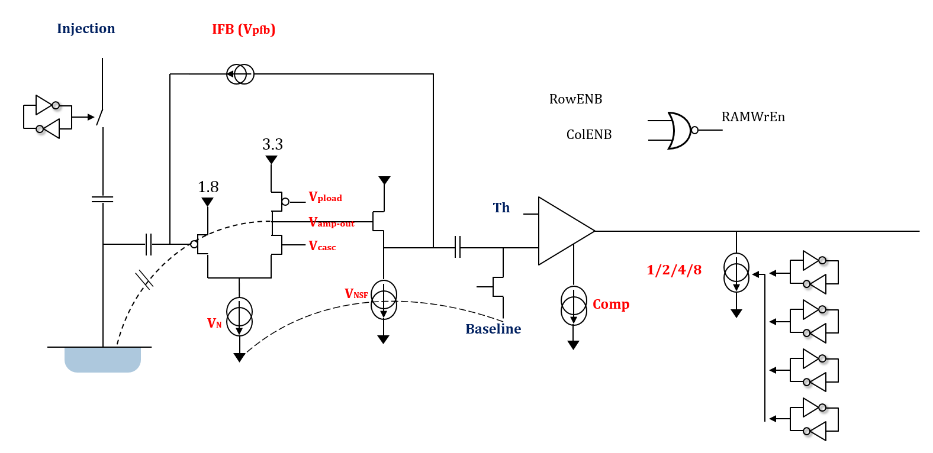
Pixel description

Slide 3
Outline
Checking basic characteristic of the 2(3 in total) chips:
IV curve
Tests Without/With Bias
Sweeping Threshold with BL=0.7V (typical value)
Similar Tests with varies BL

Slide 4
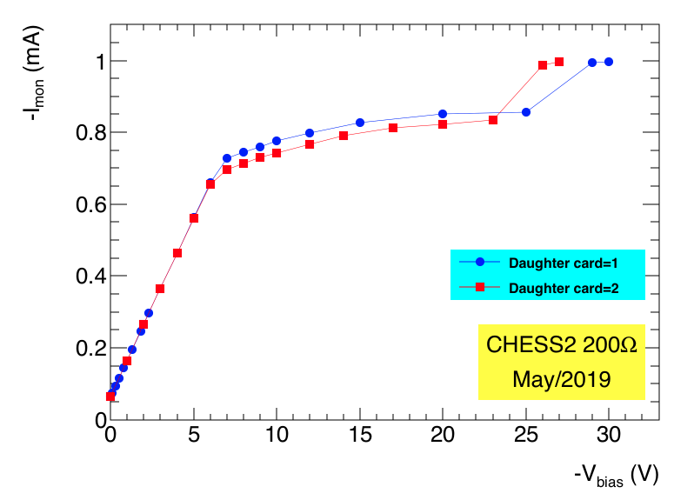
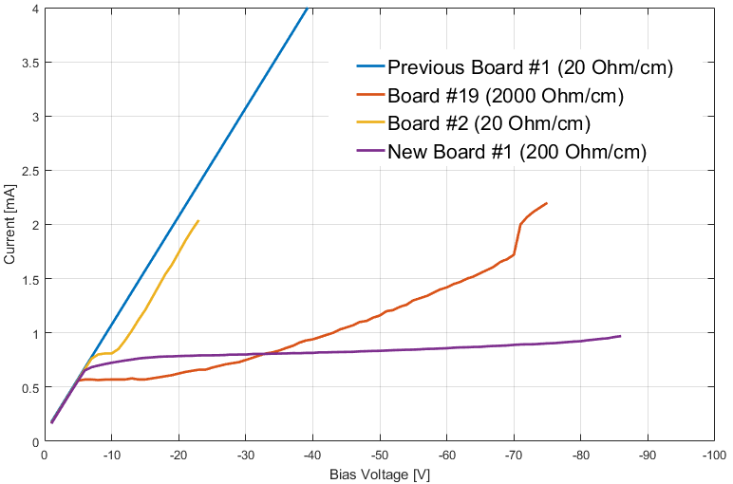
IV curves
Similar IV curve to last 200 Ohm/cm ship:
Both two chip could reach a plateau after ~ -7V
High Plateau level: ~0.8mV
A 2nd step around -25V.

Slide 5
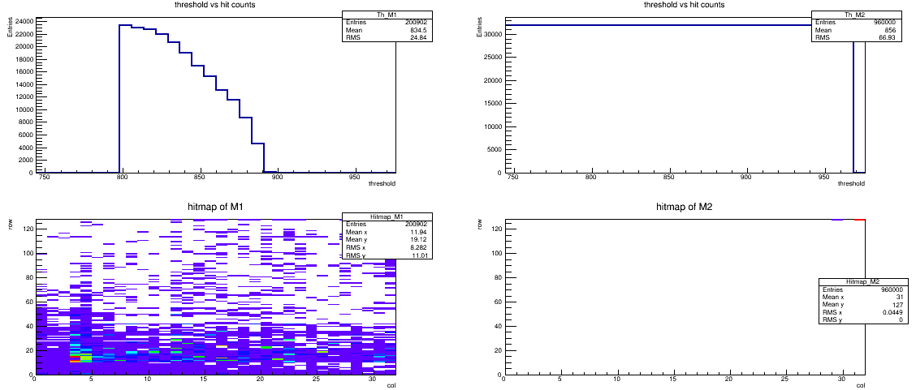
Tests of Daughter board 1
Daughter board 1
200 Ohm/cm
Test:
Without bias voltage
BL=0.7V (868)
Threshold sweeping
Observations
Matrix 1 has “normal” performance
Matrix 2 has a very hot pixel (127,31)
Matrix 1
Matrix 2

Slide 6
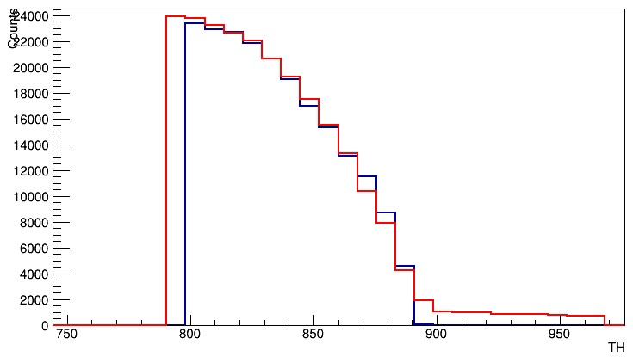
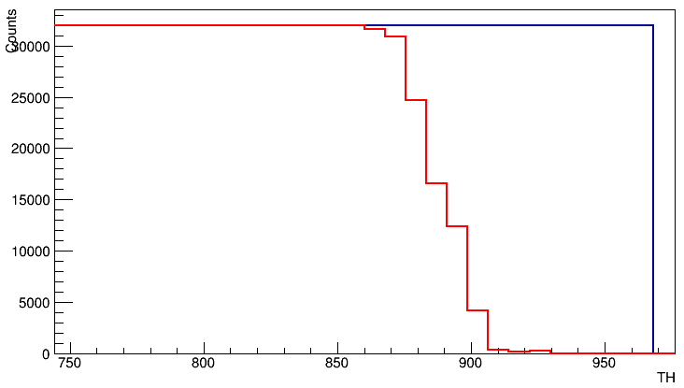
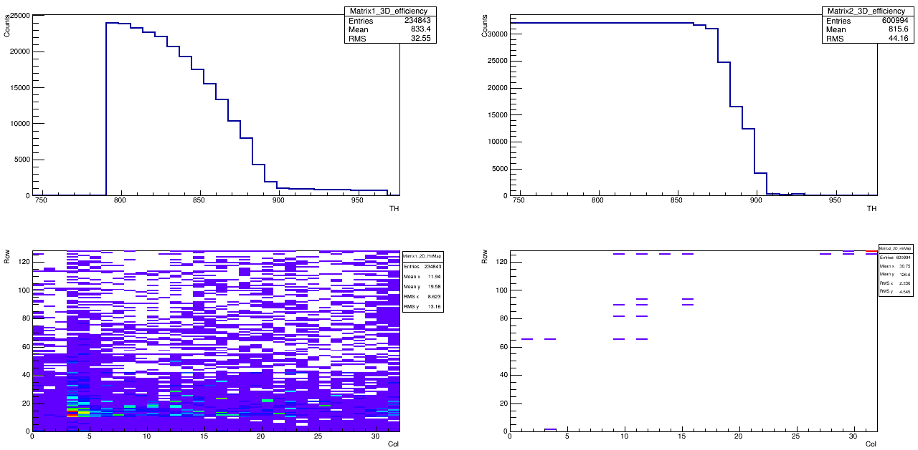
Tests of Daughter board 1
Daughter board 1
200 Ohm/cm
Matrix 1
Matrix 2
Test:
bias voltage: -10V
BL=0.7V (868)
Threshold sweeping
Observations
Matrix 1: “Tail” at higher threshold
Matrix 2: still has (127,31) problem but different threshold range to see it
No bias
Bias -10V
No bias
Bias -10V

Slide 7
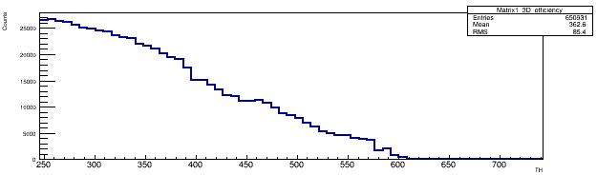
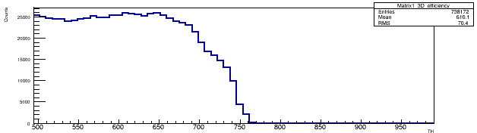
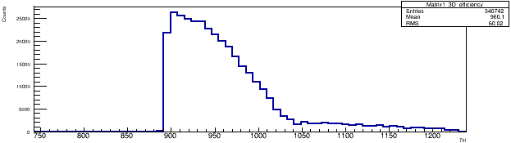
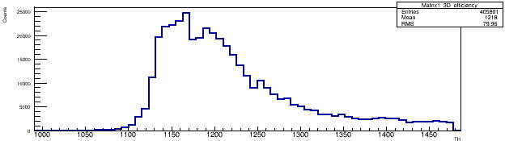
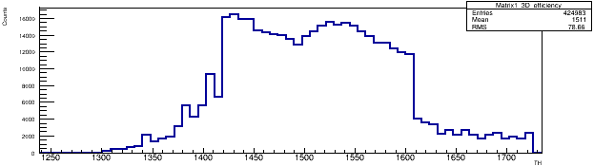
Tests of Daughter board 1
BL
Daughter board 1
200 Ohm/cm
0.4V
Tests:
Bias voltage: -10v
BL= 0.4V, 0.6V, 0.8V, 1.0V, 1.2V
Threshold sweeping: BL±0.2V
Observations
The Threshold at which the chip starts to report hits has offset with the current BL
Still suggesting BL ~0.7V might be better
0.6V
0.8V
1.0V
1.2V

Slide 8
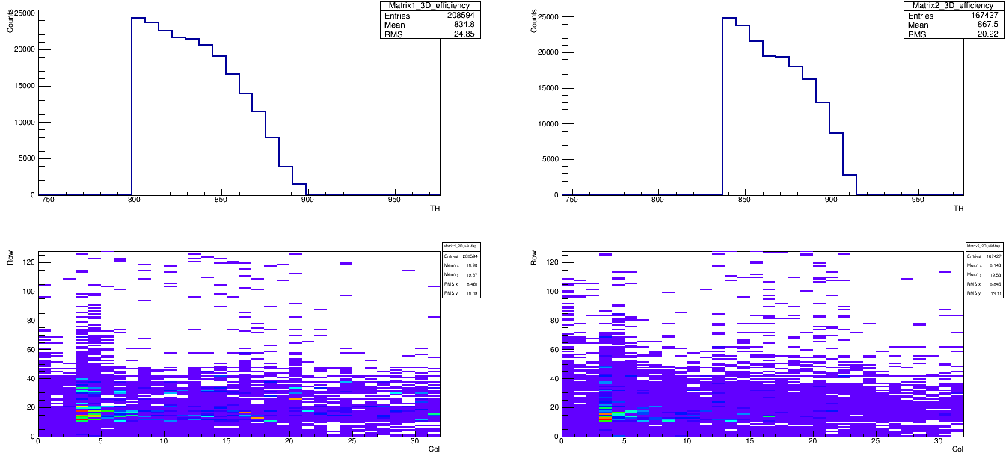
Tests of Daughter board 2
Daughter board 2
200 Ohm/cm
Test:
Without bias voltage
BL=0.7V (868)
Threshold sweeping
Observations
Both Matrix have normal TH vs Counts results
No more (127,31) pixel in Matrix 2
Matrix 1
Matrix 2

Slide 9
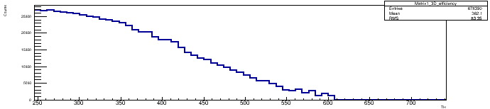
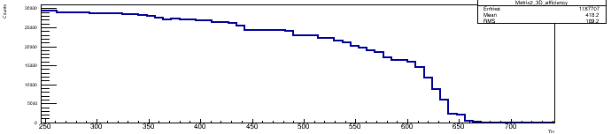
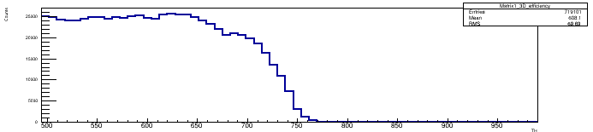
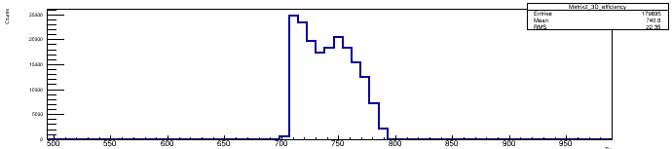
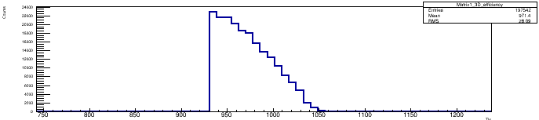
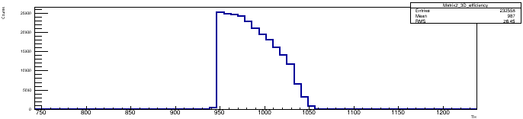
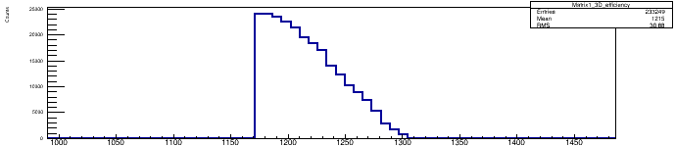
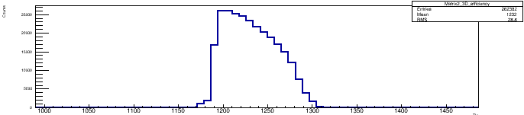
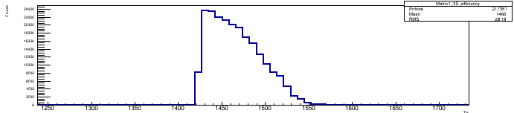
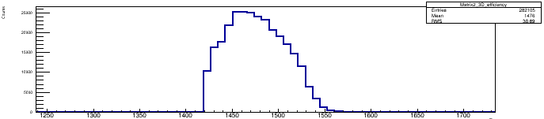
Tests of Daughter board 2
Daughter board 2
200 Ohm/cm
BL
Matrix 2
Matrix 1
BL
Tests:
No Bias voltage
BL= 0.4V, 0.6V, 0.8V, 1.0V, 1.2V
Threshold sweeping: BL±0.2V
Observations
Still suggesting BL should be set to ~0.7V

Slide 10
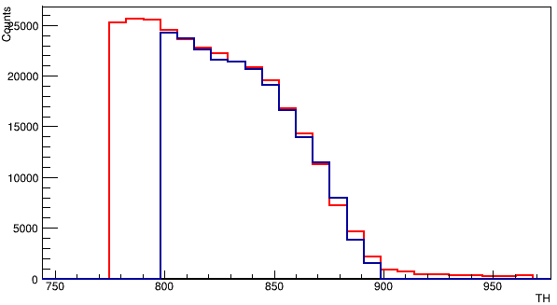
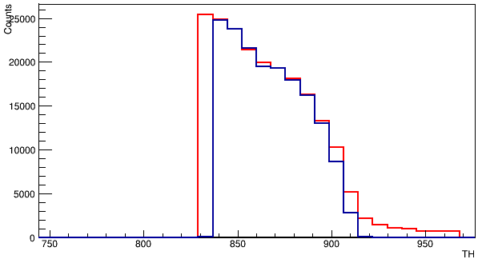
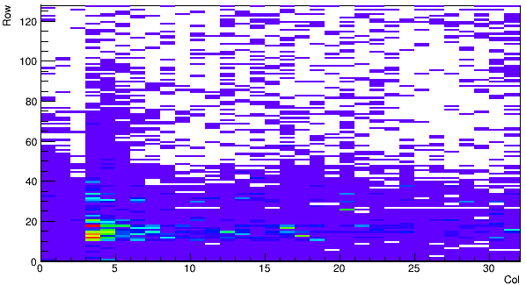
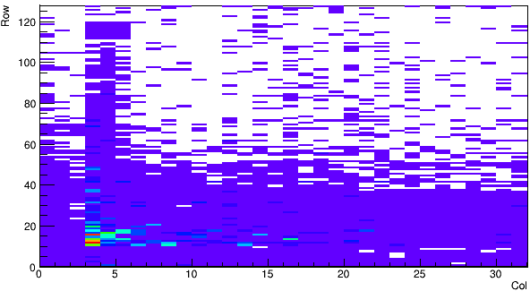
Tests of Daughter board 2
Daughter board 2
200 Ohm/cm
Matrix 1
Matrix 2
No bias
Bias -10V
No bias
Bias -10V
Test:
bias voltage: -10V
BL=0.7V (868)
Threshold sweeping
Observations
Tails at both Matrix
Threshold at which each matrix starting to see some hits moved to the left(but still has reasonable shape)

Slide 11
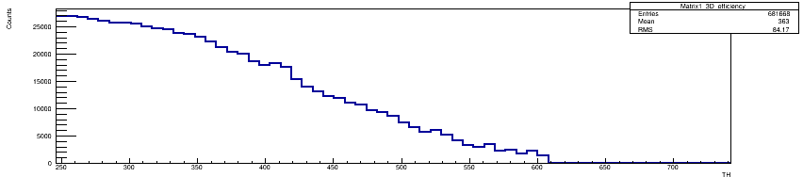
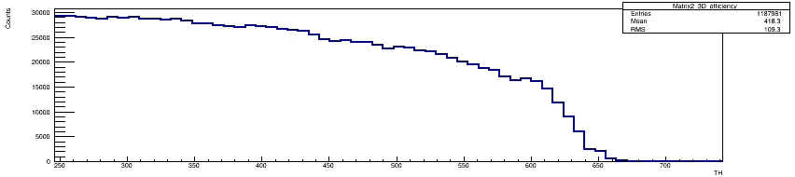
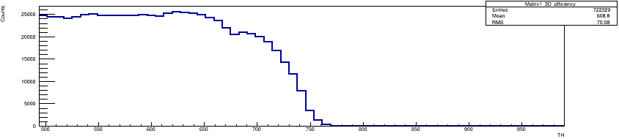
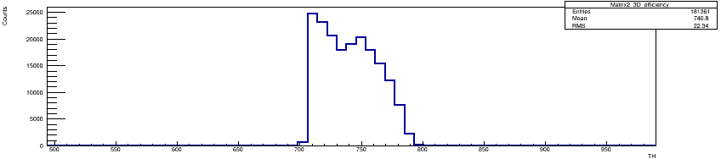
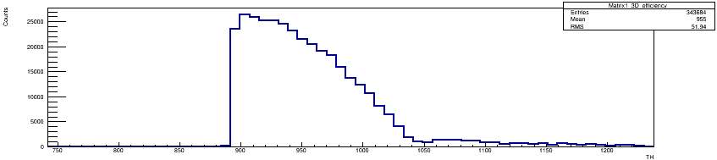
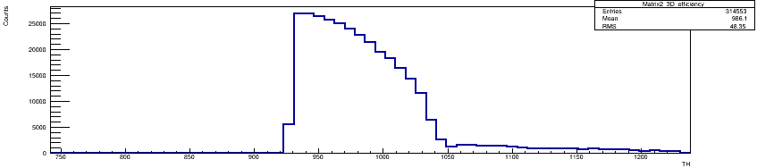
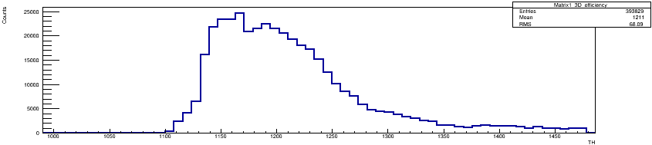
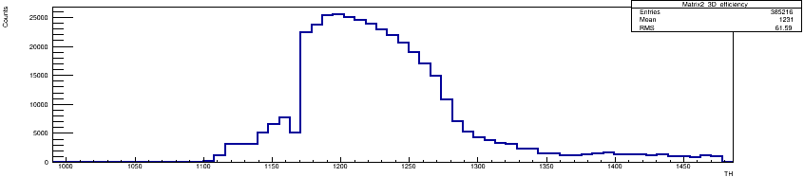
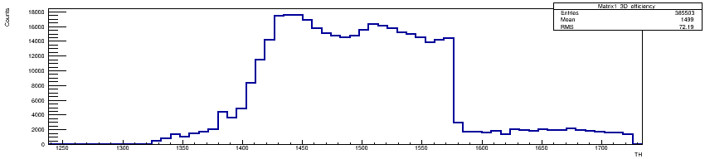
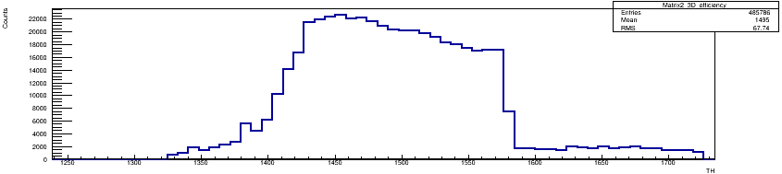
Tests of Daughter board 2
Daughter board 2
200 Ohm/cm
Matrix 1 BL
Matrix 2 BL
Tests:
Bias voltage: -10V
BL= 0.4V, 0.6V, 0.8V, 1.0V, 1.2V
Threshold sweeping: BL±0.2V

Slide 12
Summary and Next
Summary
Daughter board 1:
Could be biased but large leakage current and has 2nd step
Matrix 2 has hot pixel: (127,31)
Cannot be disabled and will block other pixels from reporting hits
Matrix 1 looks fine for now
Daughter board 2:
Could be biased but large leakage current and has 2nd step
Matrix 1 and 2 both have hits reported.
Next:
One more board to test

