Slide 1

LUXE @ XFEL
Accelerator update

Slide 2
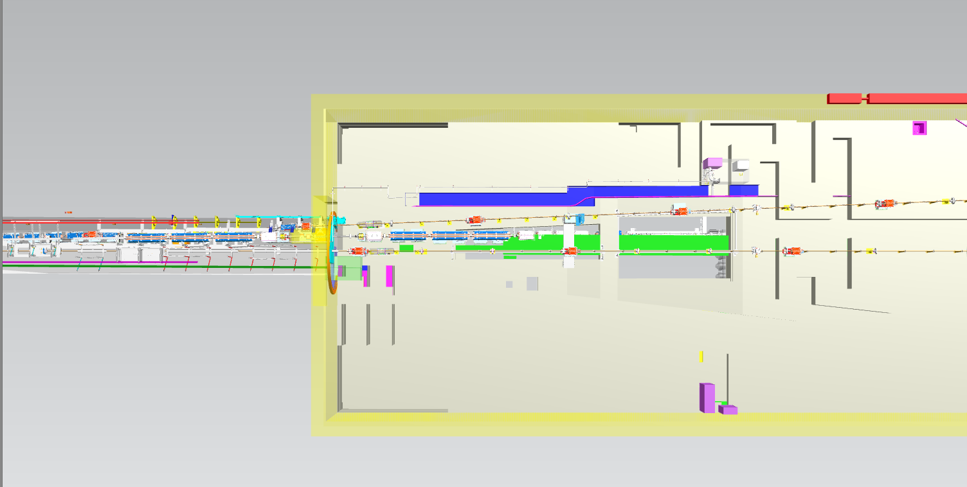
Schematic CAD Integration – XS1/TD20
XTD1
XTD2
XTD20

Slide 3
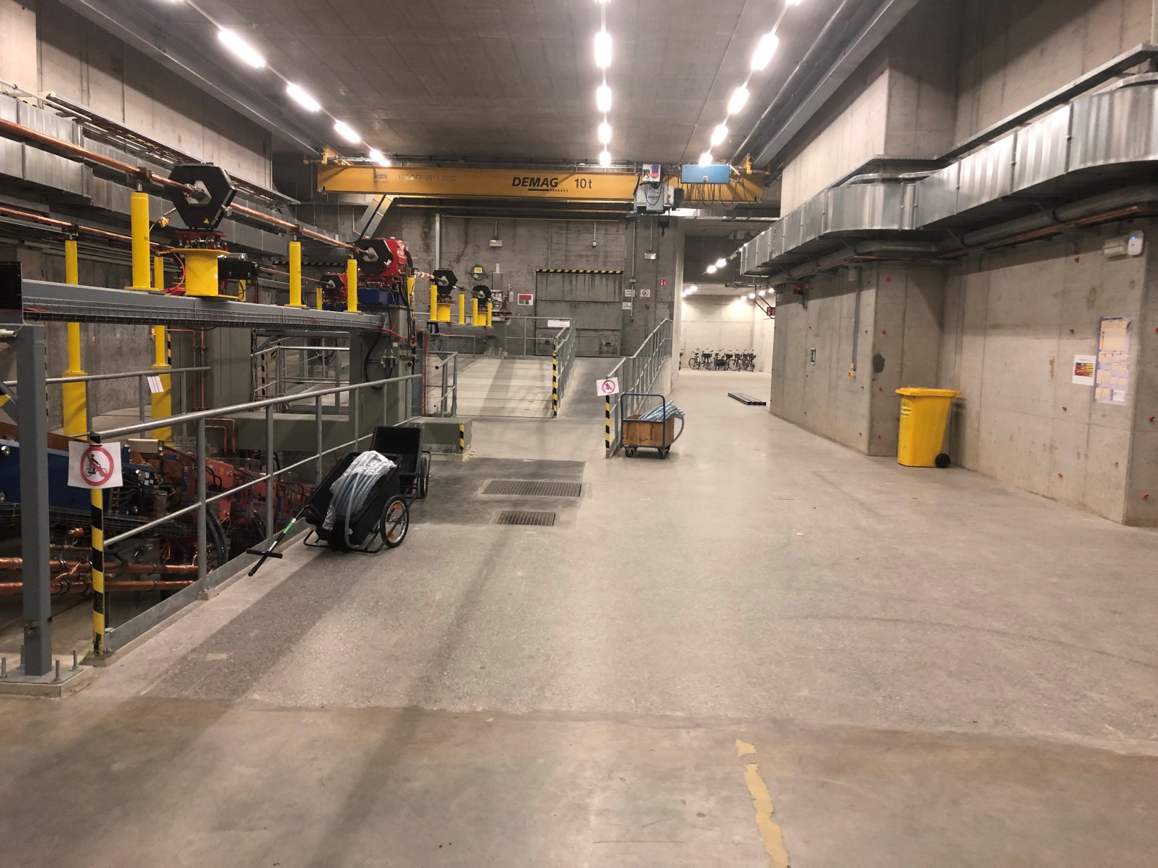
XS1/TD20

Slide 4
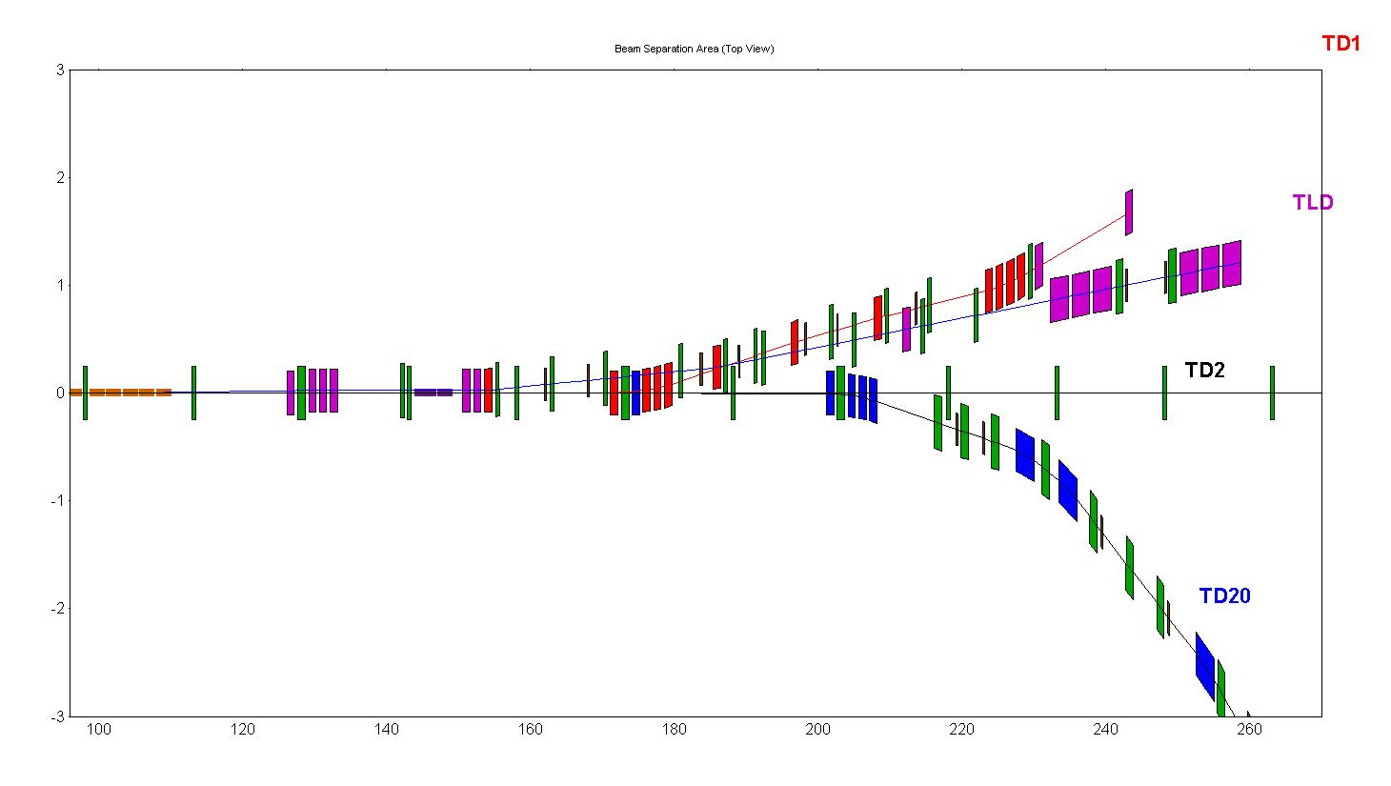
Beam extraction to TD20
2 tilted Septa
3 Septa
Kicker
Beamline, Experiment, Dump

Slide 5
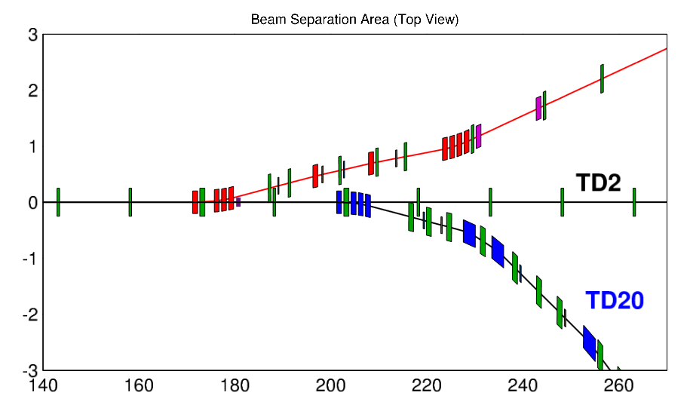
New layout
Kicker
4 Septa

Slide 6
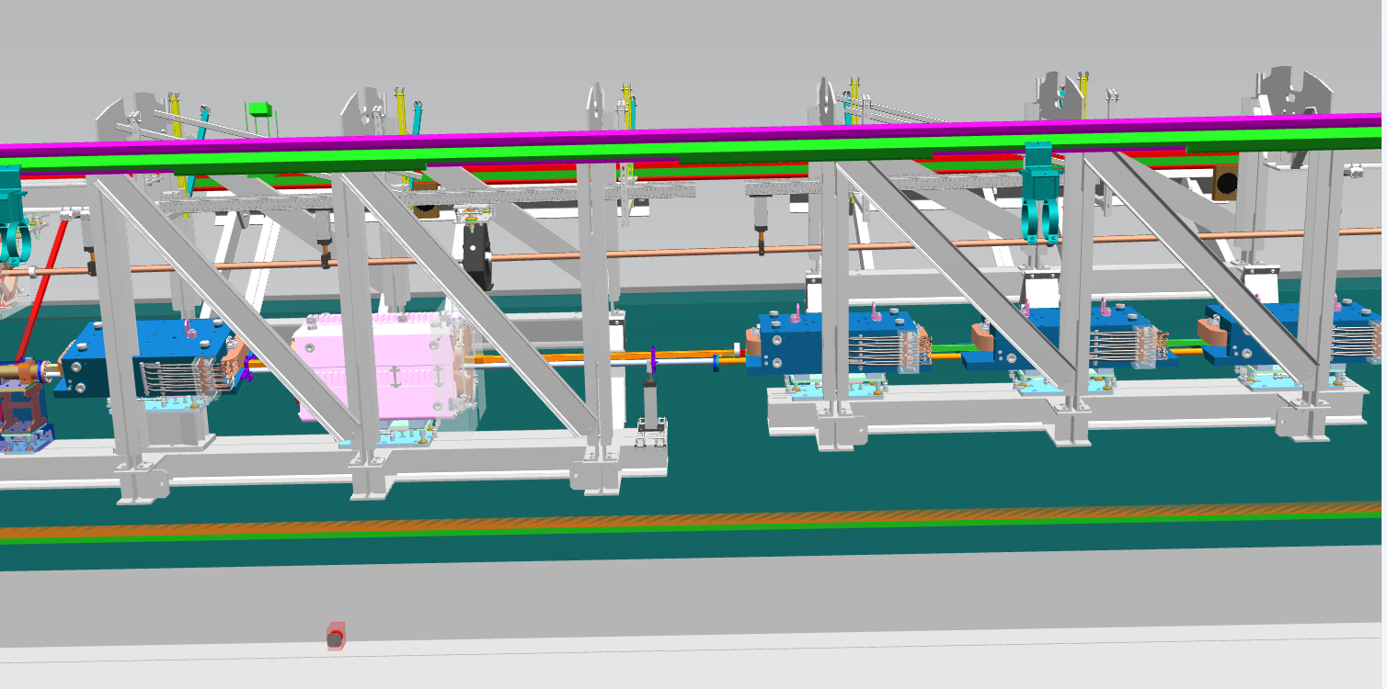

Slide 7
Kicker magnets

Slide 8
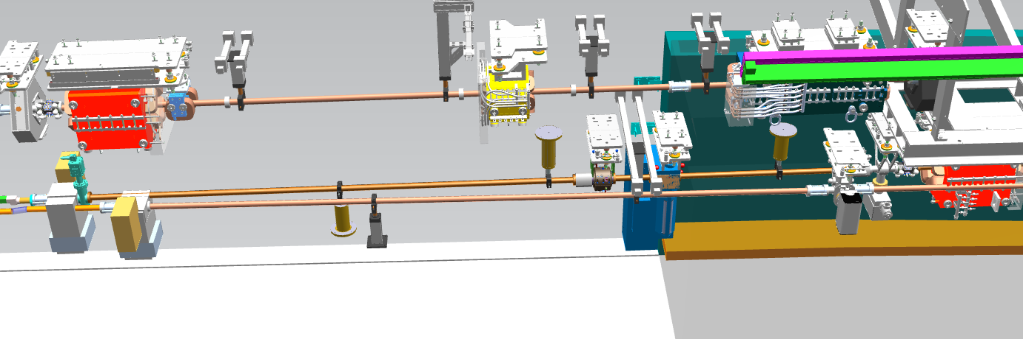
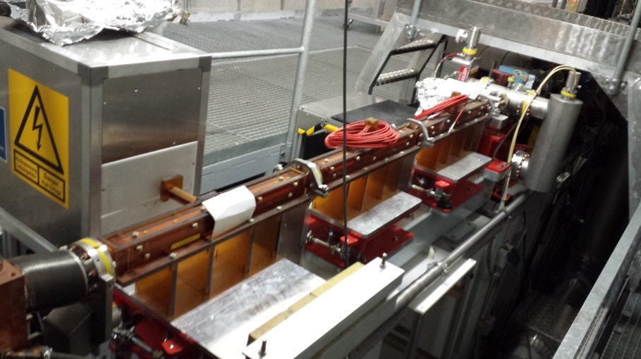
2m for kickers

Slide 9
First tilted septum

Slide 10
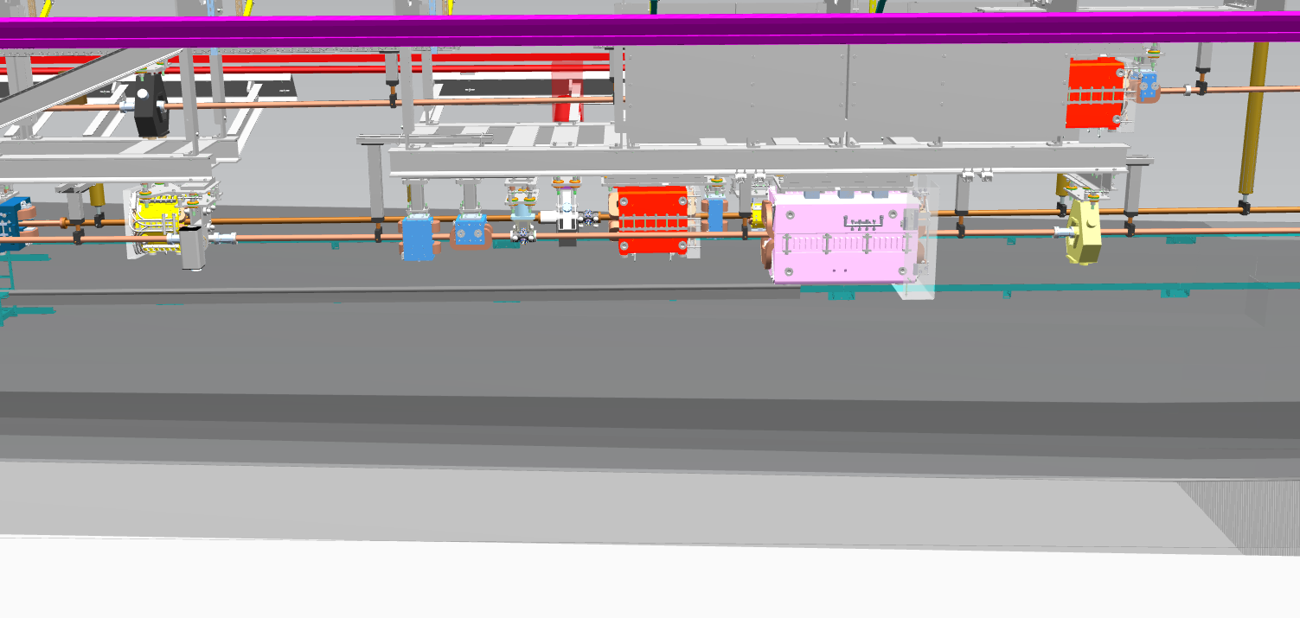

Slide 11
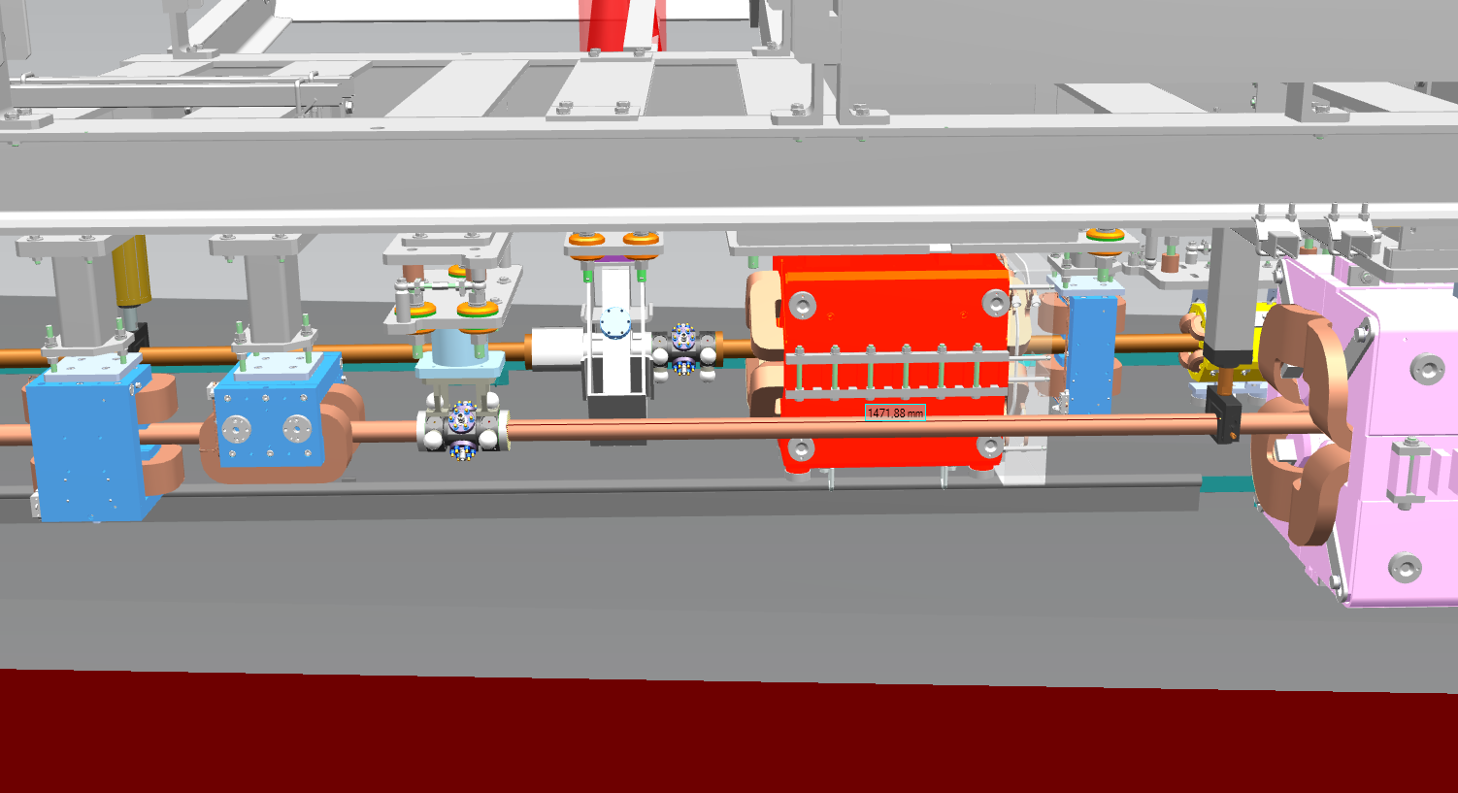

Slide 12
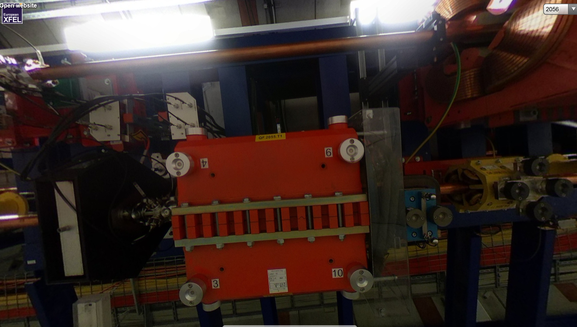

Slide 13
3 untilted septa

Slide 14
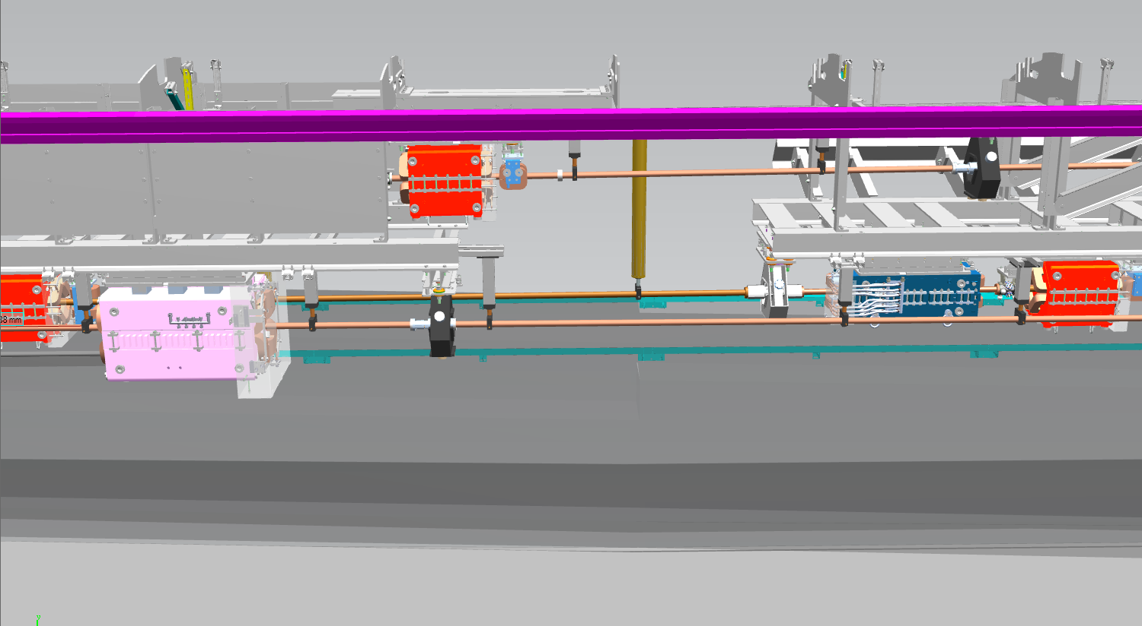

Slide 15
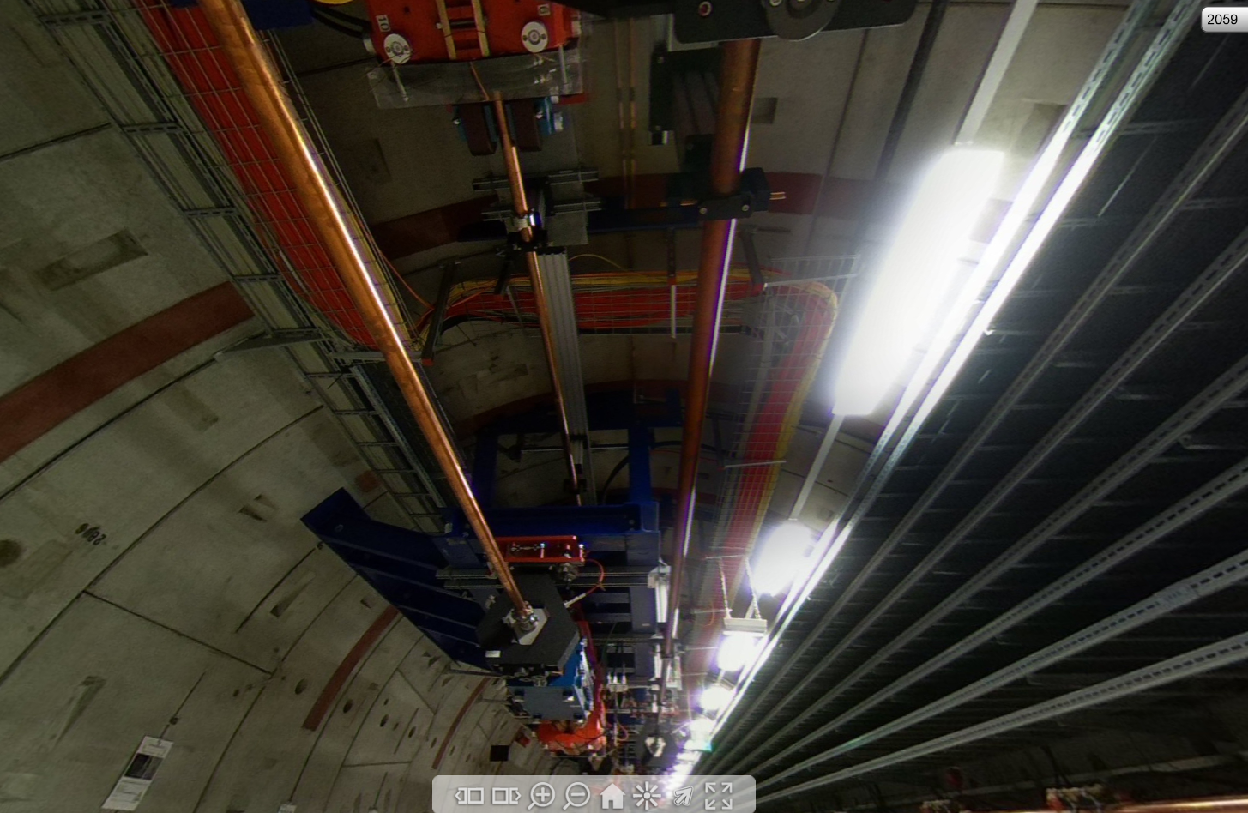

Slide 16
Groups / People involved:
XFEL operation
(Winni, N. Golubeva, E. Negodin)
MKK (power, water, etc.)
(H.J. Eckholdt, W. Kook, A. Hauberg)
MVS (vacuum design and installation)
(L. Lilje, T. Wohlenberg, J. Hauser)
MEA (installation, magnets and magnets procurement)
(M. Körfer, D. Lenz, B. Krause, M. Thede, N. Meyners)
MIN (kicker, beam dump design, photoconverter design, CAD integration)
(M. Huening, F. Obier, M. Schmitz)
ZM1 (design and production)
(C. Martens, R. Platzer)
D3 (radio protection)
(N. Tesch, W. Clement)
Next: MSK, MDI, MPS
Technical Coordination Meeting (1/month), separate meetings once a week.

