Slide 1
Jupyter Notebooks
PaNOSC WP4 meeting
Giuseppe La Rocca
EGI Foundation

Slide 2
Outline
EGI Notebooks
Data analysis using Jupyter Notebooks for Open Science
Onedata/EUDAT B2DROP and Jupyter notebooks
What's next ?
Conclusions

Slide 3
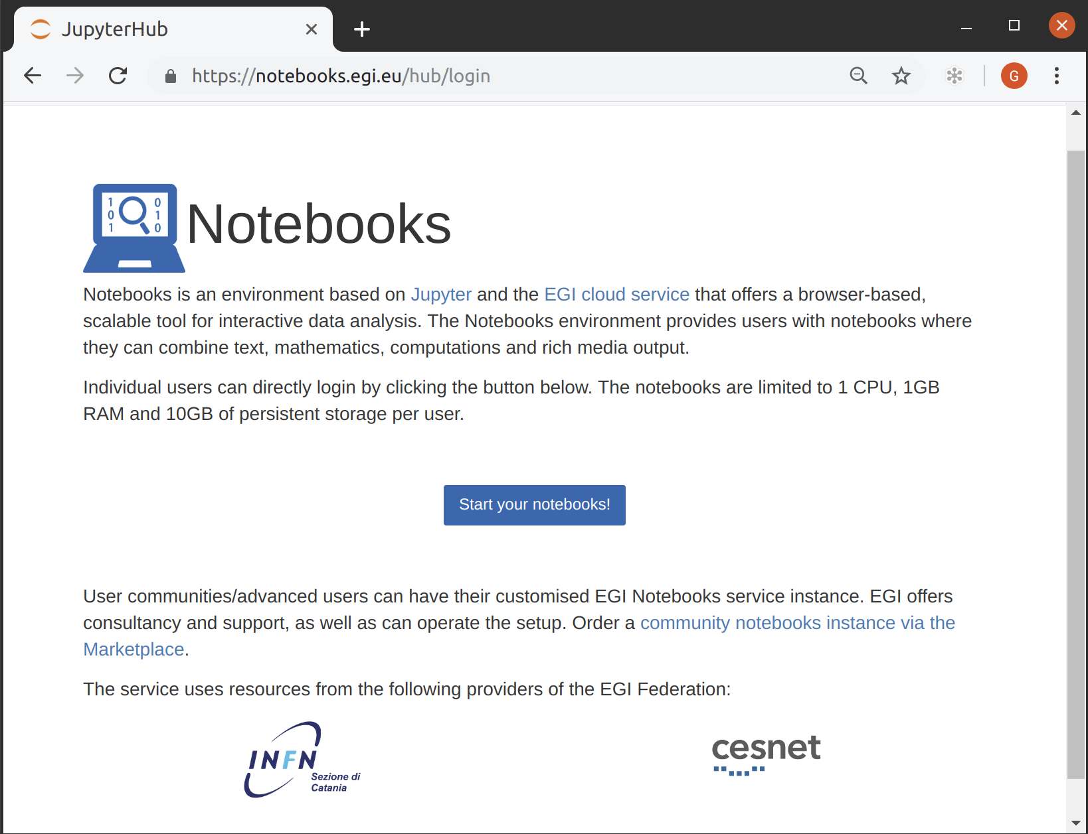
EGI Notebooks
JupyterHub hosted in the EGI Cloud
Offers Jupyter notebooks ‘as Service’
One-click solution: login and start using
Extra EGI Features:
Login with the EGI AAI Check-In service
Persistent storage for notebooks
Bring your own environments/kernels
Use EGI computing and storage resources from your notebooks

Slide 4
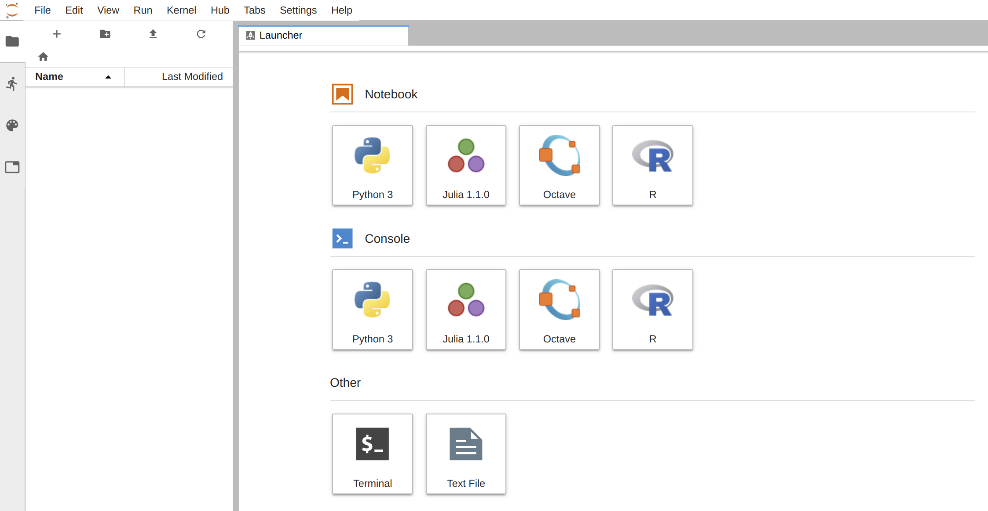
The JupyterLab interface

Slide 5
Service modes
Available via the Marketplace
Catch-all instance: https://notebooks.egi.eu
Limited resources: 1 CPU, 1GB RAM and 10GB of persistent storage
Sponsored access (free for the users)
One-click access: No need to Order it
Kills notebooks after 1 hour of inactivity (Use the persistent folder 🡪 Don’t lose your work!)
VO/Community deployments
Tailored to specific VO with custom computing/storage, e.g.:
access to GPUs, fat nodes
access to Spark, other BigData/ML environments
auto-mount filesystems on notebooks
…
Community deployment for training
1 CPU / 1GB RAM and 10GB storage / user

Slide 6
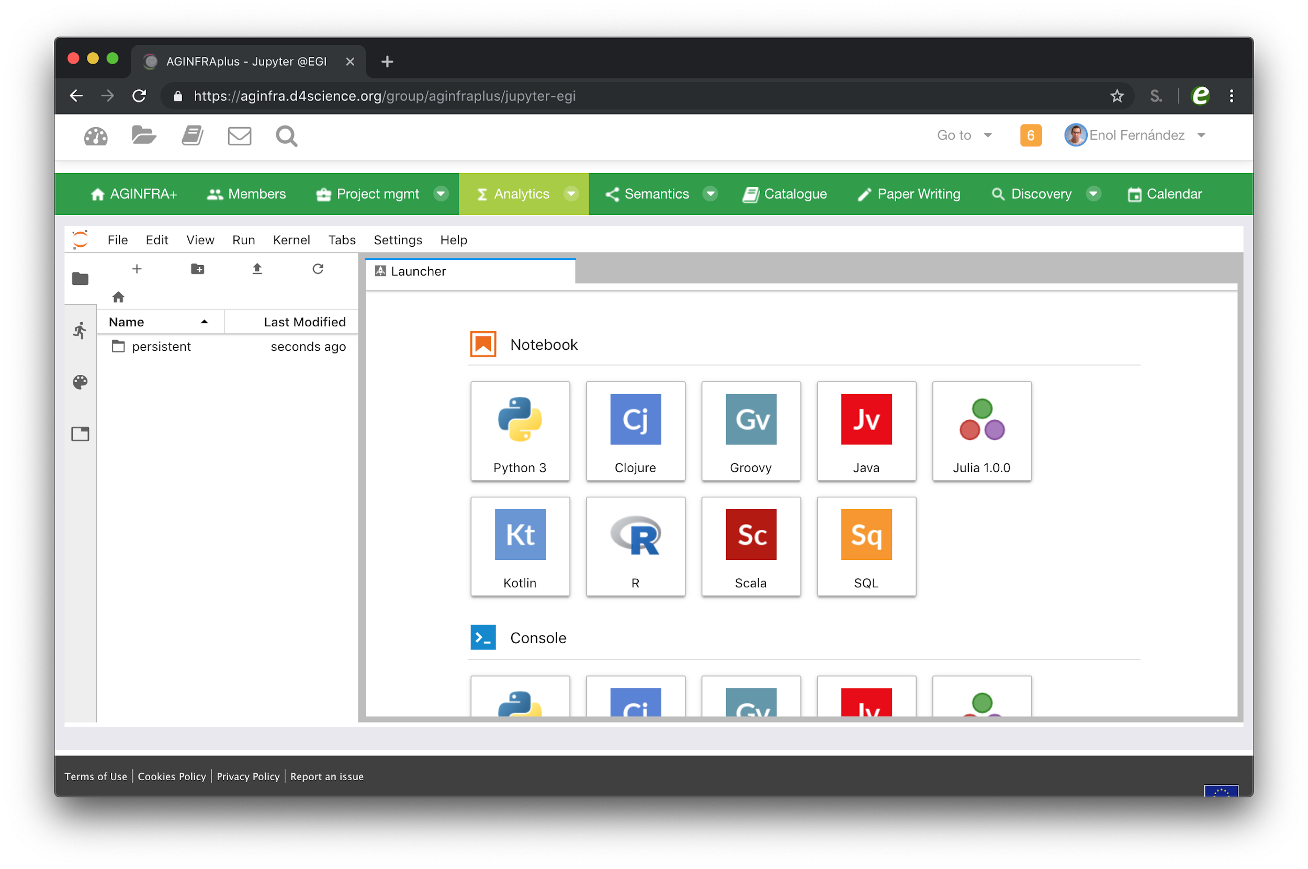
AGINFRA+ instance
Tailored to the community needs
Authentication with D4Science tokens
Extra kernels
Integration with D4Science dataminer via WPS
Access to VRE files with fuse (in progress)

Slide 7
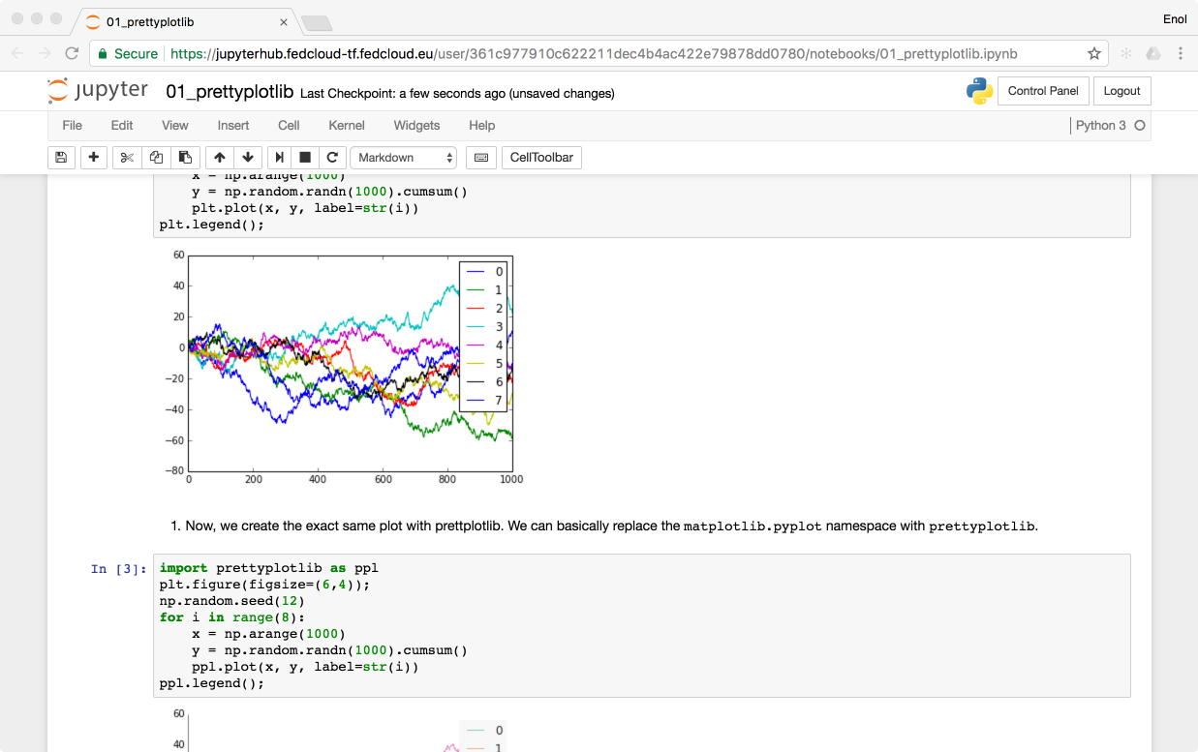
Technology Stack
https://notebooks.egi.eu
EGI CheckIn
Kubernetes cluster powered by EGI Cloud Compute
SSL Certificate
NFS Persistent
Storage
Kubernetes
Ingress

Slide 8
Integrate the EGI Notebooks with Onedata and B2DROP

Slide 9
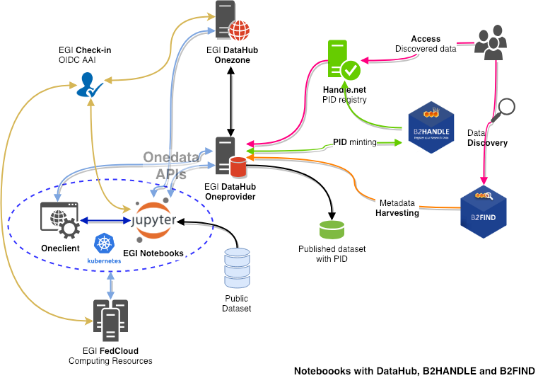
External storage: Onedata
Analysis
Notebooks / JupyterLab
FedCloud resources
Data management
DataHub / Onedata
Space
Onezone
Oneprovider
Oneclient
AAI (OIDC)
Check-in
PID management
B2HANDLE
Handle.net
Cataloguing and discovery
B2FIND

Slide 10
External storage: B2DROP
B2DROP offers online storage for researchers
Researchers can collaborate with others and work together on the data.
The data can be shared with external collaborators (B2DROP users or not)
The data can be shared with other platforms, which support the open cloud mesh.
Based on owncloud
Exposes webdav interface for accessing files
Webdav support added as FlexVolume in k8s

Slide 11
EGI Notebooks usage
Community specific deployments
AGINFRA+ instance: 28 Users
Parthenos instance: 9 users
EPOS-ORFEUS instance: 4 users
PaNOSC instance: Under setup
Training instance (deployed for specific events):
CODATA-RDA Summer School July 2018 (55 participants)
TU Wien course Jan 2018 (25 participants)
DI4R October 2018 (15 participants)
ISGC tutorial April 2019 (50 participants)
Bielefeld University May 2019 (30 participants)
EGI Conference 2019 (20 participants)
Current supporting infrastructure:
10 VMs at INFN-Catania with a total of 52 CPUs and 104GB RAM
3 VMs at CESNET with 24 CPUs and 96GB RAM

Slide 12
What's next ?
Moving the service into production
Started to deploy a binder instance within EGI
First test works with the EGI AAI Check-In
Improve the performance and the integration

Slide 13
Conclusions
EGI Notebooks: A success story
Growing usage of the catch-all instance
Growing number of community-specific instances
Integration with data access technologies
EGI DataHub and EUDAT B2DROP – Prototypes available
Integration with Binder technology started

Slide 14
References
Onedata
https://onedata.org
EGI DataHub
https://datahub.egi.eu - http://egi-datahub.readthedocs.io/
EGI Notebooks
https://www.egi.eu/services/notebooks/ - https://notebooks.egi.eu/
EGI Check-in
https://www.egi.eu/services/check-in/ - https://wiki.egi.eu/wiki/AAI
B2FIND
https://eudat.eu/services/b2find - http://eudat7-ingest.dkrz.de/
B2HANDLE
https://eudat.eu/services/b2handle - https://hdl.grnet.gr:8001/api/handles

