Slide 1
PaNOSC WP4
Jakub Grosz, ELI Beamlines

Slide 2
ELI WP4 People
Jakub Grosz, ELI Beamlines
Mariana Danielová, ELI Beamlines
Eduard Nicolescu, ELI Beamlines
Róbert Rácz, ELI ALPS
WP3 – ongoing interviews at ELI Beamlines

Slide 3
Jupyter Open .h5 data in Paraview
XDMF
file
header
body
footer

Slide 4
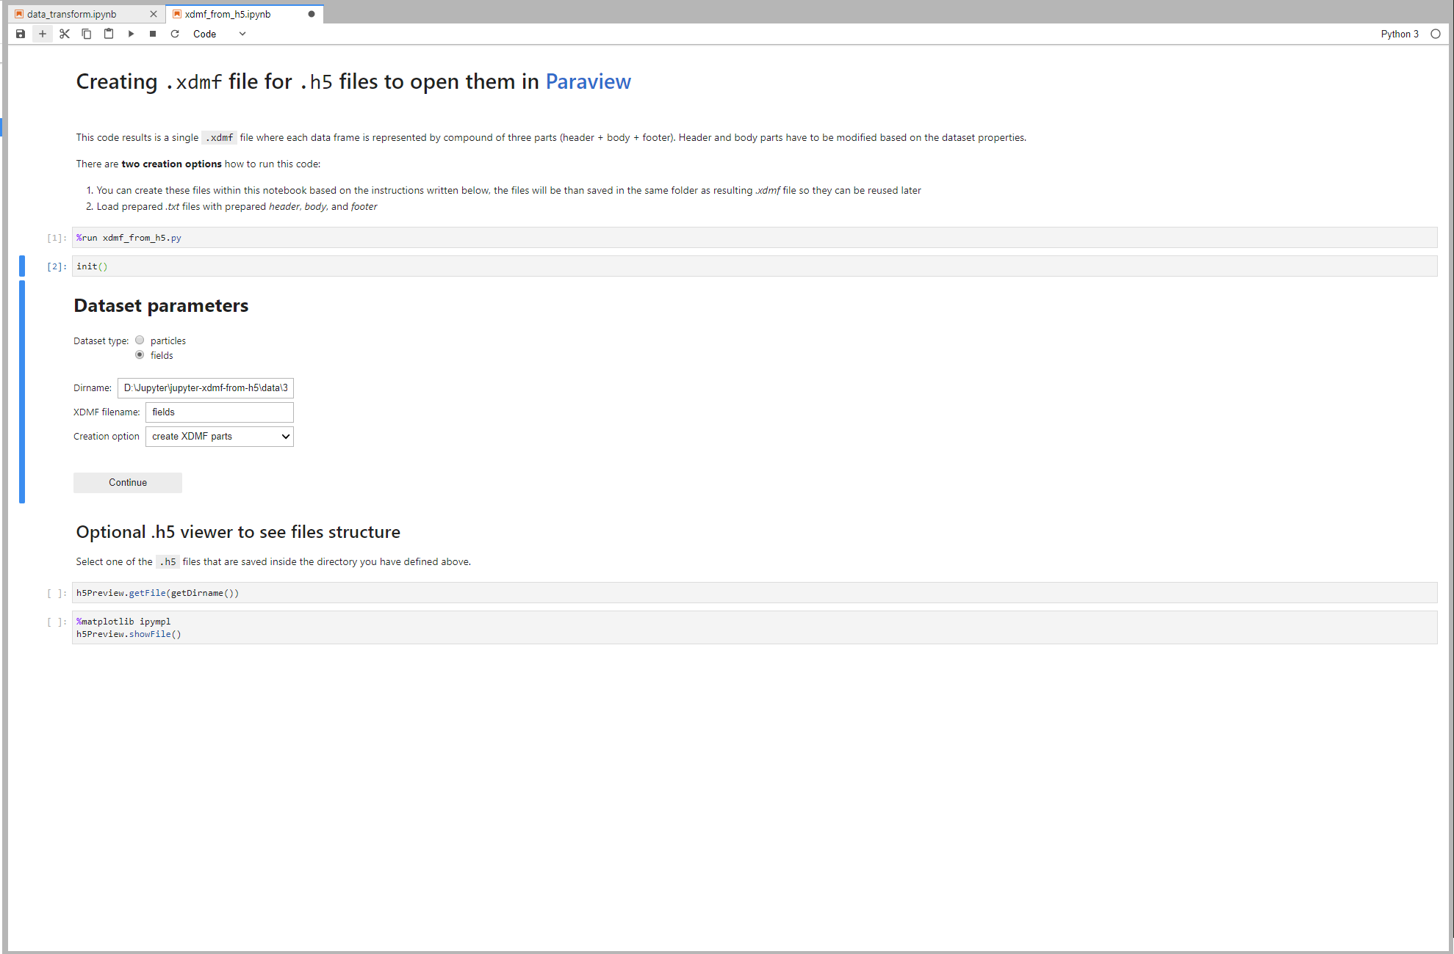
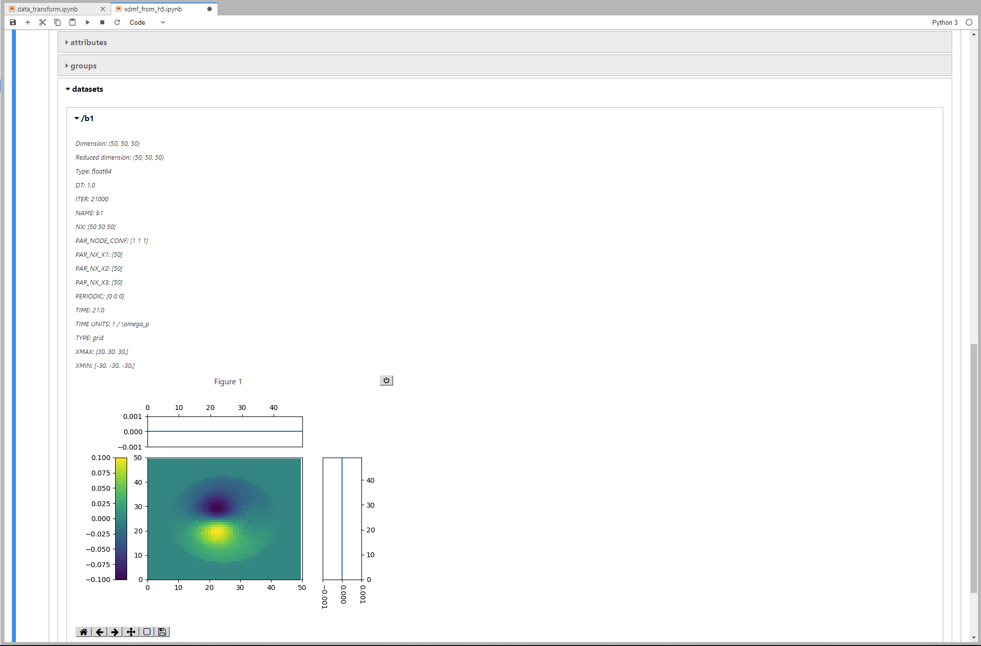
Jupyter Open .h5 data in Paraview

Slide 5
Jupyter Create VR web application
VR web application
Binary format
Configuration file for web app

Slide 6
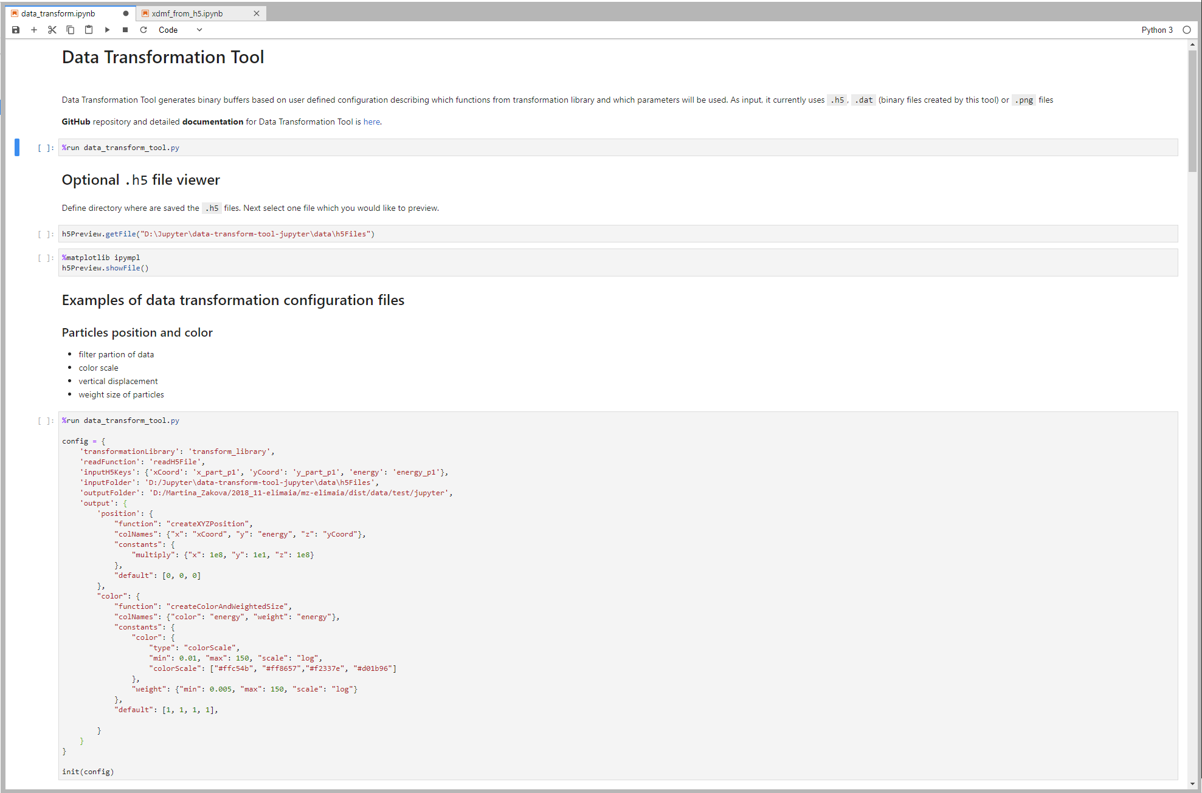
Jupyter Create VR web application

Slide 7
Interactive 3D Visualizations of Scientific Data
Interactive 3D Web Apps with VR mode based on in-house developed WebGL 2.0 framework
Currently supports: Particle-in-cell (Epoch, Osiris), Monte Carlo (Geant)
Unified code base for various datasets, 16 and growing…
UI for controlling timeline, layers visibility (e.g. particles/fields data), grids
Info layer: graphs, legends, orthogonal views, description
Optimized for visualizations of very large datasets (TB simulations)

Slide 8
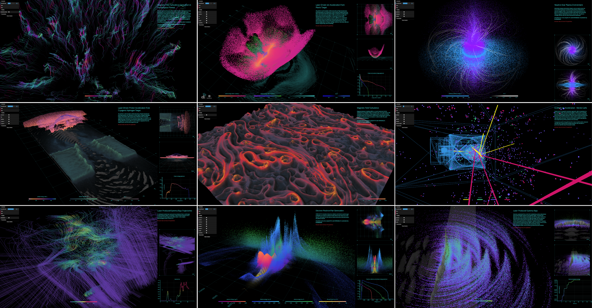

Slide 9
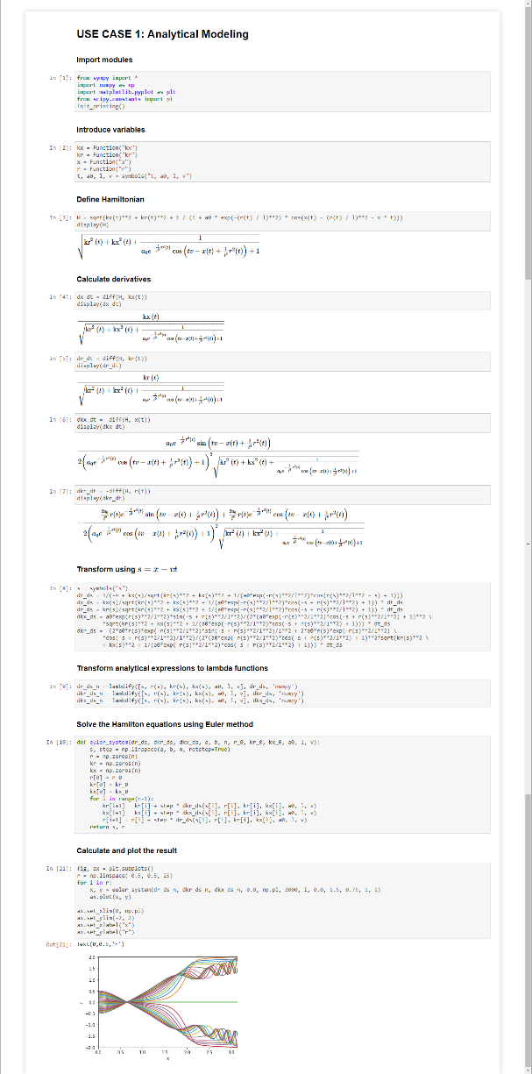
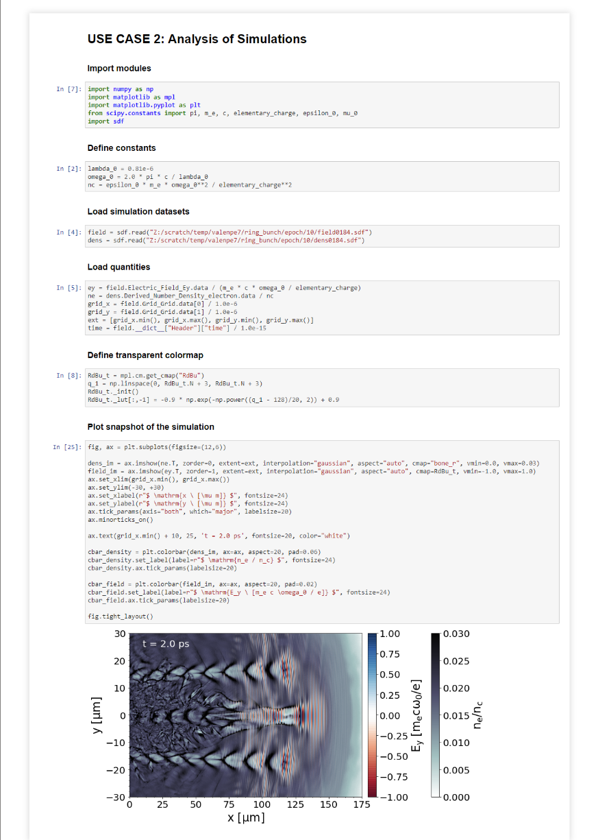
Jupyter Use cases
Analytical Modelling
Analysis of PIC Simulations

Slide 10
ELI Beamlines Experimental Data
First users now – June 2019, E1: Biomolecular and Material Applications
Data production for 2019 expected 200-400TB
PBs in following years
Data management to be addressed in PaNOSC WP3

