Slide 1
LUXE Simulations
Guillermo Marrero Samarin

Slide 2
Setup
10cm diameter collimator with a 1mm hole

Slide 3
Issues
The size of the simulation box and the high energy of electrons is a big issue in terms of simulation time
At the moment simulating the setup up to the vacuum chamber takes a day to run 10^4 particles
This number of primaries is not even sufficient to resolve any particles arriving at the spectrometer plane.
Geometry of the experiment is not being over-plotted for some reason

Slide 4
10^4 particle results
Nothing on any of the spectrometers except for the detector setup after the converter (pre-collimator)
No chance to perform any noise optimisation
The collimator seems sufficient to contain the cascades produced by the off-axis secondary particles at a radius of 5cm
Must stress this is the product of a full day of simulating, not at all ideal

Slide 5
Photon Top view

Slide 6
Positrons Top view

Slide 7
Electrons Top view

Slide 8
Modifications
Start from scratch, simulate a section of the experiment at a time
Start with a small simulation box containing only converter/collimator and detectors
Start without magnet, this seems to be the component causing the simulation to be so slow, will be a good indication of the levels f photon noise at the spectrometer plane
Able to run 2E6 primaries in a day

Slide 9
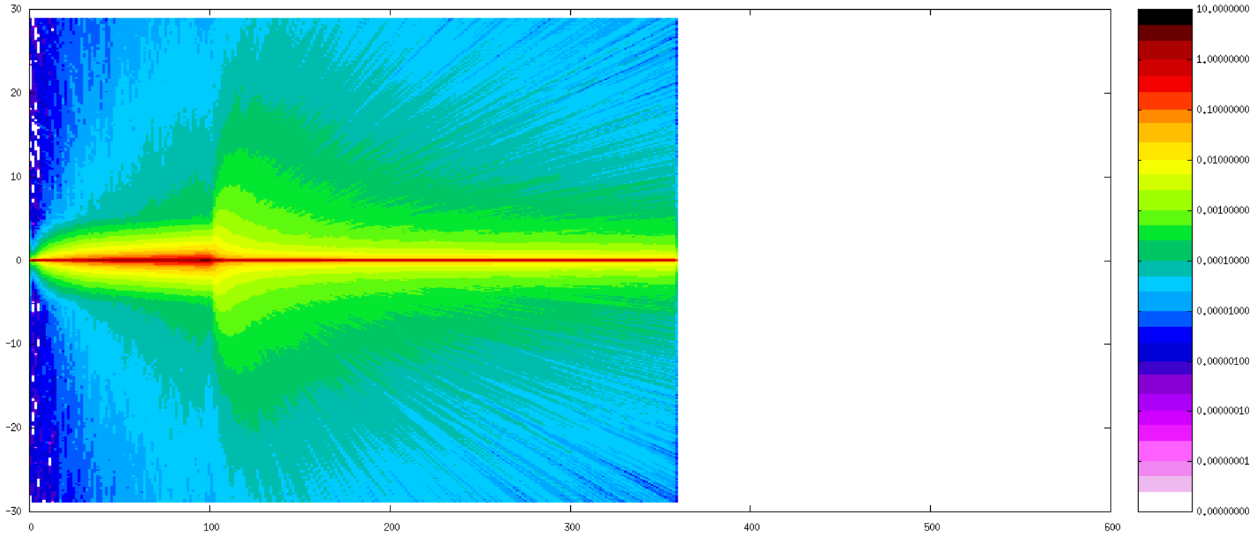
Photon Top view

Slide 10
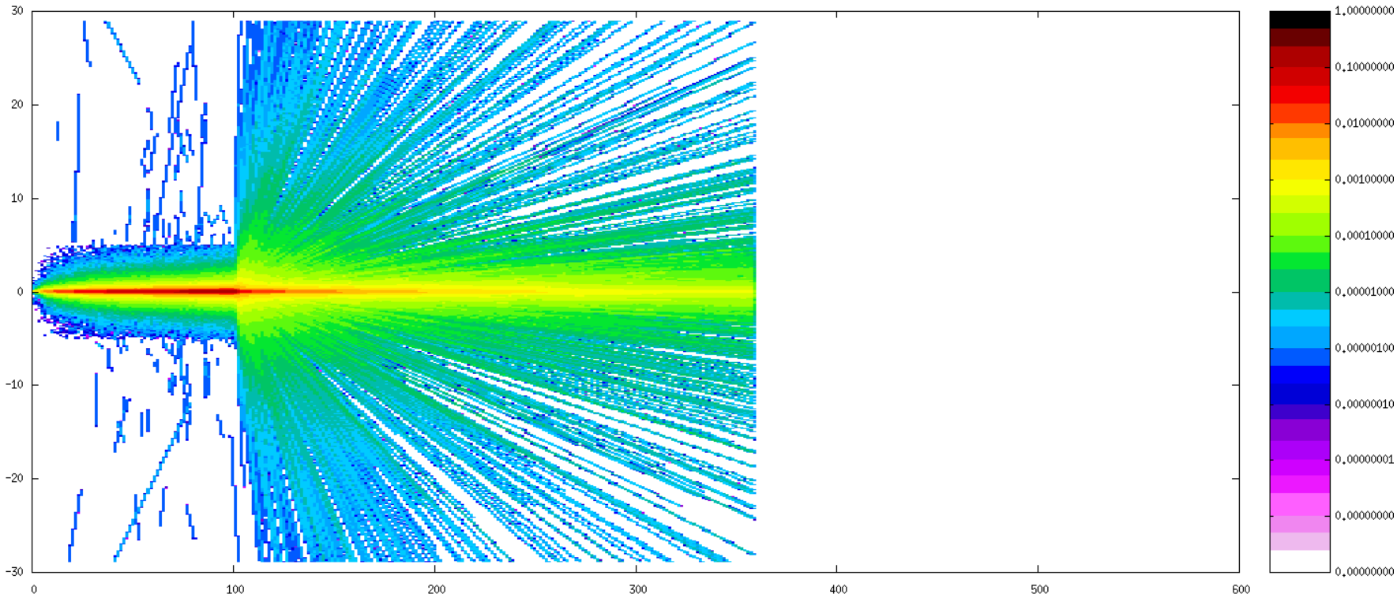
Positron Top view

Slide 11
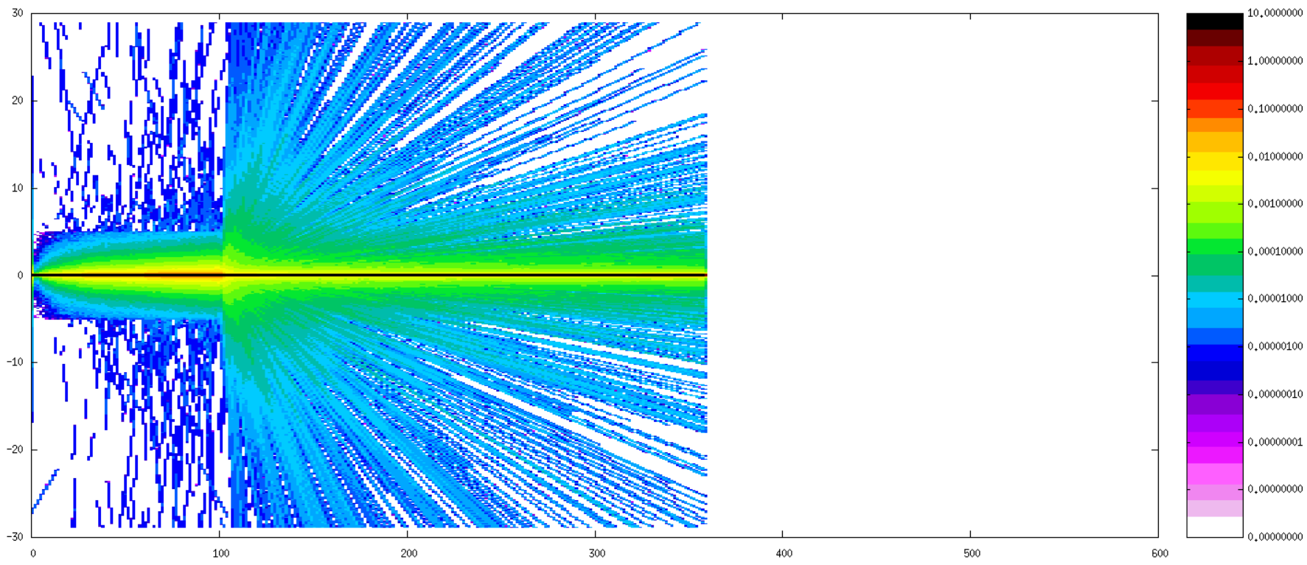
Electron Top view

Slide 12
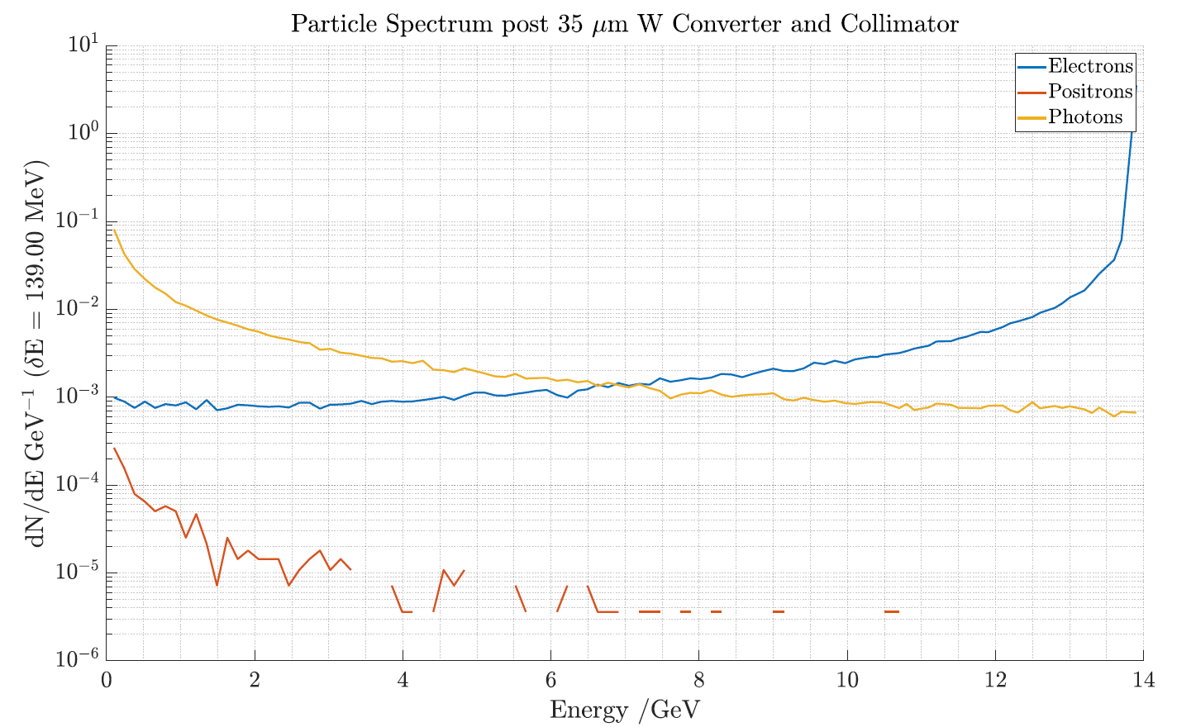
Spectra post-collimator

Slide 13
Spectrometer plane photons
Noise level is 1E-4 at displacements greater than 10cm

Slide 14
Spectrometer plane positrons
Undispersed positron signal level is 1E-3

Slide 15
Spectrometer plane electrons
Signal level apart from primary 14 GeV beam 1E-3

Slide 16
Conclusions from the setup
Single collimator probably not enough to kill noise in the spectrometer region
Positron yield with a magnet in will be very difficult to simulate because of the run time
Can use a setup similar to the proposed for SLAC, double pinhole (restricts the noise to the axis)
In order to get more positron yield per primary (for the sake of my simulations only) maybe increase converter thickness or consider back-conversion?

