Slide 1

LUXE experiment at the Eu-XFEL
pair spectrometer
Gianluca Sarri
School of Mathematics and Physics, Queen’s University Belfast, UK
g.sarri@qub.ac.uk
Gianluca Sarri

Slide 2
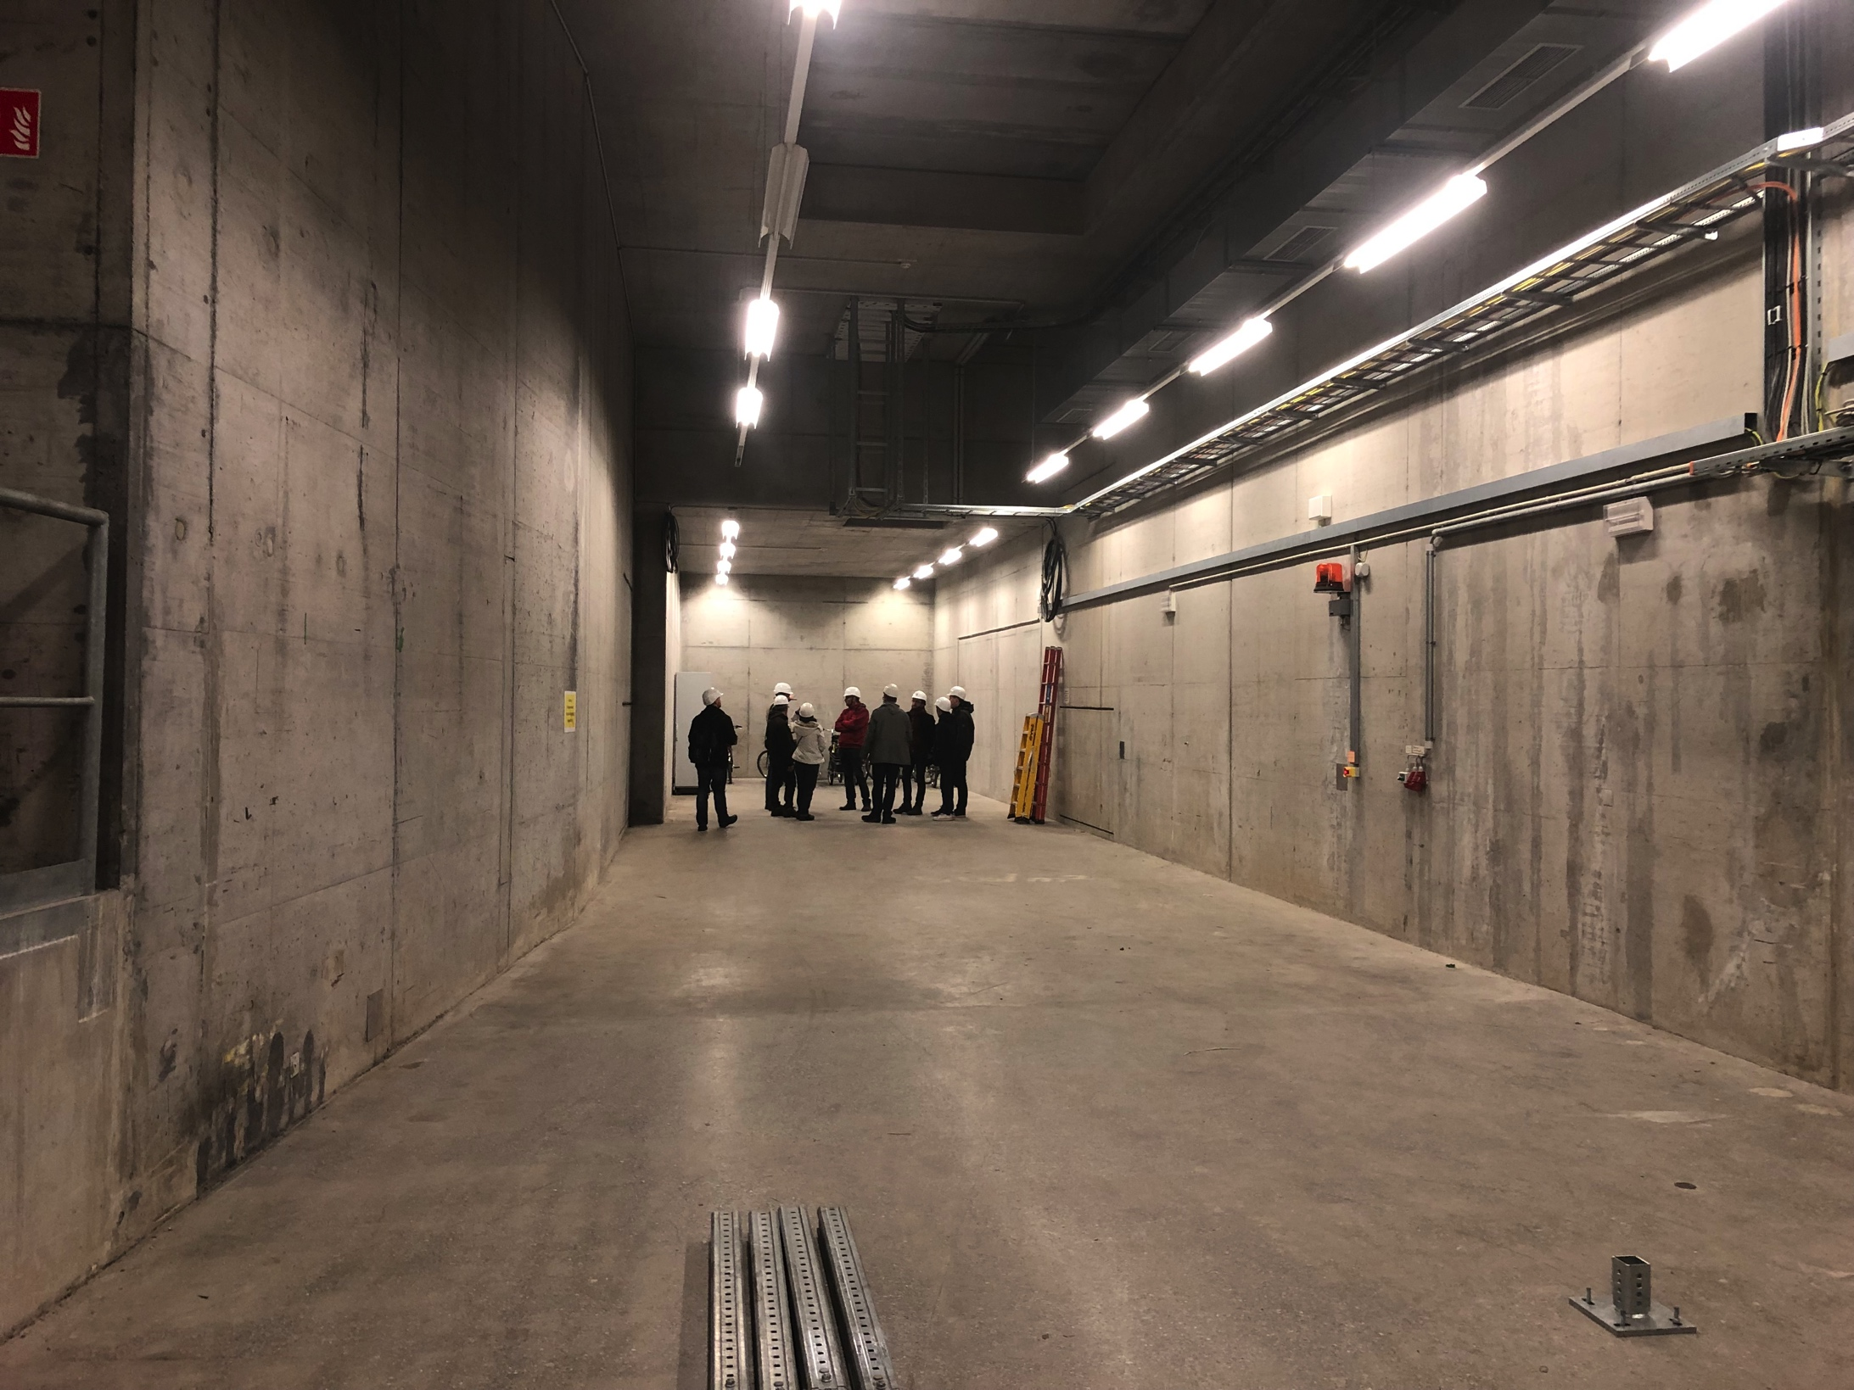
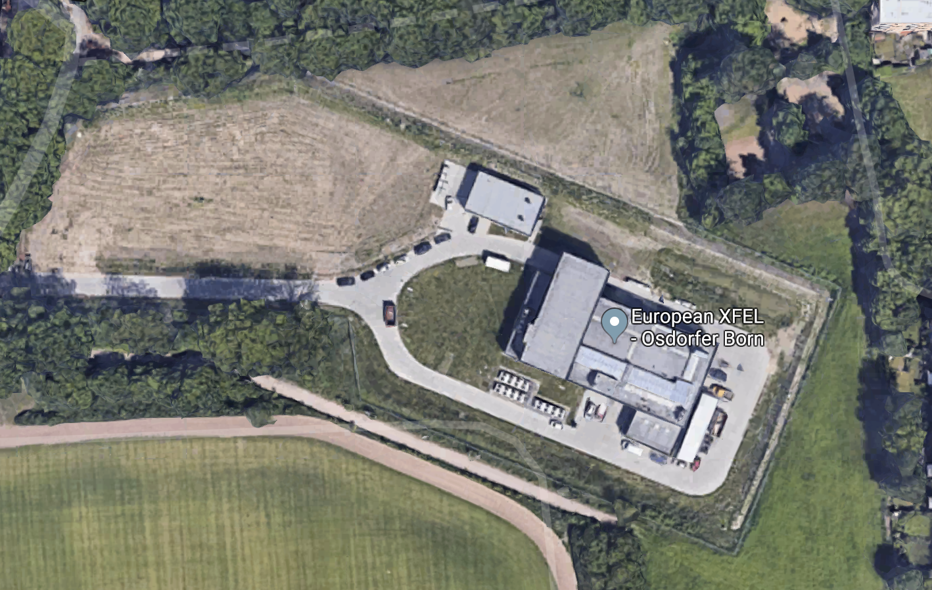
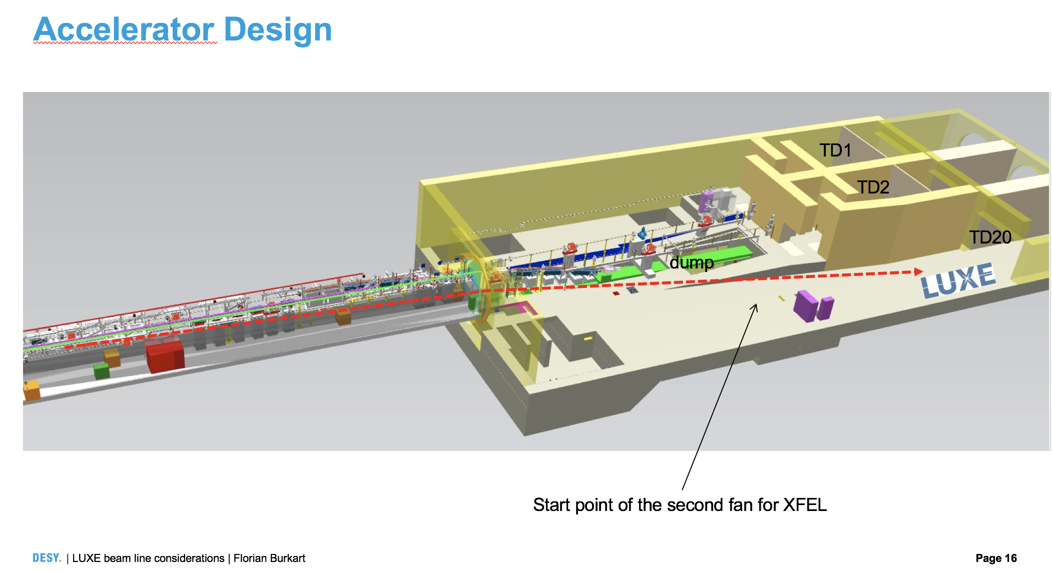
Location
90 m tunnel right after the
first electron switch
Building in Osdorfer Born available
right above it, with openings for laser transport
Gianluca Sarri

Slide 3
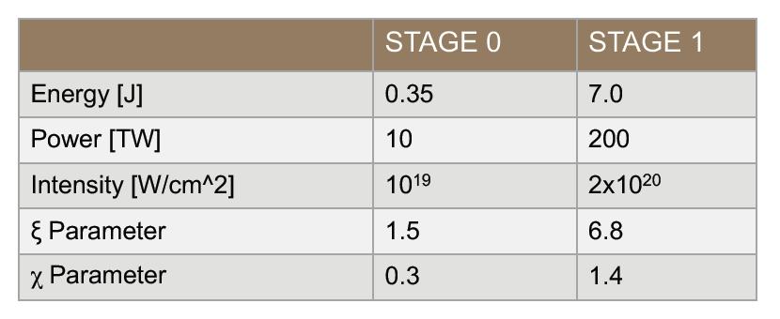
General setup
Electron beam: - Energy: 14 or 17.5 GeV
- ΔE/E: ~ 10⁻⁴ (2 MeV over 17.5 GeV)
- Number of e⁻ : 6.2x10⁹
- Beam size: 1 – 30 micron
- Duration: 1 – 80 fs (increases with charge)
Laser parameters:
Crossing angle: 17 degrees
Gianluca Sarri

Slide 4
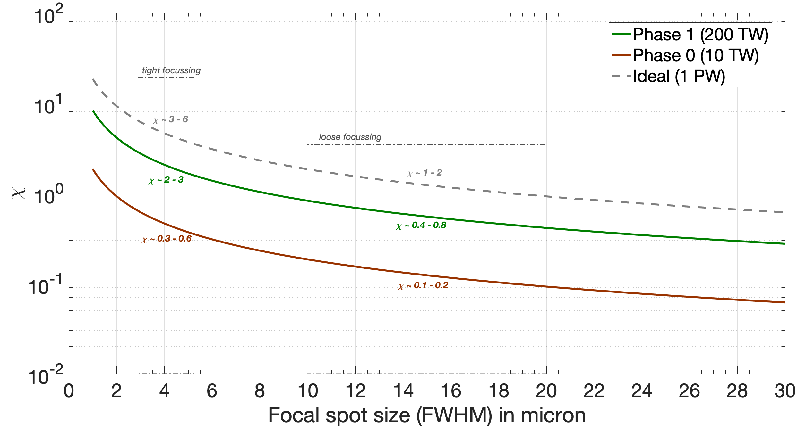
General setup
Gianluca Sarri

Slide 5
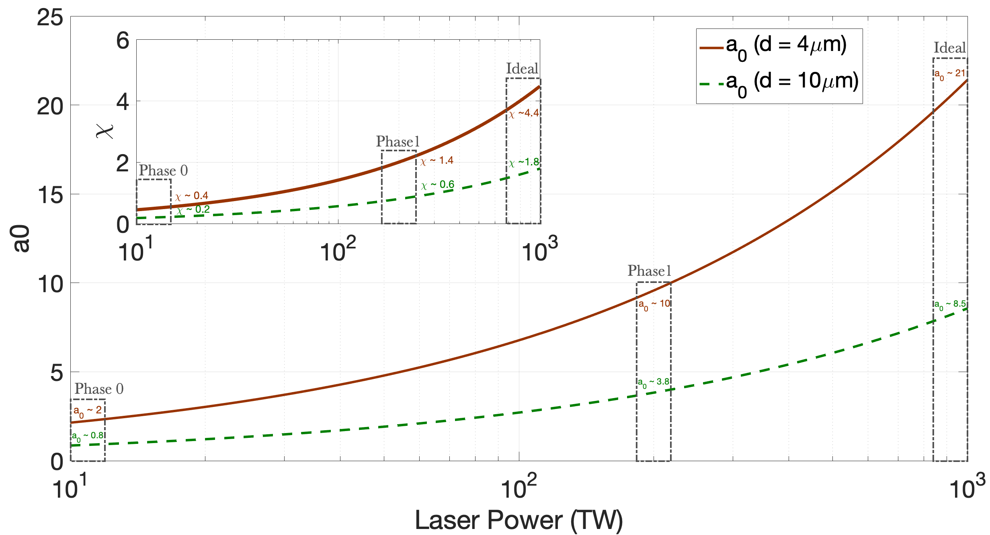
General setup
Working with a focal spot with FWHM of 10 μm will never allow χ > 1 for a 200 TW system
Gianluca Sarri

Slide 6

C. Conceptual design (phot – laser)
Positrons
Electrons
Photons
Dipole 3
In-plane deflection
(horizontal)
Out of plane deflection
(vertical)
Vertical offset
> 1 m
Dipole 1
B = 2 T
W foil
35 μm
Collimator
Laser
Dipole 2
Electrons
2 m
17.5$°$
0.5 mm hole
B = 2 T
B = 2 T
Dipole 4
1 m
0.75 m
0.25 m
2 m
20 m
2 m
B = 2 T
2m away from the interaction point, the 10 GeV photons will have a diameter of ~ 100 μm
d₀ ~ 5 μm, 1/γ (@ 10 GeV) = 50 μrad => d_{γ} (@ 2m) = 100 μm
Assuming a 10 micron laser focal spot, we get (10/100)² ~ 1% of the photons interacting with the laser
Assuming a 4 micron laser focal spot, we get (4/100)² ~ 0.2% of the photons interacting with the laser
Phase 0: P_{L}=10 TW (2x10¹⁸ Wcm⁻² , a₀ ~ 0.7, χ ~ 0.15) ➔ No pairs. However, excellent test-bed!
Phase 1: P_{L}=200 TW (4x10¹⁹ Wcm⁻² , a₀ ~ 4, χ ~ 0.7) ➔ ~ tens of pairs per shot
Phase 2: P_{L}=1 PW (2x10²⁰ Wcm⁻² , a₀ ~ 7, χ ~ 1.5) ➔ ~ hundred pairs per shot
2 m
Gianluca Sarri

Slide 7

Conceptual design (e⁻ – laser)
Positrons
Electrons
Photons
Dipole 3
Out of plane deflection
(vertical)
Vertical offset
> 1 m
Laser
Dipole 2
Electrons
17.5$°$
Dipole 4
2 m
Phase 0
If we remove the collimator, dipole 1, and the tungsten foil, we can study electron-laser collisions
In this case, we can assume the electron beam diameter to be 5 μm, so we can focus more tightly and
achieve an intensity > 10¹⁹ Wcm⁻² (a₀ ~ 1 – 2, χ ~ 0.2)
Still hard to detect pairs, but not impossible. Anyway, we can do detailed studies of radiation reaction
and stochastic photon emission
Gianluca Sarri

Slide 8
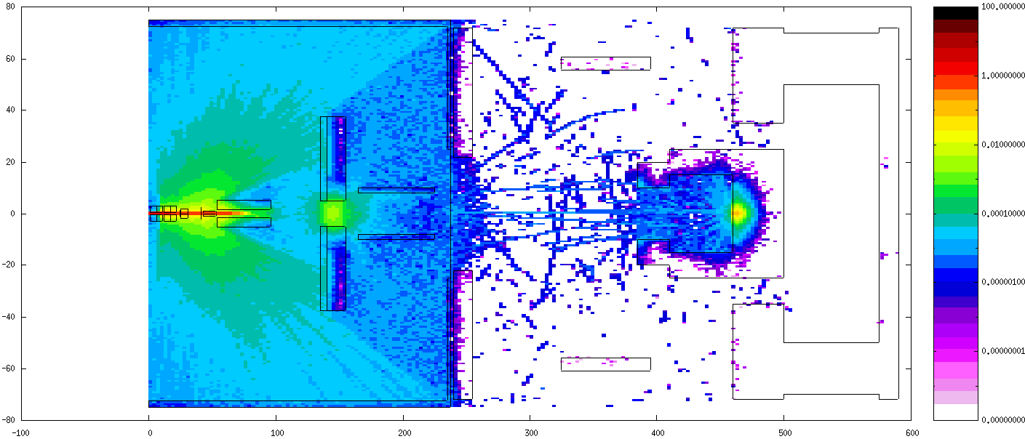
Noise estimates Gemini
SIDE VIEW (in scale):
Main sources of noise: - secondary pairs from the converter
- effective dumping of the primary γ-ray beam
- laser light
- interaction of secondaries with magnets and apertures
Gianluca Sarri

Slide 9
Noise estimates Gemini
TOP VIEW (in scale):
Vacuum
Pb
Air
Pb
Dipole 3
Teflon
Pb
Pair detectors
Converter
Electron beam
from LWFA
Dipole 1
Dipole 2
Pb
Pb
Gamma detectors
Pb collimator
Pb
Pair detectors
Teflon
Pb
Pb
20 cm
Dipole 4
Vacuum chamber wall
Pb
1m
Pb
Pb
Main sources of noise: - secondary pairs from the converter
- effective dumping of the primary γ-ray beam
- laser light
- interaction of secondaries with magnets and apertures
Positrons
Electrons
Photons
Gianluca Sarri

Slide 10
Noise estimates Gemini
TOP VIEW (in scale):
Vacuum
Pb
Air
Pb
Dipole 3
Teflon
Pb
Pair detectors
Converter
Electron beam
from LWFA
Dipole 1
Dipole 2
Pb
Pb
Gamma detectors
Pb collimator
Laser
Pb
Pair detectors
Teflon
Pb
Pb
20 cm
Dipole 4
Vacuum chamber wall
Pb
1m
Pb
Pb
Main sources of noise: - secondary pairs from the converter
- effective dumping of the primary γ-ray beam
- laser light
- interaction of secondaries with magnets and apertures
Positrons
Electrons
Photons
Gianluca Sarri

Slide 11
Noise estimates Gemini
TOP VIEW (in scale):
Vacuum
Pb
Air
Pb
Dipole 3
Teflon
Pb
Pair detectors
Converter
Electron beam
from LWFA
Dipole 1
Dipole 2
Pb
Pb
Gamma detectors
Pb collimator
Laser
Pb
Pair detectors
Teflon
Pb
Pb
20 cm
Dipole 4
Vacuum chamber wall
Pb
1m
Pb
Pb
Main sources of noise: - secondary pairs from the converter
- effective dumping of the primary γ-ray beam
- laser light
- interaction of secondaries with magnets and apertures
Positrons
Electrons
Photons
Gianluca Sarri

Slide 12
Noise estimates Gemini
TOP VIEW (in scale):
Vacuum
Pb
Air
Pb
Dipole 3
Teflon
Pb
Pair detectors
Converter
Electron beam
from LWFA
Dipole 1
Dipole 2
Pb
Pb
Gamma detectors
Pb collimator
Laser
Pb
Pair detectors
Teflon
Pb
Pb
20 cm
Dipole 4
Vacuum chamber wall
Pb
1m
Pb
Pb
Main sources of noise: - secondary pairs from the converter
- effective dumping of the primary γ-ray beam
- laser light
- interaction of secondaries with magnets and apertures
Positrons
Electrons
Photons
Gianluca Sarri

Slide 13
Noise estimates Gemini
Electron MAP (top view)
Noise < 10⁻⁸
Noise < 10⁻⁸
Electrons from aperture
Electrons from converter
Electrons from window
Electrons from gammas
in the dump
Gianluca Sarri

Slide 14
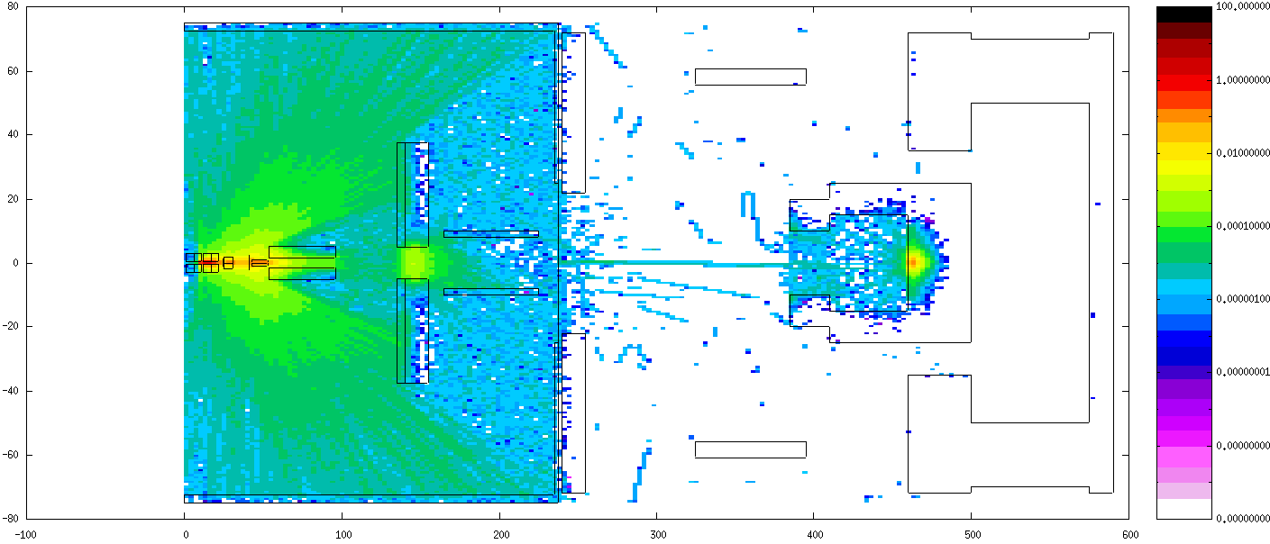
Noise estimates Gemini
Positron MAP (top view)
Noise < 10⁻⁸
Noise < 10⁻⁸
Gianluca Sarri

Slide 15
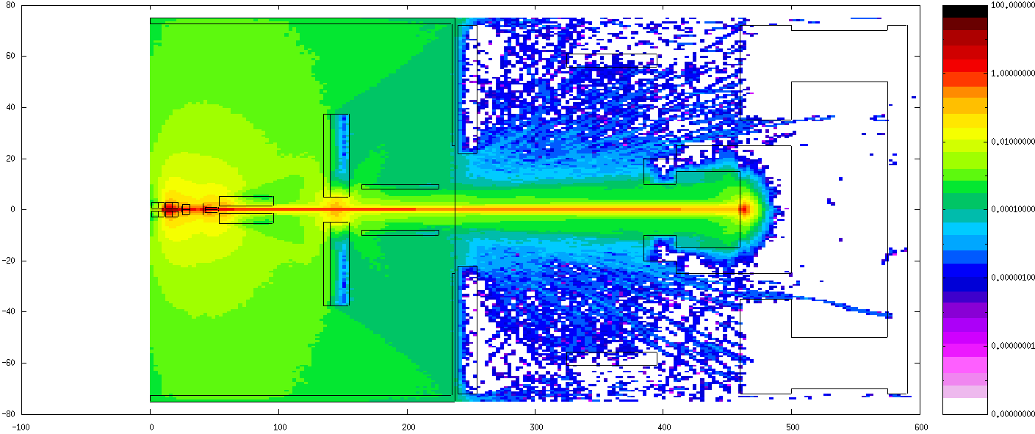
Noise estimates Gemini
Photon MAP (top view)
Gianluca Sarri

Slide 16
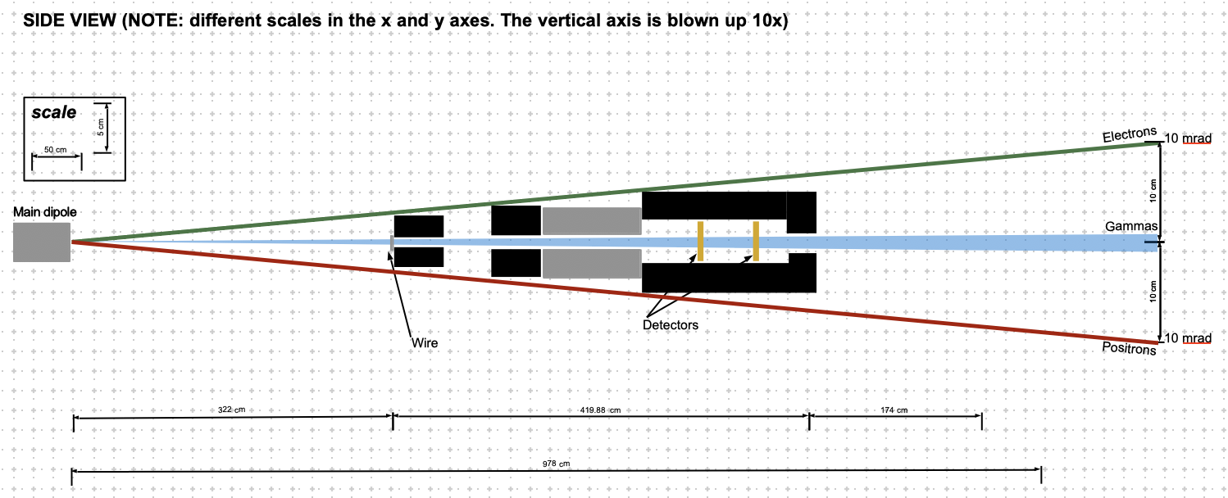
Pair spectrometer design
Main dipole separating electrons and positrons arising from the interaction point from the gamma rays
current setup includes a 1.8T, 1 m dipole magnet, but can be changed if more space is available
lead shielding depicted and simulated using FLUKA
The current setup assumes a 10 mrad kick from the main dipole at 10 GeV
Gianluca Sarri

Slide 17
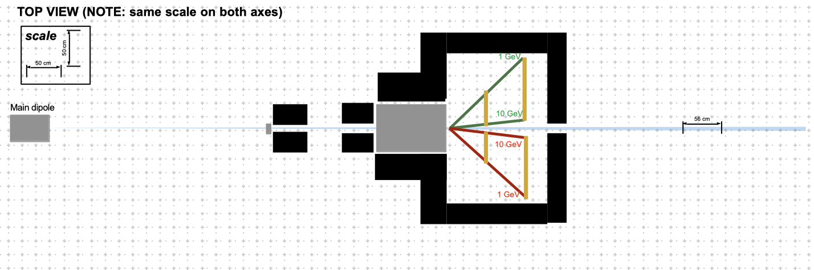
Pair spectrometer design
Main dipole separating electrons and positrons arising from the interaction point from the gamma rays
current setup includes a 1.8T, 1 m dipole magnet, but can be changed if more space is available
lead shielding depicted and simulated using FLUKA
The current setup assumes a 10 mrad kick from the main dipole at 10 GeV
Gianluca Sarri

Slide 18
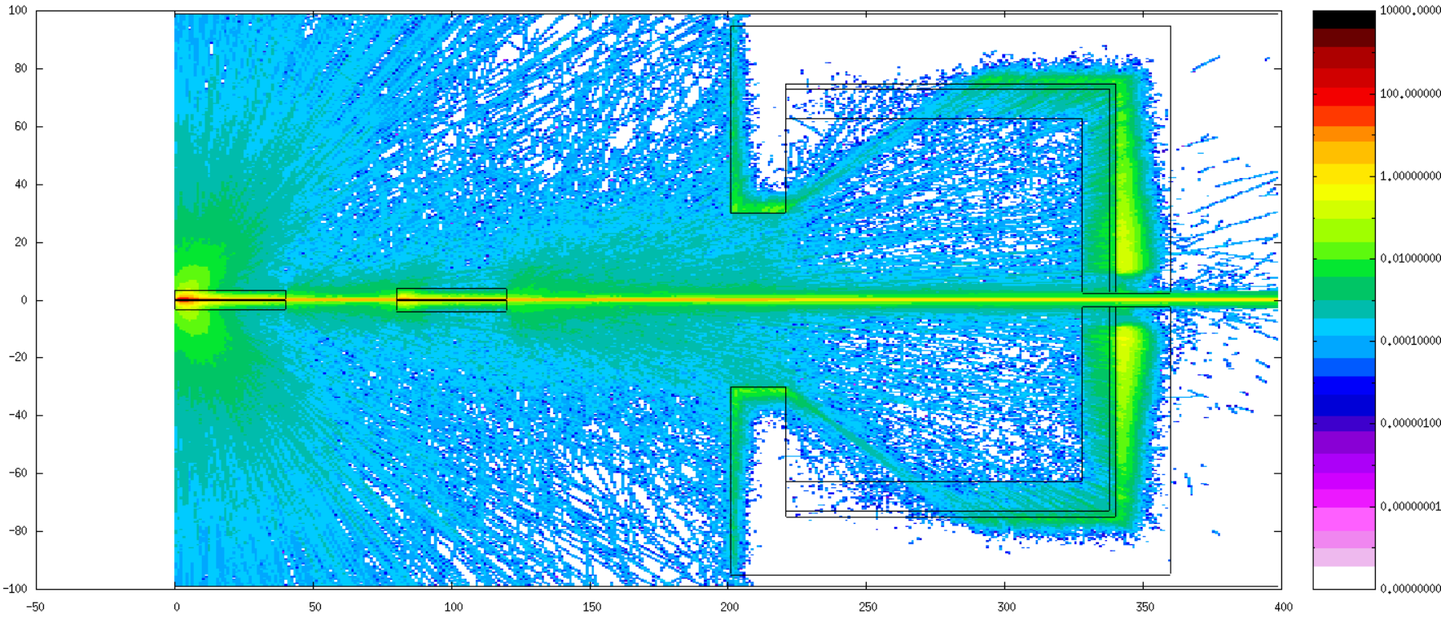
FLUKA simulations
TOP VIEW: photons
Gianluca Sarri

Slide 19
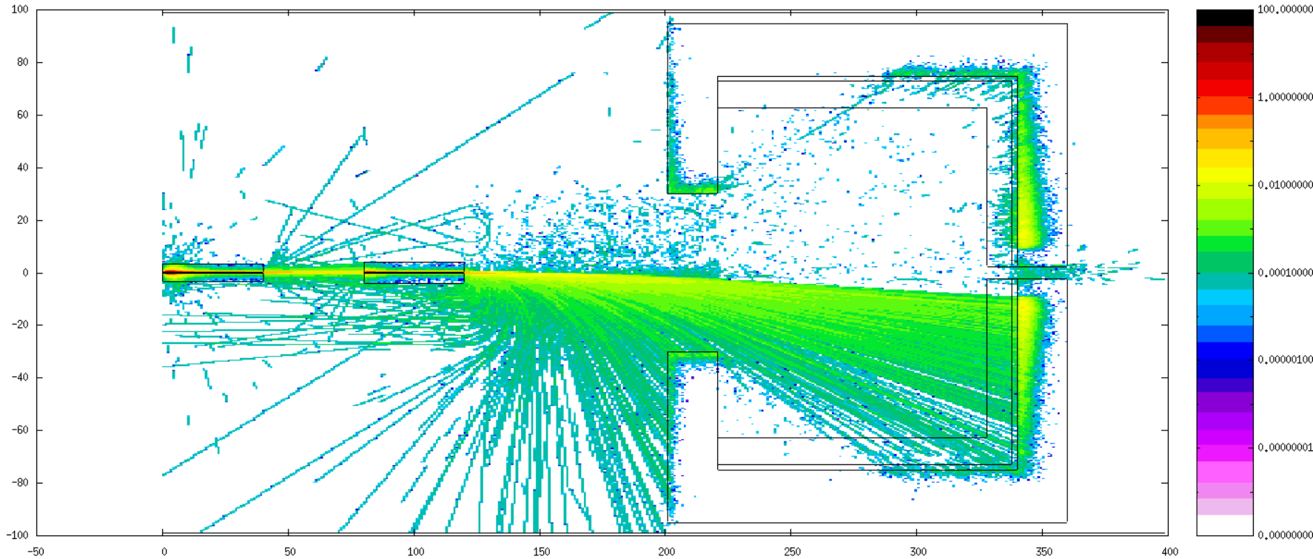
FLUKA simulations
TOP VIEW: positrons
Gianluca Sarri

Slide 20
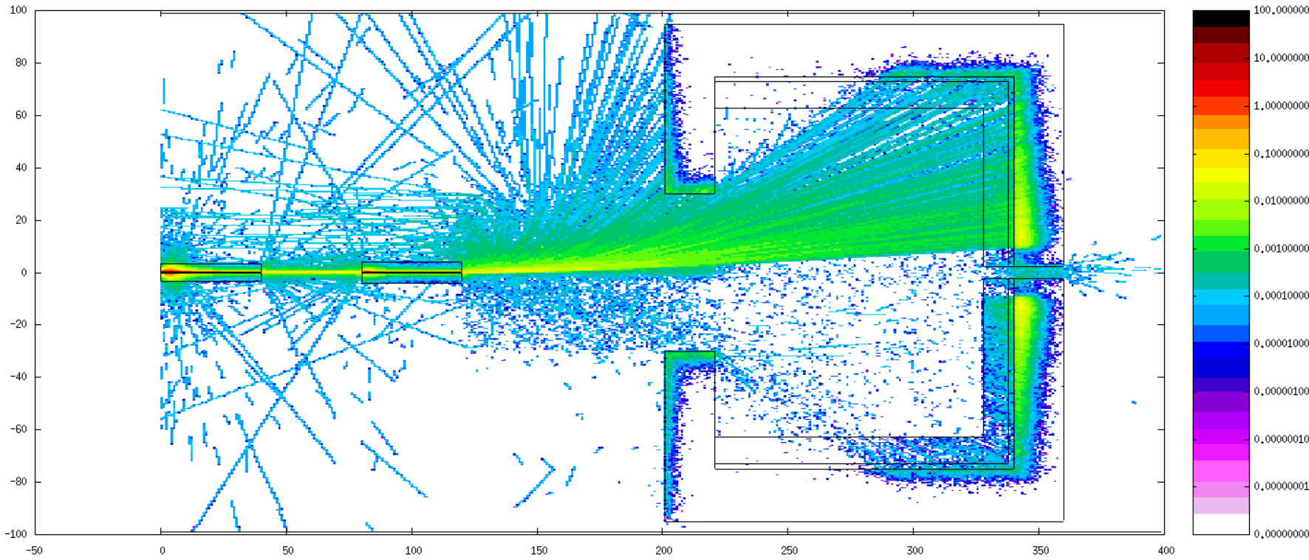
FLUKA simulations
TOP VIEW: electrons
Gianluca Sarri

Slide 21
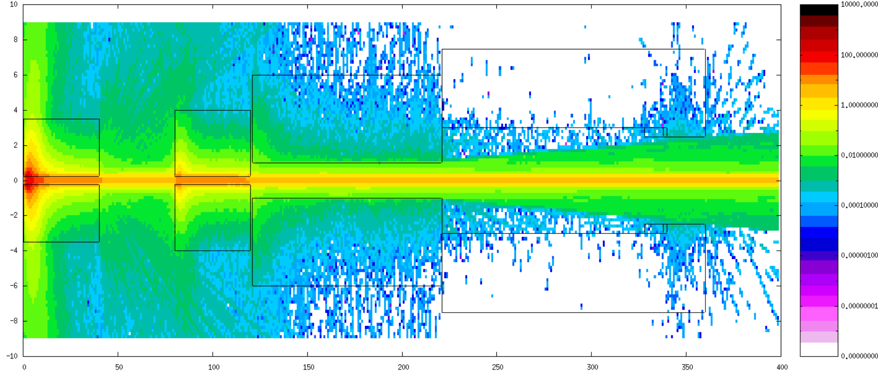
FLUKA simulations
SIDE VIEW: photons
Gianluca Sarri

Slide 22
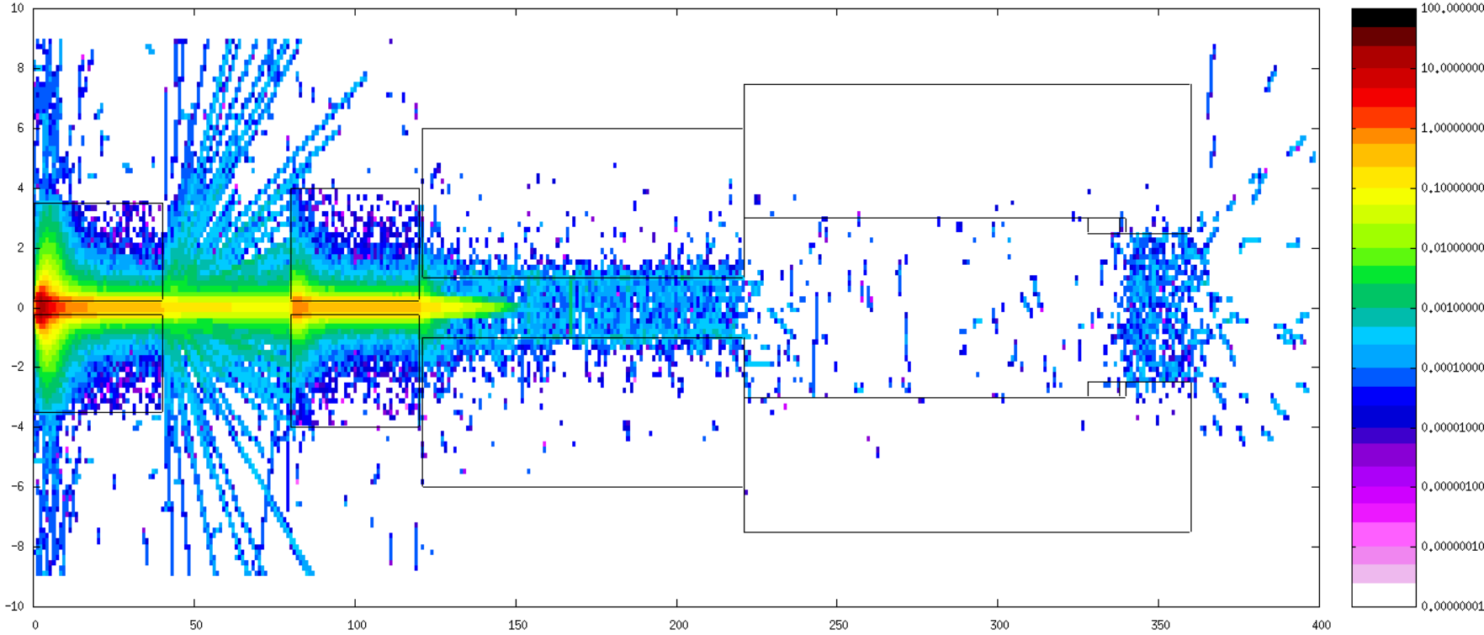
FLUKA simulations
SIDE VIEW: positrons
Gianluca Sarri

Slide 23
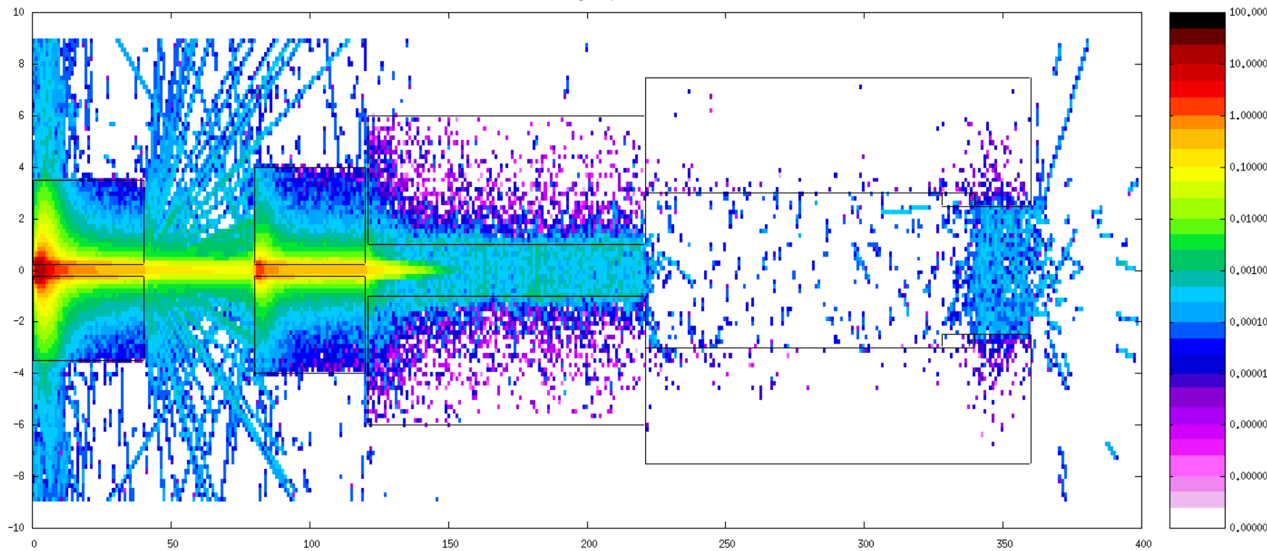
FLUKA simulations
SIDE VIEW: electrons
Gianluca Sarri

Slide 24
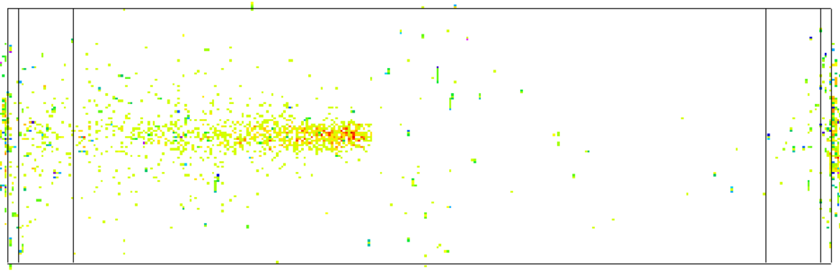
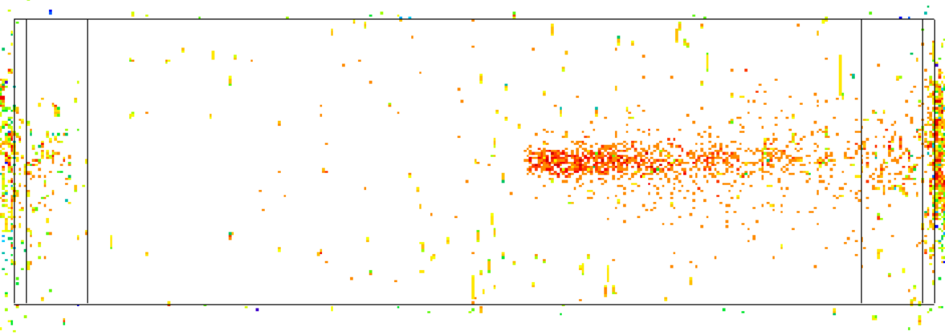
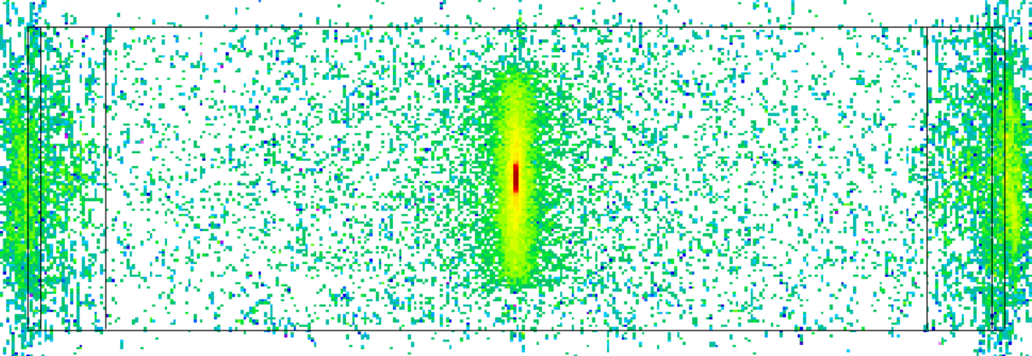
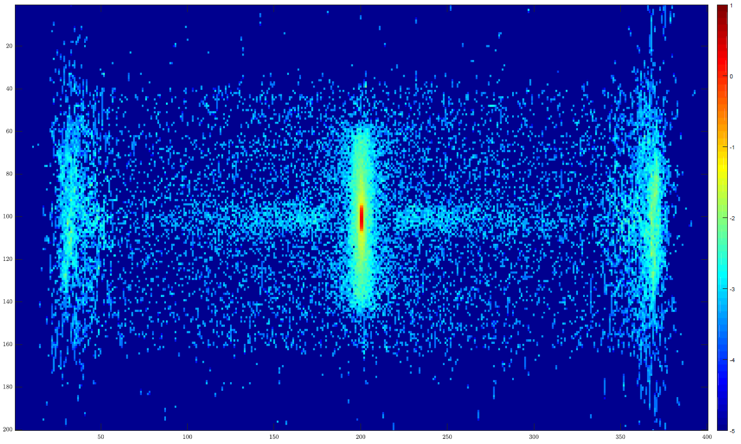
FLUKA simulations
simulated signal at the detector plane
Positrons
Electrons
Photons
6 cm
1.2 m
1.2 m
1.2 m
Combined view
Current S/N ~ 10
Gianluca Sarri

