Slide 1

LUXE experiment at the Eu-XFEL
Monte-Carlo simulations
Gianluca Sarri and Guillermo Marrero Samarin
School of Mathematics and Physics, Queen’s University Belfast, UK
g.sarri@qub.ac.uk

Slide 2
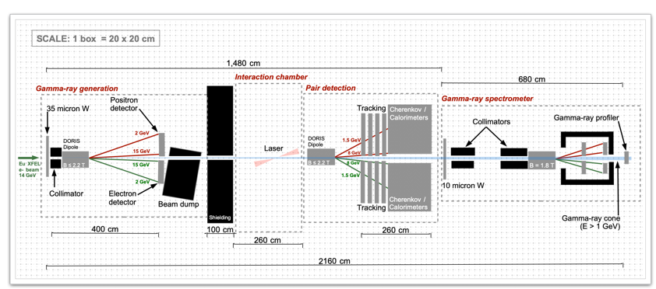
Setup
Gianluca Sarri

Slide 3
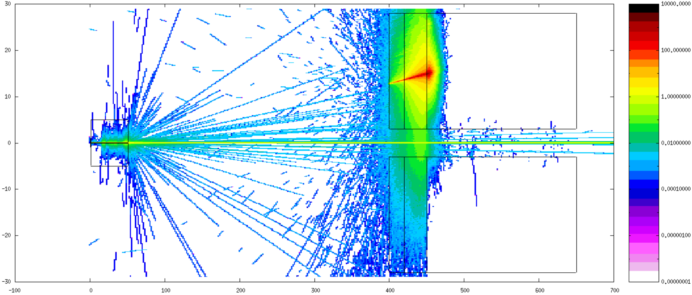
Beam dump simulations
In this first simulation, we assess the effectiveness of the beam dump to “kill” the primary
electron beam.
Below, the simulated top-view of the photon distribution with the main elements of the
geometry highlighted.
plastic
20 cm
35 micron W
aluminium
30 cm
lead
150 cm
50 cm long Pb
collimator
(1mm hole)
spatial scales in cm
Gianluca Sarri

Slide 4
Beam dump simulations
PHOTON TOP-VIEW
plastic
35 micron W
aluminium
lead
50 cm long Pb
collimator
spatial scales in cm
Gianluca Sarri

Slide 5
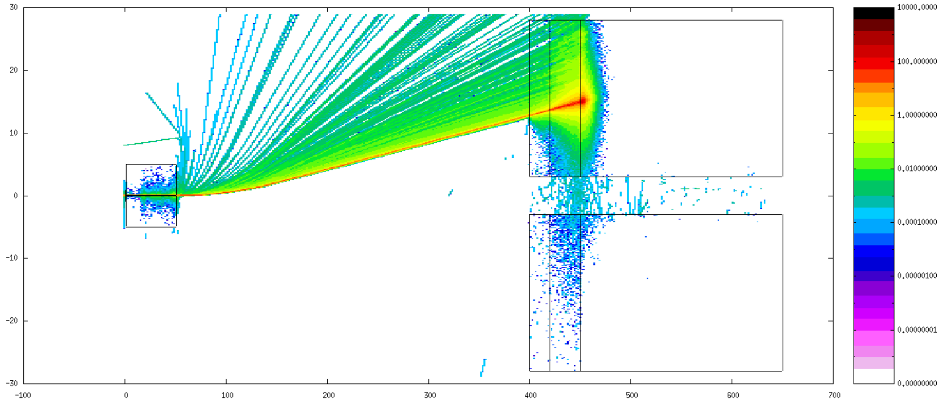
Beam dump simulations
ELECTRON TOP-VIEW
B-field region
spatial scales in cm
Gianluca Sarri

Slide 6
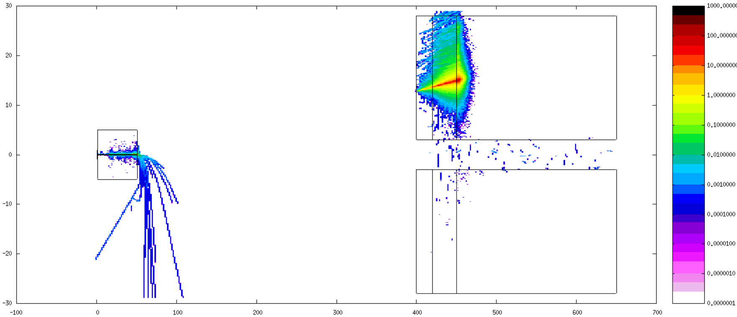
Beam dump simulations
POSITRON TOP-VIEW
B-field region
spatial scales in cm
Gianluca Sarri

Slide 7
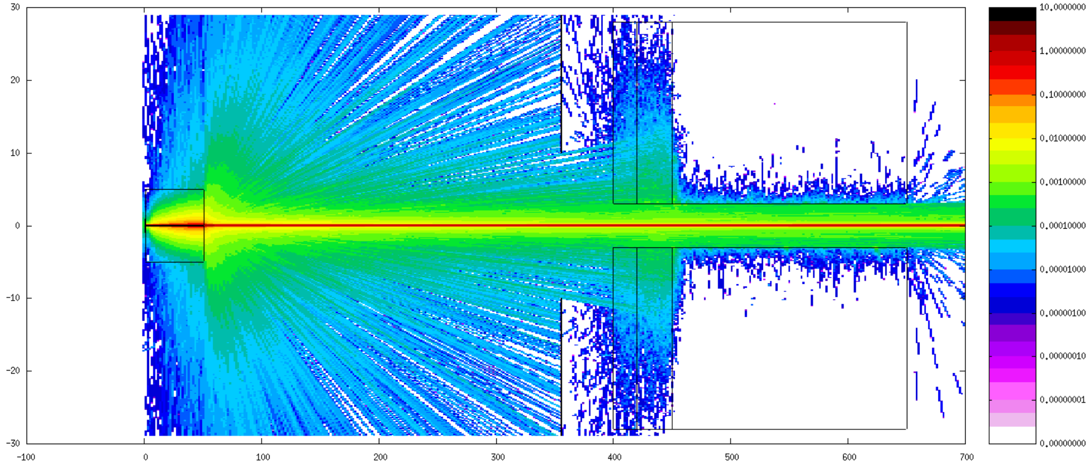
Full simulation
Given that the beam-dump kills the electron beam efficiently, we replace it with a total absorber
(black-hole in FLUKA) to save computation time
PHOTON TOP-VIEW
spatial scales in cm
Ideal Absorbers (Blackhole)
Gianluca Sarri

Slide 8
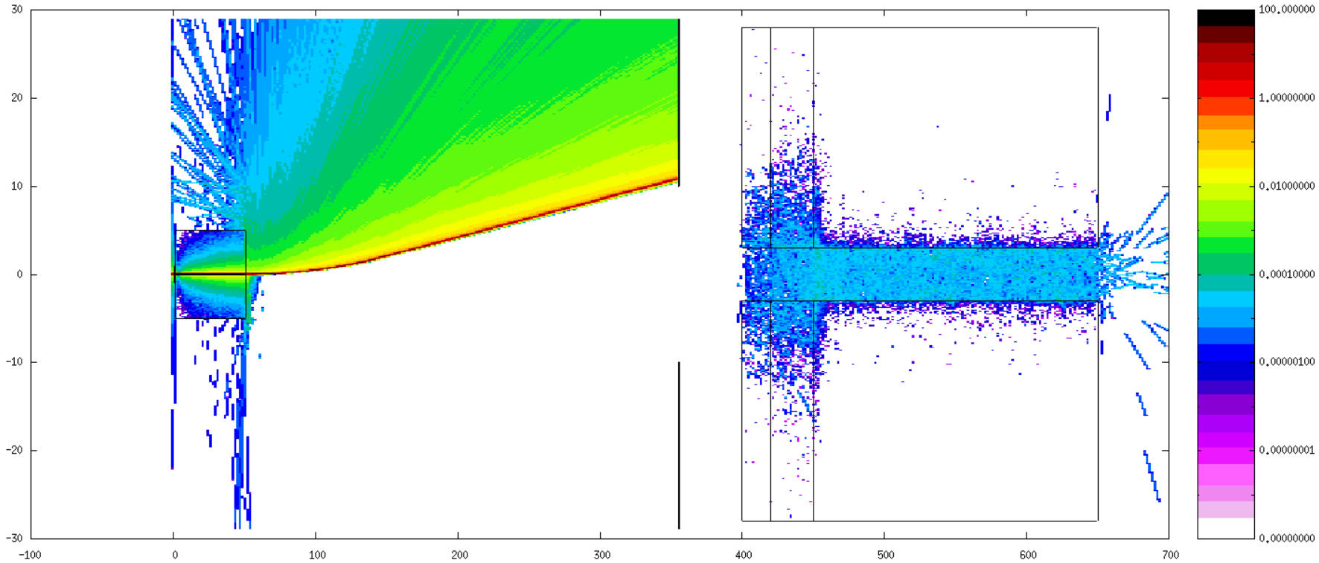
Full simulation
Given that the beam-dump kills the electron beam efficiently, we replace it with a total absorber
(black-hole in FLUKA) to save computation time
ELECTRON TOP-VIEW
Source of noise from gammas in the region of
10⁻⁵ x primary
B-field region
It can be avoided by
using a double-collimator after the W target, instead of a single one
Ideal Absorbers, Blackhole
spatial scales in cm
Gianluca Sarri

Slide 9
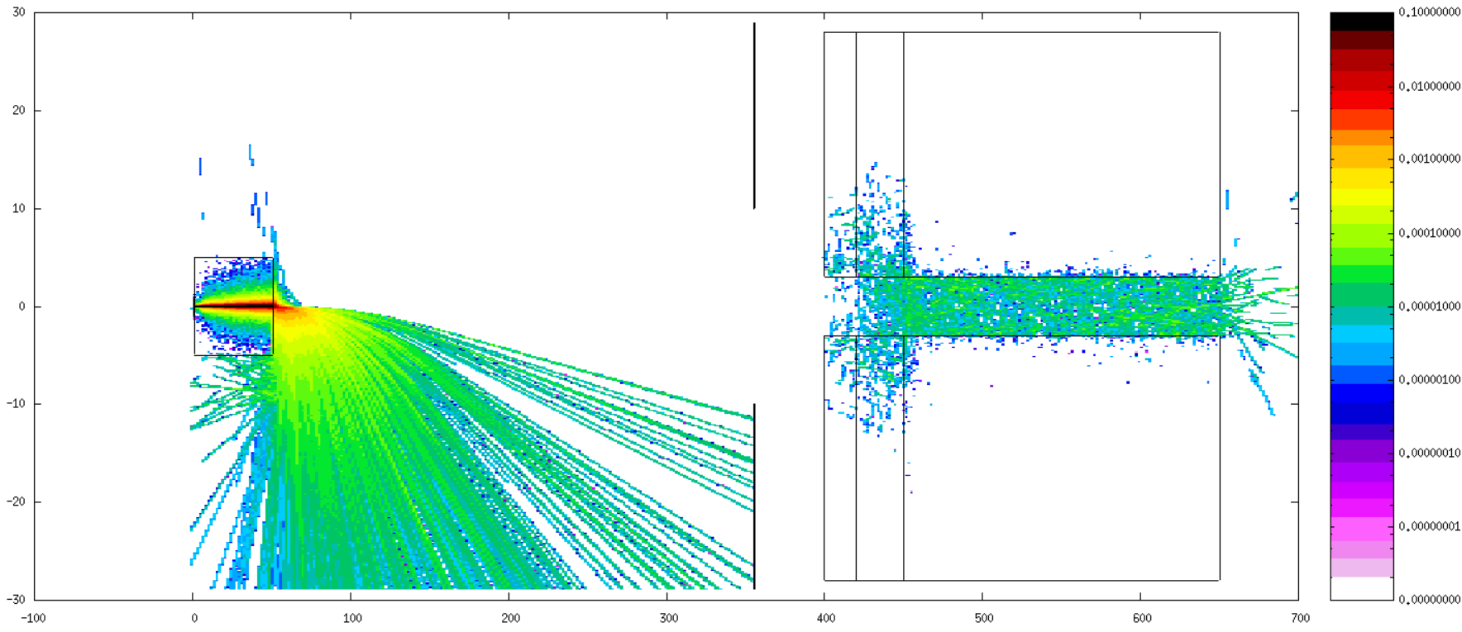
Full simulation
Given that the beam-dump kills the electron beam efficiently, we replace it with a total absorber
(black-hole in FLUKA) to save computation time
POSITRON TOP-VIEW
Source of noise from gammas in the region of
10⁻⁵ x primary
B-field region
It can be avoided by
using a double-collimator after the W target, instead of a single one
Ideal Absorbers, Blackhole
spatial scales in cm
Gianluca Sarri

Slide 10
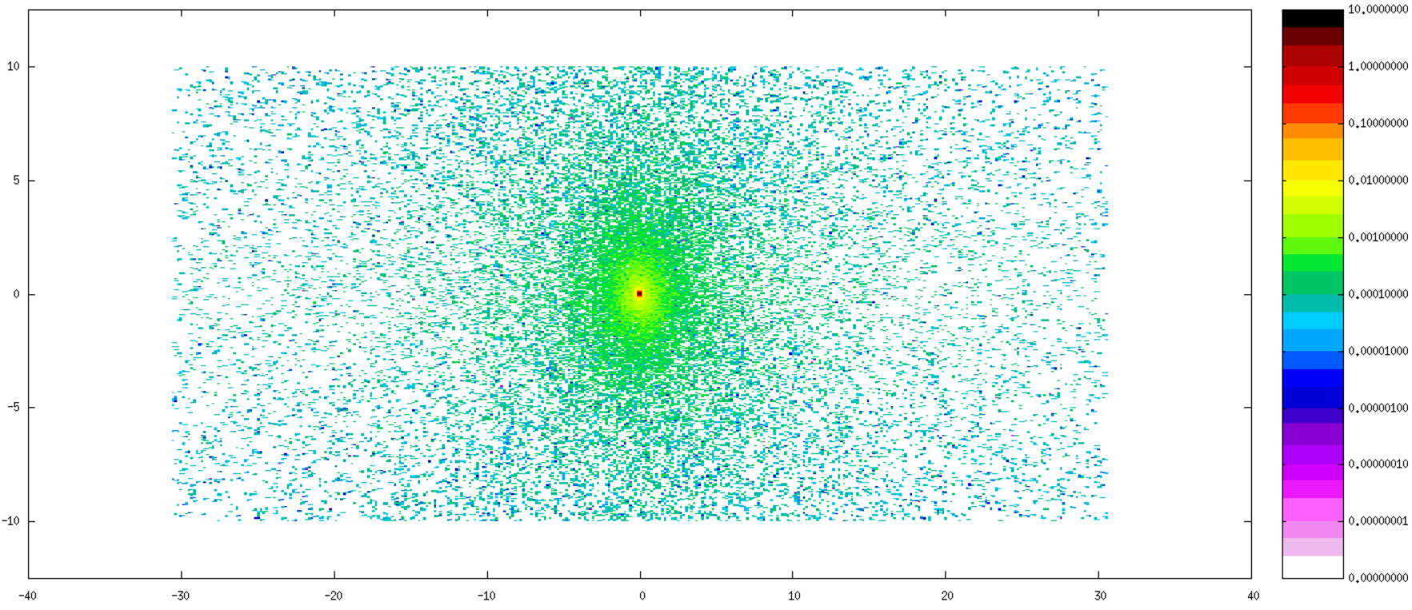
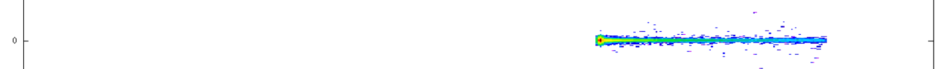
Particle distribution at the beam-dump
main gamma-ray beam
Electrons that can be
measured as a “control” diagnostic
TRANSVERSE (X-Y) VIEW
low positron signal
(masked by the photon noise)
Gianluca Sarri

Slide 11
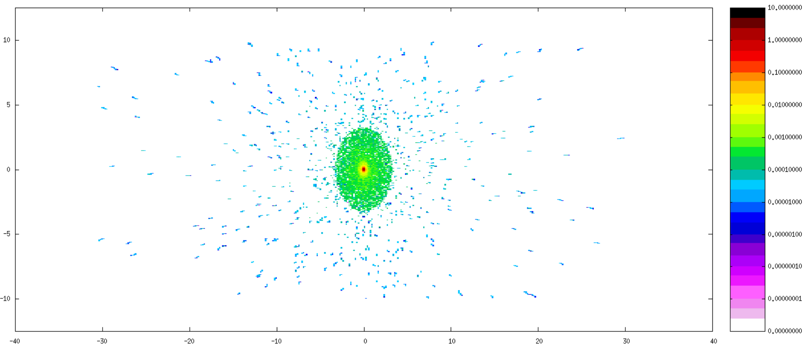
Particle distribution at the detection point
Here we show the particles arriving at the detector
plane with the laser off (noise)
PHOTON DISTRIBUTION
TRANSVERSE (X-Y) VIEW
main gamma-ray beam
(feeding into the pair spectrometer)
Gianluca Sarri

Slide 12
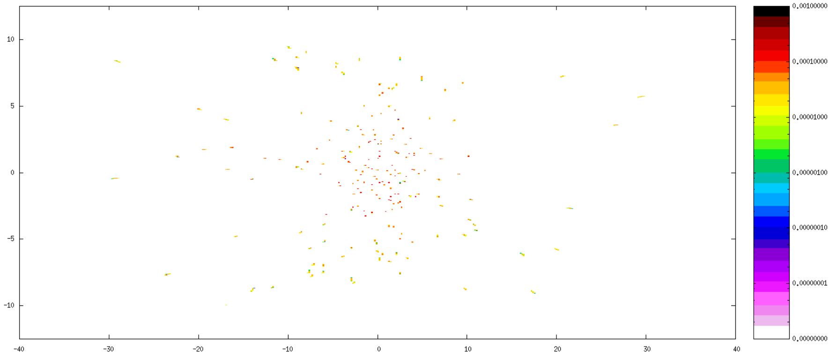
Particle distribution at the detection point
Here we show the particles arriving at the detector
plane with the laser off (noise)
ELECTRON DISTRIBUTION
TRANSVERSE (X-Y) VIEW
noise on the order of 10⁻⁴. Could be avoided by using a double collimator
Gianluca Sarri

Slide 13
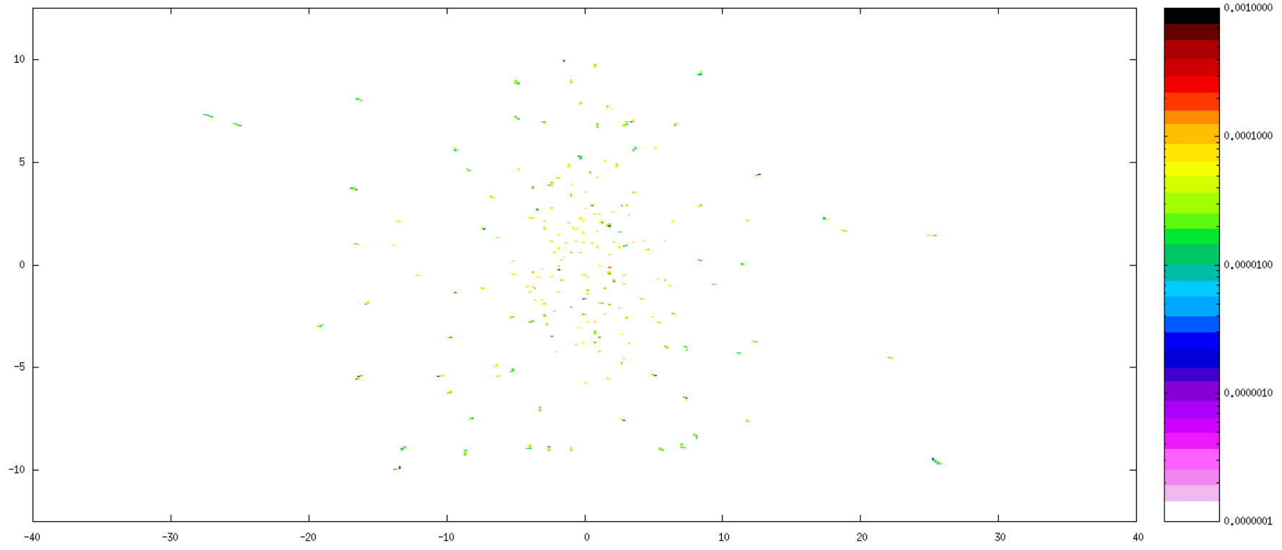
Particle distribution at the detection point
Here we show the particles arriving at the detector
plane with the laser off (noise)
POSITRON DISTRIBUTION
TRANSVERSE (X-Y) VIEW
noise on the order of 10⁻⁴. Could be avoided by using a double collimator
Gianluca Sarri

Slide 14
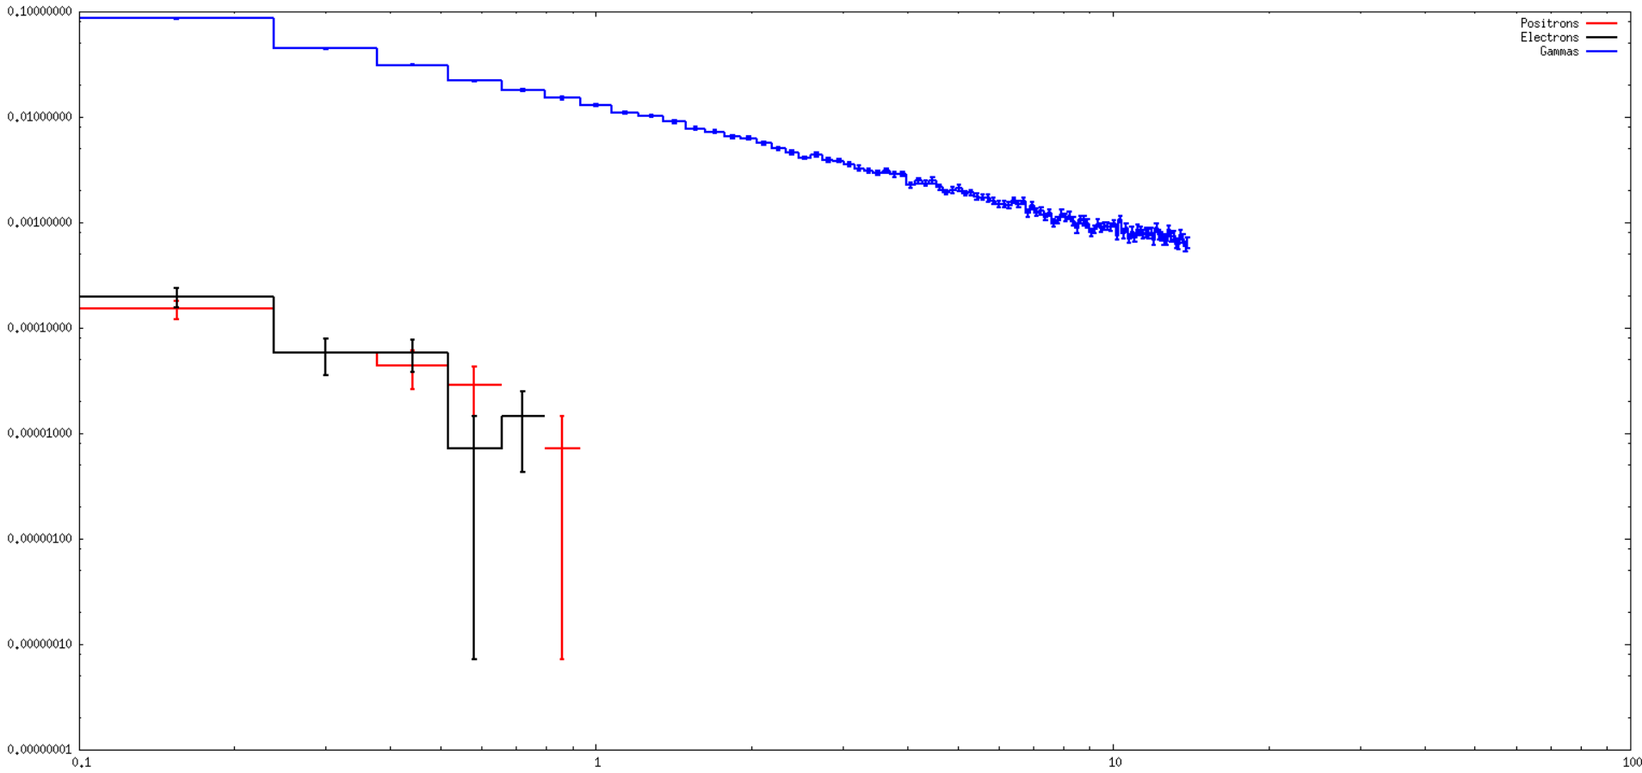
Spectrum of the particles arriving at the detector
Spectrum of the gamma-rays entering the pair spectrometer
Electron and positron “noise particles” have energies in the GeV range so it should be easy to distinguish them from the “signal particles” from the interaction of the gammas with the laser
energy (GeV)
Gianluca Sarri

Slide 15
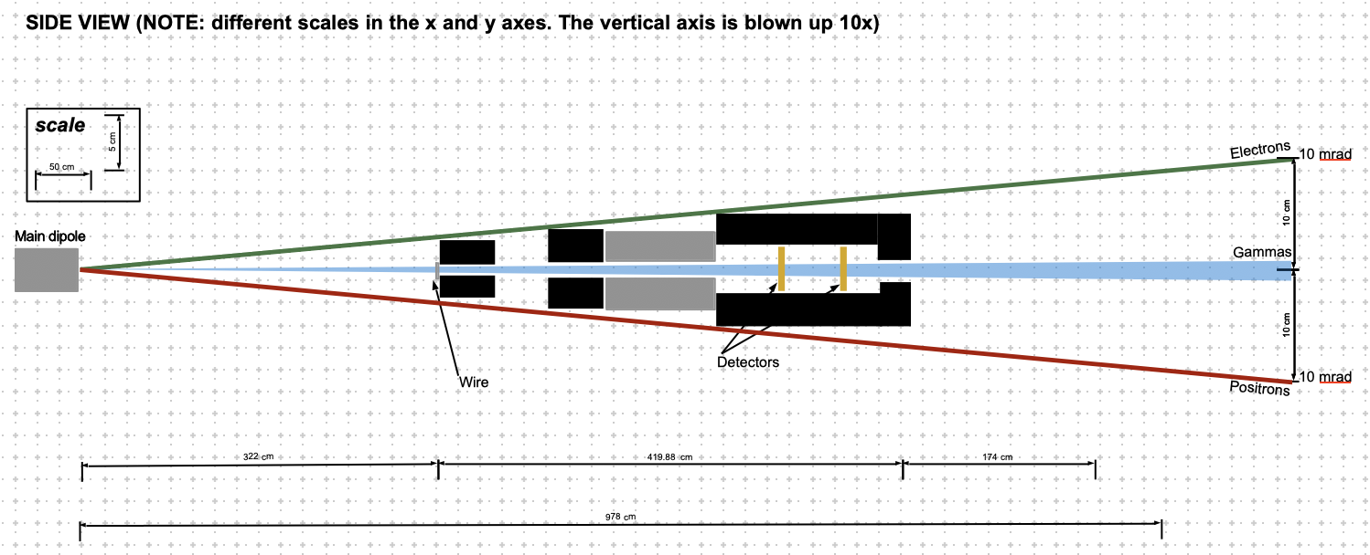
Pair spectrometer design
Main dipole separating electrons and positrons arising from the interaction point from the gamma rays
current setup includes a 1.8T, 1 m dipole magnet, but can be changed if more space is available
lead shielding depicted and simulated using FLUKA
The current setup assumes a 10 mrad kick from the main dipole at 10 GeV
Gianluca Sarri

Slide 16
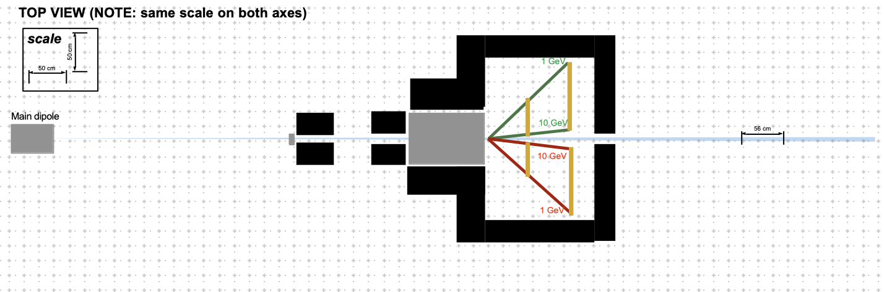
Pair spectrometer design
Main dipole separating electrons and positrons arising from the interaction point from the gamma rays
current setup includes a 1.8T, 1 m dipole magnet, but can be changed if more space is available
lead shielding depicted and simulated using FLUKA
The current setup assumes a 10 mrad kick from the main dipole at 10 GeV
Gianluca Sarri

Slide 17
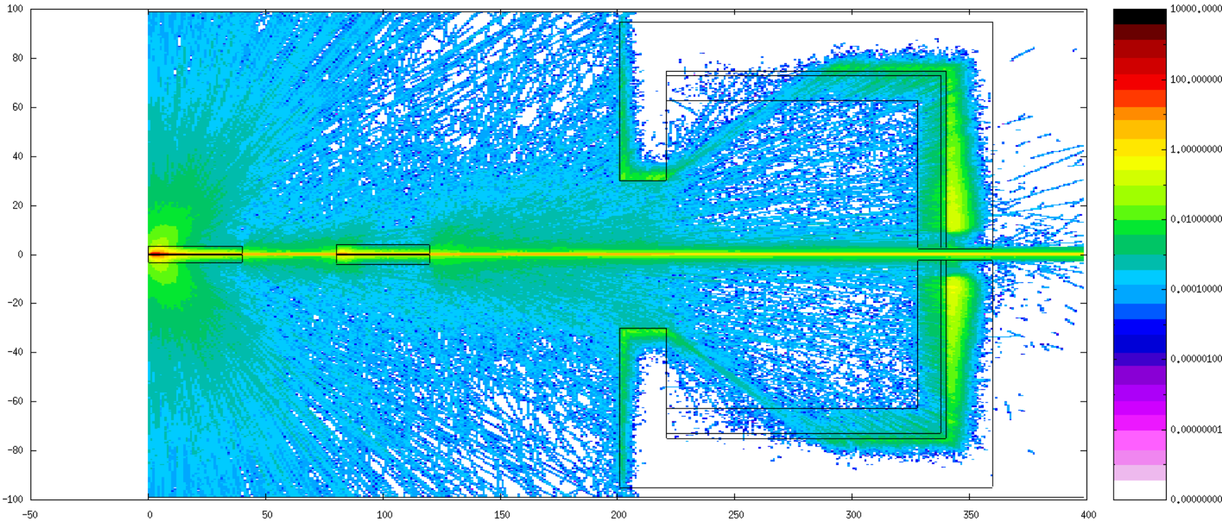
FLUKA simulations
TOP VIEW: photons
Gianluca Sarri

Slide 18
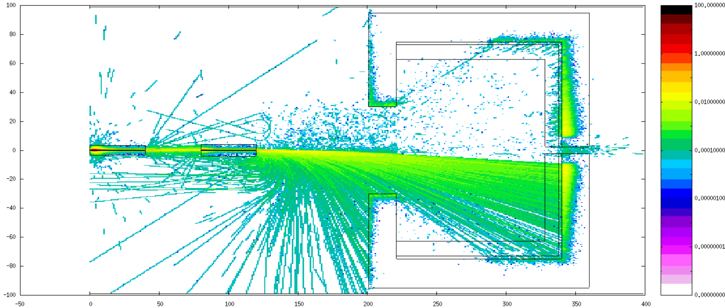
FLUKA simulations
TOP VIEW: positrons
Gianluca Sarri

Slide 19
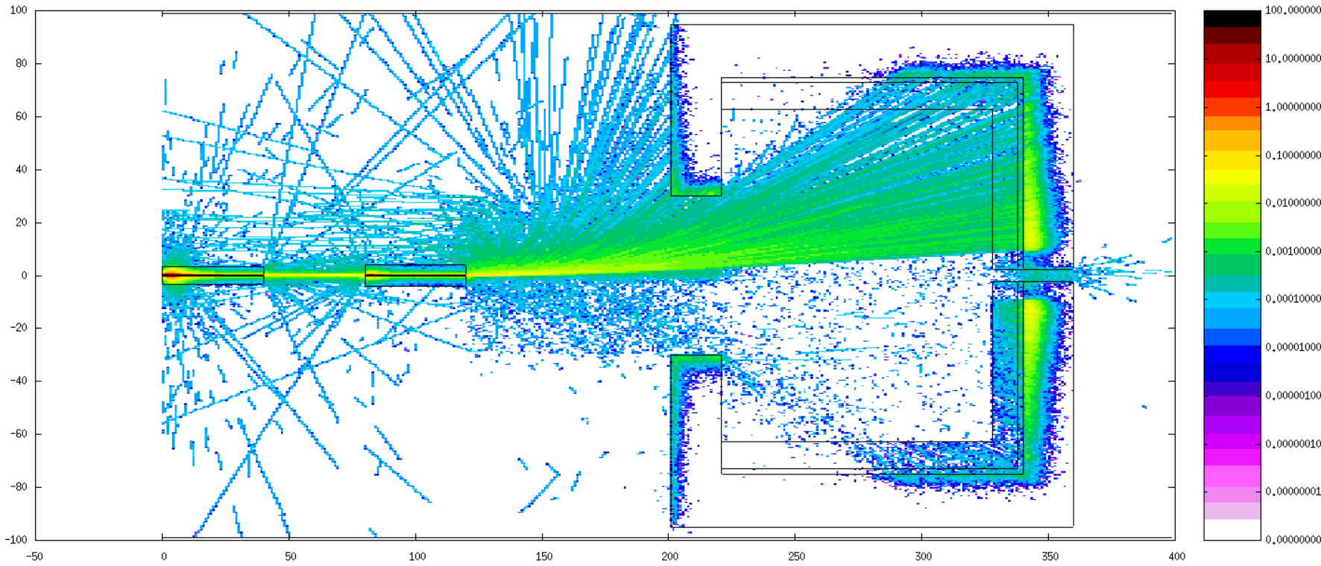
FLUKA simulations
TOP VIEW: electrons
Gianluca Sarri

Slide 20
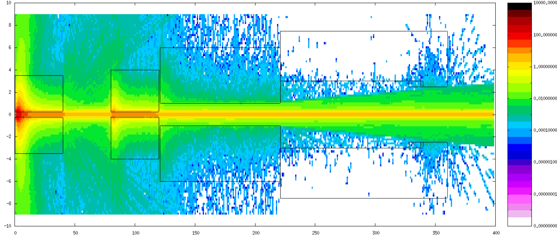
FLUKA simulations
SIDE VIEW: photons
Gianluca Sarri

Slide 21
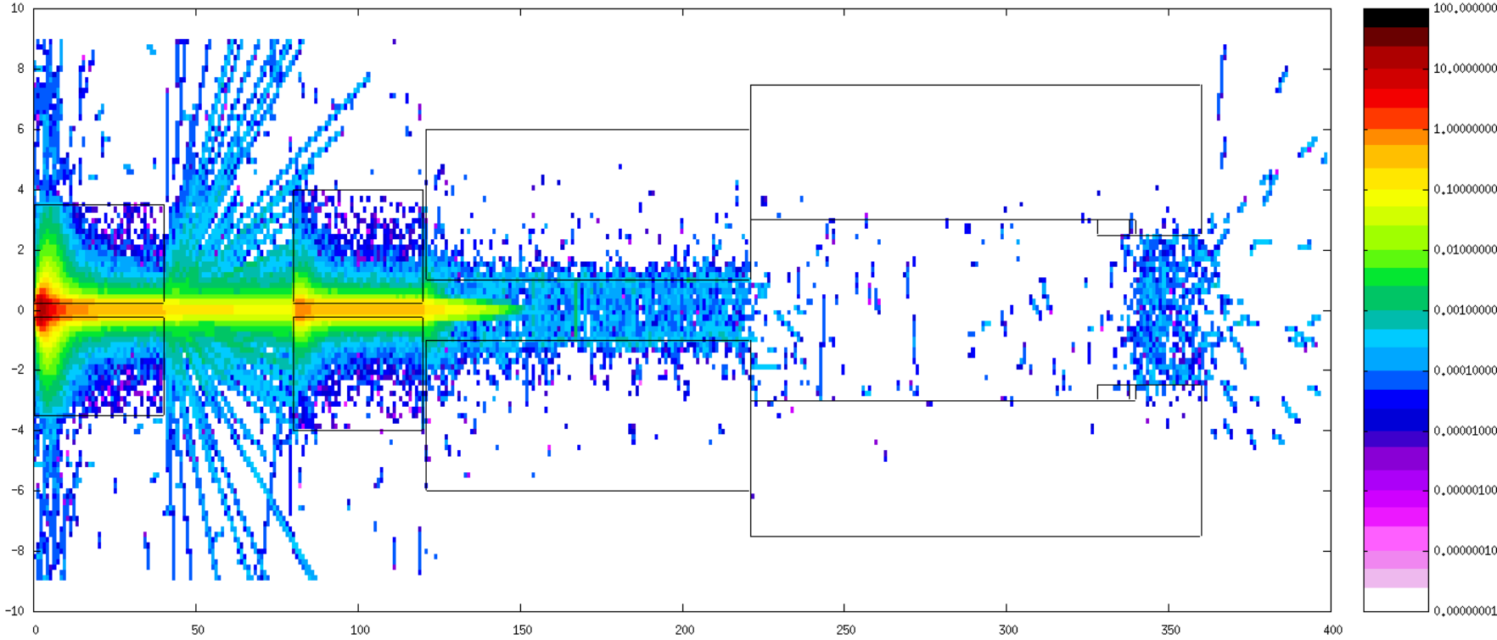
FLUKA simulations
SIDE VIEW: positrons
Gianluca Sarri

Slide 22
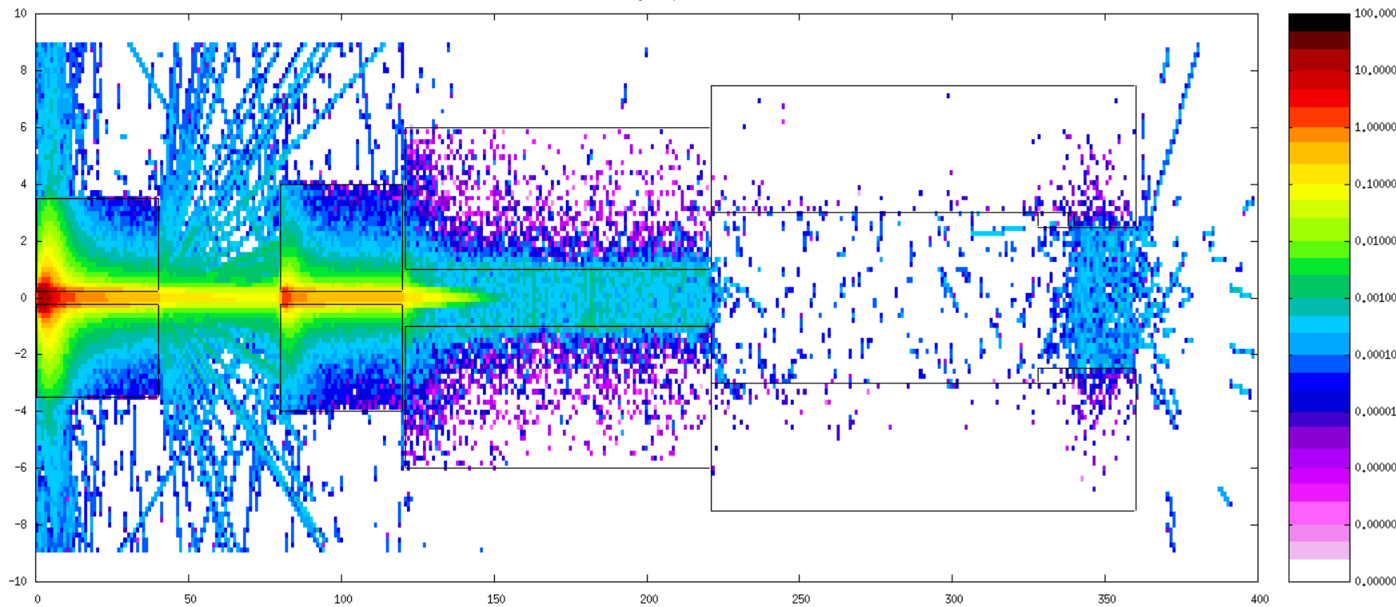
FLUKA simulations
SIDE VIEW: electrons
Gianluca Sarri

Slide 23
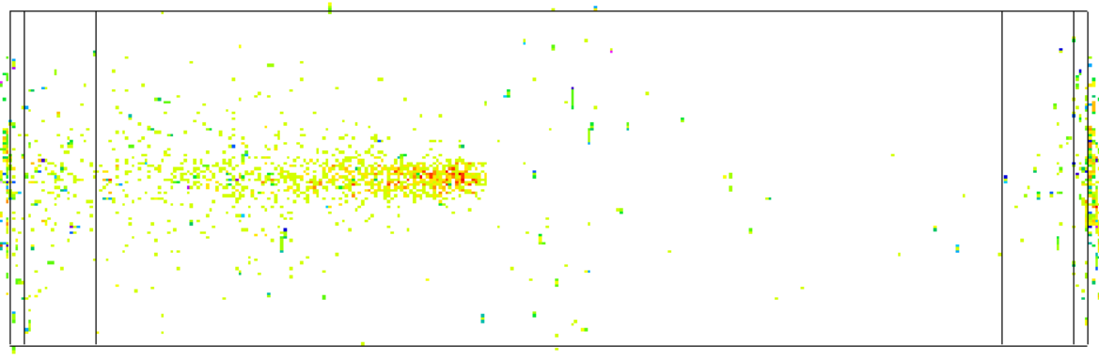
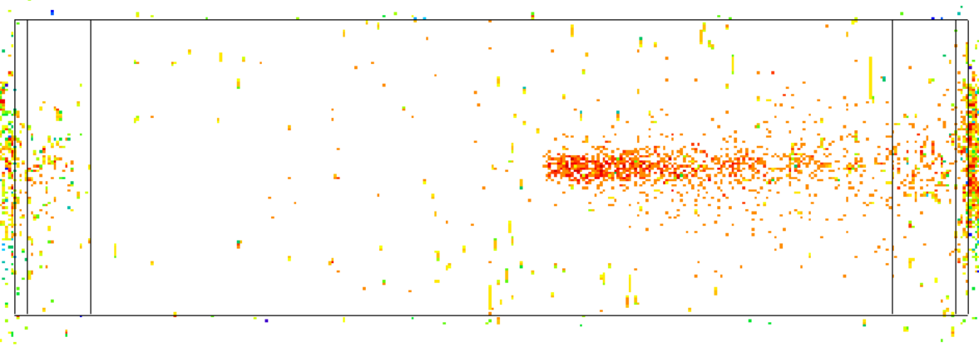
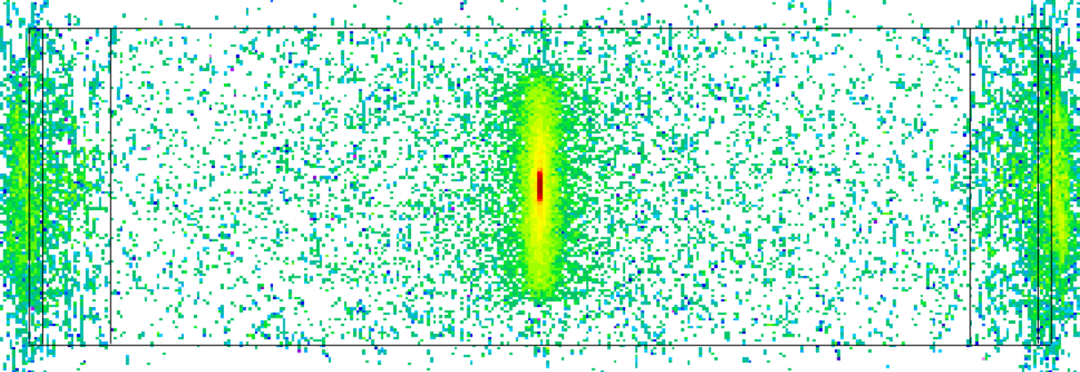
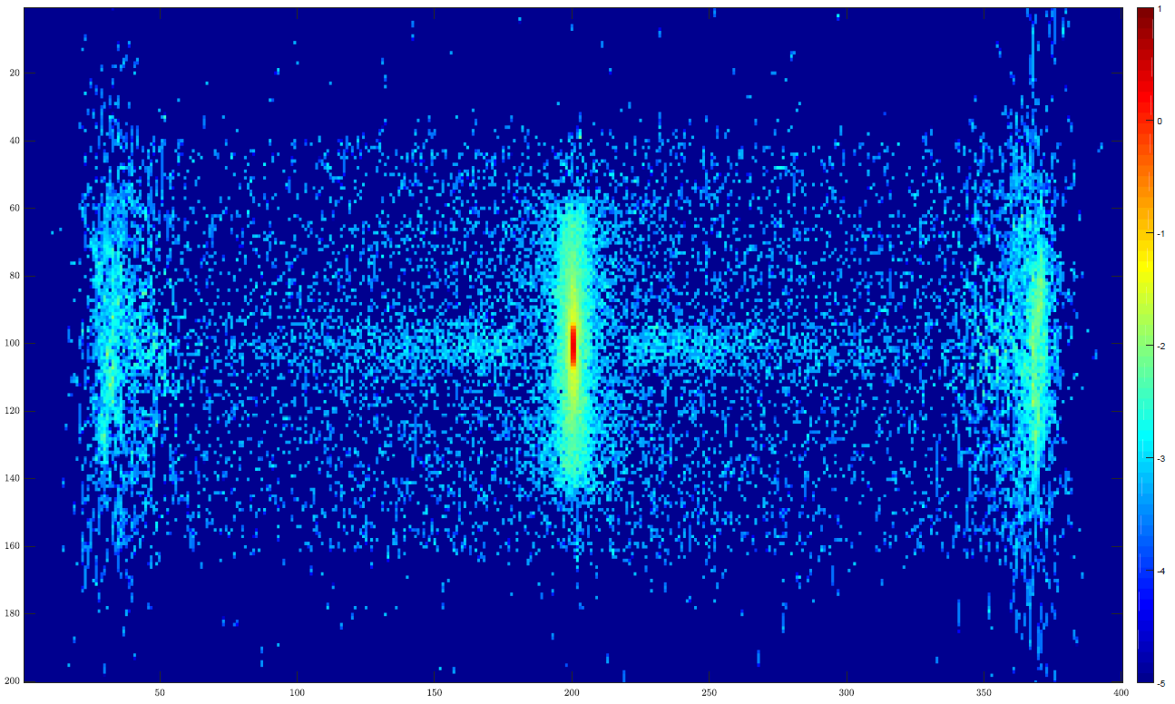
FLUKA simulations
simulated signal at the detector (X-Y) plane
Positrons
Electrons
Photons
6 cm
1.2 m
1.2 m
1.2 m
Combined view
Current S/N ~ 10
Gianluca Sarri

