Slide 1
Report from activities in the Stability Break-Out
Presenting material provided Peter, Jost, Sebastian, Marie, Christo, Julien

Slide 2
Final topic list

Slide 3
Our three topics
Pointing stability
Temporal stability
Longitudinal profile control
See slides from Peter
See slides from MSK/LbSync

Slide 4
Organizational
Set up steering group on stability issues
  people from photon diag. and/or experiment side
    Theo (XPD), Peter (FXE), Ulrike (MID), Laurent (SCS), Dennis (CAS), Wajid (CAS), Denys (CAS)
  timing
    Christo, Jost, Björn, Julien, Holger
  transversal plane
    Raimund, Winni (chair)
  laser
    Lutz, Max should name someone
Pending

Slide 5
General tasks
Pending
Work out stability measures, implement and display them -> HLC
Define common nomenclature for these (intra train, inter train, jitter vs drifts, …)

Slide 6
Pointing stability
Development: Database in Karabo for photon beam positions (next slide)
Development: Visualization tools
  Karabo: Scatter plot from imagers, XGM, IPM (next slide)
  DOOCS: Monitor x, x’ for every undulator -> HLC (usable for every BPM)
  DOOCS: Visualize photon beam position data
Experiment: Investigations on mirror vibrations with beam -> FXE, MKK
Experiment: Confirm synchronization of DOOCS and Karabo acquisition using PoD
Analysis: Evaluate correlation of e-beam and p-beam jitter (pulse resolved)
?
Done
Pending
Pending
Done see slides from Peter
Done
Pending

Slide 7
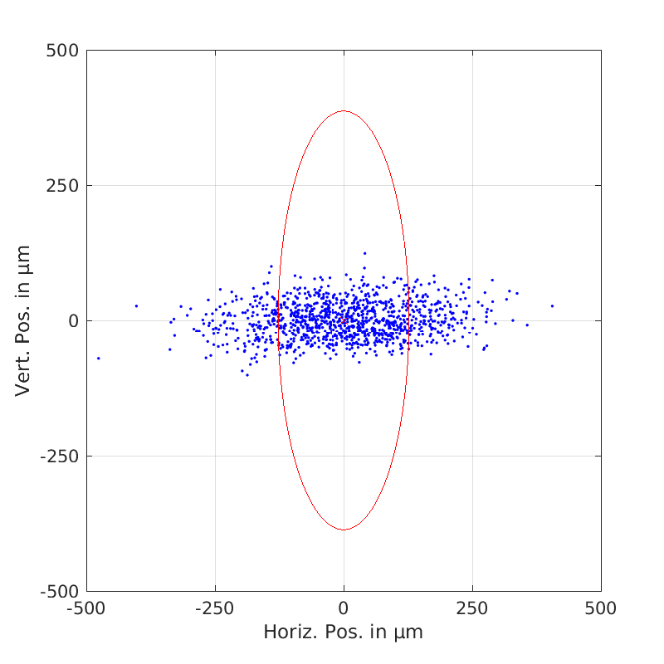
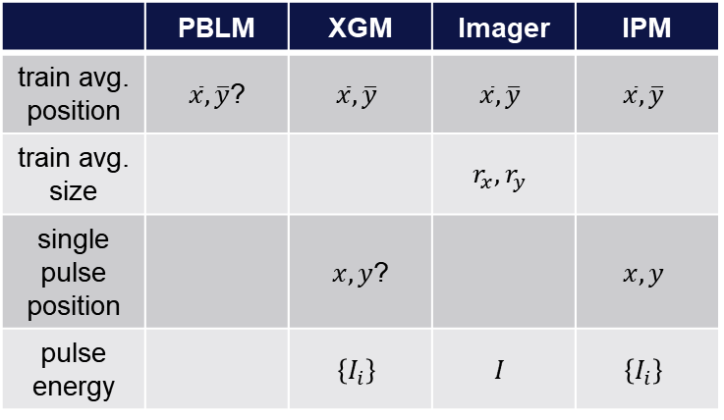
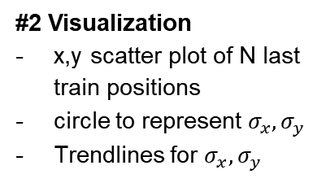
#1 Database
To be implemented by CAS to continuously collect data from various sources
Devices to include:
  SCS XGM
  XTD10 XGM
  SQS XGMD (?)
  SPB XGM
  FXE PopIn Imager
  FXE IPM
  XTD2 XGM
  XTD1 XGM
  HED XGM
  MID PopIn Imager
  SA1, 2, 3 MIRROR pitch&roll +bender
  Train Ids
  Bunch Pattern
Data to be stored in database
 | PBLM | XGM | Imager | IPM
train avg. position | $\overline{x},\overline{y}$? | $$\overline{x},\overline{y}$$ | $$\overline{x},\overline{y}$$ | $$\overline{x},\overline{y}$$
train avg. size |  |  | $$r_{x},r_{y}$$
single pulse position |  | $x,y$? |  | $$x,y$$
pulse energy |  | $$\left\{I_{i}\right\}$$ | $$I$$ | $$\left\{I_{i}\right\}$$
#2 Visualization
x,y scatter plot of N last train positions
circle to represent $σ_{x},σ_{y}$
Trendlines for $σ_{x},σ_{y}$
#3 Exchange of data
Karabo -> DOOCS
Optional: DOOCS -> Karabo (BPM)

Slide 8
Temporal stability
See slides from MSK
Temporal stability is already excellent!
Todo: Injector laser arrival time slow FB will be set up soon -> Jost, Raimund
Todo: Get gun DCM into operation (1-2 month) -> Julien
Development: Set up intra train longitudinal ITFB and prove it’s impact -> Björn
  Improve BAM performance to be ready for long. FB’ing
  Bring up BAM energy readings to displays (to compare resolution to BPMs)
Development: Consistency checks between beam based and in-loop systems measurements -> Holger, Igor or Martin
Development: Work out concept for further XTL temperature stabilization -> Winni, Eckhold
Experiment: Do cross-correlation between Timing Tool and BAM data -> FXE, SPB will nominate responsible people
Pending
see slide by Julien
See slides from MSK
?
Ongoing
Pending but done for IPM to XGM

Slide 9
Longitudinal profile control
We don’t really know the shape of the longitudinal profile
  BCMs only provide incomplete representation of current profile
  Idea: save TDS pictures for e.g. good lasing conditions
Develop control room software to reestablish long. profile (model independent, model based) -> Igor, Martin
  Bring BC2 TDS into online operation (to measure long. profile) -> Bolko
  Do complete beam dynamics simulations (include gun and laser) -> Tomin
  Work on BCM vs peak current calibrations for smooth profiles (gaussian) -> Christo
  Goal: Setup philosophy for initial lasing
Get THz diffraction spectrometer online in DOOCS (and initial analysis) -> Nils Lockmann, Hensler
Get PLL39 running to fix A1-AH1 ratio (for later FB’ing) -> MSK
Estimate impact of laser profile shape changes (does 1% change matter?) -> Igor
  FS-LA should provide laser shape profile monitoring -> Lutz
Set up server to calculate phase changes due to upstream arrival time changes -> HLC
We need to get improved on-crest phase measurement and tracking -> MSK
  Online transient based measurement for L3 and determine accuracy for L1, L2
  Existing on-crest phase scan tool to be speed up and improve precision!
  Prove of principal for HOM based phase measurements
Pending
Ongoing
see next slide
Streak cam. commissioned
Pending
Pending

Slide 10
Report from Julien
commissioning of gun Drift Compensation Module [Julien]
  firmware was installed, server is running, but not tested yet
commissioning of AH1 Drift Compensation Module [Julien]
  commissioning started, but not finished because some hardware modifications were necessary (planned for this shutdown)
investigate impact of DCM and REFM-OPT on BAM jitter
  first results obtained during the blue week before shutdown
  to be continued at next study week

Slide 11
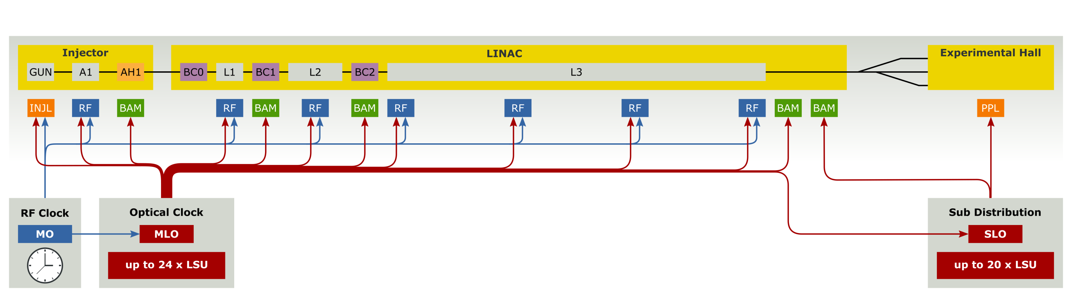
First evaluation of optical synchronization system
414m
1932m
Correlate arrival times
Chain: MLO → Distr → Link → BAM < 0.8 fs rms
(for short time scales)
Preliminary
results
Instrument noise
Residual jitter
~ 1.1fs rms
(1min ….5kHz)
1.1fs
4.2 fs
Preliminary
results
Preliminary
results
12.8 fs
12fs

Slide 12
First evaluation of optical synchronization system
414m
1932m
Correlate arrival times
Chain: MLO → SLO → Link → BAM < 1.5 fs rms
(for short time scales)
Preliminary
results
Instrument noise
Residual jitter
~ 2.1fs rms
(1min ….5kHz)
2.1fs
6.0 fs
Preliminary
results
Preliminary
results
12.2 fs
12fs

Slide 13
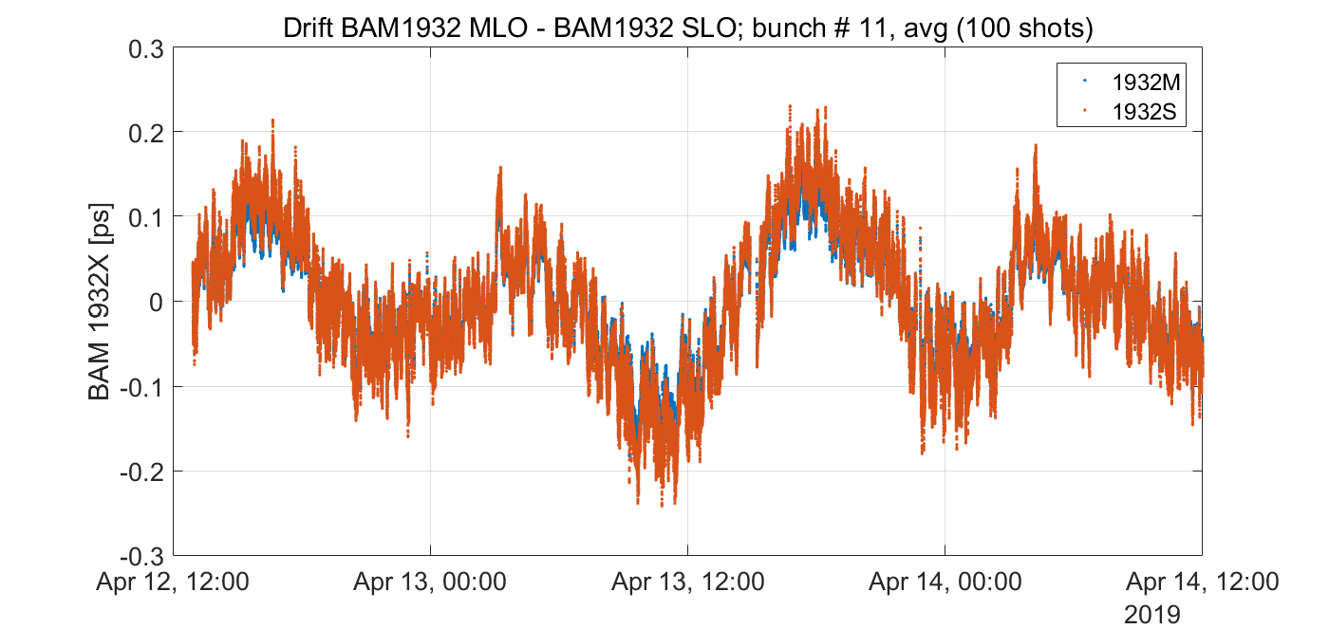
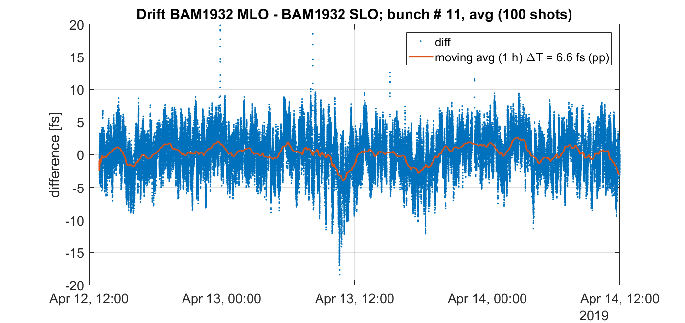
First evaluation of optical synchronization system
414m
1932m
Correlate arrival times
Chain: MLO → SLO → Link → BAM < 20 fs pkpk
(long time scales)
No arrival time feedback!!!
< 20 fs pkpk
~450 fs
pkpk
2 days
2 days
BAM non-linearity

Slide 14
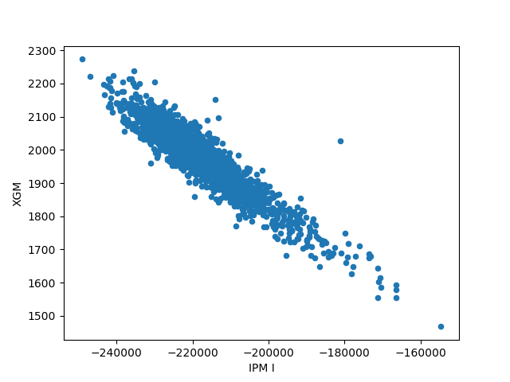
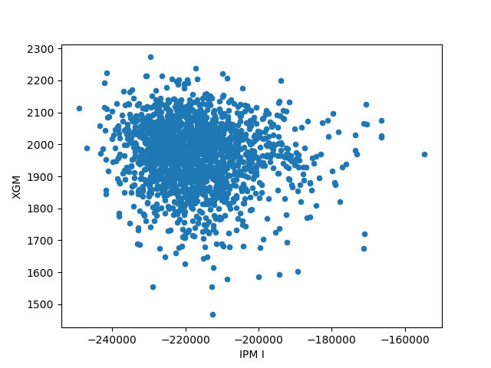
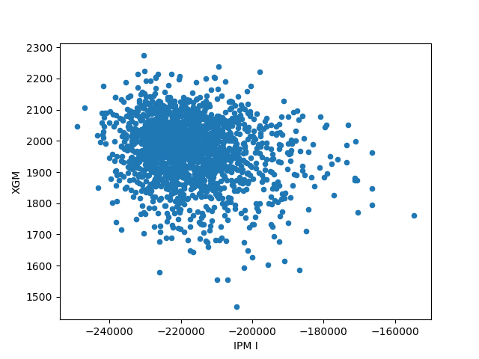
Correlation IPM intensity vs. XGM electron signal (1. bunch – 3m in time range)
Even ID(IPM) = Event ID(XGM) - 1
Even ID(IPM) = Event ID(XGM) + 1
correl. coeff. -0.93
correl. coeff. -0.11
correl. coeff. -0.18
Even ID(IPM) = Event ID(XGM)

