Slide 1
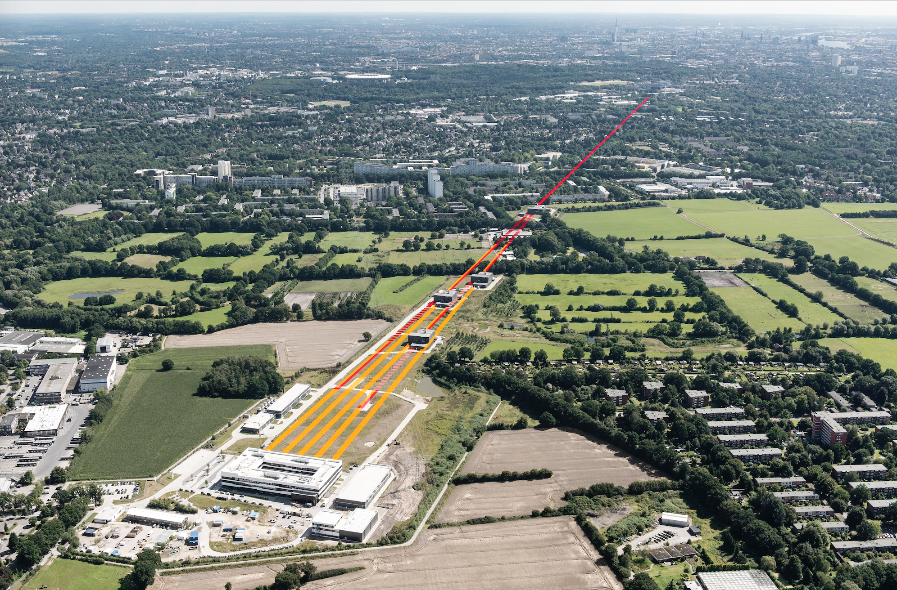
Review of Joint Operations Workshop
Travemünde (January 9 -10, 2019)
June 26 2019

Slide 2

Themes for workshop Travemünde, January 9-10, 2019
Stability
“Improve the capabilites that we have today”
Parallel Operation, EPS, MPS
Development
“Do the urgent things that we should have done yesterday”
“Develop new capabilites that we would like to have tomorrow”

Slide 3
Working Group
Parallel Operations
Status and Updates - XFEL Joint Operations Workshop in Travemünde 2019
Tim Wilksen & Harald Sinn on behalf of the Working Group
Schenefeld, 26.06.2019

Slide 4
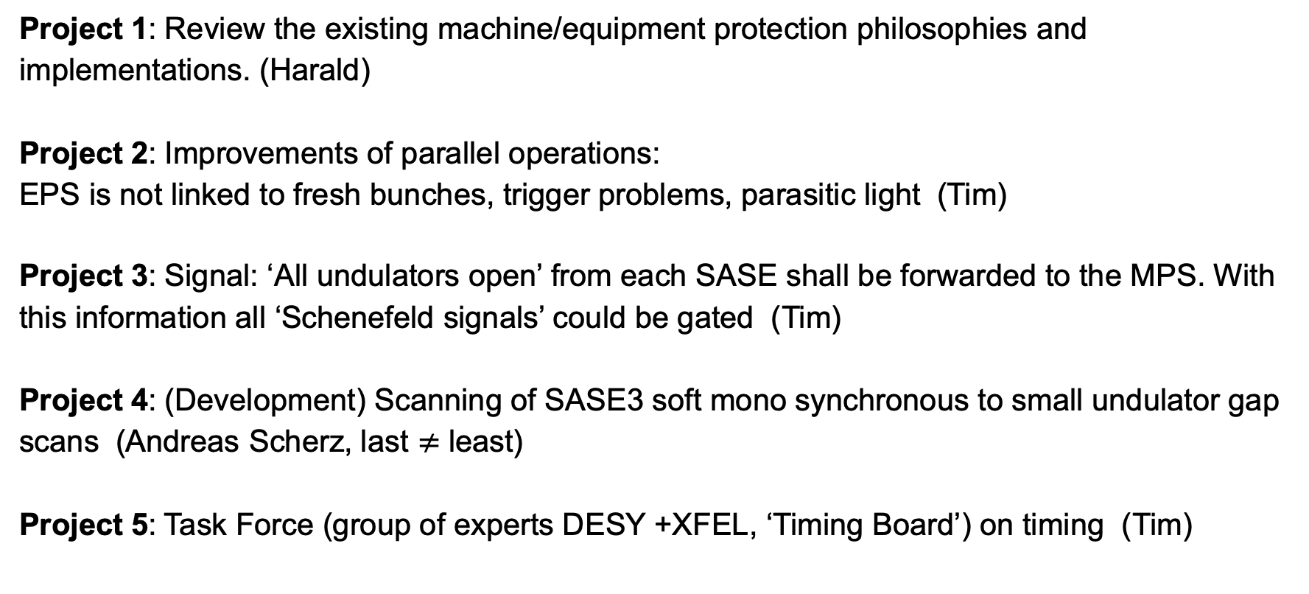
Overview
Project 1: Review the existing machine/equipment protection philosophies and implementations. (Harald)
Project 2: Improvements of parallel operations:
EPS is not linked to fresh bunches, trigger problems, parasitic light (Tim)
Project 3: Signal: ‘All undulators open’ from each SASE shall be forwarded to the MPS. With this information all ‘Schenefeld signals’ could be gated (Tim)
Project 4: (Development) Scanning of SASE3 soft mono synchronous to small undulator gap scans (Andreas Scherz, last $≠$ least)
Project 5: Task Force (group of experts DESY +XFEL, ‘Timing Board’) on timing (Tim)

Slide 5
Working group Parallel Operation, EPS&MPS: Project 1
Review the existing machine/equipment protection philosophies and implementations.
Harald, Tim, Patrick, Wolfgang Clement, Tobias Haas, D3 + SRP group, + …
Review of Layer 1-4 structures, discuss Safety Layer 1 with D3
Re-structuring of EPS Layer. On same layer as MPS or one above?
Which hardware changes/ implementations are required?
Which software adjustments are needed?
Time scale: Start early 2019, implemenation during 2019
Intermediate solutions are required earlier

Slide 6

Project 1: New safety concept / Layered safety system structure
Information ⬆ Requests ⬇
Layer 4 | Enable operation | Open high-level control system, DOOCS + Karabo | Open to larger group of operators
Layer 3 | Protect equipement | protected high-level control systems, MPS, EPS, VAC | Access control
Layer 2 | Protect equipment that protects life | protected MPS, S-EPS | Access control binary inputs
Layer 1 | Protect Life | PPS | Access control, binary inputs, SIL-2
Reviewed on
April 10 2019

Slide 7
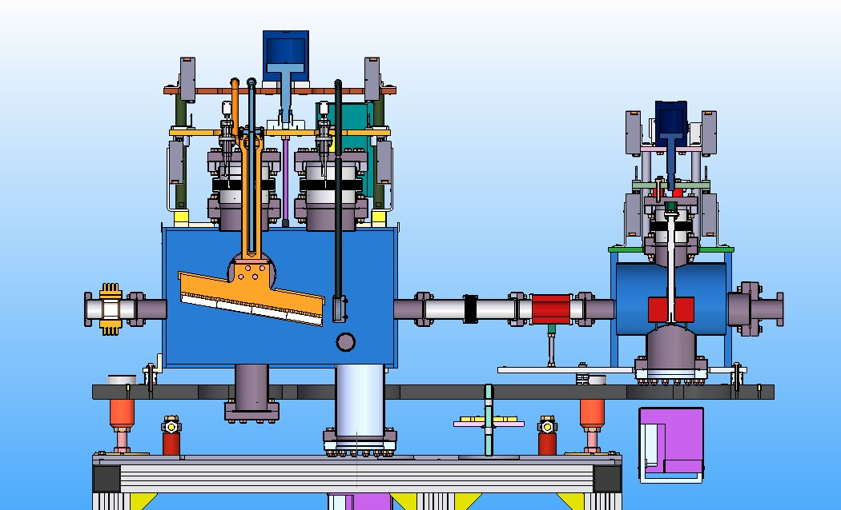
New shutter design
10 x more power!
water-cooled copper clamping mechanism
DN 100 tube for new BTM
1 or 2 diamond
plates
60 mm B4C
camera
optional W
Shutter upgrade project in WS 19/20
will solve problems in tunnels

Slide 8
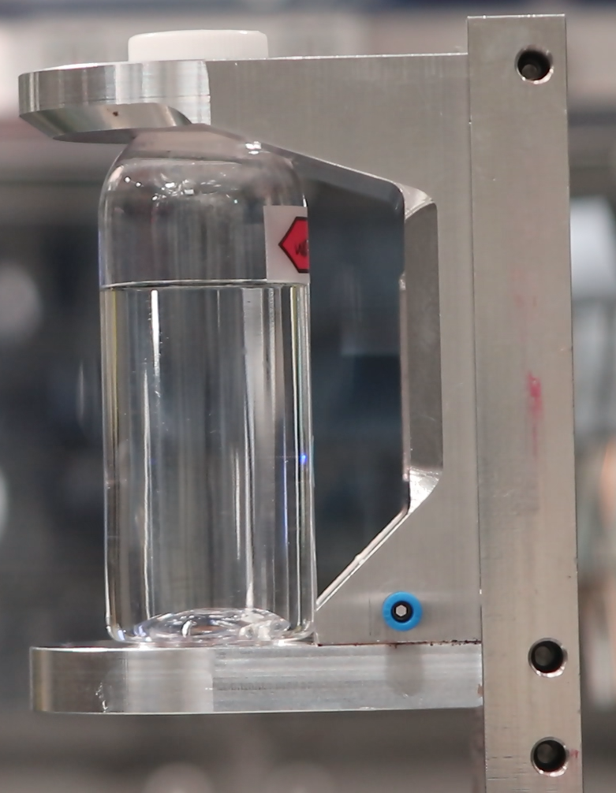
Not yet fully solved:
Final beamstop after experiment
Upgrade to SIL2 Airbox in WS19/20 (Layer 1)
‘Philosophical Problem’: Beam theoretically unstoppable
In practice feasible with 1 MHz, 5W
For 4.5 MHz, > 10W tests almost impossible at current beamlines
Additional development of a fast active beam stop via MPS (Layer 2)
H₂O
beam
Test in FXE hutch on June 13, 2019

Slide 9
Working Group Parallel Operations, EPS&MPS: Project 2
Charge:
Improvements of parallel operations for SASE1/3: EPS is not linked to fresh bunches, trigger problems, parasitic light
-> Solution is available as of January 2019 (since recently), but need to be applied and tested together
Tommaso, Andreas, Lars, Harald, Patrick, Richard, Alessandro, Tim
Requires dedicated beam time soon (e.g. one days during first orange week)
Test of pattern switching, 5 Hz, 500 kHz, ‘intermediate’ EPS via Bunch Pattern Server, using ‘trigger events’ for SASE1/3 trigger distinction (dynamic), check bunch pattern evaluation in Karabo during tests.
Time scale: Could be ready for first ‘orange’ week.

Slide 10
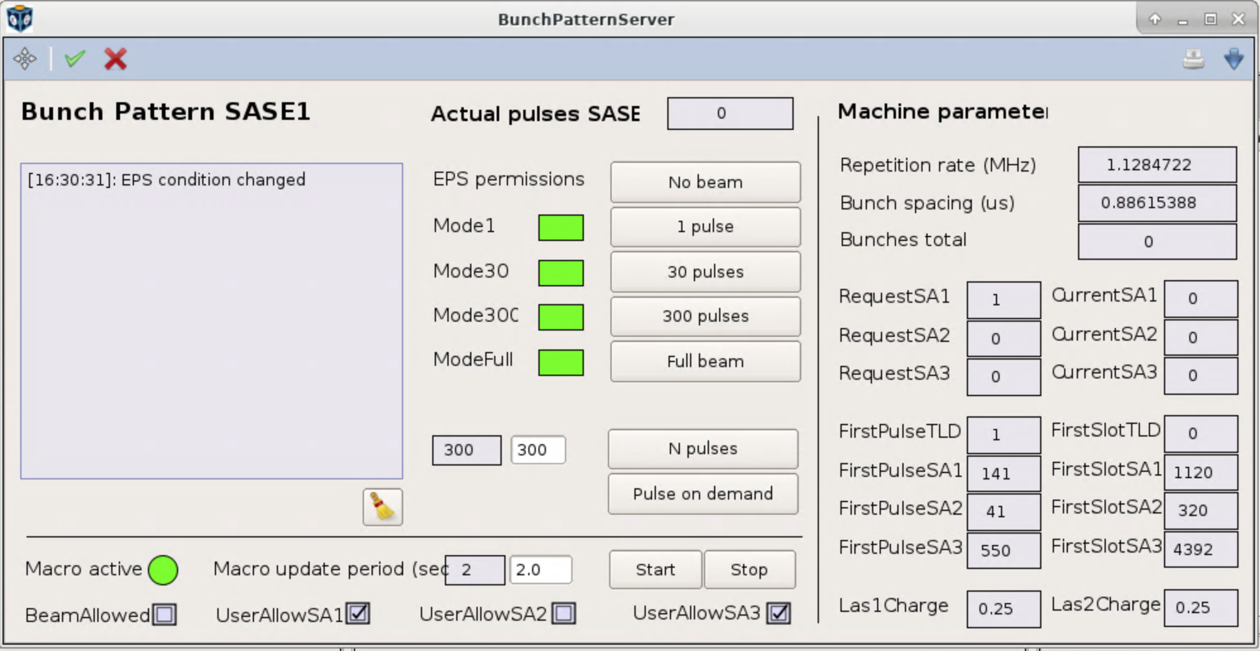
Working Group Parallel Operations, EPS&MPS: Project 2
Link EPS to fresh bunch triggers
EPS for SASE1/3 was switched from MPS mode to Bunch Pattern Server mode (currently Karabo macro) $→$EPS SASE1/3 operated decoupled during user operation 2019
Next step: direct integration into DOOCS Bunch pattern server tool

Slide 11
Working Group Parallel Operations, EPS&MPS: Project 2
5 Hz Operation Tests - Accelerator
19.02.2019:
Operation with alternating patterns for SASE1&3 - 5 Hz (1:1) and 80 % : 20 % (4:1).
Issues with charge middle layer, XGM readout, and slow orbit feedbacks SOLVED NOW
Pulse-by-pulse switching of bunch pattern works well in principle and turns out to be a viable solution for parallel operation of SA1/3 for this week's user experiment at SCS. ☺
11.04.2019:
GMD slow signal normalization is wrong, i.e. displayed pulse energy halved SOLVED NOW
Orbit server shows 0 for SA1 or SA3 bunches in the north branch -> FB does not work SOLVED NOW
T4D feedback should be re-configured with longer integration time (to be tested next time)
Bunch counting does not work SOLVED NOW
Improvements / Modifications since April:
New limits on number of SA1 and SA3 bunches available on master x2timer server
"Big Brother" server available to set these limits based on conditions like "undulator closed", "shutter closed", etc. (so far used to limit photon beam power only)
Doubts on BPM readout if time between pulses is large (due to automatic switching of attenuators); implications for orbit FB

Slide 12
Working Group Parallel Operations, EPS&MPS: Project 2
5 Hz Operation Tests – Experiments SPB/SQS(SCS)
Jan's entry https://in.xfel.eu/elog/OPERATION-2019/213 and conclusion:
  SA1 and SA3 diagnostics can cope with 5 Hz delivery to SPB-SQS with some minor issues
  SPB: ok and SQS(SCS): ok
  DAQ problems?
  Diagnostics: HIREX, MCP, XGM (except for factor 2, to be fixed) ok
  Imagers not ok -> fixed 18.04.19 via two new parameters in imager scenes: Bunch Patterns and Pattern Offset ok
Alessandro's conclusions:
  The 5 Hz trigger is effective for Diagnostic Cameras and Digitizers ok
  DAQ complies with this pattern as expected ok
  Manual work on the x2Timer boards need to be performed
  Karabo to provide a convenient way to switch between the 2 modes (test systems are available for this task at XFEL premises).
  A conditional trigger compatible with 10 Hz needs to be demonstrated for SASE1
  No large area detector has been tested
  The software filtering is currently not implemented/blocked by the image “timestamping” on Karabo side
  Joint DESY/XFEL review is welcome in the frame of the Trigger Taskforce from last Joint Workshop.
Denys message:
  Condition checked: if bit #16 is set for the bunch in bunchpatterntable for corresponding trainId, the trainId is matched ok
  As expected, trainIds are increasing by 2 for 5 Hz mode (destinations distribution was set as 1:1) and by 5 for 2 Hz mode (distribution 1:4) ok

Slide 13
Working Group Parallel Operations, EPS&MPS: Project 3
Charge:
Signal: ‘All undulators open’ from each SASE shall be forwarded to the MPS. With this information all ‘Schenefeld signals’ could be gated to allow operation.
Suren, Jürgen, Tim + Robert Kunze. + Ralf Acksteiner
Interface probably to both MPS and EPS useful.
Already prepared on the undulator PLC side (Schenefeld balcony room)
Connection path to MPS needs to be reviewed (Robert)
Need level converters, cables, space etc. in balcony room
Later one has to decide, which signals will be gated. For this more people have to be involved (D3, Dirk, Winni, Harald, Schenefeld vacuum, involved instruments). This review should also include gating by Photon Shutters (signals are already visible in the MPS).
Time scale: starts now.

Slide 14
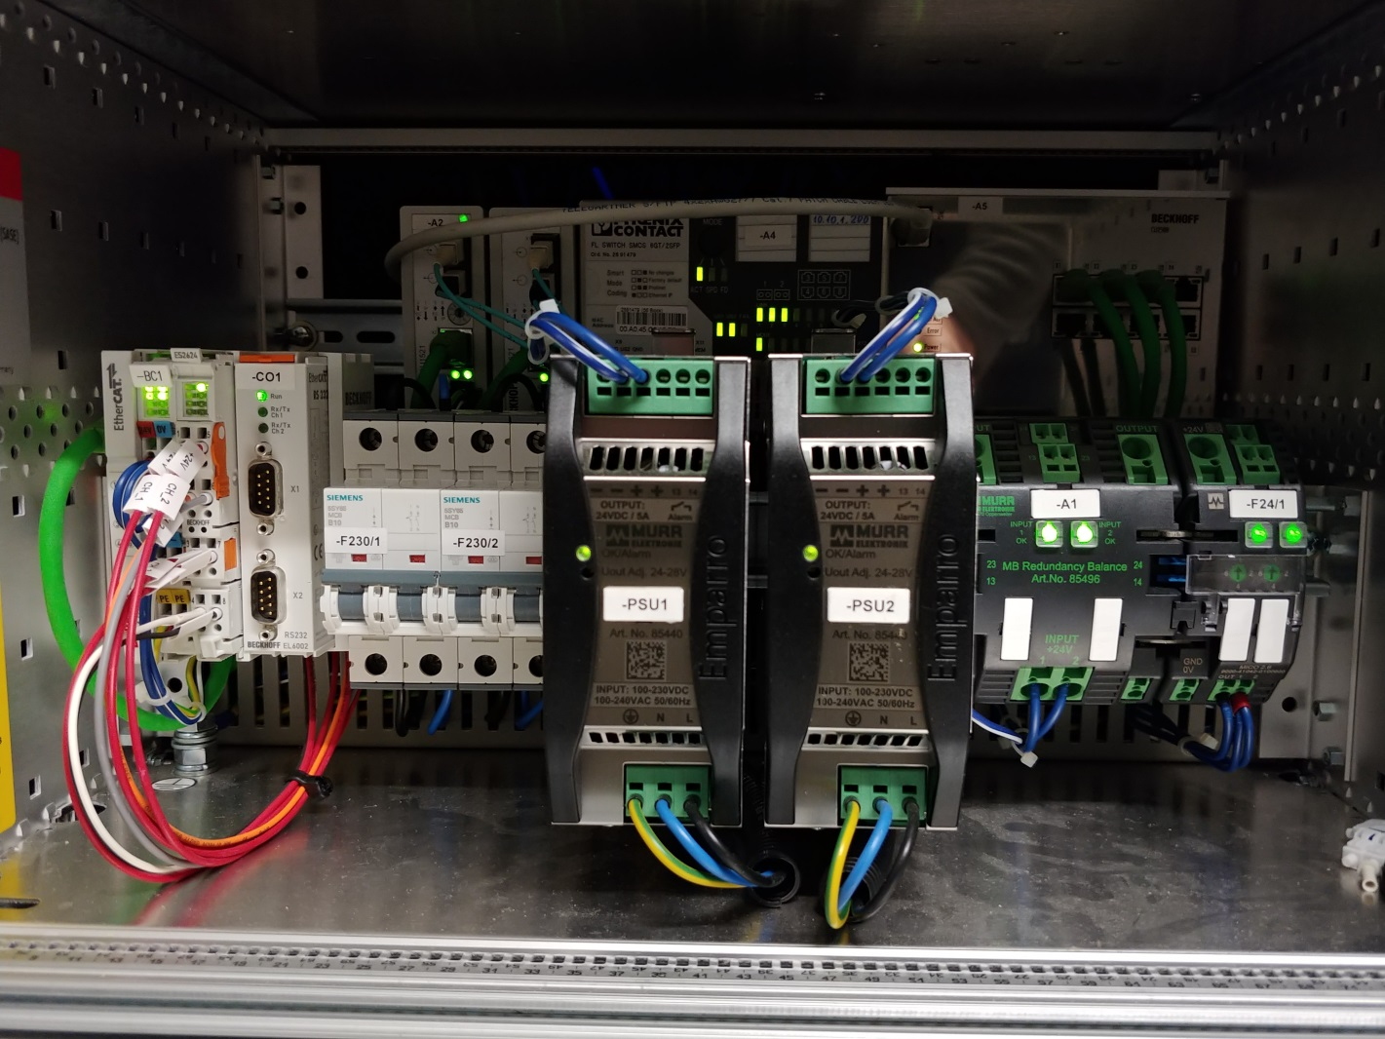
Working Group Parallel Operations, EPS&MPS: Project 3
EL2624 | 4-channel relay output terminals are used for EPS
Installed in each media converter rack
Located in the Balcony Rooms for SASE1, SASE2 and SASE3
All SASE sections wired up
Channel Nr. | Contacts on the pluggable wiring level | Contacts on the terminal | Meaning
Channel 1 | 13, 14 | 1,2 | NO_PHOTON_BEAM -->EPS
Channel 2 | 23, 24 | 5,6 | MOTORS_NOT_MOVING
Channel 3 | 33, 34 | 3,4 | ON_THE_FLY_SCAN
Channel 4 | 43, 44 | 7,8 | NO_PHOTON_BEAM -> EPS
SASE1 media converter rack in the balcony room

Slide 15
Working Group Parallel Operations, EPS&MPS: Project 3
Hardware Interface
ES2624 has 4 x normally open single contacts
NO_PHOTON_BEAM bit over the Channel 1. This bit will be insured if all undulators have gap more than 190 mm.
  Channel 1 - NO_PHOTON_BEAM:
    logical „1“ – contacts 13 and 14 are connected. Meaning: photon beam is not possible
    logical „0“ – contacts 13 and 14 are not connected. Meaning: photon beam is possible
MOTORS_NOT_MOVING bit over the Channel 2. This bit will be insured if none of undulator motors are moving.
  Channel 2 - MOTORS_NOT_MOVING:
    logical „1“ – contacts 23 and 24 are connected. Meaning: motors are not moving
    logical „0“ – contacts 23 and 24 are not connected. Meaning: motors are moving
In the future we are going to operate the undulator systems in “on-the-fly” energy scan mode. That means, that during electron beam operation, the undulator gap will be changed with the speed up to ~1µm/sec. So for the future operation, we suggest to use channel Nr. 3 to provide the information about the ON_THE_FLY_SCAN operational mode.
ON_THE_FLY_SCAN bit over the Channel 3.
  Channel 3 - ON_THE_FLY_SCAN:
    logical „1“ – contacts 33 and 34 are connected. Meaning: undulator system is on-the-fly scan mode
    logical „0“ – contacts 33 and 34 are not connected. Meaning: undulator system is not on-the-fly scan mode
  Channel 4 - Reserved

Slide 16
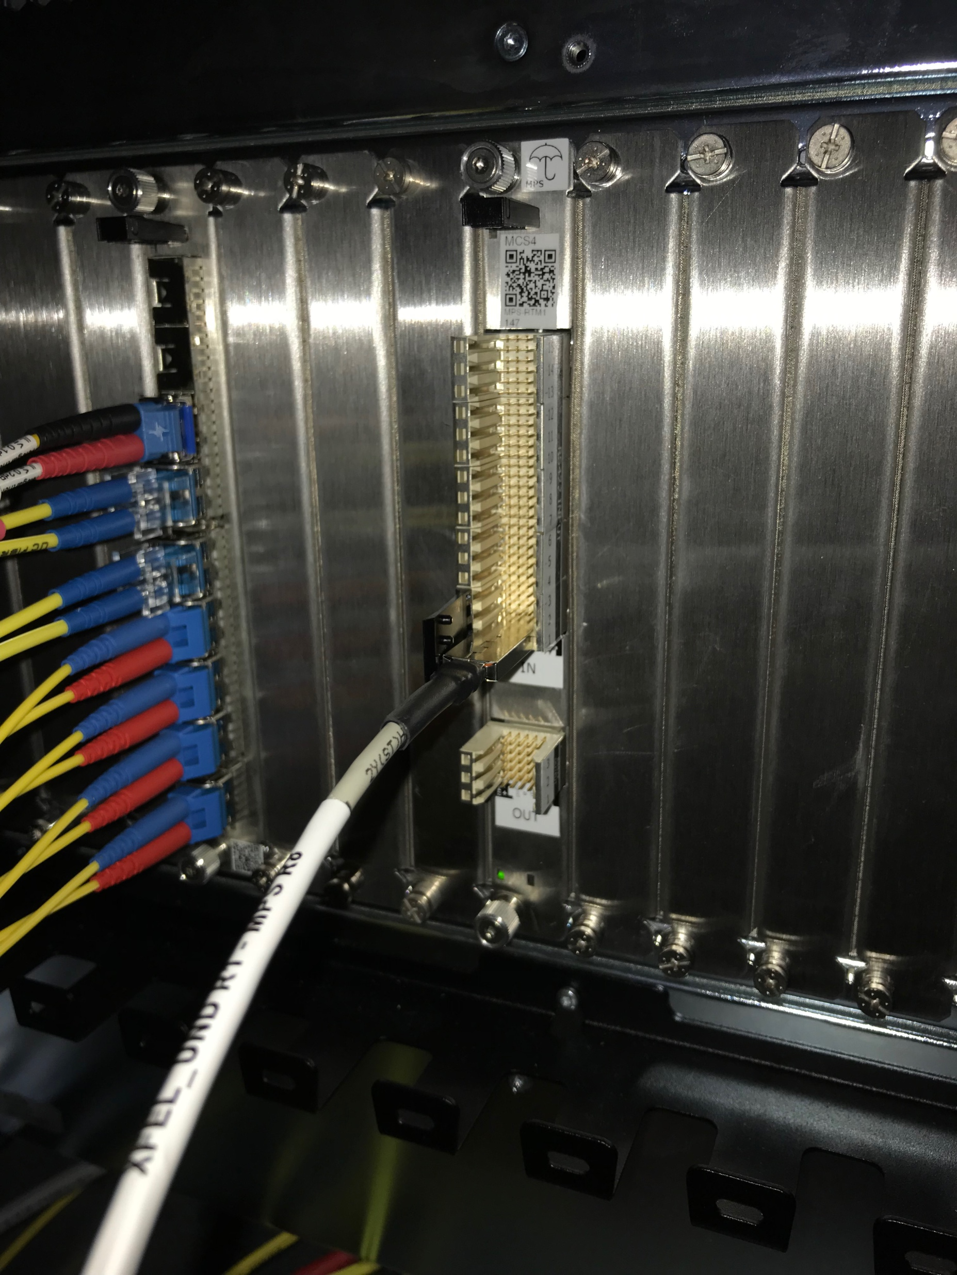
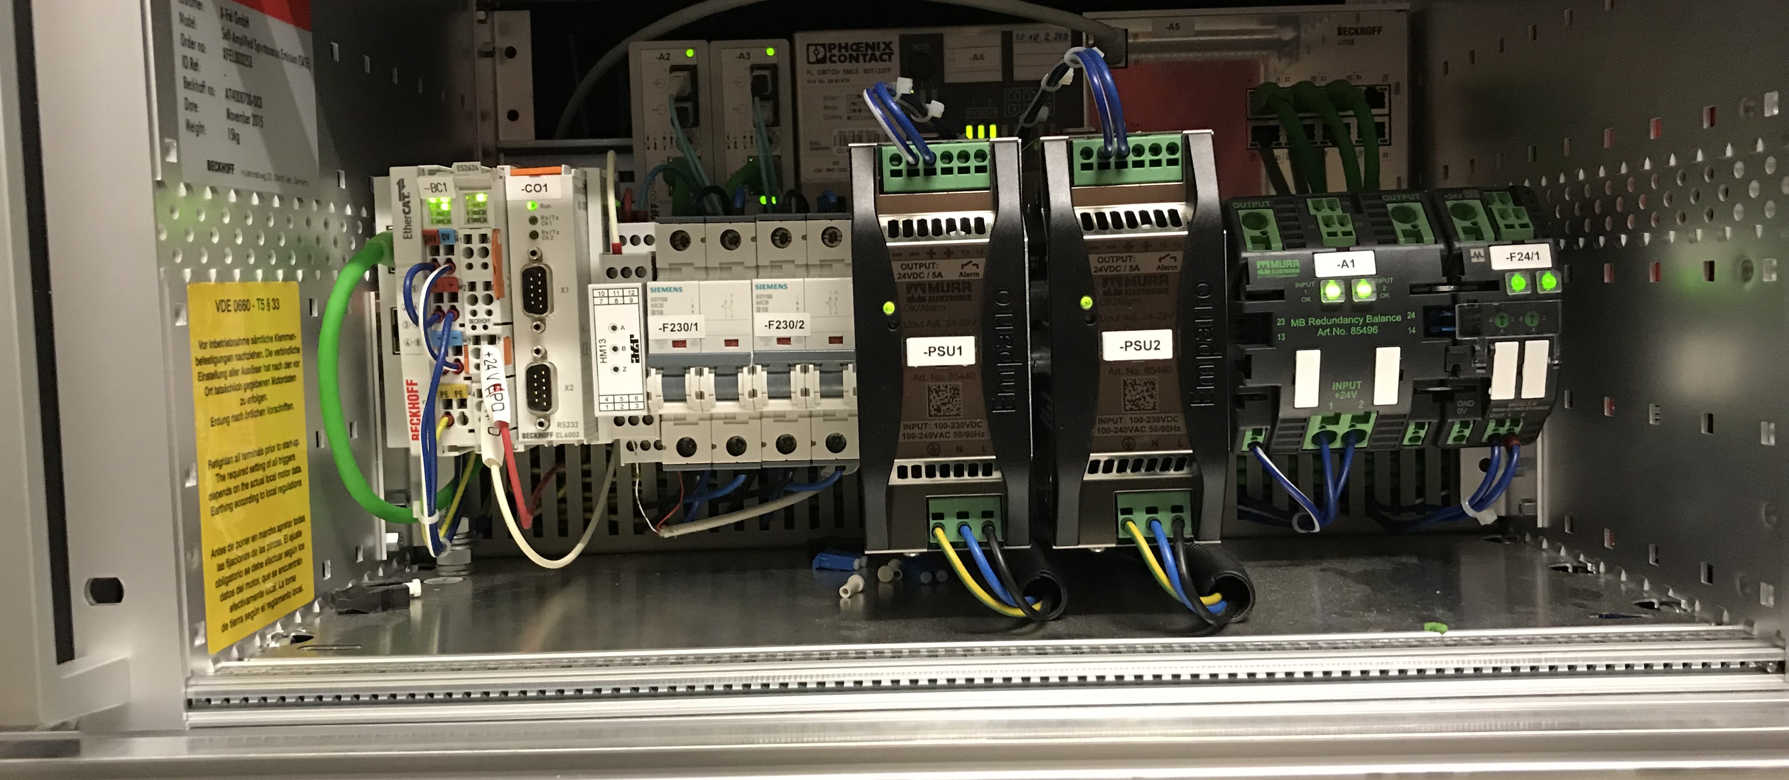
Working Group Parallel Operations, EPS&MPS: Project 3
Integration into MPS
Undulator “open signals” in MPS
Connection via RS422 and 3 FCI cables each to MPS RTM boards for all SASE1,2,3 sections (SA1-BR-R7.0, SA3-BR-R8, SA2-BR-R8) DONE
Tests on 24.06.19: move undulators from closed to open positions. At > 190 mm signal is received by MPS DONE - OK
Discussion on “safety labels” since undulator open gates now existing safety signals, too. ONGOING

Slide 17
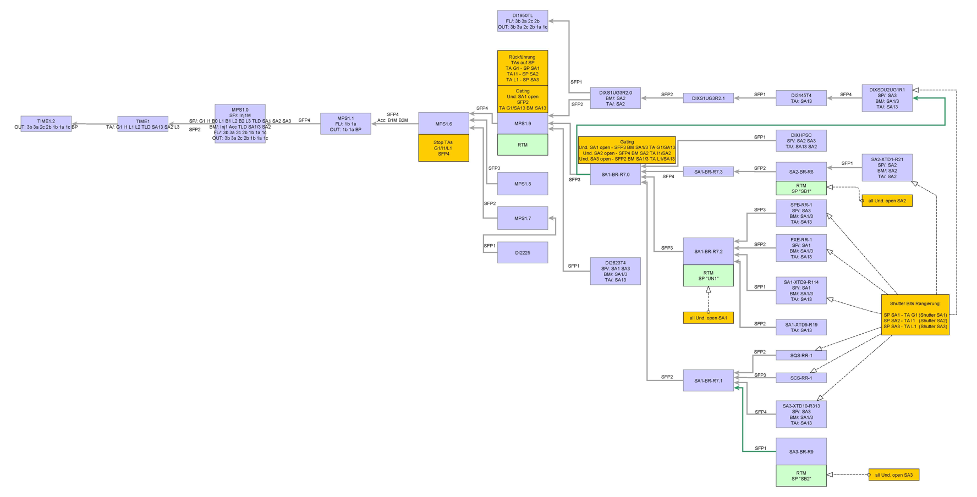
Working Group Parallel Operations, EPS&MPS: Project 3
MPS topology for undulator open signal processing

Slide 18
Working Group Parallel Operations, EPS&MPS: Project 5
Charge:
Establish a Task Force (group of experts DESY +XFEL, ‘Timing Board’) on timing, synchronization, pulse labeling, timing pattern, triggers that meets regularly and communicates developments across the facilities potentially with a review mechanism
Patrick, Tim, Alessandro, (+MCS, +CAS, ITDM …)
Could start soon
First meeting in February, Kick-Off Meeting
Specialized meeting(s) with experts on macropulse number and timestamp questions in May

Slide 19
Working Group Parallel Operations, EPS&MPS: Project 5
Timing Task Force - Kick-Off Meeting – 15.02.2019
Topics:
Scope and goals of this task force
Identification of pulse/bunch resolved data handling/identification/storage ongoing
Definition of best practice for the implementation
Documentation of translation between different concepts (if more than one)
Clarification and documentation of multiple bunch pattern distribution ongoing
Clarification on how to allow local setups compatible to master (important for PPL group) ok
Basically ideally getting the bunch pattern server usable for local installations available
Agree on procedures for upgrades of f/w and servers (timing and bunch pattern) ongoing
Evaluate synchronization between DOOCS and Karabo w/ TrainIDs / MacroPulse ongoing
Collect and make a list of all relevant documentation related to timing system ongoing
Mailing list for internal communication of Timing Task Force team (xfel-timing) and mailing list for the Timing related announcements (xfel-timing-info)
Setup of a permanent timing board as expert committee on timing matters and required modifications

Slide 20
Working Group Parallel Operations, EPS&MPS: Project 4
Scanning of soft X-ray mono
Topics: (Development) Scanning of SASE3 soft mono synchronous to small undulator gap scans
Andreas, Suren, Lars, (Alessandro, Liuba, Dirk, Harald, Olaf Hensler, Daniele La Civita, Natalia Gerassimova, David Hickin).
0.6 eV per second is the typical ‘on the fly’ speed of the soft mono
Undulators are not synchronized among each other, but should be OK for these small motions
Mono may be master, requesting enegry change
Couple over Karabo-Doocs bridge the energy
Requires undulator movement requested via Karabo
Requires test to see whether undulator stepping
Discuss implications with D3
3-6 months

Slide 21
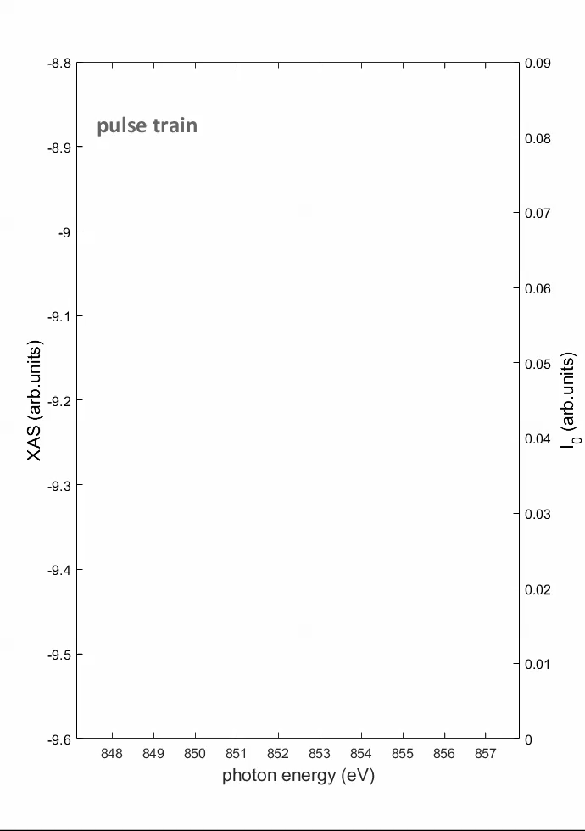
Experience SCS: Femtosecond
X-ray absorption Spectroscopy
Continuous Soft x-ray Monochromator Scan between two photon energies:
Here across SASE3 bandwidth 1%
Gap scan in development to span over several SASE3 bandwidths
Ni L3 edge ( 30 nm ), 852 eV, 1.1MHz, ~25fs pulses
Scan speed is 55 meV / pulse train, 3 times slower than the resolving power of the mono
scanning 10 eV = 180 pulse trains = 18 sec
1-3µJ / pulse x 150 pulses x 10Hz =1-3x10¹³ ph/sec
Non-destructive!

Slide 22
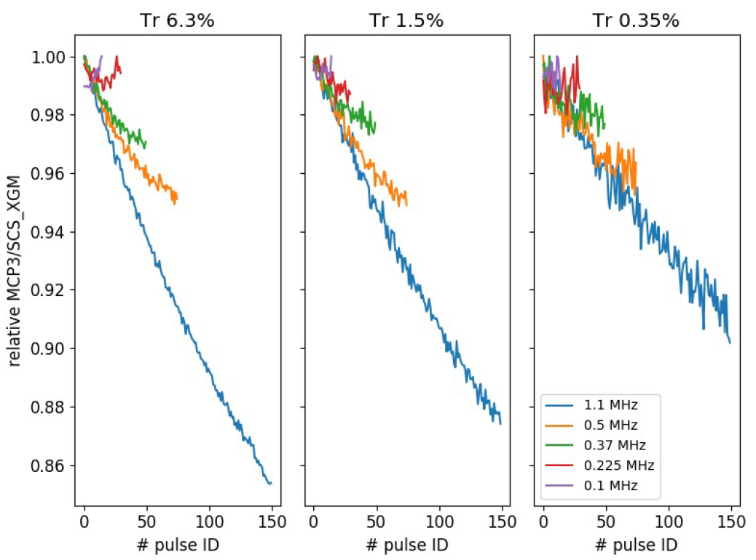
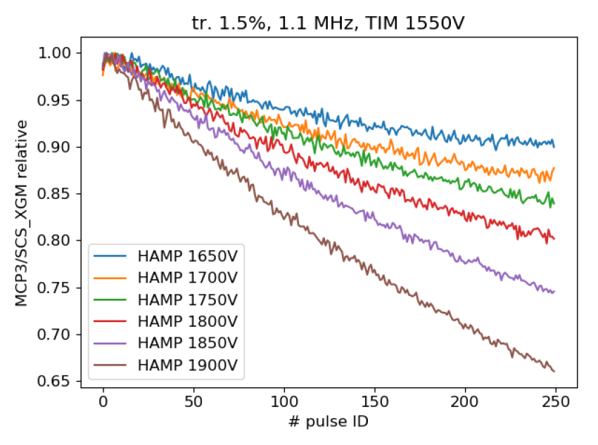
Test of I₀ / I₁ correlation without sample
Repetition rate and pulse energy dependence
Varying the HAMP voltage

Slide 23
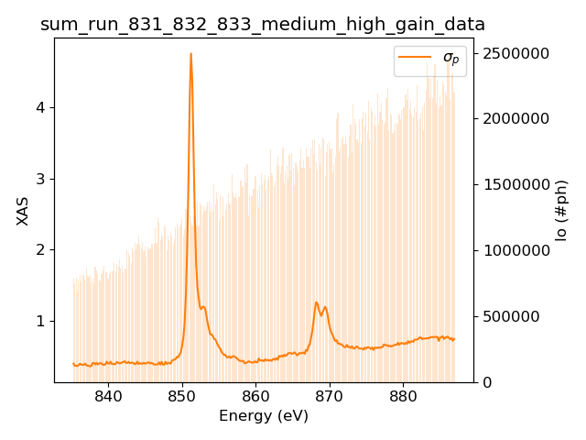
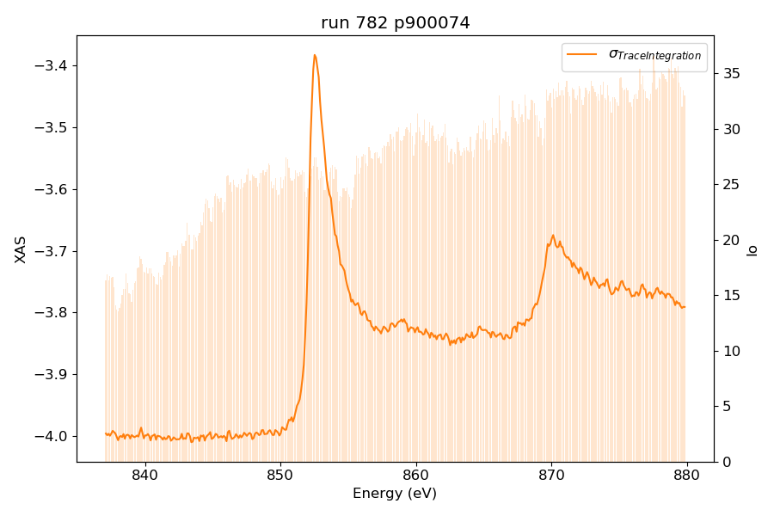
X-ray absorption spectroscopy with manual gap scan at SCS
Gap scan parameters
grating speed: 0.00008 mm/s
undulators: 0.5 eV/step
Ni metal, XAS with XGM-TIM, transmission 1%, 150 pulses
NiO, XAS with Fast CCD, transmission 0.08-0.1%, 1 pulse

Slide 24
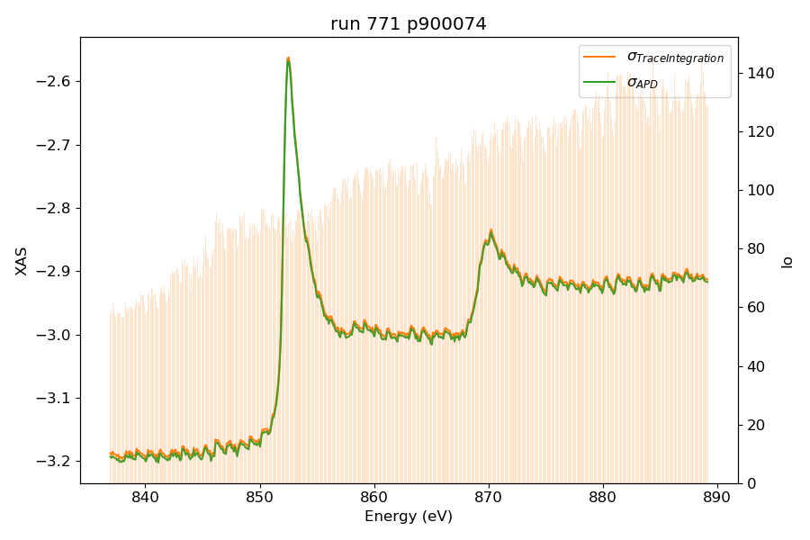
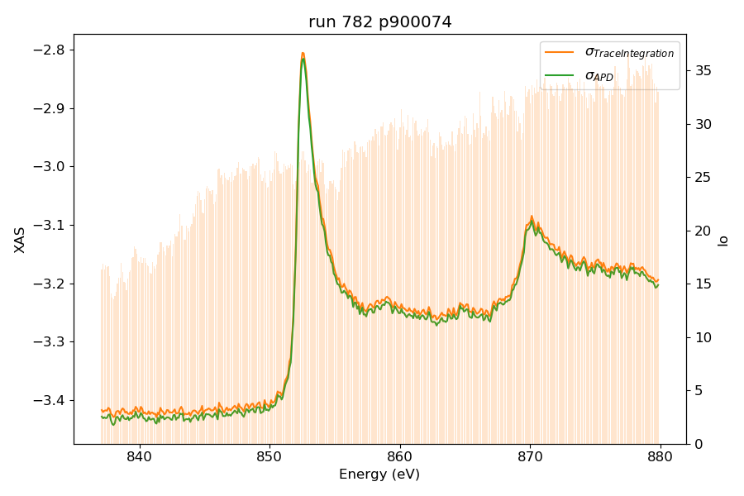
X-ray absorption spectroscopy with manual gap scan at SCS
Ni metal, detection with XGM/TIM
Gap scan parameters
grating speed: 0.00008 mm/s
undulators: 1.0 or 0.5 eV/step
Run 771, 0.5 MHz, HAMP=1550V, TIM=1500V, 1 eV step
little slope and obvious oscillations
Run 782, 0.5 MHz, HAMP=1400V, TIM=1450V, speed 0.00008 mm/s, 0.5 eV step
very small slope and still see the oscillations

Slide 25
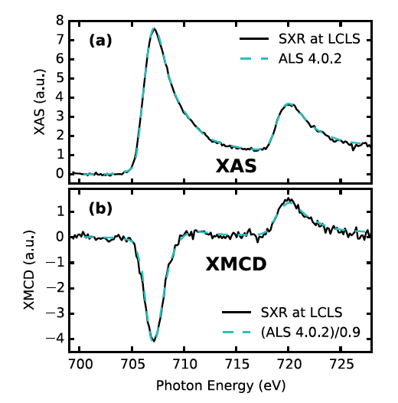
Time-resolved X-ray absorption spectroscopy and magnetic circular dichroism
Femto-slicing source @ BESSY
SXR at LCLS
Boeglin, et al., Nature 465, 458 (2010)
Higley, et al., Rev. Sci. Instr. 87, 033110 (2016)

