Slide 1
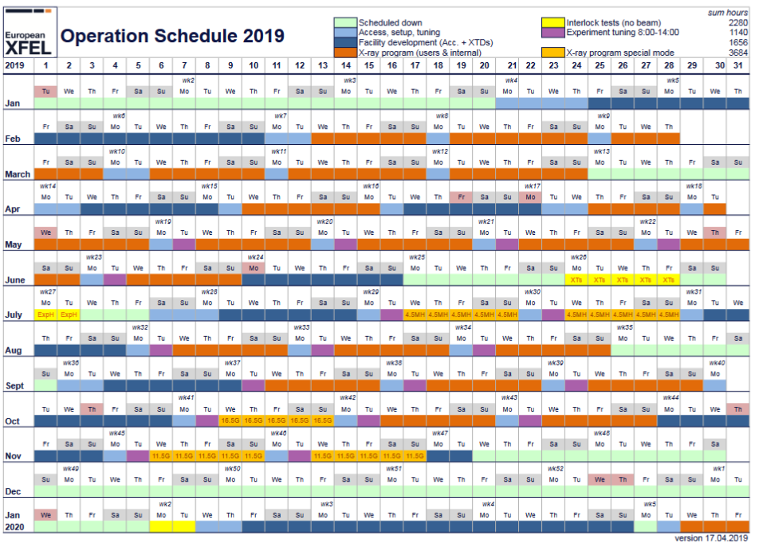
Schedule 2019

Slide 2
Things on the list in 2019
4.5 MHz operation
New energy working points (16.5 GeV & 11.5 GeV)
SASE2 HXRSS (Dev. Project #5)
Dispersion based fresh slice 2 color lasing SASE2 (Dev. Project #2, #8)
Short pulse (100 pC bunch charge operation), photon pulse characterization (Dev. Project #6, angular streaking @ SQS)
Advanced SASE set-up beyond GMD signal (Dev. project #4)
…….

Slide 3
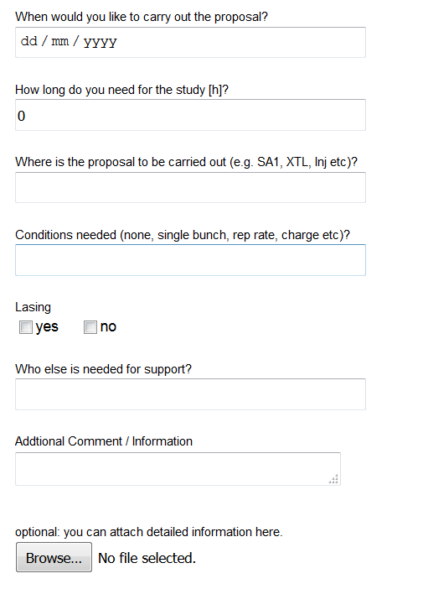
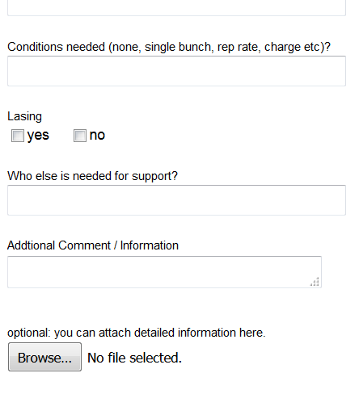
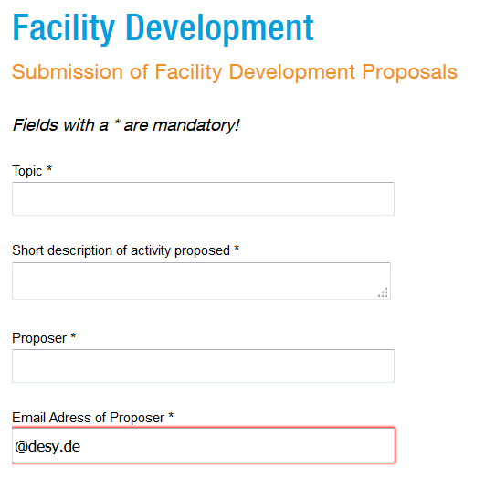
Facility Development Proposals
https://xfel.desy.de/operation/facility_development/

Slide 4
Schedule 2019

Slide 5
Possible Schedule for 2019 Development
6.7. – 15.7. : Start-up after shut-down, ‘Summer BBA’, SASE3 kicker, tune-up beam stops , 4.5 MHz preparation
27.7. – 4.8.: MCP commissioning, 4.5 MHz photon diagnostics (3 days), SA2 HXRSS (2 days), Short bunches/100 pC (2 days)
2.9. – 9.9. : Start-up after shut-down, SA2 HXRSS (2 days)
1.10. – 6.10: 16.5 GeV working point (3 days), SA2 HXRSS (2 days)
28.10. – 3.11: 11.5 GeV working point (3 days), SA2 HXRSS (2 days)

Slide 6
Outlook to 2020
Scheduled Down: 70 d
30 d scheduled maintenance
10 d interlock tests
Operation: 7100h
Access, setup and tuning: 1902 h
250 h on demand maintenance and repair
600 h set-up after long shut-down & no-beam tests
850 h tuning before user operation
Facility Development: 1176 h
X-Ray Delivery: 4026 h

Slide 7
Plans for JOWS 2019-2
Another workshop with approx. 40 attendees during winter-shutdown (i.e. before Christmas)
Possible Topics:
Let’s discuss during the barbecue

