Slide 1
WP3 EOSC data catalogue services for EU Photon and Neutron national RIs
Alun Ashton
11/09/2019

Slide 2
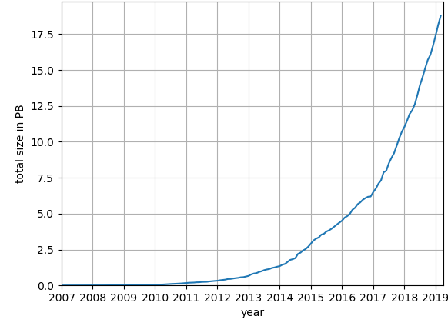
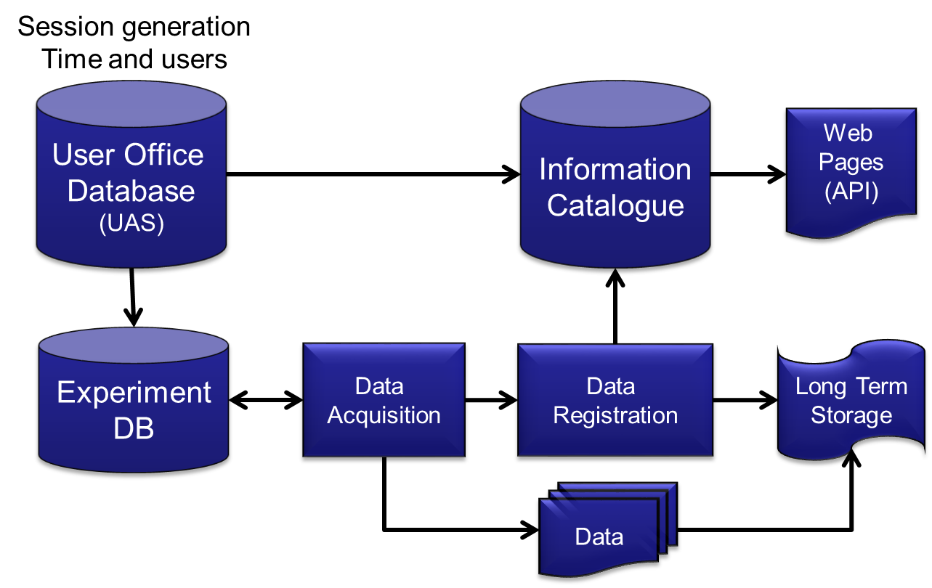



Background and Status
(21.2PB 6/9/19)
Example long term storage volume from a
national facility (Diamond).
Open or FAIR Data?
……..

Slide 3
Goals
FAIR - comply with the FAIR principles in the following ways:
Findable – all data will be federated with rich metadata and common search API
Accessible – API will support open protocol, metadata accessible even without data
Inter-operable – metadata and data to follow community standards, register metadata
Reusable – follow community standardized metadata with clear license for use

Slide 4
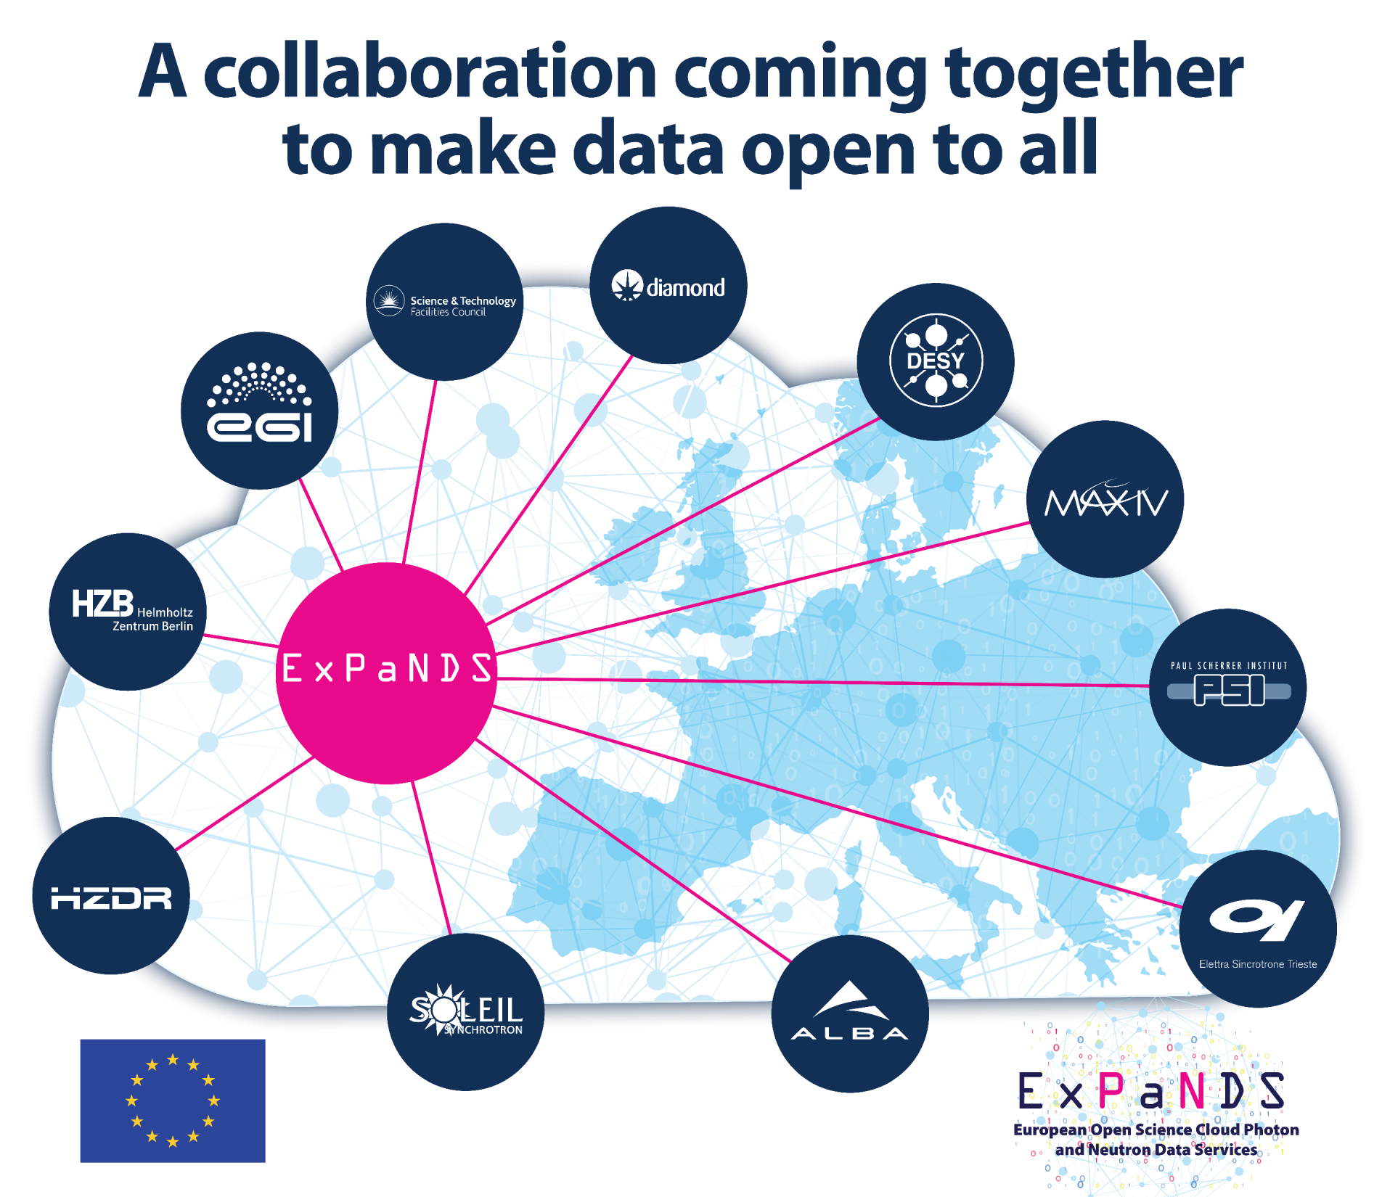
Background and Status

Slide 5
Background and Status

Slide 6
We aim to
Evaluate the current status of metadata catalogues at national RIs and perform a gap analysis.
Develop baseline standards for Metadata Catalogues based on harmonised policies (cf. WP2) to make Photon and Neutron data FAIR.
Define baseline standards for APIs linking data catalogues to data analysis platforms (WP4).
Coordinate the deployment at national RIs to capture metadata in a FAIR enabling way.
Implement standards that enable the association of FAIR data to scientific discoveries through links to publications as defined in WP2.
Provide technical documentation to WP5 for training the wider community of developers and scientists to ensure sustainability.

Slide 7
Tasks
Task 3.1: Coordinate metadata catalogue services for EU national Photon and Neutron RIs. Lead partner: PSI, Contributors: ALBA, DESY DLS, Elettra, HZB, HZDR, MaxIV, Solei, UKRI
Task 3.2: Develop EU Photon and Neutron Ontologies. Lead partner: DLS, Contributors: ALBA, DESY, HZB, MaxIV, PSI, Soleil, SFTC
Task 3.3: Implement ontologies in metadata catalogues. Lead partner: PSI, Contributors: DLS, Elettra, HZB, MaxIV, UKRI
Task 3.4: Coordinate the integration of metadata catalogues to manage the data lifecycle at EU national Photon and Neutron Ris. Lead partner: HZB, Contributors: ALBA, DESY DLS, Elettra, HZDR, MaxIV, PSI, Solei, UKRI
Task 3.5: Integrate metadata catalogue services into EOSC. Lead partner: MAX IV, Contributors: Elettra, HZB, PSI
Task 3.6: Document and provide technical information on systems, APIs and user interfaces. Lead partner: SOLEIL, Contributors: DLS, Elettra, PSI, UKRI

Slide 8
Tasks 3.1 Coordinate metadata catalogue services for EU national Photon and Neutron RIs. (M1-M12)
Perform landscape analysis on the current usage and approaches to metadata catalogues at ALBA, DESY, DLS, ELETTRA, HZB, MAX IV, PSI, SOLEIL and UKRI. Based on the landscape analysis and requirements defined in WP2 a gap analysis will provide the necessary input to develop a roadmap towards harmonised and federated metadata catalogue services.
A workshop will be performed at M6 with WP2 and WP4 to align requirements and specification of services. Coordinating this task and compatibility with PaNOSC and the EOSC-hub will be essential and a key success factor to the three projects (PaNOSC, EOSC-hub and ExPaNDS).

Slide 9
Task 3.2: Develop EU Photon and Neutron Ontologies. (M6-M24)
Develop ontologies for main application domains of Photon and Neutron science to standardise the metadata used in metadata catalogues based on requirements defined in WP2.
This will ensure that federated EOSC metadata catalogues are not only based on a common syntax, but also on a common semantics.
  The ontology itself will be provided as an EOSC service using existing tools to document and make ontologies accessible (e.g NeOn, Knoodle, Protégé, Swoop).
  Development of the ontology will be closely linked to the existing NeXus file format and its further developments (PSI, ISIS and DLS have leading roles in the specification and implementation of NeXus). Photon and Neutron-related ontologies provided by NeXus will be used and extended. In a similar way existing ontologies (such as those provided by NIST) should be taken into account.

Slide 10
Task 3.3: Implement ontologies in metadata catalogues (M11-M30)
The defined ontologies will be implemented in different data catalogues (e.g. ICAT at UKRI and SciCat at PSI).
  To foster the federation of local services a reference implementation will be provided on the basis of the NeXus format. These will result in a European standard with international impact, and as such provides the basis for APIs and interoperability. The latter activities will be aligned with the PaNOSC initiative.

Slide 11
Task 3.4: Coordinate the integration of metadata catalogues to manage the data lifecycle at EU national Photon and Neutron RIs (M24-M36)
Based on the roadmap defined in task 3.1 the national sites will deploy the developed standards and processes.
  The WP will help to coordinate these activities by providing best practices and cross site support. Technical and user interface related information will be documented and provided as input for WP5 to facilitate training. The coordination process will be continued until the end of the project.

Slide 12
Task 3.5: Integrate metadata catalogue services into EOSC (M24-M34)
The different metadata catalogues will be integrated into the PaNOSC federated metadata catalogue and provided as a service on EOSChub. Access to metadata catalogues will be facilitated by Umbrella-ID (federated AAI services for Photon and Neutron RIs).

Slide 13
Task 3.6: Document and provide technical information on systems, APIs and user interfaces. (M24-M34)
These will be used by WP5 to develop training material for facility staff responsible for data lifecycle management and provide training materials for scientific users. A training plan and material will be developed to ensure training and deployment of solutions, to ensure sustainability of support and operations in the context of EOSC.

Slide 14
The Core of ExPaNDS

Slide 15
A collaboration coming together to make data open to all.
“You can’t judge a book by the cover.“

Slide 18
Month | Project | Description
Sept19 | ExPaNDS | Kick off meeting ExPaNDS
Sept19 | PaNOSC | PaNOSC pWP3 meeting Grenoble.
Nov19 | PaNOSC | PaNOSC pWP3 one day satellite meeting to GA in Trieste.
Dec19 | ExPaNDS | eD3.1 Status Analysis
Dec19 | PaNOSC | pM3.1 Survey of APIS and Roadmap to EOSC
Dec19 | PaNOSC | pM3.2 Anthology feedback to API Tasks
Mar20 | ExPaNDS | Workshop with eWP2 and eWP4 to align requirements and specification of services
Jun20 | PaNOSC | pD3.1 API definition
Mar21 | ExPaNDS | eD3.2 Release V1.0 ExPaNDS ontology available as an EOSC online service
Apr21 | PaNOSC | pD3.2 Demonstrator Implementation
Sept21 | ExPaNDS | eM3.1 Metadata Catalogue release
Mar22 | ExPaNDS | eD3.3 Demonstrate ICAT and SciCat released with APIs compatible to ExPaNDS federated EOSC services
Mar22 | ExPaNDS | eM3.2 Metadata catalogue as EOSC service
Apr22 | ExPaNDS | eD3.4 Portfolio material to support training for target groups at all RIs (input for WP5 and WP6)
May22 | PaNOSC | pD3.3 Catalogue Service
July22 | PaNOSC | pD3.5 NeXus Metadata Mapping Schema and Proposed New Definitions
Sept22 | PanOSC | pD3.4 Implementation report from facilities
Survey
API
Demonstrator
Sustainability &
Deployment

