Slide 1
Outreach, Dissemination and communications
Isabelle Boscaro-Clarke & team
11 September 2019

Slide 2
What are the messages?
Enable EOSC services and provide coherent FAIR data services to the scientific users of PaN RIs
Connect PaN RIs through a platform of data catalogues and analysis services through the EOSC for users from RIs, universities and industry
Gather feedback and cooperate with the EOSC governance bodies to improve the EOSC
Develop standard relationships and interconnections between scientific publications, PaN scientific datasets, experimental reports, instruments and authors

Slide 3
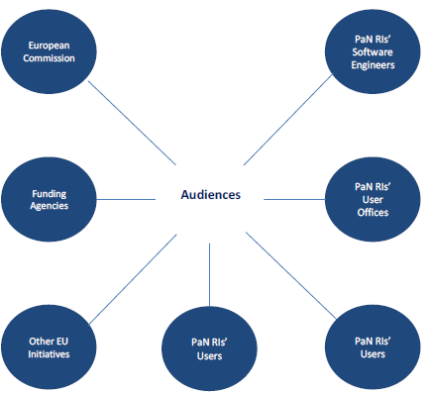
What are the audiences?
Did we miss a key audience?

Slide 4
What’s in place so far?
Listings – SYMPA lists
Mailchimp for external dissemination
ExPaNDS Sharepoint
Website – www.expands.eu
Twitter Account
Glossary of terms for consistent communications

Slide 5
What do we have so far?

Slide 6
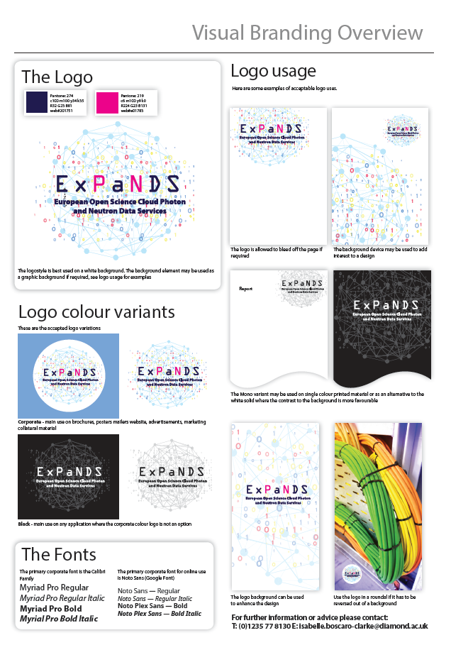
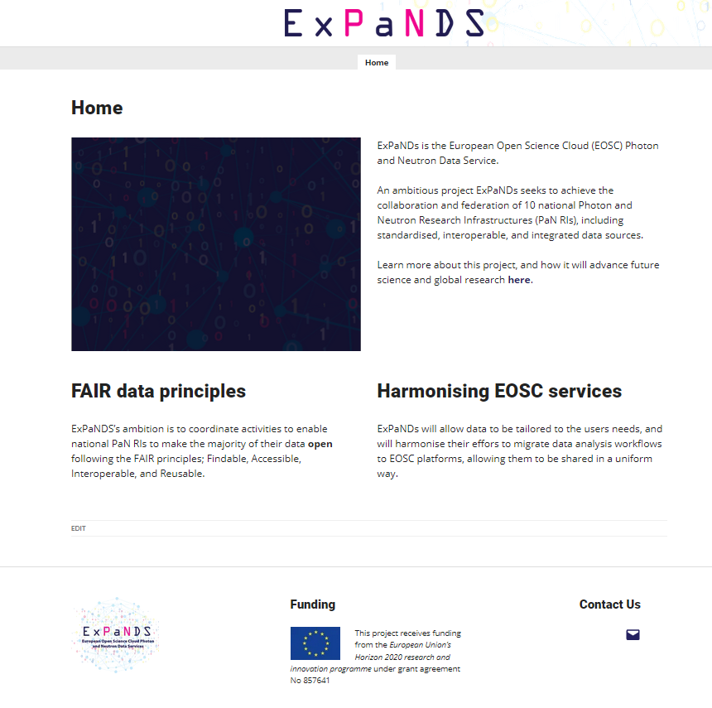
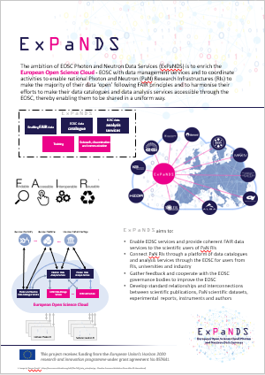
What do we have so far?

Slide 7
Next steps
Publish the website and its content
Set up a collaborative space in Diamond’s SharePoint area for all project documents & templates
Agree on 12 months activity plan and draft communication strategy
Produce the Social Media strategy and create all relevant social media accounts

