Slide 1
WP5 : Provide training activities through EOSC platforms
Nazaré GUIMARD (SOLEIL)
ExPaNDS Kick-Off Meeting 11/09/2019

Slide 2
WP5 Goal
To promote the outcomes of the catalogues and services provided by ExPaNDS for EOSC to reach a larger community of users
To set up an e-learning platform and develop and disseminate training material for both staff and users of the Ris
To allow the users
To get to know the coordinated PaNOSC and EOSC_hub metadata catalogues and learn how to use them at national RIs
To discover the set of EOSC adapted data analysis services using Jupyterhub
To learn how to deploy and support own workflows using data analysis services
To train scientists on how to make their data FAIR and how to exploit FAIR data

Slide 3
Objectives
Provide training materials
accessible to staff and users from national RIs
using EOSC data websites and e-learning platforms.
Organize a series of training events in :
data FAIR principles
data stewardship
data management
data analysis services integrated into the EOSC services

Slide 4
Work tasks
T5.1: Organising at national RIs’ a series of staff and users training events
Lead partner: SOLEIL, Contributors: HZDR, UKRI, PSI, DESY, DLS, EGI
T5.2: Evaluation of available e-platforms and provision of a training demonstrator
Lead partner: HZDR, Contributors: SOLEIL, EGI
T5.3: Collection, Preparation and Publishing of Training material
Lead partner: SOLEIL, Contributors: HZDR, EGI, UKRI, PSI, DESY
T5.4: Monitoring and Measuring of training effectiveness
Lead partner: HZDR, Contributors: SOLEIL, DLS

Slide 5
Task 5.1 – Staff and users training
Lead partner: SOLEIL, Contributors: HZDR, UKRI, PSI, DESY, DLS, EGI
WORKSHOPS TO BE ORGANISED
Workshop to promote FAIR principles (M12)
Workshop to develop common rules and best practices between national RI’s which build on previous work (e.g. PaNdata) and harmonise the provision of the EOSC services.(M12)
Workshop/meeting(s) to educate and train developers and facility staff on how to deploy and support their own workflows. This activity will be organized and performed in close collaboration with WP3 and WP4. (M25)
Workshop to educate and train metadata catalogue services including Photon and Neutron Ontologies developed in WP3 (M34)
Workshop/meeting(s) to educate and train Photon and Neutron users in the use of the data analysis services. This activity will be organized and performed in close collaboration with WP4 (M35)

Slide 6
Task 5.2 - Evaluation of available e-plaforms / training demonstrator (Task 5.2)
Lead partner: HZDR, Contributors: SOLEIL, EGI
Definition of the most suitable training material in acordance with the requirements and recommendations made by the targeted e-platform providers
Contact with the e-plateform providers (ESRF for PaNOSC and EGI for EOSC-Hub) to define together the prerequisites to maximise and expand an appropriate use of the platforms
WP2, WP3 and WP4 will deliver tailored specification for each of the online training
A demonstrator for using e-learning platforms will be developped and provided (M25)

Slide 7
Task 5.3 – Collection, preparation and publishing of training materials
Lead partner: SOLEIL, Contributors: HZDR, EGI, UKRI, PSI, DESY
STRONG CORRELATION WITH WP2, WP3 and WP4
To provide the training materials fo foster the uptake of ExPaNDS services in the existing e-learning platforms
Collection of the material provided by WP2, WP3 and WP4
Preparation and publication of the training material (Moodles, Wiki medias, modules, …):
FAIR data guidelines, common rules and best practices (Task 2.6 WP2)
Standard dataset definition (WP3) and Photon and Neutron reference datasets (WP4)
Londg term viability and sustainability of the data analysis services developed by ExPaNDS (task 4.5 WP4)
…

Slide 8
Task 5.4 – Monitoring and measuring of training effectiveness
Lead partner: HZDR, Contributors: SOLEIL, DLS
STRONG CORRELATION WITH WP2, WP3, WP4 and WP6
User feedback in the form of survey and usage statistics (final report)

Slide 9
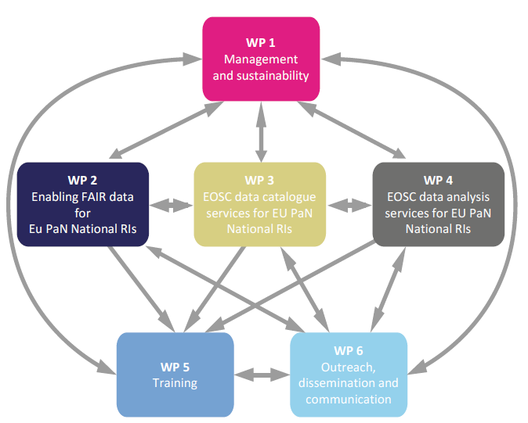
Work organisation
Developed self-training material
Will be developed in coordination with WP2, WP3,WP4 and WP6,
Will be made available through e-platforms developed by EOSC-hub and PaNOSC. An Open edX platform (an open source MOOC platform, (www.open.edx.org/) proposed and maintained by EGI will also be used
Organize a series of workshops (6 training planned)
Distributed among the participating facilities
To promote the outcomes of ExPands for EOSC
To reach a larger community of users.

Slide 10
Partners involved
SOLEIL (coordinator, 36 PM)
HZDR (deputy leader, 18 PM)
EGI (7 PM)
UKRI, PSI, DESY, DLS

Slide 11
Deliverables
KEY | Due / Month | Short Description | Type | Des. Level
D5.1 | 12, 24, 36 | Annual report on training activities, workshops held, materials published and investigations performed | R | PU
D5.2 | 25 | Demonstrator for using of e-learning platforms | DEM | PU
D5.3 | 30 | Dedicated websites and e-platforms with the teaching material published suitable for staff and user training | R | PU
D5.4 | 36 | Report on lessons learned and future prospects for adopting best practices on data FAIR principles, data management and data stewardship at the ExPaNDS RIs | R | PU

Slide 12
Milestones
KEY | Due / Month | Short Description
M5.1 | 24 | First (pilot) national training event organised and performed
M5.2 | 32 | Training websites and e-platforms online available

Slide 13
Risks
Risk Description | Type | Mitigation measures
Receive improper documentation from the WPs to prepare training material | Low | Continuous communication with the WP leaders
Appropriate attendance for the workshops | Medium | Communication activities (WP6)
Appropriate usage of the e-platforms by the users | Medium | Communication activities (WP6)

