Slide 1




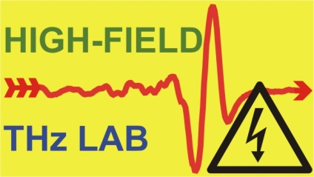

Generation and applications of extremely high-field near single cycle terahertz pulses
Institute of Physics
www.physics.ttk.pte.hu
G. Almási¹, Z. Tibai¹, G. Tóth¹, S. Turnár¹, P.S. Nugraha^{1,3}, L. Pálfalvi¹, J.A. Fülop^{2,3} and J. Hebling^{1,2,3}
¹University of Pécs, Physics Department, Pécs, H-7624, Hungary
²MTA-PTE High-Field THz Research Group, Pécs, H-7624, Hungary
³University of Pécs, Szentágothai Research Center, Pécs, H-7624, Hungary
EuPRAXIA final meeting, Hamburg, 15-18 October 2019
Notes:
Thank you mister chairman. In my talk I will speak on generation of TH pulses having high electric field or even extreme high electric field by optical rectification of ultrashort laser pulses. I will also mention a few demonstrated and a few suggested application of these THz pulses.

Slide 2
Classification of THz pulses by peak electric field and energy
Linear (TDTS) THz spectroscopy (E_{max} ≈ 100 V/cm → 10 fJ energy)
High field THz pulses (E_{max} ≈ 100 kV/cm → 1 µJ energy)
THz pump – probe measurement, nonlinear THz optics
Extreme high field THz pulses (E_{max} ≈ 100 MV/cm → 10 mJ energy)
enhancement of HHG, particle manipulation, etc.
2
Notes:
2
In my talk I will consider single-cycle THz pulses. A typical temporal shape of the electric field of such pulses are shown here. Because of the different application possibilities, it is useful to classify such THz pulses based on their energy and peak electric field strength. The weakest THz pulses with high repetition rate are used for example in linear THz spectroscopy. THz pulses with about eight orders of magnitude larger energy are used in nonlinear THz spectroscopy. In the larger part of my talk I will consider generation and applications of THz pulses which need even a few 1000 times larger THz energy. These THz pulses have extremely high field, significantly above 1 MV/cm.

Slide 3
Running projects – TACTIC ETN (Marie Curie)
University of Pécs | Hungary | Institute of Physics | József A. Fülöp, Gábor Almási
Paul Scherrer Institute | Switzerland | Gross-forschungs-anlagen / Laboratory of Nanoscale Biology (LNB ) | Rasmus Ischebeck, Jan Peter Abrahams
Lancaster University | United Kingdom | Department of Physics | Steven P. Jamison
The University of Manchester | United Kingdom | School of Physics and Astronomy | Darren M. Graham
Deutsches Elektronen Synchrotron | Germany | - | Nicholas H. Matlis, Franz X. Kärtner
Ecole Polytechnique Fédérale de Lausanne | Switzerland | School of Basic Sciences / Institute of Chemical Sciences and Engineering / Laboratory of Molecular Nanodynamics | Ulrich J. Lorenz
University of Konstanz | Germany | Department of Physics | Peter Baum
Structural Biology Institute | France | Electron Microscopy and Methods Group | Dominique Housset
Stockholm University | Sweden | Department of Materials and Environmental Chemistry | Xiaodong Zou
University of Duisberg-Essen | Germany | Experimental Physics | Klaus Sokolowski-Tinten
Ariel University | Israel | The Department of Electrical Engineering and Electronics | Aharon Friedmann
Major goal: Development of THz based electron source
for electron diffraction
2
Notes:
3
In my talk I will consider single-cycle THz pulses. A typical temporal shape of the electric field of such pulses are shown here. Because of the different application possibilities, it is useful to classify such THz pulses based on their energy and peak electric field strength. The weakest THz pulses with high repetition rate are used for example in linear THz spectroscopy. THz pulses with about eight orders of magnitude larger energy are used in nonlinear THz spectroscopy. In the larger part of my talk I will consider generation and applications of THz pulses which need even a few 1000 times larger THz energy. These THz pulses have extremely high field, significantly above 1 MV/cm.

Slide 4
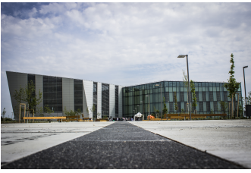

Running projects – NLTSF for ELI-ALPS
Major goal – Implementation of the THz beamline
Development of THz pump – THz probe spectrometer
High-field (E> 1 mJ) THz source for experiments
2
Notes:
4
In my talk I will consider single-cycle THz pulses. A typical temporal shape of the electric field of such pulses are shown here. Because of the different application possibilities, it is useful to classify such THz pulses based on their energy and peak electric field strength. The weakest THz pulses with high repetition rate are used for example in linear THz spectroscopy. THz pulses with about eight orders of magnitude larger energy are used in nonlinear THz spectroscopy. In the larger part of my talk I will consider generation and applications of THz pulses which need even a few 1000 times larger THz energy. These THz pulses have extremely high field, significantly above 1 MV/cm.

Slide 5
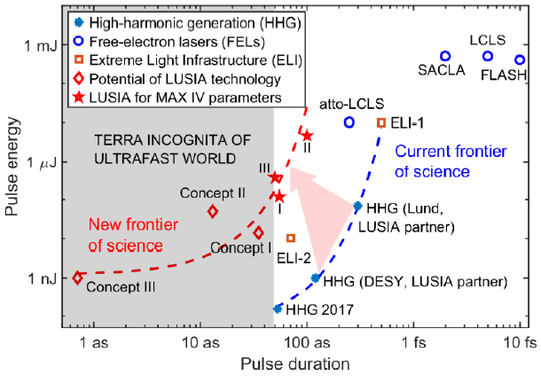
Running projects – LUSIA (FET OPEN)
Major goal: Development of CEP stable attosecond source
2
Notes:
5
In my talk I will consider single-cycle THz pulses. A typical temporal shape of the electric field of such pulses are shown here. Because of the different application possibilities, it is useful to classify such THz pulses based on their energy and peak electric field strength. The weakest THz pulses with high repetition rate are used for example in linear THz spectroscopy. THz pulses with about eight orders of magnitude larger energy are used in nonlinear THz spectroscopy. In the larger part of my talk I will consider generation and applications of THz pulses which need even a few 1000 times larger THz energy. These THz pulses have extremely high field, significantly above 1 MV/cm.

Slide 6
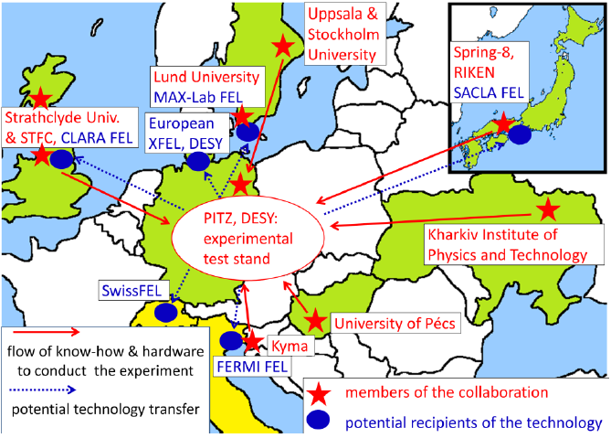
Running projects – LUSIA (FET OPEN)
2
Notes:
6
In my talk I will consider single-cycle THz pulses. A typical temporal shape of the electric field of such pulses are shown here. Because of the different application possibilities, it is useful to classify such THz pulses based on their energy and peak electric field strength. The weakest THz pulses with high repetition rate are used for example in linear THz spectroscopy. THz pulses with about eight orders of magnitude larger energy are used in nonlinear THz spectroscopy. In the larger part of my talk I will consider generation and applications of THz pulses which need even a few 1000 times larger THz energy. These THz pulses have extremely high field, significantly above 1 MV/cm.

Slide 7
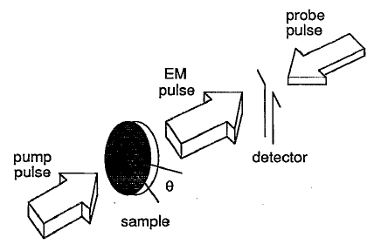
THz pulse generation by optical rectification (OR) of ultrashort laser pulses in nonlinear optical crystals
NOC: GaAs, DAST, LiTaO₃, ZnTe
X.-C. Zhang et al., Appl. Phys. Lett. 61, 2764 (1992)
X.-C. Zhang et al., Appl. Phys. Lett. 61, 3080 (1992)
A. Rice et al., Appl. Phys. Lett. 64, 1324 (1994)
Velocity matched: vgr_{pump} = v^{phase}_{THz}
ngr_{pump} = n^{phase}_{THz}
Extensively used: Ti:sapphire laser (820 nm) pulse OR in ZnTe
phase-matched (velocity matched)
Velocity matching by tilted-pulse-front pumping in LiNbO₃ (LN)
Much higher THz generation efficiency
3
Notes:
7
Using OR of ultrashort laser pulses for THz pulse generation started at the beginning of 1990s. For efficient generation of THz pulse by OR, a velocity matching condition has to be fulfilled: namely the velocity of the ultrashort laser pulse inside the nonlinear crystal has to be equal with the phase velocity of the generated THz radiation. That is, the two index of refraction has to be equal. This condition is fulfilled in the case of optical rectification of Ti:saphire laser pulses in ZnTe semiconductor crystal. Because of its simple geometry and the relatively high nonlinear coefficient of ZnTe such THz source become very popular, and was used for a decade as a high energy THz source.
However, after introducing the tilted-pulse-front-pumping technique for achieving velocity matching in OR, it become evident that THz generation from the LN dielectric crystal is much more efficient than from ZnTe.

Slide 8
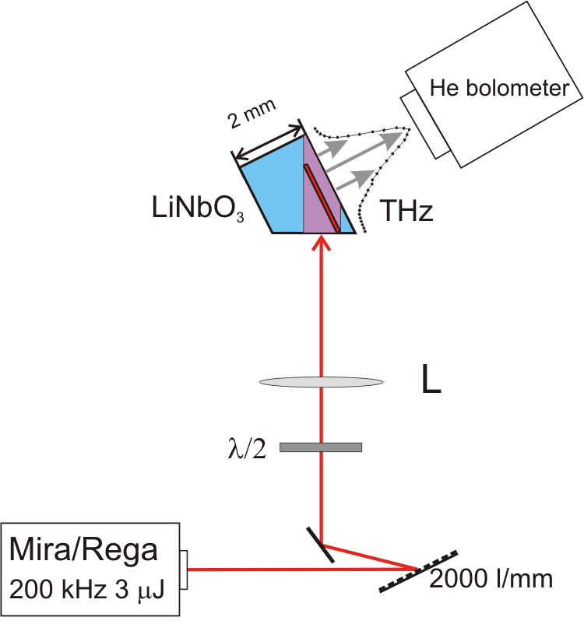
Velocity matching by tilted-pulse-front pumping
Hebling et al., Opt. Expr. 10, 1161 (2002)
lens
pulse front tilt
~100 fs typical
angular dispersion
fs laser
4
Notes:
The tilted pulse-front pumping technique was introduced seventeen years ago to achieve velocity matching between the pump pulse and the generated THz pulse in LN in which the THz radiation propagates two times slower than the NIR. The working principle is the followings: The THz radiation generated along a pump intensity front propagates perpendicular to this front, that is in the case of tilted intensity front the velocity matching condition becomes to this equation, consisting the cosine of the tilt angle, gamma. So with appropriate tilt angle velocity matching can be achieved. A typical set-up is shown here. It consists of a grating for tilting the pulse front and a lens for imaging the tilted front into the LN crystal.

Slide 9
Success of TPFP LiNbO3 THz sources
Large nonlinear coefficient
Material | ZnTe | GaP | GaAs | LN
d_{eff} [pm/V] | 68.5 | 24.8 | 65.6 | 168
Large bandgap, absence of low-order multi-photon absorption (MPA)
Very efficient THz pulse source on the 0.2 – 2 THz range
μJ level energy is enough for pump in pump – probe and control experiments
M.C. Hoffmann et al.: Phys. Rev. B 79, 161201 (2009)
Hirori et al.: Phys. Rev. B 81, 081305R (2010)
Review article:
T. Kampfrath, K. Tanaka, K. A. Nelson: Nat. Photonics 7, 680 (2013)
D. Nocoletti, and A. Cavalleri: Adv. in Opt. and Photon. 8, 401 (2016)
5
Notes:
According to published results, the efficiency of the LN TPFP terahertz source is more then two orders of magnitude larger than the simple ZnTe source, and the efficiency can be as high as 1 %. Generation of THz pulses with microjoules of energy is easily possible. Because of this, the LN TPFP set-ups are widespread used now in a lot of laboratories for THz pump – probe, and control experiments in order to investigate in different nanostructures the dynamics of different excitations, for example excitons, polaritons, spin waves and so on.
These two articles review the application of LN and other high-field THz sources in pump – probe and control experiments.

Slide 10
Limitations for further upscaling the THz field strength
Hebling et al., Opt. Expr. 10, 1161 (2002)
γ = 63º
lens
pulse front tilt
~100 fs typical
angular dispersion
fs laser
6
Notes:
As I have shown, increasing the THz pulse energy generated by the TPFP LN source was easy up to the level of tens of microjoules just by increasing the energy of the pump laser and the pumped spot size. However, limitation of further increase of the efficiency and THz pulse energy can be clearly seen. The reason of this limitations originates in the large needed tilt angle gamma of 63 degree and the corresponding large angular dispersion in the pump beam.

Slide 11
Limitations of TPFP in LN
Pump
THz
Conventional tilted-pulse-front pumping (TPFP)
Hebling et al., Opt. Express, 2002
LN
grating
Limited interaction length due to large angular dispersion (γ≈63°)
  Fundamental limit
Imaging errors at large spot sizes
  Special limit
Prism shaped LN crystal with large wedge angle leads to THz pulse and beam distortions
Special limit
  It is challenging to increase the THz energy & field strength further
  Limited focusing (field increasing)
7
Notes:
The consequences of this large tile angle are the limited interaction length and the imaging errors. Furthermore the prism shaped LN source results distortion of the generated THz beam at large spot sizes.

Slide 12
Limited effective interaction length
Limited interaction length due to angular dispersion
J. Hebling, Opt. Quant. Elect., 28, 1759 (1996)
Pulse duration increasing rate ~ D*Δλ
Solutions:
Longer pump pulse duration
Using nonlinear crystal (e. g. semiconductor) with smaller needed tilt angle
J. A. Fülöp et al., Opt. Express, 18, 12311 (2010)
J. A. Fülöp et al., Opt. Express, 19, 15090 (2011)
J. A. Fülöp et al., Opt. Lett., 37, 557 (2012)
J. A. Fülöp et al., Opt. Express, 22, 20155 (2014)
S.-W. Huang et al., Opt. Lett. 38, 796 (2013)
8
Notes:
12
12
Let us see more closely the reason of the limited effective interaction length! The large needed pulse front-tilt angle means a large angular dispersion according to this equation. And the large angular dispersion results a large group-velocity-dispersion according to the right equation. Because of the large GVD the pulse duration of the ultrashort pump pulse evolves very fast inside the LN crystal , and the effective interaction length become short, which will reduce the efficiency as well.
Recently we have suggested and demonstrated two methods to reduce this problems, namely using longer pump pulses, and using nonlinear crystal with smaller needed tilt angle.

Slide 13
Mitigate/lesser fundamental limitation
Limited interaction length due to angular dispersion
Solution 1: Longer pump pulse duration
Suggested based on simulations:
J. A. Fülöp et al., Opt. Express, 18, 12311 (2010)
J. A. Fülöp et al., Opt. Express, 19, 15090 (2011)
Experimentally demonstrated
E_{THz} = 125 μJ, 460 μJ
J. A. Fülöp et al., Opt. Lett., 37, 557 (2012)
J. A. Fülöp et al., Opt. Express, 22, 20155 (2014)
Using cryogenically cooled LN
η = 2 % conversion efficiency
S.-W. Huang et al., Opt. Lett. 38, 796 (2013)
9
Notes:
13
13
After suggesting the first solution, we have proved experimentally the advantage of using longer pump pulses, and generated THz pulses with close to half a mJ energy. Using pump pulses with optimized duration and cooling the LN in order to reduce its THz absorption, the group of Prof. Kaertner demonstrated as high as 2 % THz generation efficiency.

Slide 14
Mitigate/lesser fundamental limitation
Limited interaction length due to angular dispersion
Solution 2: Nonlinear crystal with smaller needed tilt angle
Reconsidering semiconductors for THz generation!
10
Notes:
14
14
Let us see now the possibility of the other method in order to increase the effective interaction length. So let us reconsider using semiconductors as nonlinear materials for THz generation.

Slide 15
Reconsidering semiconductors for THz generation
Collinear phase matching at 800 nm pump laser wavelength
Smaller nonlinear coefficient
Strong two-photon absorption (2PA) at such pump
wavelengths
  Free carrier absorption
  of THz
  Limited useful pump
  intensity
  Low efficiency for THz generation
Material | ZnTe | GaP | GaAs | LN
d_{eff} [pm/V] | 68.5 | 24.8 | 65.6 | 168
Solution: longer pump wavelength
  Allows for higher pump intensity and more efficient THz generation
  Requires tilted-pulse-front pumping
J. A. Fülöp et al., Opt. Express 18, 12311 (2010) F. Blanchard et al., Appl. Phys. Lett. 105, 241106 (2014)
11
Notes:
For THz generation it was very convenient to use ZnTe pumped by Ti:s lasers since a collinear phase-matching is fulfilled for this material at about 800 nm pumping. However, for 800 nm two-photon absorption is allowed in ZnTe, and because of this, free carriers will be generated resulting strong THz absorption. Actually, not the smaller nonlinearity of the ZnTe compared to LN is the mean reason of the much lower efficiency for ZnTe, but the THz absorption induced by the two-photon absorption. So let us eliminate the TP absorption in ZnTe by using longer pump wavelength!

Slide 16

Tilted-pulse-front pumping semiconductors
Small tilt angle for semiconductors ($γ≲30°$)
ZnTe contact-grating THz source
Large interaction length for THz generation compensates for smaller nonlinear coefficient
More uniform crystal length across the pumped area
Advantageous for the implementation of a contact grating
12
Notes:
In the case of longer pump wavelength tilting of the pulse front is necessary because of the decreased index of refraction at the pump wavelength. However, the required pulse front tilt is less than half for semiconductors than for LN. Therefore the angular dispersion and the GVD can be much smaller for semiconductors resulting much longer effective interaction length. We carried out experiments with such long wavelength.

Slide 17
ZnTe pumped at 1.7 μm wavelength, excluding both 2 or 3 PA
Semiconductor TPFP THz sources compared to LN ones
Pumping at 1.7 μm with 2.7 mJ, 140 fs
E_{THz}= 14 μJ, η=0.7 %
13
Comparison semiconductor THz sources:
ZnTe: η = 3.1x10⁻³ % with 48 mJ pump @ 0.8 µm (2PA) (Blanchard et al., Opt. Express, 2007)
GaAs: η = 0.05 % with 1.44 mJ pump @1.8 µm (3PA) (Blanchard et al., Appl. Phys. Lett., 2014)
Notes:
Pumping at 1.7 µm wavelength with up to 2.7 mJ energy and 140 fs duration resulted THz pulses with up to 14 microJ. The generation efficiency was as high as 0.7 %!
This graph summarizes earlier published experimental data and our recent results. The empty symbols belong to LN experiments. The blue symbols correspond to ZnTe pumped at 0.8 um where 2PA exists. For this case the efficiency for ZnTe is more than 2 orders of magnitude less than for LN has. However, if 2PA and 3PA is eliminated by using long pump wavelength the THz energy obtained with semiconductors approaches the energy obtained with LN.

Slide 18
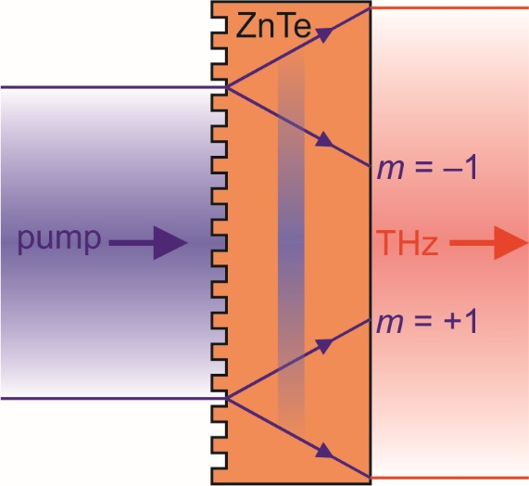
ZnTe contact-grating THz source
Elimination of the imaging error, using plan-parallel nonlinear crystal
Pump
THz
Conventional TPFP (with imaging)
grating
imaging
LiNbO₃
TPFP with contact grating (no imaging)
L. Pálfalvi et al., Appl. Phys. Lett. 92, 171107 (2008)
Collinear geometry possible
(with symmetrically propagating diffraction orders m = ±1)
  Bakunov et al., J. Opt. Soc. Am. B, 2014
THz energy easily increased by using larger pumped area
Excellent THz beam quality
14
Notes:
For semiconductors it is also possible to eliminate the imaging error and to use plan-parallel crystal instead of the prism shaped one. In order to do this, we have to apply the contact-grating technique what we proposed eleven years ago. For such set-up THz energy can be easily increased by increasing the pump energy and the pumped spot size, and an excellent THz beam quality can be expected.

Slide 19
ZnTe contact-grating THz source
X100 efficiency compared to 800 nm pumped ZnTe
X10 efficiency compared to 2 μm pumped GaAs
J. A. Fülöp et al., Optica 3, 1075 (2016)
Gy. Polónyi et al.: IEEE JSTQE 23, 8501208 (2017) GaP η = 2%
Multi-cycle: P. S. Nugraha et al.: J. Phys. B 51, 094007 (2018),
G. Krizsán et al.: EOS-TST 2018, poster, GaP up to η = 7%
Source of pump pulses (DCOPA) Gy. Tóth et al.: Opt. Express 25, 28258 (2017)
Gy Tóth et al.: EOS-TST 2018, poster η = 50%
15
Notes:
We have performed measurements with ZnTe crystal having a rectangular grating on its input surface. THz pulses with up-to 3.9 microJ energy and 0.3% generation efficiency have been observed. This efficiency is one hundred times higher than the highest value obtained for ZnTe pumped at 800 nm. Simulation predicts above one % efficiency for optimized crystal length and pump pulse duration.

Slide 20
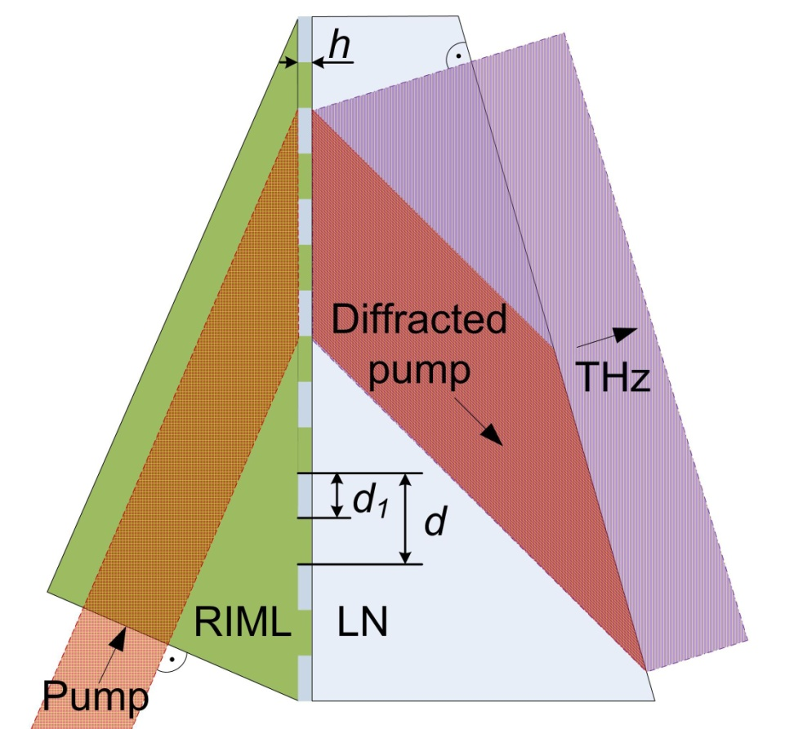
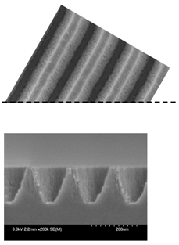
LiNbO₃ based contact gratings
Directly on crystal
Ollmann et al., Appl. Phys. B, 2012
With dielectric multilayers
Tsubouchi et al., Opt. Lett., 2014
500 nm
LN
Al₂O₃ + Ta₂O₅ multilayers on LiNbO₃
71% diffraction efficiency
0.41 µJ THz pulse energy
1.5x10⁻⁴ conversion efficiency
350 nm
Requires index-matching
Difficult manufacturing
16
Scitech Precision Ltd. (UK)

Slide 21
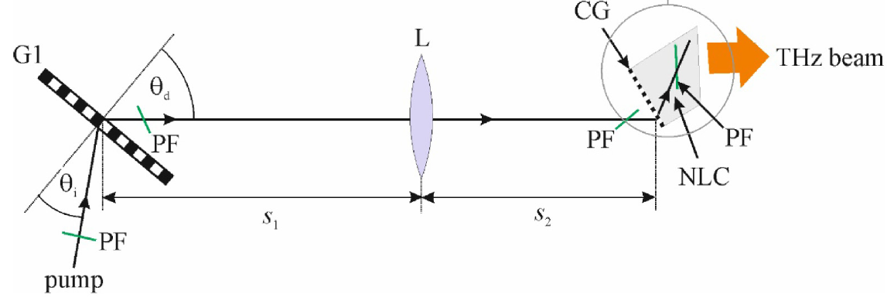
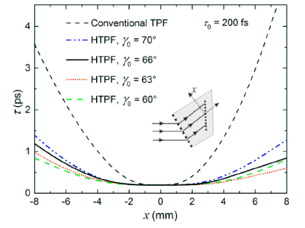
Mitigate/lesser limitation for LN
Hybrid TPFP set-up for LN
LN contact grating THz source: Z. Ollmann et al.: Appl. Phys. B 108, 821 (2012)
Reduced limitations:
1. Decreased pulse lengthening
2. Wedge angle is only: 30º
L. Pálfalvi et al.: Optics Express 24, 8156 (2016)
17
Notes:
We also suggested contact grating LN THz source. However, because of the large needed tilt angle and the correspondingly large grating grove density needed in the case of LN, such devise has proved technically not feasible.
According to our simulation there is a possibility to mitigate the limitations of efficiency and THz pulse energy increase in the case of LN THz source, too by using so-called hybrid set-ups combining the earlier used imaging set-up with LN consisting contact grating on its input surface, as shown here. We have not tried this set-up yet.

Slide 22
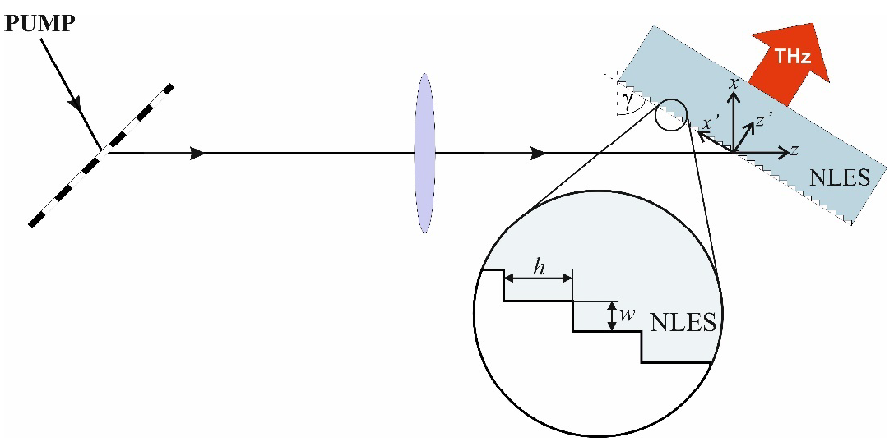
Plan-parallel Non-Linear-Echelon-Slab (NLES) LN THz source
Strongly reduced limitation in case of hybrid TPFP schemes
Echelon grating
B. K. Ofori-Okai et al.: Optics Express 24, 5057 (2016) reflection echelon, LN prism
L. Pálfalvi et al.: Optics Express 25, 29560 (2017)
18
Notes:
Instead, inspired by a publication of Prof. Nelsons group from the MIT, very recently we suggested NLES LN THz sources. The first type of these setups are shown here. It consists a grating- imaging part introducing about half of the needed tilt angle, and a plan-parallel nonlinear optical slab with an echelon structure on it input surface.

Slide 23
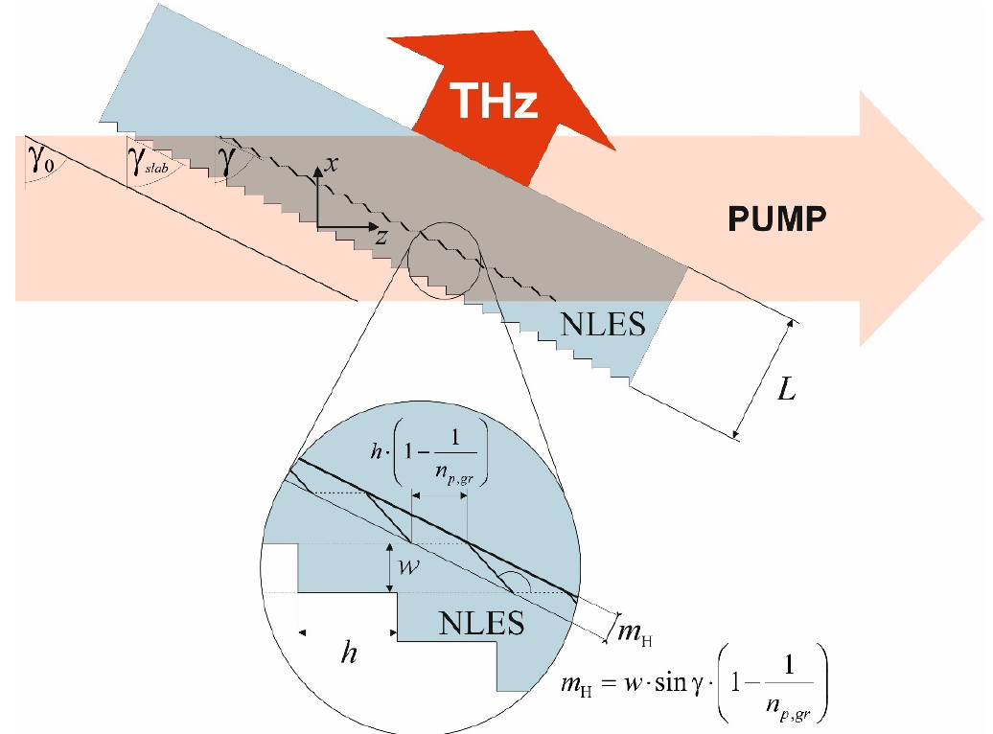
Plan-parallel Non-Linear-Echelon-Slab (NLES) LN THz source
Preliminary results: 1.2 μJ THz
= 0.06 % at 300 K
Perfect single-cycle THz pulse shape
1 mJ THz predicted at T = 100 K for 500 fs, 100 mJ pump from 1 inch diameter LN with η = 1 %
L. Pálfalvi et al.: Opt. Express 25, 29560 (2017)
P.S. Nugraha et al.: Opt. Lett. 44, 1023 (2019)
19
Notes:
For such set-up numerical simulations predict generation of THz pulses with 1 mJ energy, pumping a one inch diameter LN crystal cooled to cryogenic temperature by only 100 mJ at 1 micrometer wavelength. Our proof of principle experiment demonstrated 0.06 % generation efficiency at room temperature in not optimized conditions. From the experimental results we expect at least 0.5 % efficiency for low temperature, larger crystal size and optimized pump pulse duration.

Slide 24
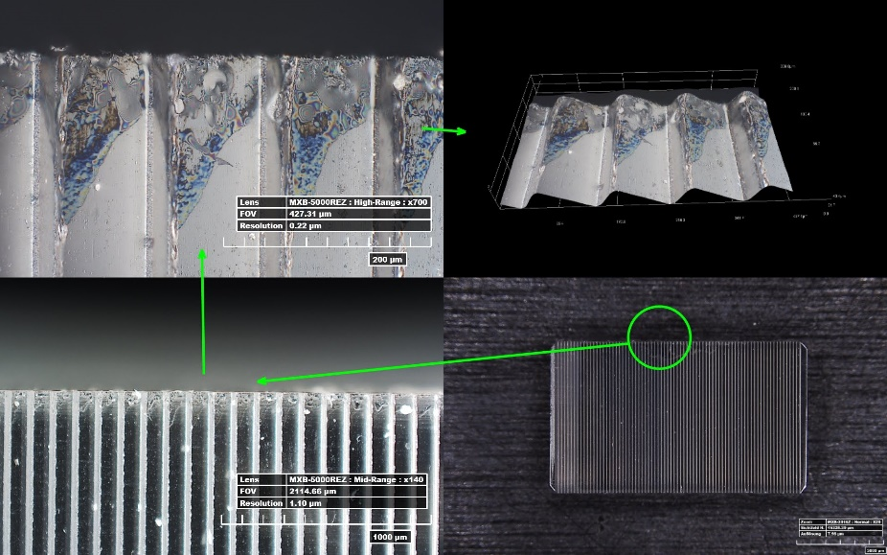
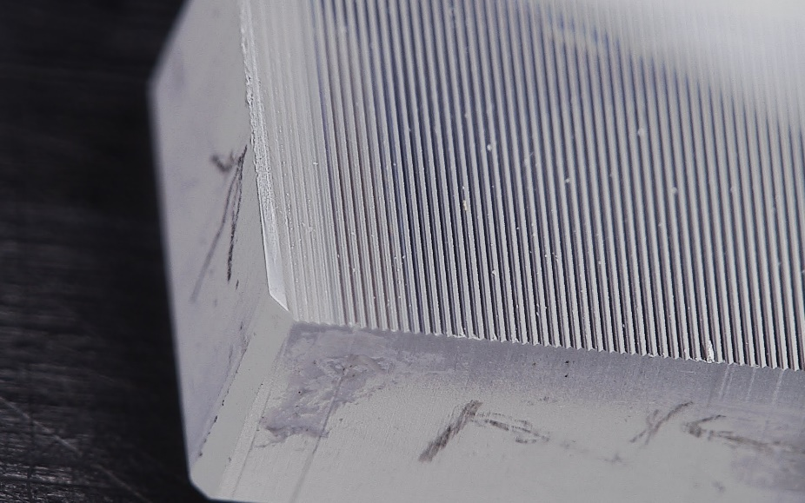
Fabrication of the echelon
Monocrystal Diamond Tool micromilling
By Kugler Precision GmbH
20
Notes:
By OR of ultrashort laser pulses in GaSe birefrigent semiconductor or in organic crystal resulted THz pulse with tens of MV/cm peak electric field strength at large frequency. At lower frequency where the focusing is more difficult peak field of a few MV/cm has been demonstrated in LN. With the set-up I introduced in my last slides generation of THz pulses above 10 MV/cm is expected on the 0.3 to 3 THz range. Let see a few application possibilities of these THz pulses having extremely high field strength!

Slide 25
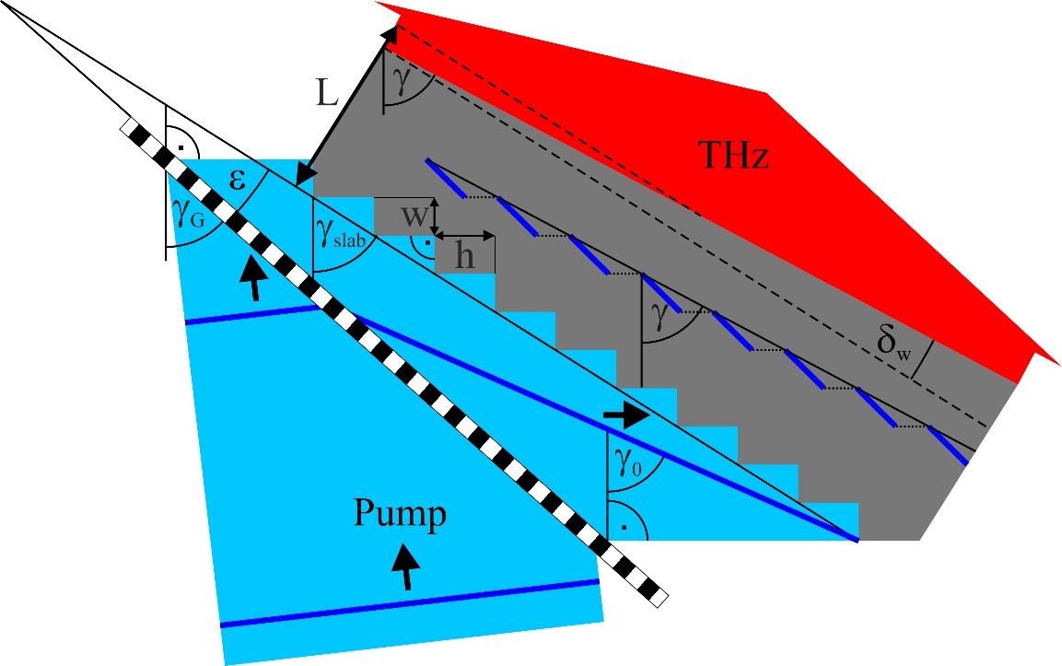
Non-Linear-Echelon-Slab (NLES) LN THz source without imaging
Gy. Tóth et al.: Opt. Express 27, 7762 (2019)
21
Notes:
We suggested a modified NLES THz source. This do not contains imaging. It contains only a transmission grating and an NLES. Depending on the pretilt angle introduced by the diffraction off the grating, the NLES has to be wedged, but only with a small wedge angle.

Slide 26
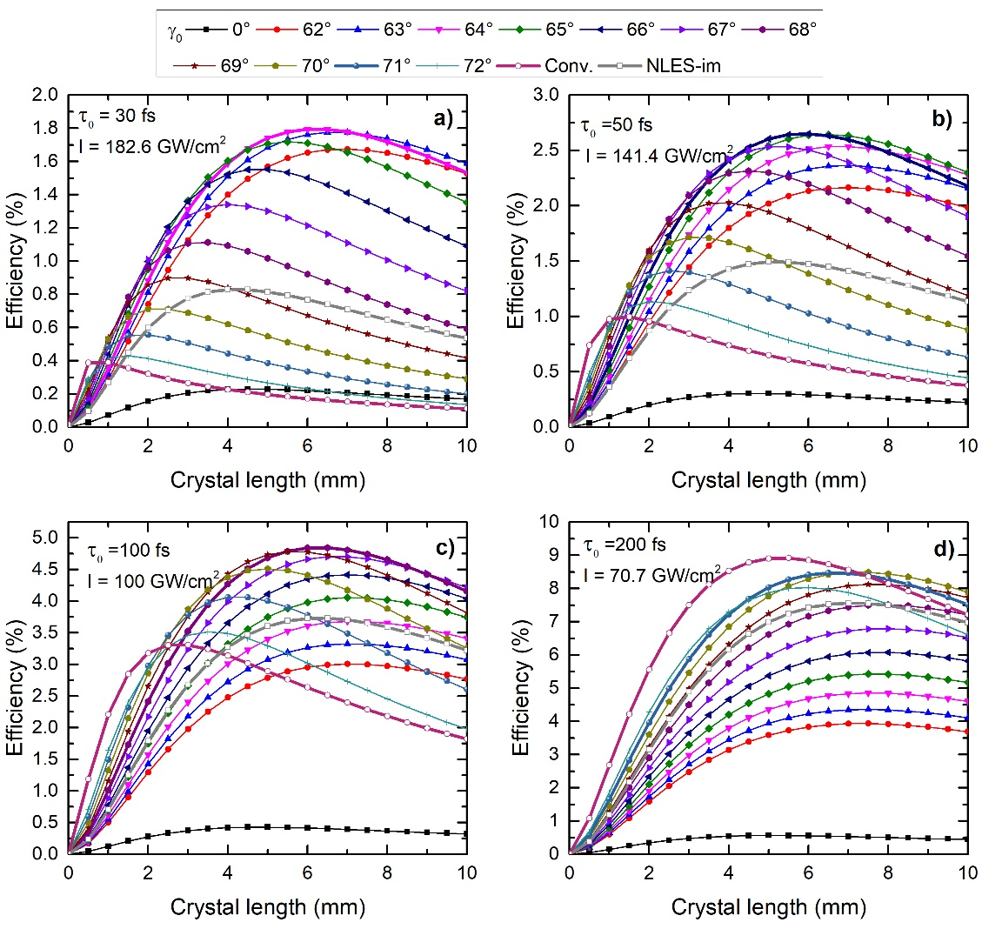
Non-Linear-Echelon-Slab (NLES) LN THz source without imaging
τ₀ = 100 fs, γ₀ = 68º,
η = 4.7 %, δ_{w}= 9º
Gy. Tóth et al.: Opt. Express 27, 7762 (2019)
22
Notes:
These graphs show the dependences of the predicted THz generation efficiency on the LN crystal thickness for a few pre-tilt angle, for four different pump pulse durations. For comparison, result of calculations for the conventional TPFP LN source and the NLES set-up containing imaging are also shown.
As you see the NLES set-up without imaging is superior for short pump pulse duration. The pre-tilt-angle needed for the highest efficiency depends on the pump pulse duration. For 100 fs pump duration the optimal pre-tilt angle is 68 degree. In this case close to 5% efficiency is predicted, and the wedge angle of the NLES is only 9 degree.

Slide 27
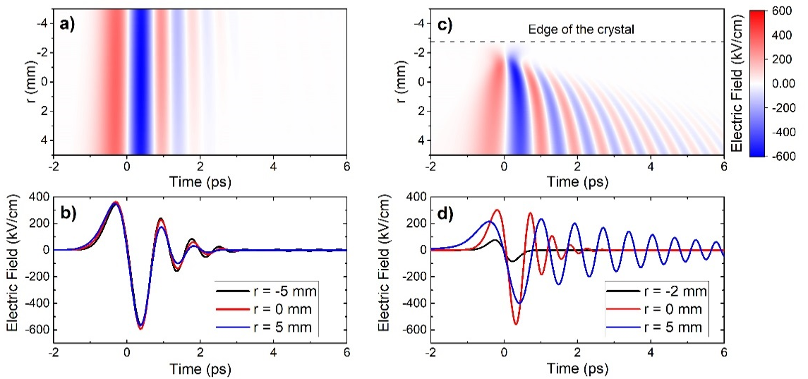
Non-Linear-Echelon-Slab (NLES) LN THz source without imaging
Temporal shapes at the center of the THz beam and at the two edges
NLES
Conventional TPFP LN prism
Gy. Tóth et al.: Opt. Express 27, 7762 (2019)
23
Notes:
The main advantage of the NLES THz source comparing to the conventional TPFP LN set-up containing prism-shaped LN is the position independent temporal shape of the THz pulse.
You can see that in the case of conventional TPFP set-up there are a strong spatial dependence of the temporal shape, in contrary to the NLES case.

Slide 28
Reflective Non-Linear Slab (RNLS) LN THz source
Gy. Tóth et al.: Optics Express, acccepted
E_{p} = 0.45 J, Δt_{p} = 1.0 ps, w_{p0} = 5 cm, I_{p0} = 26.7 GW/cm² → E_{THz} = 5.6 mJ, η = 1.2 %
Perfectly single-cycle THz pulse with 0.4 MV/cm electric field
Focusing by NA = 0.9 → > 40 MV/cm peak electric field
24
Notes:
The third version of the NLES set-up working in reflection geometry, as it is indicated on the figure. The pump pulse arrives from right, and it is reflected on the structured back side of the NLES. The generated THz pulse leaves the crystal though the input surface on the right.
This set-up is advantageous for long pump pulse duration, and generating low frequency THz pulse. For such set-up applying pump pulses having less than half J energy and 1 ps duration simulation predicts generation of THz pulses having as high as 5.6 mJ energy and higher than 40 MV/cm, focused peak electric field strength. The generated THz pulse is perfectly single-cycle, and it remains nearly single-cycle after focusing, too. This pulse shape is very important and advantageous in case of THz driven particle acceleration.

Slide 29
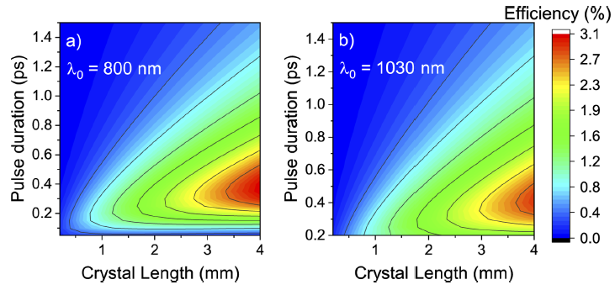
Reflective Non-Linear Slab (RNLS) LN THz source
24
Notes:
The third version of the NLES set-up working in reflection geometry, as it is indicated on the figure. The pump pulse arrives from right, and it is reflected on the structured back side of the NLES. The generated THz pulse leaves the crystal though the input surface on the right.
This set-up is advantageous for long pump pulse duration, and generating low frequency THz pulse. For such set-up applying pump pulses having less than half J energy and 1 ps duration simulation predicts generation of THz pulses having as high as 5.6 mJ energy and higher than 40 MV/cm, focused peak electric field strength. The generated THz pulse is perfectly single-cycle, and it remains nearly single-cycle after focusing, too. This pulse shape is very important and advantageous in case of THz driven particle acceleration.

Slide 30
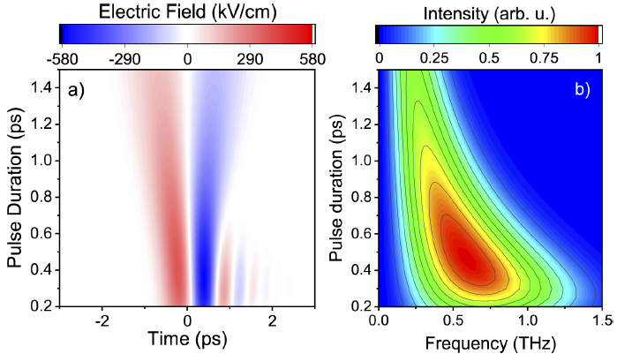
Reflective Non-Linear Slab (RNLS) LN THz source
24
Notes:
The third version of the NLES set-up working in reflection geometry, as it is indicated on the figure. The pump pulse arrives from right, and it is reflected on the structured back side of the NLES. The generated THz pulse leaves the crystal though the input surface on the right.
This set-up is advantageous for long pump pulse duration, and generating low frequency THz pulse. For such set-up applying pump pulses having less than half J energy and 1 ps duration simulation predicts generation of THz pulses having as high as 5.6 mJ energy and higher than 40 MV/cm, focused peak electric field strength. The generated THz pulse is perfectly single-cycle, and it remains nearly single-cycle after focusing, too. This pulse shape is very important and advantageous in case of THz driven particle acceleration.

Slide 31
Application possibilities of THz pulses with extremely high field strength
1., Enhancement of HH generation (for attosecond pulse generation)
E. Balogh et al.: Phys. Rev. B 84, 023806 (2011)
K. Kovács et al.: Phys. Rev. Lett. 108, 193905 (2012)
2., Field-free orientation of molecules
S. Fleischer et al.: Phys. Rev. Lett. 107, 163603 (2011)
K. N. Egodapitiya et al.: Phys. Rev. Lett. 112, 103002 (2014)
3., Acceleration (and other manipulations) of charged particles
J. Hebling et al.: arXiv 1109.6852 (2011)
L. Pálfalvi et al.: Phys. Rev. ST-AB 17, 031301 (2014)
Works of the Kaertner group
W. Ronny et al.: Sci. Reports 5, 14899 (2015)
W. Ronny et al.: Optica 3, 1209 (2016)
E. A. Nanny et al.: Nature Comm. 6, 8486 (2015)
D. Zhang et al.: Nature Photonics (2018) doi: 10.1034/s41566-01efore Lunch8-0138-7
E. Curry et al.: Phys. Rev. Lett. 120, 094801 (2018), IFEL based
Z. Tibai et al.: J. Phys. B 51, 134004 (2018)
4., Carrier-envelop-phase (CEP) stable attosecond pulse generation
Gy. Tóth et al.: JOSA B 35, A103 (2018)
25
Notes:
THz pulses having electric field strength on the range of MV/cm or above have very important and interesting application possibilities.
Just mentioning a few: According to numerical simulations both increasing the generation efficiency and the cut-off frequency of HHG is possible by applying intense THz pulses. Field-free orientation of molecules by THz pulses has been experimentally demonstrated.
We have proposed acceleration of electrons and protons by THz pulses. THz electron gun and electron acceleration has been demonstrated by the group of Prof. Kaertner. THz driven IFEL based electron manipulator has been also demonstrated. We proposed a THz driven electron gun – accelerator set up to accelerate electrons up to relativistic energy. A source of very unique attosecond pulses with CEP stability has been suggested.

Slide 32
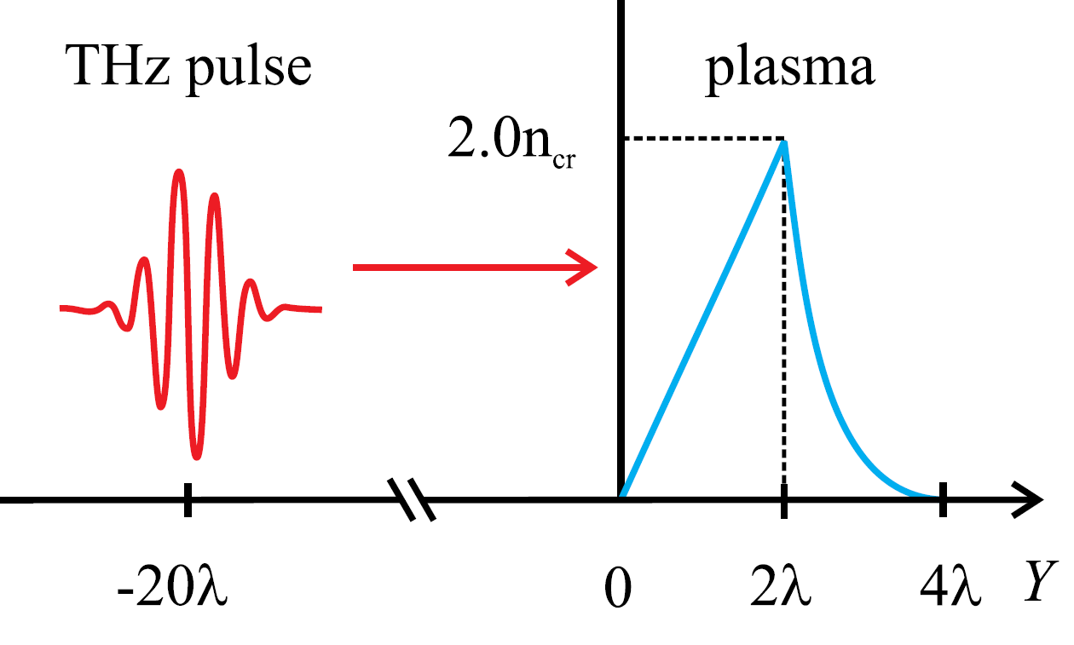
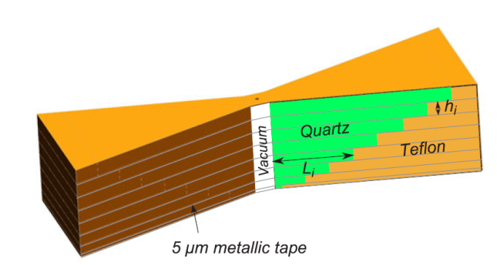
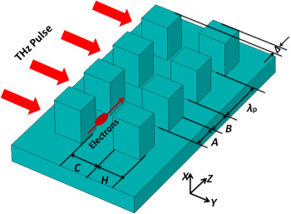

THz based particle accelerators
Proton accelerators
  Proton acceleraton in gas-jet
  A. Sharma … J. Hebling, Phys Plasmas, 2016
  Proton-post acceleration
  L. Pálfalvi … J. Hebling, Phys. Rev. ST Accel. Beams, 2014
Electron accelerators
  Electron undulation and manipulation
  Hebling et al., arXiv:1109.685
  Electron gun
  W. R. Huang … F X Kärtner, Sci. Rep., 2015,
  A. Fallahi … F. X. Kärtner, Phys. Rev. Accel. Beams, 2016
  Linear accelerator
  E. A. Nanni … F. X. Kärtner, Nat. Commun., 2015
  Dielectric accelerator
  Y. Wei … C.P. Welsch, Nucl. Instrum. Meth. A, 2018
Notes:
A nagyenergiájú lézerforrások (mind pumpa mind belőlük előállító impulzusokon keresztül) lehetővé tették részecskék manipulálását gyorsítását az elmúlt évek során a THz-es tartományon.
Pl protonokét, melyek közül egy friss tanulmány alapján gas jet-be fókuszált intenzív THz-es impulzus képes álló protonokat gyorsítani (közel 0.5 MeV-os energiára).
Vagy pl a protonok utógyorsítását is megvalósítható THz-es impulzusokkal (mely során eveneszcens tér alakul ki LN párok között).
De az elmúlt 4 év fő irányvonalát az elektrongyorsítás határozta meg.
Ennek a területnek az alapjait egy arXiv cikk fektette le, amelyet számos friss, új és kísérleti megvalósítás követett. Ezen kutatások főbb vezetője Franz Kartner.
Ilyen elrendezés pl a vákuumos elektronágyú, mely során hullámvezető segítségével megtöbbszörözik a térerősséget és vezetik az elektronforrás útjába, ahol már előre gyorsított elektronokat tovább gyorsítanak. Ilyen elrendezéssel már kísérletileg is megvalósultak az első tesztkísérletek és több keV gyorsítást sikerült elérni.
Annak a célnak az érdekében, hogy az elektronok elérjék a MeV-os cikket megalakult a THz-based linac.
Az utolsó fő eljárás pedig a DLA, melynek fő kutatója Carlsten Welsch, akik a szokásos/hagyományos dielektrikumos struktúrát THz-es tartományban is vizsgálták.
Ezen elméleti és kísérleti megvalósításoknak alapjául az szolgál, hogy az elmúlt évtizedben a THz-es impulzusok energiája 7 nagyságrendet növekedett.

Slide 33
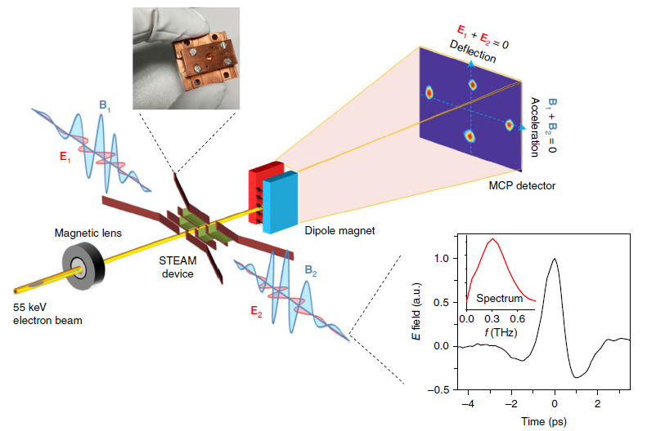
THz based particle accelerators – STEAM Device – Kärtner group
Notes:
A nagyenergiájú lézerforrások (mind pumpa mind belőlük előállító impulzusokon keresztül) lehetővé tették részecskék manipulálását gyorsítását az elmúlt évek során a THz-es tartományon.
Pl protonokét, melyek közül egy friss tanulmány alapján gas jet-be fókuszált intenzív THz-es impulzus képes álló protonokat gyorsítani (közel 0.5 MeV-os energiára).
Vagy pl a protonok utógyorsítását is megvalósítható THz-es impulzusokkal (mely során eveneszcens tér alakul ki LN párok között).
De az elmúlt 4 év fő irányvonalát az elektrongyorsítás határozta meg.
Ennek a területnek az alapjait egy arXiv cikk fektette le, amelyet számos friss, új és kísérleti megvalósítás követett. Ezen kutatások főbb vezetője Franz Kartner.
Ilyen elrendezés pl a vákuumos elektronágyú, mely során hullámvezető segítségével megtöbbszörözik a térerősséget és vezetik az elektronforrás útjába, ahol már előre gyorsított elektronokat tovább gyorsítanak. Ilyen elrendezéssel már kísérletileg is megvalósultak az első tesztkísérletek és több keV gyorsítást sikerült elérni.
Annak a célnak az érdekében, hogy az elektronok elérjék a MeV-os cikket megalakult a THz-based linac.
Az utolsó fő eljárás pedig a DLA, melynek fő kutatója Carlsten Welsch, akik a szokásos/hagyományos dielektrikumos struktúrát THz-es tartományban is vizsgálták.
Ezen elméleti és kísérleti megvalósításoknak alapjául az szolgál, hogy az elmúlt évtizedben a THz-es impulzusok energiája 7 nagyságrendet növekedett.

Slide 34
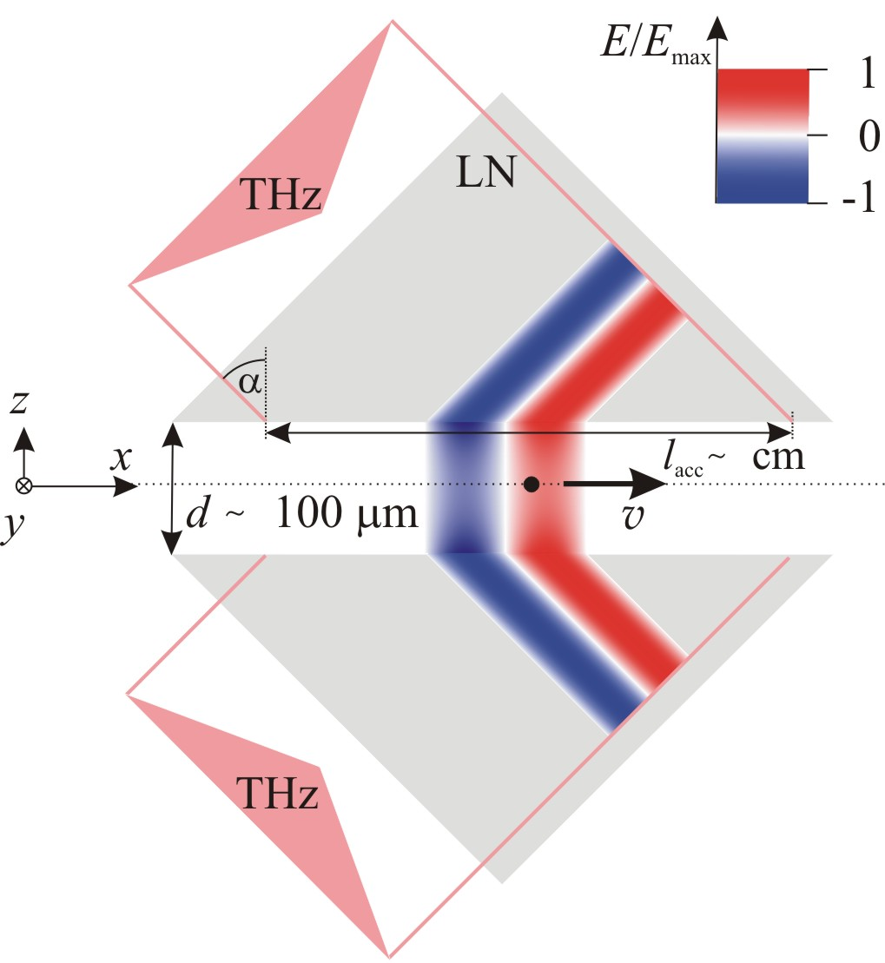
Evanescent THz wave proton post-accelerator setup
Material requirements
High optical damage threshold
Large index of refraction
Low absorption
Low dispersion
Cooled LiNbO₃ (LN)
Palfalvi et al., Phys. Rev. ST-AB 17, 031301 (2014)
Notes:
34
The THz-driven evanescent-wave proton post-accelerator consists of two symmetrically arranged identical dielectric prisms with high index of refraction. The accelerating evanescent field in the gap is generated by two identical synchronized THz pulses, both arriving on the vacuum-dielectric interfaces at the same angle of incidence, which is larger than the critical angle. Protons with an initial velocity in the x direction enter the vacuum gap.

Slide 35
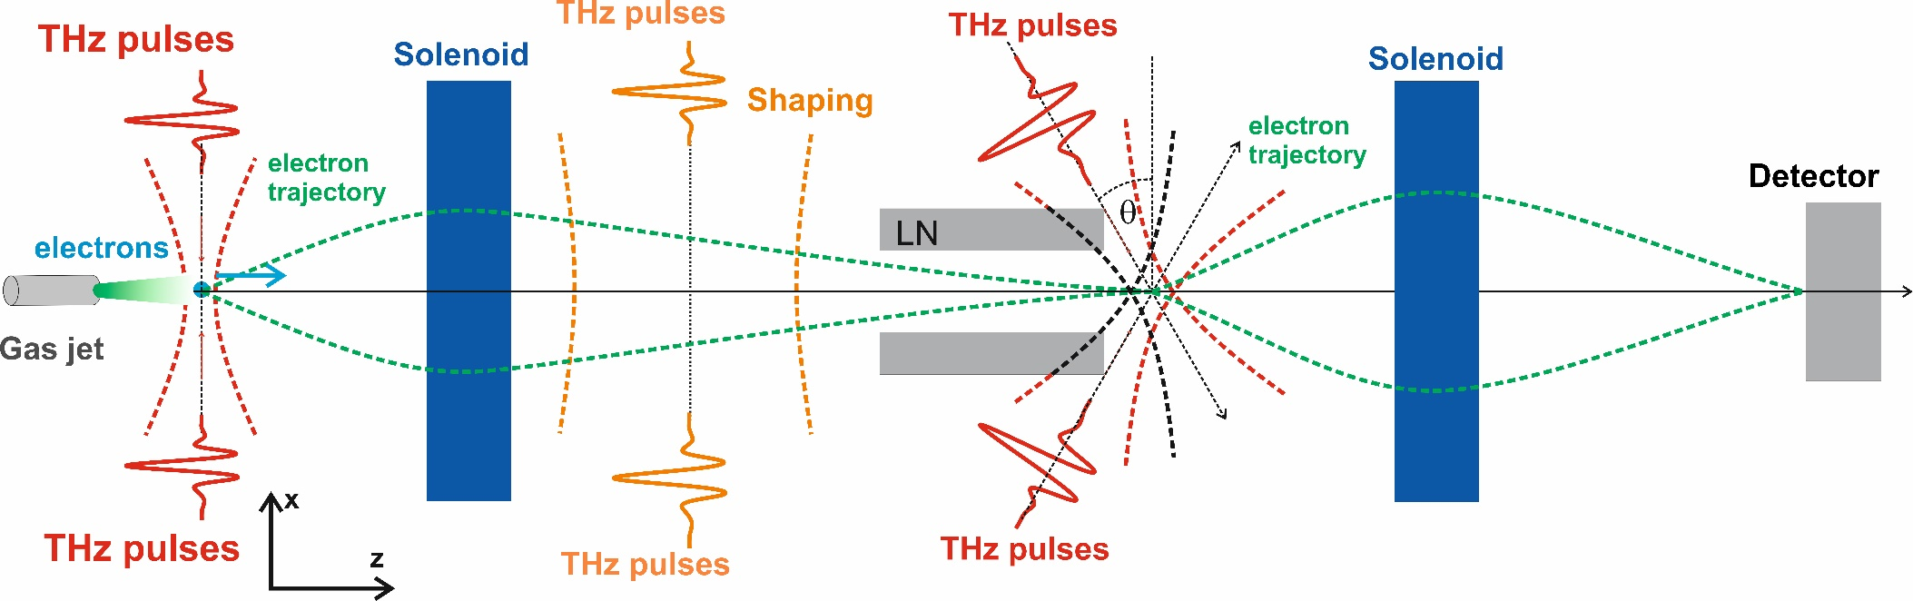
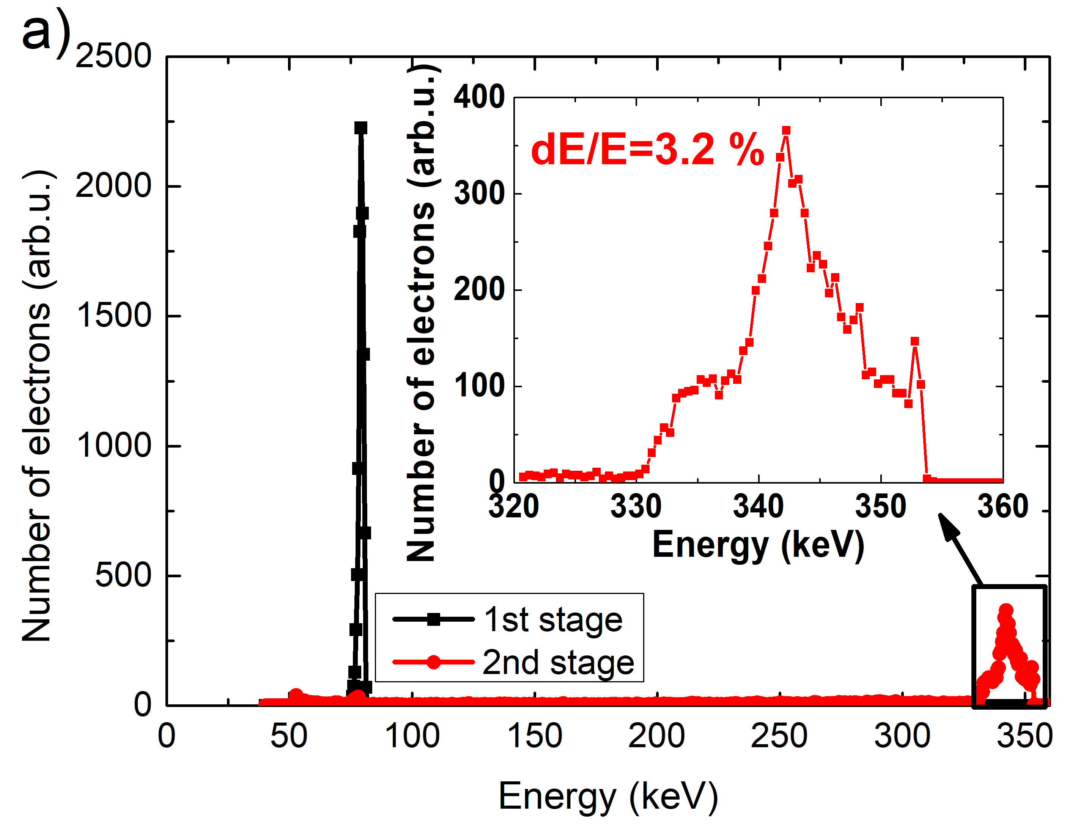
Plan of a THz-driven electron gun-accelerator system
2 x 4 x 0.5 mJ THz pulses
E = 340 keV, ΔE/E = 3.2%, τ_{b} < 90 fs, ø < 40 μm
Application possibility: time resolved electron diffraction
Tibai et al: J. Phys B 51, 134004 (2018)
Tibai et al.: unpublished
29
Notes:
This slide shows the main parts of a THz driven electron accelerator. It contains an electron gun and an accelerator. Both are driven by four single-cycle THz pulses with 0.5 mJ energy, each. A pair of small energy THz pulses are used for longitudinal compression of the electron bunch. According to the numerical simulation such only 5 cm long set-up is able to generate electron bunches with 340 keV energy, 3.2 % relative energy spread, shorter than 100 fs bunch duration and smaller than 40 micrometer spotsize.
Such device would be ideal for example for time resolved electron diffraction experiments.

Slide 36
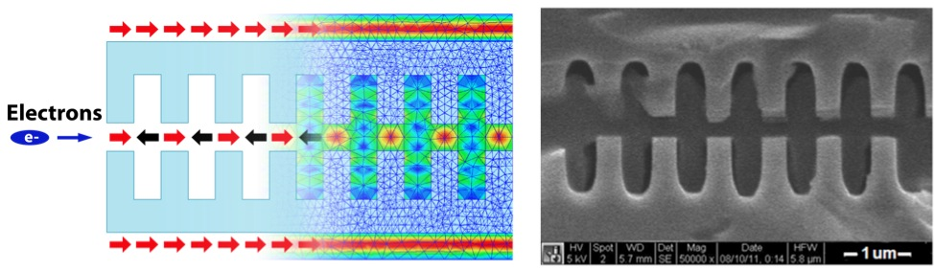
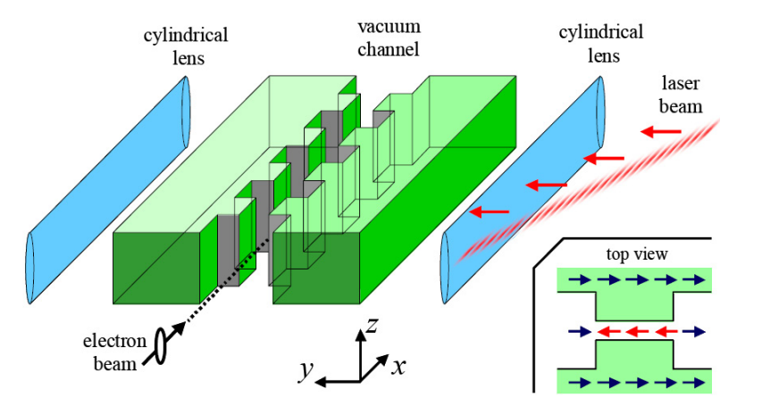
c) Dielectric laser accelerator (DLA)
T. Plettner et al., Phys. Rev. ST-AB, 9, 111301 (2006),
A. Aimidula … Y. Matsumura, Nucl. Instr. And Meth. A, 740, 108-113 (2014)
Y. Wei … C.P. Welsch, Appl. Optics, 56, 29 (2017)
THz-based DLA:
Z. Tibai … Hebling, La3net, Dresden, presentation
Y. Wei … C. P. Welsch, Nucl. Instr. And Meth. A, 877, 173-177 (2018)

Slide 37
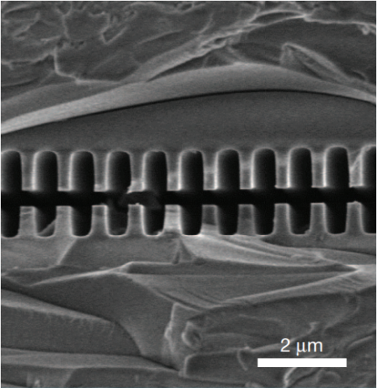
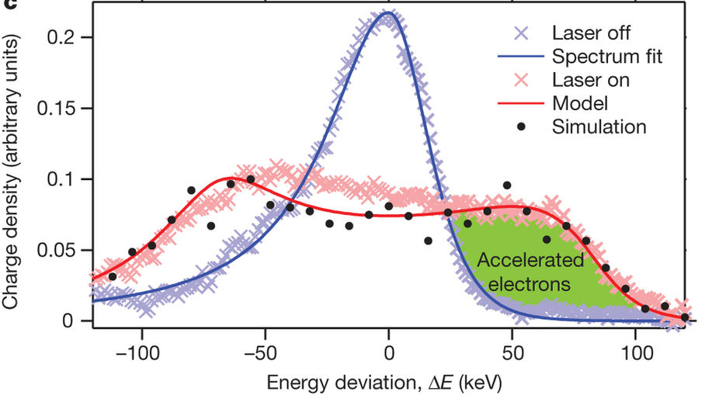
c) Dielectric laser accelerator (DLA)
E. A. Peralta et. al., Nature, 503, 91-94 (2013)
Disadvantage of 1 μm and advantage of THz:
Small gap → few charge can pass through
The length of the E-beam is of the order of mm → One part of the e-beam accelerate, one part deaccelerate

Slide 38
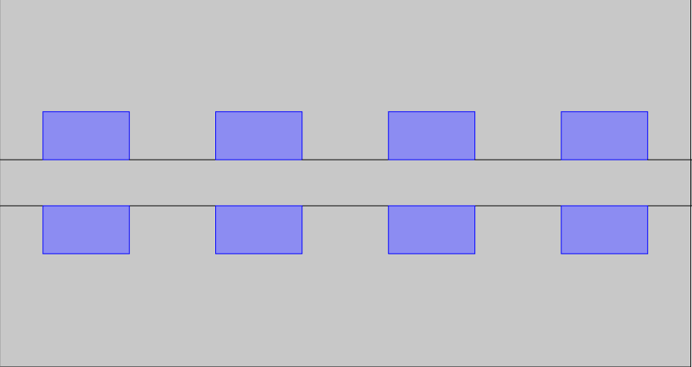
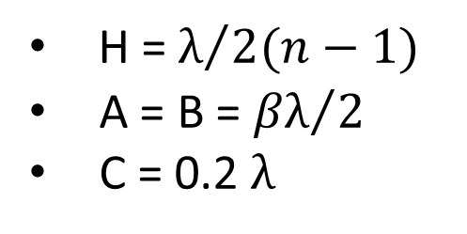
c) Dielectric laser accelerator (DLA)
THz
A
B
H
C
THz
Material: Silicon (n = 3.4)
β = 0.75 (265 keV)
H = $λ/{2(n−1)}$
A = B = ${βλ}/2$
C = 0.2 $λ$

Slide 39
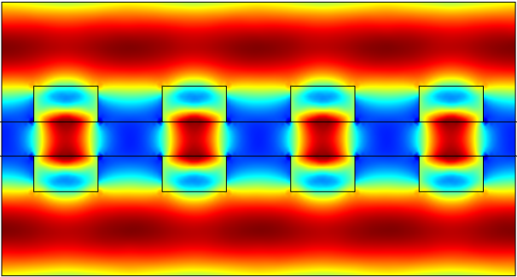
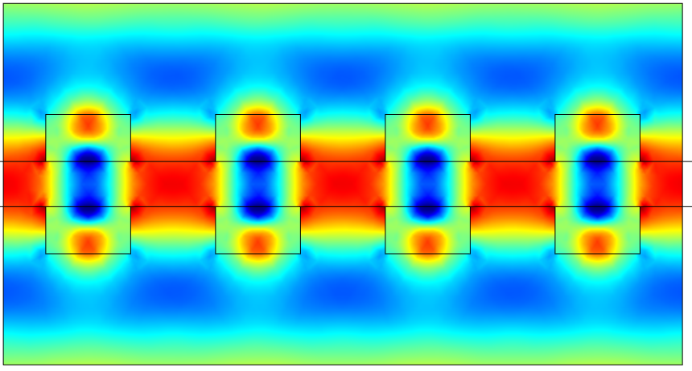
c) Dielectric laser accelerator (DLA)
 | 2 x 2.0 mJ
Frequency | 0.3 THz
Electric field: | 4.0 MV/cm

Slide 40

Thank you for your attention!
Funding Information:
National Research, Development and Innovation Office (NKFIH) (NN125808);
Hungarian Academy of Sciences (MTA) (János Bolyai Research Scholarship to J. A. Fülöp);
Ultrafast physical processes in atoms, molecules, nanostructures and biology structures (EFOP-3.6.2- 16-2017-00005);
almasi@fizika.ttk.pte.hu
tibai@fizika.ttk.pte.hu
hebling@fizika.ttk.pte.hu

