Slide 1
Measuring distances with light
Mana Zahrie
Sara Jevtic

Slide 2
Structure
Introduction: Research
Introduction: Interferometer
Building the Interferometer
Problems in Building
Measuring: Laser Wavelength
Measuring: Glass Thickness

Slide 3
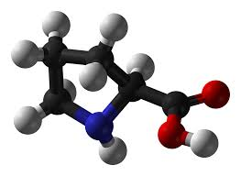
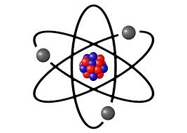
Introduction: Research
The idea is to find out how particles move by using super short beams of light (fs)
The particles move in attoseconds, so the experiment has to be precise (by nm)
Difficulties:
Adjusting the
lenght of both arms precisely
as
fs
ps
ns
μs
ms
s
10⁻¹⁸
10⁻¹⁵
10⁻¹²
10⁻⁹
10⁻⁶
10⁻³
1
10⁶
10¹²
10¹⁸

Slide 4
Introduction: Interferometer
We tried to measure short distances with light (laser)
Interferometer
Interference between two (split) beams

Slide 5
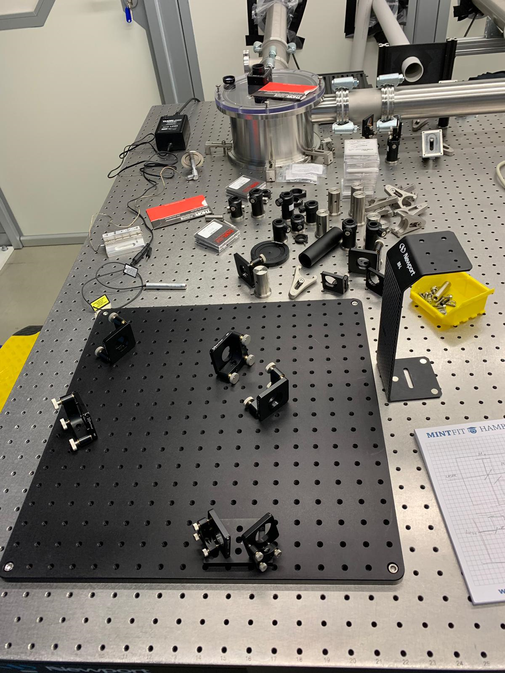
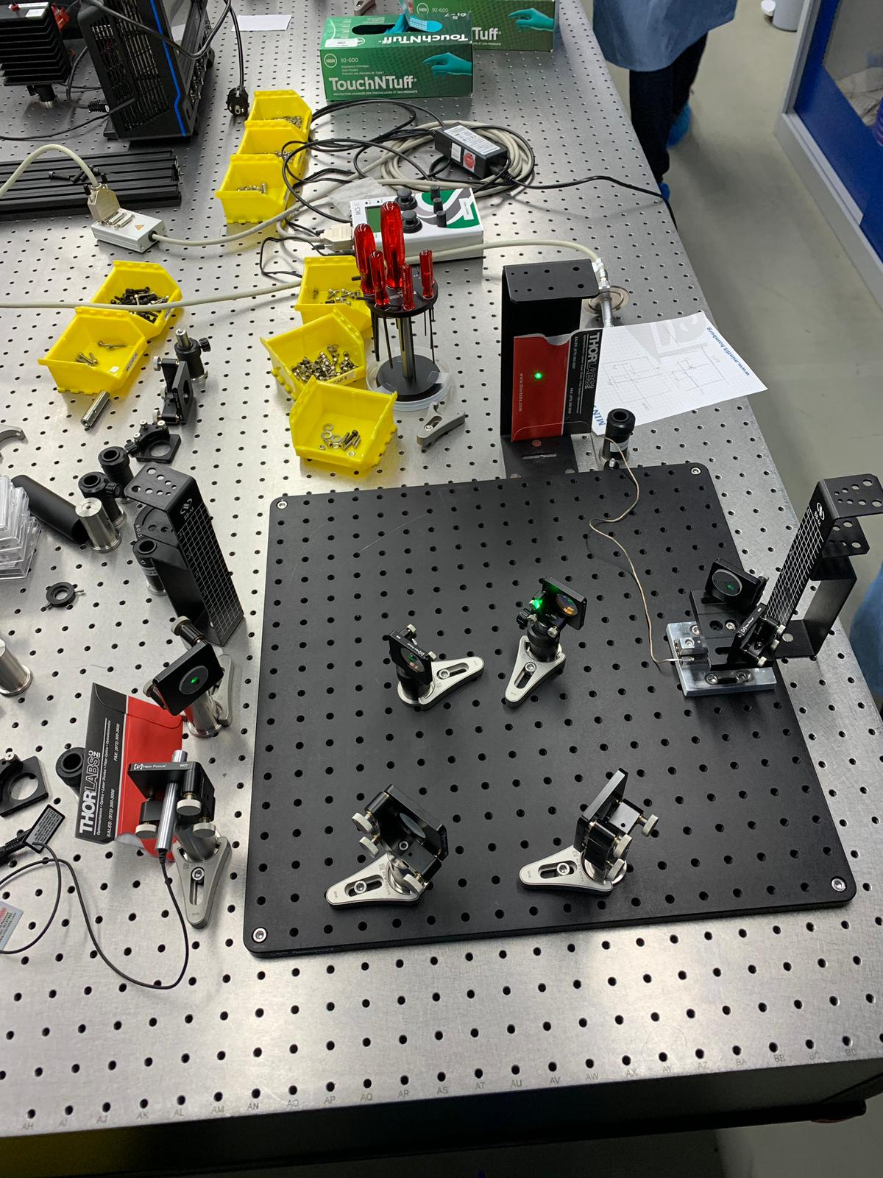
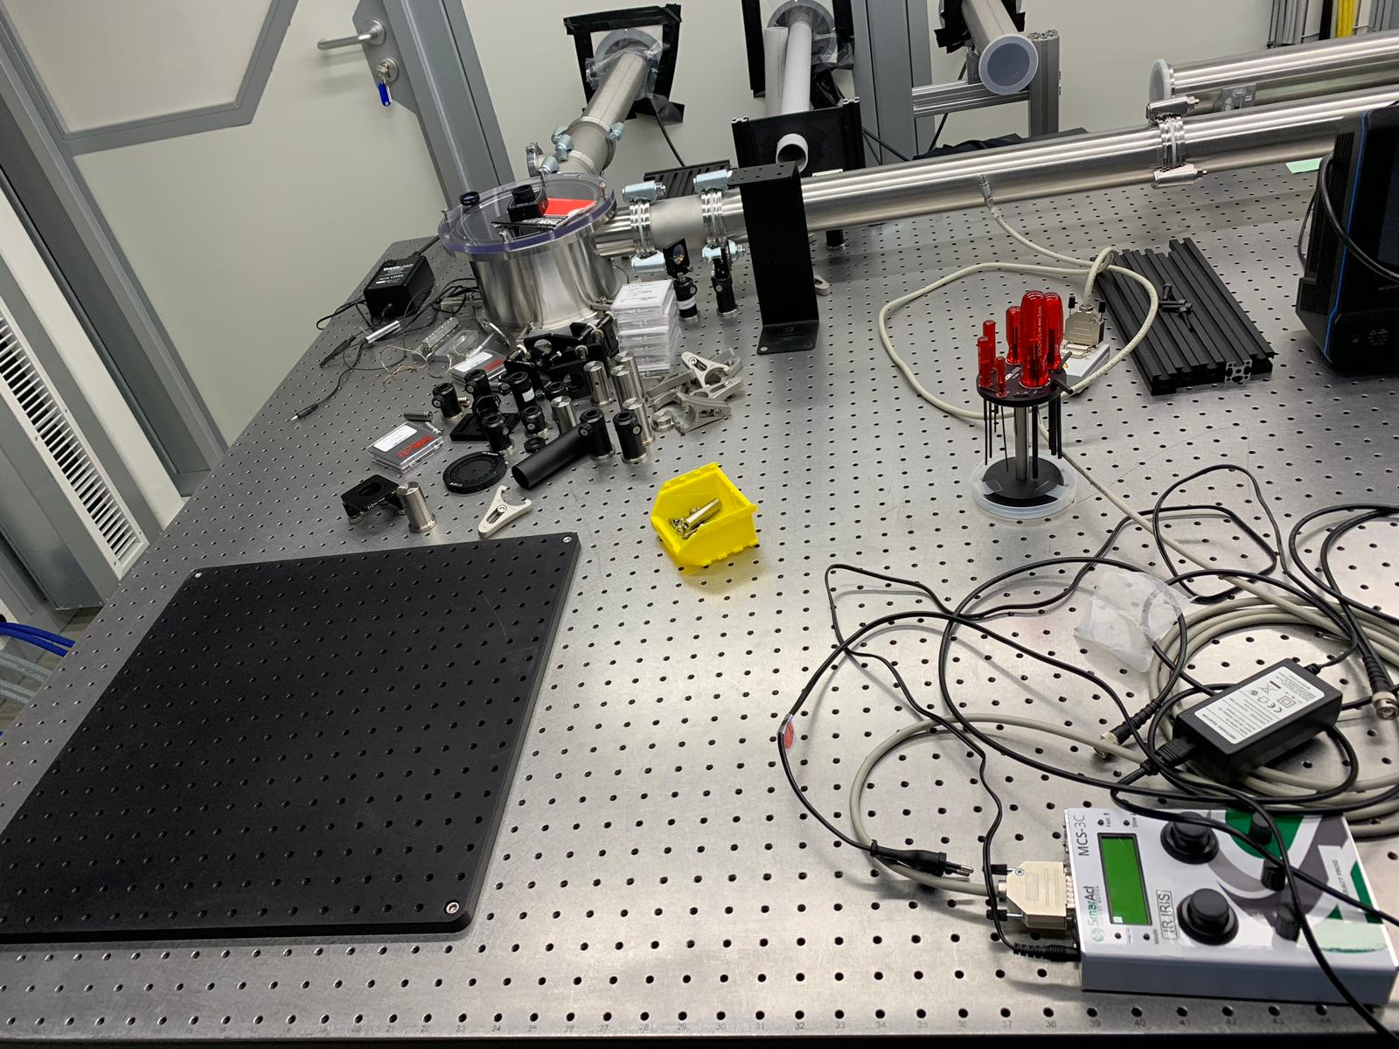
Building the Interferometer

Slide 6
Problems in Building
Occuring Problems were:
Precise alignment to see fringes
It was hard to quantify changes
Forgot a factor of two in the calculation of the wavelength

Slide 7
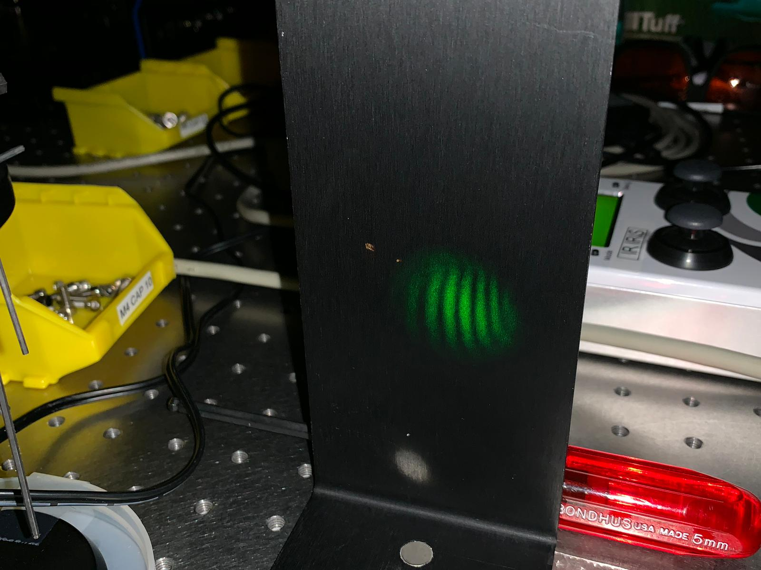
Measuring: Laser Wavelenght
We changed the lenght of one arm by nm using a stage
We looked how the fringes changed from light to dark and at what distance that happened
Average distance *2
Result: 514.4 nm
Refrence: 532 nm

Slide 8
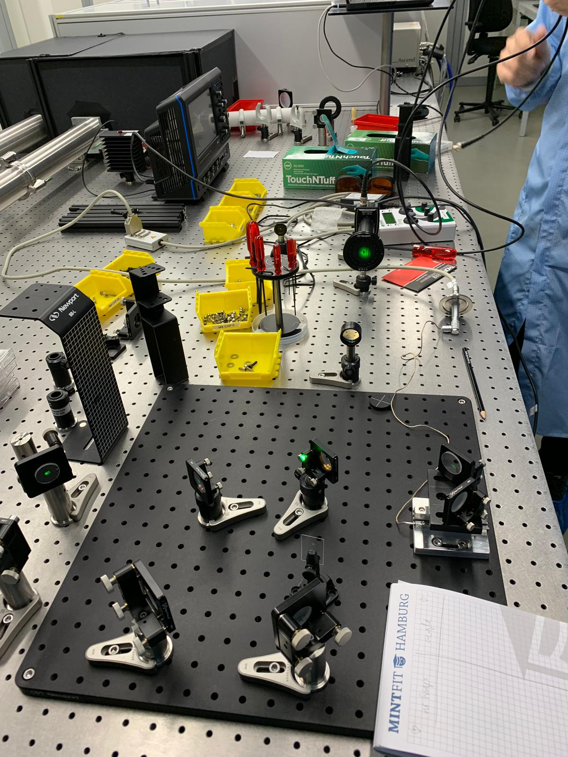
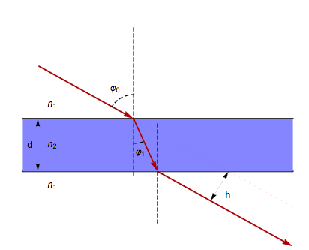
Measuring: Glass Thickness
Change of angle means longer path of glass
Result: 345 µm
Refrence: 500µm

Slide 9
Conclusion
We built an interferometer
We measured the wavelength of a green laser
We measured the thickness of a piece of glass
Thank you for your attention!

