Slide 1
Characterization of complex ultrashort laser pulses for single shot THz diagnostic
Gnezdovskaia Nelli,
Lomonosov Moscow State University, Russia
Superviser: Rui Pan
September 5, 2019

Slide 2
Outline
FLASH 1
BL1
PG2
BL2
PG1
Raman
spectrometer
Single shot THz diagnostic
FROG
Single shot FROG – GRENOUILLE
Simulations and experimental results
Conclusions
BL3
THz
Diagnostic
Hutch
Optical
laser
beamlines
Optical
laser
system
fs laser
system
THz delay
line
THz beamline
FEL mirror
chambers
Gas-filed attenuator
THz
FEL

Slide 3
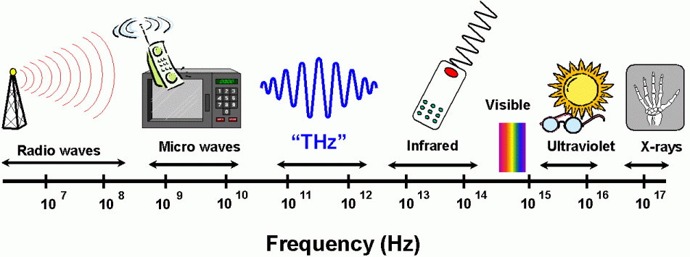
THz Radiation at FLASH 1
THz range: 10 – 0.3 THz or 30 – 1000 μm
1 THz = 10¹² Hz
Notes:
“The term typically applies to electromagnetic radiation with frequencies between high-frequency edge of the microwave band, 300 gigahertz (3×10¹¹ Hz), and the long-wavelength edge of far-infrared light, 3000 GHz (3×10¹² Hz or 3 THz)”, Wikipedia
1mm – 10um
THz is perfect tool to excite low energy excitations in solids
As well as colective excitations
And low frequency vibrational modes, e.g in photo active bio-molecule such as retinal
+
Field emission, tunneling, bending of atomic potential

Slide 4
THz single shot diagnostic
THz profile
Train of pulses for single shot THz diagnostic

Slide 5
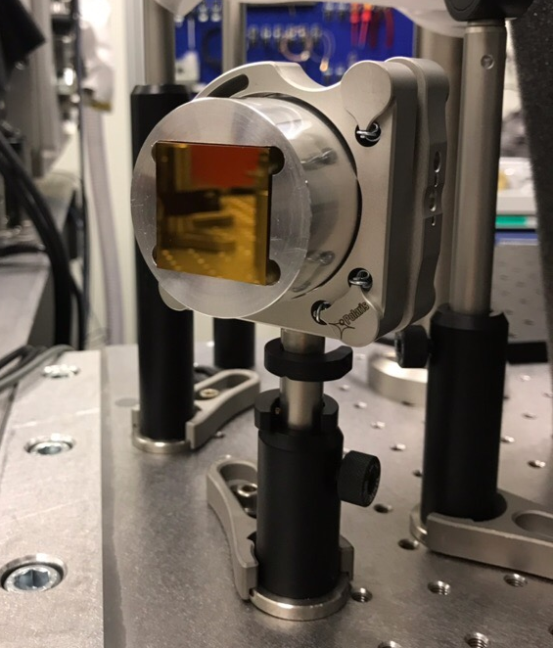
THz single shot diagnostic
Echelon mirror
30 mm
30 mm
30 mm
Each step gives 50 fs delay between pulses

Slide 6
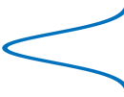
FROG
Frequency-Resolved Optical Gating
(Rick Trebino, 1990s)
spectrally resolve the pulse from autocorrelator
2. retrieve the pulse by using special algorithm
Pulse
Beam splitter
Camera
SHG crystal
Spectrometer
Delay, τ

Slide 7
FROG experimental setup
Variable delay stage
Beam splitter
BBO crystal
Pinhole
Spectrometer
SH beam
Parabolic mirror

Slide 8
Single shot FROG – GRENOUILLE
GRating-Eliminated No-nonsense Observation of Ultrafast Incident Laser Light E-fields – GRENOUILLE, which is the French word for “frog”
x
Top view
Cylindrical lens
Fresnel biprism
Thick SHG crystal
Cylindrical lenses
Camera
y
Side view

Slide 9
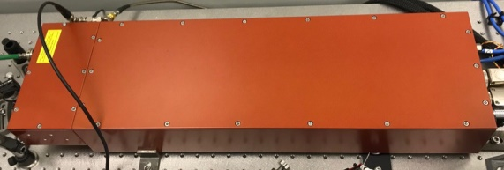
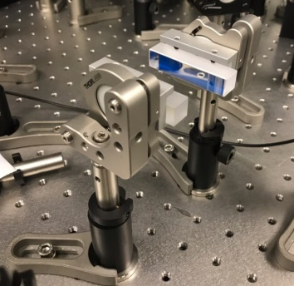
Experimental setup with GRENOUILLE
GRENOUILLE
Amplifier
Oscillator
1030 nm
OPA system
Compressor
Echelon mirror/
mirror
820 nm

Slide 10
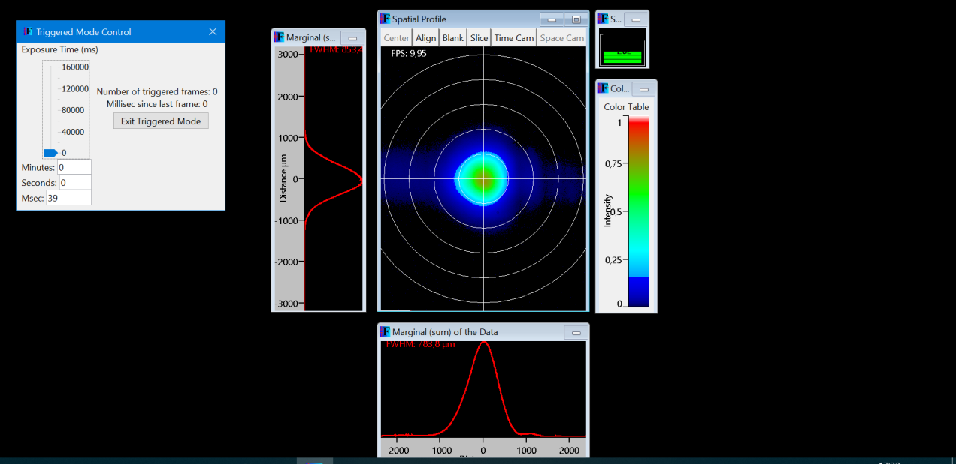
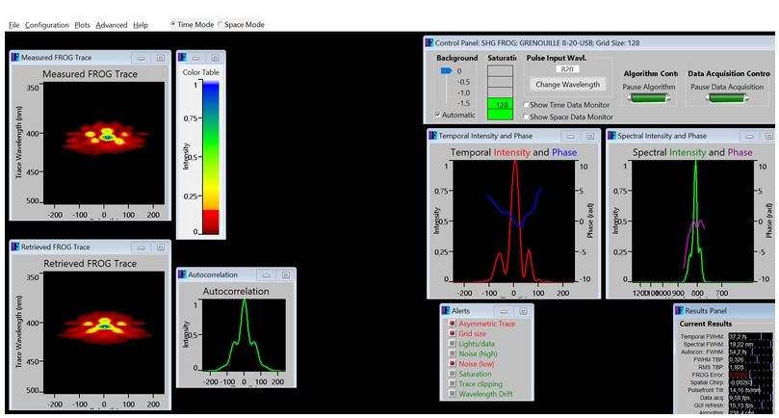
GRENOUILLE use
Space mode – beam alignment
Time mode:
Measured FROG pattern
Retrieved FROG pattern
Autocorrelation
Temporal profile and phase
Spectral profile and phase
From a single shot!

Slide 11
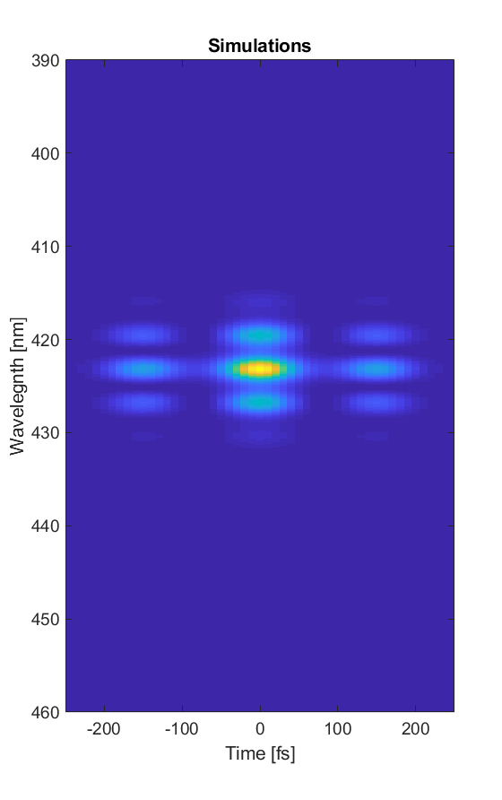
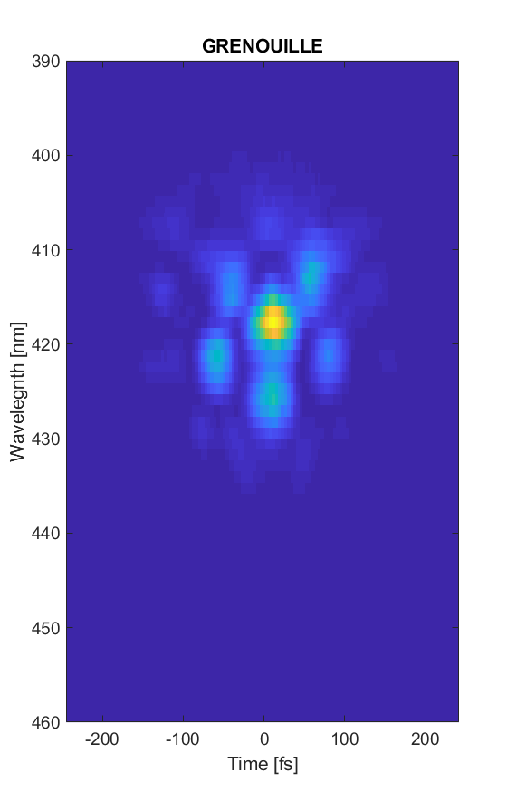
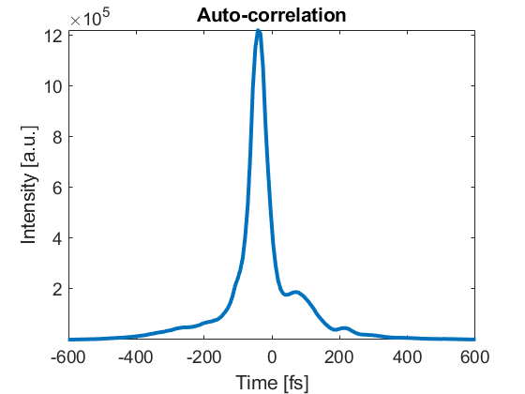
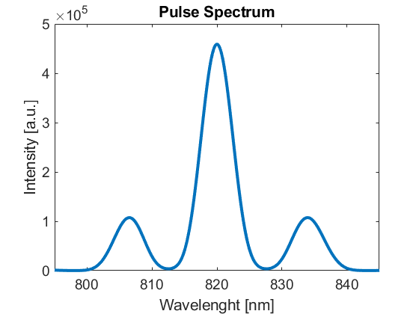
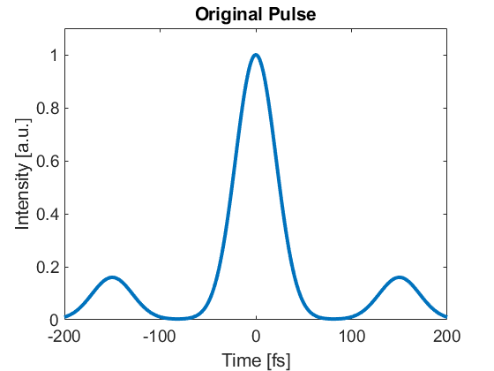
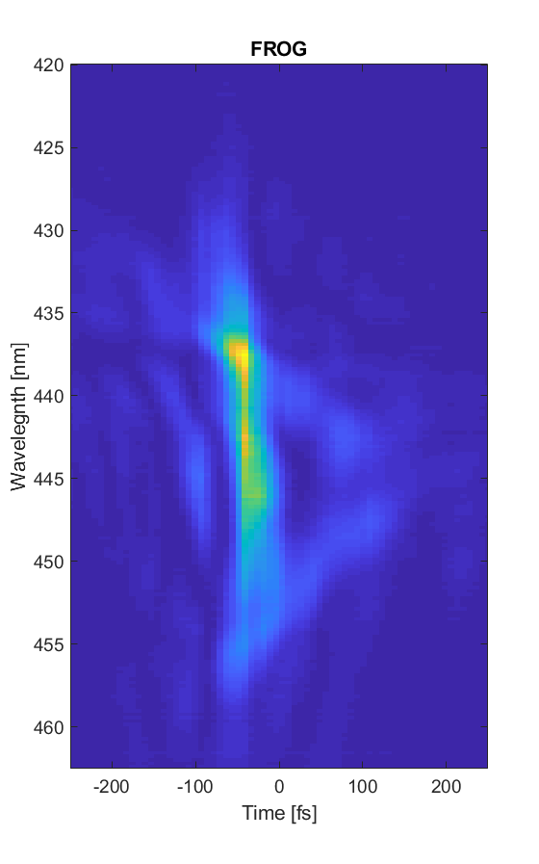
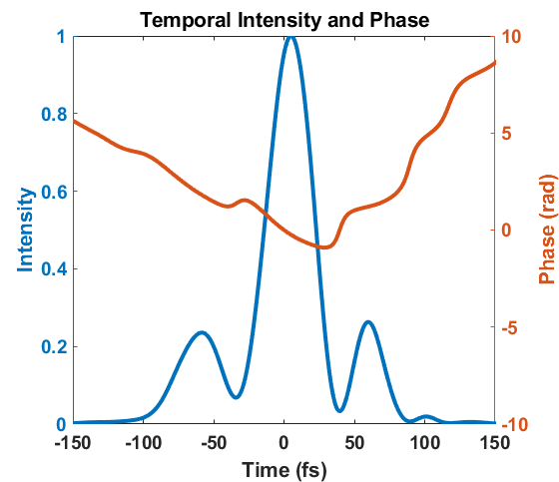
Simulations and experimental results
Ordinary mirror

Slide 12
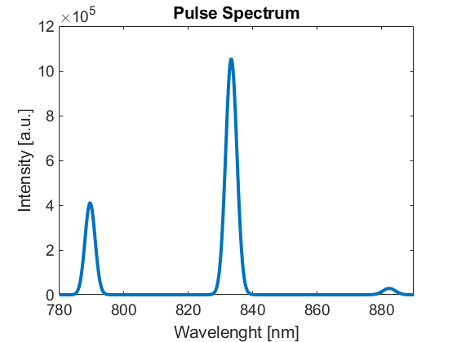
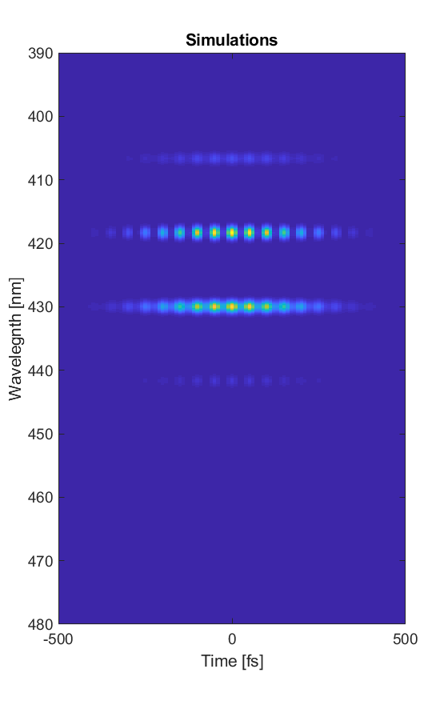
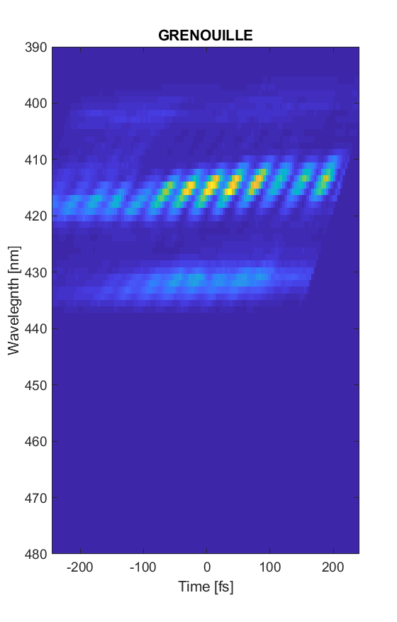
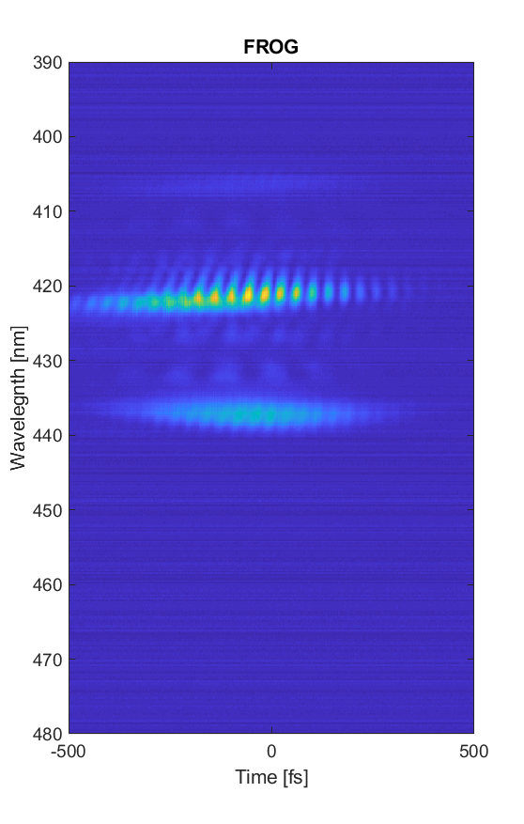
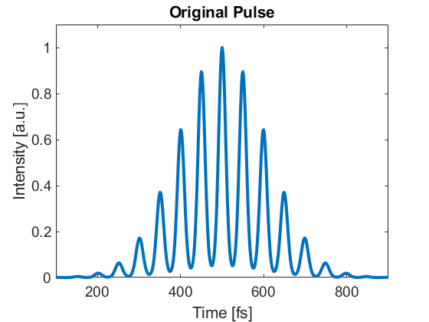
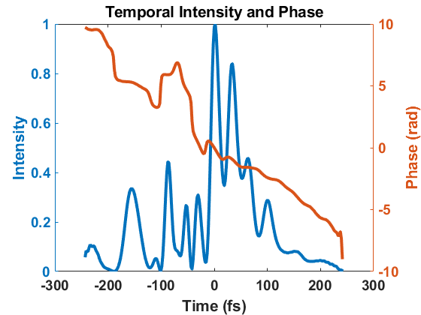
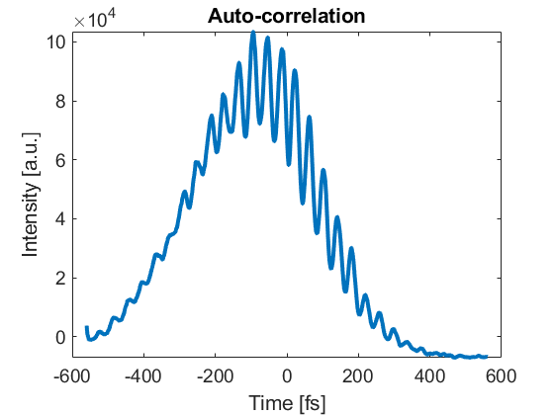
Simulations and experimental results
Echelon mirror

Slide 13
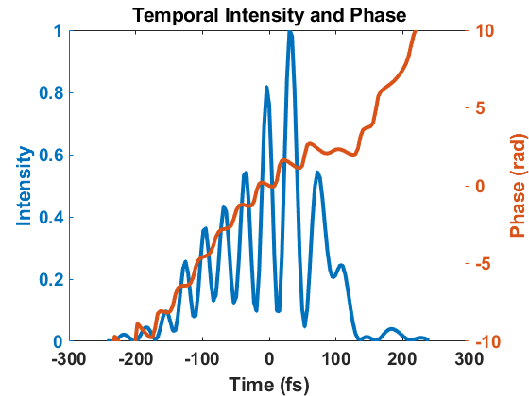
Simulations and experimental results
Echelon mirror

Slide 14
Conclusion 1
Measured train of pulses after echelon mirror with FROG and GRENOUILLE
Calculated FROG pattern is in agreement with experimental results
Echelon mirror generate multiple pulses
Echelon mirror works!

Slide 15
Conclusion 2
GRENOUILLE
Single shot
Compact and mobility
Easy to align
Can get the result immediately
Results similar to FROG
Good replacement of FROG

Slide 16
Thank you for attention!

