Slide 1

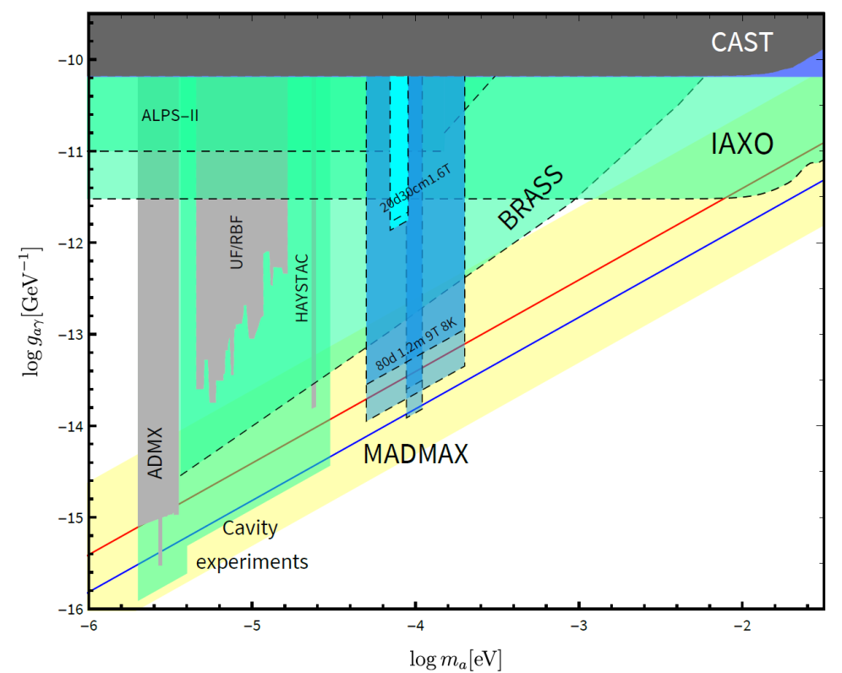

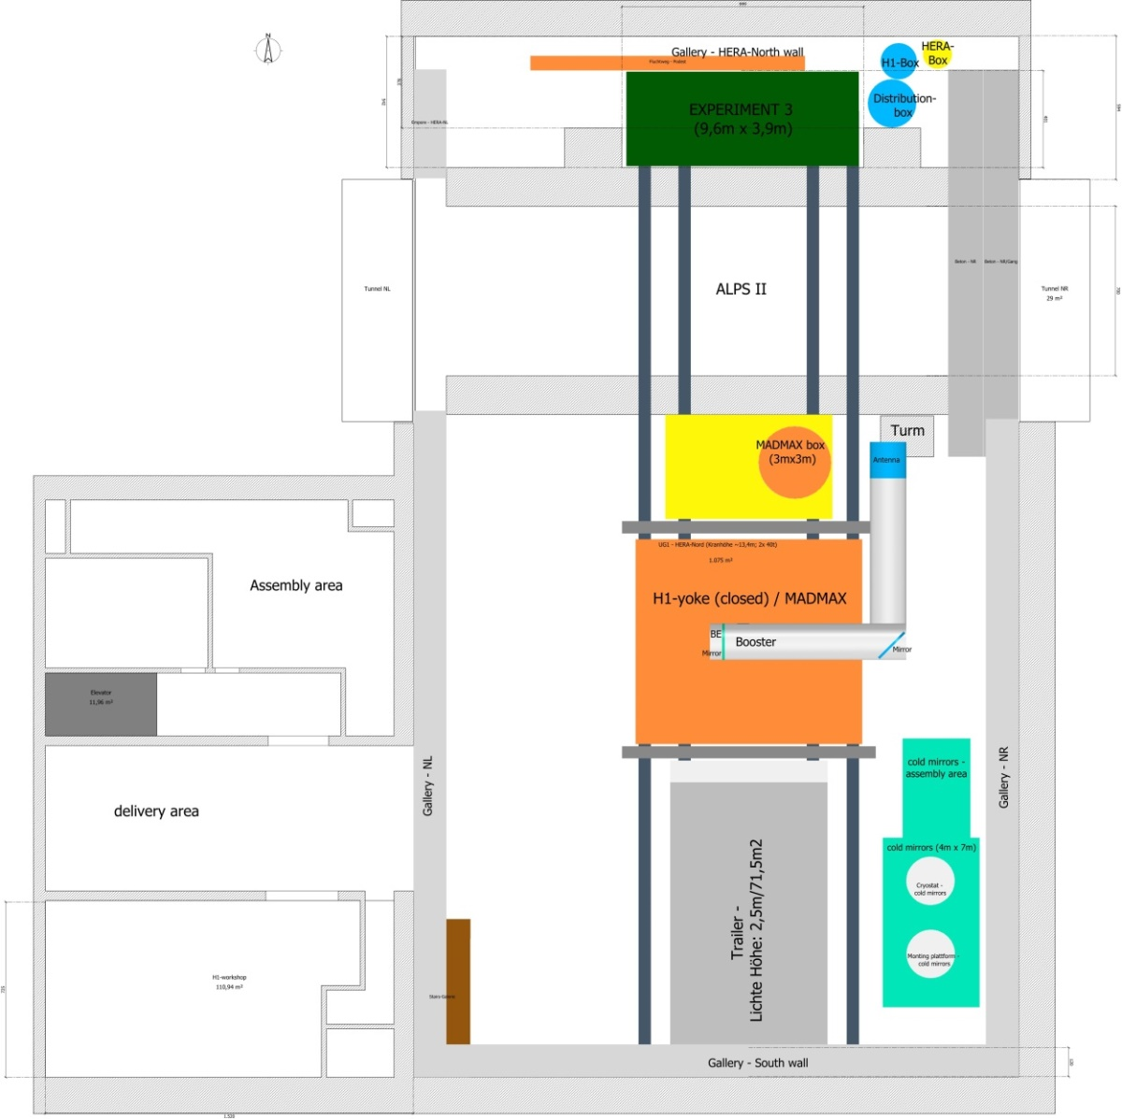
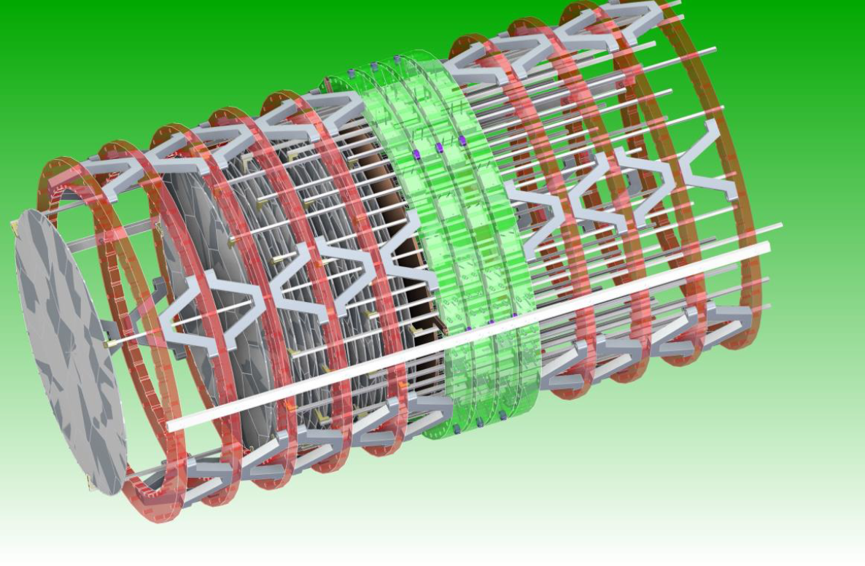
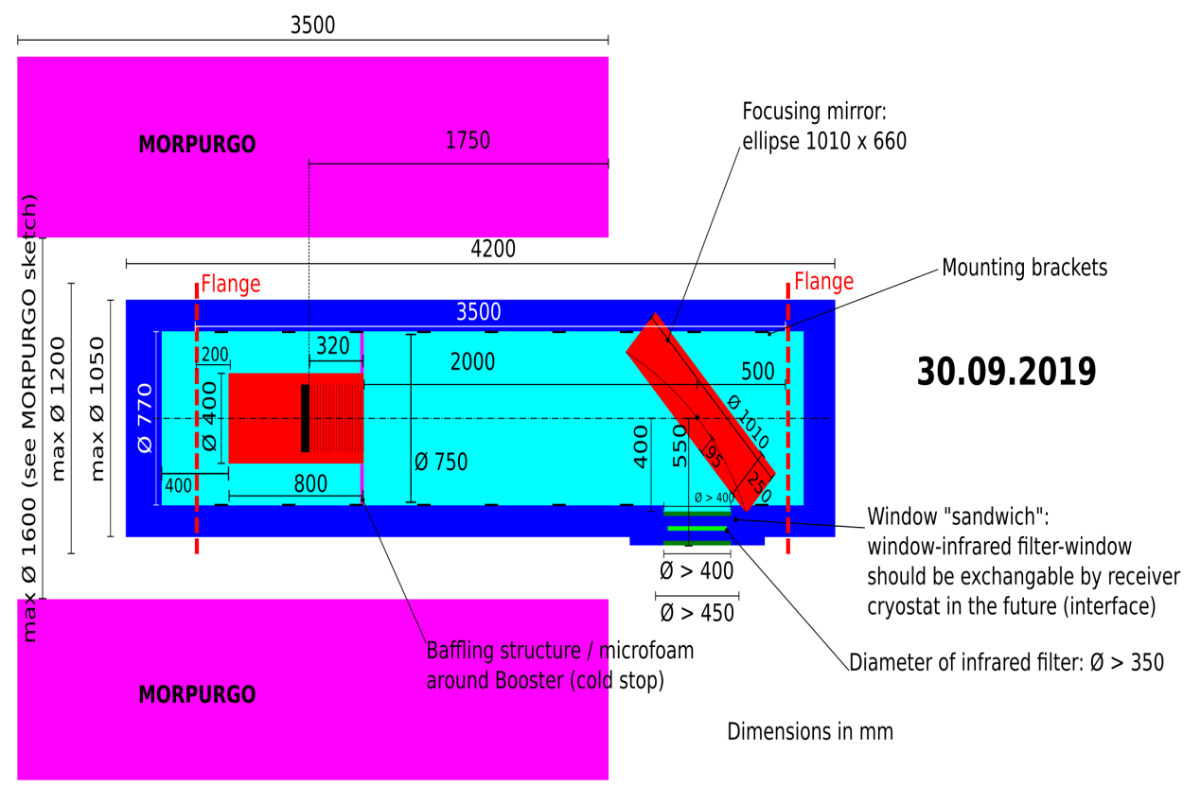
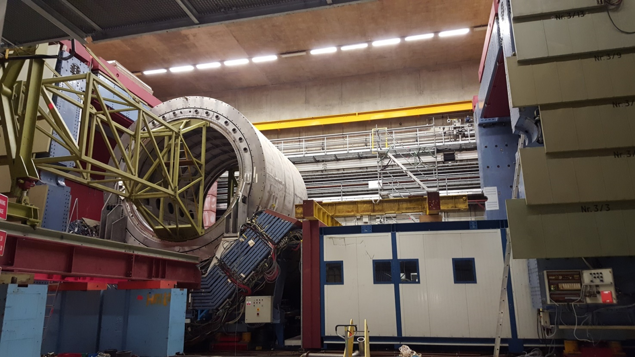
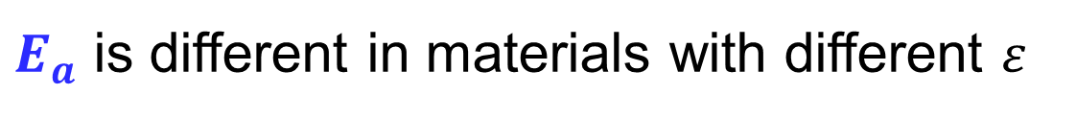
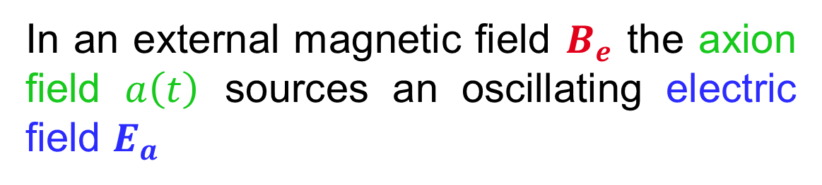


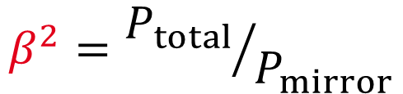
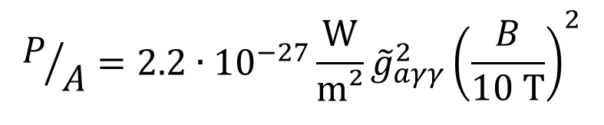

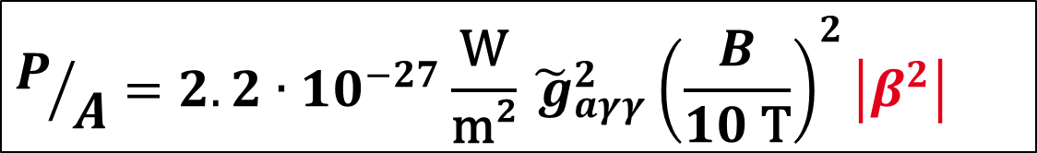
The Experiment
The MAgnetized Disc and Mirror Axion eXperiment
Abstract: MADMAX is an experiment (dielectric haloscope) to search for dark matter axion in the mass range of 40 µeV to 400 µeV. The challenge is to place a series of parallel 1.25m diameter disks with high planarity (~10 µm) at an environment of 4 K and in a 9 T magnetic dipole field parallel to the disks. A magnet of this size never has built. The former experimental hall north of the HERA accelerator could be a suitable site for such a complex experiment.
Princip of a dielectric haloscope
Physics
In an external magnetic field $B_{e}$ the axion
field $a\left(t\right)$ sources an oscillating electric field $E_{a}$
$E_{a}$ is different in materials with different $ε$
Scans the mass range of 40 µeV to 400 µeV
Not accessible with other experiments
High potential by reaching the theoretically predicted limit
At the surface, $E_{∥}$ must be continuous
→ Emission of electromagnetic waves
Power emitted from a single surface:
$$P/A=2.2∙{10}^{−27}\frac{\text{W}}{\text{m}\text{²}}{\tilde{g}}_{aγγ}^{2}{\left(\frac{B}{10 \text{T}}\right)}^{2}$$
$${\tilde{g}}_{aγγ}^{2}∝g_{aγγ}^{2}$$
$${𝒪(\tilde{g}}_{aγγ}^{2})=1$$
Shows, that Axion is dark matter!
Boost emitted power through:
coherent emission from multiple interfaces
resonance effects
The boost factor defines the sensitivity of the experiment and is simulated by using the Maxwell equations. The boost factor for the emitted power is expected to be a factor of 40000 – 60000 and strongly depends of the disk accuracy and alignment.
Power boost factor:
$$β^{2}={P_{total}}/{P_{mirror}}$$
Power emitted from all interfaces:
$$P/A=2.2∙{10}^{−27}\frac{\text{W}}{\text{m}\text{²}}{\tilde{ g}}_{aγγ}^{2}{\left(\frac{B}{10 \text{T}}\right)}^{2}\left|β^{2}\right|$$
MADMAX experimental setup
Mirror (not visible)
9 T dipole magnet
Cryostat (4 K)
~ 1 m
Horn antenna & receiver system
Booster: 80 adjustable dielectric discs (Ø1.25 m)
<10µm
Focusing mirror
Challenging mechanics:
Move 80 disks with ~ 6 kg each
Required precision: <10 µm (flatness + positioning)
Tilt <0.1mrad
Cryogenic environment (4 K) and 9 T field
Travel range of up to ~1 m
Optional: Measurement of disk positions (interferometer)
240 piezo motors (3 per disk) + redundant system
Challenging magnet:
Dipole field of 9 T, 1.35 m warm bore
Dimensions: Length: 6.5m; Diameter: 5m
Weight: ~200 t
Conductor/coil: NiTi; 9 double pancakes
Stored energy: 482 MJ (115 kg TNT equivalent)
Operation temperature: 1.8K
Current: 24 kA
Challenging disks:
Disk diameter: 1.25 m
Materiel: LaAlO₃ available in 3" wafers
Tiling necessary
Glue: Stycast Blue (cryogenic)
Gap: 0.5 µm
Flatness: <10µm
Roughness: <10µm
Currently no motors available on the market
Step forward – The prototype
HERA hall North - Infrastructure / Supply
Northern
shell
Supports for MADMAX magnet
Southern
shell
Basis
Prototype design
Infrastructure:
Dipole field of 9 T
Cryogenic supply (3-4 kW (@4.5K)
  New cryo box (contex QU)
Crane: 2x 40 t
Space: >1000m²
Iron Yoke for fringe field recuction
Check of mechanics (SHELL):
Move 30 disks with ~ 0.6 kg each
Disk diameter: 300mm
90 piezo motors
Required precision: <10 µm
Tilt <0.1mrad
Cryogenic environment (4 K) and 9 T field
Travel range: ~300 mm
Measurement of disk positions (interferometer)
Morpurgo magnet at CERN
In Morpurgo magnet at CERN
Dipole field:1.6 T (1.9 T)
Warm bore diameter: 1600mm
But: noisy environment
1st physics run
Planned in 2023
Lower mass range, but still unknown area
In parallel: check of functionality
Summary
MADMAX is a challenging project and still in the R&D phase. Nevertheless it is the only experiment that can scan this specific mass range. The magnet design is close to the end and booster setup will be proved in a prototype experiment in 2021. Finishing the installation of the final experiment is foreseen for 2025, so that first data are expected in 2026.

