Slide 1
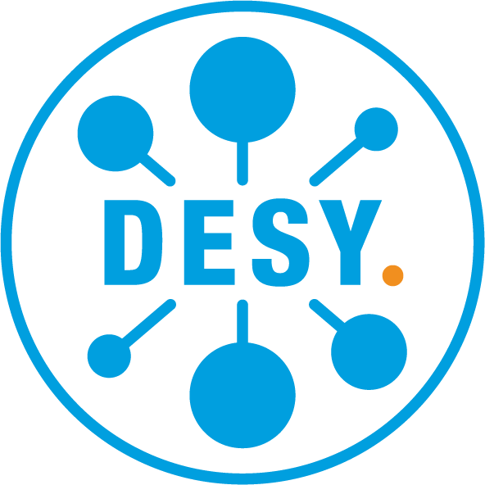
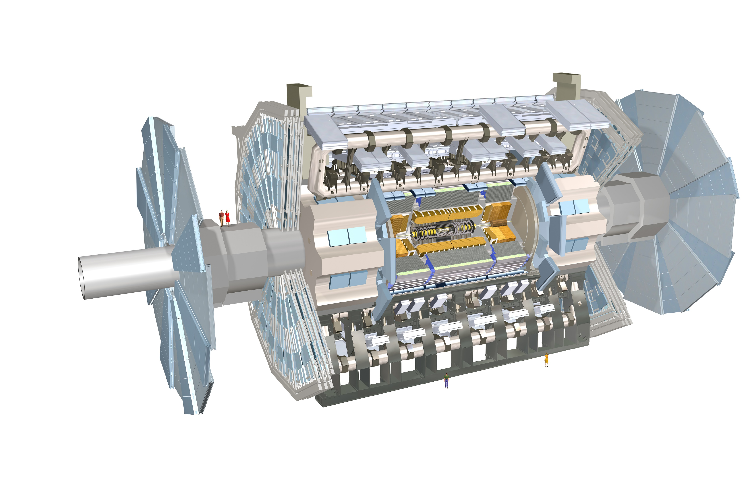
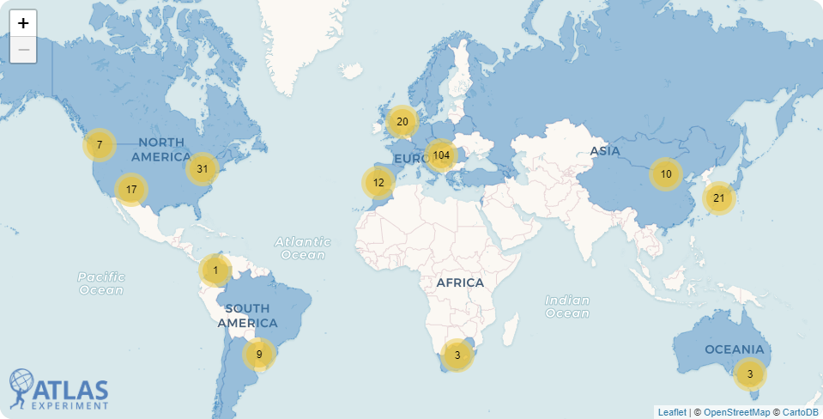
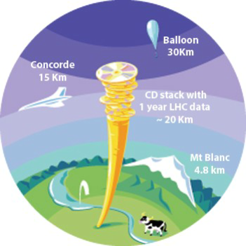
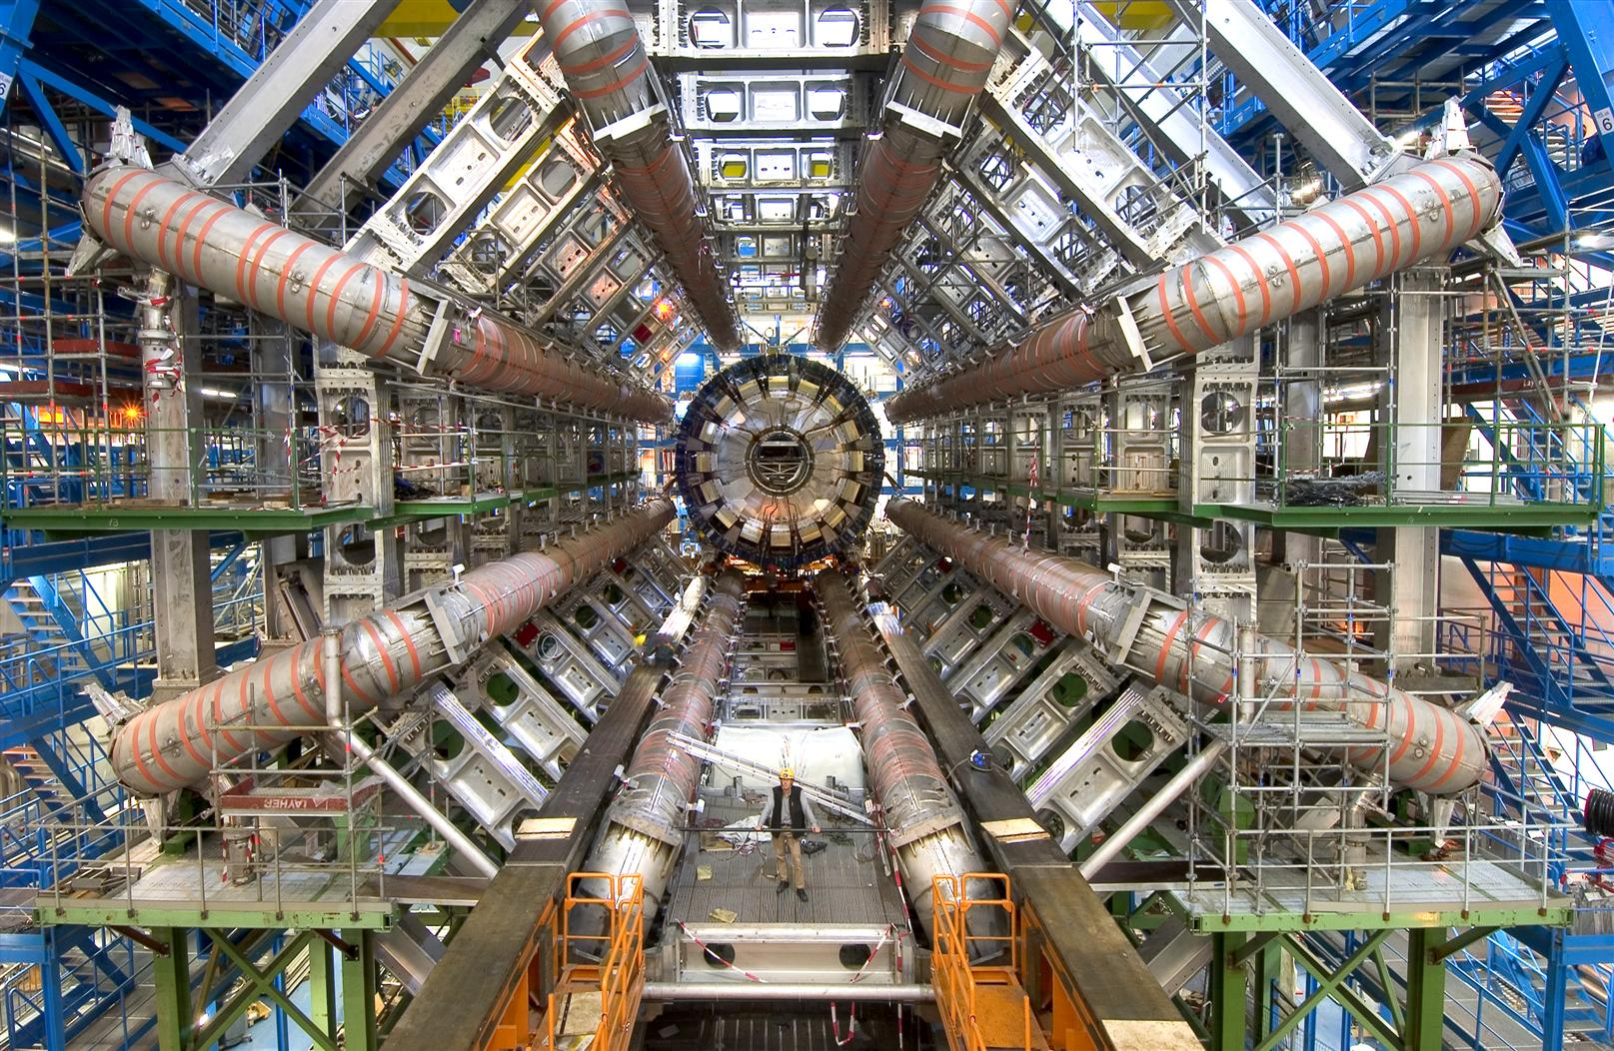
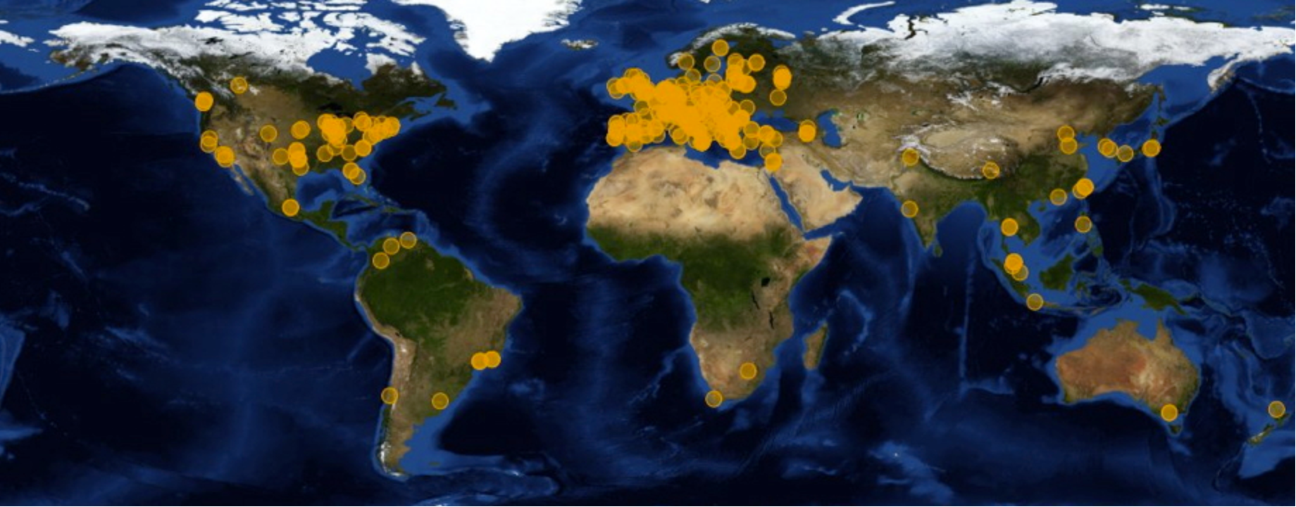
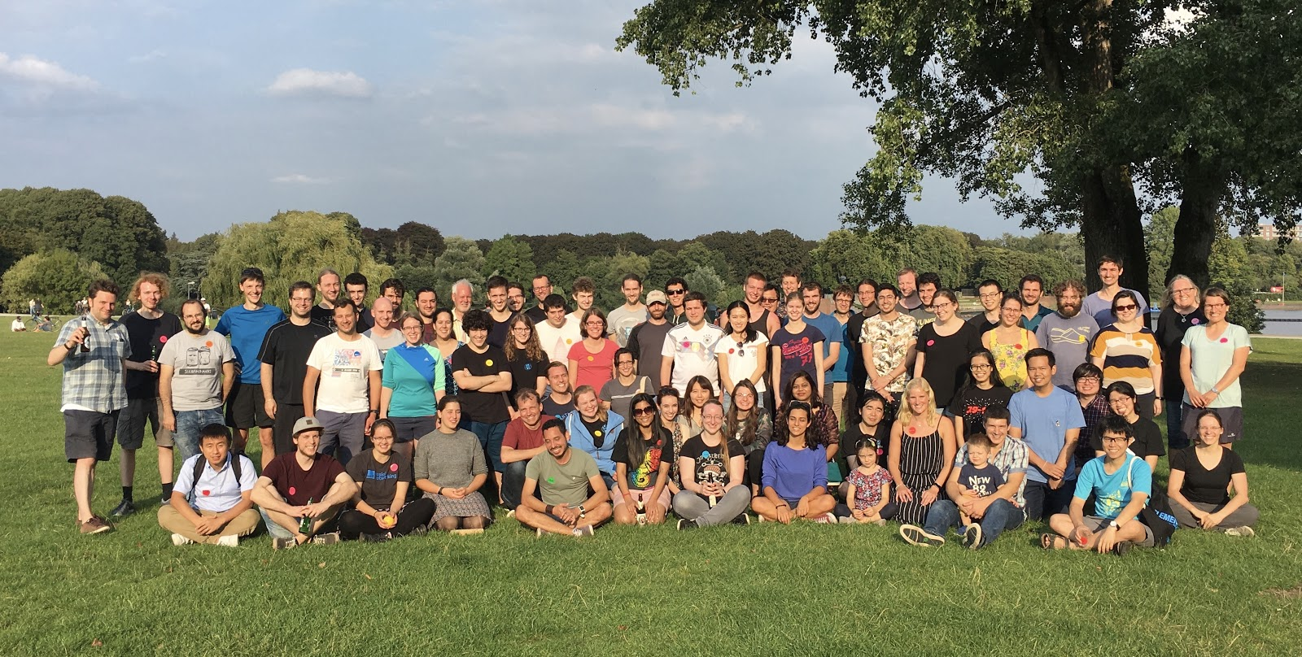
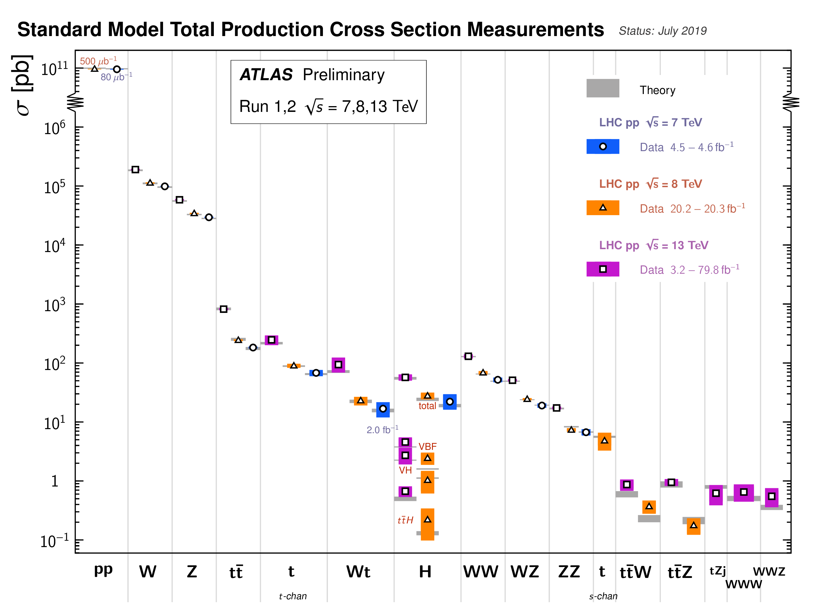
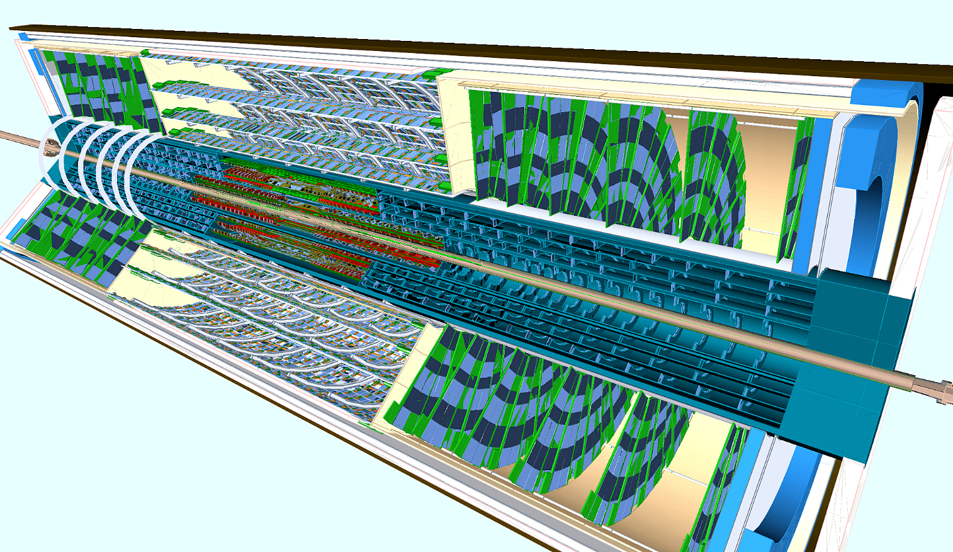
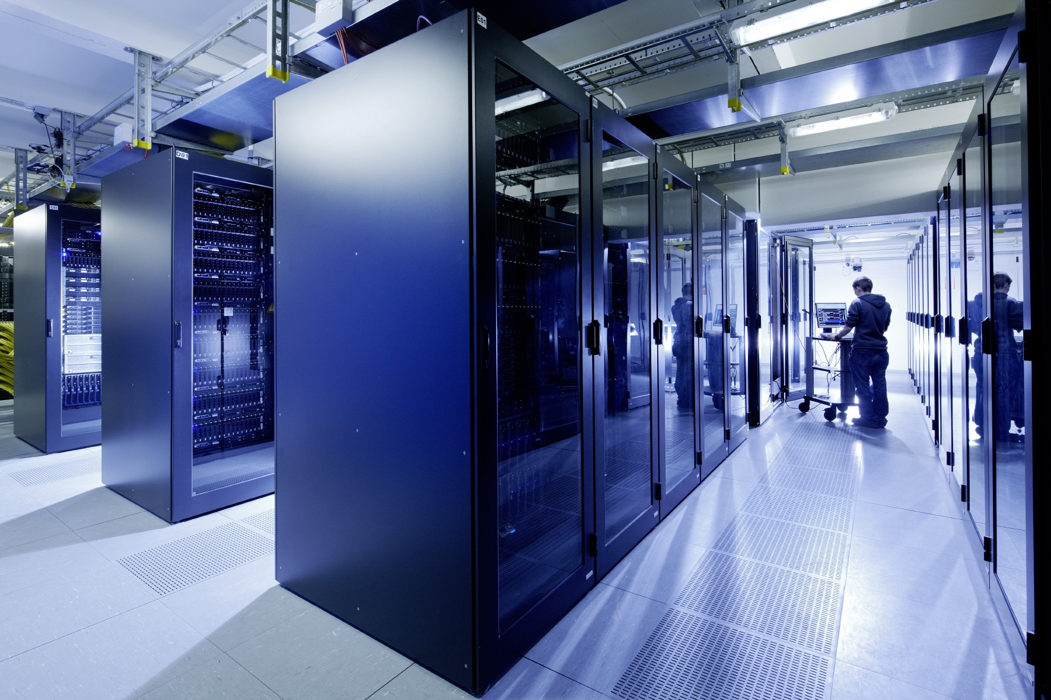
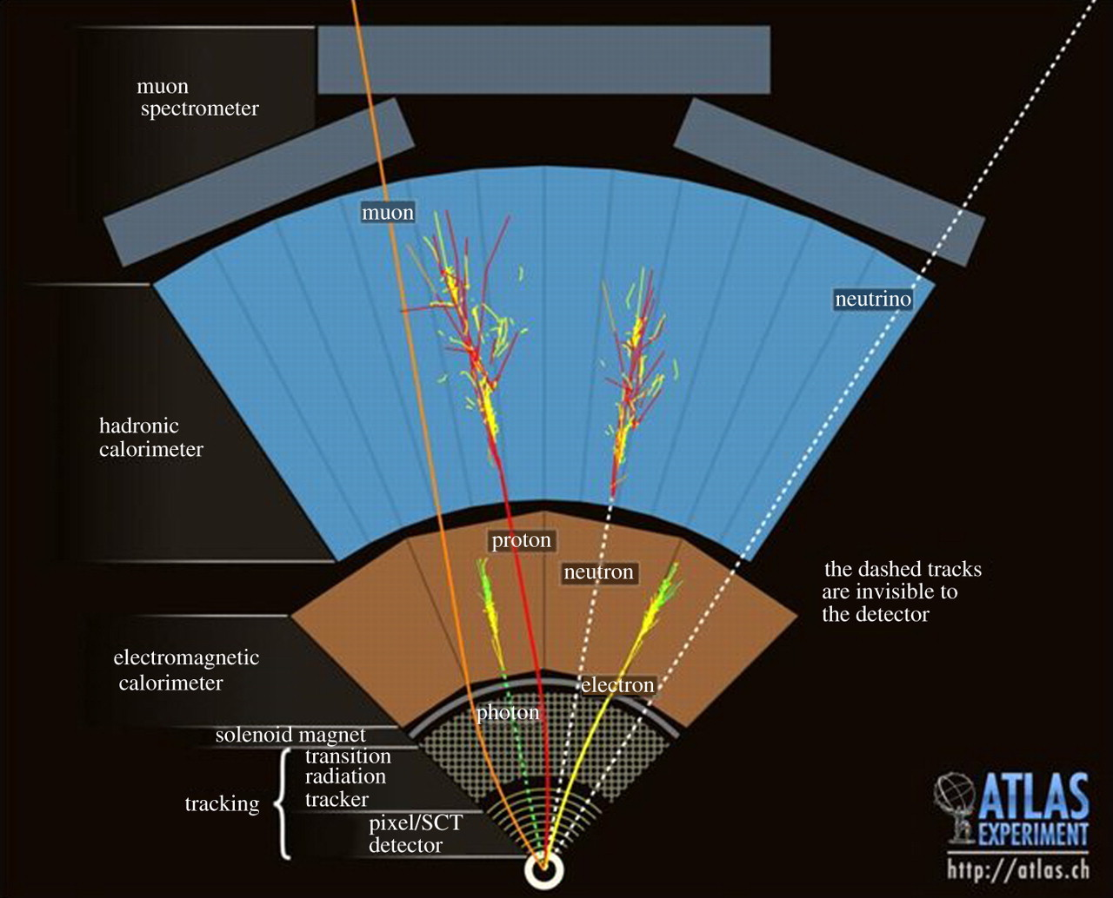
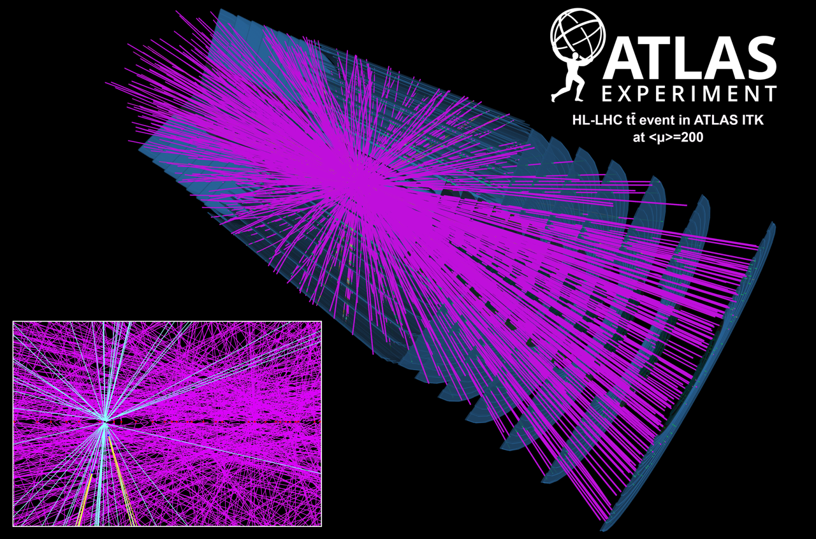
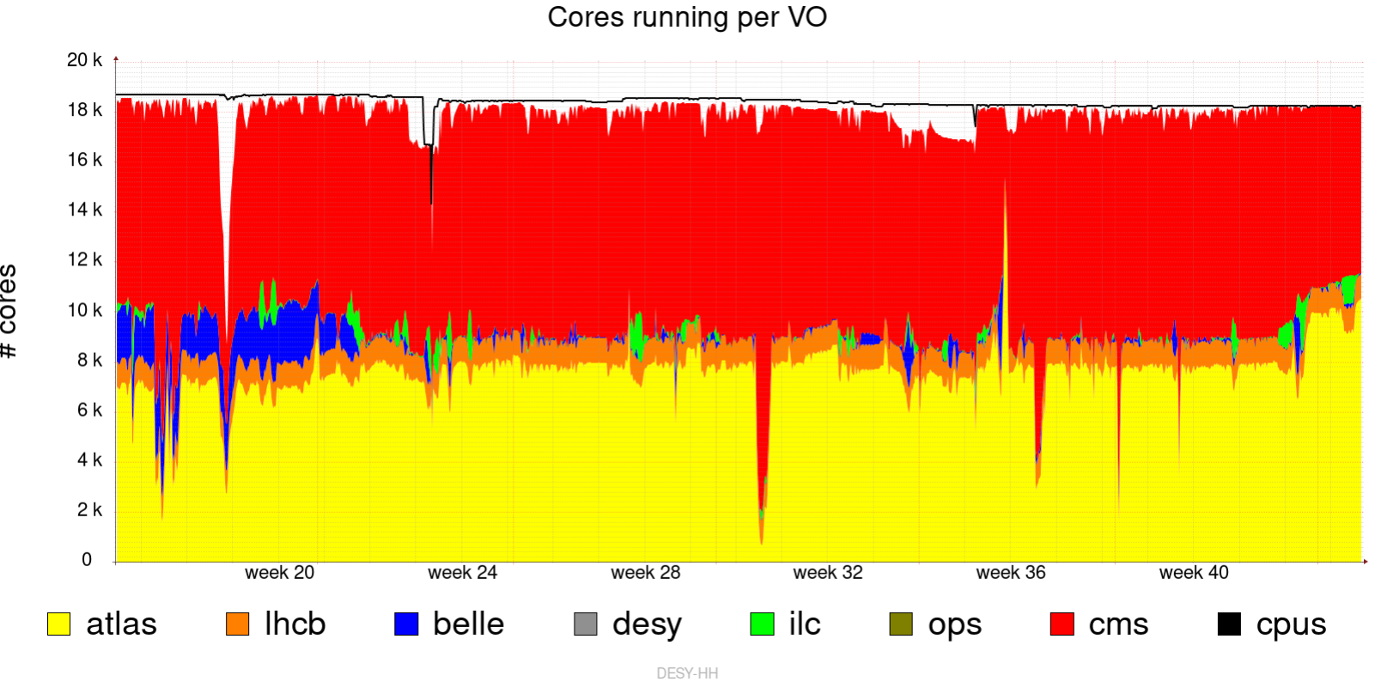
ATLAS.
The Largest collider detector. Ever!
The Detector
1.7 billions collisions per second
100,000 events per second
250 milli-second
1,000 events per second
2.5 micro-second
Level-1 custom hardware
High-Level Trigger
Save for later analysis
The Data
Up to 1.7 billion proton-proton collisions per second!
Only a few of them are “interesting”
Trigger system to the rescue
Reduced to 1,000 events per second
The logo
46 m long, 25 m in diameter
100 m below ground
7,000 tons (but would float in water!)
The Collaboration
3000+ scientific authors
183 institutions around the world
38 countries
Our group, both in Hamburg and Zeuthen, is part of this!
That is still a lot of data
LHC experiments generate 35 millions gigabyte per year
ATLAS data is a huge chunk of that
And they all need backups!
Scan for more!
ATLAS, Getting Upgrade!
High-Luminosity upgrade of LHC is scheduled for 2026
Expecting 10 times more data
Up to 200 collisions at the same time
You want more?
We have more!
Check out these posters
Detector developments
Precision measurements
Dark matter and searches
Higgs physics
Data are distributed to the Worldwide LHC Computing grid
Over 130 centers around the globe
Analyzed by ATLAS members around the world
With High-Luminosity LHC:
Increase possibility to spot new or rare physics processes
Test the Standard Model at an unprecedented precision
The new ATLAS needs:
Detectors with increase tolerant for radiation
Finer granularity
Faster readout
Most of ATLAS will get an upgrade, including an all-new inner tracker
Group outing August 2019, with our awesome summer students
Hidden treasures
Computing
Want to analyze these mountains of data with our awesome sauce algorithms
We need computers. Lots of them.
Rarer
Study everything from the most common to the rarest phenomena...
… while only see the stable particles!
Strip
We are building one of this “Strip Endcap” at
Event type
At DESY, we have the National Analysis Facility, or NAF for short
8000+ CPU cores
State-of-the-art tools: GPU, Machine Learning libraries, containers, etc.
Pixel
How many times it happens in 1,000 billions proton collisions
Strip
New physics can be down here. Therefore, the more proton collisions i.e. more data, the better!
Subdetectors, assemble!
Each of them sensitive to different effects
We design sophisticated algorithms to reconstruct what happened.
Machine Learning used throughout
DESY also provide a large pool of resources for the worldwide computing grid
And we are using them!
Both NAF and grid computers are maintained by our friendly IT colleagues

