Slide 1
XFEL Photocathode Laser Operator Training
Feb 2019
Aradhana Choudhuri
FSLA

Slide 2
Overview
XFEL Photocathode Laser Operator Training
The Laser System
Control via DOOCS
Allowed & Not Allowed
Contacts

Slide 3
The Laser System

Slide 4
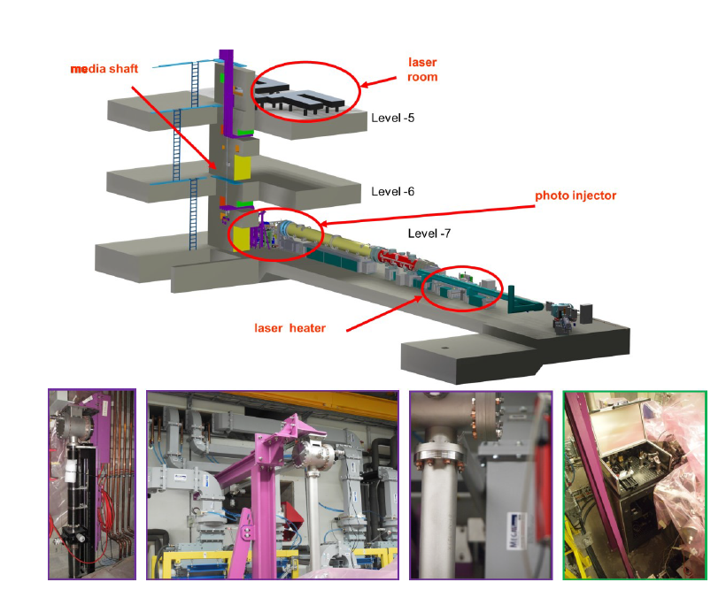
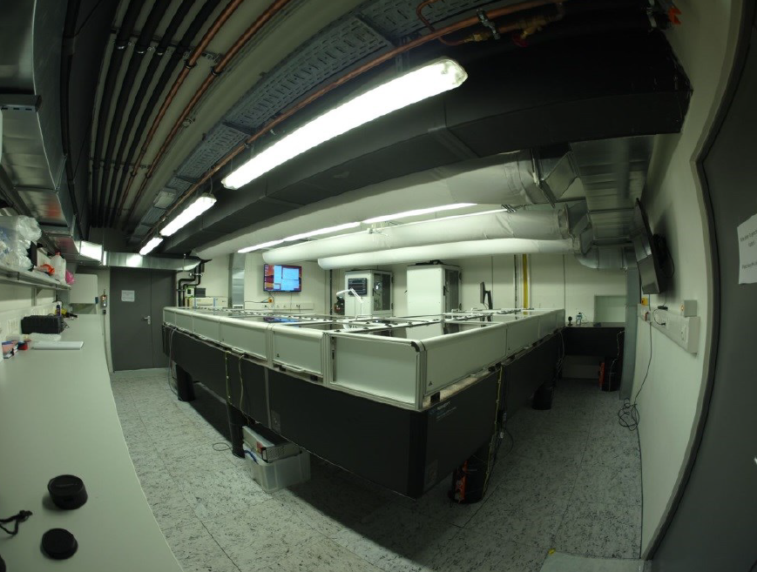
Photocathode Laser Building

Slide 5
Beamline

Slide 6
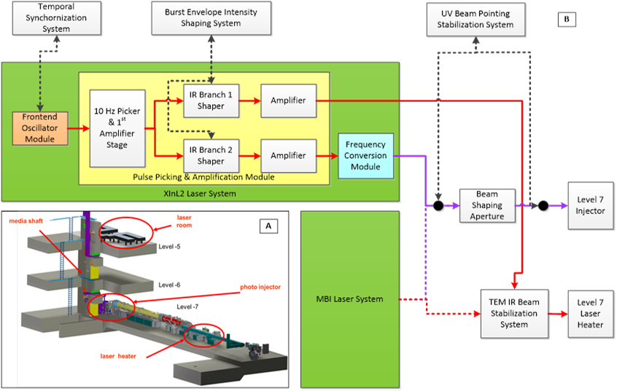
Laser 2: Prime UV Laser
266nm, 8ps, 500kHz – 4.5MHz

Slide 7
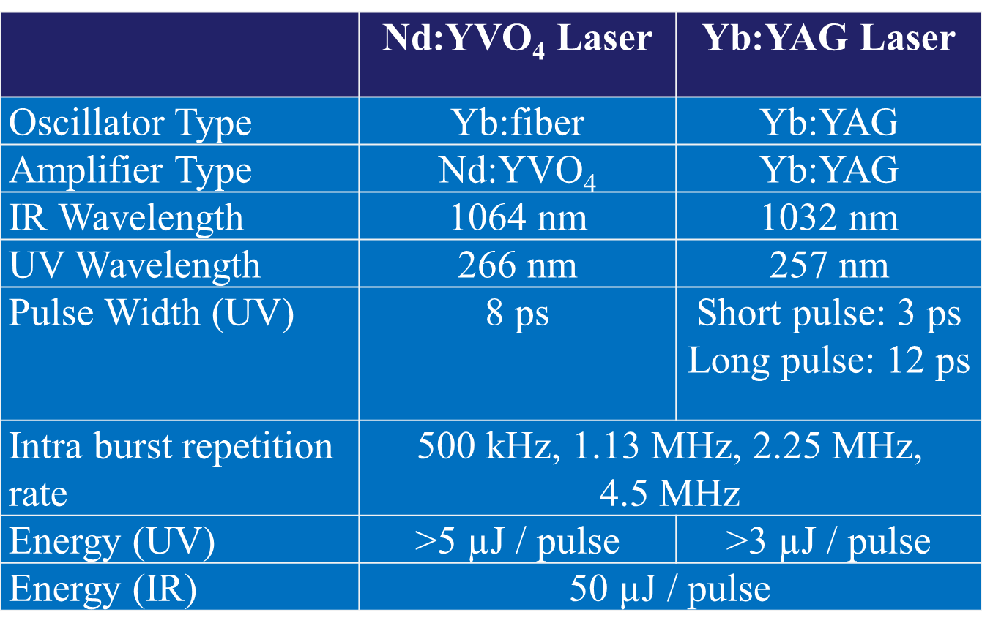
Laser 1 and Laser 2
Two operational laser systems to provide backup and multiplexed simultaneous operation.
Currently XInLas1 provides the light for the laser heater, XInLas2 provides the UV light for the photocathode.

Slide 8
Laser 2: Hybrid Yb:fiber-NdYVO4 System

Slide 9
Laser 2: Hybrid Yb:fiber-NdYVO4 System

Slide 10
Info & Control via DOOCS

Slide 11
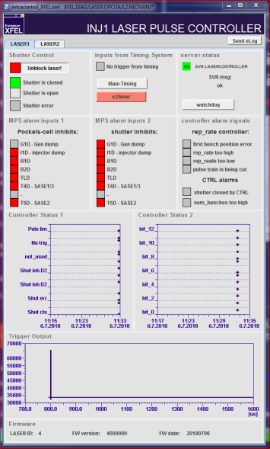
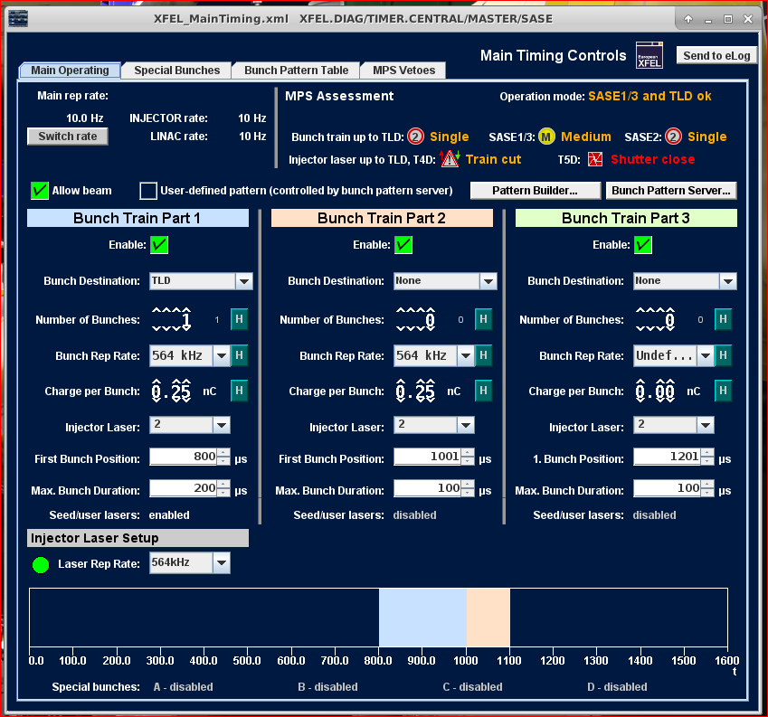
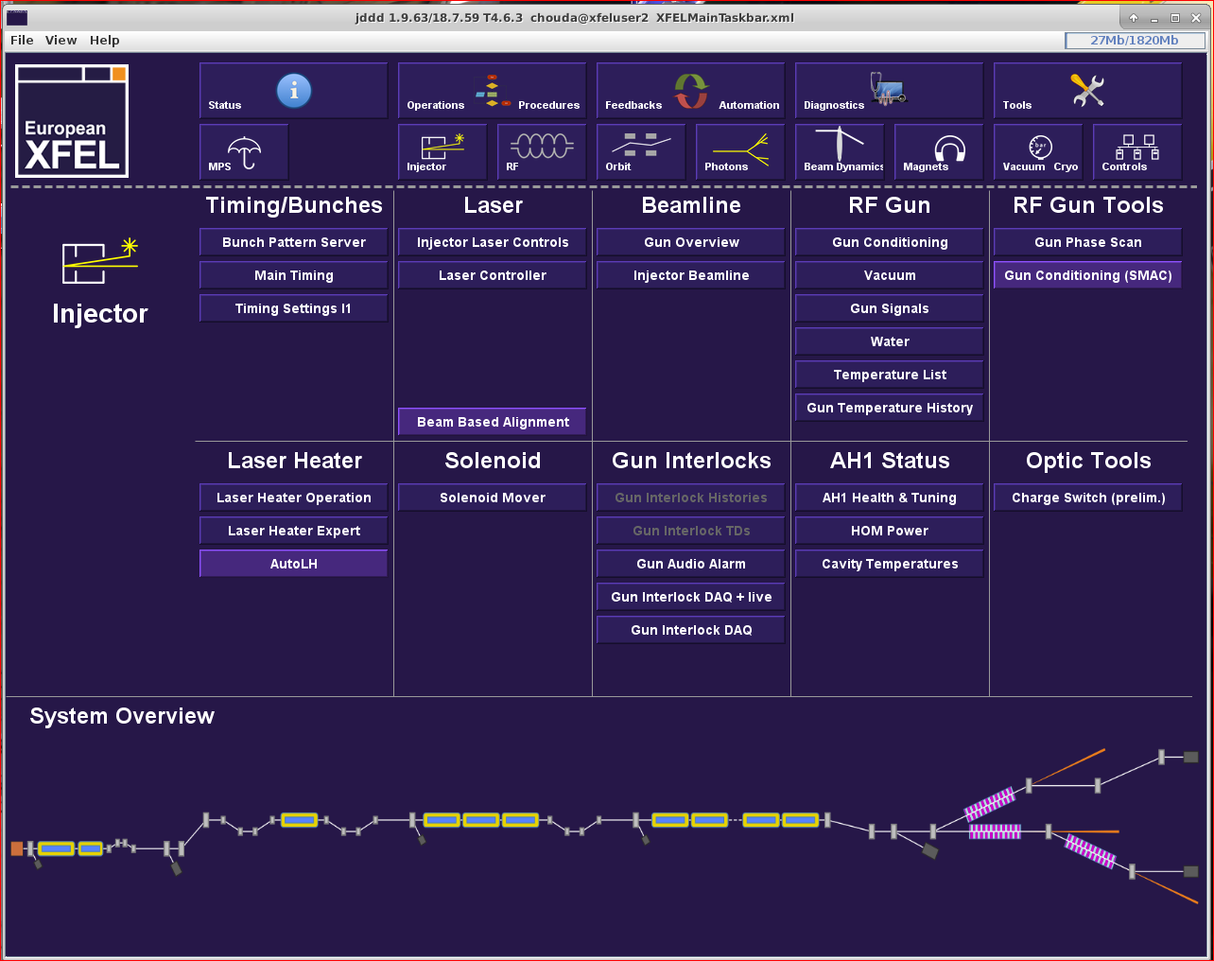
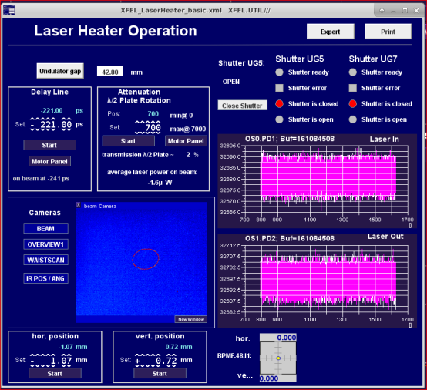
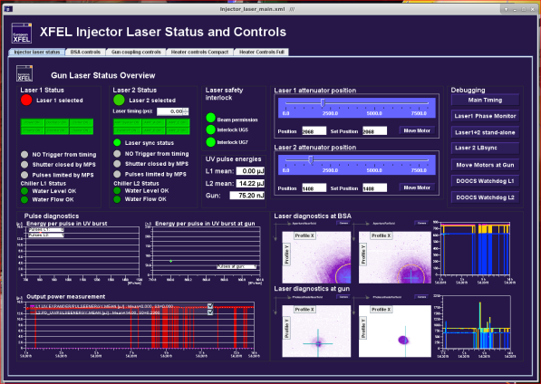
How To Get To The Laser Controls

Slide 12
The Laser Controller

Slide 13
Main Timing

Slide 14
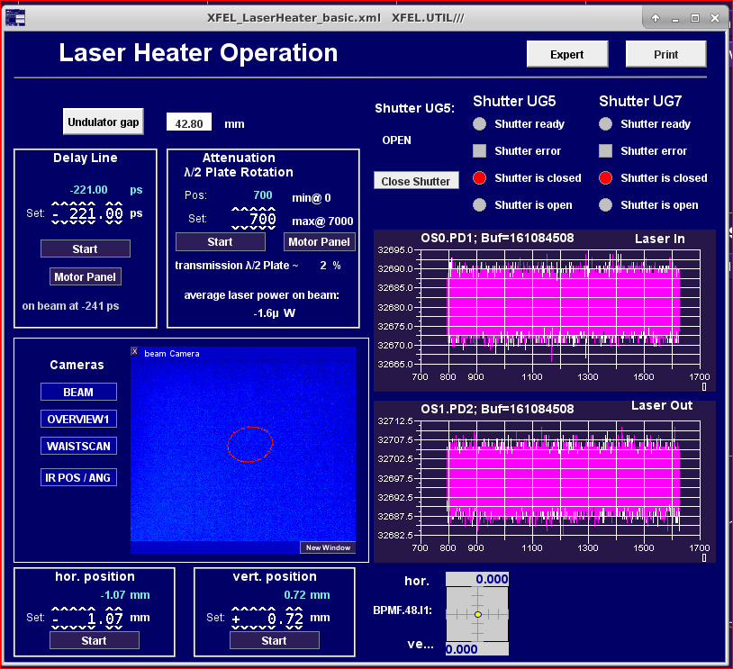
Laser Heater Panel

Slide 15
Injector Laser Status & Controls: Status

Slide 16
XFEL Injector Laser Pulse Count & Energy
Last 8-Hour Shift 26/02/2019 AM

Slide 17
Beamline

Slide 18
Injector Laser Status & Controls: BSA Controls
Do Not Use

Slide 19
Beamline

Slide 20
Injector Laser Status & Controls: Gun Coupling

Slide 21
Injector Laser Status & Controls: Laser Heater

Slide 23
Demo: Common Tasks
How-To
Block and Unblock Laser
Change UV pulse energy
Change Repetition Rate, Number of Bunches
Change beam position on cathode

Slide 24
Common Issues
How-To
No Pulses
Check Main Controller Panel (Trigger from timing? Shutters? Attenuator? Camera?)
Is the Beam Allowed? Is the number of bunches set to greater than 0?
Pulses, but no energy at gun
Stand-Alone Mode→ was the beam allowed without turning the physical key in UG5?
Attenuator settings
Beam Drift → saturation on camera? Beam autoalignment system?
Laser is not synchronized/locked → call expert
Shutter is stuck → call expert
Burst is not flat → call expert

Slide 25
Not Allowed!
Bursts with gaps
Repetition rates

Slide 26
First Contact: Ara Choudhuri, xt. 6347
Expert: Lutz Winkelmann, xt. 6385
Deputy: Sarper Haydar Salman, xt. 6083
Laser On-Call: 5581

