Slide 1
The PAHN-PaN*
Consortium
*Particle, Astroparticle, Hadron & Nuclear
Physics Accelerate(s) the NFDI
A proposal for the NFDI
Thomas Schörner-Sadenius (DESY)
Kassel, 26 September 2019

Slide 2
The Proposal
A big „Thank you!“ to the many of you who contributed so far!

Slide 3
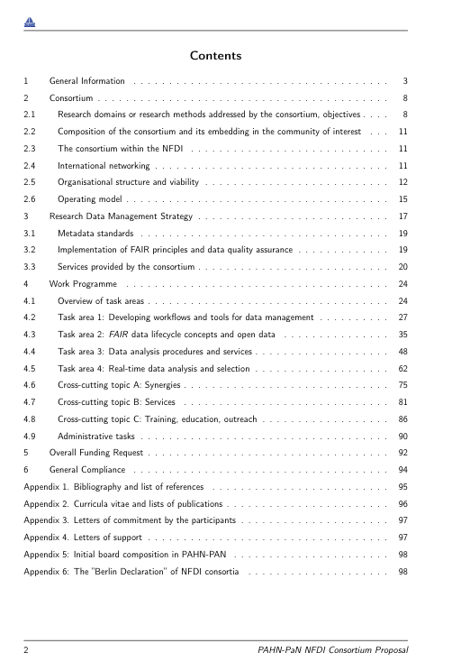
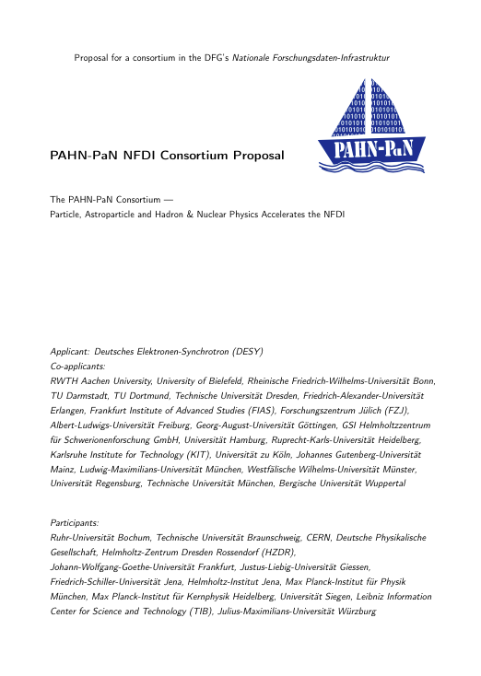
The Proposal
Status
98 pages and filling quickly
TAs in pretty good shape
CCTs less so
Numbers being consolidated
Sections 2 and 3 lack much work
→ Friday, Saturday, Sunday
Admin stuff missing (admin tasks,
CVs, letters of commitment from
participants, ...)

Slide 4
Today
Some decisions, and working on
Decide governance form
Decide names for board members (?)
Decide budget
Define own contributions
WORK ON PROPOSAL (probably in parallel groups?)
Plus some smaller issues

Slide 5
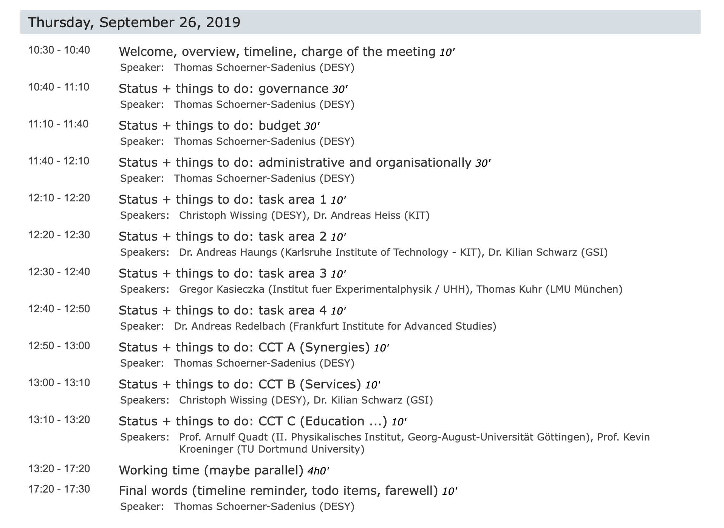
Today
Agenda
Discuss + decide
Don‘t discuss in plenary
Wrap-up at 16:00 hrs
Finish at 16:30 hrs?

Slide 6
Detour
On TA section structure + contents
Please keep in mind the following sub-section structure and discuss these aspects:
Intro
Work plan with work packages, deliverables, milestones (?)
Service perspective
Connection to other consortia
Requirements
Own contributions (discussion later)
Risks and mitigation
Tables will be filled by management
Also note:
Mention all involved co-applicants and partners (where possible)
Be concrete
Focus on service to NFDI and on coherence in the consortium: How to ensure collaboration and avoid
a trickling away of our funds?

Slide 7
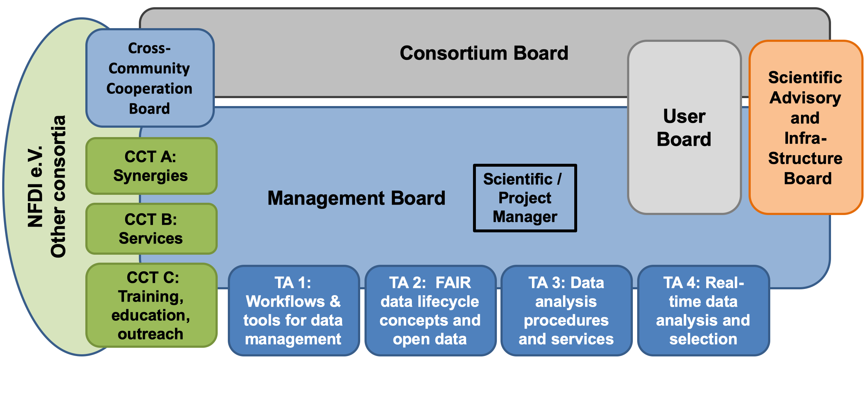
Governance and Organisation
Of the PAHN-PaN consortium – proposal (but beware of Münchhausen effect)
See beginning decription in proposal section 2.

Slide 8
Governance and Organisation
Of the PAHN-PaN consortium – discussion topics so far
Do we need a User Board? Who should staff this? The CB? The three comitees?
Mixing (external) infrastructure representatives with science advisors in the SAIB?
Names for boards?
...

Slide 9
Budget
Have to decide today
1 FTE is 72000 kEUR (DFG for E13/3) + 3 kEUR direct project cost
Gives 3900 kEUR / 22 kEUR = 52 FTE / year
Ph.D. students = 0.5 FTE
22% programme overheads = 1.1 MEUR
Reserve 100k for networking, events, travel
1 admin person (approx. 50k)
Rest to be divided with the positions
One position for a dedicated project manager
Critical: Need to check relation of own contribution to DFG requests – this is not balanced yet across
the partners.

Slide 10
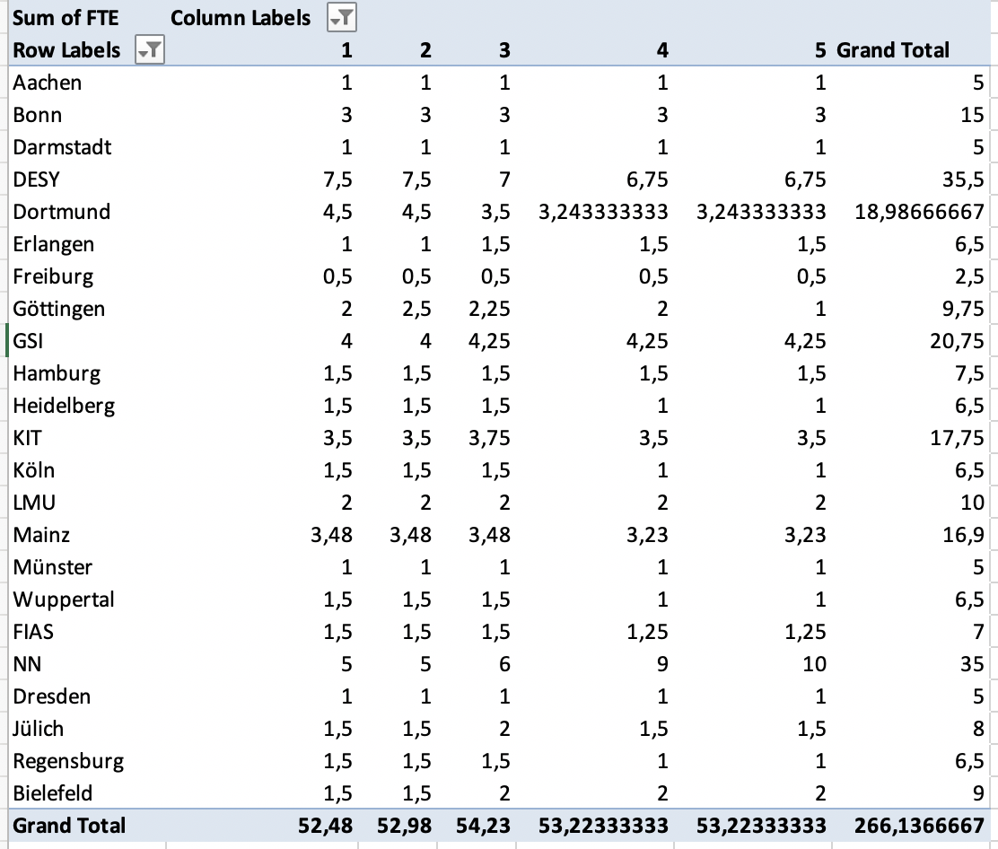
Budget
Per co-applicant
(current v6)
Still adjusting
here and there
Dortmund -2.5
Bielefeld
Others?
Freiburg size critical?
TUM now participant
→ backbone funds
Sum ~6 FTE
too high

Slide 11
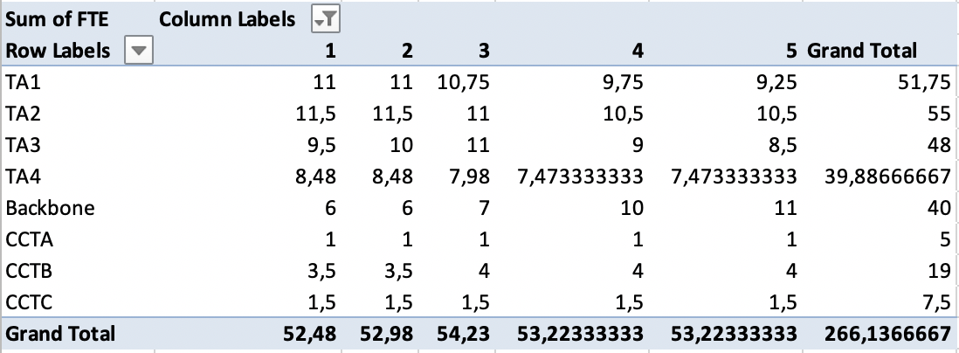
Budget
Per task area
Correct / meaningful
ratio of task areas
Some backbone in for
project manager (1 FTE)
and participants

Slide 12
Budget
Total view (=useless)

Slide 13
Own Contributions
How to display in proposal?
Proposal: Give own contributions in terms of FTEs
I.e. computing: use full invest of pledged resources to convert to FTE
Cores: 1000 cores correspond to 190 kEUR or 2,5 FTE times two (operations) over 5 years = 5 FTE
1 PB disk equally corresponds to 1.5 FTE times two = 3 FTE
1 PB tape corresponds to 0,75 FTE times two = 1.5 FTE
Other items: Use judgement
E.g. DESY
500 cores,
0.5 PB disk,
1 PB tape.

Slide 14
Board Composition
Duckeck
NN
Schwarz
NN
Your input required (but: election by CB!)
Quadt
Kroeninger
Wissing
Heiss
Haungs
NN
Kuhr
Kasieczka
Rhode
Redelbach

Slide 15
A Word on Synergies
With other NFDI consortia
NFDI Directorate / e.V.
AstroNFDI
DAPHNE
...
HPC
PAHN-PaN
...
...
FAIR-Mat
...
Math
NFDI4Phys

Slide 16
Evaluation
5/6 December in Bonn
Two-day evaluation in front of international review panel
Reviewers not (yet) known
PAHN-PaN can come with 5 persons
Proposal: Schörner, Wissing, Schwarz, Haungs, Zeitnitz
Does the consortium agree?
Need to be well prepared → involve entire consortium in preparation!

Slide 17
Todo’s
And timeline
Deadline(s)
Handing in to DFG via some portal: 15 October
(Some) university deadlines: 30 September (Monday!) in close-to-final version with numbers etc.
General compliance forms from (co-)applicants
Signed originals to be handed in to the DFG (directly) by 8 November
Letters of commitment from participants
To be attached to the proposal → deadline in 10 days
Consortium meeting – when how where?
Start of NFDI funding foreseen for 1 October 2020
Date of decision by DFG unclear (?)

Slide 18
Thank you
Thomas Schörner-Sadenius
DESY FM / CMS
E-Mail: thomas.schoerner@desy.de
Phone: +49 40 8998 3429

Slide 19
Backup

