Slide 1
Florian Lütticke
Photon Monitor
Universität Bonn, Physikalisches Institut, Nußalle 12

Slide 2
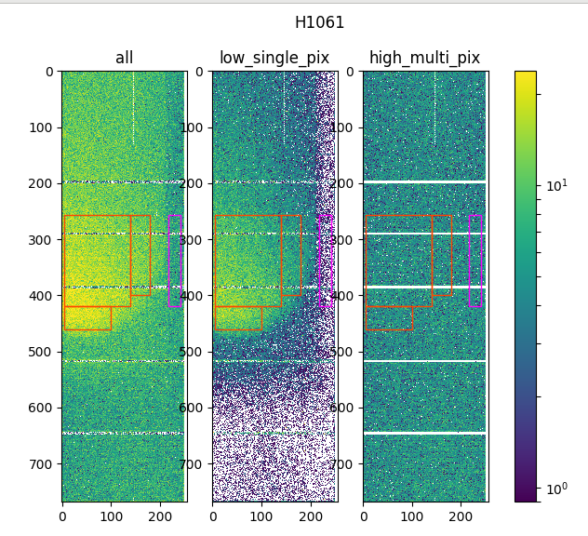
Very high low-energy photon contribution at KEK during beam optimizations
Beneficial to have a quick online check for the photon contribution

Slide 3
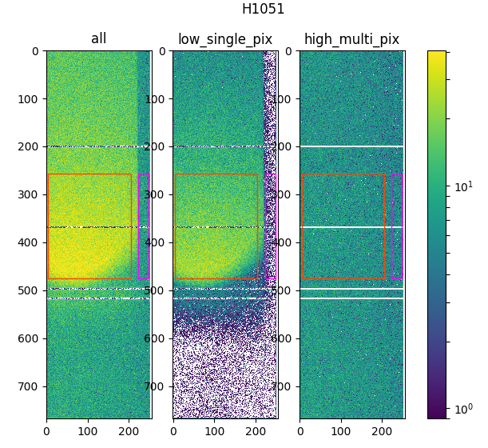
Measurement Idea
Photons show mainly as low energy single pixel clusters.
Photons will be blocked by material.
Measure hit rate in different areas, Photon vs Reference for low energy single pixel clusters
Hitrate due to photons and charged particles.
Correct for hit rate gradient by measuring the same for high energy multi pixel cluster.
No photon contibution expected in this data set

Slide 4
Observable (I)
$\frac{HitRate Photons}{HitRate Electrons, low single pix}=\frac{\frac{HitRate PhotonArea, lowEnergy}{\#HitRate RefArea, lowEnergy}}{\frac{HitRate PhotonArea, highEnergy}{HitRate RefArea, highEnergy}}−1$
Top part: How many more single pixel clusters do we see in photon area
Bottom part: How many do we expect to see more due to gradients?

Slide 5
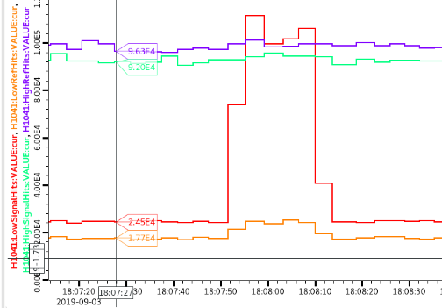
Issues with Observable (I)
$\frac{HitRate Photons A1}{HitRate Electrons A1}=\frac{\frac{\#HitRate A1}{\#HitRate A2}}{\frac{\#HitRate B1}{\#HitRate B2}}−1$
Assumption:
A1 has a mix of photons and electrons
All other don’t contain Photons.
This assumption is not completely true. A2 shows some Photons too
A2
A1
B1
B2
B1
B2
A1
A2

Slide 6
More Observables
Photons / cm^2 / s
Luminosity dependent
Absolute value – directly connected to data rate and occupancy
$\frac{HitRate Photons}{HitRate Electrons}\sim \frac{HitRate Photons}{HitRate Electrons, low single pixel+high multi pixel}$
Luminosity independent.
Less strong than first observable
More resistant against photons in reference area

Slide 7
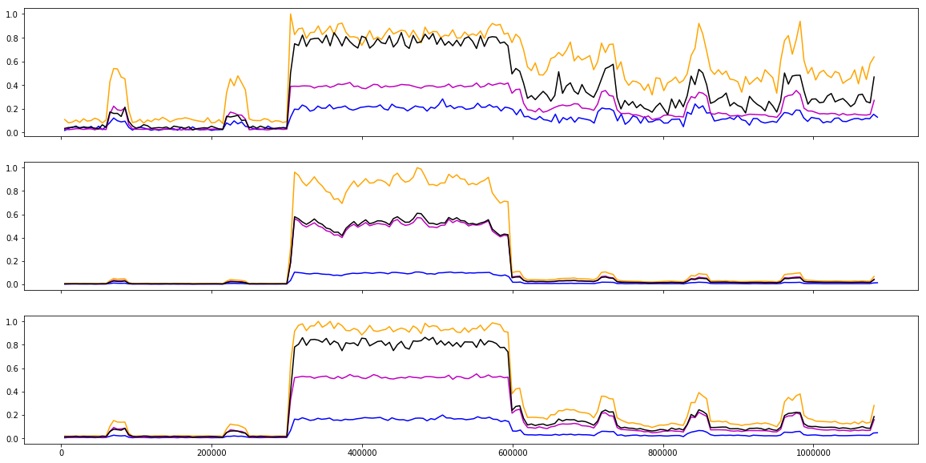
Observables for 4 Modules
$$\frac{Photon Rate}{LE 1Pix Electron Rate }$$
Photon Count
Run 2656
Run 3080
Run 3085
Run 3080
$$\frac{Photon Rate}{Electron Rate }$$

Slide 8
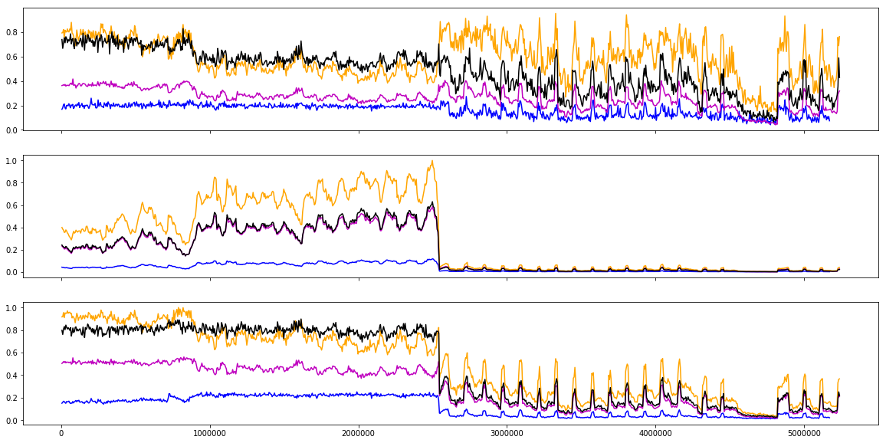
Observables for 4 Modules
$$\frac{Photon Rate}{LE 1Pix Electron Rate }$$
Photon Count
Run 3080
$$\frac{Photon Rate}{Electron Rate }$$

Slide 9
Observables
 | $$\frac{Photon Rate}{LE 1Pix Electron Rate }$$ | Photon Count | $$\frac{Photon Rate}{Electron Rate }$$
Luminosity dependent | no | yes | no
Represents occupancy | no | yes | no
Photon present | Very good | good | ok
Photon number | bad | very good | good
Photons in Ref. Area | sensitive | Less sensitive | almost insensitive
Collisions vs Single Beam | very different | same | very different

Slide 10
Outlook
Three observables for each module
Suggestion for Accelerator control room: Sum of electron/photon Rate for 3 (or all?) modules
Suggestion for an Alarm or a second PV: Sum over all Photons.

Slide 11
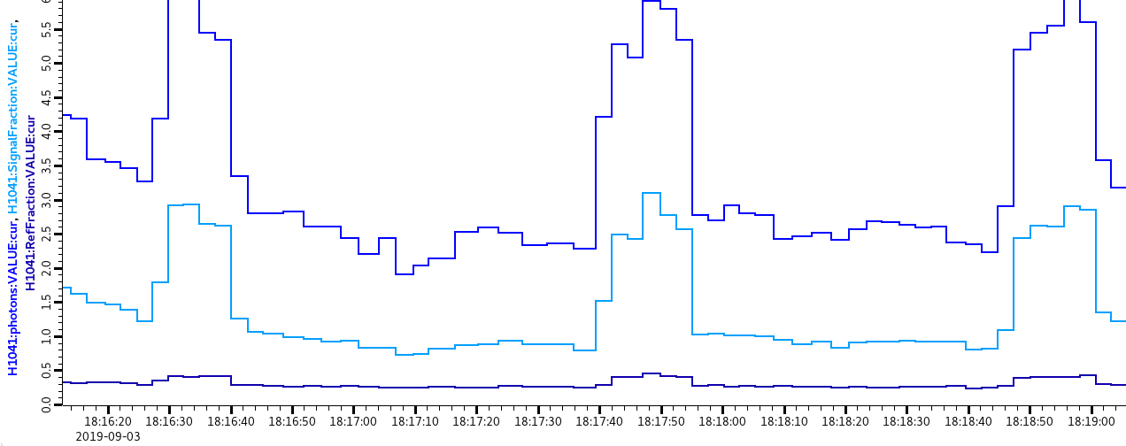
$$\frac{\frac{\#HitRate A1}{\#HitRate A2}}{\frac{\#HitRate B1}{\#HitRate B2}}−1$$
A2
A1
B1
B2
$$\frac{\#HitRate A1}{\#HitRate B1}$$
$$\frac{\#HitRate A2}{\#HitRate B2}$$

Slide 12
More Observables
Photons / cm^2 / s
Luminosity dependent
Absolute value – directly connected to data rate and occupancy
$\frac{HitRate Photons}{HitRate Electrons}\sim \frac{HitRate Photons}{HitRate Electrons, low single pixel+high multi pixel}$
Luminosity independent.
Less strong than first observable
More resistant against photons in reference area

Slide 13
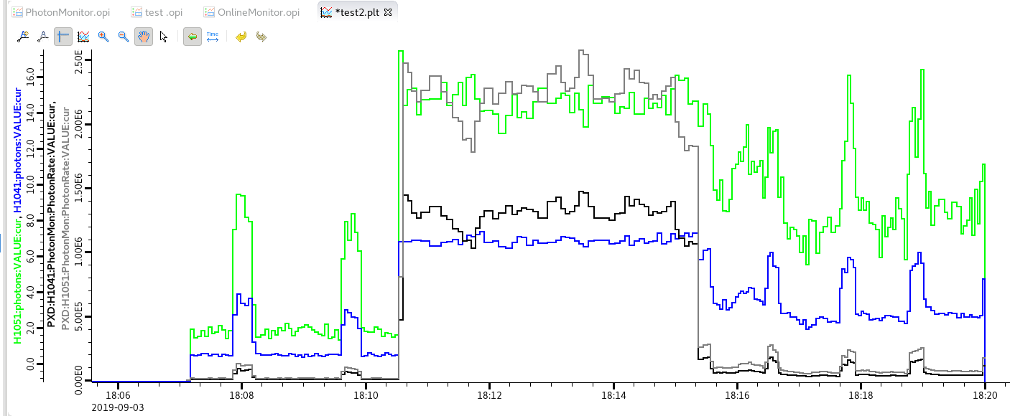
Test of Photon count
Run 3080
Run 3085
Run 2656

Slide 14
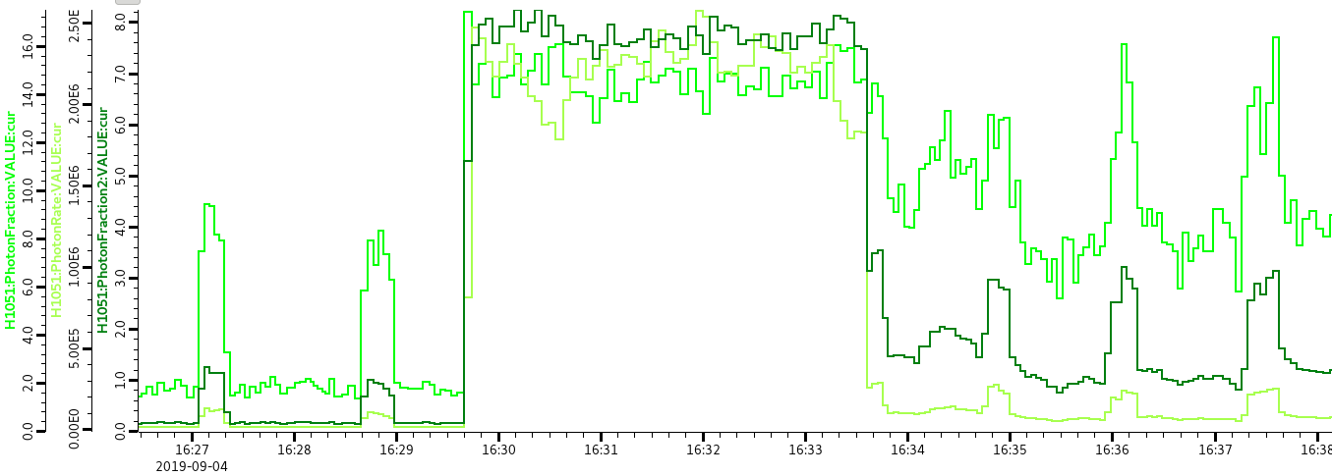

Slide 15
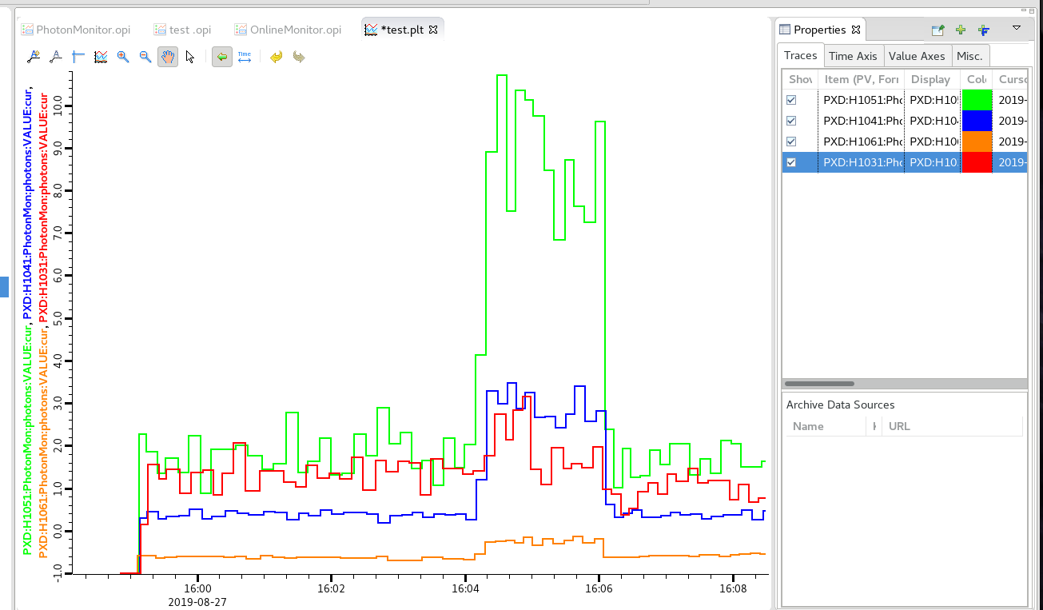
Good Run

Slide 16
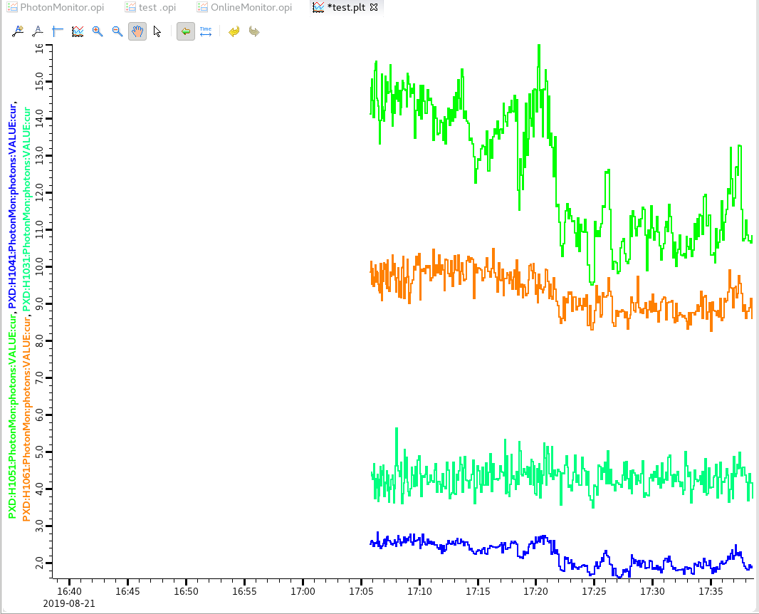
Bad Run

Slide 17
Measure Photon Rate
Observable: Photons / cm^2 / s

Slide 18
Hit Rates

