Slide 1
Florian Lütticke
PV Renaming
Local DAQ Status
Universität Bonn, Physikalisches Institut, Nußalle 12

Slide 2
PV Renaming
Online Monitor: ->U PXD:Hxyyz:OnlineMon:hitmap -> PXD:Uxyyz:hitmap:MAP:cur
Photon Monitor -> V PXD:Hxyyz:PhotonMon:PhotonRate:VALUE:cur -> PXD:Vxyyz:PhotonRate:RATE:cur
Format Monitor ->W PXD:Hxyyz:FormatMon:CRC_Error:VALUE:cur -> PXD:Wxyyz:CRC_Error:CNT:cur PXD:Hxy:FormatMon:Size_word_bad:VALUE:cur -> PXD:Wxy:Size_word_bad:CNT:cur PXD:Hxyyz:Dx:FormatMon:padding:VALUE:cur -> PXD:Wxyyz:Dx:padding:CNT:cur
daqMonitor -> X PXD:LDAQ:connections -> PXD:X:connections PXD:Hxyyz:LDAQ:trigger_missmatch_errors -> PXD:Xxyyz:trigger_missmatch_errors PXD:Hxy:LDAQ:frameNumber -> PXD:Xxy:frameNumber

Slide 3
Updating the naming Document
We are running out of letter for IOC names…
Chosen U, V, W, X for Online Monitor, Photon Monitor, Data Format Monitor and DAQ Monitor
The PV Naming document is out of date. Fixed where I noticed inconsistency

Slide 4
Local DAQ Status

Slide 5
Server
2 free PCI Slots: We can add the Server to another network
40 TB Storage full -> Was assumed to last 10 years
Current configuration: 5+1 Discs (Raid5 + Hot Spare)
New Storage
4 free Slots, 30-50TB more possible (Raid 6+ Hot Spare – Raid 5, no hot spare) , 1.5k€
Else: External Storage Box?
Firmware updates needed.

Slide 6
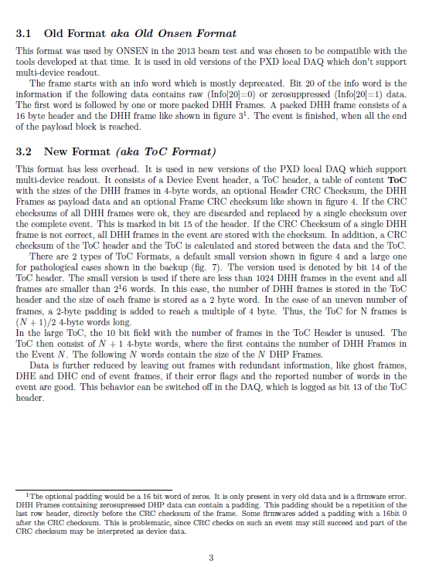
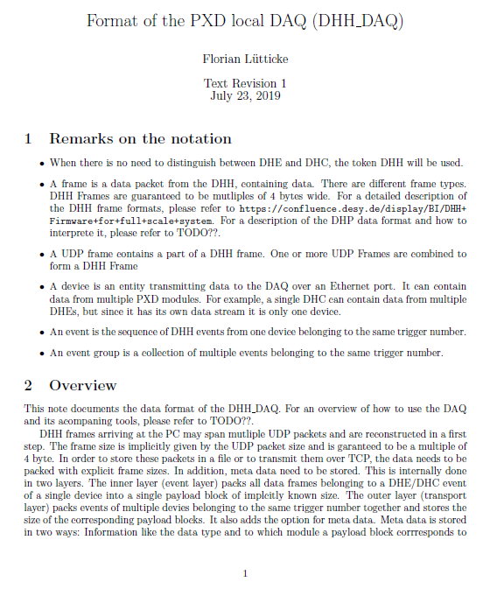
Local Data Format Document (I)
Document available soon. Could Experts have a look?

Slide 7
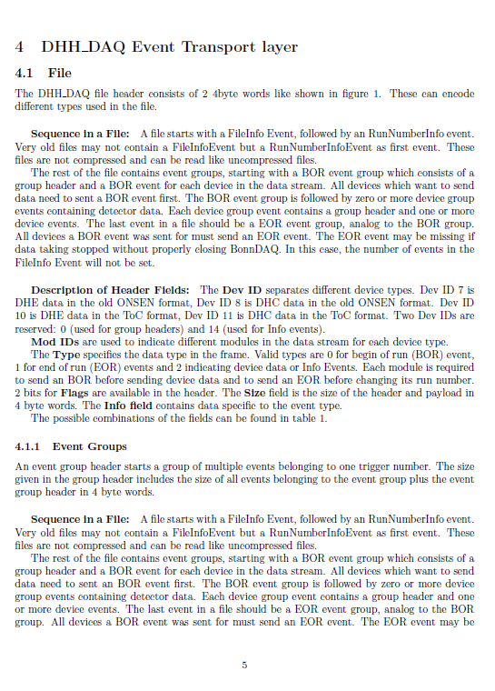
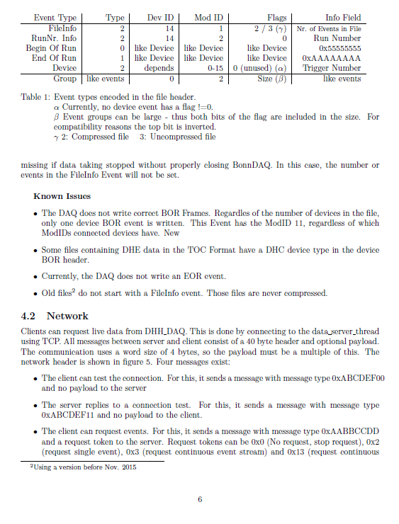
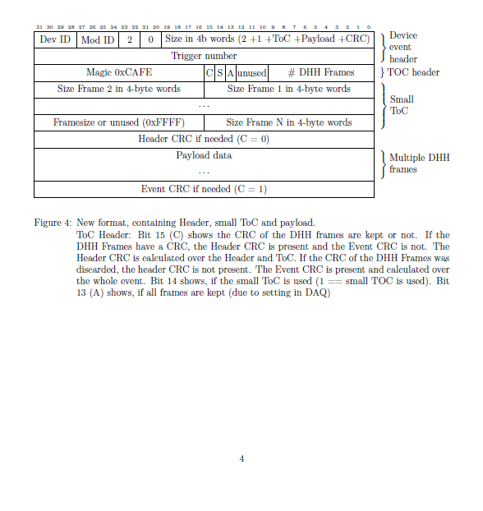
Local Data Format Document (II)

Slide 8
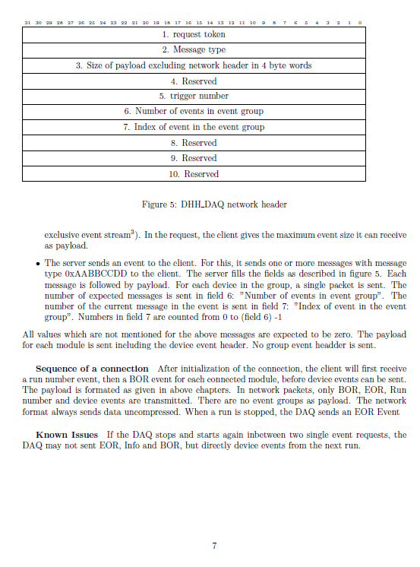
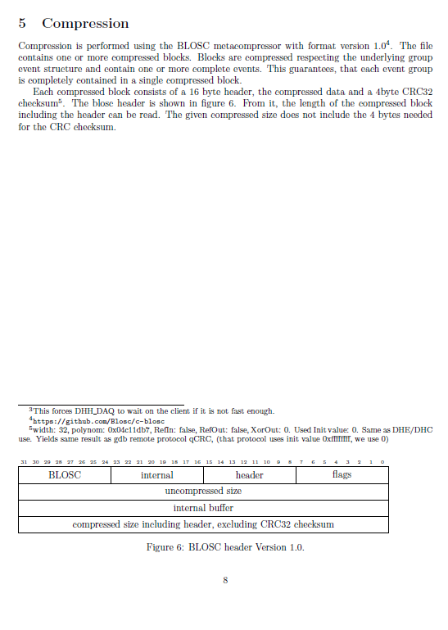
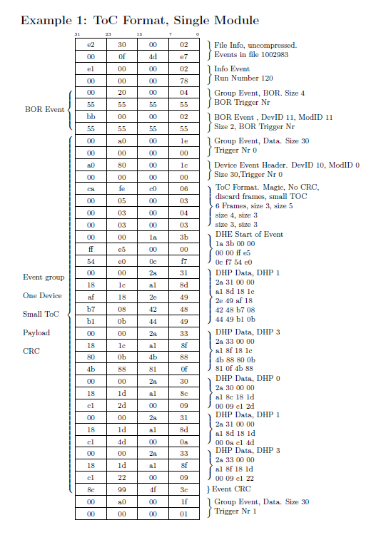
Local Data Format Document (III)

Slide 9
