Slide 1
There and Back Again
LC from an European XFEL perspective
(With many stolen slides from N. Walker, O. Napoly, M. Omet, S. Michizono, A. Grassellino)
Marc Wenskat (UHH)
LC Forum @ 13th „Physics at the Terascale“ Meeting

Slide 2
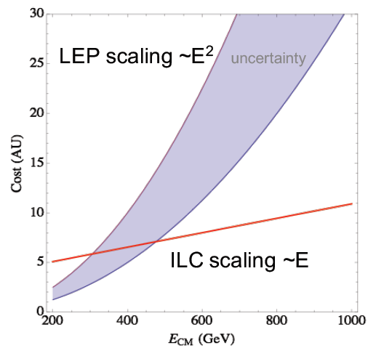
Why LC at all?
We could argue where the cross-over point is – but it is there
Future for e⁺e⁻ is linear

Slide 3
Evolution of Linearcollider Ideas
1994
Technology Review
Comittee (TRC) I
2003
TRC II
2003
International Technology
Review Panel
2005
TESLA (DESY) 1.3GHz
TESLA (DESY) 1.3GHz
TESLA (DESY) 1.3GHz
SBLC (DESY) 3.0GHz
JLC-S (KEK) 2.8GHz
ILC (GDE) 1.3GHz
JLC-C (KEK) 5.7GHz
JLC-C (KEK) 5.7GHz
JLC-X (KEK) 11.4GHz
JLC-X (KEK) 11.4GHz
JLC-X (KEK)
NLC (SLAC) 11.4GHz
NLC (SLAC) 11.4GHz
NLC (SLAC) 11.4GHz
VLEP (IHEP) 14GHz
CLIC (CERN) 30GHz
CLIC (CERN) 30GHz
CLIC (CERN) 12GHz
CLIC (CERN) 12GHz

Slide 4
Tesla Technologie
And the Adventure for High Gradients and Low Losses
R&D Goal in the 1990s: reduction $/MeV by a factor of 20!
Factor 5 in Gradient 5 to 25 MV/m
Factor 4 from cryomodule fabrication
Optimized for
Low-Loss operation
Emittance preservation
RF power generation

Slide 5
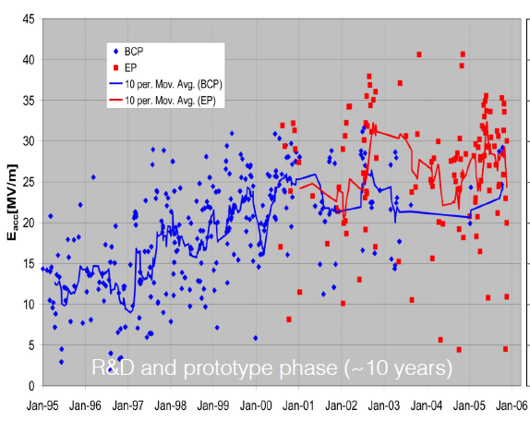
Tesla Technologie

Slide 6
Why SRF
“The construction of the superconducting XFEL free electron laser will provide prototypes and test many aspects of the linac.”
ITRP final report summary

Slide 7
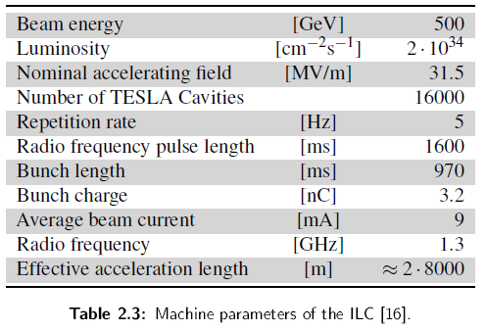
European XFEL
A „Sandbox-ILC“ ?

Slide 8
EXFEL Fabrication Results

Slide 9
EXFEL Fabrication Results

Slide 10
EXFEL Fabrication Results

Slide 11
EXFEL Fabrication Results

Slide 12
Operation of EXFEL
Incl. Installation in module, impact of waveguide system
If all cavities in the RF station operate at 29 MV/m
Avg. Gradient is 23 MV/m

Slide 13
From EXFEL to ILC
How close are we?
Cavity Specs
ILC TDR assumed ±20% gradient spread (28 ≤ G ≤ 42 MV/m)
 | ILC |  | XFEL
 | G [MV/m] | Q₀ | G [MV/m] | Q₀
Vertical Test | 35 | 5x10⁹ | 26 | 10¹⁰
Installed | 31.5 | 10¹⁰ | 23.6 | 10¹⁰
 | Yield ≥28MV/m | ‹G›≥28MV/m
As received (1st Pass) | 75% | 35MV/m
After 25% retreated (2nd Pass) | 90% | 35MV/m
This is usable gradient!

Slide 14
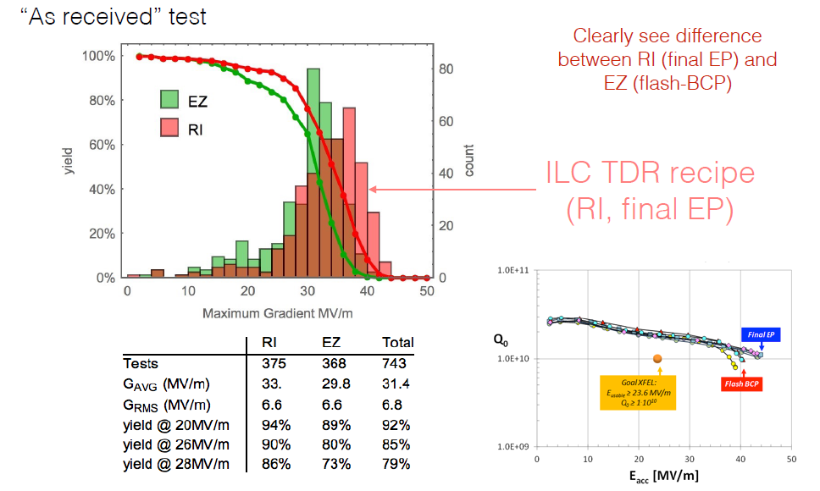
Test results per Vendor (max. G)

Slide 15
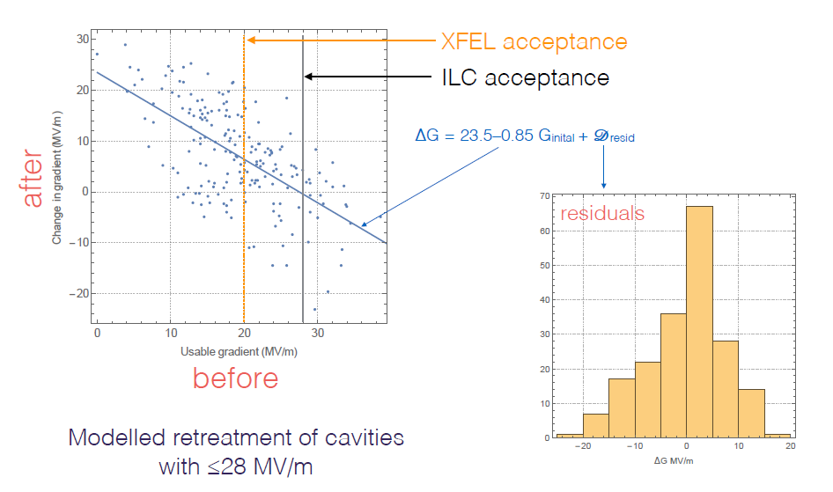
Retreatment Model
Thanks to Nick Walker

Slide 16
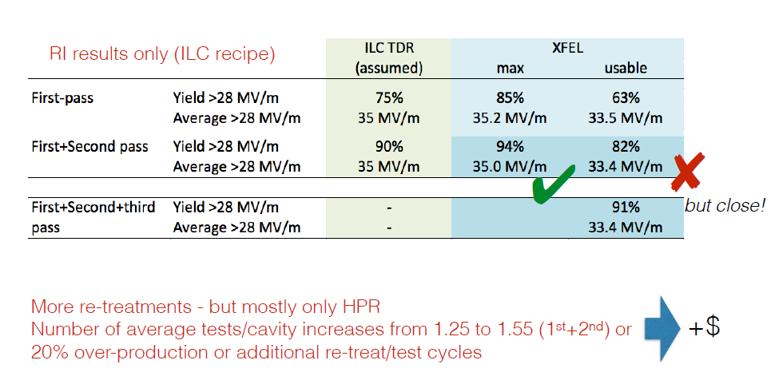
Extrapolation to ILC-VT

Slide 17
SRF cost reduction R&D
How much can we safe?

Slide 18
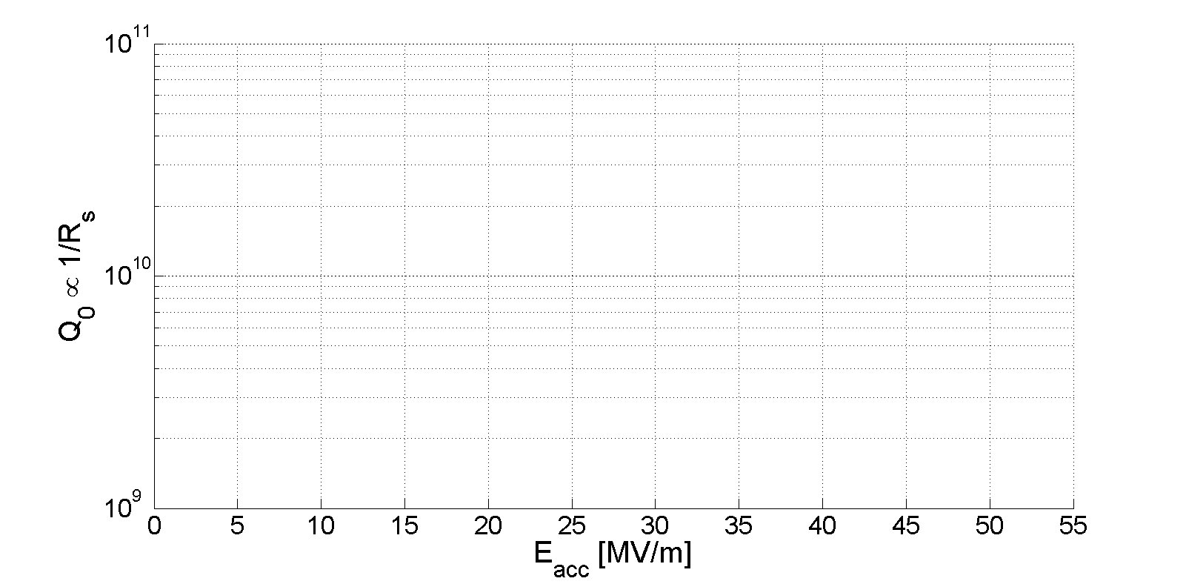
General R&D
Standard Cavity
Doped Cavity
Infused Cavity
Low-T Baked Cavity
[Reschke et al., Phys. Rev. Accel. Beams, 20, 042004 (2017)]
[Grassellino et al., SUST, 26, 102001 (2013) ]
[Grassellino et al., SUST, 30, 094004 (2017) ]
[Grassellino et al., arxiv 1806.09824]
Cavities limited by quench

Slide 19
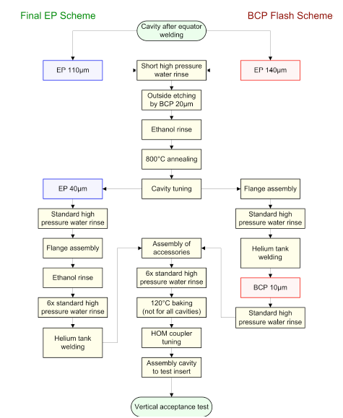
Cavity Fabrication Process
Only modifies recipe
Is industrialized (LCLSII)
No high gradients (LCLS-HE)
Changes recipe (less steps)
Not every lab succeeds
Recipe not fully understood
Only modifies recipe
Shows strong dependency
on cooldown procedure

Slide 20
Summary
It’s been a long road…
TESLA technology is now mature and industrialized
almost ‘off the shelf’ (see LCLS-II)
Performance is very close to ILC requirements
But not the cost!
Larger scale industrialization will help if planned correctly
New SRF ‘breakthroughs’ may bring significant cost benefits
higher gradients, higher quality factors
but it’s industrial yield that matters

Slide 21
Thanks for Listening!
Questions?

Slide 22
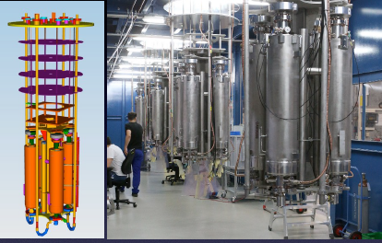
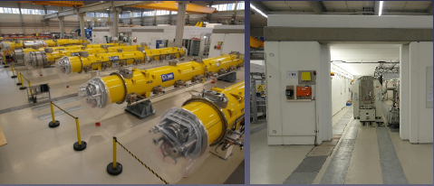
Cavity & Cryomodule Fabrication
AMTF @ DESY
Cavities
Vertical Tests
2 independen cryostats
6 inserts, 4 cavities each
3 days per Tests
Plan: 8 cavities per week
Modules
3 parallel test benches
Original plan 21 days
Optimized down to 14 days
1 module finished per week

Slide 23
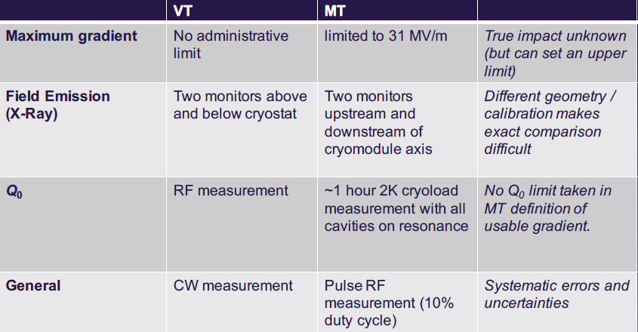
Comparison VT to module

Slide 24
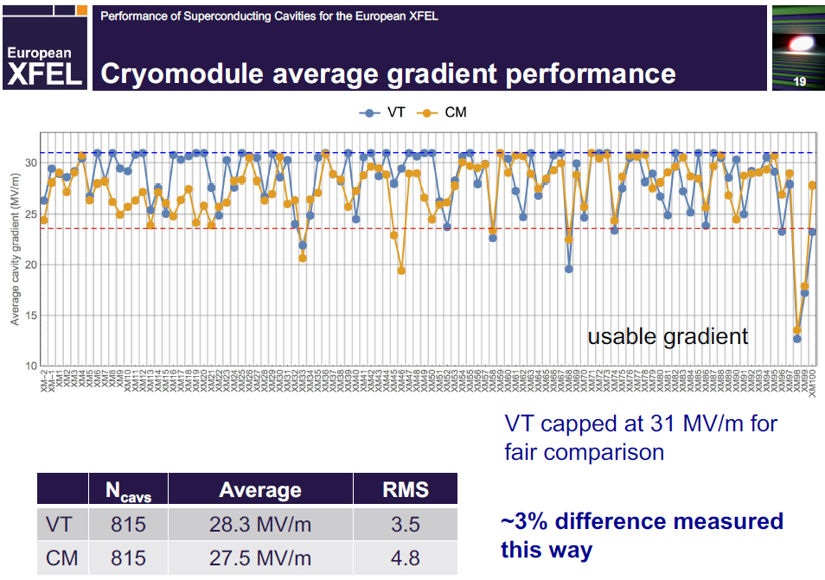
Comparison VT to module

Slide 25
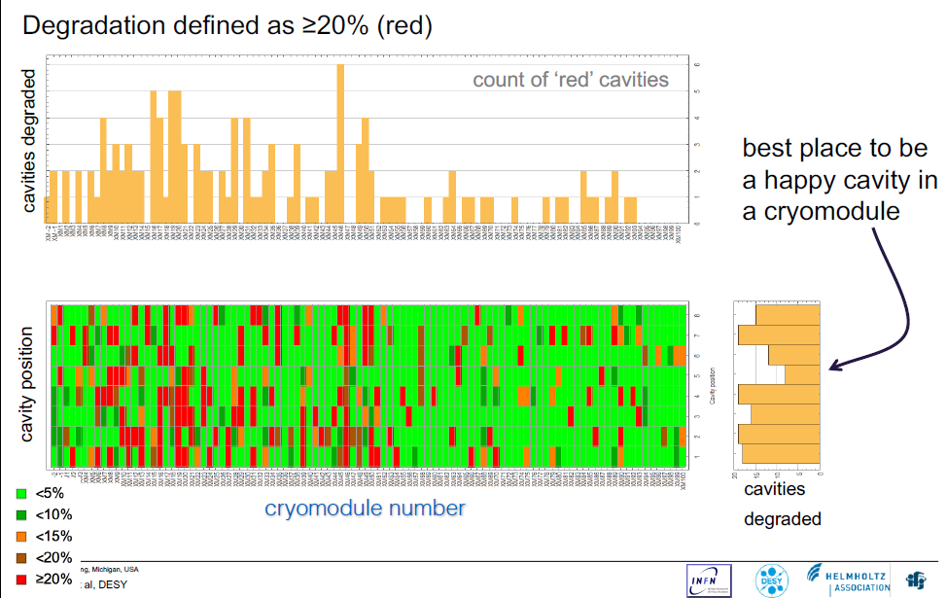
Degradation

Slide 26
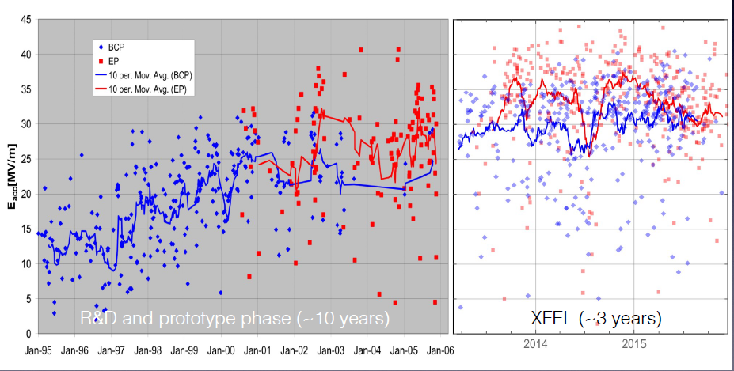

Slide 28
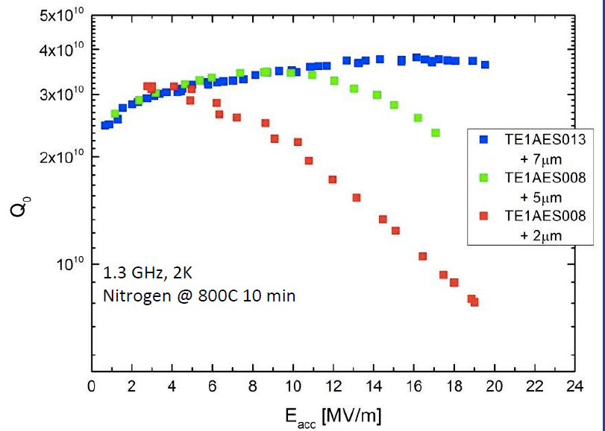
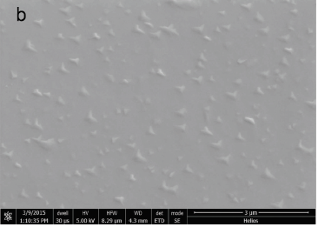
The Recipe
N-Doping: Change of baking procedure
N₂
800°C
Pressure [mbar]
Temperature [°C]
Time [h]
+ 5-10 μm removal of inner layer by chemical etching necessary

Slide 29
The Recipe
N-Infusion
N₂
800°C
Pressure [mbar]
Temperature [°C]
No chemistry needed
120°C
Time [h]
Problem: No one cooks like Grandma

Slide 30
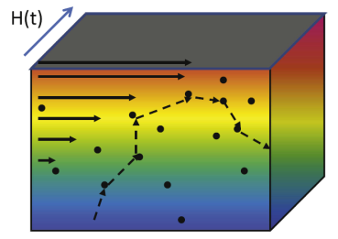
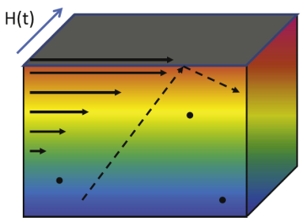
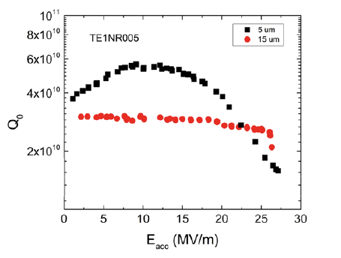
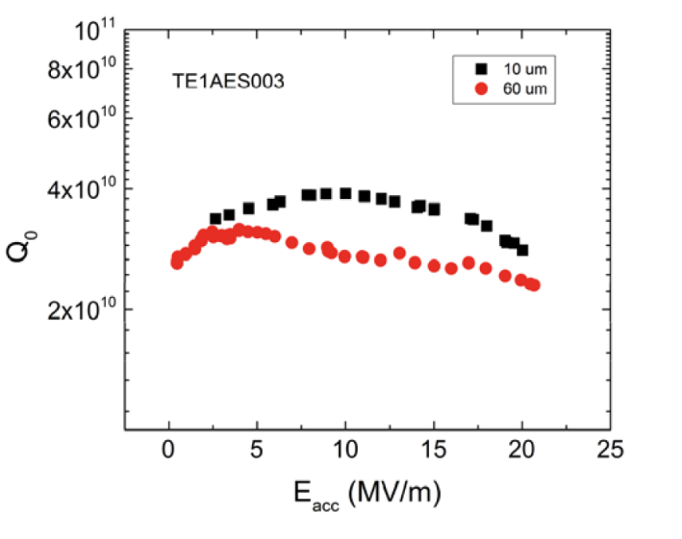
How is the performance affected?
Model can explain Q₀ increase but not difference between Doping & Infusion
Q₀(E) dependency change
Effect has not been seen in low mfp cavities
Difference in Quenchfield
Quench field does not increase/reset with more inner surface removal!
$R_{s}=R_{BCS}$+$R_{res}$

Slide 31
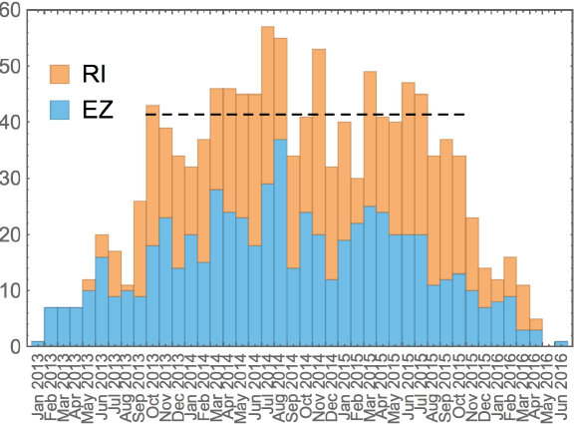
Cavity-Tests
10.4 tests per week
Peak: 15 tests per week
1.48 tests per cavity
(1.2 assumed)

Slide 32
Tesla Technologie
And the Adventure for High Gradients and Low Losses
Control of niobium material (high purity)
Mechanical construction in a clean environment
electron-beam welding (EBW)
Preparing RF (inner) surface ultra-clean mirror surface
electro-polishing (EP)
Removing hydrogen from the surface layer
800° C bake
Removing surface contamination
alcohol and/or detergent rinsing
100-150 bar high-pressure rinsing (HPR)

Slide 33
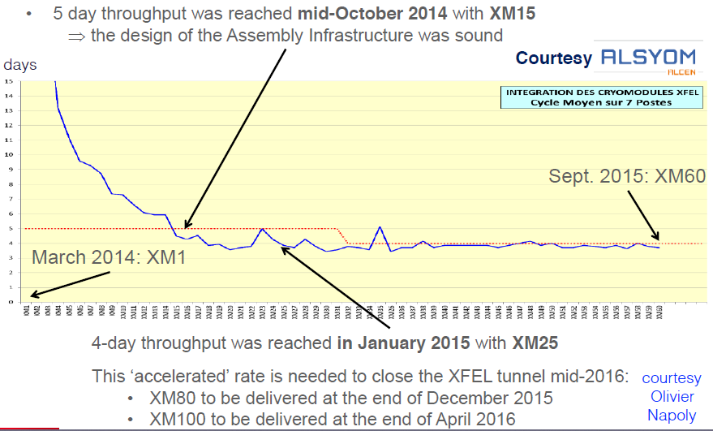
Module Assembly Rate

Slide 34
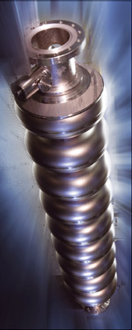
Why SRF?
Low-Loss cavities
High RF → Beam-power efficiency
Lower operational costs
„Simple“ RF power generation
1.3 GHz relative low f – standard components
Long pulses / fill time (1ms/0.6ms)
Low peak power
Emittance preservation
Large cavity iris (low f)
Low transverse / longitudinal wakefields
Loose alignment tolerances

