Slide 1
Plasma Lens: Possible alternative OMD at the ILC (work in progress)
G. Moortgat-Pick, K. Floettmann, S. Riemann, M. Formela, N. Hamann

Slide 2
Motivation:
OMD alternative to flux concentrator (FC) & quarter wave transformer (QWT) at ILC by M. Fukuda
High potential for positron yield improvement due to azimuthal magnetic field ($→$radially symmetric, decreased chromatic aberration & focal length)
Lots of on-site expertise at DESY and Uni HH (Dr. Floettmann, Dr. Osterhoff, Prof. Gruener)
If simulations are promising: $→$ prototype at DESY-site possible
LCForum 2019

Slide 3
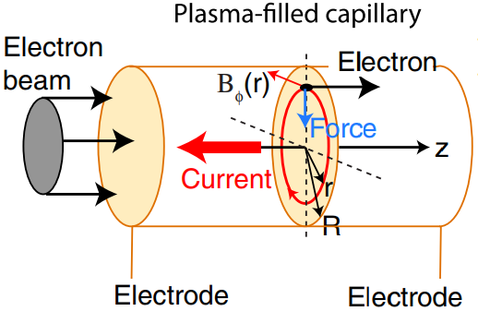
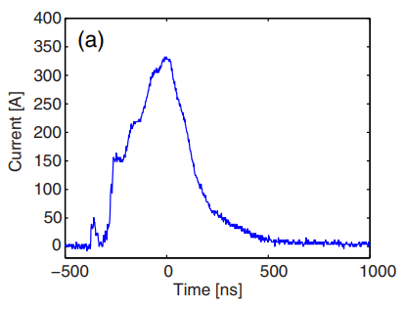
Principle of an Active Plasma Lens:
Gas filled capillary (e.g. with H₂)
Applying voltage pulse (some kV) by electrodes $→$ Ionization: gas ions + e⁻ = plasma $→$ Axial electric discharge current pulse (some 100 A) $→$ Azimuthal B-field (similar to an ordinary wire) $→$ Radially symmetric focussing of particle beam (little interaction with plasma)

Slide 4
Simulation:
Programm:
„A Space Charge Tracking Algorithm“ (ASTRA) programmed by K. Floettmann
Positron Distribution:
for Ti6Al4V (& W26Re) simulated by M. Fukuda
OMD:
QWT (& FC) designed/simulated by W. Liu & M. Fukuda reproducing by M. Formela & N. Hamann (soon to be finished)
Plasma Lens (PL) optimization by M. Formela & N. Hamann (soon to be started)
LCForum 2019

Slide 5
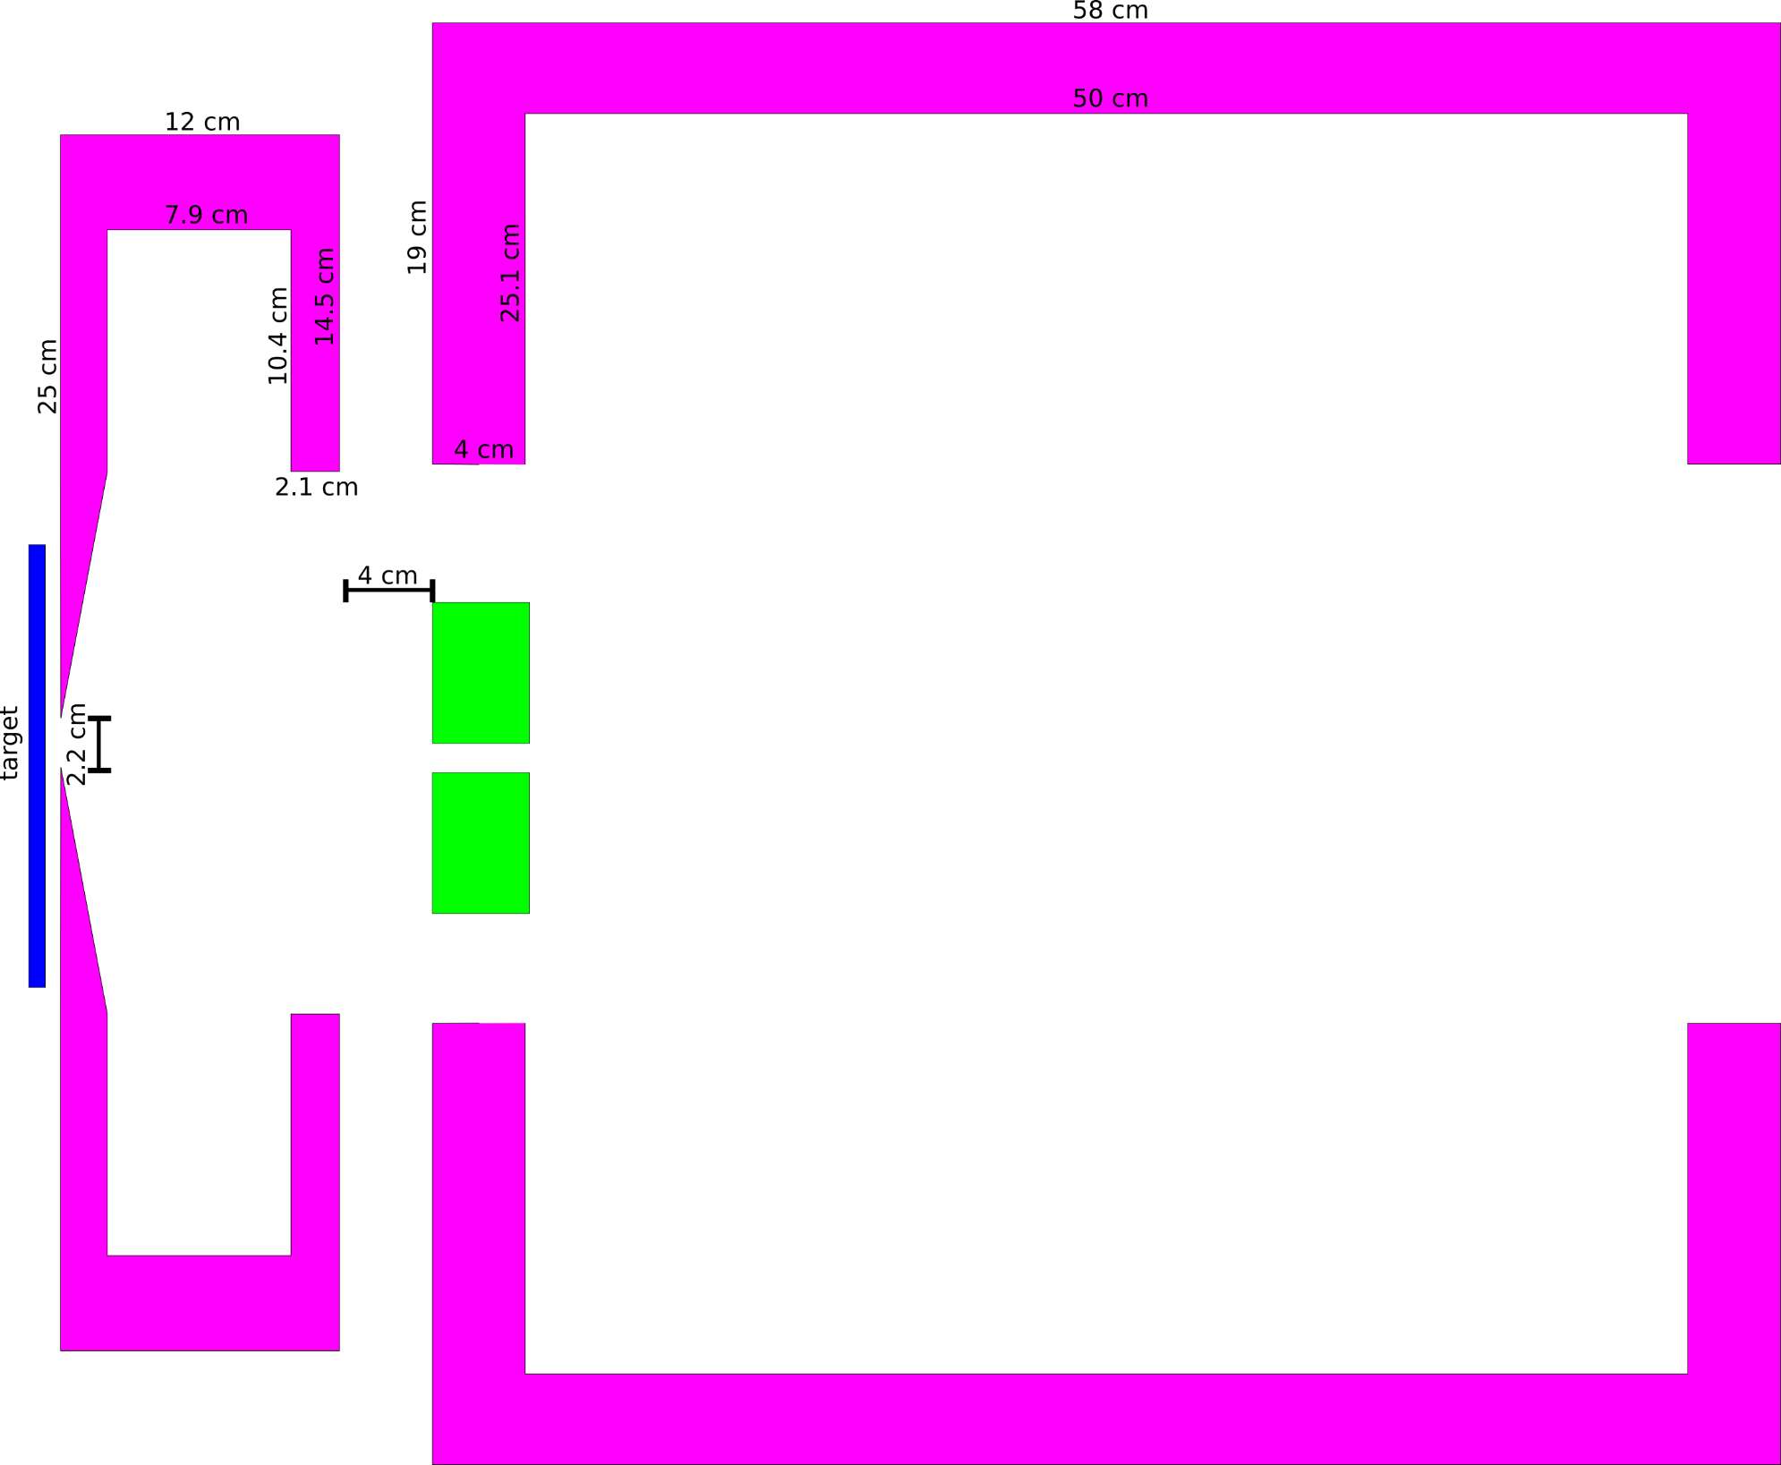
QWT: geometry (Ushakov)
Matching
solenoid
QWT
Accelerator (Acc)
aperture
Target (Ti6Al4V) thickness: 7 mm
Rear target side to QWT front: 7.6 mm
Rear QWT side to Acc front: 40 mm

Slide 6
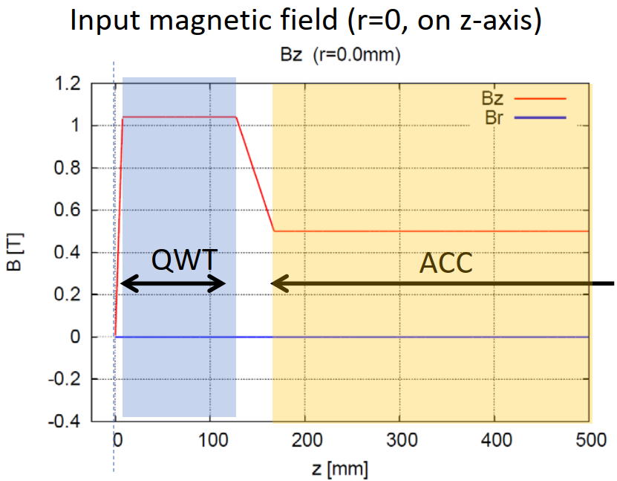
QWT: approximated field (Ushakov)

Slide 7
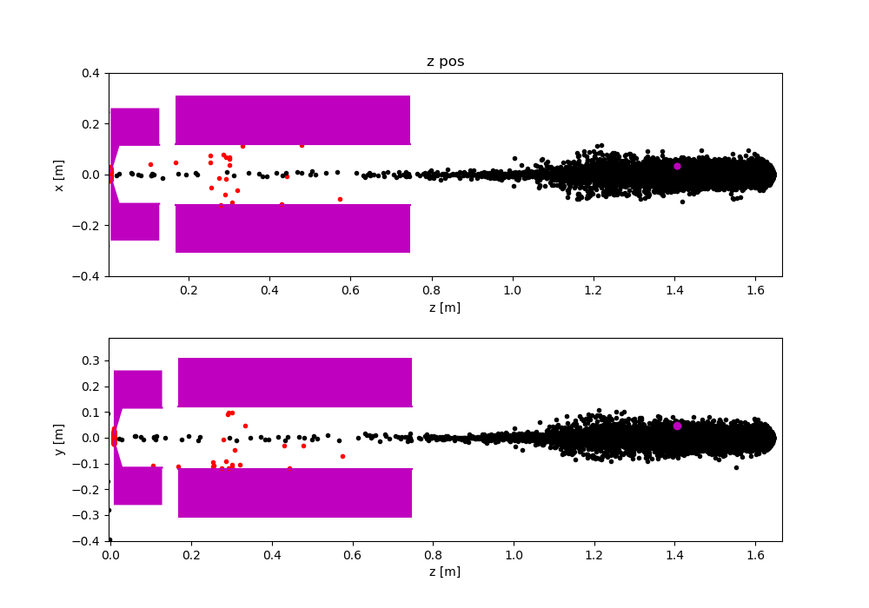
QWT: results (approx. field)
No space charge (e⁺- e⁺ Coulomb interaction)
without accelerator aperture
LCForum 2019

Slide 8
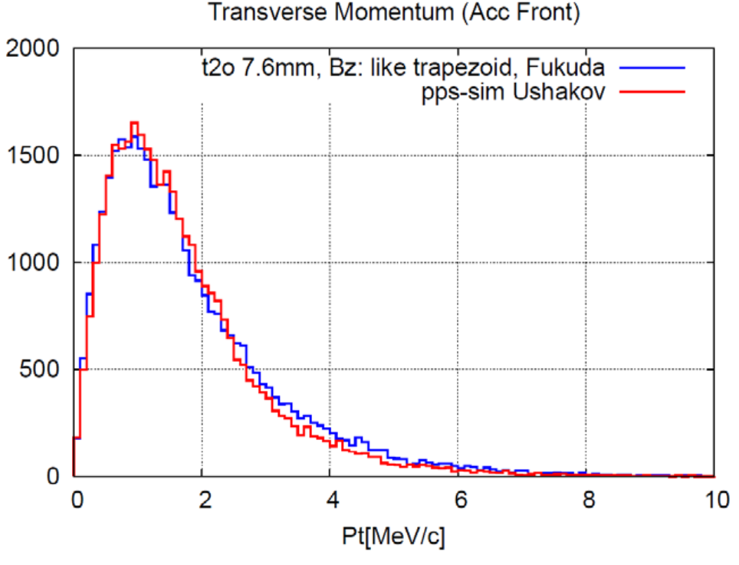
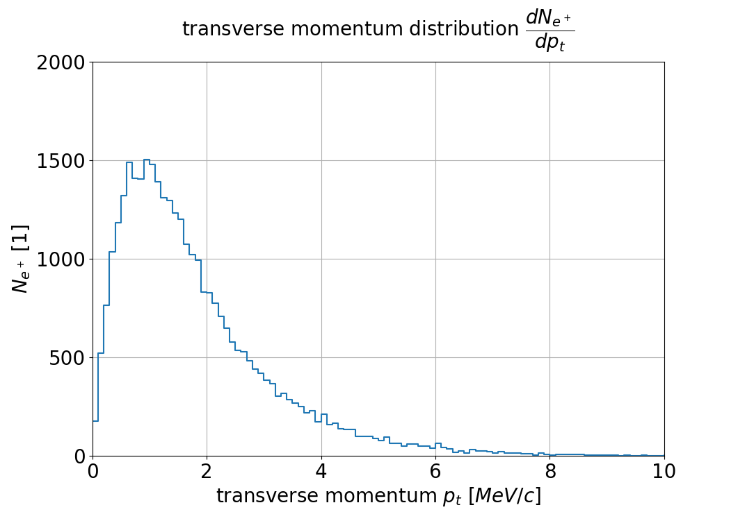
QWT: results at Acc front (approx. field)
No space charge (e⁺- e⁺ Coulomb interaction)
Fukuda: $N_{e^{+}}=35865$
Formela: $N_{e^{+}}=33732$
($∼6\%$ less)
QWT
Target (Ti6Al4V): $N_{e^{+}}=42917$
Source: M. Fukuda, “Undulator Positron Source
Capture Simulation” LCWS 2019

Slide 9
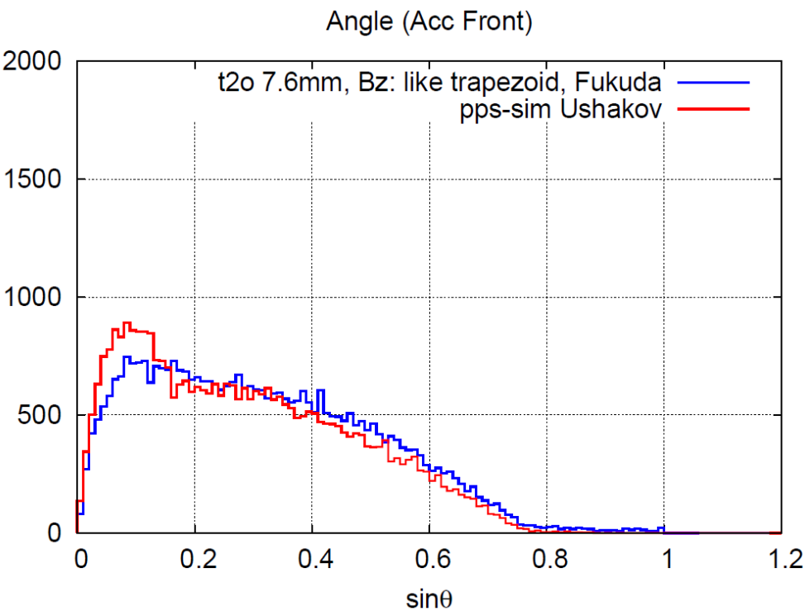
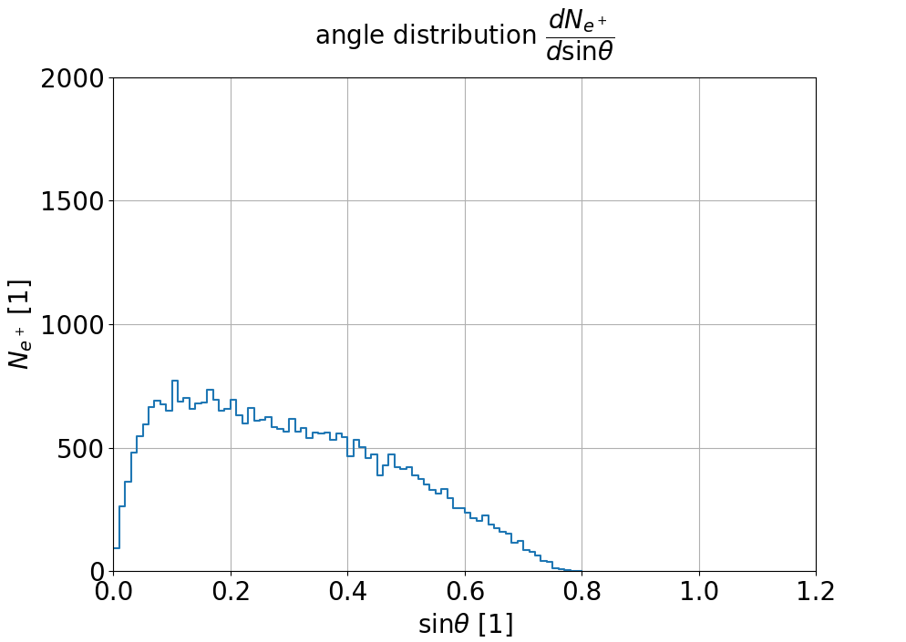
QWT: results at Acc front (approx. field)
No space charge (e⁺- e⁺ Coulomb interaction)
Fukuda: $N_{e^{+}}=35865$
Formela: $N_{e^{+}}=33732$
($∼6\%$ less)
QWT
Target (Ti6Al4V): $N_{e^{+}}=42917$
Source: M. Fukuda, “Undulator Positron Source
Capture Simulation” LCWS 2019

Slide 10
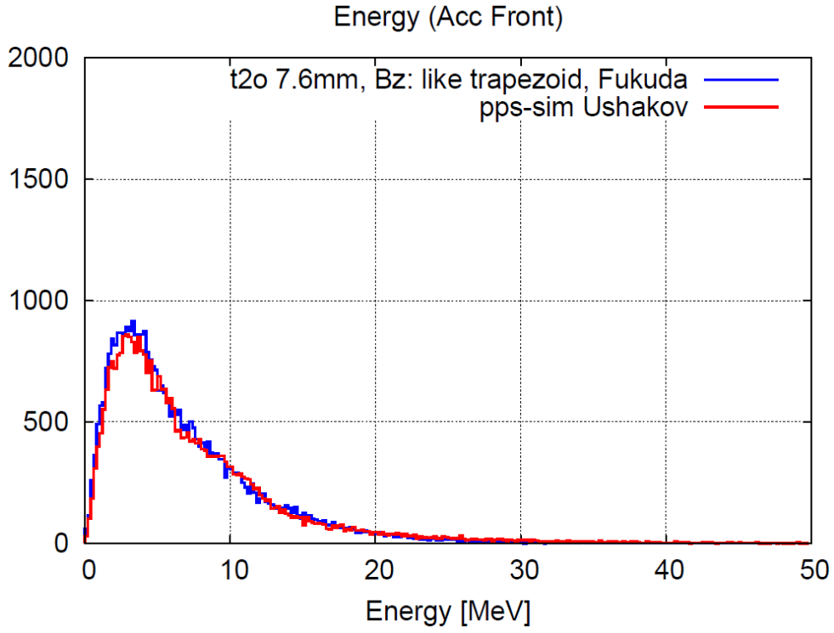
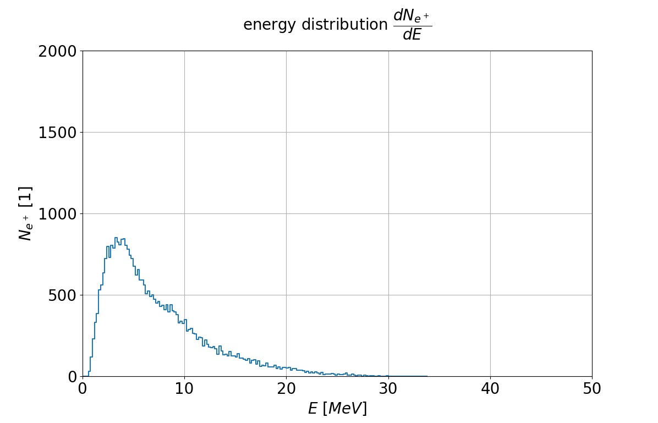
QWT: results at Acc front (approx. field)
No space charge (e⁺- e⁺ Coulomb interaction)
Fukuda: $N_{e^{+}}=35865$
Formela: $N_{e^{+}}=33732$
($∼6\%$ less)
QWT
Target (Ti6Al4V): $N_{e^{+}}=42917$
Source: M. Fukuda, “Undulator Positron Source
Capture Simulation” LCWS 2019

Slide 11
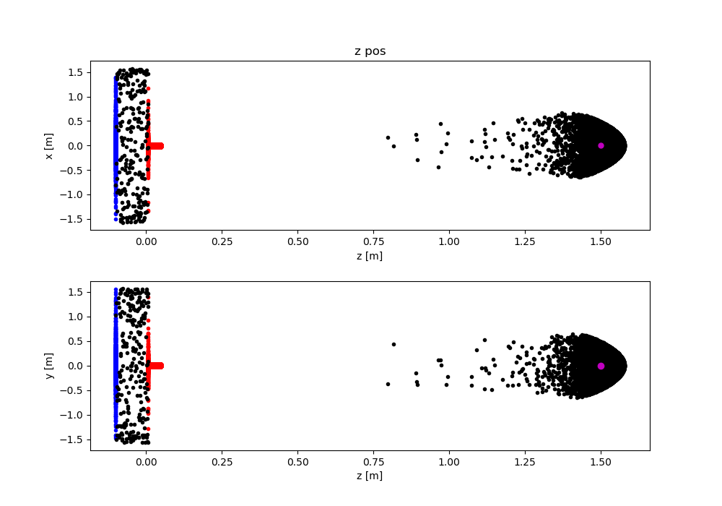
PL: example
Length: $L=42.4 mm$
Radius: $R=20 mm$
Current: $I_{0}=1,000 A$
$$N_{e^{+}}^{}≈17,000$$
More compact in z-direction,
Less compact in x-y plain
Source: Kowalewicz, R., et al. “Performance of the CERN plasma lens
in laboratory and beam tests at the antiproton source.”
No. CERN-PS-91-24-AR. CM-P00059466, 1991.

Slide 12
Outlook:
Simulations:
QWT (& FC) designed/simulated by W. Liu & M. Fukuda reproducing by M. Formela & N. Hamann: (soon to be finished)
Using more precise field
Space charge (e⁺-e⁺ Coulomb interaction)
Accelerator field
Plasma Lens (PL) optimization by M. Formela & N. Hamann (soon to be started)
Experiments: (possibility)
Prototyping
LCForum 2019

Slide 13
Thank you for your attention!

